Slide 1


Visual Studio Online: Overview and Best Practices
DEV-B216
Neno Loje
Consultant & MVP for Visual Studio ALM, TFS & Scrum
www.tfsblog.com

Slide 2


© 2014 Microsoft Corporation. All rights reserved. Microsoft, Windows, and other product names are or may be registered trademarks and/or trademarks in the U.S. and/or other countries.
The information herein is for informational purposes only and represents the current view of Microsoft Corporation as of the date of this presentation. Because Microsoft must respond to changing market conditions, it should not be interpreted to be a commitment on the part of Microsoft, and Microsoft cannot guarantee the accuracy of any information provided after the date of this presentation. MICROSOFT MAKES NO WARRANTIES, EXPRESS, IMPLIED OR STATUTORY, AS TO THE INFORMATION IN THIS PRESENTATION.

Slide 3

Thank you for your attention!
Visit me at the TechExpo
or e-mail me at:
neno.loje@teamsystempro.com

Slide 4

Evaluate this session

Slide 5


Please Complete An Evaluation Form
Your input is important!
TechEd Schedule Builder
CommNet station or PC
TechEd Mobile app
Phone or Tablet
QR code

Slide 6

Resources
Learning
  Sessions on Demand
  Microsoft Certification & Training Resources
http://channel9.msdn.com/Events/TechEd
www.microsoft.com/learning
TechNet
Developer Network
  Resources for IT Professionals
http://microsoft.com/technet
http://developer.microsoft.com

Slide 7

Claim your Visual Studio Online domain
MSDN subscribers, activate your Azure
benefits now
Simply get started @ http://aka.ms/teched-eu

Slide 8
DEV Track Resources
http://www.visualstudio.com
http://blogs.msdn.com/b/developer-tools/
http://msdn.microsoft.com/vstudio
visualstudio
@visualstudio
visualstudio

Slide 9
What's Next (at this TechEd)?
Today
  DEV-B215 Case Study of an Agile Transformation in a Large Organization (Today, 3:15 PM)
  Find Me Later At the TechExpo: Welcome Reception 6:00-8:30pm Hall 7
Wednesday
  DEV-B206 Application Insights Overview: How to Keep Your Applications Available, Performing, and Succeeding (Wednesday, 8:30 AM)
  DEV-B338 Better Together: Using Team Foundation Server and Visual Studio Online to Increase Agility (Wednesday, 5 PM)
Thursday
  DEV-B214 But, Is It Safe? A Closer Look at Visual Studio Online (Thursday 8:30 AM)
  DEV-B317 Make Data-Driven Improvements to Your Application with Application Insights (Thursday, 10:15 AM)

Slide 10
What's Next?
Try it for yourself: http://tfs.visualstudio.com
  No charge for teams with up to five users
Submit new ideas and vote on others' ideas
  http://visualstudio.uservoice.com
Have a look at the docs
  MSDN: Application Lifecycle Management with Visual Studio and Team Foundation Server
  http://msdn.microsoft.com/en-us/library/fda2bad5

Slide 11
Book Recommendations for VSO/TFS
Professional Team Foundation Server 2013
  The definite reference for TFS. A "must-have".
Visual Studio Team Foundation Server 2012: Adopting Agile Software Practices: From Backlog to Continuous Feedback (3rd Ed)
  Written by the Product Owner of Visual Studio and Europe's first MVP for TFS this book is recognized as a de facto guide for teams adopting agile practices.
Professional Scrum Development with Microsoft Visual Studio 2012
  Scrum, Agile Practices and Tools that make a Professional Scrum Developer.
Testing for Continuous Delivery with VS 2012 (Free download)
  This book is aimed at test engineers, managers, developers, and folks interested in understanding the changing world of test.
For the latest version of this slide, see: http://teamsystempro.com/go/tfsbooks.aspx

Slide 12
More Information?
Visual Studio Online Pricing Details
  http://azure.microsoft.com/en-us/pricing/details/visual-studio-online/
Elastic Build Service
  http://www.visualstudio.com/get-started/hosted-build-controller-vs
Continuous Deployment to Azure
  http://www.visualstudio.com/get-started/deploy-to-azure-vs
Cloud Load Testing Service
  http://blogs.msdn.com/b/visualstudioalm/archive/2014/04/04/cloud-load-testing-with-visual-studio-online-launching-general-availability.aspx
Application Insights
  http://www.visualstudio.com/get-started/get-usage-data-vs

Slide 13
Visual Studio Online is more than just TFS
Hosted TFS solution
  Hosted Version Control (TFVC or Git), Work Item Tracking, Build service, Test Case Management, etc.
Elastic Build Service
  No need to run dedicated hardware to get the benefits of continuous integration
Continuous Deployment to Azure
  Deploying a service or website into production has never been easier
Cloud Load Testing Service
  No need to have dedicated hardware for capacity and stress testing
Application Insights
  Get deep insights into how your app or service performs and how the users use it

Slide 14
DEMO
Stakeholder Access to Visual Studio Online

Slide 15
Stakeholder License
What you can do with the Stakeholder License
  Full read/write/create on all work items
  Create, run and save (to “My Queries”) work item queries
  View project and team home pages
  Access to the backlog, including add and update (but no ability to reprioritize the work)
  Ability to receive work item alerts
What you can't do with the Stakeholder License
  No ability to reprioritize/decompose work (using Backlog features in Web Access)
  No ability to create Work Item Charts
  No access from MS Excel or MS Project clients
  No access to Code, Build, Team Rooms or Test hubs
  No access to any administrative functionality (Team membership, license administration, permissions, area/iterations configuration, sprint configuration, home page configuration, creation of shared queries, etc.)
Source: http://blogs.msdn.com/b/bharry/archive/2014/07/09/upcoming-vs-online-licensing-changes.aspx

Slide 16
DEMO
Application Insights
Preview

Slide 17
Application Insights
Preview
Availability & Alerting
  Is my site or service still running as expected?
Performance
  Identify actual issues and take actionable response
Usage
  Become smarter about your application by learning from live data

Slide 18
Application Insights
Preview
A set of cloud-based services to provide “360 degree view” into the availability, performance, and usage of your applications and services

Slide 19
Application Insights
Preview

Slide 20
Visual Studio Load Testing Service
What you need to get started
  The application under test needs a public endpoint (IP)
  Load Testing is a Visual Studio Ultimate feature only
Free usage
  15,000 virtual user minutes free per month (per VSO account)
  Example: A load test with 250 concurrent virtual users can be run for a total of 60 minutes per month

Slide 21
Cloud Load Testing

Slide 22
DEMO
VSO Build Service

Slide 23
VSO Build Service
"Hosted Build Controller" automatically added
  Free amount: 60 Minutes / month (per VSO account)
Pre-Configured
  For the list of pre-installed software, see:
  http://www.visualstudio.com/en-us/get-started/hosted-build-controller-vs.aspx#software
Customizable
  Ability to run Custom Build Activities or Build Process Templates
  Run custom scripts (Batch, PowerShell, command line tools) as part of your builds
Flexibility
  Run and connect on-premises build agents to your VSO account

Slide 24
VSO Build Service

Slide 25
DEMO
Integrating VSO with other services on the Web

Slide 26
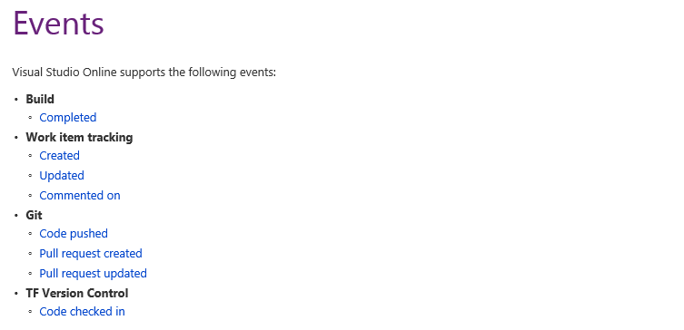
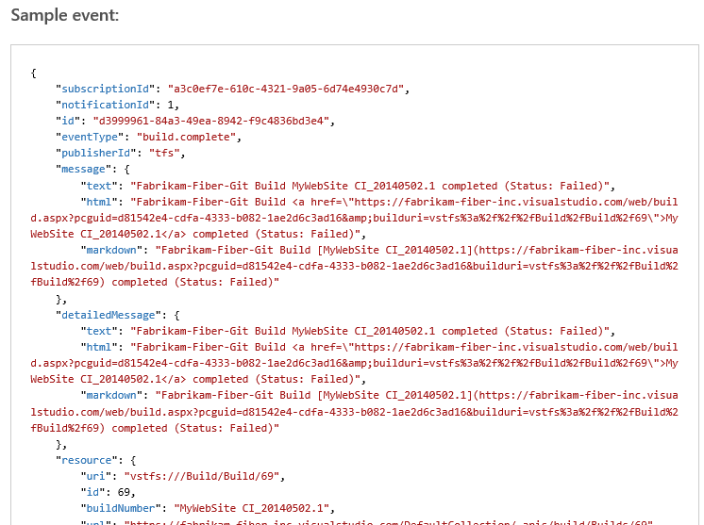
Service Hooks / Events
Source: http://www.visualstudio.com/en-us/integrate/get-started/get-started-service-hooks-events-vsi

Slide 27
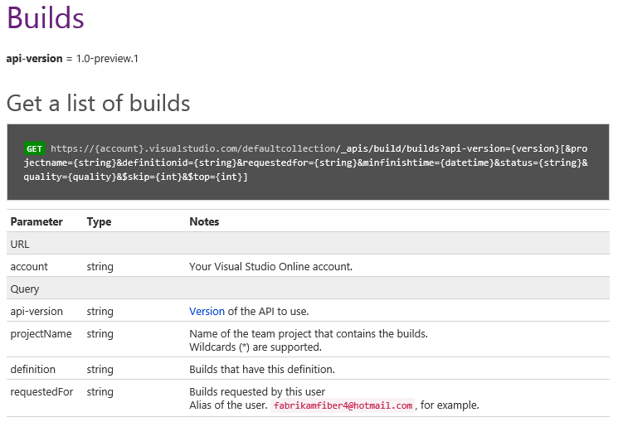
REST APIs

Slide 28
Integrating with Visual Studio Online
REST APIs
  Lightweight and easy to work with JSON REST APIs
  Create and query work items, queue a build, access source code, and more
Authorization
  OAuth 2.0-based authorization (Safer and more secure compared to basic authentication)
Service hooks
  Receive events on secure HTTP endpoints, Azure Service Bus queues, or via other services
  Avoid constantly polling Visual Studio Online to check for new or updated resources
Source: www.visualstudio.com/integrate

Slide 29
Integrating with
Visual Studio Online

Slide 30
DEMO
Visual Studio Online: End-to-End

Slide 31
Facts about Visual Studio Online
VSO and TFS share the codebase
  Vast majority of the work accrues to both scenarios
General availability (GA) in April 2014
  Full commercial service with financially-backed SLA (incl. Build Services and Load Testing Service)
  Over 2 million users registered with VSO
TFS Team at Microsoft recently started using VSO
  For all their assets: code, work items, builds, etc.
  Already the largest and most active account on VSO
VSO gets updated every 3 weeks
  15 updates to Visual Studio Online since VS 2013 launch
  As of April, VSO runs on 212 machines (21 application tiers, 16 job agents, 175 build/load test VMs)
Sources: http://blogs.msdn.com/b/bharry/archive/2014/07/07/tfs-adoption-at-microsoft-july-2014.aspx
http://www.visualstudio.com/en-us/news/2014-Apr-3-vso

Slide 32
What about Backups?
Is my data backed up? How often?
  All data is stored in triplicate on three physically-distinct servers.
  Full backups are taken every day with incremental backups every hour.
  If you want your own backup of your source code, you can sync your source to your local machine.
  Source: http://www.visualstudio.com/en-us/support/faq-vs#Features_Q8

Slide 33
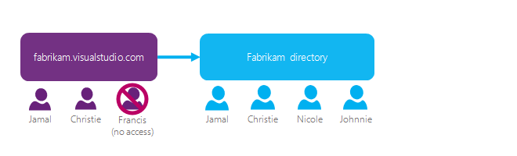
Using Organizational Accounts
Link VSO account to an Azure Active Directory
If you use an on-premises Active Directory (AD), you can synchronize it with your directory in Azure AD
Source: http://www.visualstudio.com/get-started/manage-organization-access-for-your-account-vs

Slide 34
Links to Add to Your Favorites
VSO - Support Overview (shows Service Status)
http://www.visualstudio.com/support/support-overview-vs
VSO - Service Blog (shows detailed Service Status)
http://blogs.msdn.com/b/vsoservice/
VSO/TFS Feature Timeline (lists when Features were added)
http://www.visualstudio.com/en-us/news/release-archive-vso

Slide 35
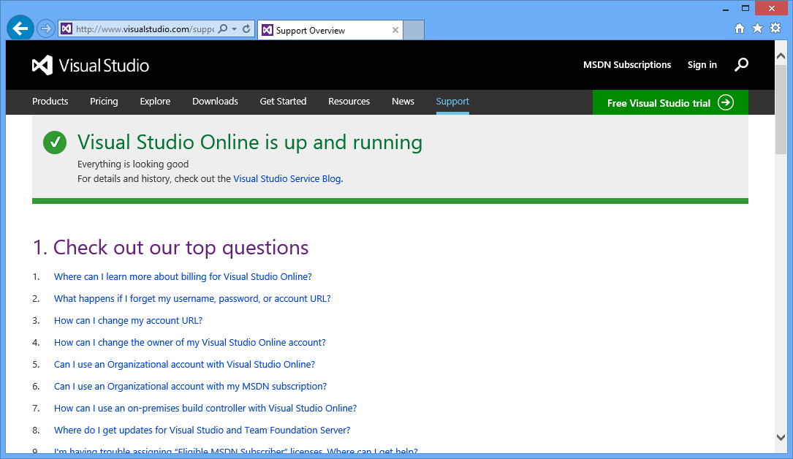
Service Status

Slide 36
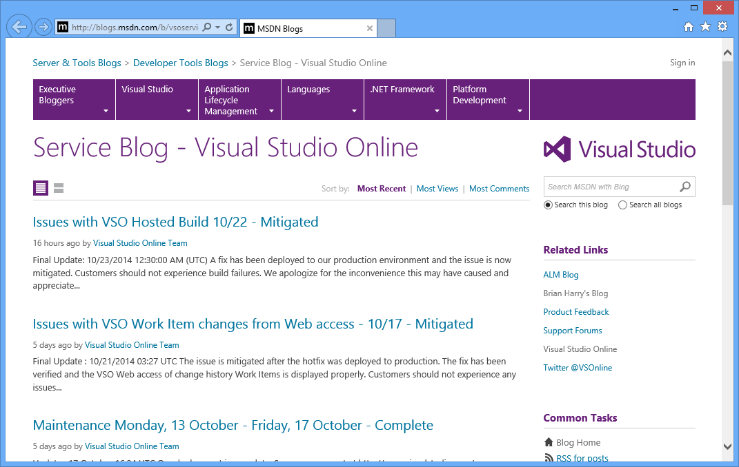
Detailed Service Status

Slide 37
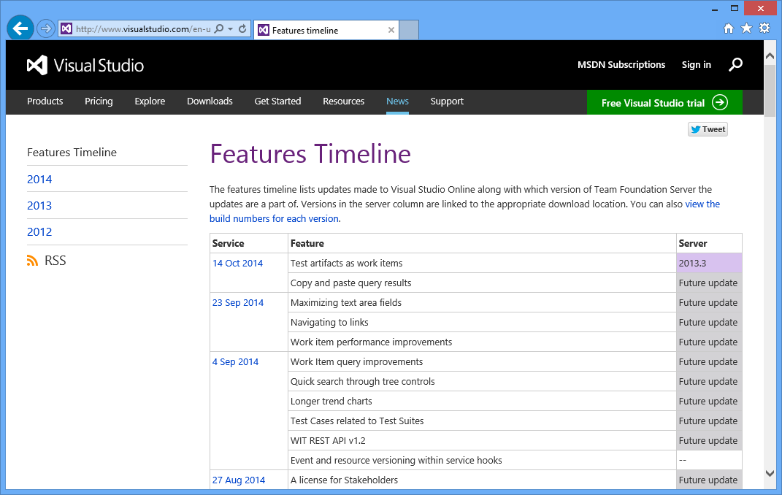
Features Timeline

Slide 38
What's different in VSO (vs. TFS on-premises)?
Automatic Profile Pictures
  Users with no picture in their profile get an automatically created one based on their initials
Users hub
  Every user needs a license assigned
  Account administrator can assign Licenses to Users in the "Users Hub"
Some resources are limited
  Build Minutes, Virtual Load Test Minutes
Create/Delete Team Projects in Web Access (not VS)
Project Alerts via e-mail
  Users have to confirm their e-mail address once (after changing it)
  Alerts are coming from VisualStudioOnline@microsoft.com

Slide 39
Many things are the same between TFS and VSO but some are not…

Slide 40
Some other limitations of VSO
as of
February 2014
No Data Export
  It was made available for a short time period
No Data Import
  No ability to move your collections from on-premises TFS to VSO
No Process Customization
  No ability to add custom fields, modify the workflow of a work item, etc.
No Integration with Active Directory
  Users sign in using Microsoft Accounts (formerly "Live ID")
No choice of geographic location
  Data stored in data center in Chicago

Slide 41
Some other limitations of VSO
as of
today
No Data Export
  It was made available for a short time period
No Data Import of your TFS collections
  Using the free OpsHub migration utility you might be able to move most of your assets to VSO
No Process Customization
  No ability to add custom fields, modify the workflow of a work item, etc.
Integration with Azure Active Directory (Azure AD)
  Users can sign in using Microsoft Accounts (formerly "Live ID") or organizational accounts
Choice of geographic location
  European Data Center

Slide 42
Visual Studio Online & Team Foundation Server
Visual Studio Online
Team Foundation Server
SQL Reporting Services
Work Item Tracking
VSO Build Service
SharePoint Integration
Source Control
(TFVC or Git)
Load Test Service
Project Server Integration
Build Automation
Application Insights*
System Center Integration
Test Case Management
* In Preview

Slide 43
Feature Comparison
 | TFS | VSO
Work Items, Version Control, & Build | Yes | Yes
Agile Product/Project Management | Yes | Yes
Test Case Management | Yes | Yes
Heterogeneous Development (Eclipse, Git) | Yes | Yes
Ease of Installation and Setup | +/- | ++
Collaborate with anyone, from anywhere | +/- | ++
Data stays inside your network | Yes | No
Process Template & Work Item Customization | Yes | No
SharePoint Integration | Yes | No
Data Warehouse & Reporting | Yes | No
CodeLens Support (for TFVC) | Yes | No
Load Testing Service (Cloud Load Testing) | No | Yes
Application Insights (Preview) | No | Yes
Always running the latest version of TFS | No | Yes

Slide 44
Why you might want to use VSO
Use VSO instead TFS on-premises for development
  Easy Setup, almost zero administrational overhead,
Evaluate if TFS/VSO is the right thing for you
  Use VSO to evaluate if TFS (or VSO) is the right thing for you
Evaluate new/upcoming features
  Use VSO to try out new features before they make it into a TFS update
Combine best of both-worlds
  For example: use VSO for source control + work items with an on-premises build server

Slide 45
The TFS Admin's Life before VSO
Initial Setup of TFS Environment
  Install & Configure according to best practices: IIS, SQL Server, SSRS, SSAS, TFS App Tier, etc.
  Install & Configure Build Controllers + Agents
Maintenance Tasks
  Keep all parts up to date (Windows Server, SQL Server, TFS, etc.)
  Monitor Backup Runs (and try out disaster recovery scenario)
  Monitor Hard Disk space
The Life of a VSO Admin
  Log in at tfs.visualstudio.com
  Create an VSO Account
  Create your first Team Project
  Add Users

Slide 46
Session Goals
What is Visual Studio Online (VSO)?
Scenarios when to use VSO
Capabilities and Limitations of VSO (vs. TFS)
Additional Services offered as part of VSO

Slide 47
Visual Studio Online: Overview and Best Practices
DEV-B216
Neno Loje
Consultant & MVP for Visual Studio ALM, TFS & Scrum
www.tfsblog.com

Slide 48
Please Complete An Evaluation Form
Your input is important!
TechEd Schedule Builder
CommNet station or PC
TechEd Mobile app
Phone or Tablet
QR code

Slide 49


