Slide 2
Go Mobile with C#, Visual Studio, and Xamarin
DEV-B217
James Montemagno
Developer Evangelist
Xamarin

Slide 3
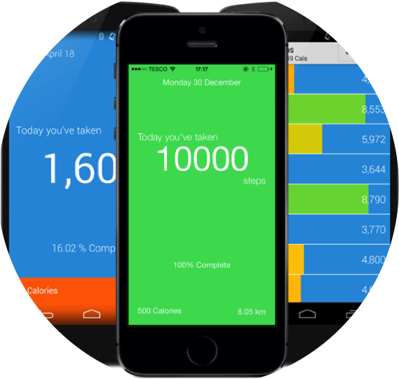
Who is this guy?
James Montemagno
Developer Evangelist, Xamarin
@JamesMontemagno
motzcod.es
MyStepCounterApp.com

Slide 4
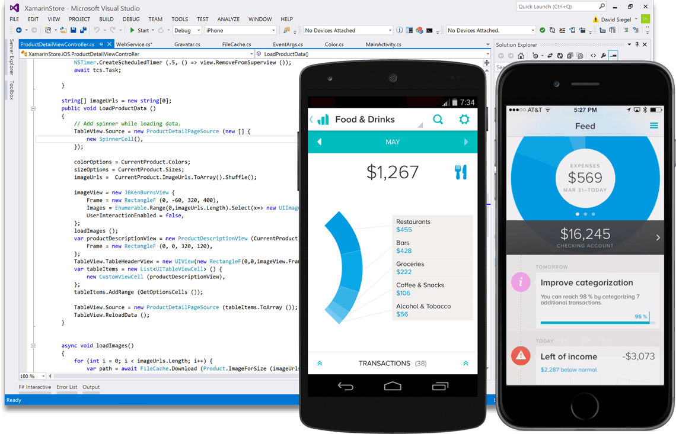
Platform
Create native iOS, Android, Mac and
Windows apps in Visual Studio and C#

Slide 5
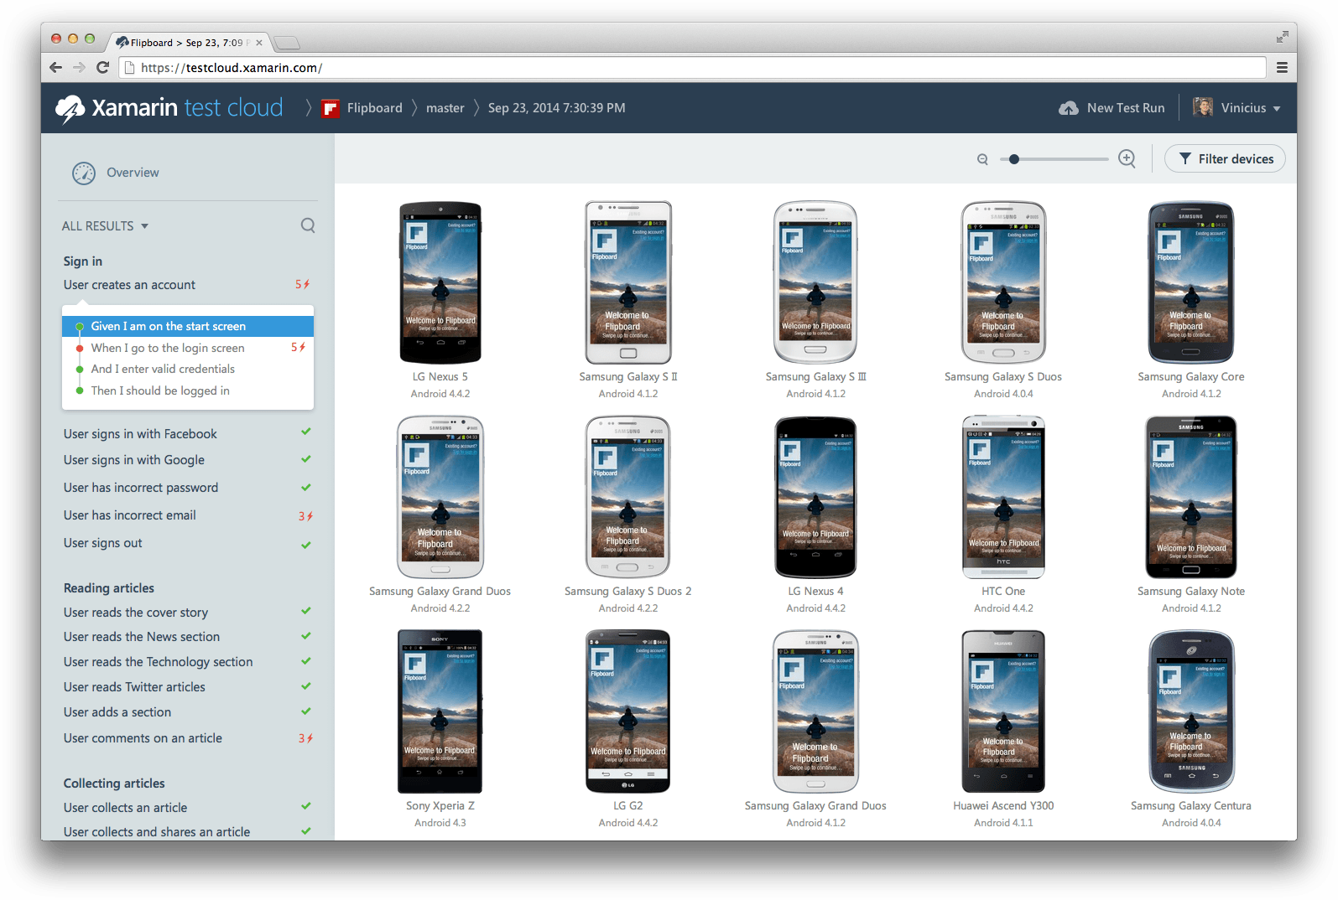
Automatically test your app on thousands of real devices in the cloud.

Slide 6
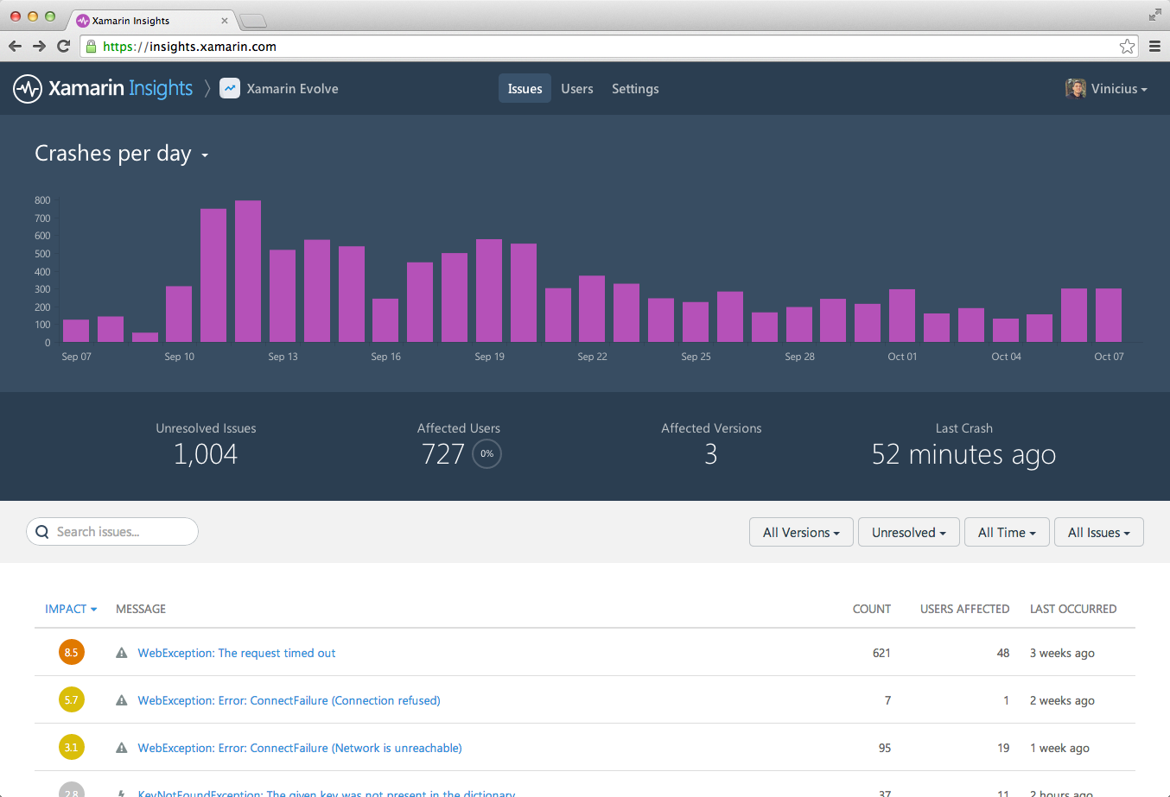
Real-time monitoring. Track crashes and exceptions to understand what is happening with live users

Slide 7
What is native?

Slide 8
?
?
?
Native User Interfaces
Native API Access
Native Performance

Slide 9
Architecting Mobile Apps

Slide 10
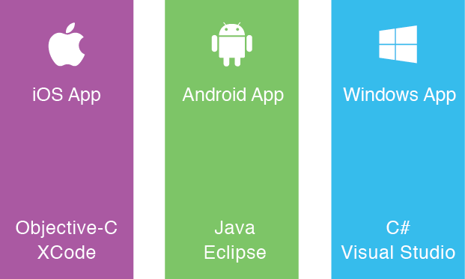
The Silo Approach
Build App
Multiple Times

Slide 11
Write-Once-Run-Anywhere Approach
Lowest
Common
Denominator
Black box

Slide 12
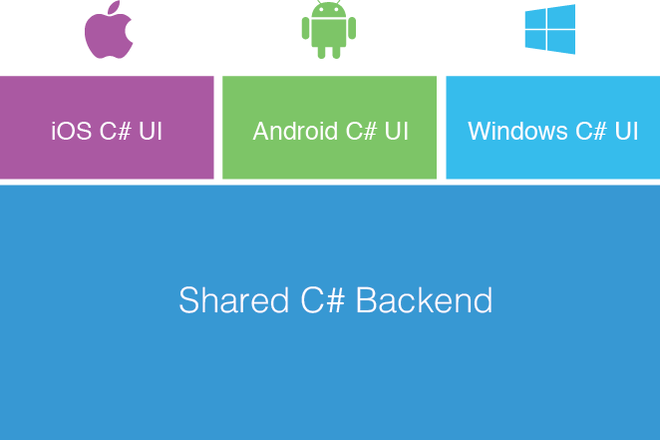
Xamarin’s Unique Approach
Native with Code Sharing

Slide 13
How Xamarin Works

Slide 14
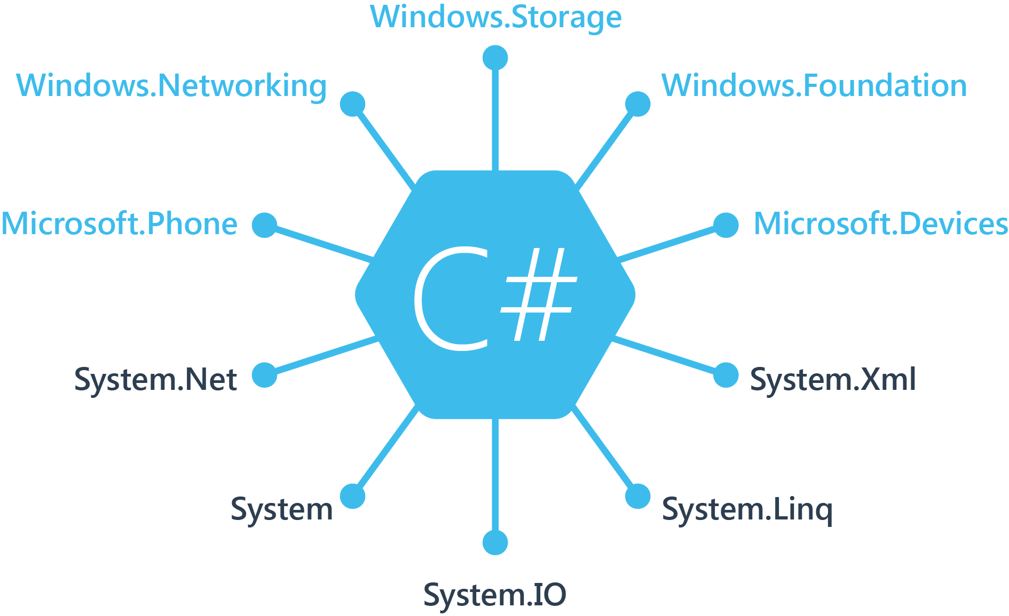
Windows APIs

Slide 15
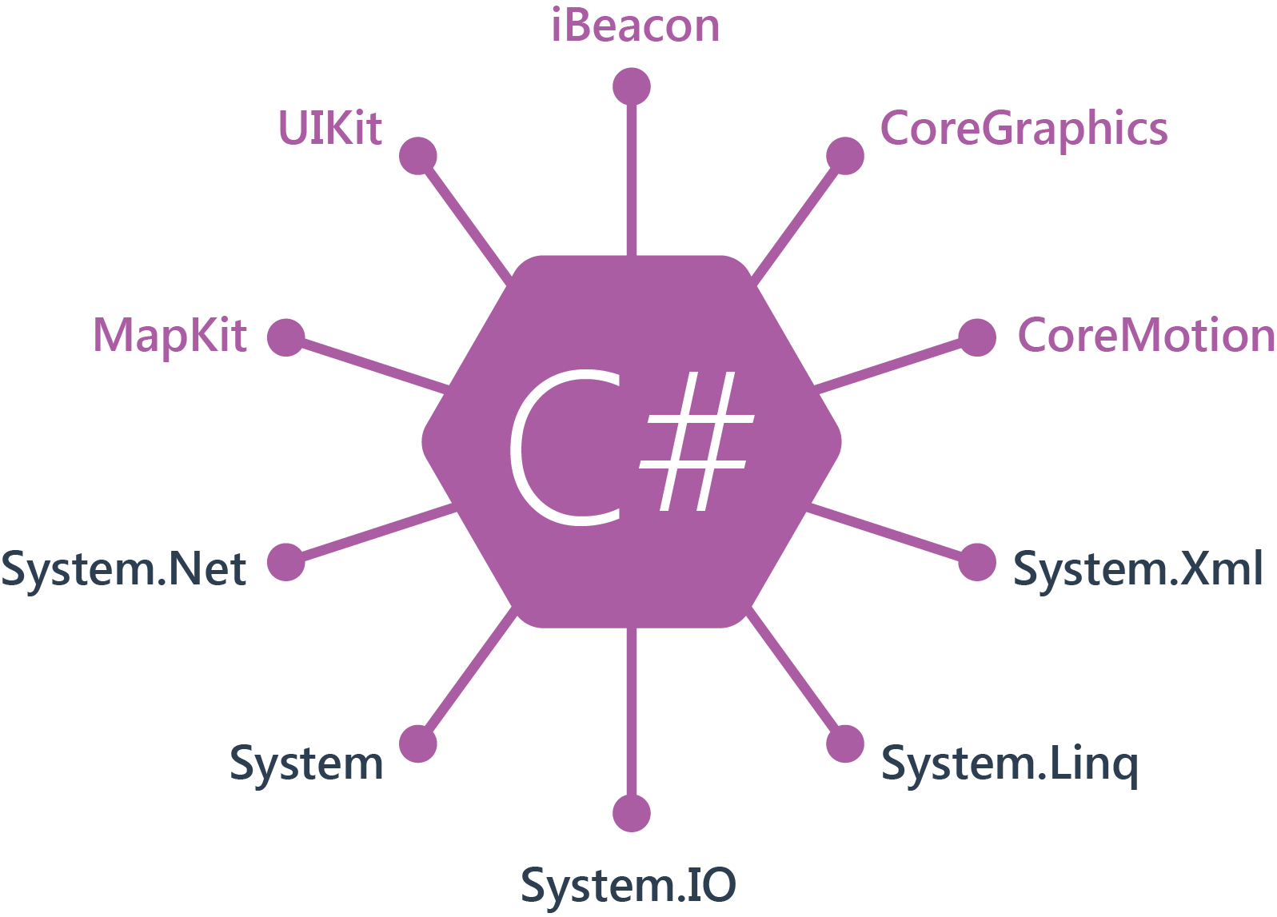
iOS
100% APIs Coverage

Slide 16
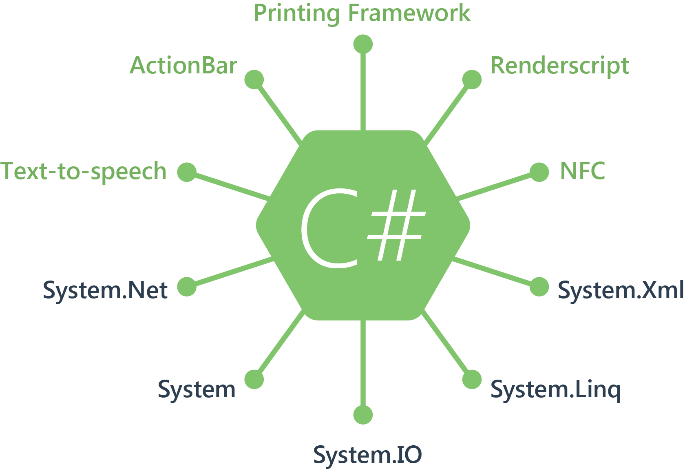
Android
100% APIs Coverage

Slide 17
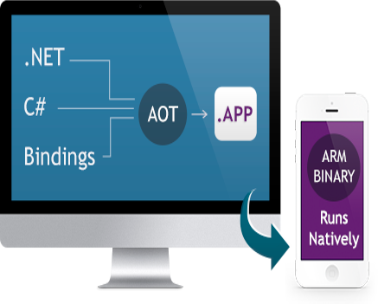
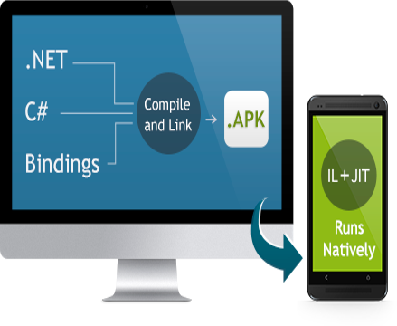
Native Performance
Xamarin.iOS does full Ahead Of Time (AOT) compilation to produce an ARM binary for Apple’s App Store.
Xamarin.Android takes advantage of Just In Time (JIT) compilation on the Android device.

Slide 18
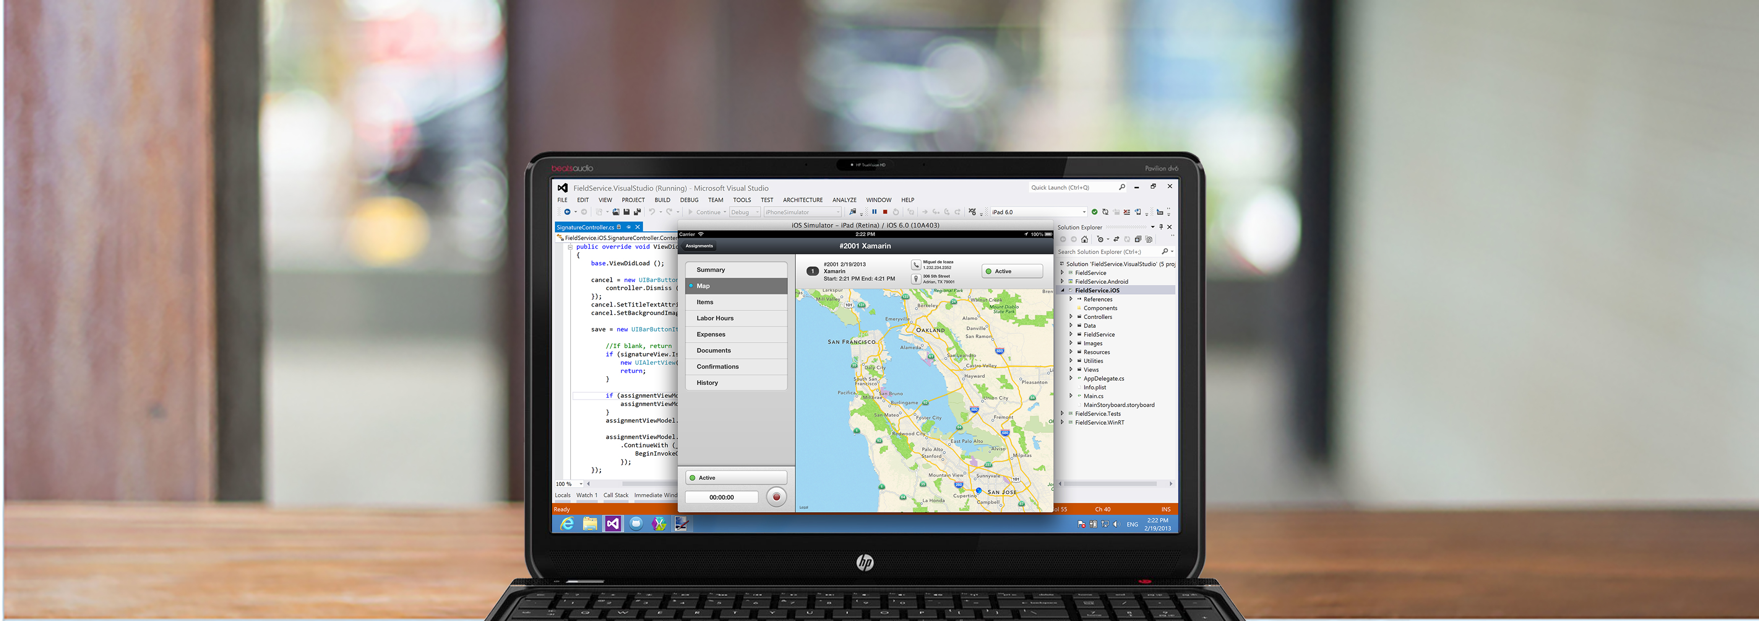
Anything you can do in Objective-C, Swift, or Java can be done in C# in Visual Studio with Xamarin.

Slide 19
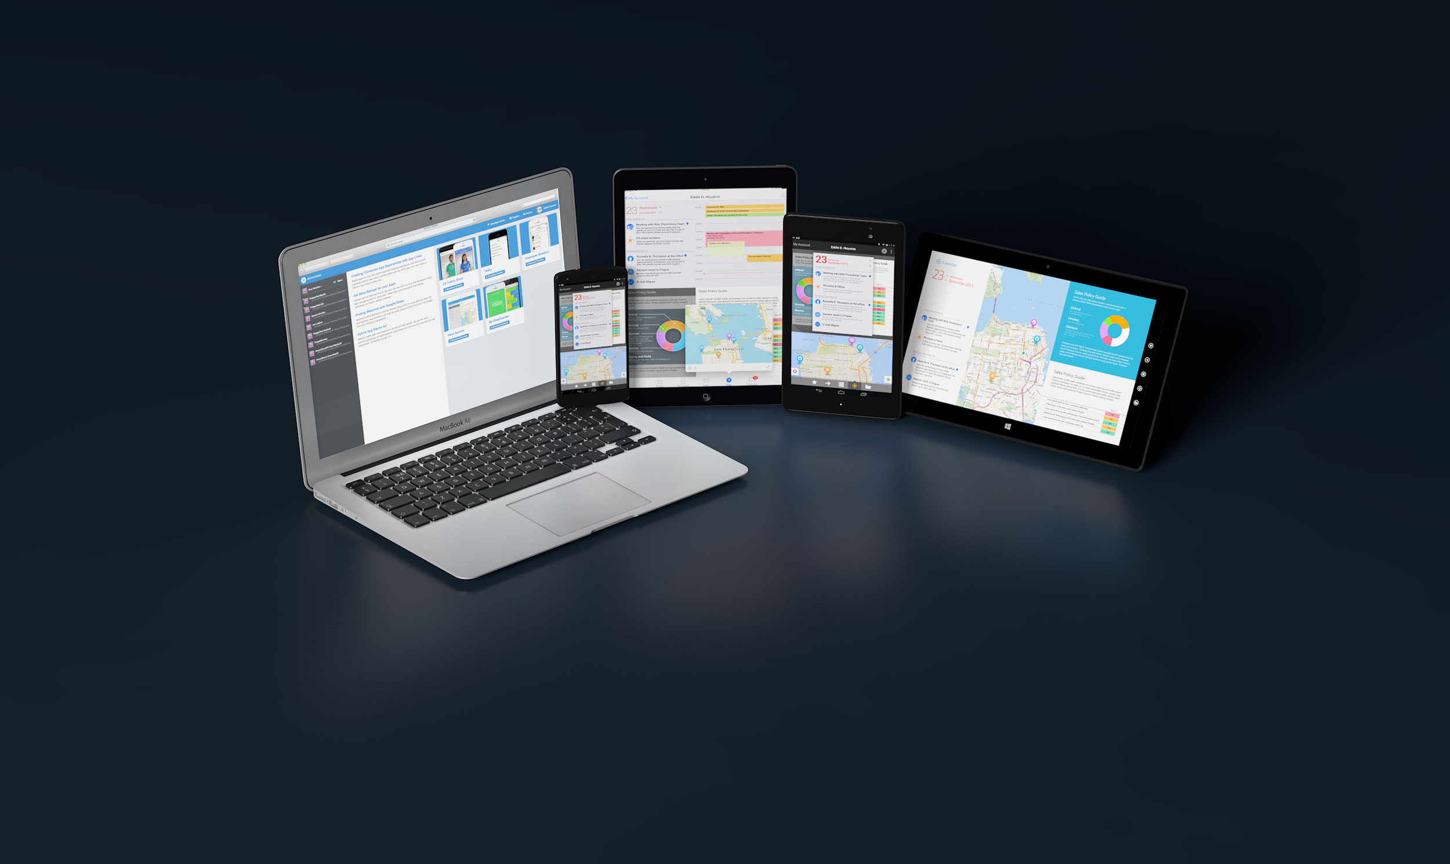
C# Runs on 2.6 Billion Devices

Slide 20
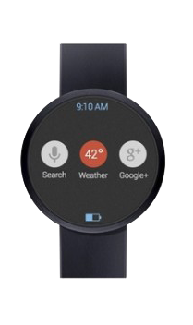
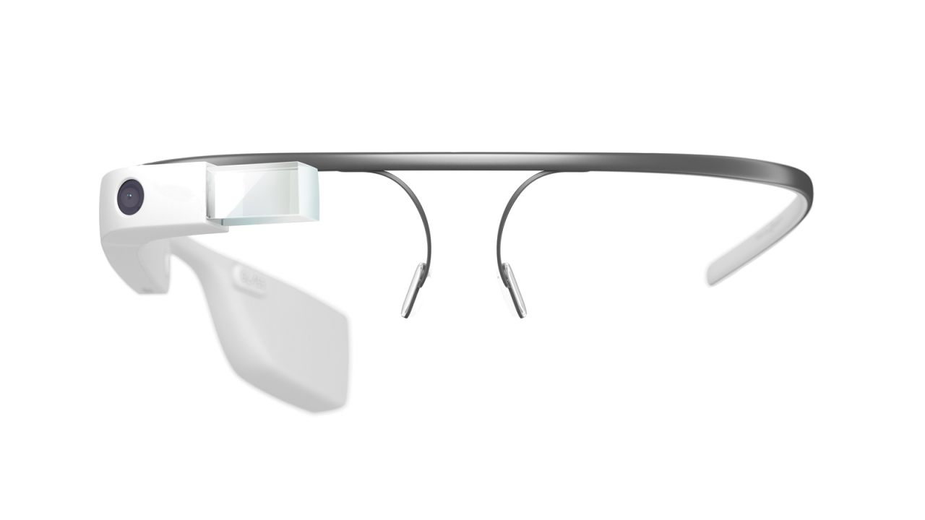
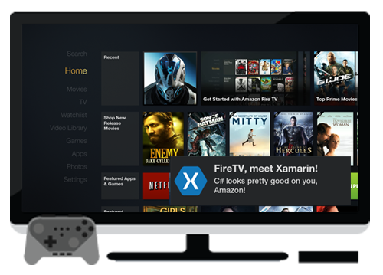
Always Up-to-Date
Track record of offering same-day support:
iOS 5, iOS 6, iOS 7, iOS 7.1, iOS 8
Full support for:
Google Glass, Android Wear, Amazon Fire TV

Slide 21
iOS & Android Development in Visual Studio
Demo

Slide 22
Platform Importance

Slide 23
More Platforms. More Customers

Slide 24
Platform Importance to Developers

Slide 25
Platform Importance to Developers

Slide 26
Platform Importance to Developers

Slide 28
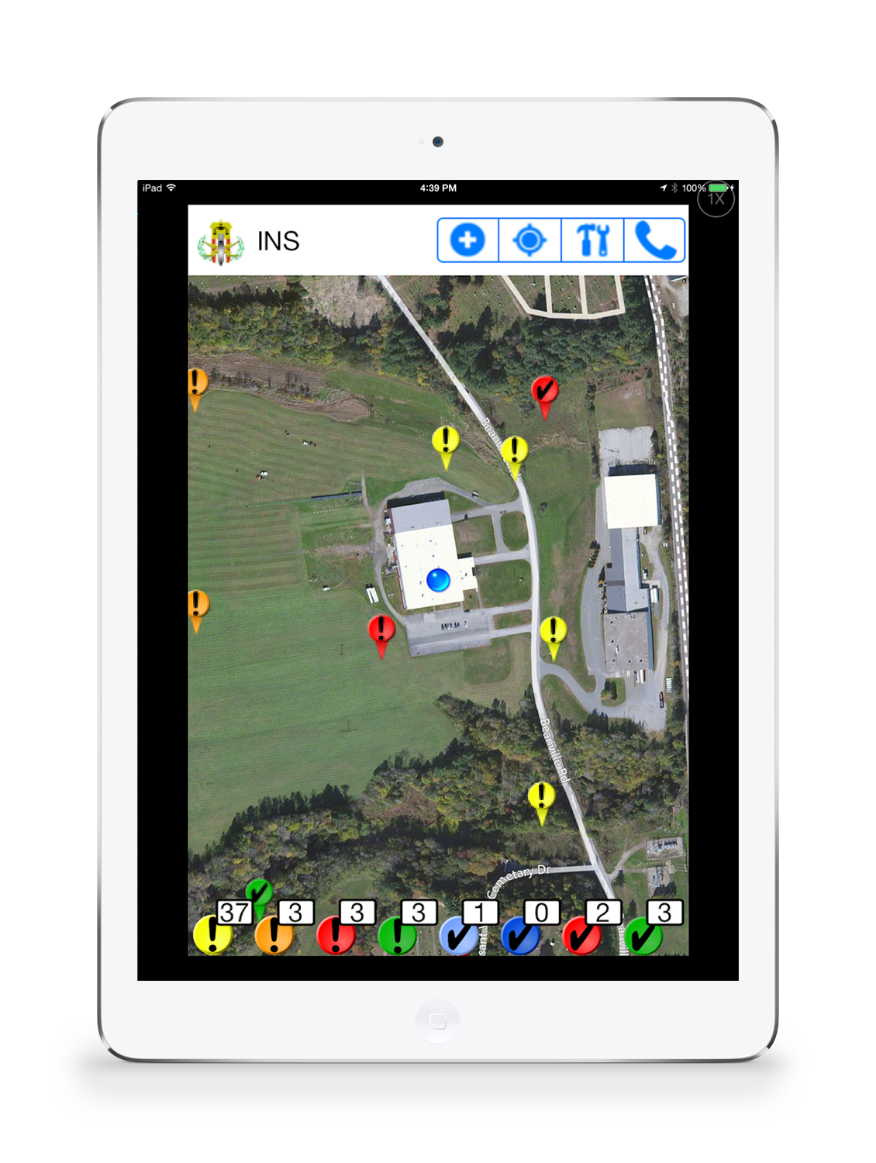
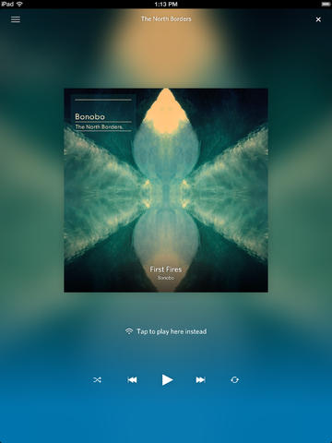
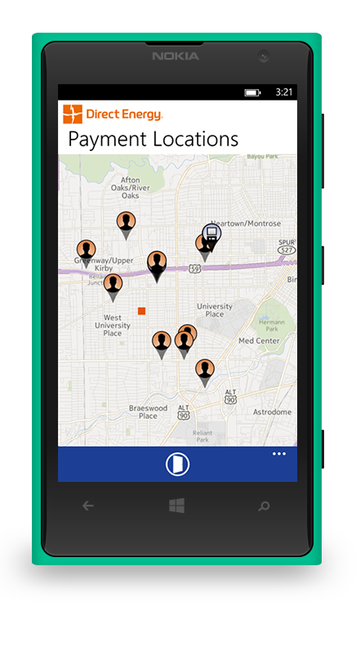
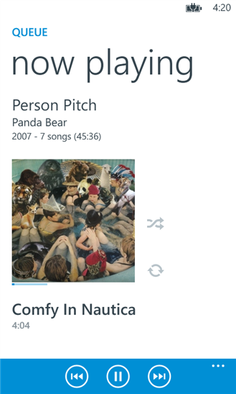
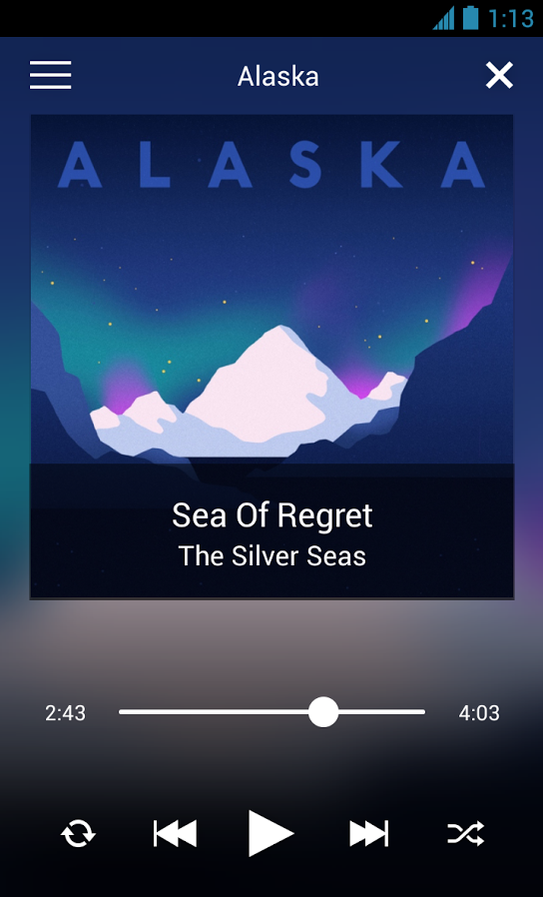
Sharing 50,000+ Lines of Code
Focus on Feature-parity
Focus on User Experience
Focus on Award Winning Mobile Apps

Slide 29
“Xamarin offers the best of all worlds. We deliver high performance, native apps that, until Xamarin, were only possible with Objective-C and Java. Sharing over 50,000 lines of code across platforms gives us more time to spend on great user experiences.”
Matt Crocker
Director of Client Engineering, Rdio

Slide 30
Code Sharing

Slide 31
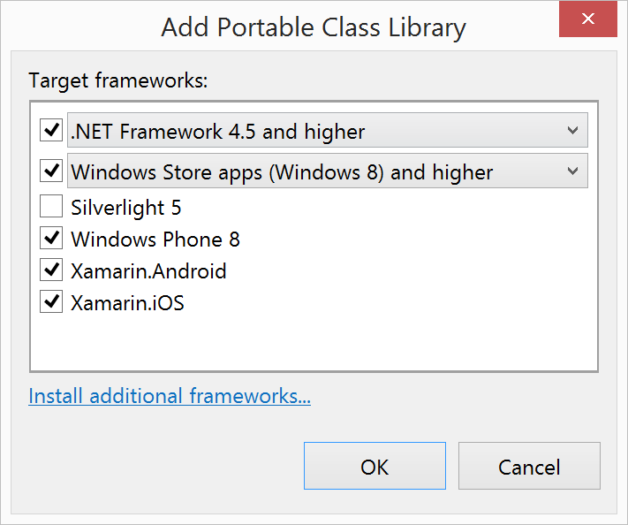
Portable Class Libraries
1 Assembly
Multiple Platforms
Including:
Xamarin.iOS
Xamarin.Android

Slide 32
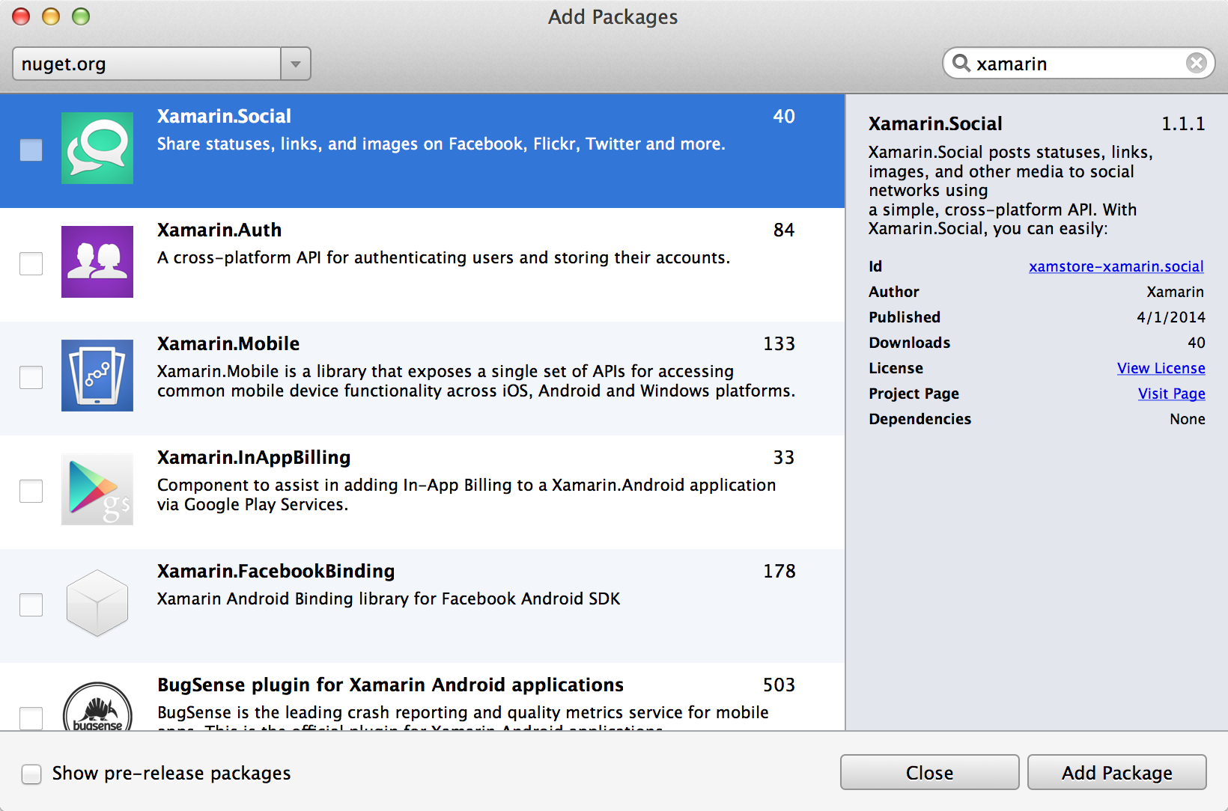
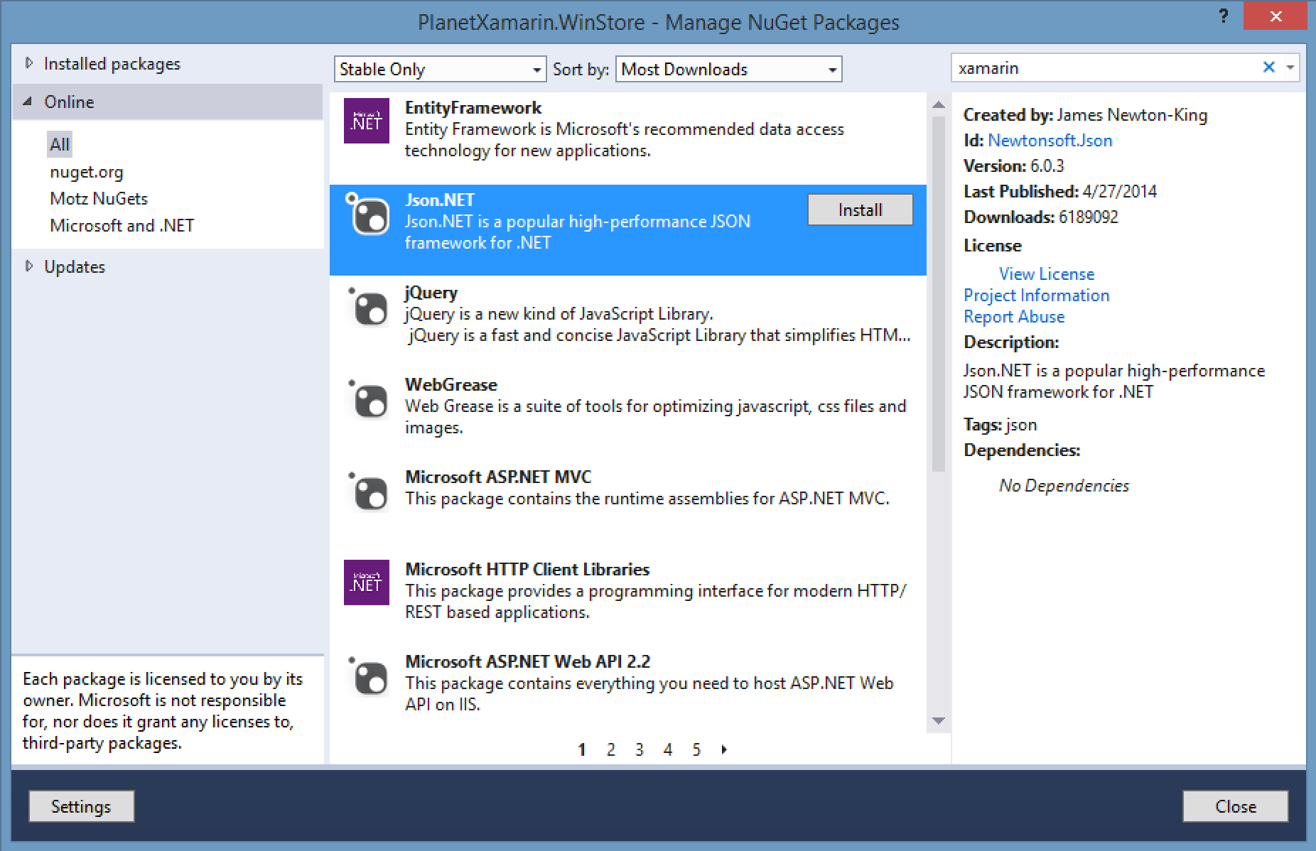
NuGet

Slide 33
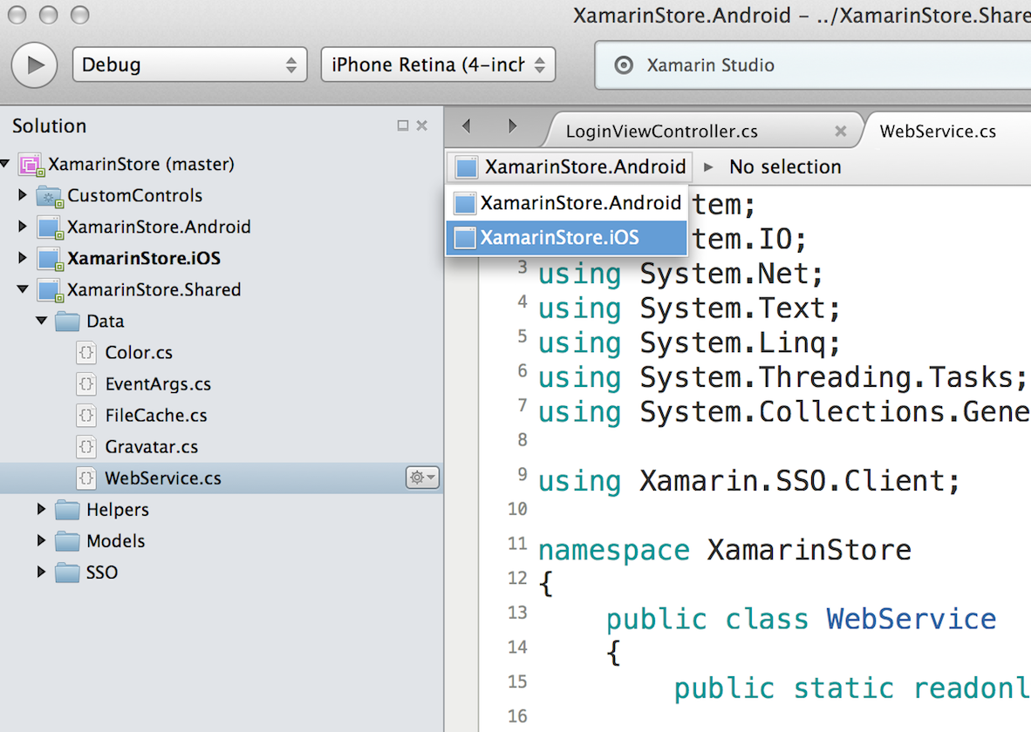
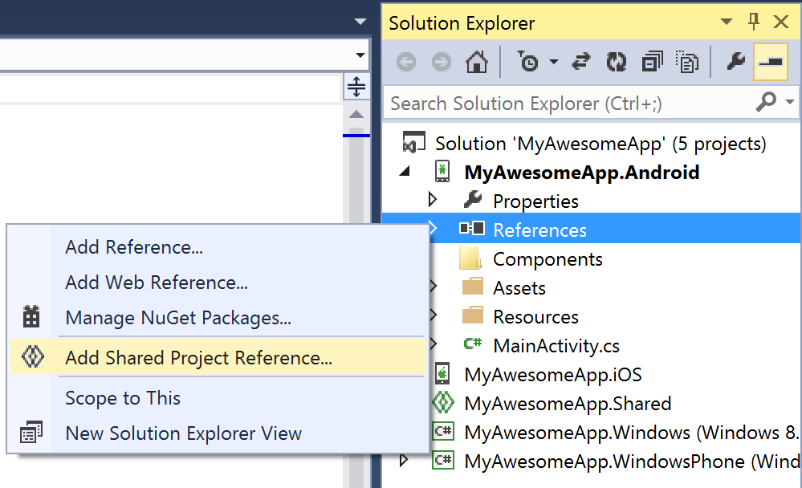
Shared Projects

Slide 34
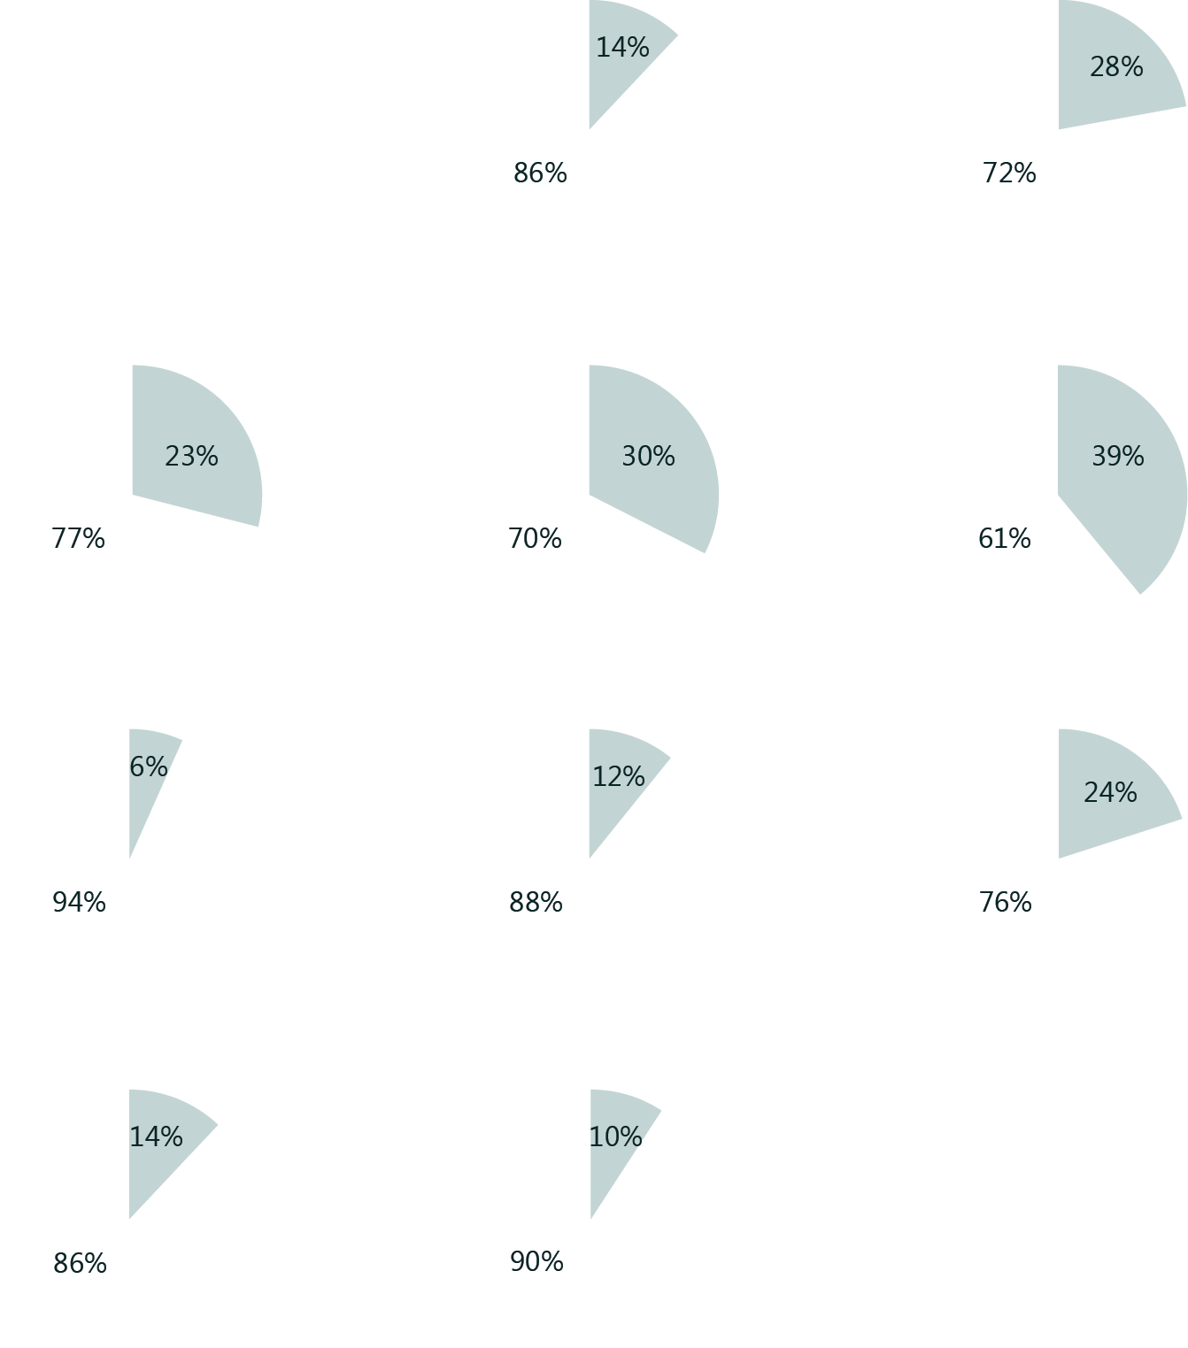
Code Sharing Stats
Calca
iCircuit
Touch Draw
Android
iOS
Mac
Windows Phone

Slide 35
Code Sharing Strategies with Xamarin
Demo

Slide 36
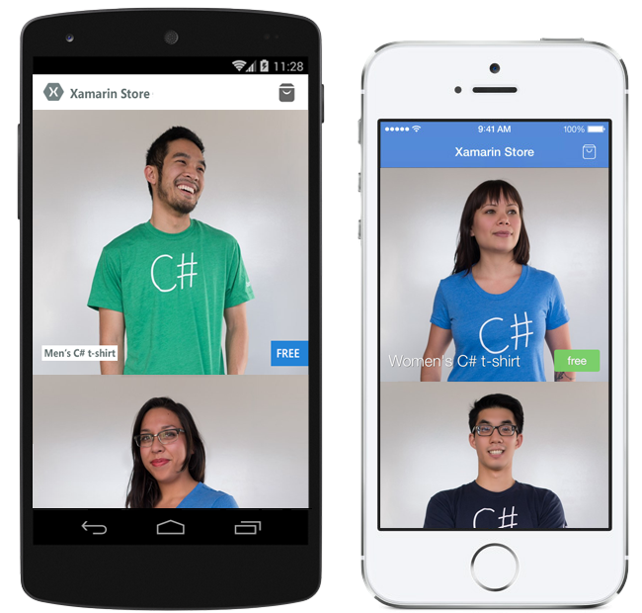
Get your free C# Shirt Xamarin.com/Shirt

Slide 37
What about the UI?

Slide 38
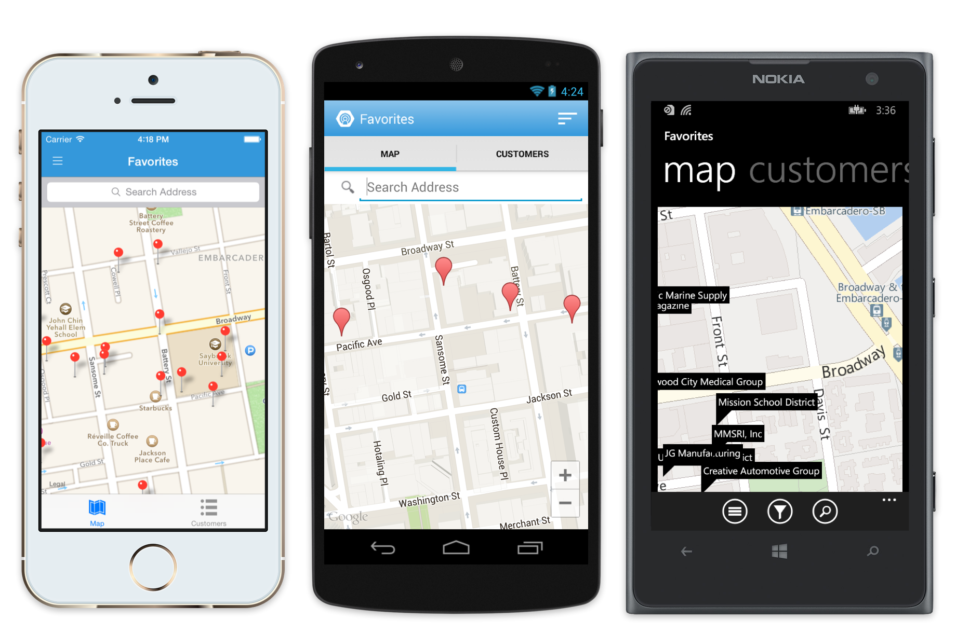
Meet Xamarin.Forms
Build native UIs for iOS, Android and Windows Phone from a single, shared C# codebase.

Slide 39
Xamarin + Xamarin.Forms
Shared UI Code
Traditional Xamarin Approach
With Xamarin.Forms:
More code-sharing, all native

Slide 40
What’s Included
40+ Pages, Layouts, and Controls
Build from code behind or XAML
Two-way Data Binding
Navigation
Animation API
Dependency Service
Messaging Center
Shared UI Code

Slide 41
Pages
Content
MasterDetail
Navigation
Tabbed
Carousel

Slide 42
Layouts
Stack
Absolute
Relative
Grid
ContentView
ScrollView
Frame

Slide 43
Controls
ActivityIndicator
BoxView
Button
DatePicker
Editor
Entry
Image
Label
ListView
Map
OpenGLView
Picker
ProgressBar
SearchBar
Slider
Stepper
TableView
TimePicker
WebView
EntryCell
ImageCell
SwitchCell
TextCell
ViewCell

Slide 44
Xamarin.Forms 3 Apps 1 C# Codebase
Demo

Slide 45
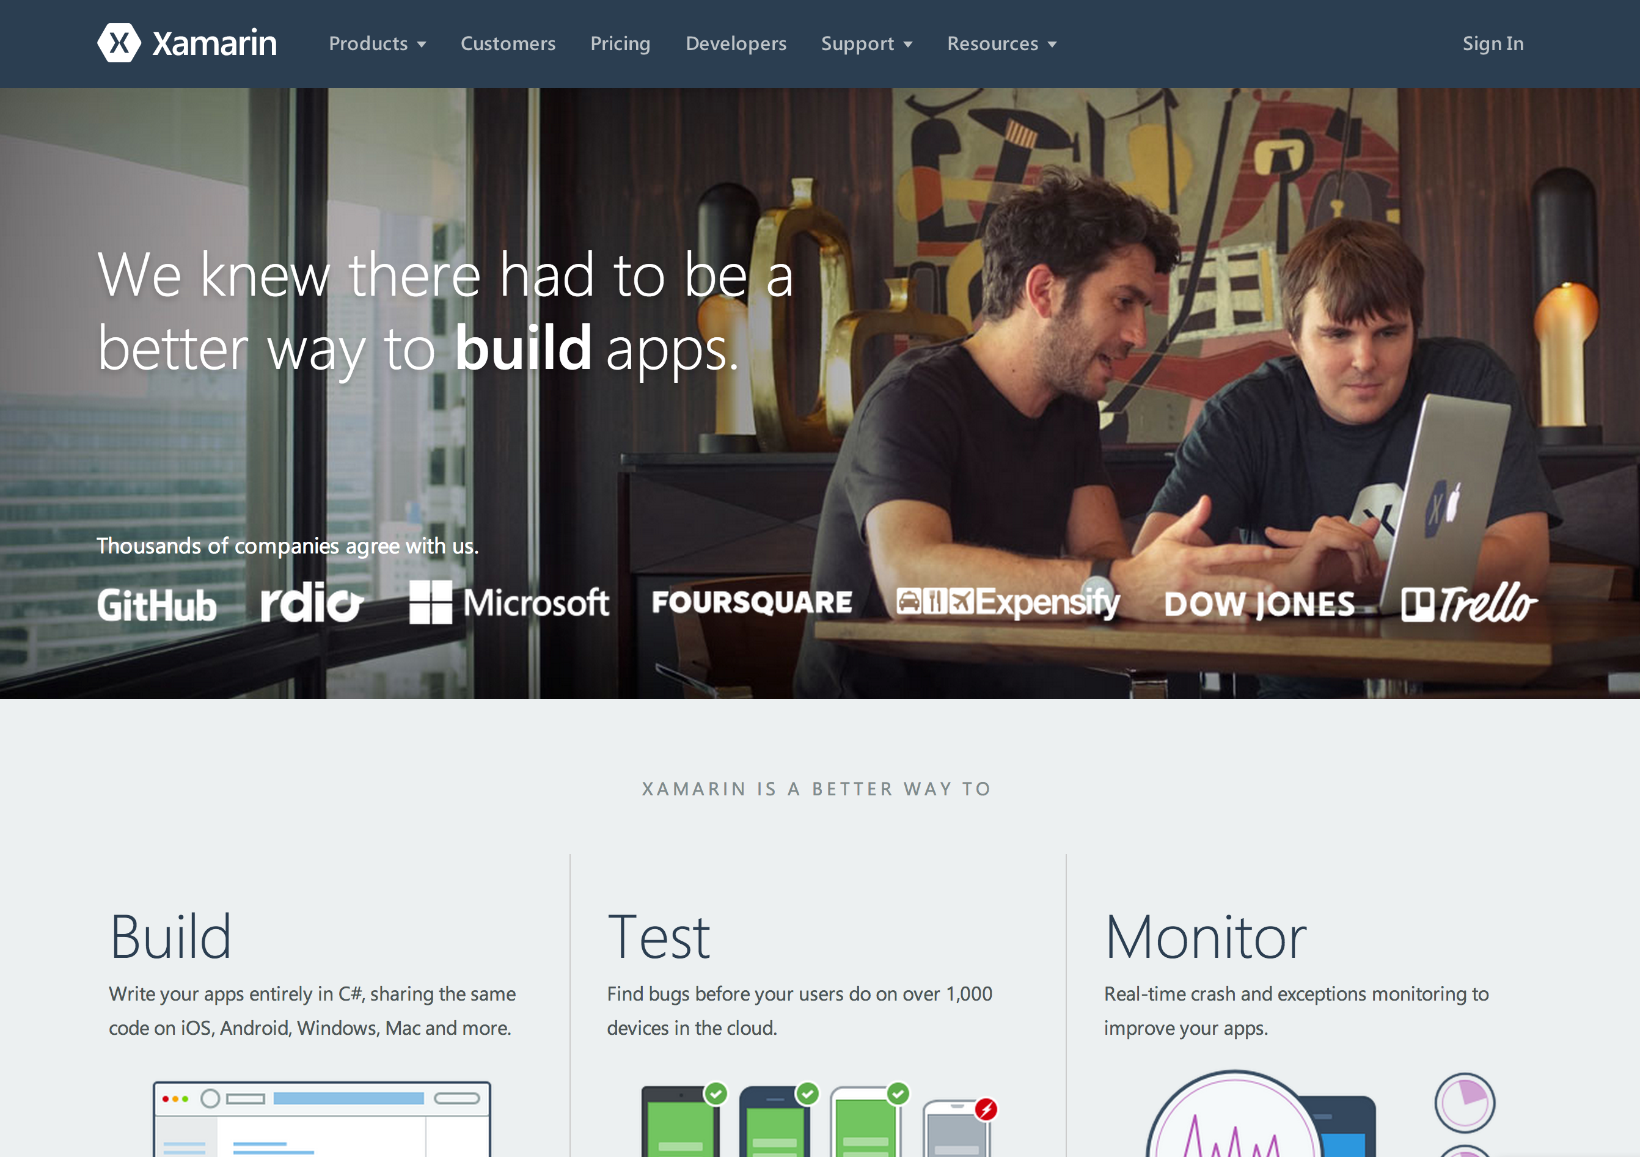
Get Started Xamarin.com

Slide 46
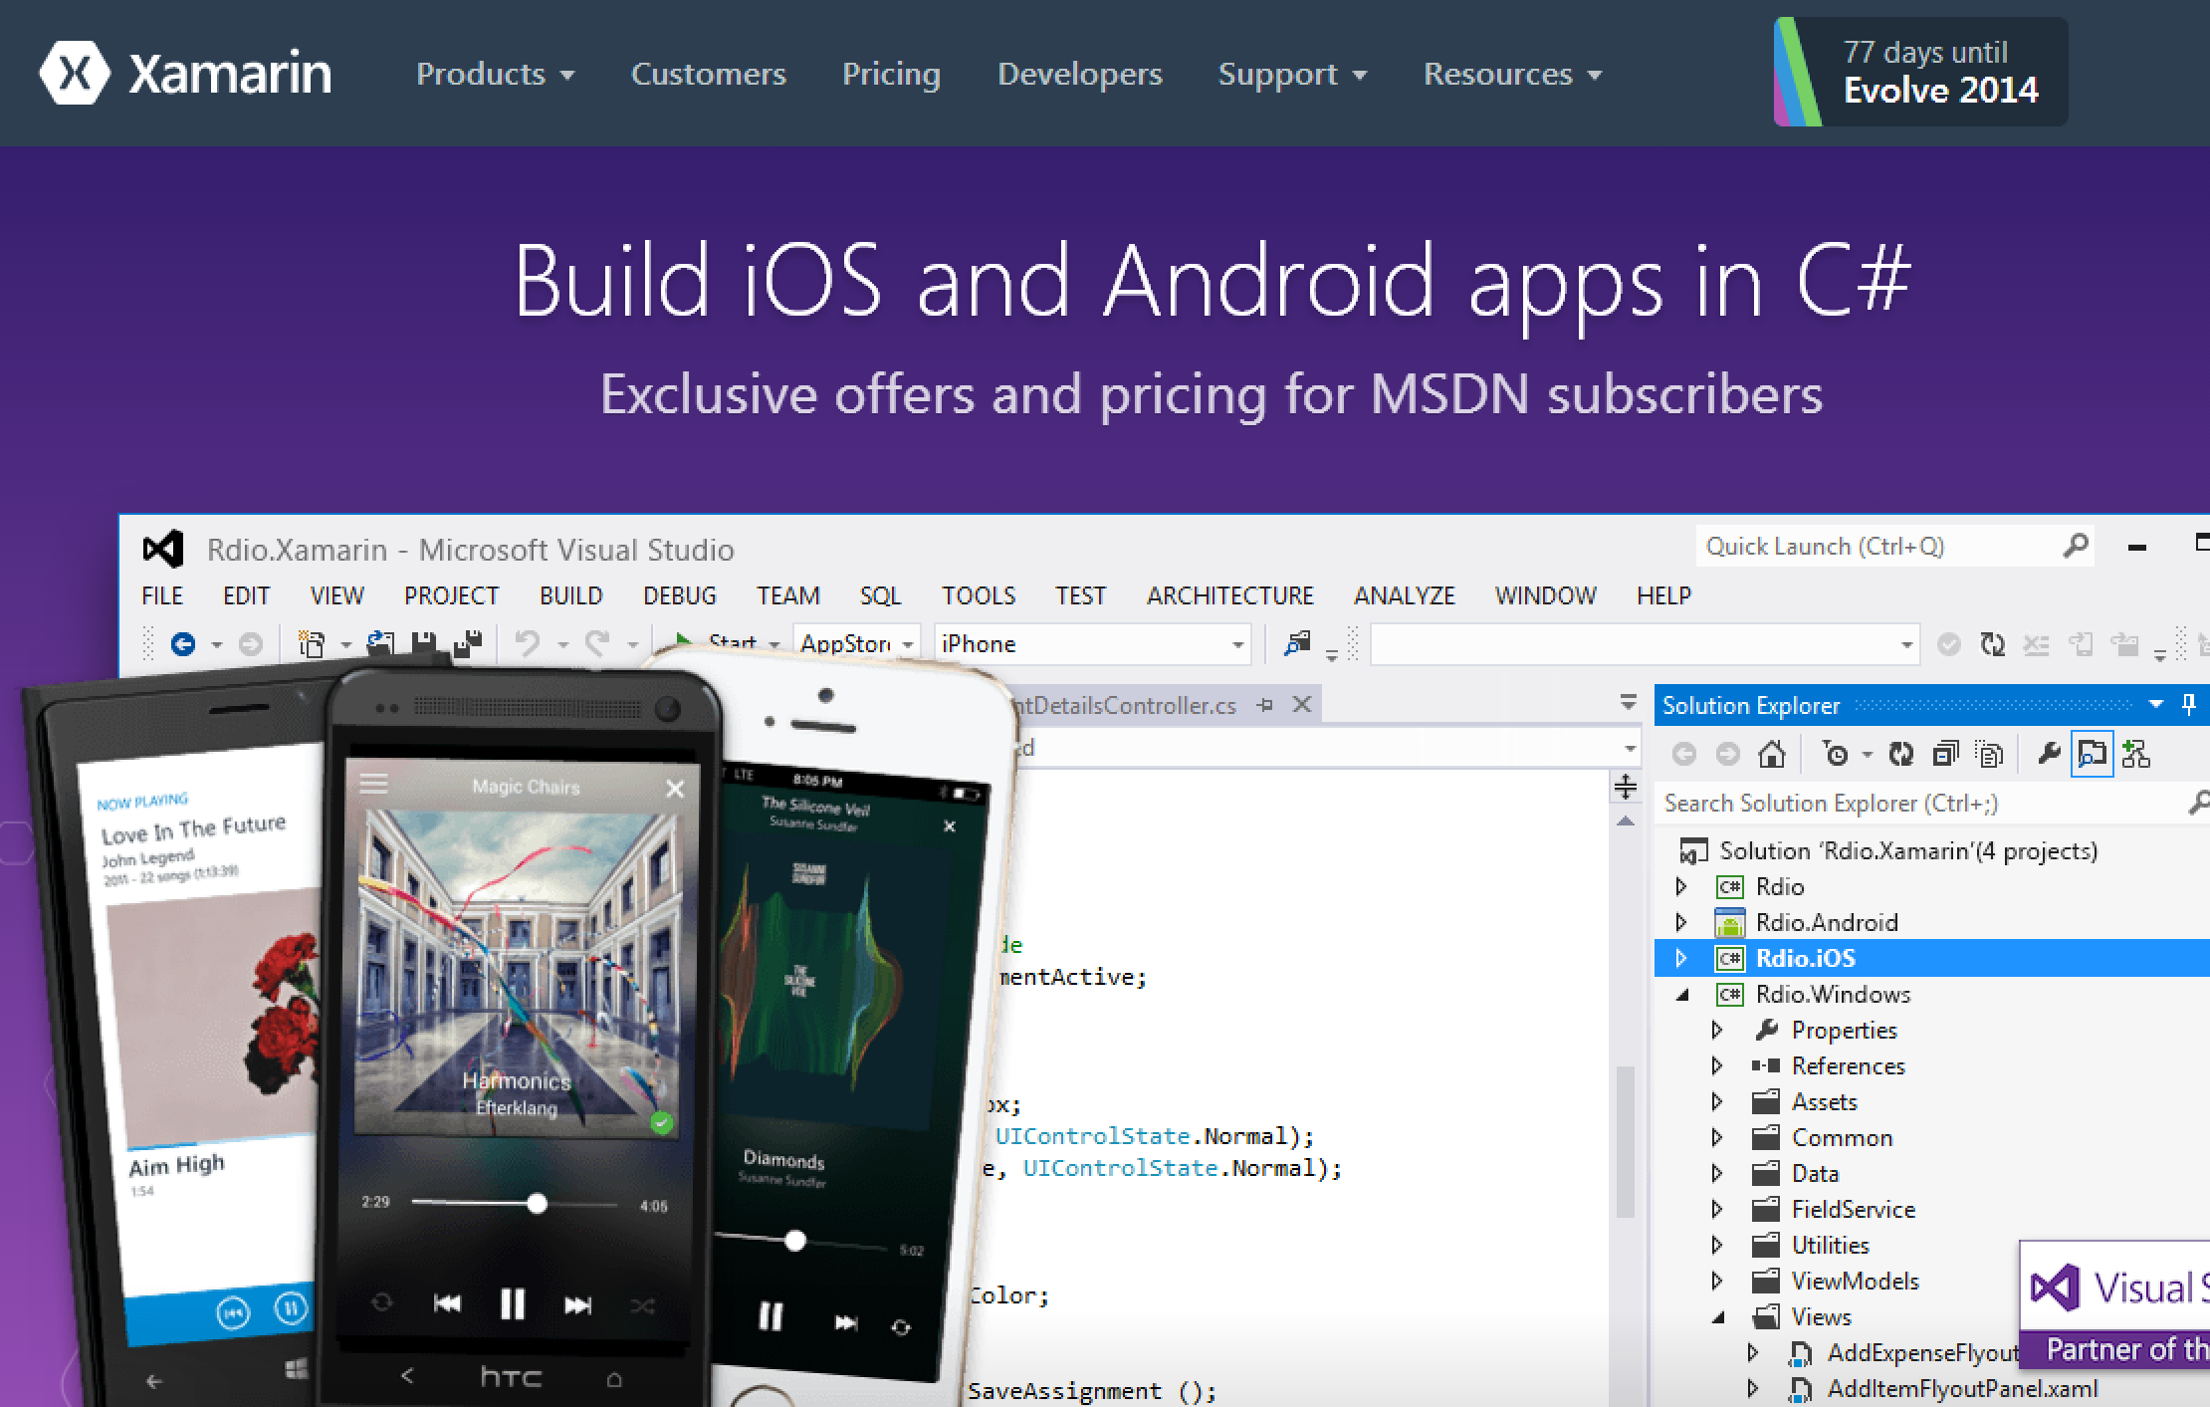
MSDN Offers Xamarin.com/MSDN

Slide 47
Xamarin.com/University
Unrivaled Mobile Development Training
Live unlimited mobile development training from mobile experts, in your time-zone, on your schedule, and as often as you'd like.

Slide 48
Connect with Me
James Montemagno
Developer Evangelist
james@xamarin.com
+1 (602) 492-6689
@JamesMontemagno

Slide 49
Summary
1
Xamarin enables C# developers to create native iOS, Android, Mac, and Windows apps leveraging their C# and .NET skills, and use all of your favorite .NET libraries.
Xamarin apps look and feel native because they are native. You get 100% API access on every device and with Xamarin you are always up to date.
Use the tools you love like Visual Studio to debug and analyze iOS and Android apps with all of the debugging capabilities such as breakpoints and watch windows.
Share on average 70%+ code between all mobile apps with the ability to connect to all of your favorite services like Azure Mobile Services, Office 365, and more.
2
3
4

Slide 50
Related content
DEV-B306 Building Multi-Device Applications with Xamarin and Cordova with Office 365 APIs
DEV-B350 Build Employee and Partner Facing Mobile Apps Using Microsoft Azure
Find Me at:
Xamarin Booth
Ask the Experts: Thursday, 30 October 18:00 – 20:00

Slide 51
DEV Track Resources
http://www.visualstudio.com
http://blogs.msdn.com/b/developer-tools/
http://msdn.microsoft.com/vstudio
visualstudio
@visualstudio
visualstudio

Slide 52
Resources
Learning
Sessions on Demand
Microsoft Certification & Training Resources
http://channel9.msdn.com/Events/TechEd
www.microsoft.com/learning
TechNet
Developer Network
Resources for IT Professionals
http://microsoft.com/technet
http://developer.microsoft.com

Slide 53
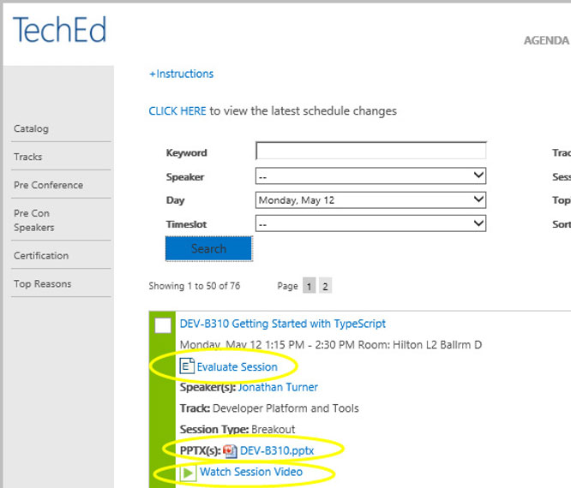
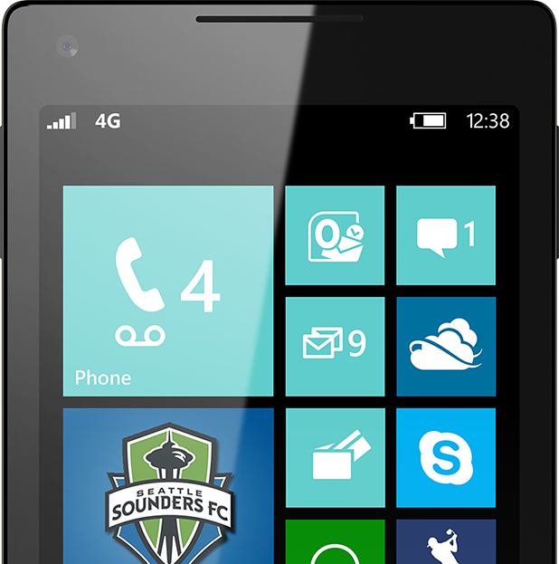
Please Complete An Evaluation Form Your input is important!
TechEd Schedule Builder
CommNet station or PC
TechEd Mobile app
Phone or Tablet
QR code

Slide 54
Evaluate this session

Slide 55
© 2014 Microsoft Corporation. All rights reserved. Microsoft, Windows, and other product names are or may be registered trademarks and/or trademarks in the U.S. and/or other countries.
The information herein is for informational purposes only and represents the current view of Microsoft Corporation as of the date of this presentation. Because Microsoft must respond to changing market conditions, it should not be interpreted to be a commitment on the part of Microsoft, and Microsoft cannot guarantee the accuracy of any information provided after the date of this presentation. MICROSOFT MAKES NO WARRANTIES, EXPRESS, IMPLIED OR STATUTORY, AS TO THE INFORMATION IN THIS PRESENTATION.

