Slide 1


Slide 2

.NET OSS Showcase
DEV-B220
Jay Schmelzer, Bertrand Le Roy, Marcus Wendt, Edward Thomson, Scott Hunter

Slide 3
Orchard
Bertrand Le Roy, PhD

Slide 4
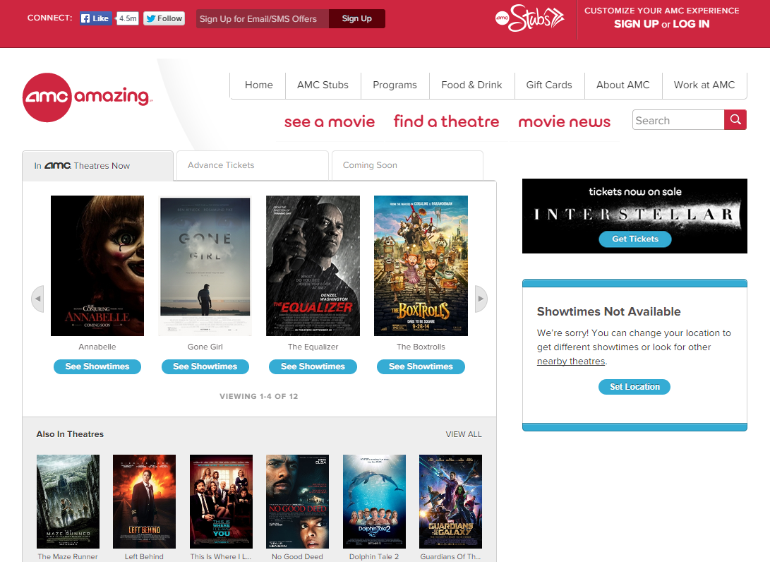
AMC Theatres
https://www.amctheatres.com/
<meta content="Orchard" name="generator" />

Slide 5
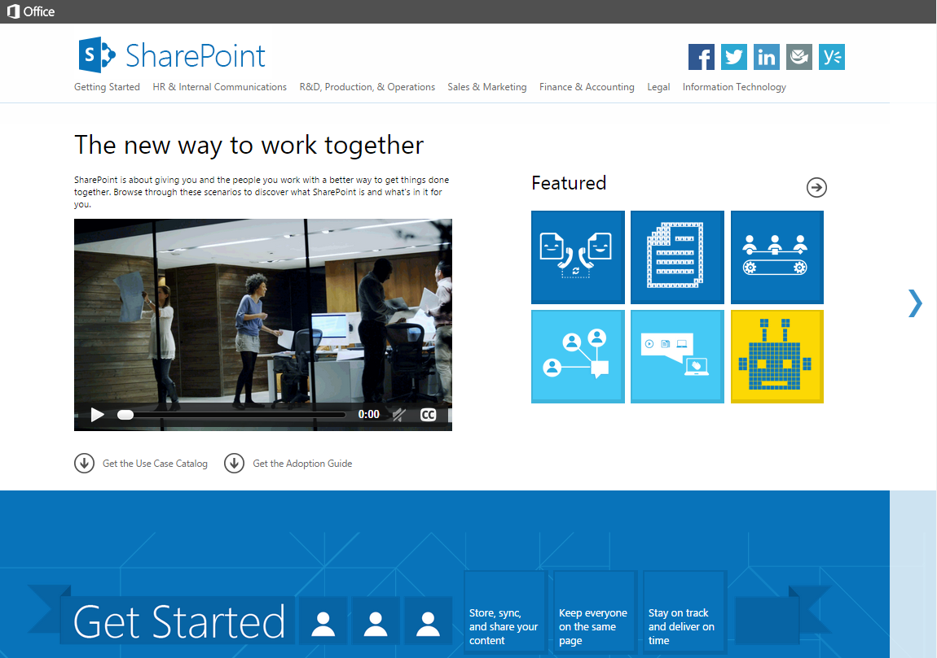
Discover SharePoint
http://www.discoversharepoint.com/
<meta content="Orchard" name="generator" />

Slide 6
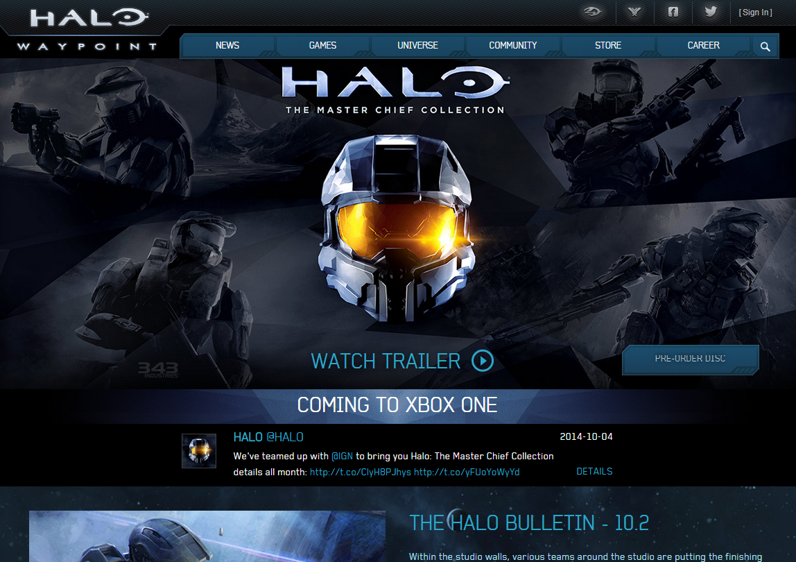
Halo Waypoint
https://www.halowaypoint.com/
<meta content="Orchard" name="generator" />

Slide 7

Frye
http://www.thefryecompany.com/
<meta content="Orchard" name="generator" />

Slide 8
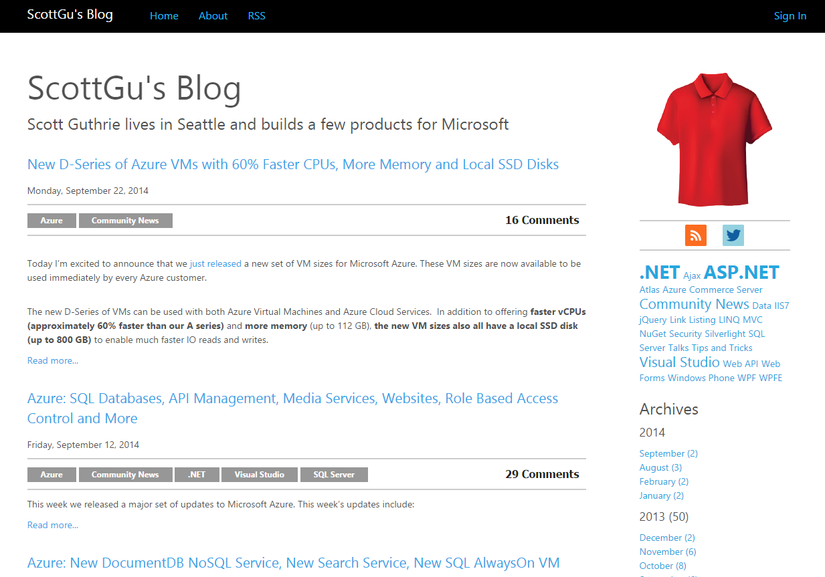
ASP.NET Blogs
https://weblogs.asp.net/
<meta content="Orchard" name="generator" />

Slide 9
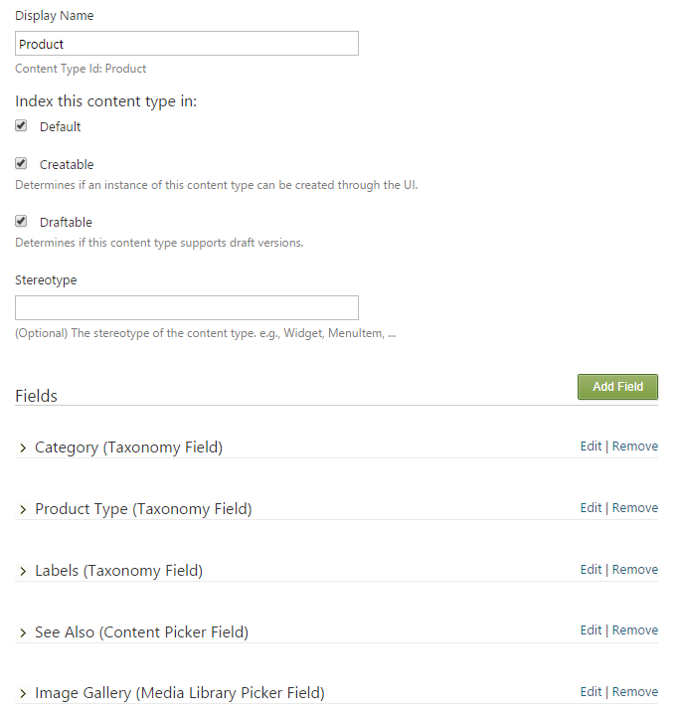
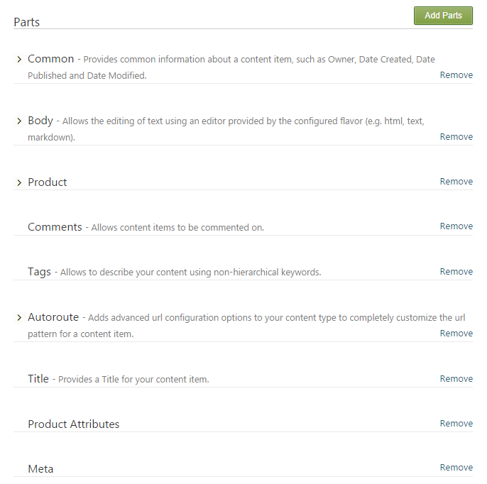
Built on composition

Slide 10
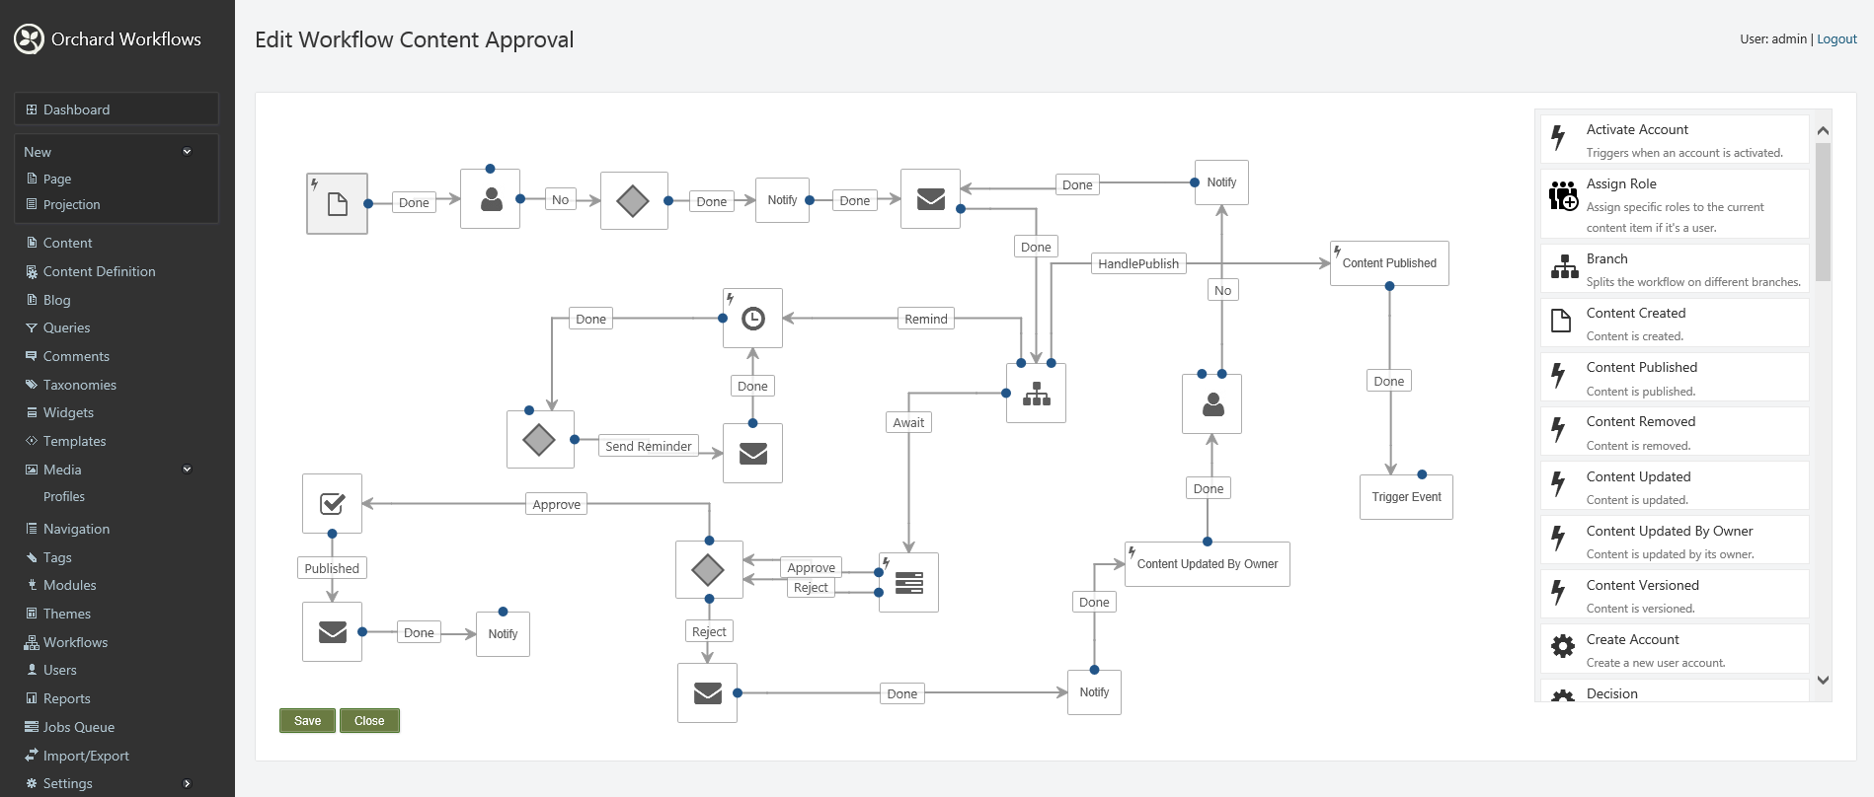
Full-featured & super-extensible

Slide 11
Scalable
750 blogs
75k posts, 250k comments
4 Web Sites, 1 Instance
4 Azure SQL Databases
1 Blob Storage Account
1 Azure Cache Service
Average CPU usage: 20%
Monthly cost: ~$520
Every month:
17 TB out
1.3 Million Views
750,000 Unique Visitors
1.1 Million Visits

Slide 12
Origins
α
ASP.NET app building
Small subgroup of ASP.NET
Work for hire agreement
Taking contributions
New BSD license

Slide 13
Governance: OPEN++
Yearly Elections
Benevolent Dictator Elect
Steering Committee
Weekly Podcast
Weekly Public Triage & Pull Request Evaluation

Slide 14
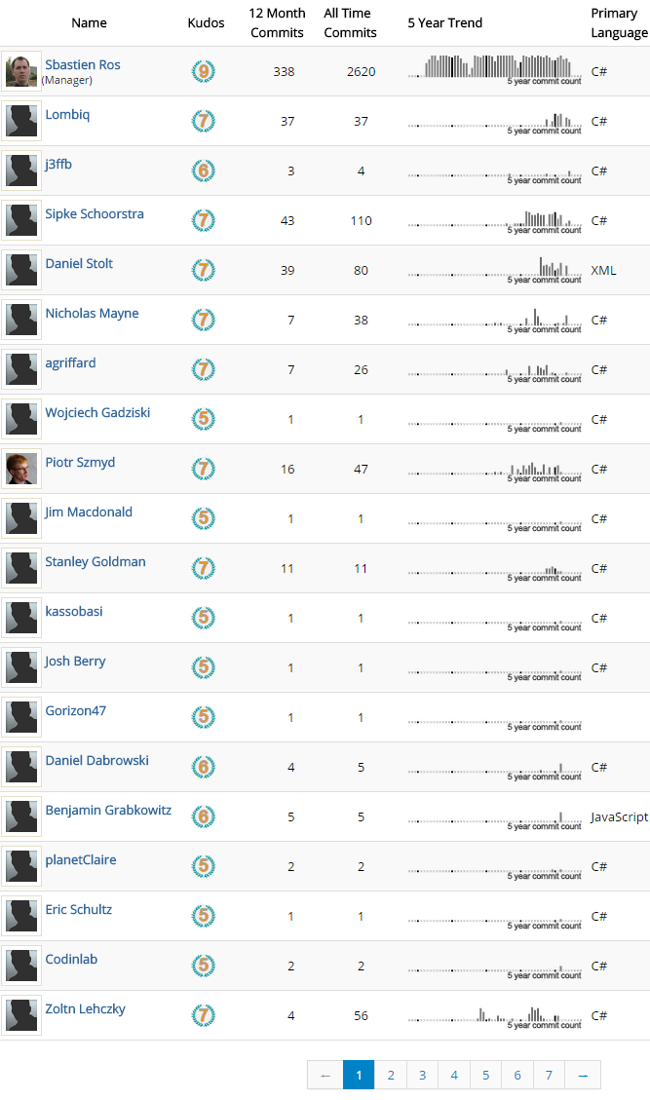
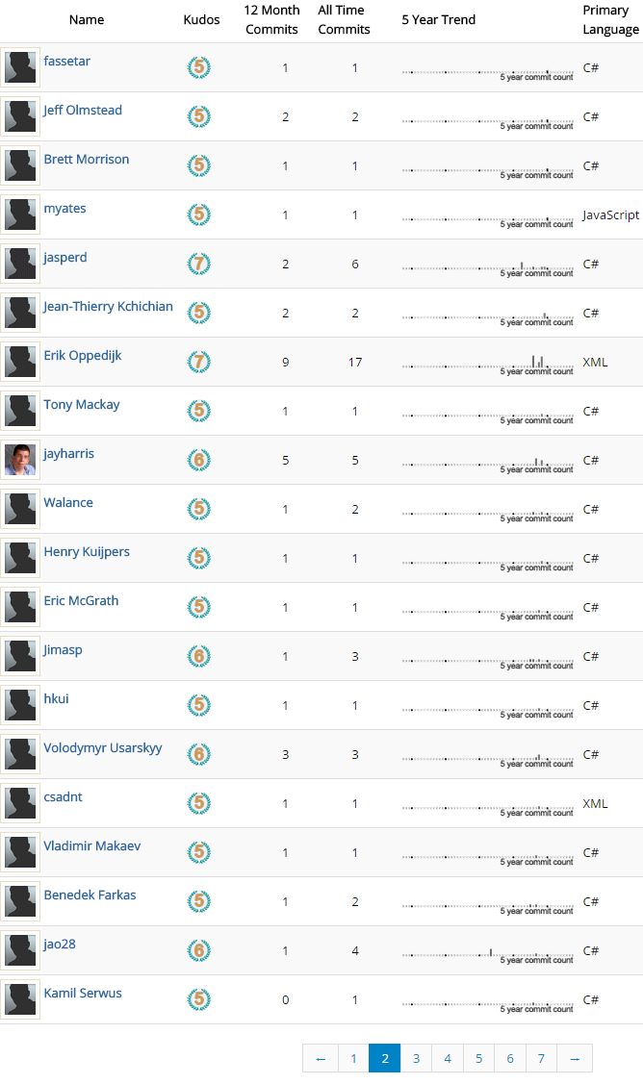
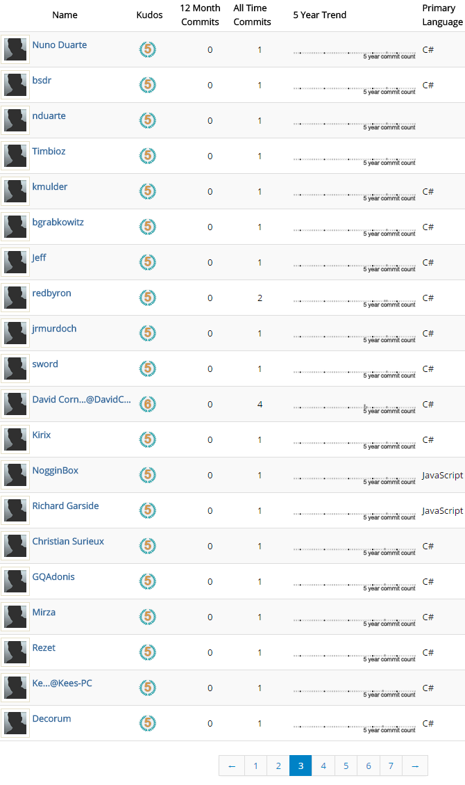
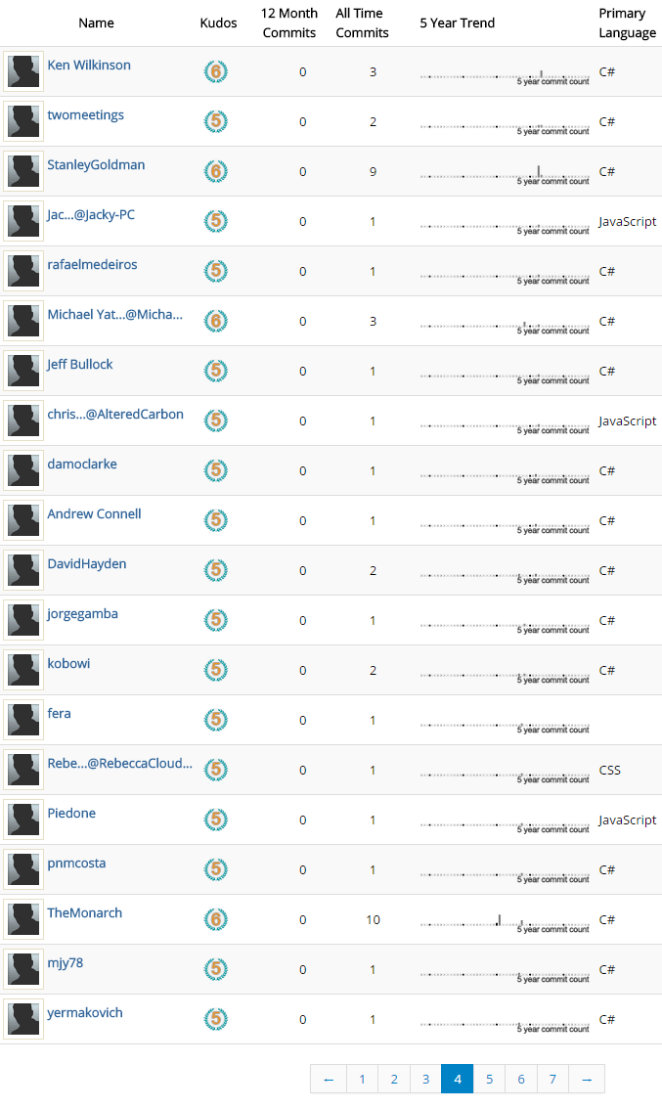
Contributors

Slide 15
Try it and get involved
Community Site: http://orchardproject.net
Repo, Bugs, & Forum: https://orchard.codeplex.com
Modules & Themes: http://gallery.orchardproject.net
All the things are open:
source, documentation, translations, extensions, governance

Slide 16




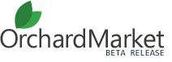



Orchard companies
Decent Consulting

Slide 17
Composite C1
Marcus Wendt

Slide 18
What is Composite C1, how do you guys get paid while building open source software … and how might I help?

Slide 19
What is Composite C1 building open source

Slide 20
What is Composite C1 building open sourced in 2010

Slide 21
What is Composite C1 top rated CMS on CodePlex

Slide 22
What is Composite C1 power company websites

Slide 23
What is Composite C1 is powered by a community

Slide 24
What is Composite C1 installed 50.000 times used in 160 countries translated to 10 languages

Slide 25
Cross Section of a feature

Slide 26
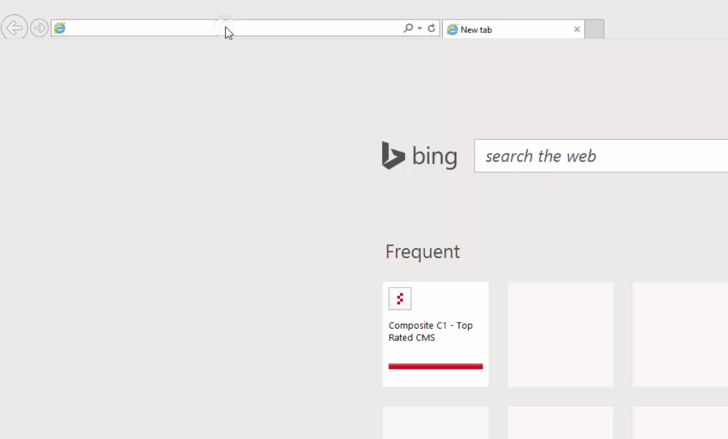

Slide 27
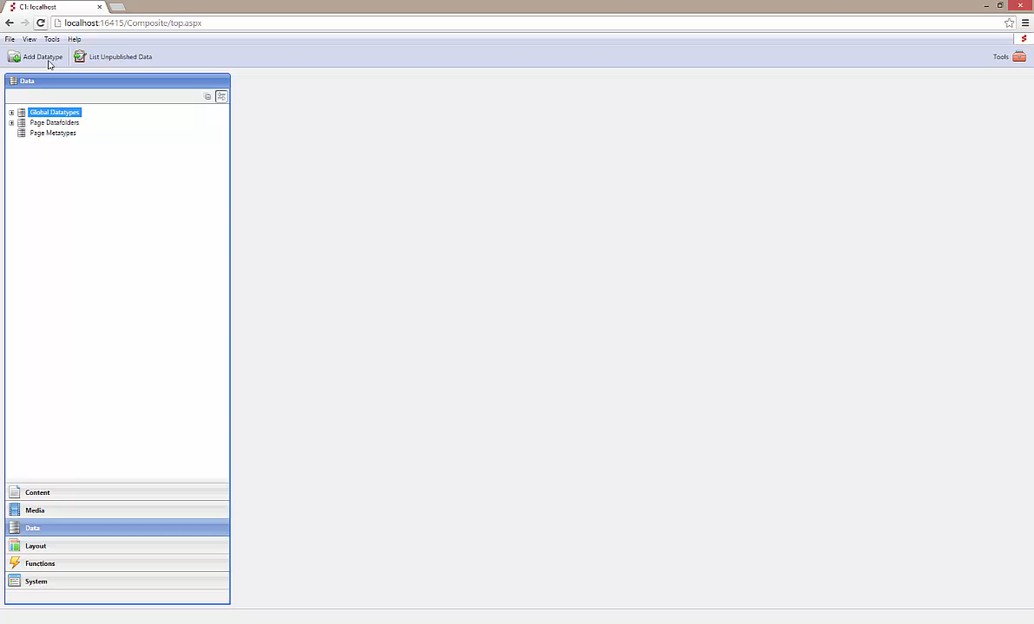

Slide 28
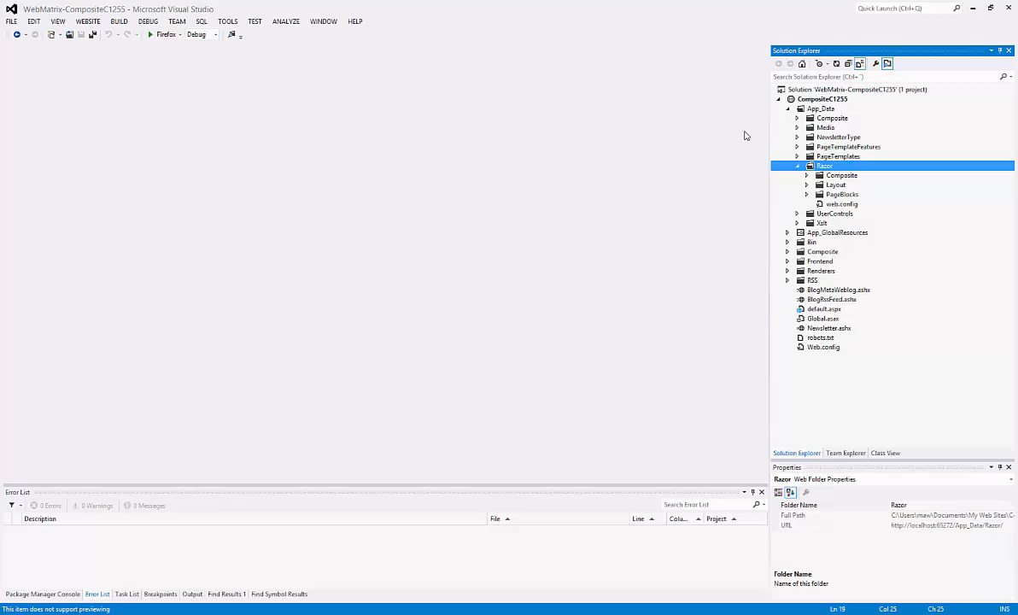

Slide 29
Selected Highlights

Slide 30
Composite C1 will make you faster!
Starter sites cover the basics out of the box
Consistent use of ASP.NET Razor, LESS and Bootstrap
C1 Packages – add-ons that solve common needs
The source code is always available for download

Slide 31
Composite C1 will make you cooler!
Use the latest .NET, Visual Studio and ASP.NET
Query data stores the type safe way - using LINQ
Use Razor, Web Forms or XSLT for layout
Provider Model based – extend deep when needed

Slide 32
All of this is free open source?
Who builds it? How is all this awesome stuff funded?

Slide 33
The nourishment

Slide 34
Composite C1 is nourished by you guys!
The community is the marketing department
The community contribute code and C1 Packages
The community drive the road map
The community provide quality bug reports
The community help newcomers in the forums

Slide 35
Composite C1 is nourished by customers
Commercial packages
  Visual Form Builder
  Newsletter Publisher
  Versioning & Audit
  …
Automated upgrade tooling
Bug Fix warranty (commercial license)
Gold Partner Network
Premium support and consulting services

Slide 36
Composite C1 is nourished by Azure
Web Roles for scaling
  Custom built web role perfect for hosting Composite C1
  Single instance use is free
  2 – N instances is a product
  Cross Data Center scaling with Traffic Manager is a product
Composite C1 as a Service
  Launched October 2014
  Easy and tailored Composite C1 hosting
  Sign up via www.composite.net for a free trial

Slide 37
Ahh! You can be commercial on top of open source…
Fair enough. How might I help?

Slide 38
Help us grow further

Slide 39
Be a positive force
Use Composite C1
Alert us if we have done something terribly bad
Rate and review us – share your thoughts
Submit feature requests, upvote those you like
Found a bug? Really? Submit a quality report
Help people around you and in the community
Always treat other community members with respect

Slide 40
Be a truly awesome force
Translate the C1 Console to your own language
Contribute code to the core
Create open source or commercial C1 Packages
Create Starter Sites
Help us create events in your local area
Blog about Composite C1
Bring in customers to fund the development
Create something amazingly cool and share it

Slide 41
Let us know that you are there and what you think. Connect with us!

Slide 42
LibGit2Sharp
Edward Thomson

Slide 43



Git Repository Management for .NET
+
= ♥

Slide 44



Trusted in Production

Slide 45

Git Repository Management for .NET

Slide 46
Features
Write C# code to manage a repository
    Provides a proper object model with proper data structures
    Don’t have to write shell scripts against git command-line
Enables complex scenarios
    History rewriting, direct object manipulation, pluggable database layers
Easy to get started
    NuGet package
    Documentation on NuDoq
Permissive MIT license

Slide 47
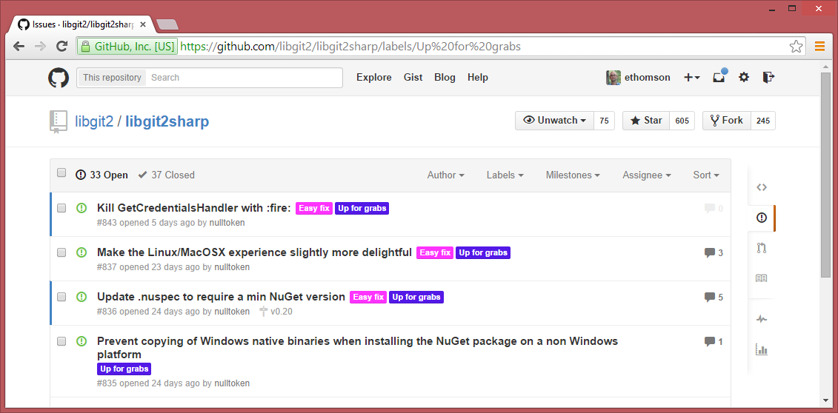
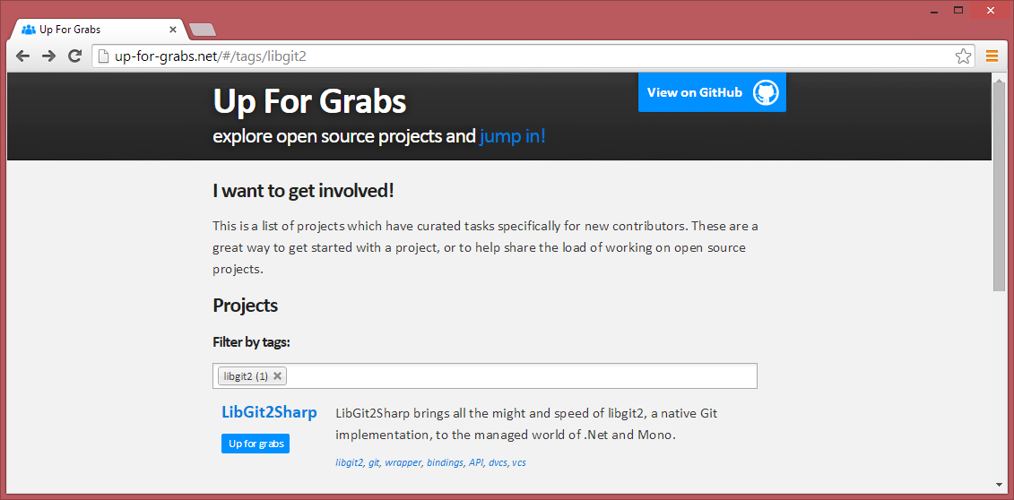
Community
encouraged
New contributors welcome
Easy changes are labeled, described
    Referenced at up-for-grabs.net

Slide 48
Development
Heavily test-driven
    No PRs are merged without corresponding unit tests
Close relationship with the libgit2 project
    Idiomatic .NET bindings
    Powerful, fast native performance
Some features not yet implemented
    Rebase (in progress)
    SSH (in progress)
    Git server
Usage guide / beginner documentation

Slide 49
Demo
Using LibGit2Sharp

Slide 50

Contact
LibGit2Sharp Project Site
    https://github.com/libgit2/libgit2sharp
Radar
    https://github.com/ethomson/radar
Twitter: @libgit2sharp
StackOverflow tag: libgit2sharp
    https://stackoverflow.com/questions/tagged/libgit2sharp

Slide 51
Related content
DEV-B334: Using Git with TFS and Visual Studio Online
Developer Tools & Technologies Booth
Friday 11:15-13:15

Slide 52
ASP.NET vNext
Scott Hunter

Slide 53
ASP.NET and OSS History
2008 – ASP.NET MVC Source Released
2008 – jQuery ships with ASP.NET
2010 – NuGet
2012 – ASP.NET MVC, Web API, Razor, EF
2014 – ASP.NEXT vNext

Slide 54
ASP.NET Open Source Highlights
ASP.NET vNext 115 commits by 23 authors
ASP.NET Web Stack 47 commits by 27 authors
SignalR 133 commits by 46 authors
Entity Framework 92 commits by 20 authors
Major features
  Attribute routing
  CORS
  Entity Framework Performance

Slide 55


ASP.NET vNext and the Modern Web
Totally Modular
Faster Development Cycle
Seamless transition
from on-premises to cloud
Choose your Editors
and Tools
Open Source
with Contributions
OSS
Cross-Platform
Fast

Slide 56
Demo
ASP.NET on Mono on OS X

Slide 57
Contact
GitHub Site:
    https://github.com/aspnet/home
Project Site:
    http://www.asp.net/vnext
Twitter: @aspnet

Slide 58
DEV Track Resources
http://www.visualstudio.com
http://blogs.msdn.com/b/developer-tools/
http://msdn.microsoft.com/vstudio
visualstudio
@visualstudio
visualstudio

Slide 59

Resources
Learning
  Sessions on Demand
  Microsoft Certification & Training Resources
http://channel9.msdn.com/Events/TechEd
www.microsoft.com/learning
TechNet
Developer Network
  Resources for IT Professionals
http://microsoft.com/technet
http://developer.microsoft.com

Slide 60



Please Complete An Evaluation Form
Your input is important!
TechEd Schedule Builder
CommNet station or PC
TechEd Mobile app
Phone or Tablet
QR code

Slide 61
Evaluate this session

Slide 62


© 2014 Microsoft Corporation. All rights reserved. Microsoft, Windows, and other product names are or may be registered trademarks and/or trademarks in the U.S. and/or other countries.
The information herein is for informational purposes only and represents the current view of Microsoft Corporation as of the date of this presentation. Because Microsoft must respond to changing market conditions, it should not be interpreted to be a commitment on the part of Microsoft, and Microsoft cannot guarantee the accuracy of any information provided after the date of this presentation. MICROSOFT MAKES NO WARRANTIES, EXPRESS, IMPLIED OR STATUTORY, AS TO THE INFORMATION IN THIS PRESENTATION.

