Slide 2
ASP.NET Identity
DEV-B314
Pranav Rastogi

Slide 3
About Me
ASP.NET
Author
http://blogs.msdn.com/b/pranav_rastogi/

Slide 5
So… what does ASP.NET Identity bring?
“One ASP.NET” – Web Apps & Web APIs
Variety of identity providers
Easily add profile data
Control over persistence
Improve unit testability of application code.
Claims
Roles
Async

Slide 6
Migrating from Membership
SQL Membership http://www.asp.net/identity/overview/migrations/migrating-an-existing-website-from-sql-membership-to-aspnet-identity
Simple Membership
https://aspnet.codeplex.com/SourceControl/latest#Samples/Identity/SimpleMembershipMigration/readme.txt
https://aspnet.codeplex.com/SourceControl/latest#Samples/Identity/SimpleMembershipSchemeUpdateMigration/readme.txt
Universal Membership http://www.asp.net/identity/overview/migrations/migrating-universal-provider-data-for-membership-and-user-profiles-to-aspnet-identity
Use in any app that can target 4.5

Slide 7
ASP.NET Identity – authentication
Can authenticate via middlewares
Local user name & password
Social
Microsoft Account
Google
Twitter
Facebook
Active Directory
Azure Active Directory

Slide 8
Features
Login username/ password
External Logins – Social providers + Azure AD
Roles
Profile
Claims
User Management – Create, edit and delete Users
Role Management – Create, edit, delete Roles and manage Users.
Identity Storage Extensibility

Slide 9
Features…
Stronger passwords
Two-Factor Authentication
Account Lockout
Account Confirmation
Security Stamp (Sign out everywhere)
Change/ Reset password
Pluggable password hasher
Custom Password Policies
Validators and extensibility
Customize Primary Key

Slide 10
Roadmap
ASP.NET Identity 1.0 – VS 2013 RTM
ASP.NET Identity 2.0 – VS 2013 Update 2
ASP.NET Identity 2.1 – VS 2013 Update 3
ASP.NET Identity 2.2-alpha1
ASP.NET Identity 3.0 – ASP.NET vNext/ Visual Studio vNext

Slide 11
Related content
Dev-B332: Entity Framework Now and Later
Microsoft Solutions Experience Location (MSE)
Find Me Later At Ask the Experts

Slide 12
Track resources
http://www.asp.net/identity/
Recommended Resources
Migrating to ASP.NET Identity
Two-factor authentication
2FA using Google Authenticator app
Web Admin using Thinktecture IdentityManager
Identity Samples
Raven Db ASP.NET Identity provider by Tugberk
ASP.NET Identity providers

Slide 13
About Me
ASP.NET
Author
Outdoorsy
http://blogs.msdn.com/b/pranav_rastogi/

Slide 14
DEV Track Resources
http://www.visualstudio.com
http://blogs.msdn.com/b/developer-tools/
http://msdn.microsoft.com/vstudio
visualstudio
@visualstudio
visualstudio

Slide 15
Resources
Learning
Sessions on Demand
Microsoft Certification & Training Resources
http://channel9.msdn.com/Events/TechEd
www.microsoft.com/learning
TechNet
Developer Network
Resources for IT Professionals
http://microsoft.com/technet
http://developer.microsoft.com

Slide 16
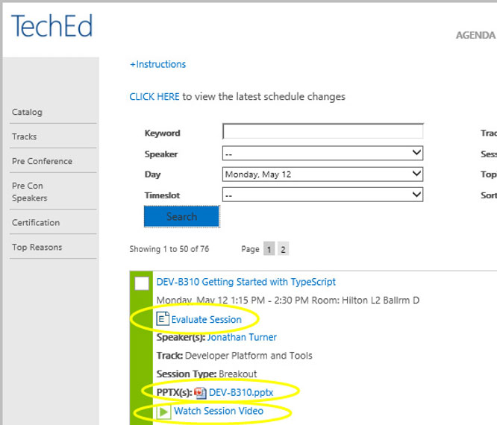
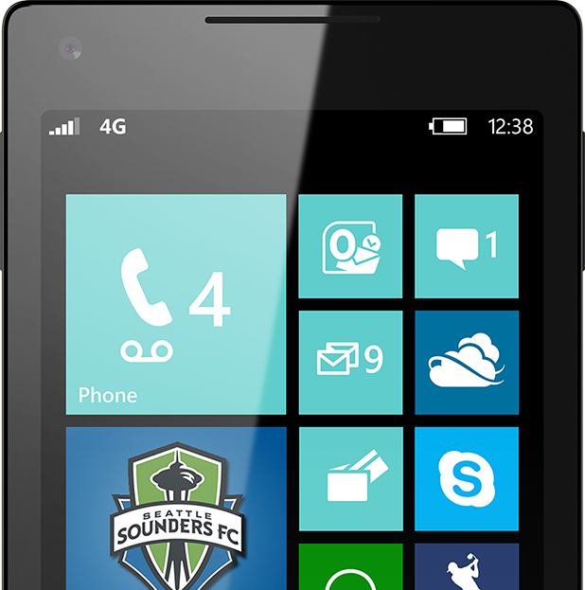
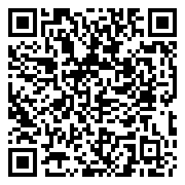
Please Complete An Evaluation Form Your input is important!
TechEd Schedule Builder
CommNet station or PC
TechEd Mobile app
Phone or Tablet
QR code

Slide 17
Evaluate this session

Slide 18
© 2014 Microsoft Corporation. All rights reserved. Microsoft, Windows, and other product names are or may be registered trademarks and/or trademarks in the U.S. and/or other countries.
The information herein is for informational purposes only and represents the current view of Microsoft Corporation as of the date of this presentation. Because Microsoft must respond to changing market conditions, it should not be interpreted to be a commitment on the part of Microsoft, and Microsoft cannot guarantee the accuracy of any information provided after the date of this presentation. MICROSOFT MAKES NO WARRANTIES, EXPRESS, IMPLIED OR STATUTORY, AS TO THE INFORMATION IN THIS PRESENTATION.

