Slide 2
Make Data-Driven Improvements to your Application with Application Insights
DEV-B340
Peter Provost

Slide 3
Today we will cover
Overview
What is Application Insights all about?
Real User Monitoring
Collecting and analyzing performance and usage data from real users
Synthetic Monitoring
Outside-in observation of your application’s availability
Custom telemetry and metrics
Collect and analyze your custom business measures and KPIs
Log search
Logging directly to Application Insights from your app

Slide 4
“The price of light is less than the cost of darkness”
-Arthur Nielsen

Slide 5
Building successful apps is hard
Competition is fierce
User retention requires constant improvements to your apps and services
Constant evolution
Web services & mobile apps need to evolve rapidly to survive & grow
Continuous delivery is here
Most major services like Microsoft, Facebook, and others push update as often as every day
Success requires data-drive decision making
Making effective choices about your backlog requires deep understanding of your users behaviors and habits

Slide 6
Modern Application Lifecycle
Plan
Monitor + Learn
REQUIREMENTS
BACKLOG
Development
Production
Collaboration
Develop + Test
Release

Slide 7
Existing impediments
Plan
Monitor + Learn
REQUIREMENTS
BACKLOG
Prioritize and validate investments based on real data
Actionable and contextual info to resolve incidents
Development
Production
Collaboration
Quickly detect and triage application issues
Tools and processes
Collaboration
Develop + Test
Release

Slide 8
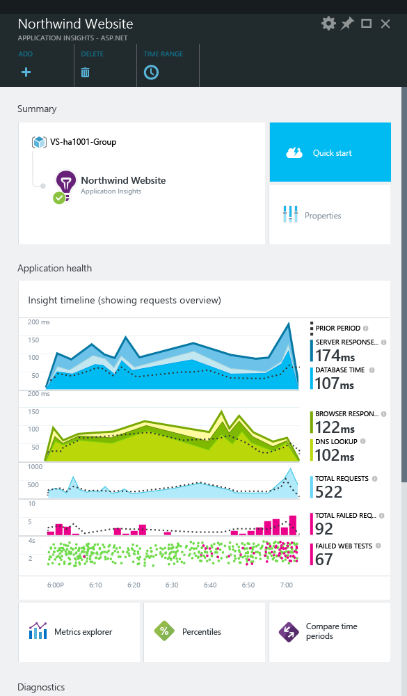
Application Insights
Application
Insights
1. Telemetry is collected at each tier: Mobile applications, server applications and browser
2. Telemetry arrives to Application Insights service where it is processed & stored
3. Get 360° view of the application covering availability, performance & usage

Slide 9
Telemetry for 360° view
1
Outside-in monitoring
URL pings and web tests from 8 global points of presence
2
Observed user behavior
How is the application being used?
3
Developer-emitted traces and events
app
Whatever the developer would like to send to Application Insights
platform
4
Observed application behavior
No coding required – service dependencies, queries, response time, exceptions, logs, etc.
infrastructure
5
Infrastructure performance
System performance counters

Slide 10
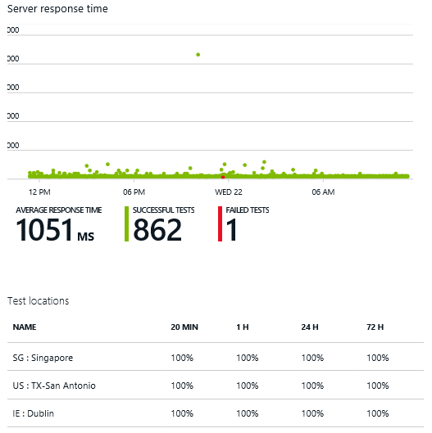
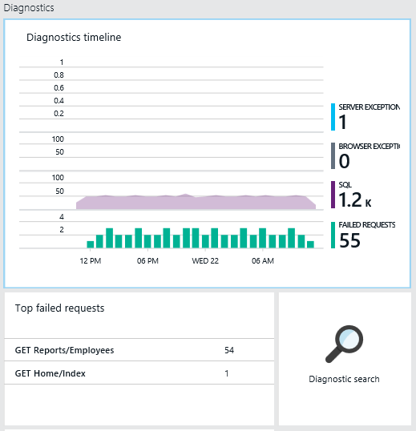
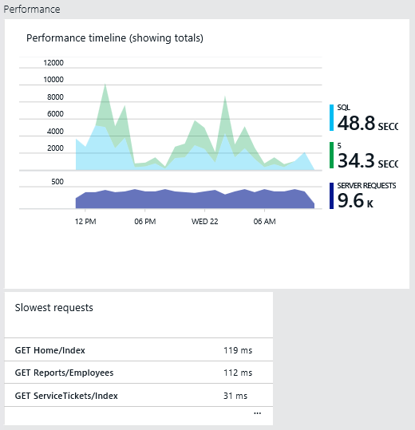
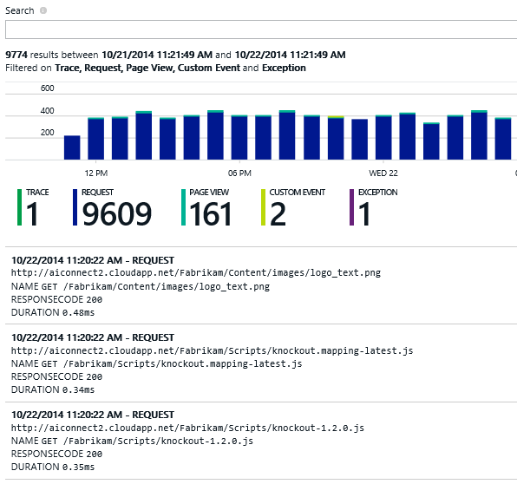
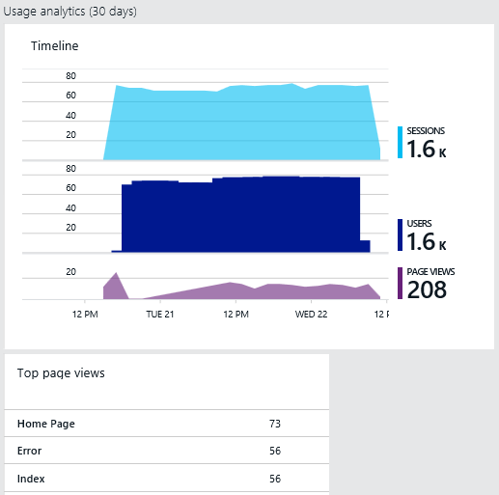
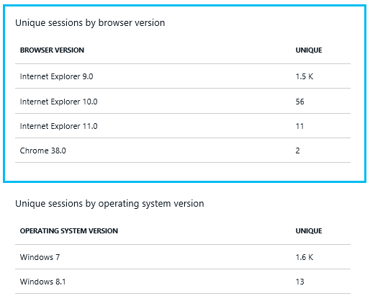
Identify & Triage
Diagnose & Solve
Application Insights
Learn & Improve

Slide 11
Real User Monitoring The best data comes from real people

Slide 12
“I love mankind… it’s people I can’t stand!”
-Linus from Peanuts
by Charles Schulz

Slide 13
What is Application Insights all about?
Enabling you to efficiently build better applications
Making analytics ambient with “zero effort” integration from dev to prod
Providing dev team with 360° view of their app
‘Find-Fix-Release’ and ‘Build-Measure-Learn’ all in one place
Making it easy to explore multi-dimensional data to form & validate hypotheses

Slide 14
Real User Monitoring
Typically passive monitoring
Collect performance, usage, track and funnel data
Understand and identify where your app is failing to meet its goals

Slide 15
Demo
Real User Monitoring in
Application Insights (Preview)

Slide 16
Synthetic Monitoring The best data comes from real people

Slide 17
“Any code that cannot be tested is inherently flawed.”
-Anonymous

Slide 18
What is synthetic testing?
Often the first line of defense to detect an outage or failure
Always on, always watching…
Outside-in monitoring of your web app
External monitoring of your site from 8 points-of-presence around the world
Simple or complex… you choose
Simple HTTP “ping” tests or more complex Visual Studio Webtests

Slide 19
Demo
Synthetic Monitoring with
Application Insights (Preview)

Slide 20
Custom Telemetry and Metrics Track and analyze the data you care about

Slide 21
“You can have data without information, but you cannot have information without data.”
-Daniel Keys Moran

Slide 22
Custom telemetry and metrics
To truly understand your business, you need to track your own custom metrics
Passive and automatic tracking will get you started
But won’t tell you anything about your real business goals
Determining what to track is often harder than implementing it
Tracking is easy… tracking the right thing takes thought and planning

Slide 23
Demo
Custom Telemetry and Metrics with
Application Insights (Preview)

Slide 24
Log Search Using the telemetry you already emit to help solve problems

Slide 25
“Everyone knows that debugging is twice as hard as writing a program in the first place.”
-Brian W. Kernighan

Slide 26
Logging and Log Search
All developers use logging
It is the first way we learn to debug
Aka “printf” debugging
You’re probably using it already
System.Trace
Nlog
Log4net
Application Insights can ingest that telemetry right now!

Slide 27
Demo
Logging and Log Search in
Application Insights (Preview)

Slide 28
Closing Thoughts…

Slide 29
Data Privacy & Security
Privacy
Your data is for your eyes only; Application Insights will never make your data available to advertisers, partners or 3rd parties
Security
With Application Insights you can be confident that your data is secure in Microsoft’s Azure data centres
Learn More at http://azure.microsoft.com/en-us/support/trust-center/

Slide 30
Try it today!!
Add Application Insights to your web app
Help direct where we go next
User Voice: visualstudio.uservoice.com
Email us: aifeedback@microsoft.com

Slide 31
Related content
Breakout Sessions
CDP-B215 Build, Deploy, Manage, and Monitor Your Cloud Applications Using the New Microsoft Azure Portal
DEV-B206 Application Insights Overview: How to Keep Your Applications Available, Performing, and Succeeding
DEV-B317 Make Data-Driven Improvements to Your Application with Application Insights
DEV-B347 Discovering Performance and Scale Impediments in Your Web Applications
Find me later…
At the “Developer Tools and Technologies” booth on Thursday from 12:45-4:00pm.

Slide 32
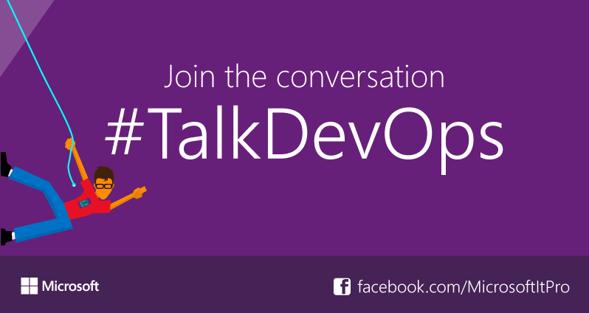
DevOps Resources
Connect with peers: DevOps meet up on Thurs (30th) 14:30–15:30 @ IT Community Experts in the Resource Zone (Expo Hall 7)
DevOps sessions @ TEE http://aka.ms/techeddevops
Resources for Devs http://aka.ms/teched-eu
Resources for IT Ops http://aka.ms/devopstl
Join the DevOps Insiders Group msdevops@microsoft.com

Slide 33
DEV Track Resources
http://www.visualstudio.com
http://blogs.msdn.com/b/developer-tools/
http://msdn.microsoft.com/vstudio
visualstudio
@visualstudio
visualstudio

Slide 34
Resources
Learning
Sessions on Demand
Microsoft Certification & Training Resources
http://channel9.msdn.com/Events/TechEd
www.microsoft.com/learning
TechNet
Developer Network
Resources for IT Professionals
http://microsoft.com/technet
http://developer.microsoft.com

Slide 35
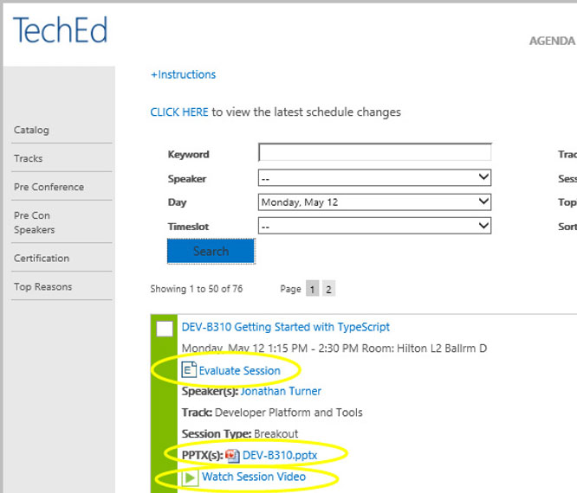
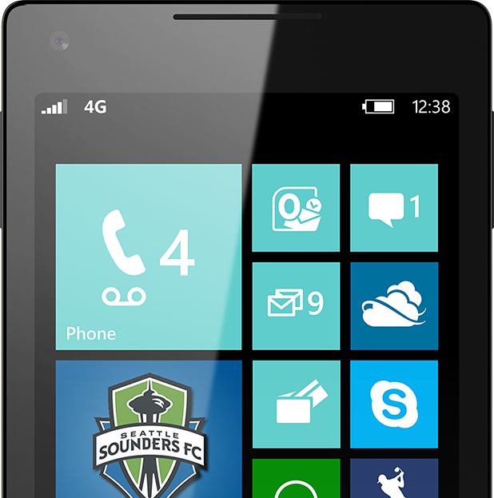
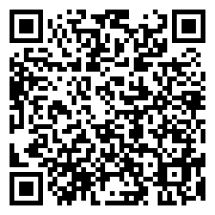
Please Complete An Evaluation Form Your input is important!
TechEd Schedule Builder
CommNet station or PC
TechEd Mobile app
Phone or Tablet
QR code

Slide 36
Evaluate this session

Slide 37
© 2014 Microsoft Corporation. All rights reserved. Microsoft, Windows, and other product names are or may be registered trademarks and/or trademarks in the U.S. and/or other countries.
The information herein is for informational purposes only and represents the current view of Microsoft Corporation as of the date of this presentation. Because Microsoft must respond to changing market conditions, it should not be interpreted to be a commitment on the part of Microsoft, and Microsoft cannot guarantee the accuracy of any information provided after the date of this presentation. MICROSOFT MAKES NO WARRANTIES, EXPRESS, IMPLIED OR STATUTORY, AS TO THE INFORMATION IN THIS PRESENTATION.

