Slide 1


Slide 2

Building Microsoft Azure Mobile Services with Visual Studio
DEV-B320
Merwan Hade

Slide 3





Last time I was in Europe…

Slide 4
Building Microsoft Azure Mobile Services with Visual Studio
DEV-B320
Merwan Hade

Slide 5
I am familiar with Mobile Services

Slide 6
Agenda
Overview of Mobile Services
  .NET Mobile Services
Build a Win Store app with .NET Mobile Services in Visual Studio
  Storing and accessing data with SQL
  Authentication using AAD
  Storing files in blob storage
  Push Notifications using Notification Hubs

Slide 7
Overview

Slide 8








Mobile Services
Data Storage
SDKs
Windows Store
iOS
Android
HTML 5/JS
Xamarin
PhoneGap
Sencha
SQL
Table Storage
Blob Storage
Mongo DB
Hybrid Connections
Node.js Express
ASP.NET
Web API
User Authentication
REST API
Facebook
Twitter
Microsoft
Google
Azure Active Directory
Push Notifications
Offline sync
Source Control
WNS
APNS
GCM
Notification Hubs

Slide 9
Enable enterprise .NET developers to easily add a backend to their apps, use their preferred frameworks, tools, and processes

Slide 10
.NET Mobile Services
Web API for Mobile with minimal code for data, auth, and push notifications.
Tooling
Client NuGet Runtime available on NuGet Visual Studio support: Scaffolding IntelliSense Local F5 In-browser test client Remote debugging Publish via Web Deploy Source control using TFS View runtime logs Send test messages View registrations
Data
Based on Web API Supports various data stores: Azure databases Table Storage MongoDB
Auth
Facebook Twitter Google Microsoft Account AAD
Push
Uses Notification Hubs integration for high-scale, cross-platform push

Slide 11
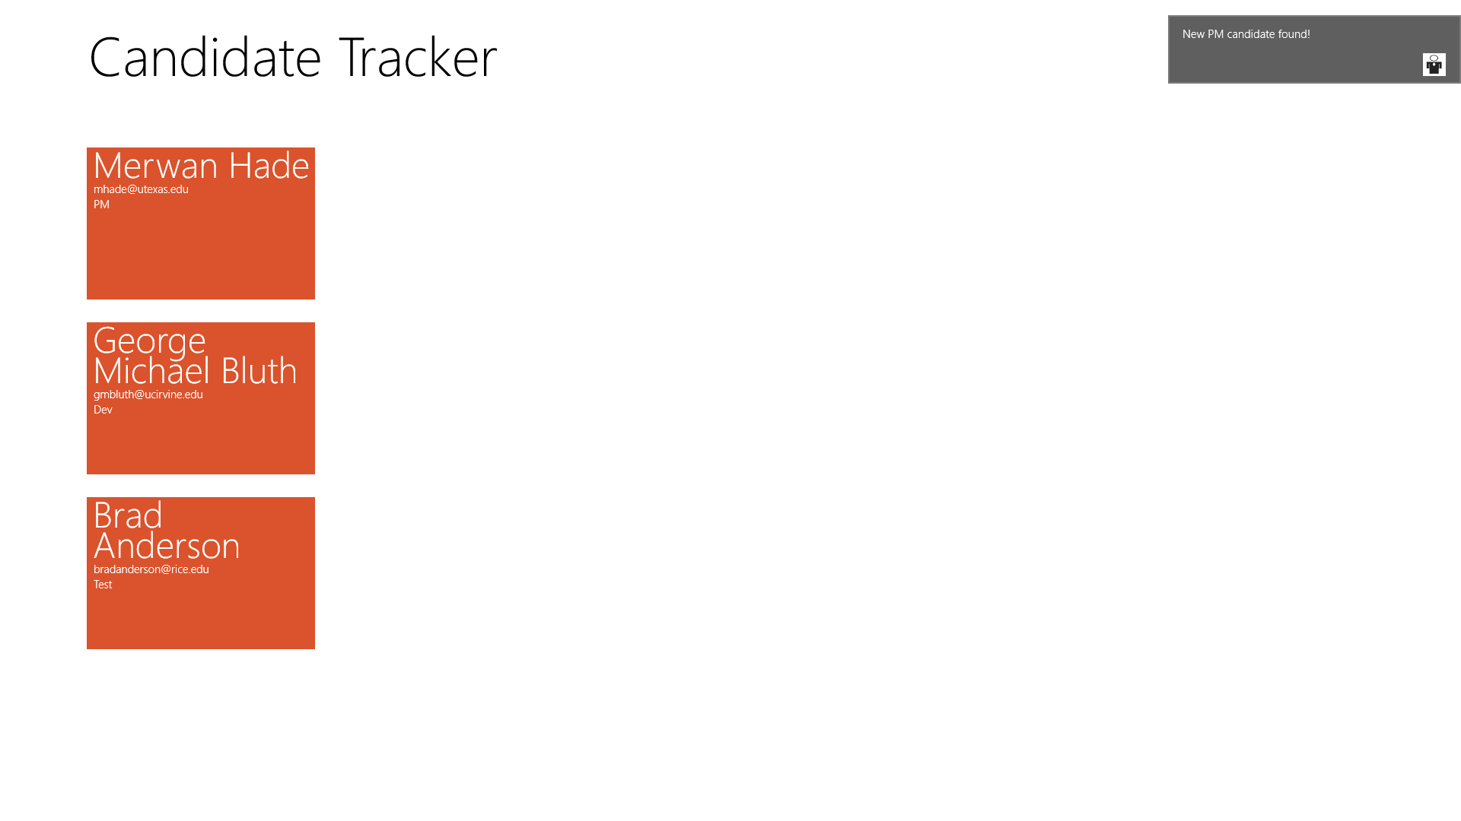
Demo App – Candidate Tracker
Recruiting app to store candidate information
Recruiters must log in with their AD credentials
Recruiters can upload resumes to blob storage
Recruiters are sent notifications for candidates in their discipline

Slide 12
Demo
Storing and accessing data with SQL

Slide 13
Authentication

Slide 14
Azure Active Directory and Mobile Services
Extend line-of-business to mobile
Bring turn-key login experience with corporate credentials to mobile developers
Enable applications built around organizational structures

Slide 15
Active Directory Authentication Library (ADAL)
Facilitates login to AAD-protected resources
Provides single sign-on to multiple enterprise resources
Available for Windows Store, iOS, and Android

Slide 16
AAD and Mobile Services
User logs in to AAD and requests token
AAD returns access token to mobile device
Client passes access token to Mobile Service

Slide 17
Demo
Authentication with AAD and Mobile Services

Slide 18
Blob Storage + Mobile Services

Slide 19
Store files using Azure Storage
Storing files in Azure Storage
Cost effective, scalable, and accessible from anywhere
Can’t burn secrets into your client app
Imagine malicious users uploading random files to your storage account
Shared Access Signature
Allows clients to read/write/update data without a storage account key
Obtain a restricted token that allows you to access storage account for a short period of time

Slide 20

Mobile Services and SAS to Azure Storage
Set a limited access policy and request SAS token
Authenticate against MS and request SAS token
Acquire SAS token for storage
Access storage resources using SAS token

Slide 21
Demo
Storing files in blob storage

Slide 22
Push notifications

Slide 23
Why Notification Hubs?
Any back-end technology
Backend can be on-prem or in the cloud
.NET, Node JS, Java, PHP, etc
Cross Platform
Windows, Windows Phone, iOS, Android, Kindle Fire, and more coming
Scalable with low latency
Can reach millions of devices with a single call in a very short period of time
Segmentation by tags
Target individual users or interest groups using tags
Integrated into Mobile Services
All Mobile Services push calls are made using notification hubs

Slide 24
Case studies
Bing (News, Finance, Sports)
Pre-installed on Windows 8 devices
10s millions of devices
3+ million tiled notifications/day
<2 minutes to deliver
Sochi Winter Olympics 2014
Windows Phone, iOS, and Android apps for tracking Olympic results
Powered by a SQL backed hosted in Azure
100s of interest groups for athletes, countries, and sports
3+ million devices
150+ million notifications sent

Slide 25
How do push notifications work?
Step 1: Registration
e.g. WNS, APNS, GCM, ADM
Acquires platform specific identifier
Push Notification Service
Creates registration with the Notification Hub and subscribes to tags
Notification Hub

Slide 26
How do push notifications work?
Step 2: Send Notification
Sends a message
Notification Hub
Sends platform specific message
e.g. WNS, APNS, GCM, ADM
Delivers notification to devices
Push Notification Service

Slide 27
Demo
Push notifications using Notification Hubs

Slide 28
Demo
Head to Head App

Slide 29
Summary
With .Net Mobile Services and Visual Studio, you can easily:
store data in the cloud
authenticate your users
interact with Azure storage and other third party resources
send push notifications

Slide 30
Call To Action
Check out Mobile Services documentation
http://azure.microsoft.com/en-us/documentation/services/mobile-services/
Download Mobile Services Accelerators Now!
https://code.msdn.microsoft.com/Field-Engineer-501df99d

Slide 31
THANK YOU!
Twitter - @merwanhade
Email - mhade@microsoft.com

Slide 32
Related content
Breakout Sessions (session codes and titles)
  DEV-B312 Building Customer Facing Mobile Apps with Microsoft Azure
  DEV-B350 Build Employee and Partner Facing Mobile Apps Using Microsoft Azure
  DEV-B322 Building Web Apps and Mobile Apps Using Microsoft Azure Active Directory for Identity Management

Slide 33
DEV Track Resources
http://www.visualstudio.com
http://blogs.msdn.com/b/developer-tools/
http://msdn.microsoft.com/vstudio
visualstudio
@visualstudio
visualstudio

Slide 34
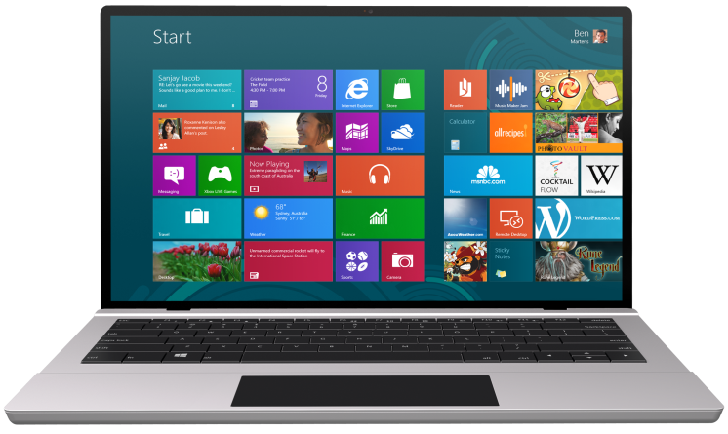


SUBMIT YOUR TECHED EVALUATIONS
We value your feedback!
Fill out an evaluation via
CommNet Station/PC: Schedule Builder
LogIn: europe.msteched.com/catalog
TechEd Mobile app
for session evaluations
is currently offline

Slide 35

Resources
Learning
  Sessions on Demand
  Microsoft Certification & Training Resources
http://channel9.msdn.com/Events/TechEd
www.microsoft.com/learning
TechNet
Developer Network
  Resources for IT Professionals
http://microsoft.com/technet
http://developer.microsoft.com

Slide 36


© 2014 Microsoft Corporation. All rights reserved. Microsoft, Windows, and other product names are or may be registered trademarks and/or trademarks in the U.S. and/or other countries.
The information herein is for informational purposes only and represents the current view of Microsoft Corporation as of the date of this presentation. Because Microsoft must respond to changing market conditions, it should not be interpreted to be a commitment on the part of Microsoft, and Microsoft cannot guarantee the accuracy of any information provided after the date of this presentation. MICROSOFT MAKES NO WARRANTIES, EXPRESS, IMPLIED OR STATUTORY, AS TO THE INFORMATION IN THIS PRESENTATION.

