Slide 2
Building Web Apps and Mobile Apps Using Microsoft Azure Active Directory for Identity Management
DEV-B322
Vittorio Bertocci

Slide 3
DEV Track Resources
http://www.visualstudio.com
http://blogs.msdn.com/b/developer-tools/
http://msdn.microsoft.com/vstudio
visualstudio
@visualstudio
visualstudio

Slide 4
Resources
Learning
Sessions on Demand
Microsoft Certification & Training Resources
http://channel9.msdn.com/Events/TechEd
www.microsoft.com/learning
TechNet
Developer Network
Resources for IT Professionals
http://microsoft.com/technet
http://developer.microsoft.com

Slide 5
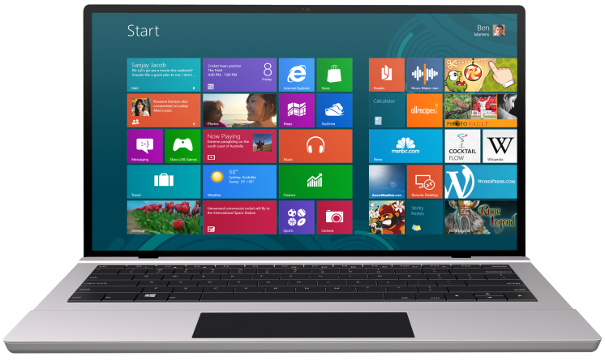
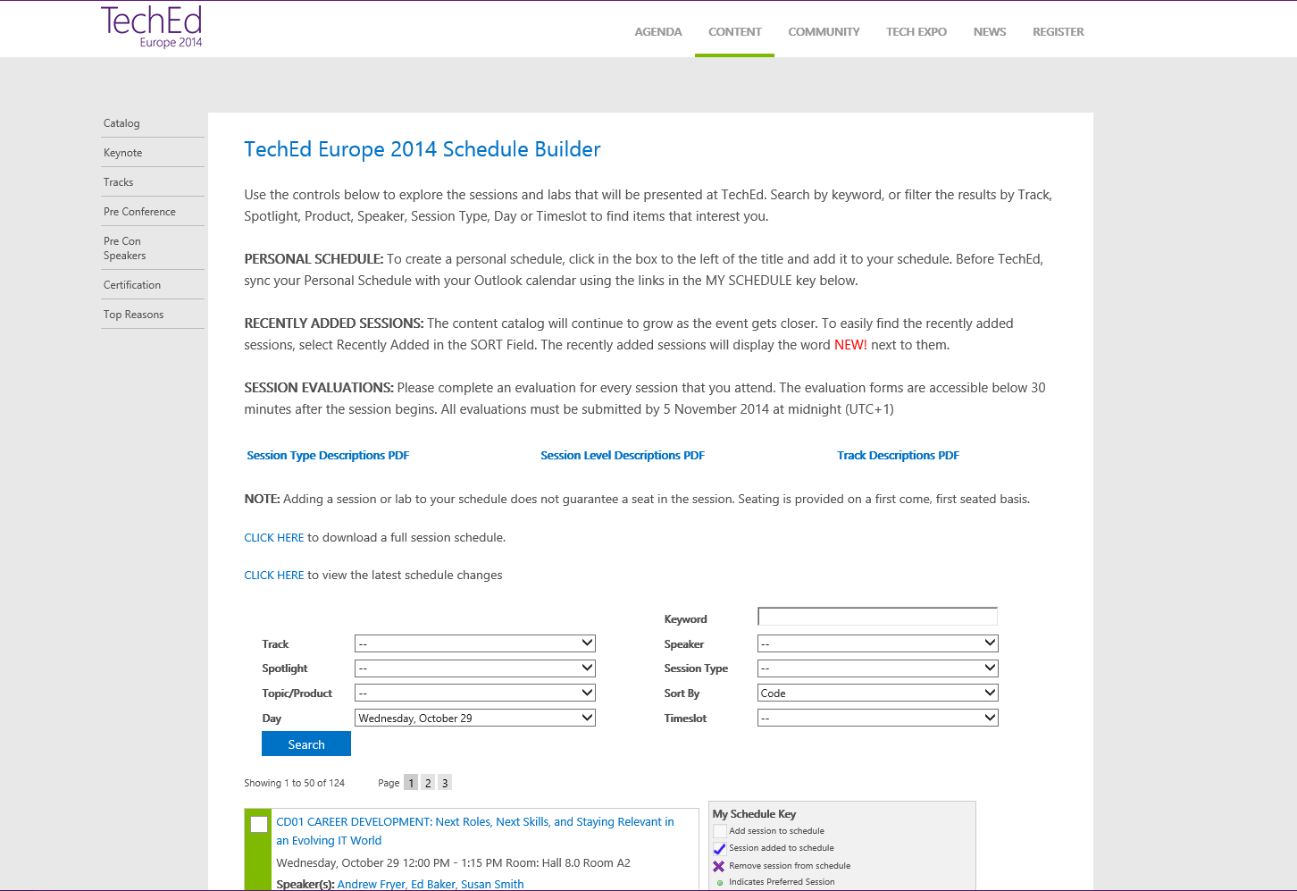
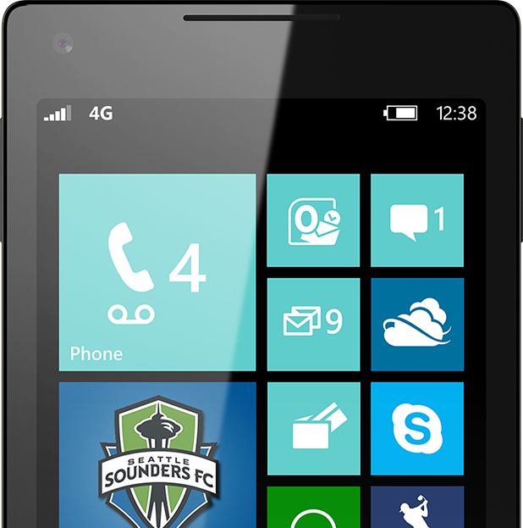
SUBMIT YOUR TECHED EVALUATIONS
We value your feedback!
Fill out an evaluation via
CommNet Station/PC: Schedule Builder
LogIn: europe.msteched.com/catalog
TechEd Mobile app for session evaluations is currently offline

Slide 6
© 2014 Microsoft Corporation. All rights reserved. Microsoft, Windows, and other product names are or may be registered trademarks and/or trademarks in the U.S. and/or other countries.
The information herein is for informational purposes only and represents the current view of Microsoft Corporation as of the date of this presentation. Because Microsoft must respond to changing market conditions, it should not be interpreted to be a commitment on the part of Microsoft, and Microsoft cannot guarantee the accuracy of any information provided after the date of this presentation. MICROSOFT MAKES NO WARRANTIES, EXPRESS, IMPLIED OR STATUTORY, AS TO THE INFORMATION IN THIS PRESENTATION.

