Slide 2
Building Web Apps Using ASP.NET and Visual Studio 2013
DEV-B323
Scott Hunter - @coolcsh
Microsoft

Slide 3
http://friday.azure.com

Slide 4
ASP.NET

Slide 7
ASP.NET
Web Tools

Slide 8
One ASP.NET
Sites
Services
Web
Forms
Web
Pages
Single
Page
Apps
MVC
Web
API
SignalR
ASP.NET

Slide 9
One ASP.NET
Sites
Services
YOU!
Web
Forms
Web
Pages
Single
Page
Apps
MVC
Web
API
SignalR
YOU!
ASP.NET

Slide 10
One ASP.NET
Sites
Services
YOU!
Web
Forms
Web
Pages
Single
Page
Apps
MVC
Web
API
SignalR
YOU!
ASP.NET

Slide 11
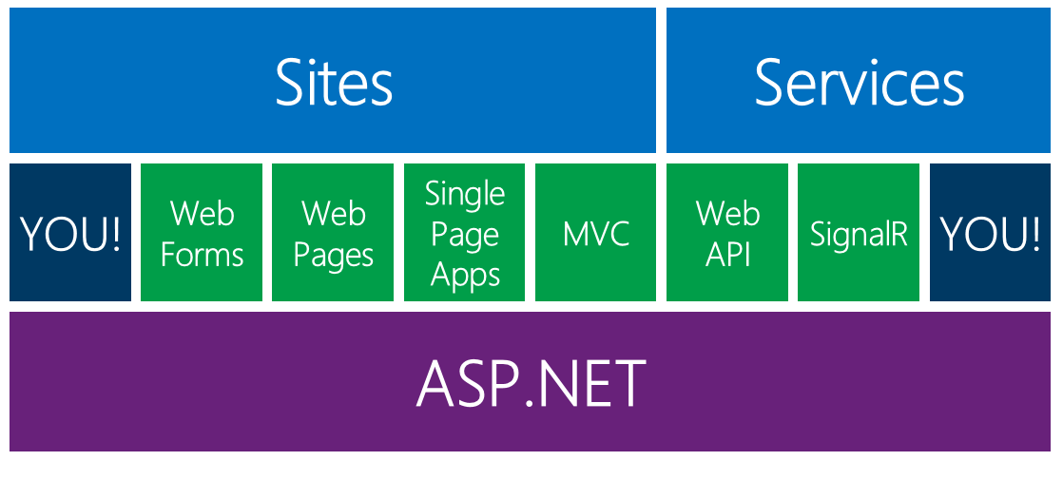
One ASP.NET
The MVP program recently changed…
You can now be an ASP.NET MVP based solely on open source contributions.

Slide 12
ASP.NET and Web Tools Cadence
Release every ~6 months since 2012!
Feb 2013
ASP.NET and Web Tools 2012.2
Oct 2013
VS2013
March 2014
ASP.NET and Web Tools 2013.2

Slide 13
ASP.NET and Web Tools Cadence
Release every ~6 months
Feb 2014
ASP.NET Web Tools 2013.2
Aug 2014
Fall 2014
ASP.NET Web Tools 2013.3
“Magic”

Slide 14
ASP.NET and Web Tools Cadence
Release every ~6 months
Feb 2014
ASP.NET Web Tools 2013.2
Mid 2014
Fall 2014
Modern Web
“Magic”

Slide 15
ASP.NET and Web Tools Cadence
Release every ~6 months
Feb 2014
ASP.NET Web Tools 2013.2
Mid 2014
Fall 2014
ASP.NET Web Tools 2013.3
“Magic”

Slide 17
From the Web Tools “Labs”
Release every ~2 months
http://www.vswebessentials.com

Slide 18
General
New ASP.NET Identity System
Templates based on Bootstrap
One ASP.NET
One Project: Web Forms, MVC, Web API
Add any framework to any project
New Scaffolding
Configurable Authentication
Azure SDK
Azure Server Explorer: SSO, Remote Debugging, Web Sites, Mobile Services, Mgmt APIs, Log DL
Web API
CORs, Attribute Routing
MVC
Attribute Routing
Entity Framework
Async, Stored Procs, Resiliency
Visual Studio
New HTML Editor
Live Browser Link + Extensibility
AngularJS Class Intellisense
Oct 2013
VS2013

Slide 19
Web API
BSON formatter (Binary JSON)
Improved Attribute Routing
MVC
Better bootstrap scaffolding
Helper fixes for Dropdowns & Enum
Improved Attribute Routing
Entity Framework
EF Power Tools graduate
Reverse engineer DB to Code First
Visual Studio
More LESS support
JSON Editor
Phone Emulator and easy SSL
One ASP.NET
Scaffolding Improvements
ASP.NET Identity Two-Factor Auth
Account Lockout, Confirmation, Reset, and lots more
Web Forms
Scaffolding
EF 6 Data Source
EF 6 Dynamic Data
SignalR
Xamarin
No jQuery
C++
Android
Feb 2014
ASP.NET Web Tools 2013.2

Slide 20
MVC & Web API
Merge together
Entity Framework
Web, Phone, Store, Desktop
NoSQL support
Visual Studio
New project system
Grunt, Bower, NPM integrated
More tooling for SASS, LESS, JSON
More BrowserLink
Angular Tooling
ASP.NET
Blazing FAST!!!!
Side by Side
Modular
Cloud Ready
Fast Development
Open
Open Source
Cross-Platform
FUTURE
ASP.NET v.Next

Slide 21
Scheduler
Web Jobs
Mobile Services
Media Services
Web Sites
Azure Batch
HDInsight/ Hadoop
Worker Roles
Virtual Machines
Azure Storage

Slide 22
Web Sites
.NET,
node,
PHP,
Python
Azure Managed OS Updates
.NET, node, PHP,
Java, Scala, Python, Ruby,
C++,
freakin’ Erlang…
Virtual Machines
You Manage OS + Apps

Slide 23
.NET,
node,
PHP,
Python
Web Sites
Azure Managed OS Updates
Cloud Apps
.NET, node, PHP,
Java, Scala, Python, Ruby,
C++,
freakin’ Erlang…
Virtual Machines
You Manage OS + Apps

Slide 24
.NET,
node,
PHP,
Python
Hotel
Azure Managed OS Updates
Renting a Room
.NET, node, PHP,
Java, Scala, Python, Ruby,
C++,
freakin’ Erlang…
Your First House
You Manage OS + Apps

Slide 25
Nothing but demos

Slide 26
DEV Track Resources
http://www.visualstudio.com
http://blogs.msdn.com/b/developer-tools/
http://msdn.microsoft.com/vstudio
visualstudio
@visualstudio
visualstudio

Slide 27
Claim your Visual Studio Online domain
MSDN subscribers, activate your Azure benefits now
Simply get started @ http://aka.ms/teched-eu

Slide 28
Resources
Learning
Sessions on Demand
Microsoft Certification & Training Resources
http://channel9.msdn.com/Events/TechEd
www.microsoft.com/learning
TechNet
Developer Network
Resources for IT Professionals
http://microsoft.com/technet
http://developer.microsoft.com

Slide 29
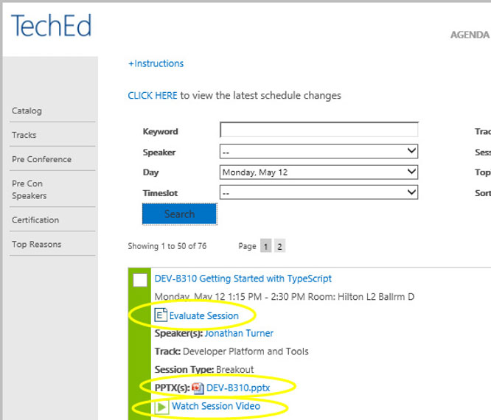
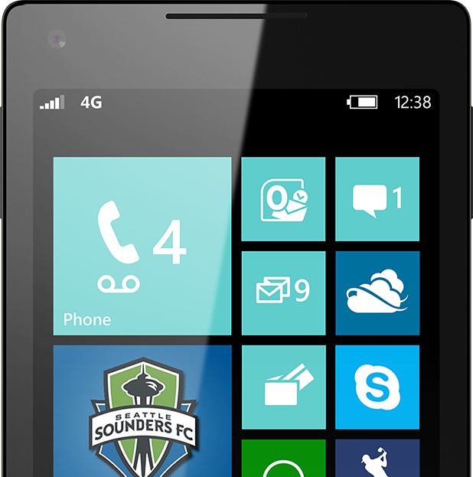
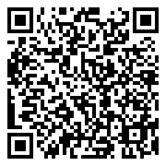
Please Complete An Evaluation Form Your input is important!
TechEd Schedule Builder
CommNet station or PC
TechEd Mobile app
Phone or Tablet
QR code

Slide 30
Evaluate this session

Slide 31
© 2014 Microsoft Corporation. All rights reserved. Microsoft, Windows, and other product names are or may be registered trademarks and/or trademarks in the U.S. and/or other countries.
The information herein is for informational purposes only and represents the current view of Microsoft Corporation as of the date of this presentation. Because Microsoft must respond to changing market conditions, it should not be interpreted to be a commitment on the part of Microsoft, and Microsoft cannot guarantee the accuracy of any information provided after the date of this presentation. MICROSOFT MAKES NO WARRANTIES, EXPRESS, IMPLIED OR STATUTORY, AS TO THE INFORMATION IN THIS PRESENTATION.

