Slide 2
Deep Dive into Agile Planning for Team Foundation Server 2013 and Visual Studio Online
DEV-B327
Justin Marks, Sr. Program Manager
justin.marks@microsoft.com

Slide 3
Justin Marks
From Miami, Florida
Married (6 years)
2 kids (5 & 2)
Microsoft 12 years
Program Manager by trade
“Foodie” by passion

Slide 4
The journey
Limited Preview
09/11
Public Preview
06/12
Released!
10/12
Visual Studio 2008
Visual Studio 2010
Visual Studio 2012
Visual Studio 2013
Visual Studio Online
Visual Studio
2008
2009
2010
2011
2012
2013
2014

Slide 5
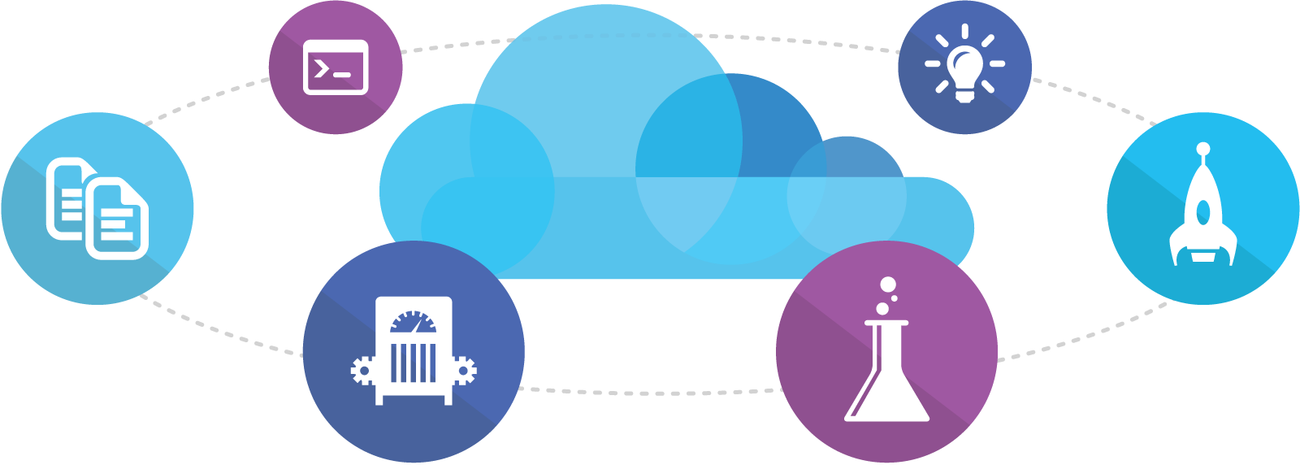
Online
Code
Insights
Agile
Deploy
Build
Test

Slide 6
Agenda
Agile Portfolio Management
Demo
+
Example Scenarios
Our Process
+
Lessons Learned

Slide 7
The Problem
A
B
C

Slide 8
The Problem
Stakeholders
?
?
?
?
?
?
?
?
?
A
B
C
D
E
F
G
H

Slide 9
Portfolio Backlogs

Slide 10
Backlog Linking

Slide 11
n Levels

Slide 12
Autonomy
Stakeholders
A
B
C
D
E
F
G
H

Slide 13
Drive:
Autonomy
the urge to direct our own lives
Mastery
expert skill: expert knowledge or outstanding ability
Purpose
the reason for which something exists

Slide 14
Kanban Columns
Stakeholders
A
B
C
D
E
F
G
H

Slide 15
Work Item Tags
Stakeholders
A
B
C
D
E
F
G
H

Slide 16
Visualizing Progress

Slide 17
Agenda
Agile Portfolio Management
Demo
+
Example Scenarios
Our Process
+
Lessons Learned

Slide 18
APM with VSO
Portfolio Backlogs
Backlog linking
Kanban columns
Tags
Charting

Slide 19
Agenda
Agile Portfolio Management
Demo
+
Example Scenarios
Our Process
+
Lessons Learned

Slide 20
How do we do it?
Roles
Organization
Teams
Cadence
Plan
Practices
Alignment
Autonomy

Slide 21
Our Roles
Program Manager – Responsible to ensure we’re building the right thing.
Development – Responsible to ensure we’re building products that are fast, reliable, and well engineered.
QA – Responsible to ensure we’re building high quality products that meet customers needs.

Slide 22
Organization Chart
Program Management
Development
Testing

Slide 23
Teams
Program Management
Development
Testing

Slide 24
Teams
Version Control
Cross-discipline
8-12 people
Led by their triad
Intact for 12-18 months
Autonomous backlog

Slide 25
3-week sprints
Sprint planning
Done!
Deployment
Week 1
Week 2
Week 3
Sprint 56
Sprint 57
Sprint 58
Week 1
Week 2
Week 3
Backlog grooming
Week 1
Week 2
Week 3
Sprint planning

Slide 26
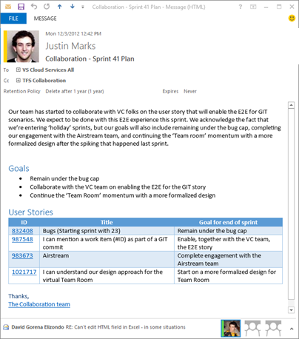
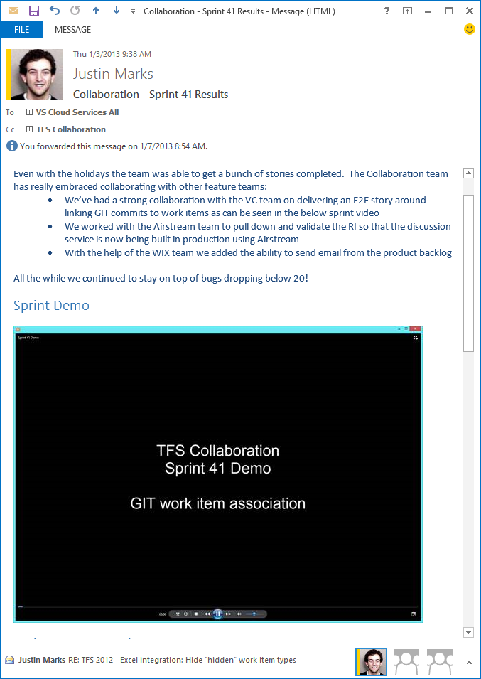
Sprint mails
The sprint plan
What we accomplished
Week 1
Week 2
Week 3
Sprint 56
Sprint 57
Sprint 58
Week 1
Week 2
Week 3
Week 1
Week 2
Week 3

Slide 27
Team “chats”
Chat
Chat
Chat
Chat
Chat
Chat
Every 3 sprints we sit down with the team for a “chat”

Slide 28
Team “chats”
What’s next on your backlog?
How are you doing with regards to debt?
Any issues?
Version Control

Slide 29
Team “chats”

Slide 30
Planning
Sprint
3-week sprints
Season
6-month season
Vision
18-month vision
3
6
18

Slide 31
Vision
6 month plan
18 month vision
Specs
Specs
Specs
Specs
Experience Reviews
Scenario Review
Spring
Fall
Spring
Fall

Slide 32
Now what?
What did we learn over the last 6 months?
What did customers tells us?
What changed in the marketplace?
Done!
Spring
Fall
Spring
Fall

Slide 33
Planning
& Learning
6 month plan
18 month vision
Specs
Specs
Specs
Specs
Experience Reviews
Scenario Review
Done!
Done!
Spring
Fall
Spring
Fall

Slide 34
Work Items
Scenario
Scenario – A large initiative in a release.
Feature – A shippable unit that provides an end-to-end user experience.
User Story – A requirement capturing the role, functionality, and value.
Task – Work the team does to fulfill a Story.
Feature
User Story
Task

Slide 35
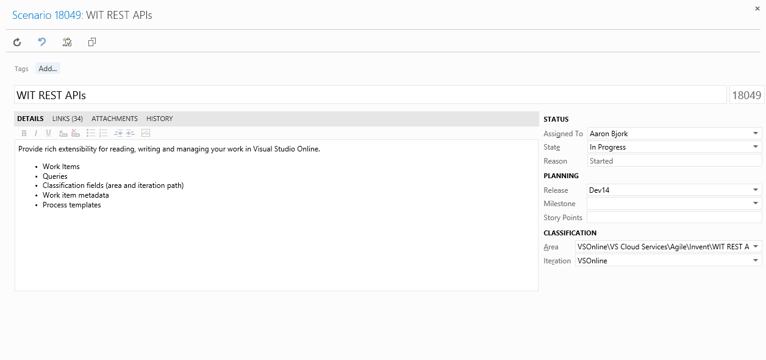
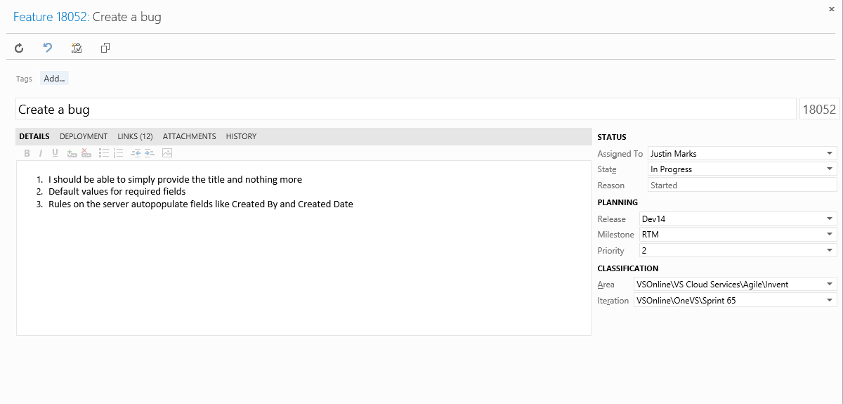
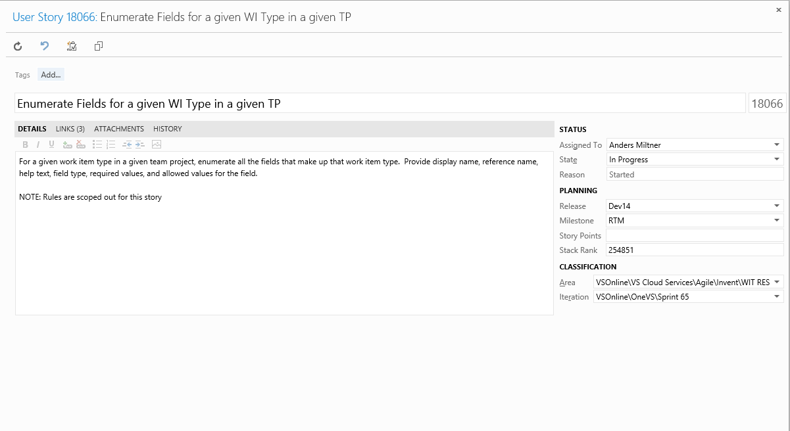
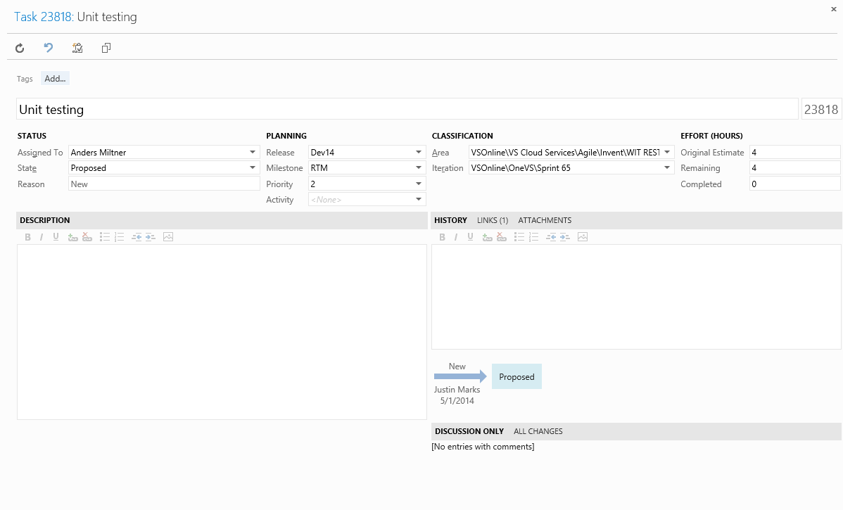
Work Items
Scenario
Feature
User Story
Task

Slide 36
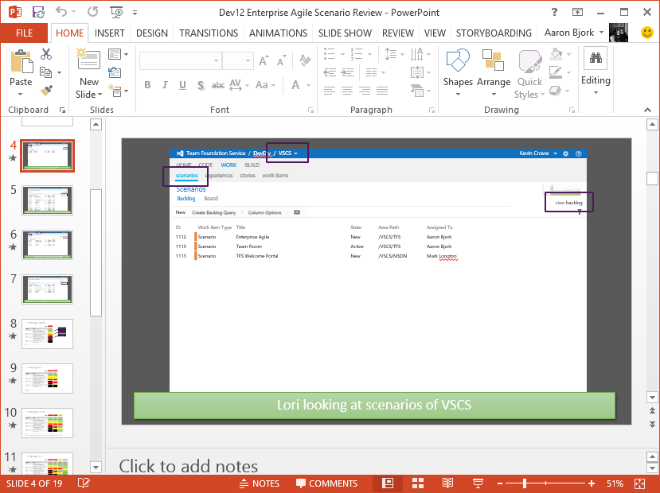
Scenario
Scenario
Review
Scenario
Scenario
Scenario
Feature
Team A
Team B
Stories
Stories
Stories
Stories
Stories
Stories
Stories
Stories

Slide 37
Agenda
Agile Portfolio Management
Demo
+
Example Scenarios
Our Process
+
Lessons Learned

Slide 38
Sign up for a Visual Studio Online account
To do
In progress
Done
Build a backlog
New website on Azure
CI & CD
Load test
Insights

Slide 39
Thank you!
justin.marks@microsoft.com
@justincmarks

Slide 40
Resources
Learning
Sessions on Demand
Microsoft Certification & Training Resources
http://channel9.msdn.com/Events/TechEd
www.microsoft.com/learning
TechNet
Developer Network
Resources for IT Professionals
http://microsoft.com/technet
http://developer.microsoft.com

Slide 41
DEV Track Resources
http://www.visualstudio.com
http://blogs.msdn.com/b/developer-tools/
http://msdn.microsoft.com/vstudio
visualstudio
@visualstudio
visualstudio

Slide 42
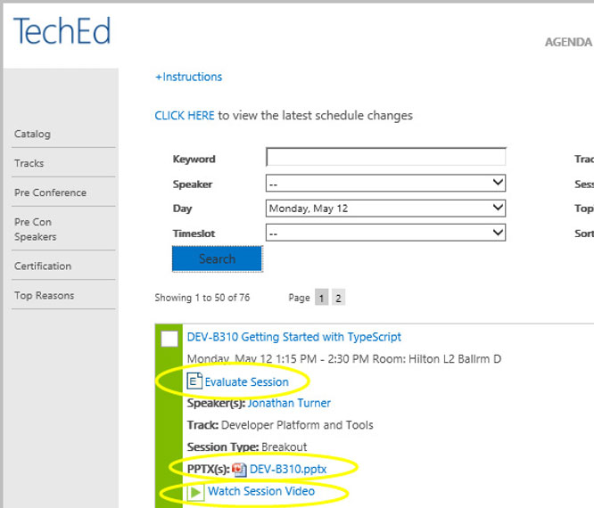
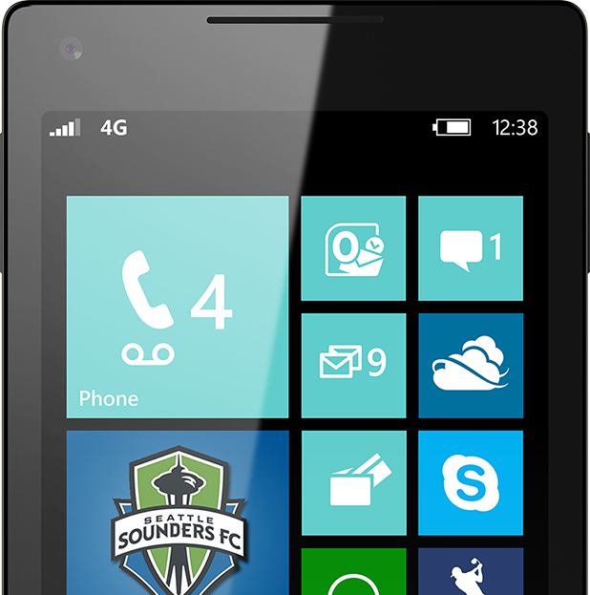
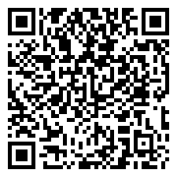
Please Complete An Evaluation Form Your input is important!
TechEd Schedule Builder
CommNet station or PC
TechEd Mobile app
Phone or Tablet
QR code

Slide 43
Evaluate this session

Slide 44
© 2014 Microsoft Corporation. All rights reserved. Microsoft, Windows, and other product names are or may be registered trademarks and/or trademarks in the U.S. and/or other countries.
The information herein is for informational purposes only and represents the current view of Microsoft Corporation as of the date of this presentation. Because Microsoft must respond to changing market conditions, it should not be interpreted to be a commitment on the part of Microsoft, and Microsoft cannot guarantee the accuracy of any information provided after the date of this presentation. MICROSOFT MAKES NO WARRANTIES, EXPRESS, IMPLIED OR STATUTORY, AS TO THE INFORMATION IN THIS PRESENTATION.

