Slide 2
Using Git with TFS and Visual Studio Online
DEV-B334
Edward Thomson
Software Development Engineer, Microsoft

Slide 3
Edward Thomson
Senior Software Development Engineer
TFS Version Control
ethomson@microsoft.com
@ethomson
http://www.edwardthomson.com/

Slide 4
Edward Thomson
Senior Software Development Engineer
TFS Version Control
ethomson@microsoft.com
@ethomson
http://www.edwardthomson.com/

Slide 6
Team Foundation Server

Slide 7
A comprehensive ALM offering
Web • Client • Server • Cloud • SharePoint • Java • iOS
Visual Studio • Team Explorer Everywhere
Scrum • CMMI • Agile
Team Foundation Server
Planning
SCM
Work Item Tracking
Continuous Deployment
Build Automation
Feedback Management

Slide 8
The Team Foundation Server
team is very distributed.

Slide 9
writing
Hey, maybe we should be using
a distributed version control system!

Slide 10
Modern source-control approaches
Strengths
Best for
Centralized Version Control
Check-out /
Edit / Check-in
Scales to very large codebases
Fine level permission control
Allows usage monitoring
Large integrated codebases
Control and auditability over source code down to the file level
Edit /
Merge / Commit
Offline editing support
Easy to edit files outside Visual Studio or Eclipse
Medium-sized integrated codebases
A balance of fine-grained control with reduced friction
Distributed
Version Control
Full offline experience
Complete repository with portable history
Simplified branching model
Modular codebases
Integrating with open source
Highly distributed teams

Slide 14
DVCS popularity
(possibly?)

Slide 15
(possibly?)
DVCS popularity

Slide 16
(possibly?)
DVCS popularity

Slide 17
Trends in the DVCS Ecosystem
Git is the Leading DVCS Tool
Adoption of Git is growing exponentially
Git is used to interchange data between SCM tools
Git as a Deployment Protocol
Used to deploy web applications on many cloud providers (Windows Azure, Heroku, Facebook)
Git has support across platforms
Strong Linux and Mac tooling
Support could be improved for Windows developers

Slide 18
Git is fully integrated into Visual Studio and Team Foundation Server

Slide 19
♥

Slide 20
Demo
Git in Team Foundation Server

Slide 21
Implementation

Slide 22
terrible!
I’ve got a great idea!
What if we can magically bridge between TFS and Git and we can support both system?

Slide 23
Git is just Git

Slide 28
Git in Visual Studio
Team Explorer
TFS SCC Provider
Git SCC Provider
TFVC Object Model
libgit2 / LibGit2Sharp
TFS / Visual Studio Online
Project 1
Project 2
3rd Party Tools
3rd Party Tools
WIT
Build
Test
Agile
WIT
Build
Test
Agile
Xcode
Eclipse
Eclipse
Command-Line
TFVC
Git Repository
Command-Line
Windows Explorer
Windows Explorer

Slide 29
Git in Team Foundation Server
Data Tier
SQL Server / SQL Azure
SQL Server
Azure Blob Storage
LibGit2 Server
Application Tier
Web Access
Git Protocols
Job Agent

Slide 30
Git Repositories in SQL
Repository structure in SQL
On-premises Team Foundation Server: SQL Server
Visual Studio Online: SQL Azure
Files stored in TFS File Service
On-premises Team Foundation Server: SQL Server
Visual Studio Online: Azure Blob Storage

Slide 31
Git Repositories in SQL
Repository Existence and Ownership
tbl_GitRepository (RepositoryId, Name, CreationDate, State, TeamProjectUri)
Git Ref Pointers
tbl_GitRef (RepositoryId, Name, ObjectId, IsDefaultBranch)
Git Push Log
tbl_GitPush (PushId, PusherId, PushTime)
Git Ref Log
tbl_GitRefLog (PushId, Name, OldObjectId, NewObjectId)

Slide 32
Advanced Git Usage

Slide 33
Installing the perfect command line
http://aka.ms/GitCL
Install Git for Windows
Install PoshGit
Install Windows Credential Helper

Slide 34
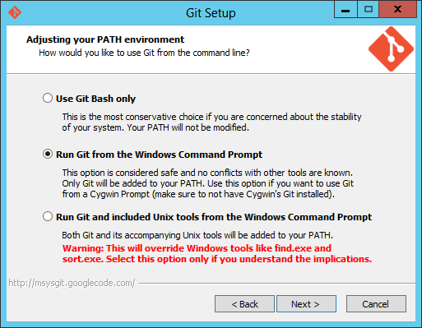
Tip: Installing Git for Windows
Pick the middle one:

Slide 35
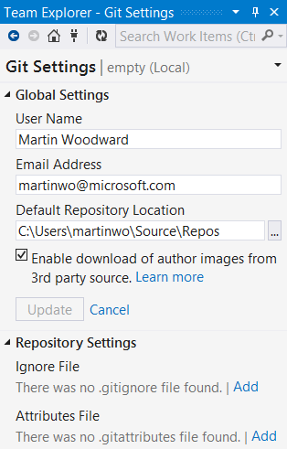
Ignoring stuff with .gitignore
gitignore file specifies which files get ignored from the repo by default
Best stored in the repo
Go to Git Settings in VS to create a default one

Slide 36
Git Attributes
Git configuration can be stored in the repo and be path specific using .gitattributes
Commonly controls
Which files are treated as binary
Merge strategies
Line ending conversion

Slide 37
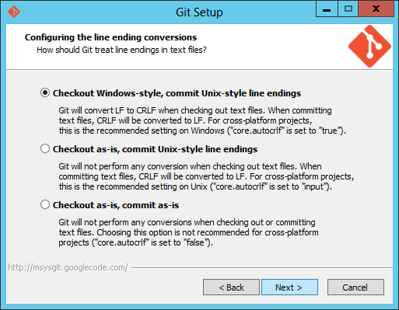
A note on line endings
 git config --global core.autocrlf=true

Slide 38
Adopting Git
Git is different
Don’t force change on a team, give them choice
Build out set of internal advocates and expertise via PoC’s
Can use Git-TF or Git-SVN etc to migrate history
Do you really need to migrate ALL history?
Does the historical repo need to be the working one?
If moving to Git, move to Git
For large repos:
Remove binary dependencies first (NuGet is your friend)
Componentize code before migrating

Slide 39
Visual Studio Online
Free for small teams
Free for up to five users; includes 60 minutes of Cloud Build per month
Included in MSDN subscriptions
Increased value to existing and new MSDN subscribers
New cloud-only monthly user plans
Scales beyond the free five user plan; purchased via Windows Azure

Slide 40
Supporting Your Workflow
Choice in source control workflow
Use centralized or distributed version control
Integrated ALM capabilities for TFVC or Git
Choice in development process
Out-of-the-box support for Scrum, Agile, CMMI processes, or create your own
Tools support best-of-breed practices regardless of your development methodology
Choice of platforms
Target the platform of your choice from the environment of your choice
Team Explorer Everywhere for TFVC
Any Git client for Git in TFS

Slide 41
Related content
DEV-B220 Microsoft .NET Open Source Software Projects Showcase
Find Me Later At Microsoft Solutions Experience (Right Now!)

Slide 42
Resources
Learning
Sessions on Demand
Microsoft Certification & Training Resources
http://channel9.msdn.com/Events/TechEd
www.microsoft.com/learning
TechNet
Developer Network
Resources for IT Professionals
http://microsoft.com/technet
http://developer.microsoft.com

Slide 43
DevOps Resources
Connect with peers: DevOps meet up on Thurs (30th) 14:30–15:30 @ IT Community Experts in the Resource Zone (Expo Hall 7)
DevOps sessions @ TEE http://aka.ms/techeddevops
Resources for Devs http://aka.ms/teched-eu
Resources for IT Ops http://aka.ms/devopstl
Join the DevOps Insiders Group msdevops@microsoft.com

Slide 44
DEV Track Resources
http://www.visualstudio.com
http://blogs.msdn.com/b/developer-tools/
http://msdn.microsoft.com/vstudio
visualstudio
@visualstudio
visualstudio

Slide 45
Claim your Visual Studio Online domain
MSDN subscribers, activate your Azure benefits now
Simply get started @ http://aka.ms/teched-eu

Slide 46
Thank you!
Edward Thomson
Senior Software Development Engineer
TFS Version Control
ethomson@microsoft.com
@ethomson
http://www.edwardthomson.com/

Slide 47
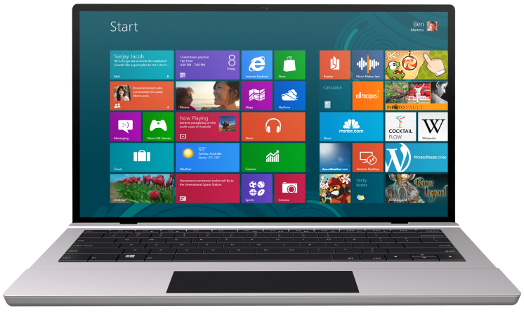
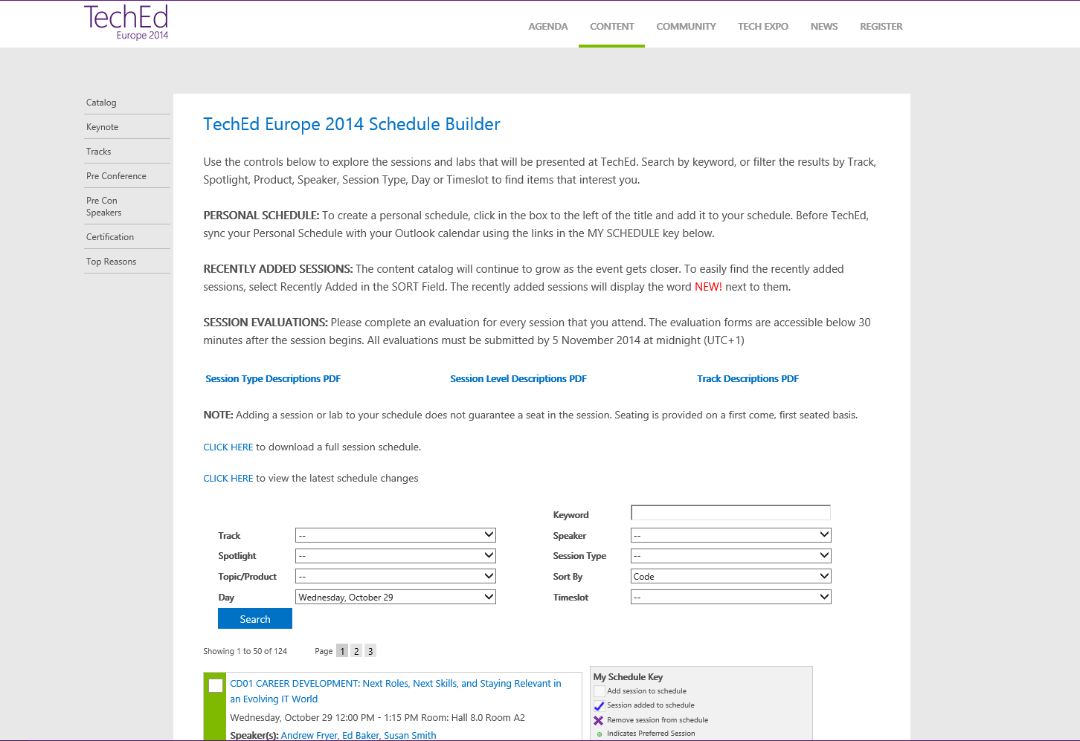
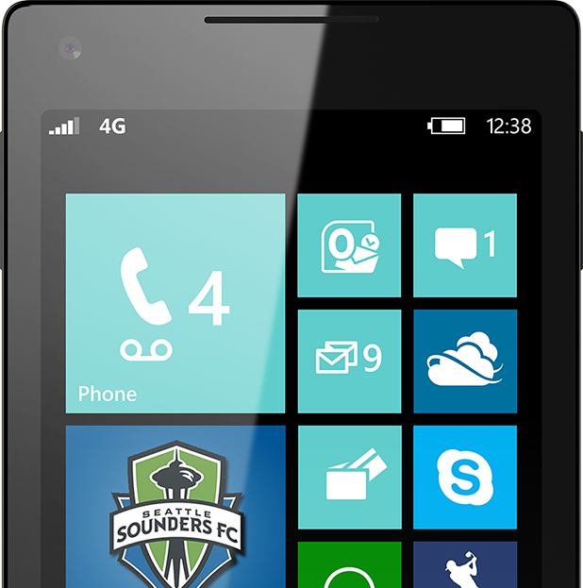
SUBMIT YOUR TECHED EVALUATIONS
We value your feedback!
Fill out an evaluation via
CommNet Station/PC: Schedule Builder
LogIn: europe.msteched.com/catalog
TechEd Mobile app for session evaluations is currently offline

Slide 48
© 2014 Microsoft Corporation. All rights reserved. Microsoft, Windows, and other product names are or may be registered trademarks and/or trademarks in the U.S. and/or other countries.
The information herein is for informational purposes only and represents the current view of Microsoft Corporation as of the date of this presentation. Because Microsoft must respond to changing market conditions, it should not be interpreted to be a commitment on the part of Microsoft, and Microsoft cannot guarantee the accuracy of any information provided after the date of this presentation. MICROSOFT MAKES NO WARRANTIES, EXPRESS, IMPLIED OR STATUTORY, AS TO THE INFORMATION IN THIS PRESENTATION.

