Slide 1


Slide 2

Getting Started with Microsoft Azure for ASP.NET Developers
DEV-B336
Dan Fernandez
Principal PM Manager
@Danielfe

Slide 3
“For the things we have to learn before we can do them, we learn by doing them.”
- Aristotle

Slide 4
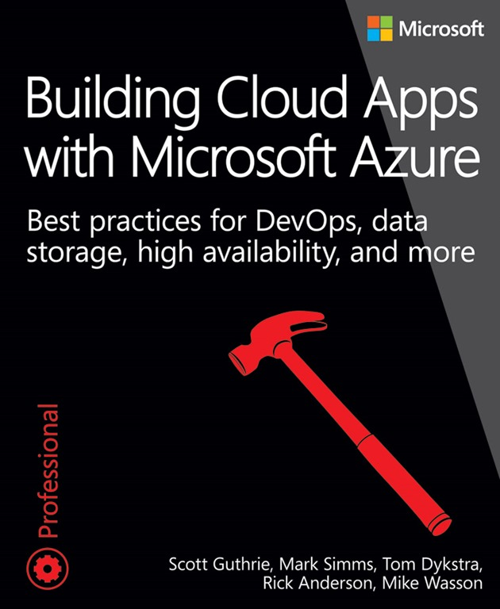
Learn by doing it live
Build an ASP.NET MVC app on Azure – FixIt Demo app
Create an Azure Website
Add SQL Server and Entity Framework
Store photos using Azure Blob Storage
Deploy app using Visual Studio
Setup Remote Debugging
Add Diagnostics
Azure Portal
Setup Website slots
Setup Continuous Integration using Visual Studio Online
AutoScale the Website
View Usage with App Insights
Scale out using Azure Storage Queues and Worker Roles
Dev & Test in the cloud with Azure VMs

Slide 5
Azure Overview in 3 Slides

Slide 6
Microsoft Azure
Programming languages + tools
.NET, Visual Studio, TFS + Git, Java, NodeJS, PHP, Python, Ruby, C++
IaaS
PaaS
Windows VMs
Linux VMs
Storage
Networking
Web
Mobile
Gaming
Cloud services
Data
Analytics
Media
Identity
Microsoft cloud infrastructure

Slide 7
Hosting Models
  On Premises
  Infrastructure
  (as a Service)
  Platform
  (as a Service)
  Applications
Applications
  You manage
Applications
  You scale, make resilient and manage
  You scale, make
  resilient & manage
Data
Data
Data
Runtime
Runtime
Runtime
Middleware
Middleware
Middleware
  Scale, resilience and
  management by vendor
O/S
O/S
O/S
Virtualization
Virtualization
  Managed by vendor
Virtualization
Servers
Servers
Servers
Storage
Storage
Storage
Networking
Networking
Networking

Slide 8






Azure Services
Office Add-in
PC
Tablet
Phone
Browser
Games console
On-premises service
On-premises database
Client layer
(on-premises)
Access Control
Layer
AD
Multifactor
Authentication
BizTalk Services
Service Bus
CDN
Traffic Manager
Virtual Networks
Express Route
Integration
layer
API Mgmt
Mobile Services
Websites
Cloud Services
VM
Media Services
Notification Hubs
Scheduler
Automation
Application
layer
Blobs
Tables
Queues
SQL Database
Machine Learning
HD Insight
Caching
Backup and Recovery
StorSimple
Data Layer
Storage
Data

Slide 9
Building the App

Slide 10








What we’ll Build
Continuous Integration
using Visual Studio Online
Azure Website Slots
Dev
CI Build
Application Insights
(Usage & Monitoring)
Stage
Prod
SQL Server (FixIt Entity)
Auto Scale
Azure Load
Balancer
Blob Storage (Photos)

Slide 11
Data Services in our demo
Blob Storage
Storage Queue
SQL Database
Database as a Service
Database-Level SLA (HA built-in)
Auto updates and patch
Pay only for what you use (no license required)
Max size of 500GB per DB
SQL Server on IaaS VM an option
Highly scalable, durable, available file storage
Blobs can be exposed publically over HTTP
Can secure blobs as well as grant temporary access tokens
Max size of 100 TB per Storage Account
Provides a reliable messaging system
Decouple Web frontend & background worker role and scale independently
Building process/work flows, priority queues, etc

Slide 12
Build the app

Slide 13
Scale Out using a Queue Centric Work Pattern

Slide 14
Queue Centric Work Pattern
Loose coupling
Background processing
Scale independently
Resource intensive or time-consuming (image processing)
Work dependent on unreliable services (3rd party)
Prod
Auto Scale
Azure Storage
Queue
Azure Storage
Queue
SQL Server (FixIt Entity)

Slide 15
Redundancy in Azure
Website
  Multi-instance websites
  Traffic Manager to allow failover across regions
SQL Database
  Active Geo-Replication – Auto data replication (Premium Edition)
  Built-in backup servers
Azure Storage
  Read Only Globally Redundant Storage (RA-GRS)
  Use SDK to failover across regions

Slide 16
Dev & Test in the Cloud

Slide 17
Dev & Test On Premises
Challenges
Longer Infrastructure Wait Time
Higher Infrastructure Costs
Lower Developer Productivity
Developers
Use VMs
Your Datacenter
Provision VMs
VMs in dev & test environment
IT Admin

Slide 18
Dev & Test in the Cloud
Developers
Use VMs
Provision VMs
Benefits
Shorter Infrastructure Wait Time
Lower Infrastructure Costs
Higher Developer Productivity
Manage environment
IT Admin

Slide 19






{
MSDN Credits
$50/ month
professional
3 VMs for 16 hours a day
$100/ month
PREMIUM
80 VMs for 20 hours
$150/ month
ULTIMATE
Up to 500 web sites plus SQL DB

Slide 20
Related content
Breakout Sessions
  DEV-B330 Developing Enterprise Web Applications on Microsoft Azure Websites
  DEV-B332 Entity Framework Now and Later
  DEV-B206 Application Insights Overview: How to Keep Your Applications Available, Performing, and Succeeding
  DEV-B216 Visual Studio Online: Overview and Best Practices
  DEV-B219 Latest Innovations for ASP.NET MVC Development
  DEV-B316 Automating Microsoft Azure with the Management Libraries
  DEV-B323 Building Web Apps Using ASP.NET and Visual Studio 2013
  DEV-B329 Deep Dive into Hidden Gems, Tips and Tricks for Microsoft Azure Websites
Free eBook
  http://www.asp.net/aspnet/overview/developing-apps-with-windows-azure/building-real-world-cloud-apps-with-windows-azure/design-to-survive-failures

Slide 21
DEV Track Resources
http://www.visualstudio.com
http://blogs.msdn.com/b/developer-tools/
http://msdn.microsoft.com/vstudio
visualstudio
@visualstudio
visualstudio

Slide 22

Resources
Learning
  Sessions on Demand
  Microsoft Certification & Training Resources
http://channel9.msdn.com/Events/TechEd
www.microsoft.com/learning
TechNet
Developer Network
  Resources for IT Professionals
http://microsoft.com/technet
http://developer.microsoft.com

Slide 23



Please Complete An Evaluation Form
Your input is important!
TechEd Schedule Builder
CommNet station or PC
TechEd Mobile app
Phone or Tablet
QR code

Slide 24
Evaluate this session

Slide 25


© 2014 Microsoft Corporation. All rights reserved. Microsoft, Windows, and other product names are or may be registered trademarks and/or trademarks in the U.S. and/or other countries.
The information herein is for informational purposes only and represents the current view of Microsoft Corporation as of the date of this presentation. Because Microsoft must respond to changing market conditions, it should not be interpreted to be a commitment on the part of Microsoft, and Microsoft cannot guarantee the accuracy of any information provided after the date of this presentation. MICROSOFT MAKES NO WARRANTIES, EXPRESS, IMPLIED OR STATUTORY, AS TO THE INFORMATION IN THIS PRESENTATION.

