Slide 2
Mastering IntelliTrace in Development and Production DEV-B339
Sasha Goldshtein
CTO, Sela Group
C# MVP and Azure MRS

Slide 3
Ask The Experts
Key and floorplan
Cloud and Datacenter Platform
Data Platform and Business Intelligence
Developer Platform and Tools
Enterprise Mobility
Office 365
Windows
Microsoft Azure
Trustworthy Computing
Following this session at 18:30 in Hall 5
Meet with Microsoft Product Experts
Snacks and Beverages Served
CDP
DEV
AZR
TWC
EM
OFC
WIN
DBI

Slide 4
IntelliTrace is a Visual Studio Ultimate feature that improves developer productivity during debugging

Slide 5
IntelliTrace
“Historical Debugging”
Tracks events and method call information at runtime
Records stack trace, local variables, and custom information for each event

Slide 6
IntelliTrace Experiences
F5 Debugging
Live debugging from Visual Studio, unit tests, and other developer experiences
Production Debugging
Collection on production systems for later analysis on a development machine

Slide 7
DEMO
Historical Debugging with IntelliTrace

Slide 8
Collection Modes
Low impact
Interesting runtime events are collected
Low overhead if collecting low-frequency events
High impact
Every method call is collected
Up to 10x potential slowdown
Configure for specific modules only to reduce impact

Slide 9
Events
WCF, ADO.NET, file access, registry access, ASP.NET, and myriads of other events
Can customize with your own events

Slide 10
What Exactly Is Collected?
Parameters
Return values
Reference type locals
For each referenced object, whether or not it was there, but not its contents
void ReadTweets(string account)
{
var tweets = GetTweets(account);
int count = 3;
for (int i = 0; i < count; ++i)
DisplayTweet(tweets[i]);
}

Slide 11
Collecting IntelliTrace Logs
Visual Studio saves .itrace files from each run
IntelliTrace stand-alone collector
IntelliTraceSC.exe launch /cp:plan.xml app.exe
PowerShell cmdlets for ASP.NET/SharePoint
Start-IntelliTraceCollection "MyAppPool" plan.xml C:\Logs
Microsoft Test Manager
Azure Cloud Services

Slide 12
DEMO
Collecting IntelliTrace Logs

Slide 13
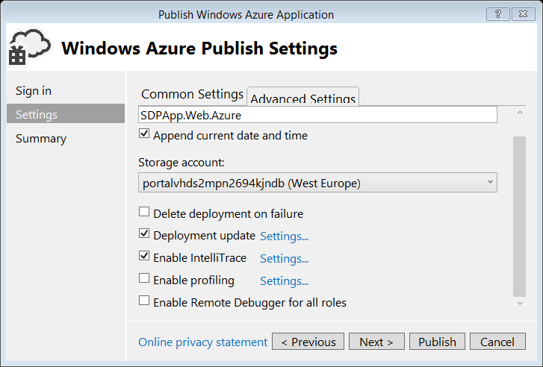
IntelliTrace on Azure
The only practical way to debug long-standing issues in cloud applications
Works with all kinds of Cloud Services (Web/Worker Role)

Slide 14
DEMO
IntelliTrace with Azure Cloud Services

Slide 15
Extending IntelliTrace Events
Add your events to the collection plan XML
IntelliTrace can generate an event from any method in your code or framework code
Custom parameter formatting is available
<DiagnosticEventSpecification enabled="true">
<CategoryId>gc</CategoryId>
<SettingsName>Full collection</SettingsName>
...
<Bindings>
<Binding>
...
<TypeName>System.GC</TypeName>
<MethodName>Collect</MethodName>
<ShortDescription>
Garbage collection forced by the app
</ShortDescription>
...
</DiagnosticEventSpecification>

Slide 16
DEMO
Custom IntelliTrace Events

Slide 17
Summary & Call To Action
Use IntelliTrace as the perfect companion for live debugging in Visual Studio
Collect IntelliTrace information from test, staging, and production environments
Extend IntelliTrace with your own events

Slide 18
Thank You!
Sasha Goldshtein
blog.sashag.net
@goldshtn

Slide 19
Resources
Learning
Sessions on Demand
Microsoft Certification & Training Resources
http://channel9.msdn.com/Events/TechEd
www.microsoft.com/learning
TechNet
Developer Network
Resources for IT Professionals
http://microsoft.com/technet
http://developer.microsoft.com

Slide 20
DEV Track Resources
http://www.visualstudio.com
http://blogs.msdn.com/b/developer-tools/
http://msdn.microsoft.com/vstudio
visualstudio
@visualstudio
visualstudio

Slide 21
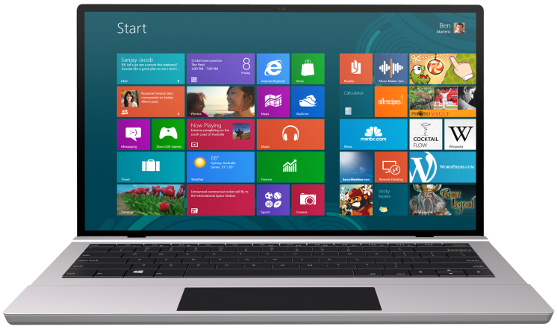
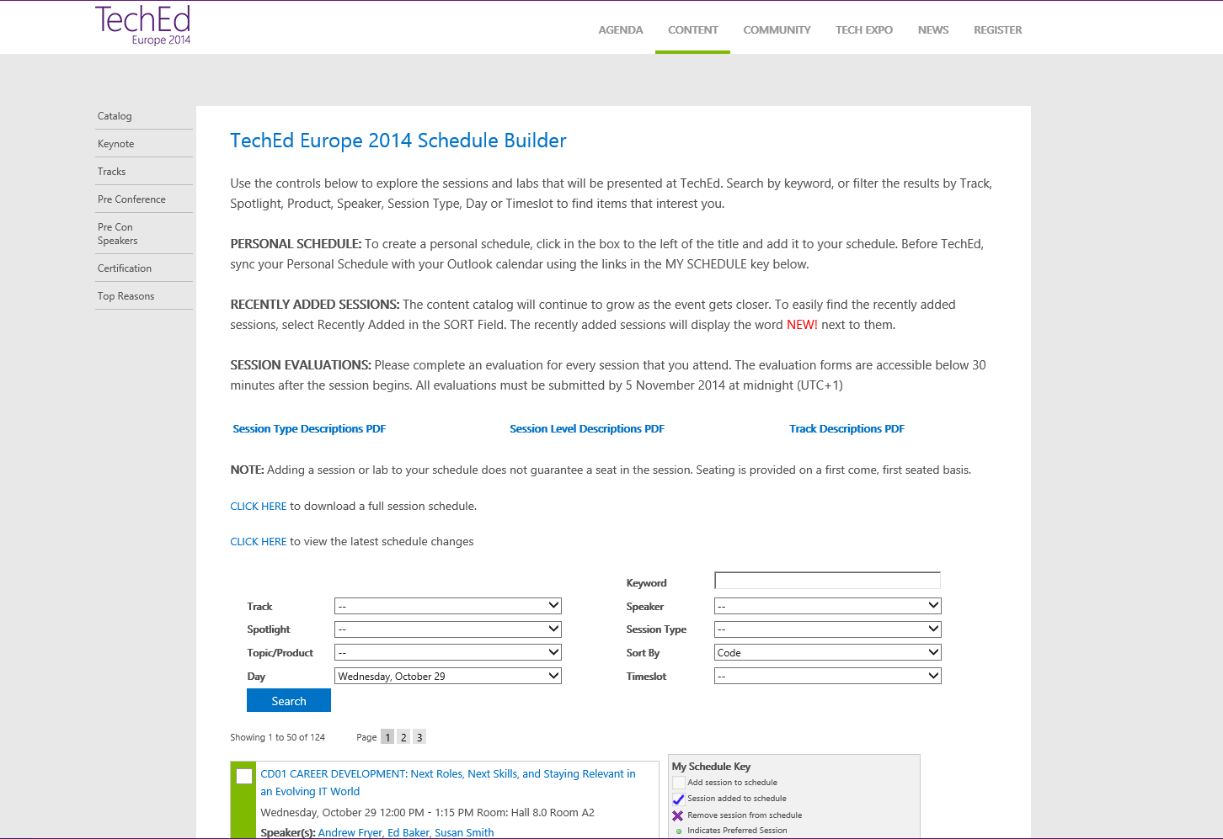
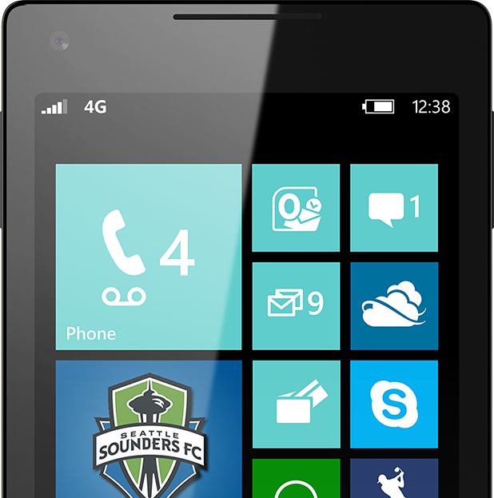
SUBMIT YOUR TECHED EVALUATIONS
We value your feedback!
Fill out an evaluation via
CommNet Station/PC: Schedule Builder
LogIn: europe.msteched.com/catalog
TechEd Mobile app for session evaluations is currently offline

Slide 22
Ask The Experts
Key and floorplan
Cloud and Datacenter Platform
Data Platform and Business Intelligence
Developer Platform and Tools
Enterprise Mobility
Office 365
Windows
Microsoft Azure
Trustworthy Computing
Following this session at 18:30 in Hall 5
Meet with Microsoft Product Experts
Snacks and Beverages Served
CDP
DEV
AZR
TWC
EM
OFC
WIN
DBI

Slide 23
© 2014 Microsoft Corporation. All rights reserved. Microsoft, Windows, and other product names are or may be registered trademarks and/or trademarks in the U.S. and/or other countries.
The information herein is for informational purposes only and represents the current view of Microsoft Corporation as of the date of this presentation. Because Microsoft must respond to changing market conditions, it should not be interpreted to be a commitment on the part of Microsoft, and Microsoft cannot guarantee the accuracy of any information provided after the date of this presentation. MICROSOFT MAKES NO WARRANTIES, EXPRESS, IMPLIED OR STATUTORY, AS TO THE INFORMATION IN THIS PRESENTATION.

