Slide 2
The Future of .NET on the Server
DEV-B344
Scott Hunter - @coolcsh
Microsoft

Slide 3
1.8B
From 64k embedded systems, PCs, tablets, phones, up to and past 64-way Cloud Servers
active installs of .NET
6M
.NET professional developers

Slide 4
What we are hearing from customers
“Our role is more important than ever before”
“We are required to innovate and deliver much faster”
“I need a cross-device development strategy”
“Open Source enriches the platform and the community
“…but I have existing applications to run and evolve”

Slide 5
.NET – Current state of Web and Services
Standards
based
Productivity of Visual Studio + Flexibility of Web
Interactive HTML / CSS tools for web apps that look and behave the same across any browser
Highly
interactive apps
Powerful tools and technologies for interactive apps
Develop JavaScript/TypeScript complex logic with powerful editing, debugging and diagnostics.
Suited for
LOB apps
Supports demanding needs of LOB apps
Hybrid cloud requirements, flexibility, productivity,
Tools to develop and test complex web applications that scale.

Slide 6
Our new approach to building .NET
.NET innovation
Innovation at the core for your existing and future applications
.NET
Flexibility and agile delivery
Continuous modular releases
OSS
Openness
Transparent, open and community driven

Slide 7
The .NET Foundation
.NET API for Hadoop WebClient
Composition (MEF2)
MEF (Managed Extensibility Framework)
.NET Compiler Platform ("Roslyn")
Windows Phone Toolkit
.NET Map Reduce API for Hadoop
Entity Framework
WnsRecipe
.NET Micro Framework
Rx (Reactive Extensions)
Couchbase for .NET
ASP.NET Web Pages
ASP.NET MVC
Xamarin.Mobile
System.Drawing
Openness
Community
Rapid innovation
ASP.NET Web API
Mimekit
Mailkit
Xamarin.Auth
ASP.NET SignalR
Web Protection Library
OWIN Authentication Middleware
Linq to Hive
Windows Azure .NET SDK
Join the conversation with the community
http://www.dotnetfoundation.org
@dotnetfdn // #dotnetfdn

Slide 8
ASP.NET vNext and the Modern Web
Totally Modular
Faster Development Cycle
Seamless transition from on-premises to cloud
Choose your Editors
and Tools
Open Source with Contributions
OSS
Cross-Platform
Fast

Slide 9
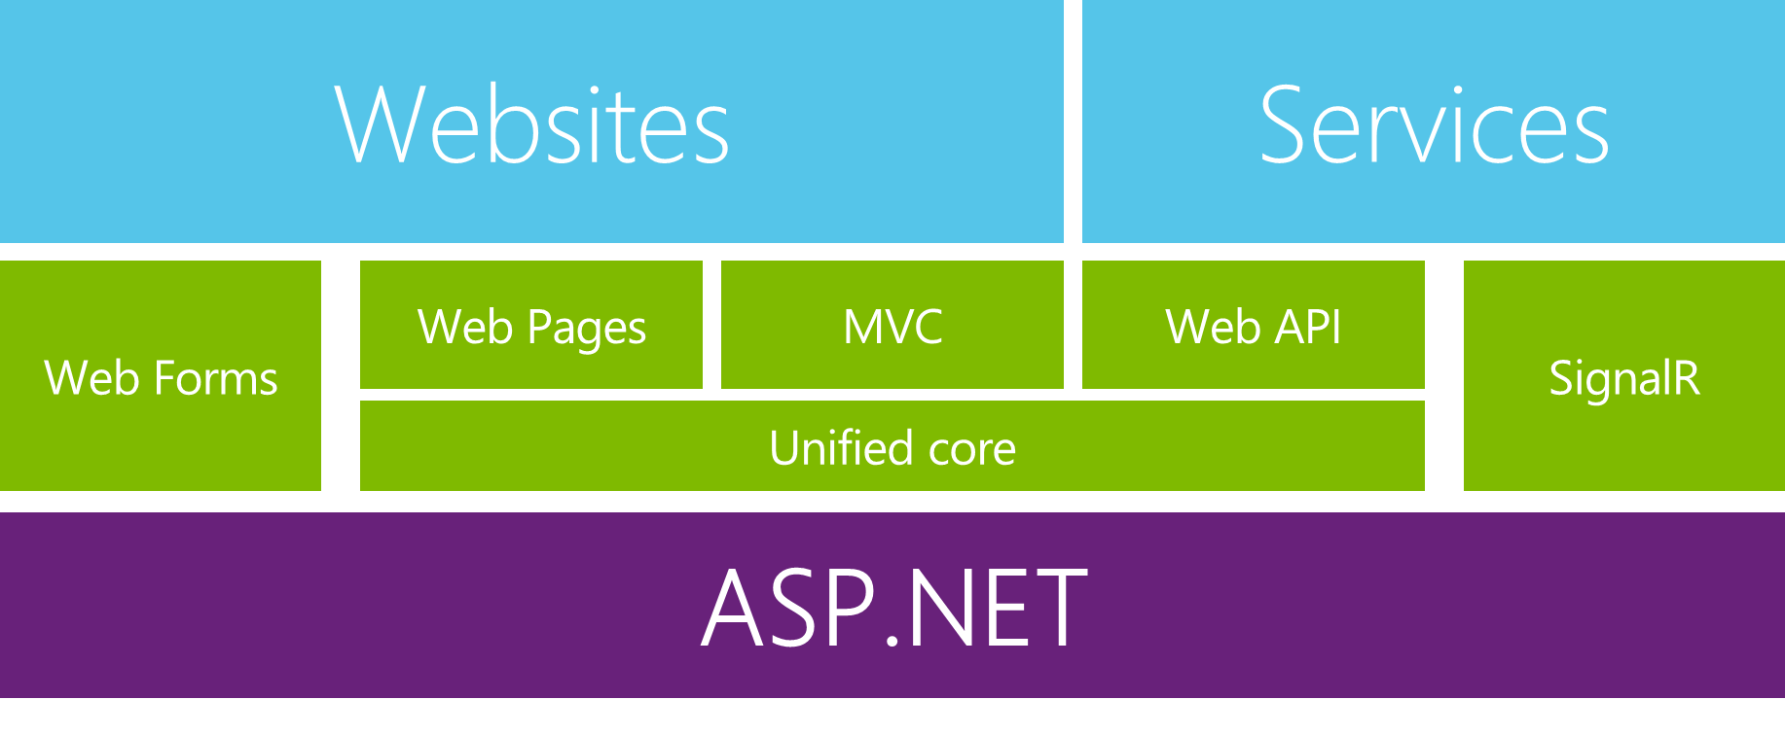
Enabling the Modern Web and Cloud
Extending Application Types
Enterprise LOB on Web
Enterprise LOB desktop apps with web backend
Modern Web applications
Common Improvements
Consistency
Modularization
Tracing & Diagnostics
Dependency Injection
Familiar frameworks

Slide 10
Modern Web – Agility
Faster Development Cycle
Features are shipped as packages
Framework ships as part of the application
More Control
Zero day security bugs patched by Microsoft
Same code runs in development and production
Developer opts into new versions, allowing breaking changes

Slide 11
Modern Web - Fast
Runtime Performance
Faster startup times
Lower memory / higher density (> 90% reduction)
Modular, opt into just features needed
Use a raw socket, framework or both
Development productivity and low friction
Edit code and refresh browser
Flexibility of dynamic environment with the power of .NET
Develop with Visual Studio, third party and cloud editors

Slide 12
Modern Web – Cloud
Seamless transition from on-premises to cloud
Cloud ready
Configuration
Session
Cache
Diagnostics
Run/Debug in Cloud
Tracing/Logging without re-deploy

Slide 13
Modern Web – Cross Platform
Runtime
Windows, Mac, Linux
Editors
Visual Studio, Text, Cloud editors
No editors (command line)
OSS
Open Source with Contributions

Slide 14
ASP.NET vNext - Summary
MVC, Web API, Web Pages 6, SignalR 3, EF 7
Feature | .NET vNext | .NET vNext (Cloud Optimized)
Cloud Ready | * | *
Modular Design | * | *
Dependency Injection | * | *
Consistent Tracing / Debugging | * | *
Faster Development (No Build Step) | * | *
Open Source | * | *
Full Side by Side (framework deployed inside application) |  | *
Fast startup, Low memory / High throughput (best of class) |  | *

Slide 15
ASP.NET vNext - Compatibility
Web Forms, MVC 5, Web API 2, Web Pages 3, SignalR 2, EF 6
Fully supported on .NET vNext
MVC, Web API, Web Pages 6, SignalR 3, EF 7
Breaking changes:
New project system
New configuration system
MVC / Web API / Web Pages merge
No System.Web, new lightweight HttpContext (not System.Net.Http)
.NET vNext (Cloud Optimized)
Subset of the .NET vNext Framework
Things you depend on might not be available yet (images, etc)

Slide 17
Future of .NET
.NETvNext
Openness
Client apps
Web and services
Windows Store, WPF, Windows Forms,
Console apps and related libraries.
ASP.NET vNext: Web Forms, MVC, Web Pages, Web API, SignalR
WCF
Multi-purpose
Device optimized
Native compilation
Small footprint, side-by-side
Cross-device enabled
Cloud optimized
High throughput
Small footprint, side-by-side
Cross-platform enabled
Specialized
Common
Runtime
Compilers
Libraries
Next gen JIT (“RyuJIT”)
SIMD (Data Parallelization)
.NET Compiler Platform (“Roslyn”)
Languages innovation
BCL and PCL
Entity Framework

Slide 18
Summary
Providing the best end-to-end development experience…
…on your terms
Platform
Framework
Tools
…or bring your own
…or bring your own
…or bring your own

Slide 19
Related content
DEV-B344 The Future of Microsoft .NET on the Server
DEV-B314 ASP.NET Identity
DEV-B332 Entity Framework Now and Later
DEV-B343 Building Real-Time Applications with ASP.NET SignalR
DEV-B316 Automating Microsoft Azure with the Management Libraries
DEV-B220 Microsoft .NET Open Source Software Projects Showcase

Slide 20
Resources
Learning
Sessions on Demand
Microsoft Certification & Training Resources
http://channel9.msdn.com/Events/TechEd
www.microsoft.com/learning
TechNet
Developer Network
Resources for IT Professionals
http://microsoft.com/technet
http://developer.microsoft.com

Slide 21
DEV Track Resources
http://www.visualstudio.com
http://blogs.msdn.com/b/developer-tools/
http://msdn.microsoft.com/vstudio
visualstudio
@visualstudio
visualstudio

Slide 22
Claim your Visual Studio Online domain
MSDN subscribers, activate your Azure benefits now
Simply get started @ http://aka.ms/teched-eu

Slide 23
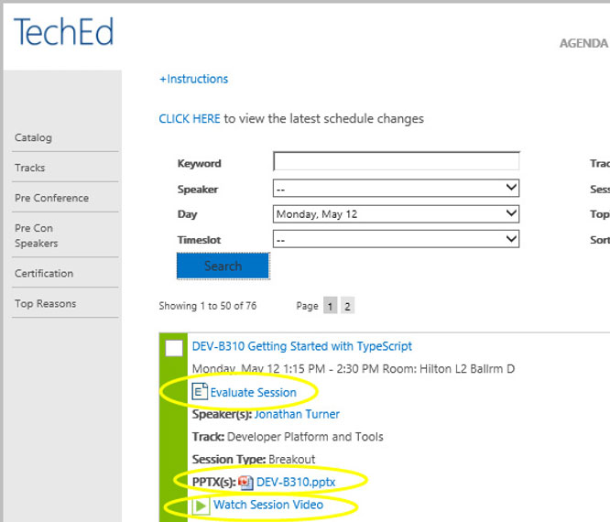
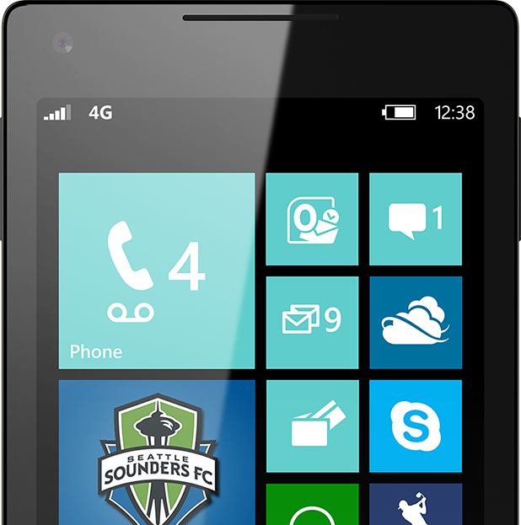
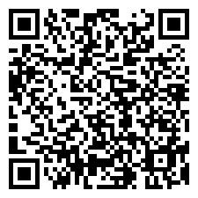
Please Complete An Evaluation Form Your input is important!
TechEd Schedule Builder
CommNet station or PC
TechEd Mobile app
Phone or Tablet
QR code

Slide 24
Evaluate this session

Slide 25
© 2014 Microsoft Corporation. All rights reserved. Microsoft, Windows, and other product names are or may be registered trademarks and/or trademarks in the U.S. and/or other countries.
The information herein is for informational purposes only and represents the current view of Microsoft Corporation as of the date of this presentation. Because Microsoft must respond to changing market conditions, it should not be interpreted to be a commitment on the part of Microsoft, and Microsoft cannot guarantee the accuracy of any information provided after the date of this presentation. MICROSOFT MAKES NO WARRANTIES, EXPRESS, IMPLIED OR STATUTORY, AS TO THE INFORMATION IN THIS PRESENTATION.

