Slide 2
AD + BYOD = Peace of Mind
EM-B310
Samuel Devasahayam

Slide 3
Managing risk in the mobile world
How to allow employee anywhere access, without opening the door for everyone on the internet?
Azure
ECS
force.com
Amazon.com
AWS
HyperV
Salesforce.com
Private cloud or On-premises

Slide 4
IT admins need better risk management tools
Require stronger authentication for end-users
based on business needs
Protect against risk associated with unknown or non-compliant devices
Enable users to access company resources from anywhere and on a device of their choice
(SaaS, on-premises, ISV & LOB apps)
IT Admin

Slide 5
Introducing Conditional access control
User attributes
User identity & valid employee of org.
Group memberships
Authentication strength
Devices
Known to organization
Managed by organization
Policy compliance
Not lost/stolen
access
Application
Business sensitivity
Allow ‘anywhere’ access
Authentication freshness & strength
Applications
Conditional access control in Active Directory
Network awareness
Inside corporate network

Slide 6
Manage risk: Conditional Access Control
Allow anywhere access to specific resources from devices compliant with policies
Azure
ECS
HyperV
force.com
Amazon.com
AWS
Private cloud or On-premises
Salesforce.com
Employee Access
Employee Access
Personal device joined to company
Corporate device, managed
force.com
Managed by MDM (Intune)
Compliant with device policies
Salesforce.com
Compliant with device policies

Slide 7
Manage risk: Conditional Access Control
Allow access to specific resources from unknown devices, but require multi-factor auth
Azure
ECS
force.com
Amazon.com
AWS
HyperV
Salesforce.com
Private cloud or On-premises
Employee Access
Access from unknown device
Vendor access
Access from outside corp net
Device unknown
force.com
Azure MFA satisfied
Vendor did not succeed Azure MFA

Slide 8
Manage risk: Conditional Access Control
Disallow access from lost, stolen, non-compliant devices
Azure
ECS
HyperV
force.com
Amazon.com
AWS
Salesforce.com
Private cloud
Employee Access
Personal device joined to company
force.com
Device reported lost/stolen

Slide 9
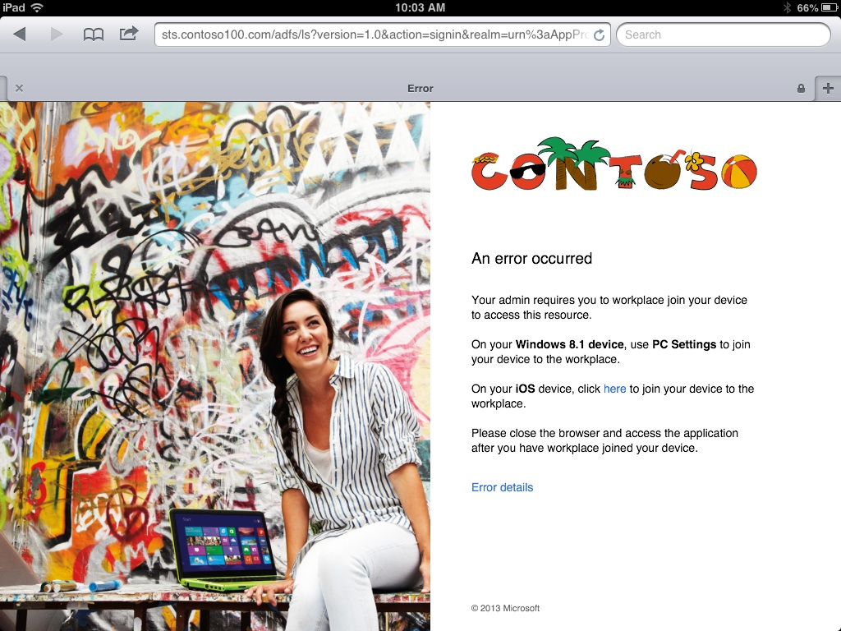
For the end user …
You have been denied access

Slide 10
Conditional access control capabilities in Windows Server 2012 R2 AD
Web App Proxy
Published applications
Devices
Claims & Kerberos web apps
Office Forms Based Access
HTTP Proxy
Apps & Data
ADFS
Restful OAuth apps
ADFS Proxy
Users can access corporate data regardless of device or location.
Users are pre-authenticated securely at the edge before being allowed to access corporate resources from extranet.
IT can create business driven access policies based on user, device, authentication method & content being accessed
IT can centrally audit access policies and user access to help with compliance.

Slide 11
Conditional access control for Office 365
Q1 CY2015
Office 365 MDM:
Integrated management experience from O365 portal (powered by Intune)
More comprehensive device & app management with Intune (EMS)
Conditional access control for:
Exchange ActiveSync (EAS) on iOS6+, Android 4+, Windows Phone 8.1+
OneDrive Pro for Business (OD4B) on iOS & Android
Mobile Outlook Web Access Apps (MOWA) on iOS & Android
Office for iPad
Office Mobile for Android
Learn more at “OFC-B330 - Mobile Device Management for Office 365”

Slide 12
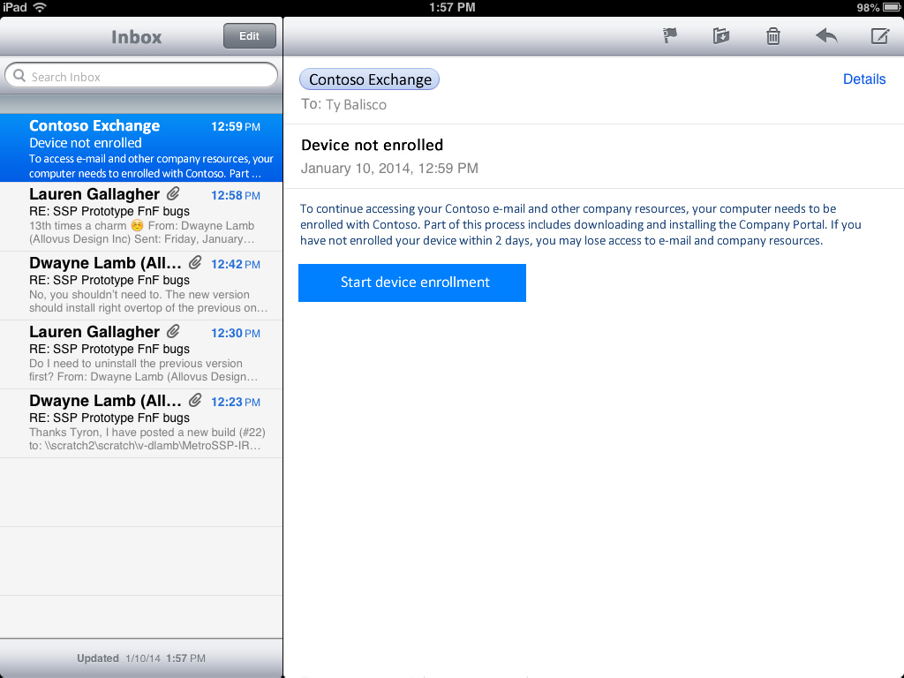
To access your e-mail and other company resources, this device needs to be enrolled with Contoso. To enroll your device follow the instructions below:
Step 1
Enroll your device.
Step 2
Once you’ve enrolled your device, tap here to Activate your email client.

Slide 13
Conditional access control - Exchange ActiveSync (EAS)
Device object
device id
isManaged
MDMStatus
EASIDs
Lookup device compliance state
2
Azure AD
7
EAS Server
Set device management/ compliance status
Create EASID to device ID binding
5
Azure DRS
Push device into quarantine
3
Intune
Device authn.
Get email
EAS ID, username, password
Quarantine email
1
Enrollment website
Quarantine email
Step 1: Enroll device
Step 2: Register EAS client
Unified enrollment (WPJ + management)
EAS Client
Register EAS
email client
4
6

Slide 14
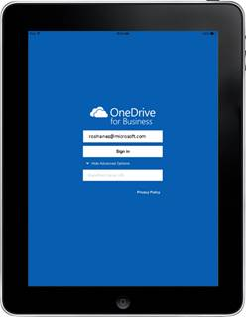
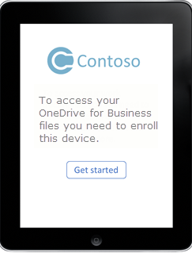
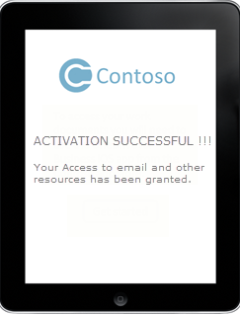
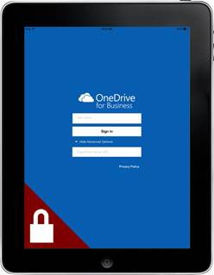
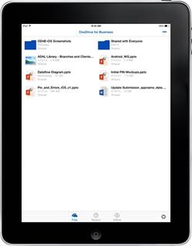
Built-In
Q1 2015
Conditional Access
Before mobile devices can access Office 365 data, they must be enrolled and healthy.
1. A user downloads the public OneDrive app on a personal iPad | 2. The user is shown a page that directs them to enroll the iPad | 3. The user steps through the enrollment process | 4. The OneDrive app is now MDM enabled | 5. The user is able to access their OneDrive data

Slide 15
Conditional access control – OneDrive Pro for Business (OD4B)
OD4B app
SharePoint Online
Azure AD
Intune
You need an access token from AAD.
Get documents
Update compliance info under device object
Acquire access token
Federate with ADFS if required
Authenticate user
Perform device authentication
Retrieve device object
Evaluate condl. access policy for SharePoint Online
Who does what?
Intune: Evaluate policy compliance for device & report to Azure AD
Azure AD: Enforce conditional access policy
Access Denied
Device not compliant
Click here for more details.
Access denied – remediation link to Intune
Non-compliant device
Access token
Compliant device
Get docs

Slide 16
ADFS enhancements in WS2012 R2
Devices
AD Workplace Join
Device authentication
iOS6+, Windows 8.1+, Windows 7+ domain-joined, Android (coming soon!)
Protection from lost/stolen devices
User authentication
Alternate login ID (login via email)
Built-in support for MFA
Extensible MFA provider support with partners
Extranet soft-account lockout protection
Self-service change password from extranet
Password expiry notification
Long-lived SSO
Modern Apps
OAuth 2.0 support
Confidential clients, authorization code grant – with refresh tokens
Fully compatible with AD Authentication Library
Works seamlessly with Windows Web Authentication Broker (WAB)
Long-lived refresh tokens for workplace joined devices
JSON Web Tokens (JWT) for Ws-Trust, Ws-Fed & Oauth protocols
Require MFA using protocols (Ws-Fed or SAML)

Slide 17
ADFS enhancements in WS2012 R2
Deployment
No longer dependent on IIS
Fully integrated deployment with Server Manager
Configure ADFS with SQL Server via UI
Pre-requisite checks
GMSA support
SQL merge replication support for ADFS configuration.
Sign-in experience / customization
Improved default sign-in pages – consistent with Azure AD
Responsive mobile-friendly UI design
User authentication choice
Automatic Windows Authentication fallback to forms for intranet
PowerShell based customization
Standard links, Description messages
Web themes, Logos, illustrations
Customized per-RP access denied messages
One-click error reporting for users
Home Realm discovery
Auto-discovery using organizational suffix
Filtering of claims providers on per-RP basis
HRD bypass for intranet access

Slide 18
ADFS enhancements in WS2012 R2
Conditional Access Control
Admin configurable global authentication policy
Network location specific authentication methods
Global MFA triggers
Admin configurable additional authentication methods for MFA
Integrated support for extensible (3rd party) MFA providers
Admin configurable per-application conditional access control
Require MFA based on specific conditions.
Configure token issuance based on specific conditions.
Configurable access denied messages
Always Require fresh authentication for sensitive apps.
Global SSO revocation – deal with ‘breach’ events.

Slide 19
A few concepts

Slide 20
Workplace join – the foundation of BYOD support
Locate DRS
1
Perform DRS discovery
2
Authenticate user
Start
3
Register device
4
ADFS
DRS
6
Device registered, install device certificate
5
ADFS
Create device object in AD, associate device with user
Supported platforms
Windows 8.1+, Windows RT 8.1+
iOS 6+
Android - Samsung
Windows 7 Pro (domain-joined)
Start
Active Directory
DRS – Device Registration Service

Slide 21
Benefits of Workplace Join
Irwin on an unknown device
Start
Irwin is authenticated
AD FS
Apps
Irwin on his Workplace Joined device
Irwin is authenticated
Start
Irwin’s device is authenticated
AD FS
Apps
Device authentication
Establishes an identity for the device
Seamless for the end-user: Done using client TLS, handled by the device OS platform, transparent to user.
Compound identity (‘user@device’): Provides second factor authentication
Validates device identity – resources can be restricted to prevent access from unknown devices.

Slide 22
Continuum of device association with Active Directory
Unknown
Workplace Joined
Domain Joined
Start
← BYOD devices →
Active Directory
No control
Partial control
Full control
Organization
No access
Partial access
SSO
Full access
End-user

Slide 23
Azure AD Device Registration Service
Preview
Start
Authenticate user
1
Register device
2
Azure DRS
4
Device registered,
install device certificate
Create device object in AD, associate user with device
3
Start
Azure AD
Workplace Join using the Azure AD Device Registration Service (Azure DRS)
Enables end-users to join their BYOD devices to the workplace
Recommended for customers who have hybrid deployments (resources across on-premises & the cloud).
No need to deploy DRS on-premises
Device objects need to be synchronized to on-premises directory using DirSync to enable conditional access control on-premises

Slide 24
Use known devices in risk mitigation strategy
Workplace joined devices
Domain joined devices
Allow only users on ‘authenticated devices’ to access this app.
IT Admin
AD
Applications
Domain-joined computer | → Company owned device
Workplace joined device | → User owned (BYO) device known & authenticated to the workplace

Slide 25
Network location awareness in ADFS
extranet
intranet
Start
Extranet access
‘InsideCorporateNetwork’
(Boolean) claim
Web Application
Proxy
ADFS
Benefits:
Network location specific primary authentication methods offered to end-users
Stronger (multiple-factor) authentication based on network location:
Trigger MFA for extranet access
Require device authentication
Drives conditional access control - network location claim
IP Address claims
Intranet access
Start

Slide 26
Access control in ADFS

Slide 27
ADFS Access control – from a 1000 ft. vantage point
Authentication
Authorization
Access token
Primary Authentication
Additional authentication
Access denied
User authentication
Device authentication
Establish user identity
Seamless second factor authn.
Verify user identity
Compound identity (user @ device)
Multiple factor authentication (MFA)

Slide 28
Conceptually, it resembles a pipeline …
Authentication & Authorization
No
OAuth
Protocol Handlers
Primary & Device Authentication
MFA reqd.?
Yes
Additional Authn.
RP Issuance Authz. Rules
Client request
WS-Fed
Access token
SAML
Access denied
MFA Triggers

Slide 29
No
Protocol Handlers
Primary & Device Authentication
MFA reqd.?
Yes
Additional Authn.
RP Issuance Authz. Rules
Access token
Access denied
MFA Triggers
Primary & Device Authentication

Slide 30
Primary & device authentication
Primary & Device Authentication
Access denied
Invalid device cert./
Lost device
Primary authn failure
To additional authentication &
token issuance
OAuth
Dev. authn?
Device authn. stage1
Primary Authn.
MFA reqd.?
…
Client request
WS-Fed
Protocol Handlers
Device authn. stage2
SAML
Device regd. to user
Disabled
Device reg. ID
claim
IsRegisteredUser
claim = true
Claims bag

Slide 31
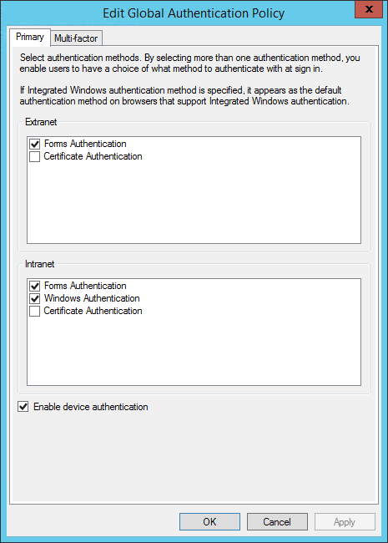
Primary & Device Authentication
Authentication Policy
Global Primary Authentication Policy
Intranet access
Default – Windows Integrated Authentication (WIA)
Options:
Windows Integrated Authentication with forms fallback,
Forms Authentication,
Certificate/Smart-card Authentication
Extranet access
Default – Forms Authentication
Options:
Forms Authentication,
Certificate/Smart-card Authentication
Device authentication
PS > Get/Set-AdfsGlobalAuthenticationPolicy

Slide 32
Primary & Device Authentication
Primary authentication - the gory details
Wire authn. method request?
Primary authn. method - Network location dependent
If multiple authentication methods are enabled, user gets a choice on sign-in page.
Device authentication is performed if enabled.
If request specified an authentication method enabled in policy, it is used.
Supported for SAML (RequestedAuthnContext) & WS-Fed (wauth)
For intranet access, if WIA is enabled, it is performed by default.
Forms Fallback: Browsers that do not support WIA – fallback to forms.
Default: IE, WAB
Configurable: Set-AdfsProperties –
WIASupportedUserAgents
Authn. method Requested. (protocol)
Yes
Global extranet authn policy
Primary Authentication with selected authn method.
No
Network Location?
Extranet authn. methods
Extranet
Intranet
Intranet authn. methods
Global intranet authn policy

Slide 33
Extranet soft-lockout protection for user accounts
Admin configurable ‘Lockout Threshold’ & ‘Observation Window’
Once threshold is exceeded:
Authentication from extranet with username/pwd is denied for duration of ‘Observation Window’
Does not cause AD bad password count (badPwdCount) to be incremented during observation window.
Intranet access continues to work for the user.
Helps protect against DOS/brute-force attacks that lockout user accounts.
Recommendation – set threshold below AD account lockout threshold.
PS > $ExtranetObservationWindow = New-Timespan -Minutes 30
PS > Set-ADFSProperties -EnableExtranetLockout $true –ExtranetLockoutThreshold 3
-ExtranetObservationWindow $ExtranetObservationWindow

Slide 34
Demo
ADFS Authentication Policy

Slide 35
No
Protocol Handlers
Primary & Device Authentication
NeedMFA?
Yes
Additional Authn.
RP Issuance Authz. Rules
Access token
Access denied
MFA Triggers
MFA Triggers

Slide 36
What triggers MFA?
MFA Triggers
Logical ‘OR’ semantics – MFA is triggered if:
Wire parameter (WS-Fed/SAML) requires MFA - OR -
Global MFA policy requires MFA - OR -
Resource/relying party MFA policy requires MFA
MFA triggers in policy (global & per-RP) can be expressed as claim rules:
Rich and expressive semantics
Familiar syntax for ADFS administrators
Create a claim rule to issue an authenticationmethod claim with value multipleauthn to trigger MFA.
Global MFA policy
MFA Requested. (protocol)
Perform MFA
Skip MFA
Resource MFA policy
Claim rule to trigger MFA:
issue(Type = “http://schemas.microsoft.com/ws/2008/06/identity/claims/authenticationmethod”, Value = “http://schemas.microsoft.com/claims/multipleauthn”);

Slide 37
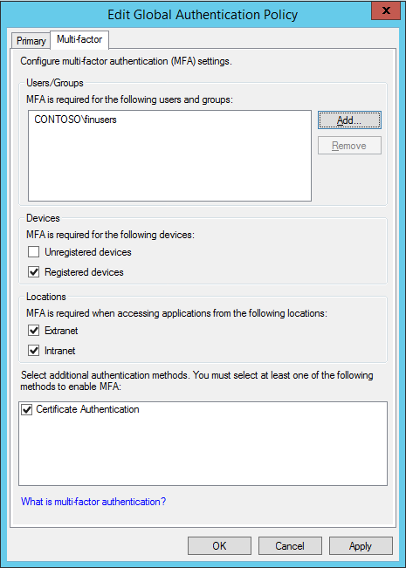
Trigger MFA in Policy
You can configure global MFA policies
Applies to all relying parties secured by that ADFS instance.
You can also configure resource specific (per-RP) MFA policies
Applies only to that specific resource/relying party.
MFA triggers are based on multiple factors (supported in UI):
User identity/group membership
Device type (workplace-joined or not)
Network location (intranet or extranet)
Complicated triggers can be expressed using claim rules & PowerShell.
* MFATriggerClaimRule – MFA trigger claim rule in string format.
PS > Set-AdfsAdditionalAuthenticationRule –
AdditionalAuthenticationRules $MFATriggerClaimRule*
PS > Set-AdfsRelyingPartyTrust –
AdditionalAuthenticationRules $MFATriggerClaimRule

Slide 38
Additional authentication (MFA) rules and Active Protocols
Problem: MFA rules block access from active protocols (Office 365 – Lync, Outlook etc.)
Solution: Use the ‘x-ms-endpoint-absolute-path’ claim to exclude active endpoint from having to do MFA in your trigger rule
Note: ‘adfs/ls’ → WS-Fed, SAML requests.
‘/adfs/oauth2’ → OAuth requests
The Federation Service could not authorize token issuance for caller ‘DOMAIN\User’. The caller is not authorized to request a token for the relying party 'urn:dumptoken'. See event 501 with the same Instance ID for caller identity.
Additional Data
Instance ID: xxxxxxxxxxx
Relying party: yyyy
Exception details:
Microsoft.IdentityServer.Service.IssuancePipeline.CallerAuthorizationException: MSIS5007: The caller authorization failed for caller identity xxxxxx for relying party trust yyyy.
at Microsoft.IdentityModel.Threading.AsyncResult.End(IAsyncResult result)
at Microsoft.IdentityModel.Protocols.WSTrust.WSTrustServiceContract.ProcessCoreAsyncResult.End(IAsyncResult ar)
at Microsoft.IdentityModel.Protocols.WSTrust.WSTrustServiceContract.EndProcessCore(IAsyncResult ar, String requestAction, String responseAction, String trustNamespace)
User Action
Use the AD FS Management snap-in to ensure that the caller is authorized to request a token for the relying party.
Sample rule:
c:[Type == "http://schemas.microsoft.com/ws/2012/01/insidecorporatenetwork", Value == "false"] && c1:[Type == "http://schemas.microsoft.com/2012/01/requestcontext/claims/x-ms-endpoint-absolute-path", Value =~ `"(/adfs/ls)|(/adfs/oauth2)"]
=> issue(Type = "http://schemas.microsoft.com/ws/2008/06/identity/claims/authenticationmethod", Value = "http://schemas.microsoft.com/claims/multipleauthn");

Slide 39
No
MFA reqd?
Yes
RP Issuance Authz. Rules
Protocol Handlers
Primary & Device Authentication
Additional Authn.
Access token
Access denied
MFA Triggers
Additional Authentication

Slide 40
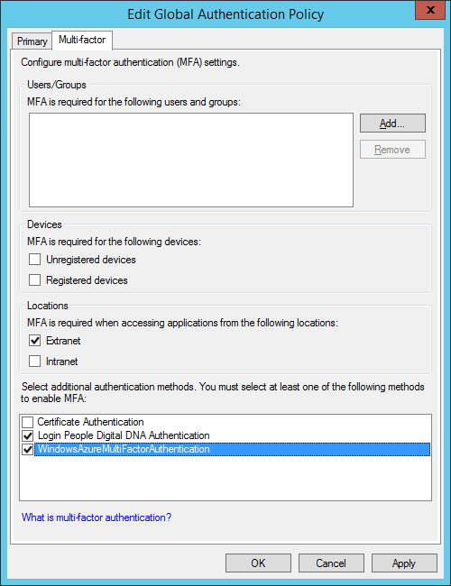
Additional authentication
Invoked if MFA triggers determine a need to perform additional authentication.
Built-in additional authentication:
In-box support for X509 Certificate Authentication (eg. ‘Smart cards’)
Extensible additional authentication infrastructure:
Admins can enable additional authentication methods using the Global authentication policy (UI or PowerShell)
Multiple additional authentication methods enabled
Users get a choice on sign-in page
PS > Set-AdfsGlobalAuthenticationPolicy –
AdditionalAuthenticationProvider “CertificateAuthentication”

Slide 41
Azure Multi-Factor Authentication
Integrates with ADFS via pluggable authentication provider.
Offers many convenient MFA methods:
out-of-band phone call,
text message,
mobile app authentication, as well as
one-time-passcodes
Synchronizes with Active Directory for centralized user management and automated enrollment
Features built-in support for leading on-premises applications as well as federation to cloud services
Get started @ http://technet.microsoft.com/en-us/library/dn280949.aspx
(Walkthrough Guide: Manage Risk with Additional Multi-Factor Authentication for Sensitive Applications)

Slide 42
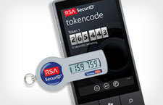
MFA Integration with Partners – 3rd party MFA adapters
More Information: www.emc.com/security/rsa-securid/rsa-authentication-agents/microsoft-ad-fs.htm
More Information: www.gemalto.com/identity
More Information: www.loginpeople.com
More Information: www.inwebo.com
More Information: www.safenet-inc.com
MORE ON THE WAY!

Slide 43
Demo
Authentication Providers & MFA Triggers

Slide 44
Access Tokens issued after MFA was performed - JWT
{"aud":"urn:iostestrp",
"iss":"http://adfs.contoso.com/adfs/services/trust",
"iat":1373305904,
"exp":1373309504,
"auth_time":"2013-70-8T17:51:44.994Z",
"authmethod":"http://schemas.microsoft.com/ws/2008/06/identity/authenticationmethod/windows",
"upn":"administrator@contoso.com",
"primarygroupsid":"S-1-5-21-369457380-891524138-205581132-513",
"primarysid":"S-1-5-21-369457380-891524138-205581132-500",
"winaccountname":“CONTOSO\\Administrator",
"amr":["http://schemas.microsoft.com/ws/2008/06/identity/authenticationmethod/windows",
"http://schemas.microsoft.com/ws/2008/06/identity/authenticationmethod/tlsclient",
"http://schemas.microsoft.com/ws/2008/06/identity/authenticationmethod/x509",
"http://schemas.microsoft.com/claims/multipleauthn"],
"insidecorpnetwork":"true",
"clientip":"2001:4898:2b:5:804c:5c6a:b474:3fa4",
"sub":"92gdY4IaPnsNyUU7YXuWgv15eWLxgGroAsCb3UCnKzA=",
"ver":"1.0",
"appid":"iOSTestRP“ }

Slide 45
Access Tokens issued after MFA was performed - SAML
<?xml version="1.0" encoding="utf-16"?>
<samlp:Response … >
<Issuer xmlns="urn:oasis:names:tc:SAML:2.0:assertion"> … </Issuer>
<samlp:Status><samlp:StatusCode Value="urn:oasis:names:tc:SAML:2.0:status:Success" /></samlp:Status>
<Assertion ID="_b28abb55-4af3-407e-8f20-18bacea35c7e" IssueInstant="2013-07-10T00:35:05.093Z" Version="2.0“
xmlns="urn:oasis:names:tc:SAML:2.0:assertion">
<Issuer>http://adfs.contoso.com/adfs/services/trust</Issuer>
<ds:Signature> … </ds:Signature>
<Subject> … </Subject>
<Conditions> … </Conditions>
<AttributeStatement>
…
<Attribute Name="http://schemas.microsoft.com/claims/authnmethodsreferences">
<AttributeValue>urn:oasis:names:tc:SAML:2.0:ac:classes:PasswordProtectedTransport</AttributeValue>
<AttributeValue>http://schemas.microsoft.com/ws/2008/06/identity/authenticationmethod/tlsclient</AttributeValue>
<AttributeValue>http://schemas.microsoft.com/ws/2008/06/identity/authenticationmethod/x509</AttributeValue>
<AttributeValue>http://schemas.microsoft.com/claims/multipleauthn</AttributeValue>
</Attribute>
…
</AttributeStatement>
<AuthnStatement AuthnInstant="2013-07-10T00:35:04.358Z">
<AuthnContext><AuthnContextClassRef>urn:oasis:names:tc:SAML:2.0:ac:classes:PasswordProtectedTransport</AuthnContextClassRef>
</AuthnContext>
</AuthnStatement>
</Assertion>
</samlp:Response>
Note: Token contents are truncated for brevity.

Slide 46
No
Protocol Handlers
Primary & Device Authentication
MFA reqd.?
Yes
Additional Authn.
RP Issuance Authz. Rules
Access token
Access denied
MFA Triggers
RP Issuance Authz. Rules

Slide 47
Conditional access control
You can enforce conditional access to resources – depending on:
User identity or group membership
Network location
Device (workplace joined)
Authentication state (whether MFA was performed etc.)
Sensitivity of resource
Flexible & expressive per-application authorization policies:
Permit/Deny access based on user, device, network location & authentication state
Create RP Issuance Authorization Rules for the application/RP.
UI/wizard experience for common scenarios.
Rich claims language & PowerShell for advanced scenarios.
Custom ‘Access Denied’ messages
Let users understand why exactly they were denied access
Facilitate self-service remediation where possible – eg. Prompt users to workplace join their device.
Error messages are customizable on a per-application basis

Slide 48
Demo
Conditional access control

Slide 49
Let’s swim through the pipeline …
Extranet:
Forms based authn
Certificate based authn.
Intranet:
WIA with forms fallback
Forms based authn
Certificate based authn.
Global extranet authn policy
Global intranet authn policy
Smartcard authn.
External authn. providers
Authn. method Requested. (protocol)
Device authentication
No
OAuth
Protocol Handlers
Primary & Device Authentication
MFA reqd.?
Yes
Additional Authn.
RP Issuance Authz. Rules
Access token
Client request
WS-Fed
SAML
Inspect & consume SSO state
Inspect & consume SSO state
Access denied
SSO satisfies primary authn requirements
SSO satisfies MFA requirements
MFA Requested. (protocol)
Global MFA policy
RP/Resource MFA policy
Update SSO state
Update SSO state
MFA Triggers (policy/protocol)
SSO state

Slide 50
Peace of mind

Slide 51
Your AD toolbox never looked richer!
Start
Resources/Applications
Devices
Users

Slide 52
AD empowers you to protect resources
A
D
Network location aware primary authentication
Allow only specific users/groups
Authentication policy
A] No passwords for extranet access – smartcard only
Resource specific settings
B] No SSO – User must always provide credentials afresh
RP Issuance Authorization Rules
C] Access allowed only from workplace joined devices
D] Only a specific set of users/groups allowed access
E] Access allowed only if MFA was performed
B
E
Always require fresh authentication for sensitive resources
Require multiple factor authentication
C
Require known devices

Slide 53
… and devices
A
D
Authentication blocked on Lost/disabled devices
Configurable SSO invalidation threshold
Lost device protection
A] Delete/disable ‘User@Device’ objects in AD
B] SSO state is invalidated if workplace join certificate does not match information stored in encrypted SSO state.
C] Conditional wipe of corporate data with Intune.
Protection for ‘breach’ events
D] SSO state generated prior to configured timestamp is invalidated to protect against rare ‘breach’ events.
Secure workplace join
E] Workplace join protected by MFA – device authentication is a reliable & seamless second factor authentication method.
B
E
Automatic SSO invalidation for lost/disabled devices
MFA for Workplace Join
C
Conditional remote wipe using Intune

Slide 54
… as well as users!
A
Extranet bad password lockout
A] Extranet bad password lockout
Protect AD accounts from misuse or DOS attacks.
B] Require MFA for sensitive users/groups (executives/finance users etc.) to limit risk & information disclosure.
B
Require MFA for users/groups

Slide 55
Related content
Tue, Oct 28 3:15 PM-4:30 PM | EM-B214 | Privileged Access Management for Active Directory
Wed, Oct 29 8:30 AM-9:45 AM | EM-B316 | Directory Integration: Creating One Directory with Active Directory and Azure Active Directory
Wed, Oct 29 3:15 PM-4:30 PM | EM-B319 | Microsoft Identity Manager vNext Overview
Wed, Oct 29 3:15 PM-4:30 PM | CDP-B210 | Cloud Identity: Microsoft Azure Active Directory Explained
Wed, Oct 29 5:00 PM-6:15 PM | EM-B318 | Free Your Apps: Introducing Microsoft Azure Active Directory Application Proxy and Windows Server Web Application Proxy
Thu, Oct 30 10:15 AM-11:30 AM | CDP-B312 | Microsoft Azure Active Directory Premium, in Depth
Fri, Oct 31 2:45 PM-4:00 PM | EM-B313 | Microsoft Azure Multi-Factor Authentication Deep Dive: Securing Access on Premises and in the Cloud
Thu, Oct 30 12:00 PM-1:15 PM | EM-B310 | Active Directory + BYOD = Peace of Mind
Thu, Oct 30 5:00 PM-6:15 PM | DEV-B322 | Building Web Apps and Mobile Apps Using Microsoft Azure Active Directory for Identity Management
Fri, Oct 31 8:30 AM-9:45 AM | CDP-B207 | Securing Organizations: Azure Active Directory Intelligence as a Differentiator
Microsoft Solutions Experience Location (MSE)

Slide 56
Enterprise Mobility Track Resources
Enterprise Mobility Suite http://aka.ms/enterprise mobilitysuite
Microsoft Intune http://aka.ms/microsoftintune
Configuration Manager http://aka.ms/configmgr
Hybrid Identity http://aka.ms/hi
Access & Info Protection http://aka.ms/aip
Desktop Virtualization http://aka.ms/virtualdesktop

Slide 57
Resources
Learning
Sessions on Demand
Microsoft Certification & Training Resources
http://channel9.msdn.com/Events/TechEd
www.microsoft.com/learning
TechNet
Developer Network
Resources for IT Professionals
http://microsoft.com/technet
http://developer.microsoft.com

Slide 58
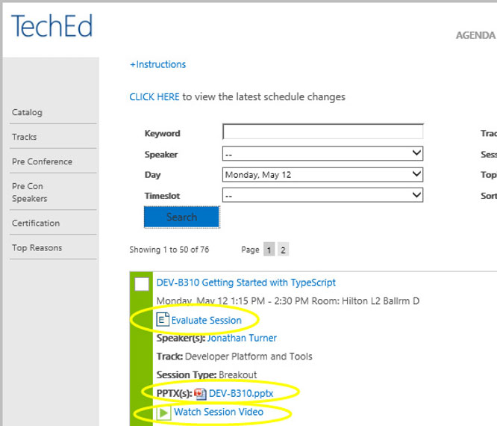
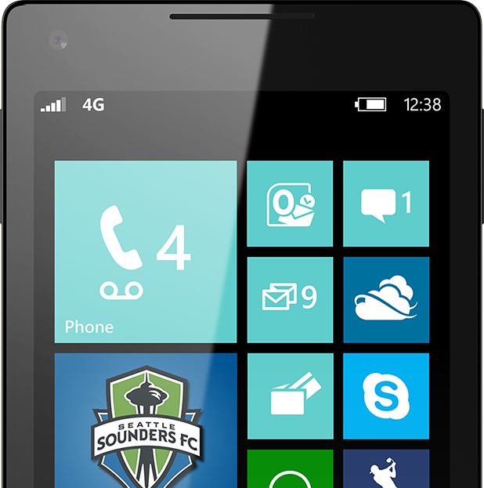
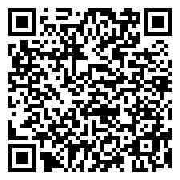
Please Complete An Evaluation Form Your input is important!
TechEd Schedule Builder
CommNet station or PC
TechEd Mobile app
Phone or Tablet
QR code

Slide 59
Evaluate this session

Slide 60
© 2014 Microsoft Corporation. All rights reserved. Microsoft, Windows, and other product names are or may be registered trademarks and/or trademarks in the U.S. and/or other countries.
The information herein is for informational purposes only and represents the current view of Microsoft Corporation as of the date of this presentation. Because Microsoft must respond to changing market conditions, it should not be interpreted to be a commitment on the part of Microsoft, and Microsoft cannot guarantee the accuracy of any information provided after the date of this presentation. MICROSOFT MAKES NO WARRANTIES, EXPRESS, IMPLIED OR STATUTORY, AS TO THE INFORMATION IN THIS PRESENTATION.

Slide 61
Appendix (Addition content for you to read, samples etc…)

Slide 62
Claims available for conditional access control
Claim Type | What does it mean?
User Information
http://schemas.microsoft.com/ws/2008/06/identity/claims/denyonlyprimarygroupsid | The deny-only primary group SID of the user
http://schemas.microsoft.com/ws/2008/06/identity/claims/denyonlyprimarysid | The deny-only primary SID of the user
http://schemas.microsoft.com/ws/2008/06/identity/claims/groupsid | The group SID of the user You can use this claim to find out if the user belongs to a specific group.
http://schemas.microsoft.com/ws/2008/06/identity/claims/primarygroupsid | The primary group SID of the user
http://schemas.microsoft.com/ws/2008/06/identity/claims/primarysid | The primary SID of the user
http://schemas.microsoft.com/ws/2008/06/identity/claims/windowsaccountname | The domain account name of the user in the form of domain\user
http://schemas.xmlsoap.org/claims/CommonName | The common name of the user
http://schemas.xmlsoap.org/ws/2005/05/identity/claims/denyonlysid | The deny-only group SID of the user
http://schemas.xmlsoap.org/ws/2005/05/identity/claims/name | The unique name of the user
http://schemas.xmlsoap.org/ws/2005/05/identity/claims/upn | The user principal name (UPN) of the user
Device Information (if the device is joined to the workplace)
http://schemas.microsoft.com/2012/01/devicecontext/claims/displayname | Display name of Device Registration
http://schemas.microsoft.com/2012/01/devicecontext/claims/identifier | Identifier of the device
http://schemas.microsoft.com/2012/01/devicecontext/claims/isregistereduser | User is registered to use this device When the value of this claim is true, it means that the user who authenticated is the one who originally registered the device.
http://schemas.microsoft.com/2012/01/devicecontext/claims/ostype | OS type of the device
http://schemas.microsoft.com/2012/01/devicecontext/claims/osversion | OS version of the device

Slide 63
Claim Type | What does it mean?
Request information
http://schemas.microsoft.com/2012/01/requestcontext/claims/client-request-id | Identifier for a user session (for troubleshooting purposes)
http://schemas.microsoft.com/2012/01/requestcontext/claims/relyingpartytrustid | Identifier for the Relying Party
http://schemas.microsoft.com/2012/01/requestcontext/claims/x-ms-client-application | Type of the Client Application
http://schemas.microsoft.com/2012/01/requestcontext/claims/x-ms-client-ip | IP address of the client
http://schemas.microsoft.com/2012/01/requestcontext/claims/x-ms-client-user-agent | Device type the client is using to access the application
http://schemas.microsoft.com/2012/01/requestcontext/claims/x-ms-endpoint-absolute-path | Absolute Endpoint path which can be used to determine active versus passive clients Since MFA is supported only for browser applications, you can use this claim to tell apart browser from non-browser requests, in case you have both kinds of protocols in the same relying party trust, which is the typical case when issuing tokens to a federation provider STS.
http://schemas.microsoft.com/2012/01/requestcontext/claims/x-ms-forwarded-client-ip | IP address of the user
http://schemas.microsoft.com/2012/01/requestcontext/claims/x-ms-proxy | DNS name of the federation server proxy that passed the request
http://schemas.microsoft.com/ws/2012/01/insidecorporatenetwork | Used to indicate if a request originated inside corporate network. When the value is false, it means the request came through a web application proxy. When true, it means the request came directly from the browser to the STS.
Authentication information
http://schemas.microsoft.com/2012/12/certificatecontext/* (multiple claim types) | Claims that represent different fields and extensions of the X509 client certificate when used as an authentication method. One interesting use case here is to use the EKU claim (http://schemas.microsoft.com/2012/12/certificatecontext/extension/eku) to ascertain whether the user used a smart card (exact EKU depends upon the PKI infrastructure of the customer)
http://schemas.microsoft.com/ws/2008/06/identity/claims/authenticationmethod | The primary authentication method used to authenticate the user
http://schemas.microsoft.com/claims/authnmethodsreferences | Used to indicate all authentication methods used to authenticate the user.
http://schemas.microsoft.com/ws/2008/06/identity/claims/authenticationinstant | Used to display the time and date that the user was authenticated

Slide 64
MFA Triggers
Sample 1 – Trigger MFA based on Group membership
$rp = Get-AdfsRelyingPartyTrust –Name claimapp
$GroupMfaClaimTriggerRule = ‘c:[Type == “http://schemas.microsoft.com/ws/2008/06/identity/claims/groupsid”, Value == “S-1-5-21-2051694910-254885857-3069878782-1114”] => issue(Type = “http://schemas.microsoft.com/ws/2008/06/identity/claims/authenticationmethod”, Value = “http://schemas.microsoft.com/claims/multipleauthn”);’
Set-AdfsRelyingPartyTrust –TargetRelyingParty $rp –AdditionalAuthenticationRules $GroupMfaClaimTriggerRule
* “S-1-5-21-2051694910-254885857-3069878782-1114” – ‘Finance Users’ Group
GroupSid
claim == ‘S-1-5-…’
issue
AuthenticationMethod
claim = ‘multipleauthn’
trigger
Additional Authn.

Slide 65
MFA Triggers
Sample 2 – Trigger MFA for access from extranet
'c:[type == "http://schemas.microsoft.com/ws/2012/01/insidecorporatenetwork", value == "false"] => issue(type="http://schemas.microsoft.com/ws/2008/06/identity/claims/authenticationmethod", value = "http://schemas.microsoft.com/claims/multipleauthn" );'
InsideCorporateNetwork
claim == FALSE
issue
AuthenticationMethod
claim = ‘multipleauthn’
trigger
Additional Authn.

Slide 66
MFA Triggers
Sample 3 – Trigger MFA when users access from non-workplace joined devices
‘c:[type=="http://schemas.microsoft.com/2012/01/devicecontext/claims/isregistereduser", value == “false"] => issue (type="http://schemas.microsoft.com/ws/2008/06/identity/claims/authenticationmethod", value = "http://schemas.microsoft.com/claims/multipleauthn");‘
IsRegisteredUser claim ➔ Device is workplace joined & registered to the user.
IsRegisteredUser
Claim == FALSE
issue
AuthenticationMethod
claim = ‘multipleauthn’
trigger
Additional Authn.

Slide 67
MFA Triggers
Trigger MFA using wire protocols
SAML Protocol:
Using the ‘RequestedAuthnContext’ element
Sample:
<samlp:AuthnRequest>
...
<samlp:RequestedAuthnContext Comparison="exact">
<saml:AuthnContextClassRef>
http://schemas.microsoft.com/claims/multipleauthn
</saml:AuthnContextClassRef>
</samlp:RequestedAuthnContext>
</samlp:AuthnRequest>
WS-Fed Protocol:
Using the wauth query parameter
Sample:
?WAUTH=http://schemas.microsoft.com/claims/multipleauthn
This mechanism is useful to enforce MFA policies in federation scenarios :
- Across organizations using ADFS
- Cloud resources secured by Azure AD

Slide 68
Sample 1 – Permit access only if MFA was performed
@RuleTemplate = “Authorization”
@RuleName = “PermitAccessWithMFA”
c:[Type == “http://schemas.microsoft.com/claims/authnmethodsreferences”, Value =~ “^(?i)http://schemas\.microsoft\.com/claims/multipleauthn$”] => issue(Type = "http://schemas.microsoft.com/authorization/claims/permit", Value = “PermitUsersWithClaim");
AuthnMethodsReferences
Claim == ‘multipleauthn’
Permit Access

Slide 69
Sample 2 – Permit access from workplace joined device
@RuleTemplate = “Authorization”
@RuleName = “PermitAccessFromRegisteredWorkplaceJoinedDevice”
c:[Type == “http://schemas.microsoft.com/2012/01/devicecontext/claims/isregistereduser”, Value =~ “^(?i)true$”] => issue(Type = "http://schemas.microsoft.com/authorization/claims/permit", Value = “PermitUsersWithClaim");
IsRegisteredUser
Claim == TRUE
Permit Access

Slide 70
Sample 3 – Permit access from extranet if MFA was performed
@RuleTemplate = “Authorization”
@RuleName = “RequireMFAForExtranetAccess”
c1:[Type == “http://schemas.microsoft.com/claims/authnmethodsreferences”, Value =~ “^(?i)http://schemas\.microsoft\.com/claims/multipleauthn$”] &&
c2:[Type == “http://schemas.microsoft.com/ws/2012/01/insidecorporatenetwork”, Value =~ “^(?i)false$”] => issue(Type = "http://schemas.microsoft.com/authorization/claims/permit", Value = “PermitUsersWithClaim");
InsideCorporateNetwork
Claim == FALSE
Permit Access
AuthnMethodsReferences
Claim == ‘multipleauthn’

Slide 71
Sample 4 – Permit access from workplace joined device if MFA was performed
@RuleTemplate = “Authorization”
@RuleName = “RequireMFAOnRegisteredWorkplaceJoinedDevice”
c1:[Type == “http://schemas.microsoft.com/claims/authnmethodsreferences”, Value =~ “^(?i)http://schemas\.microsoft\.com/claims/multipleauthn$”] &&
c2:[Type == “http://schemas.microsoft.com/2012/01/devicecontext/claims/isregistereduser”, Value =~ “^(?i)true$”] => issue(Type = "http://schemas.microsoft.com/authorization/claims/permit", Value = “PermitUsersWithClaim");
IsRegisteredUser
Claim == TRUE
Permit Access
AuthnMethodsReferences
Claim == ‘multipleauthn’

Slide 72
© 2014 Microsoft Corporation. All rights reserved. Microsoft, Windows, and other product names are or may be registered trademarks and/or trademarks in the U.S. and/or other countries.
The information herein is for informational purposes only and represents the current view of Microsoft Corporation as of the date of this presentation. Because Microsoft must respond to changing market conditions, it should not be interpreted to be a commitment on the part of Microsoft, and Microsoft cannot guarantee the accuracy of any information provided after the date of this presentation. MICROSOFT MAKES NO WARRANTIES, EXPRESS, IMPLIED OR STATUTORY, AS TO THE INFORMATION IN THIS PRESENTATION.

