Slide 2
Configuring Corporate-Owned Mobile Devices with Microsoft Intune
EM-B317
Dilip Radhakrishnan & Jason Githens
Principal PM Managers, Microsoft Intune

Slide 3
Agenda
Enterprise Mobility Overview
Scenarios for Corp owned devices
Enrollment for Corp owned iOS devices
Enrollment for other Corp owned devices
Device security and lockdown

Slide 4
Enterprise Mobility Suite

Slide 5
Enterprise Mobility Platform
Microsoft Differentiation
Managed Mobile Productivity
Layered Protection
Hybrid Solutions
Enterprise Mobility Suite
Azure Active Directory
Office 365
Dynamics
Workday

Slide 6
Scenarios and Solutions for Corporate Managed Devices

Slide 7
The World of Corporate Owned Devices
Corporate owned phones and tablets (CYOD), with personal use allowed
Retail outlets using tablets as point of sales devices, gift registries, etc.
Restaurants using tablets as hostess devices, for monitoring equipment
Medical staff at hospitals using tablets for patient charts and data
Schools providing tablets for technology based learning
Airlines providing pilots tablets to securely host flight manuals

Slide 8
Management Needs for These Devices
Multitude of device types, OS platforms, form factors, and versions in use
Number one need for management of the device is to assure that corporate resources are safe
Assure that devices are enrolled into management so data is protected
Assure that devices are blocked from accessing corporate data if managed but not compliant
Simple, low-cost process for mass enrolling devices or forcing users to enroll
Deep levels of control on device experience, like lockdown to single apps, denying certain applications
Ability to rapidly support new device capabilities through the service (URI model)

Slide 9
Enrollment of Corporate iOS devices

Slide 10
iOS enrollment options
Scenario | Enrollment option
Corporation/Education institution purchases devices and prepares it before handing it over to users | Apple Configurator + Intune MDM Needs devices connected to a Mac for provisioning
Corporation/Education institution directly procures devices from Apple and directly deliver devices to users | Apple DEP + Intune Zero touch, OTA enrollment and configuration.
Corporation provides reimbursement for employee purchased devices. Corporate owned personal use devices | Use conditional access to IT services to force MDM enrollment

Slide 11
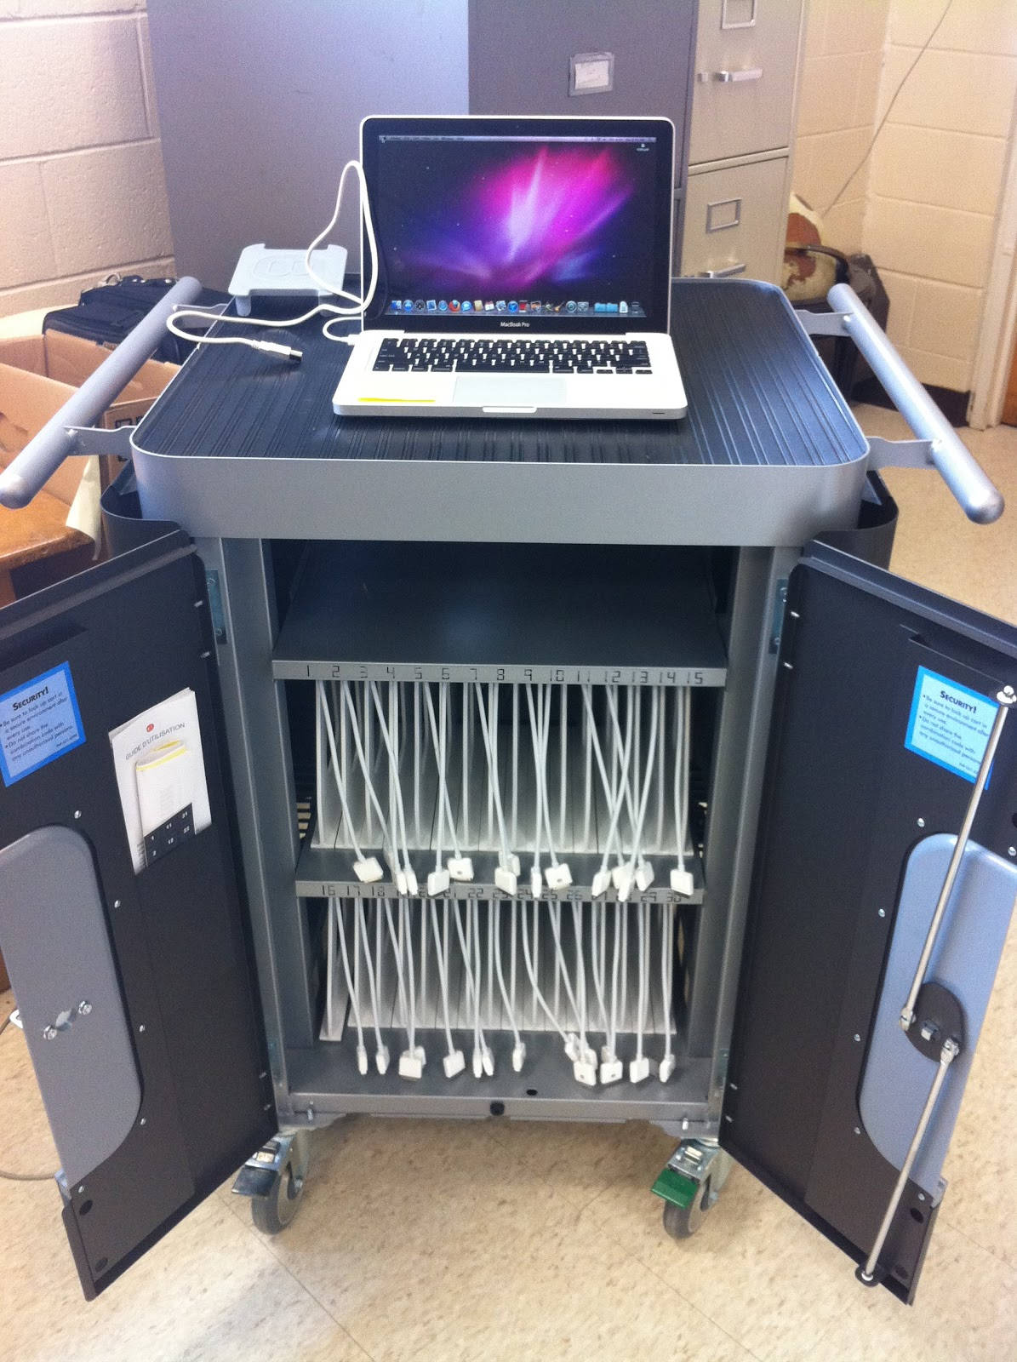
Apple Configurator
A free Apple application for Mac OS X computers
Enables IT to prepare multiple devices with specific restrictions and settings.
Devices need to be tethered to a Mac.
Enables supervised mode and assign mobile devices to certain users or groups.

Slide 12
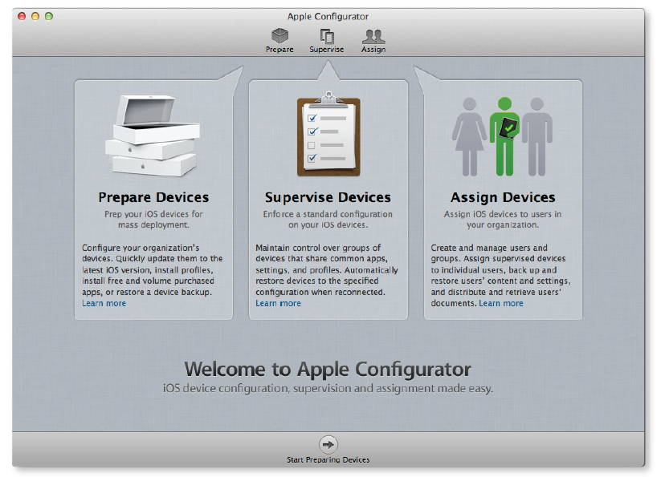
Apple Configurator
Prepare:
Update to latest iOS
Setup MDM enrollment
Restore a device backup
Supervise
Enable advanced settings and restrictions
Assign
Associate devices to users/groups

Slide 13
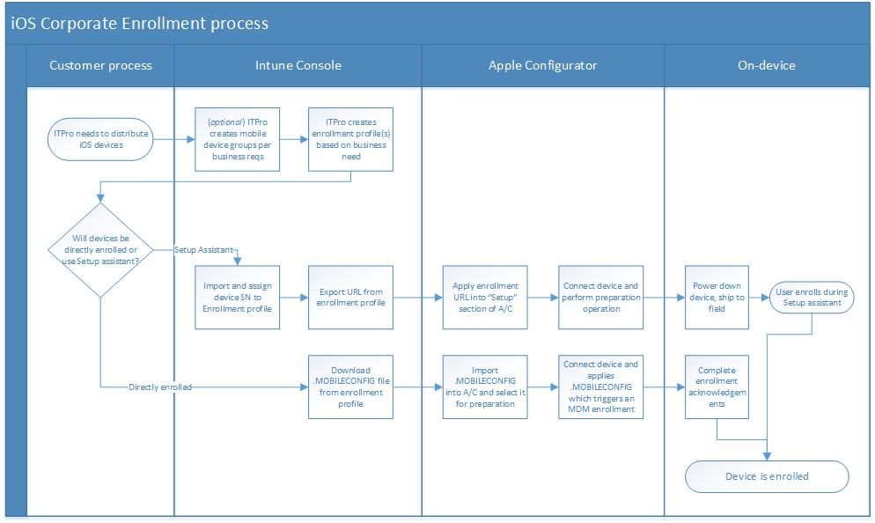
Bulk enrollment – Intune + Apple Configurator

Slide 14
Demo: Apple Configurator and iOS Corp Enrollment
Dilip Radhakrishnan

Slide 15
Troubleshooting Profile install issues
The iOS device is on a Wifi network, has airplane mode turned off and has internet access.
Ensure that the Mac computer running Apple Configurator has access to the internet

Slide 16
Enrollment: Apple Device Enrollment Program

Slide 17
Apple Device Enrollment Program (DEP)
New streamlined program from manage iOS/Mac devices purchased directly from Apple
Zero touch configuration
OTA MDM enrollment and device configuration
Enhanced Supervisor mode
Improved capability to restrict removal of MDM profiles
OTA Supervisor mode without Mac Apple configurator tool

Slide 18
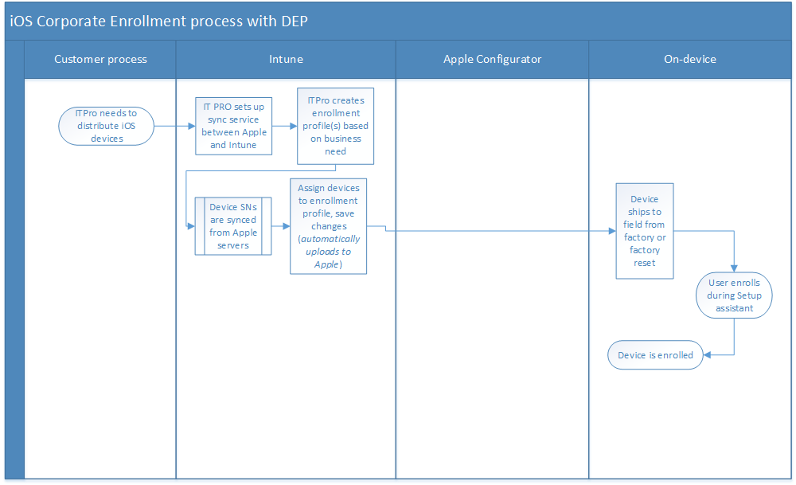
Bulk enrollment workflow with Intune & DEP

Slide 19
Intune & DEP - Concept walkthrough

Slide 20
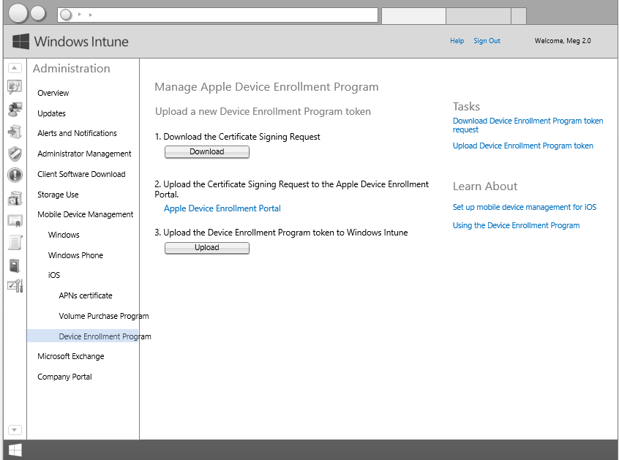
DEP setup

Slide 21
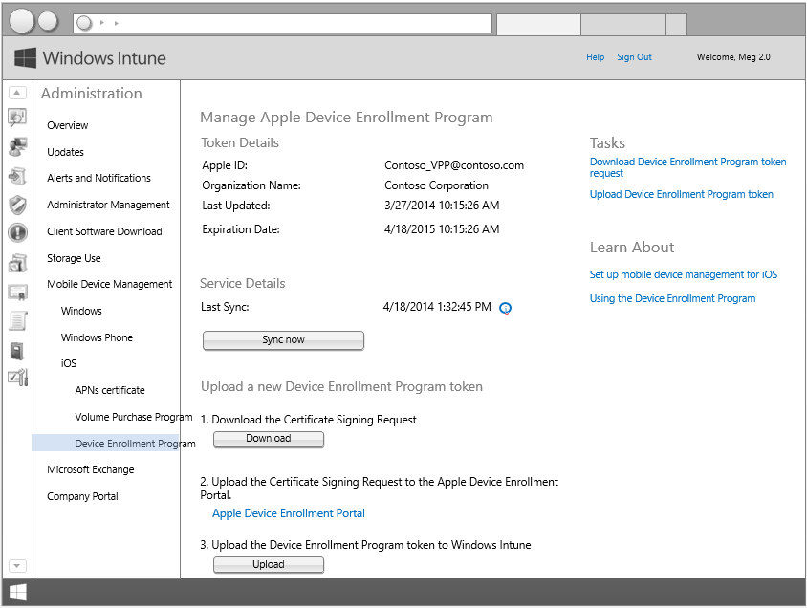
Connection to Apple DEP established

Slide 22
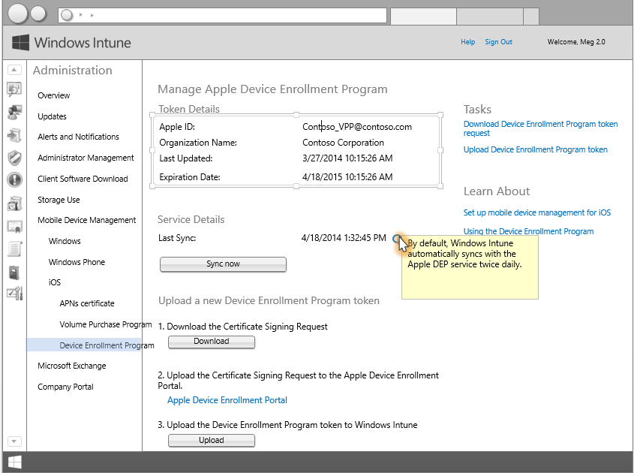
Intune – Apple sync frequency

Slide 23
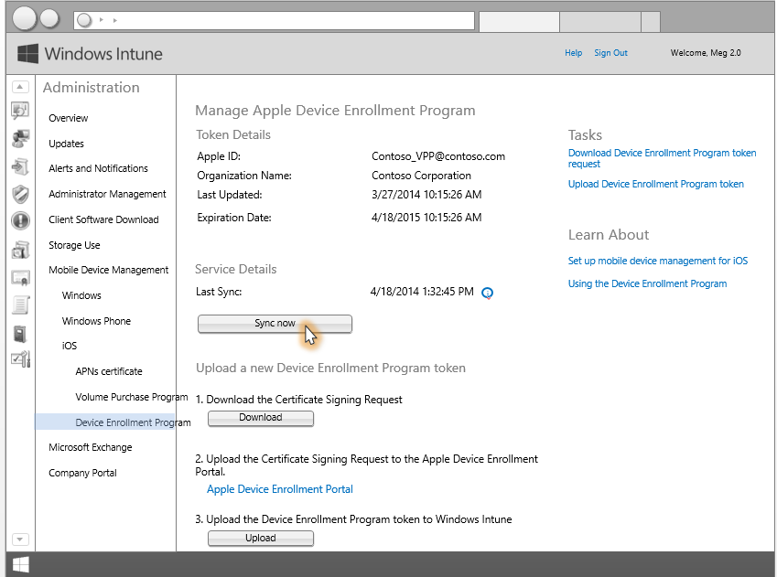
Manual sync

Slide 24
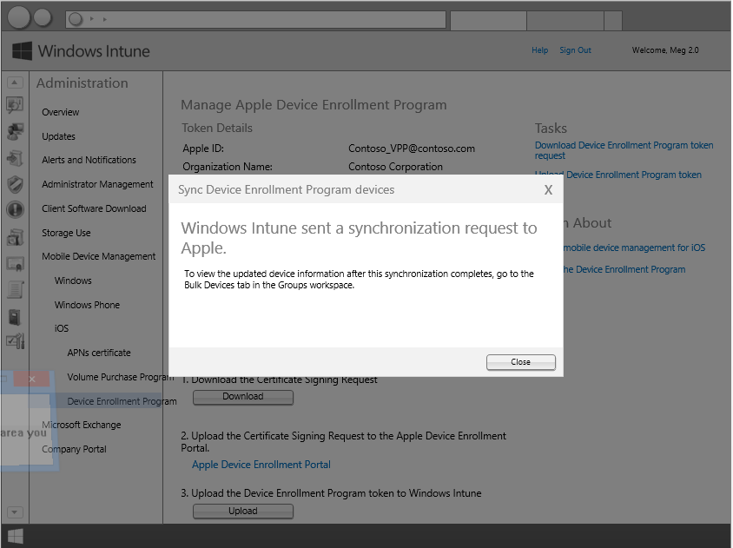
Sync request notification

Slide 25
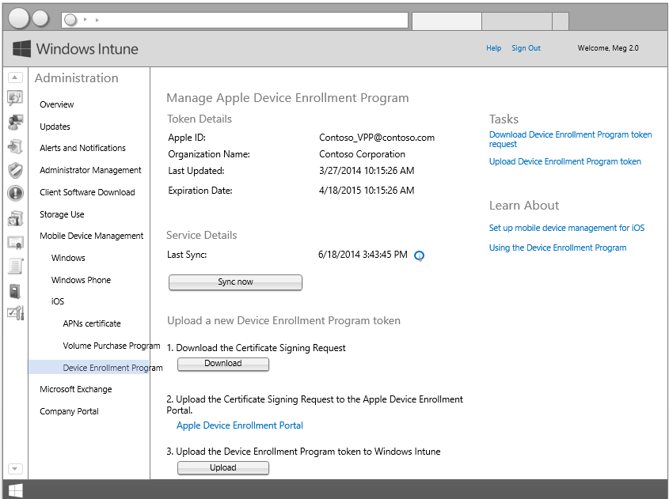
DEP sync succeeds

Slide 26
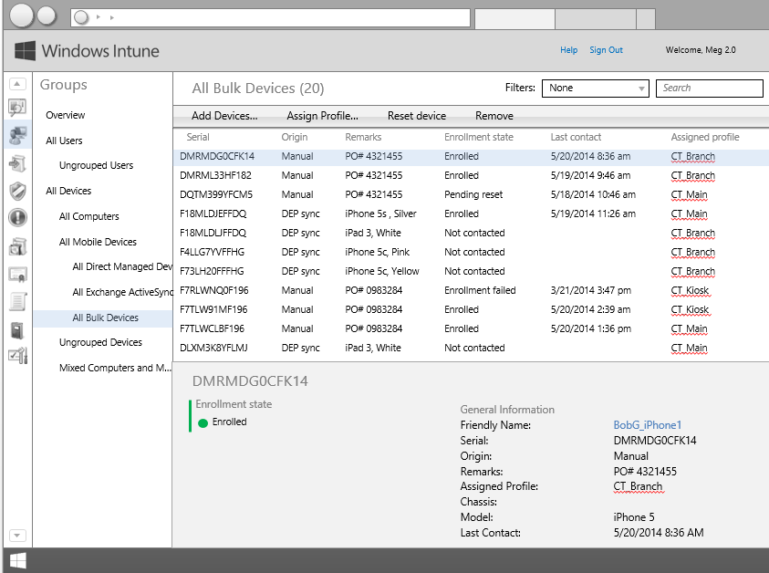
Updated list of Corp owned devices after sync

Slide 27
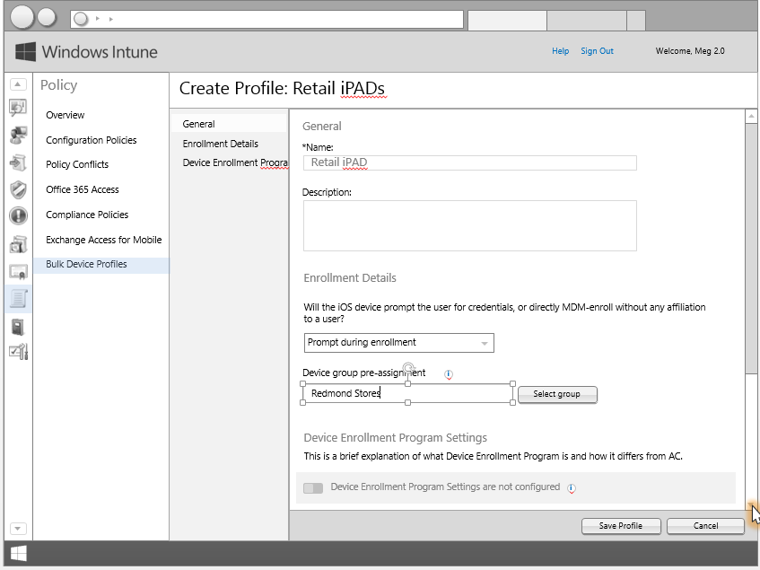
Enrollment Profile creation

Slide 28
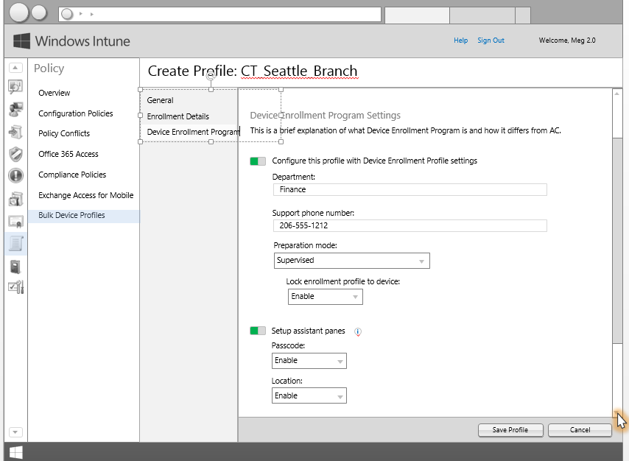
DEP settings in Enrollment Profile

Slide 29
Conditional access for Corp owned personal use devices

Slide 30
Features
Block access to O365 services like email if device is not compliant to IT policies
Simple end user experience for remediating the non compliance status

Slide 31
Demo – Conditional Resource access
Dilip Radhakrishnan

Slide 32
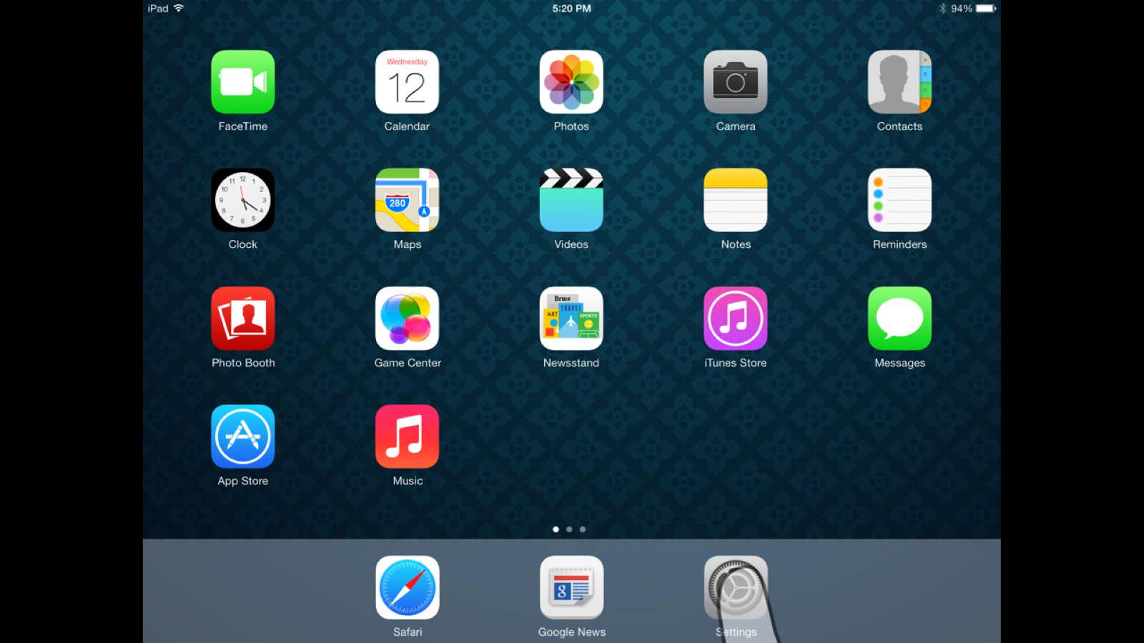

Slide 33
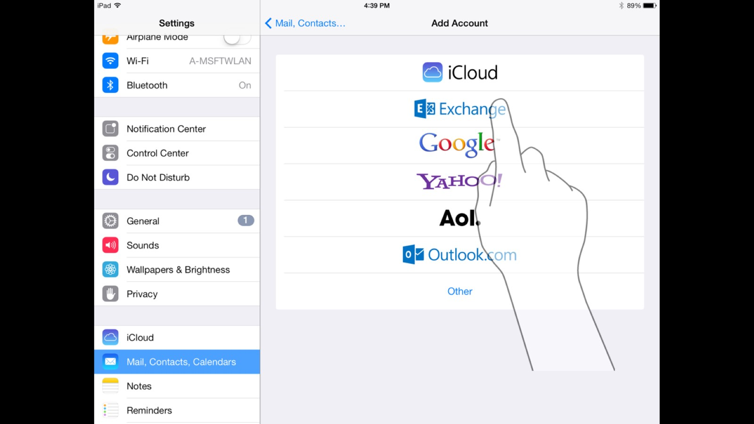

Slide 34
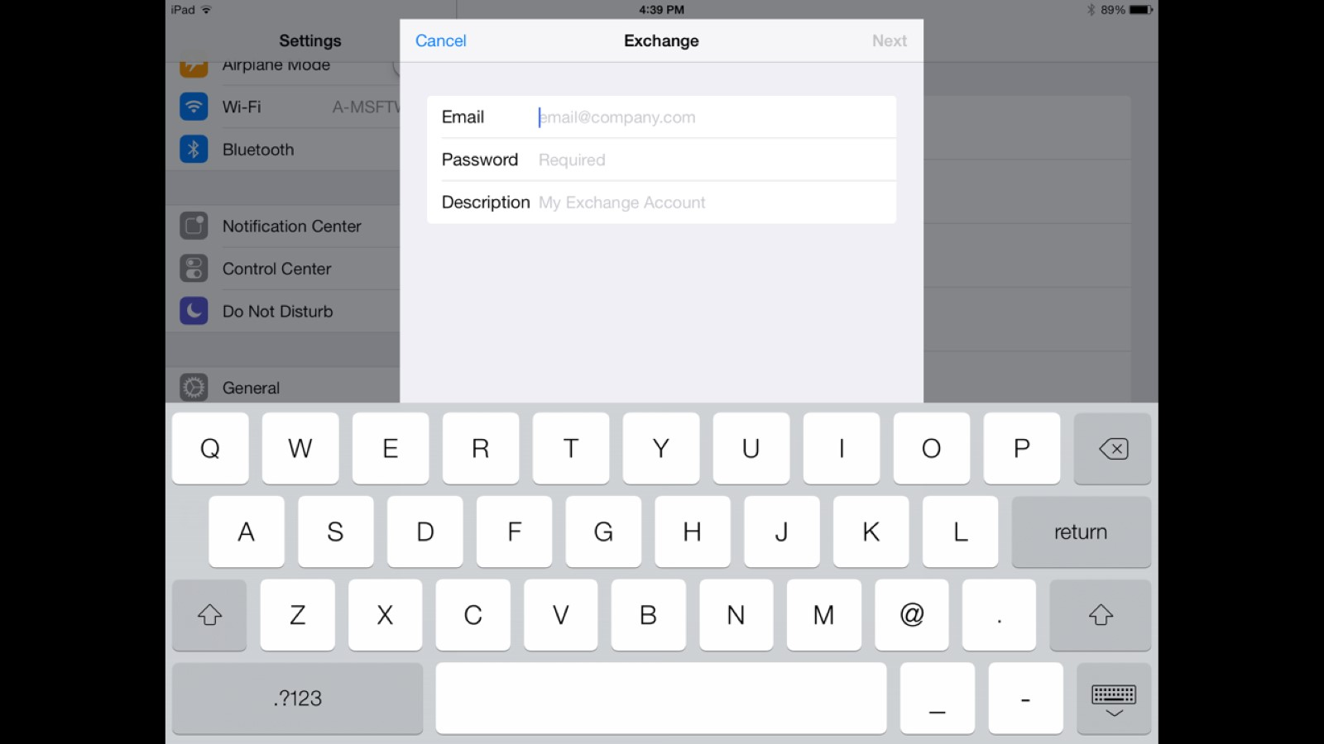

Slide 35
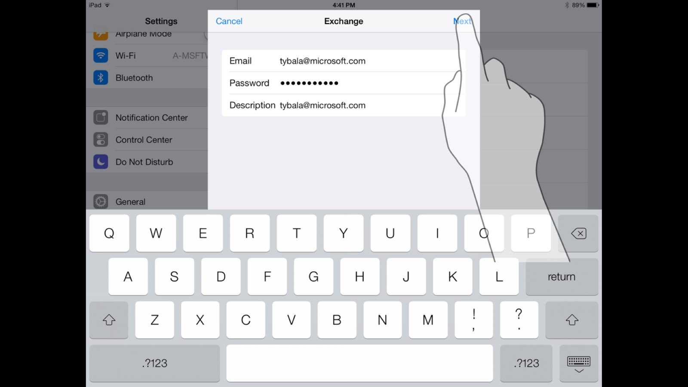

Slide 36
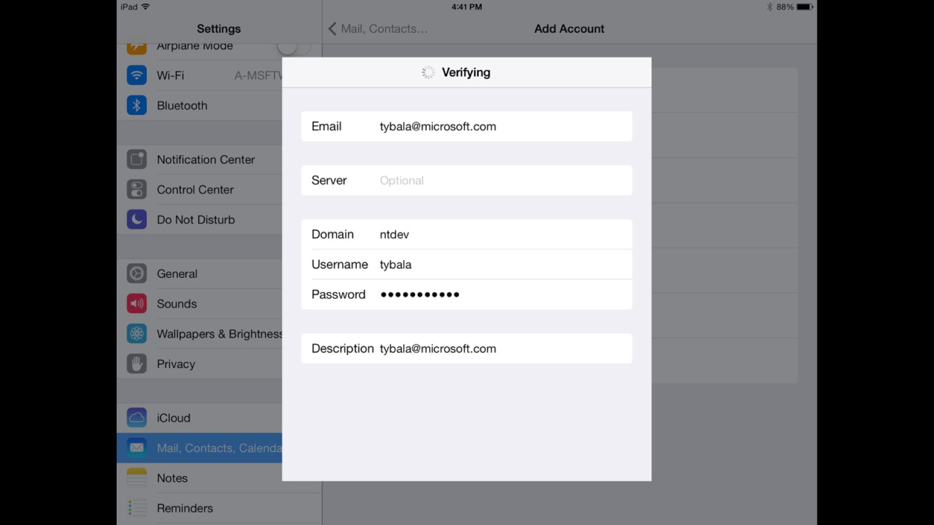

Slide 37
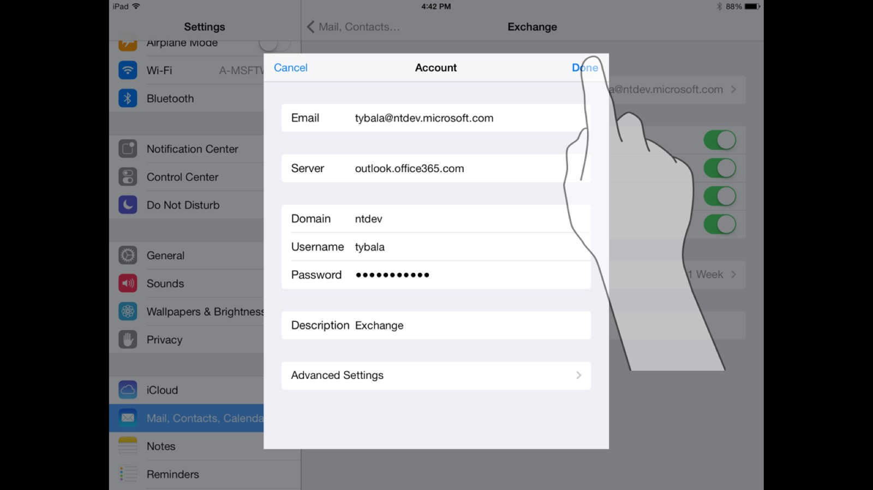

Slide 38
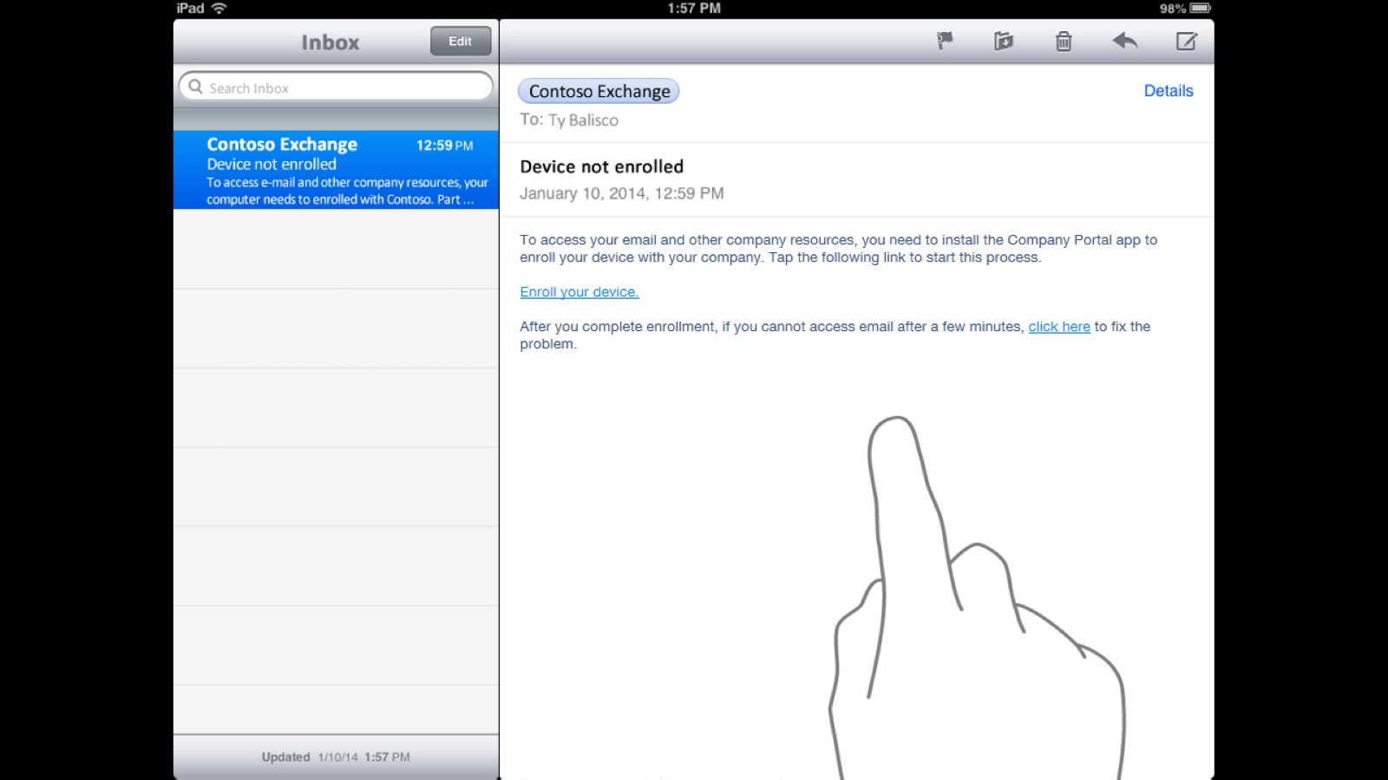

Slide 39
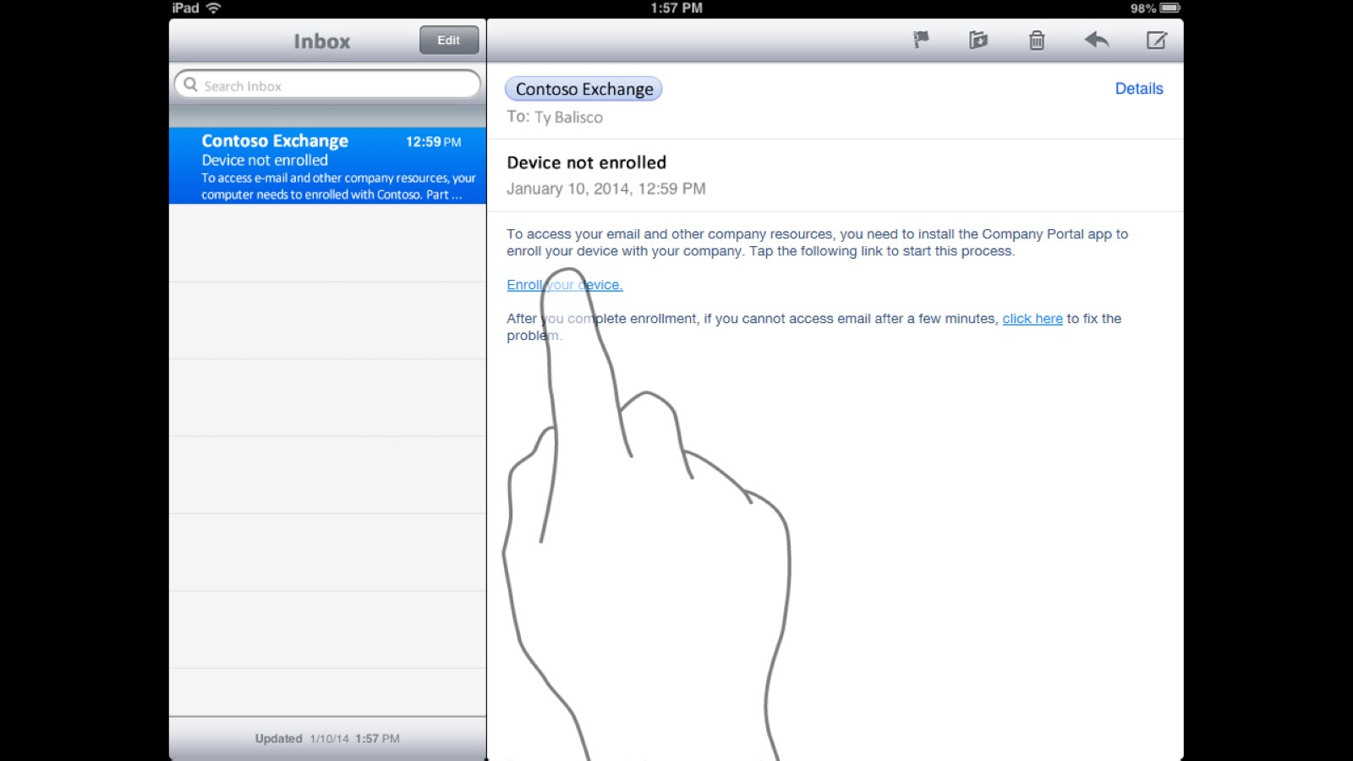

Slide 40
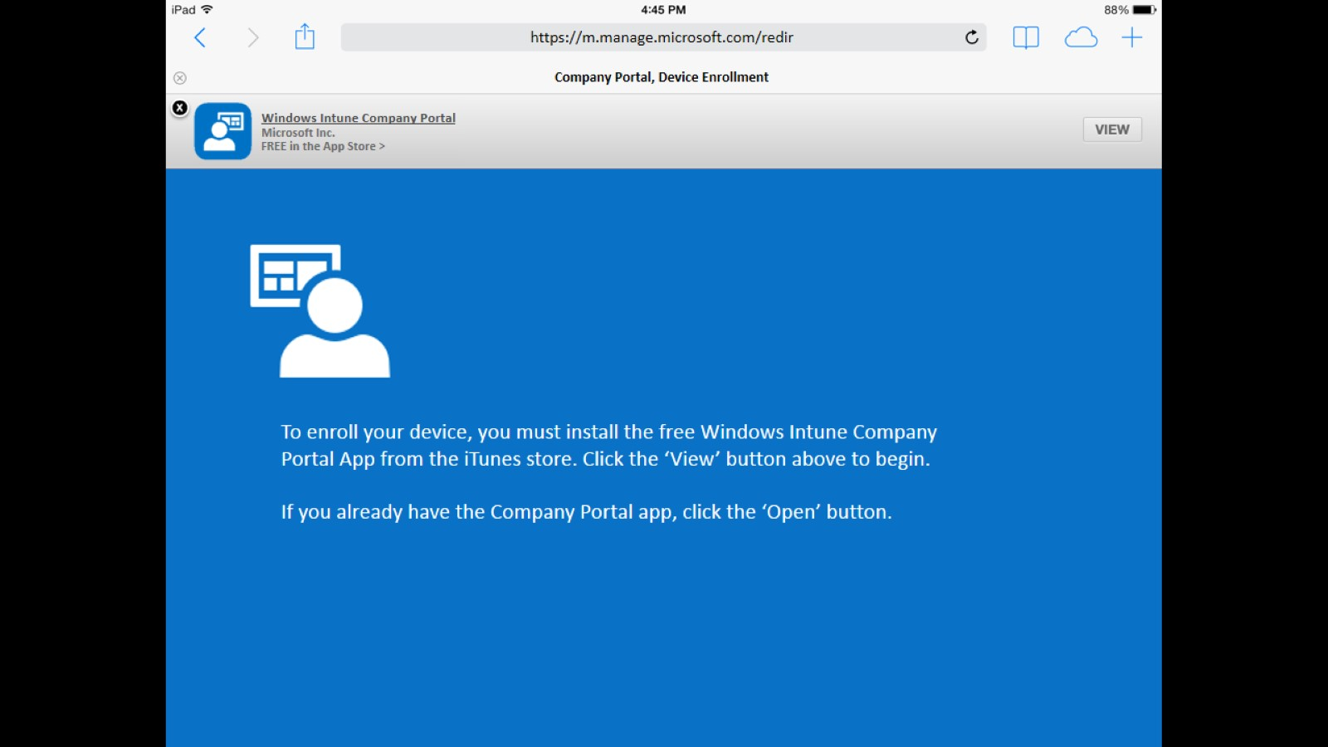

Slide 41
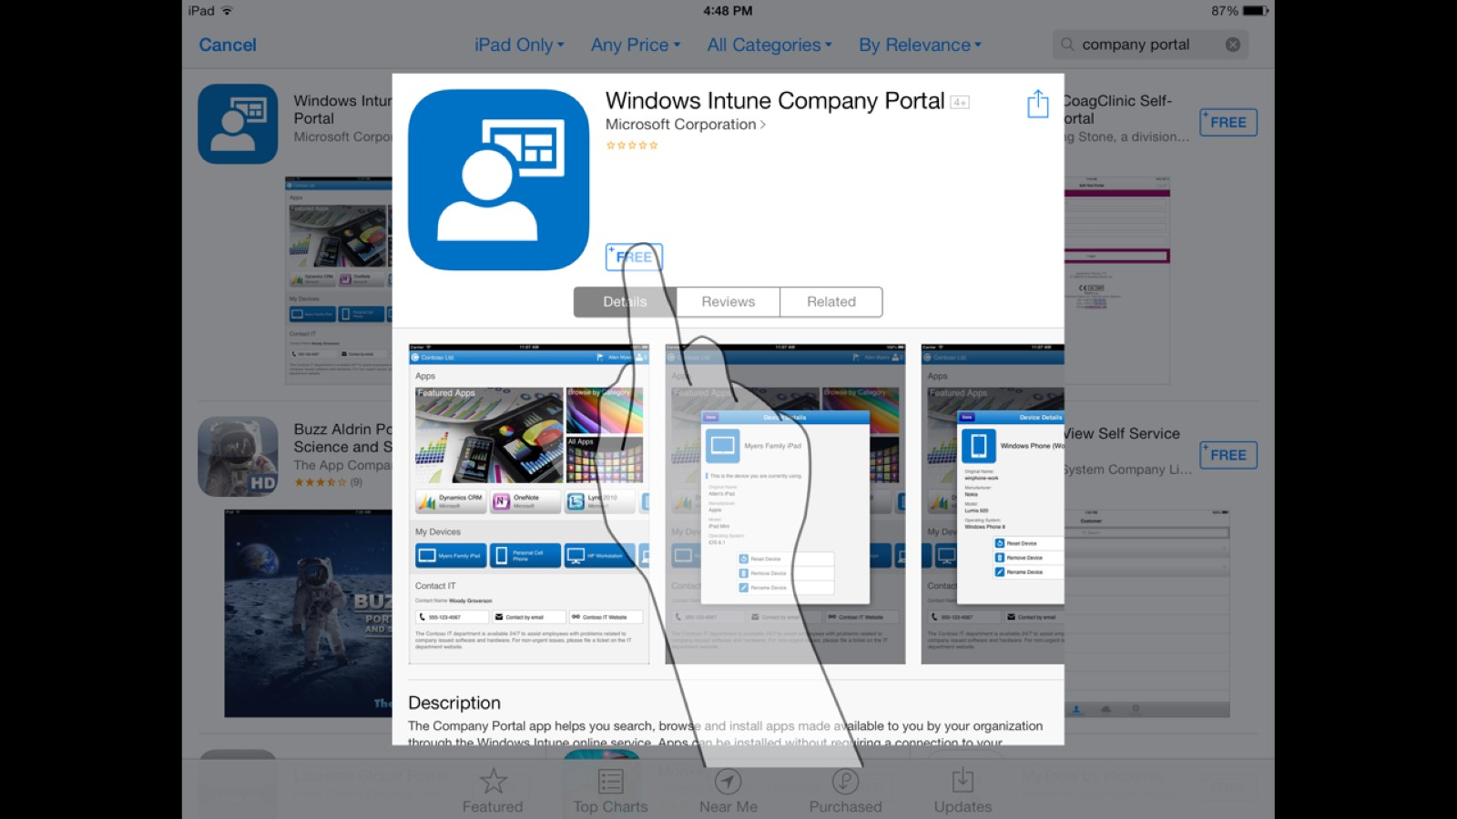

Slide 43
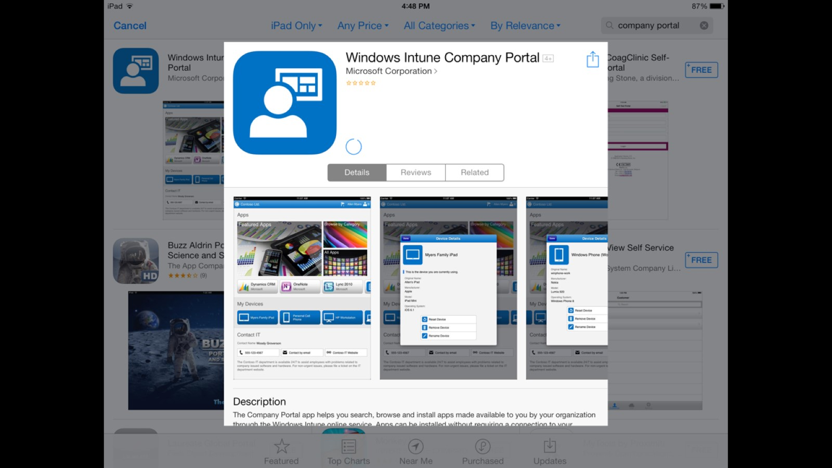

Slide 44
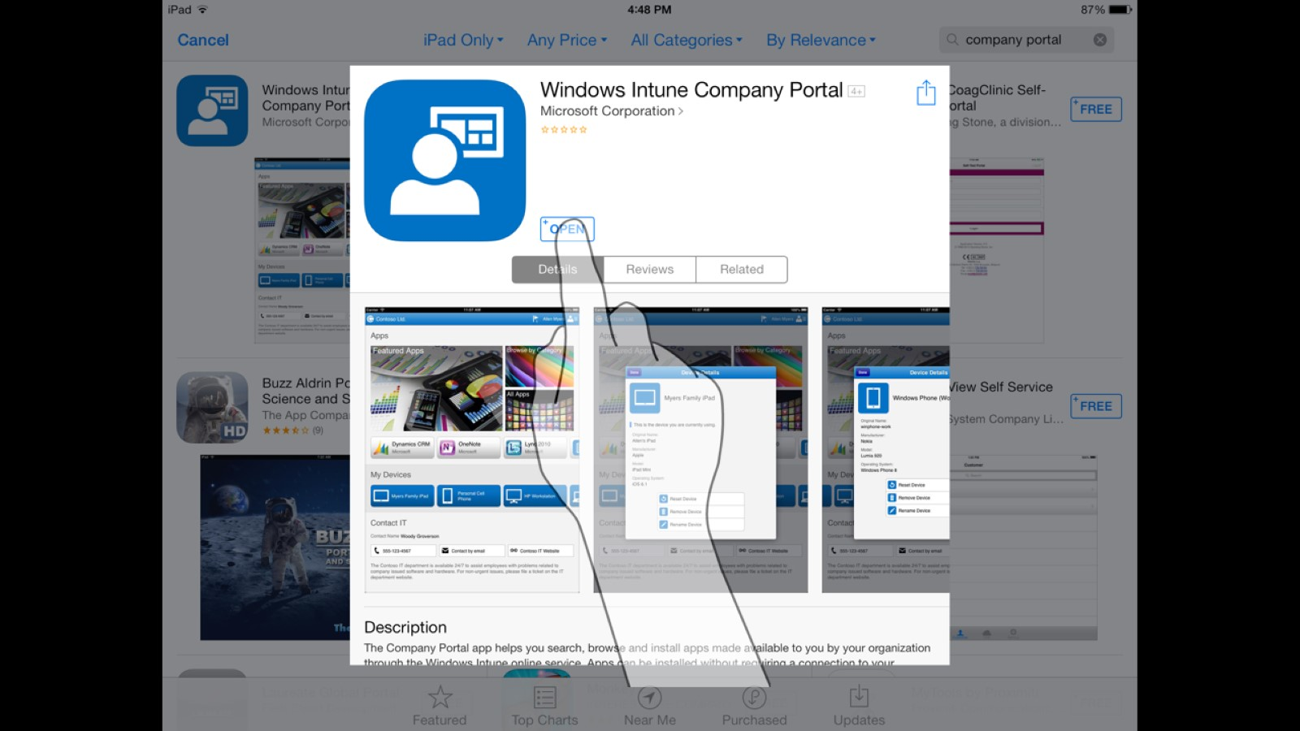

Slide 45
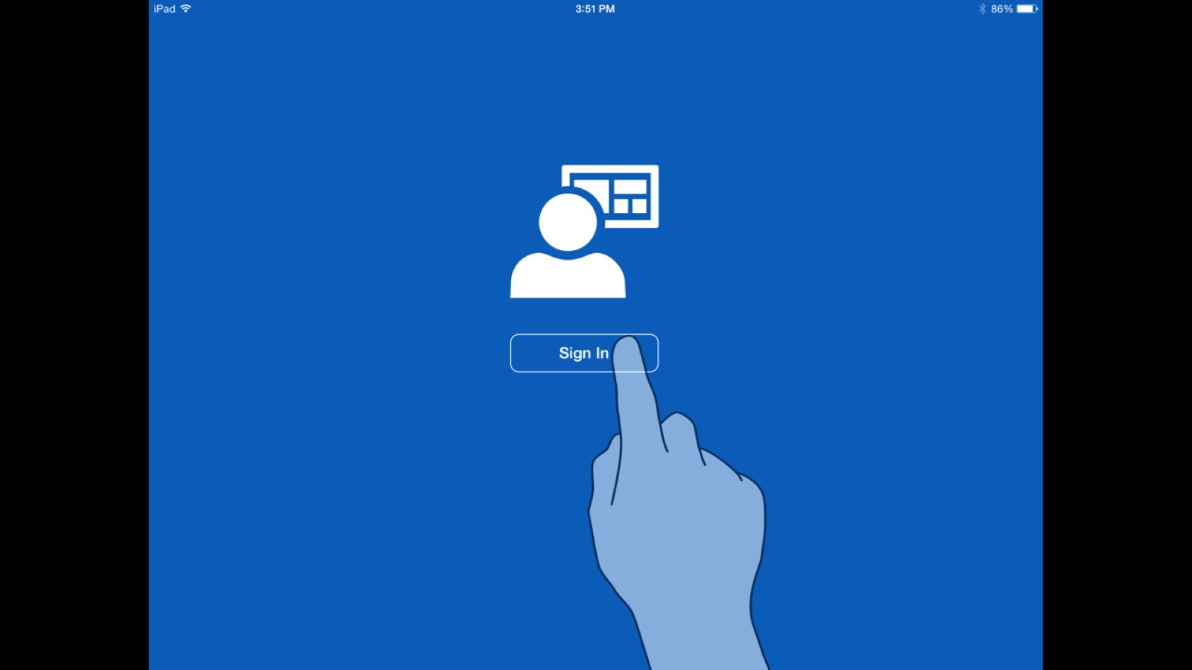

Slide 46
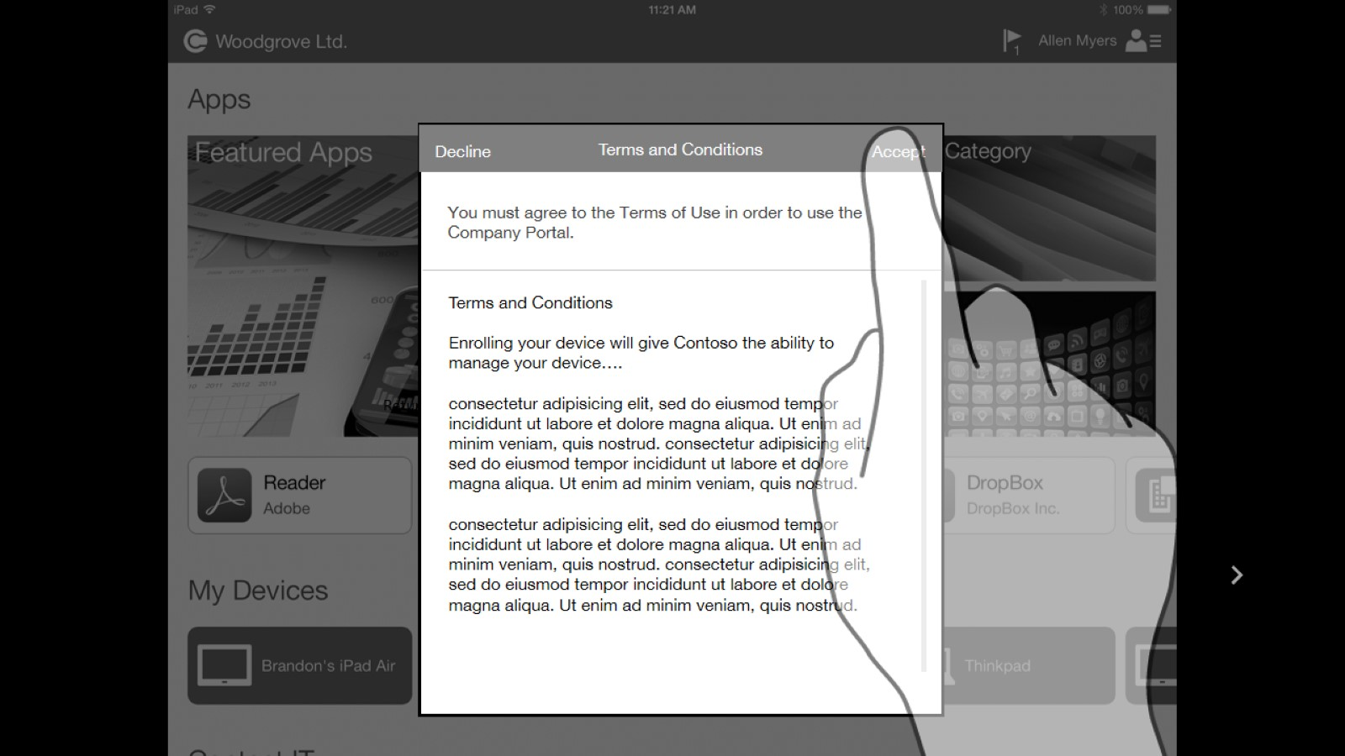

Slide 47
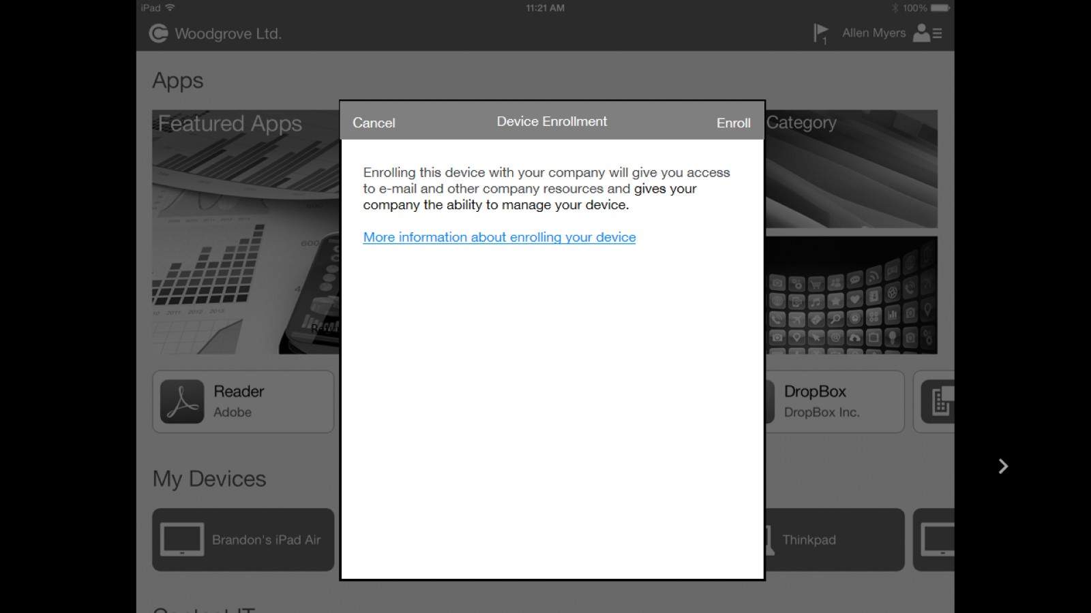

Slide 48
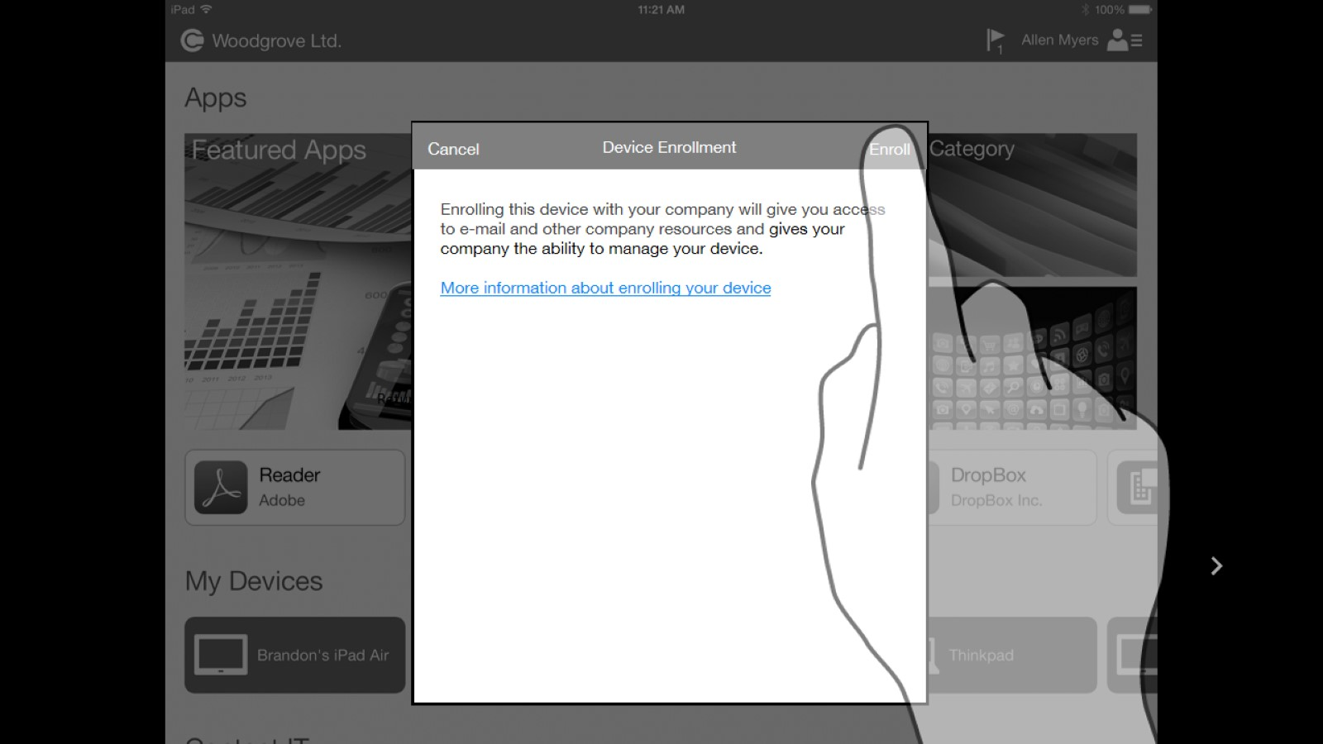

Slide 50
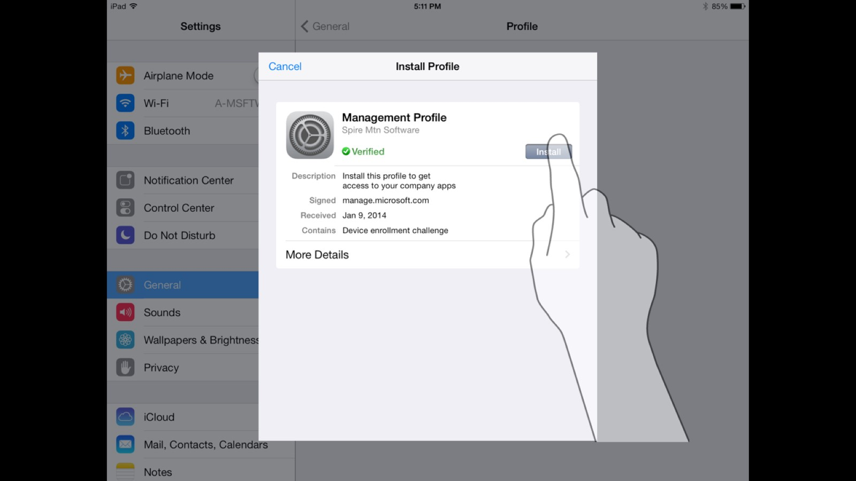

Slide 51
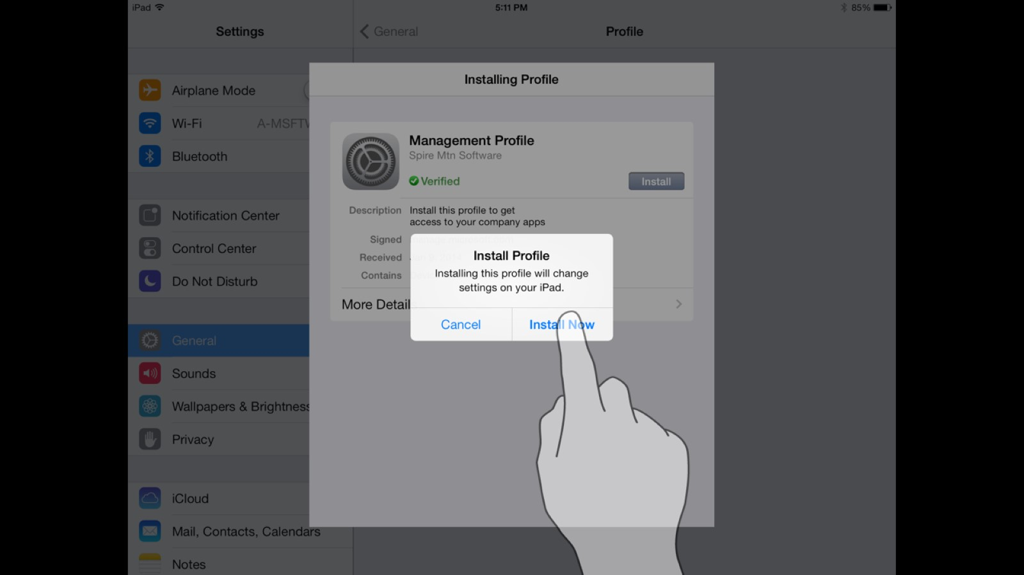

Slide 52
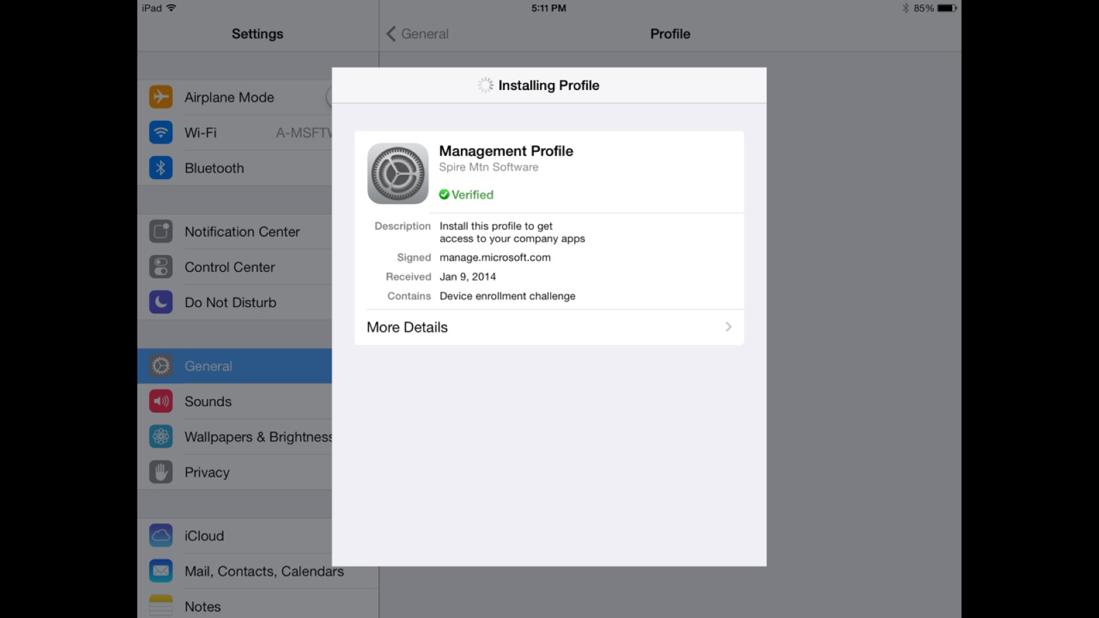

Slide 54
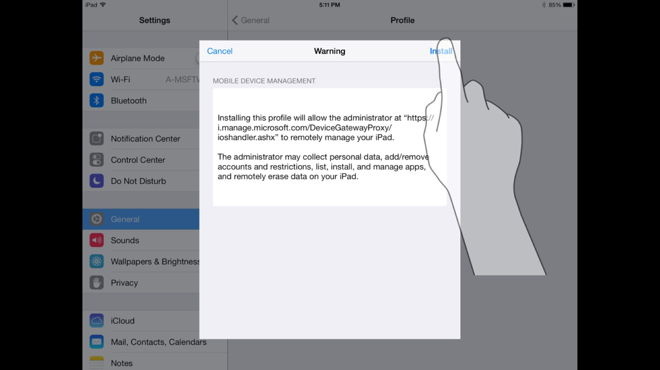

Slide 57
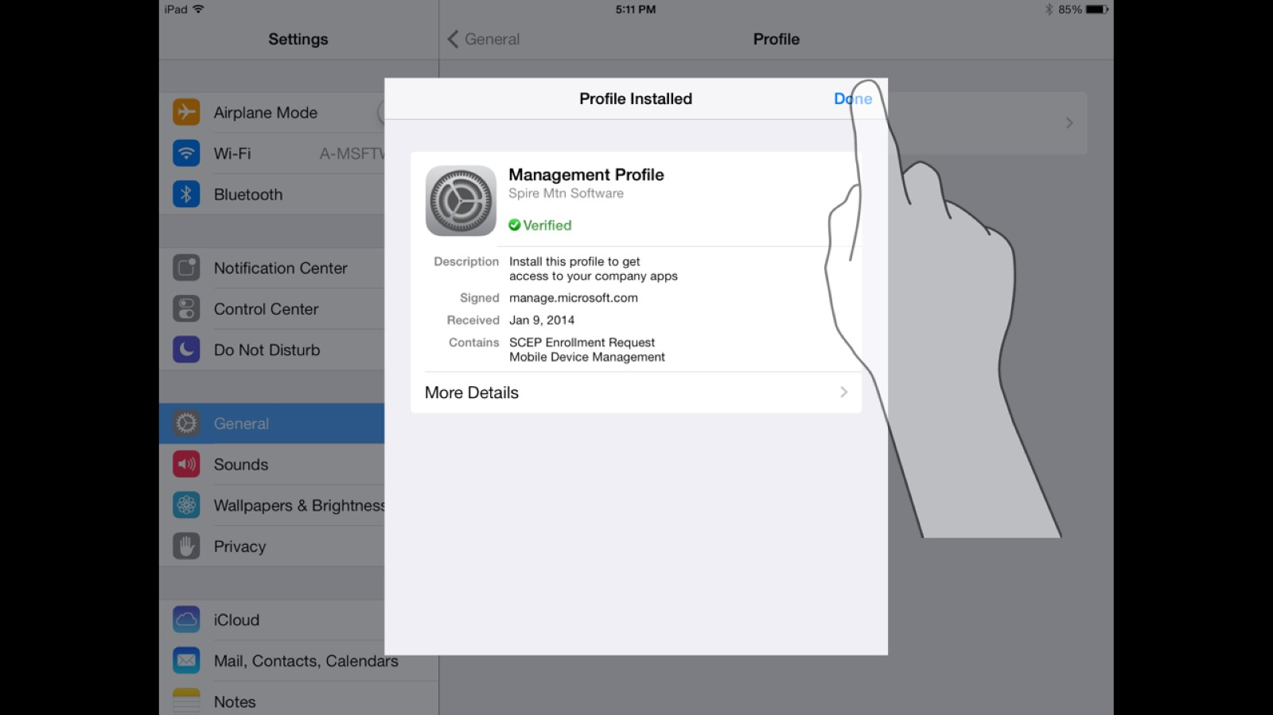

Slide 60
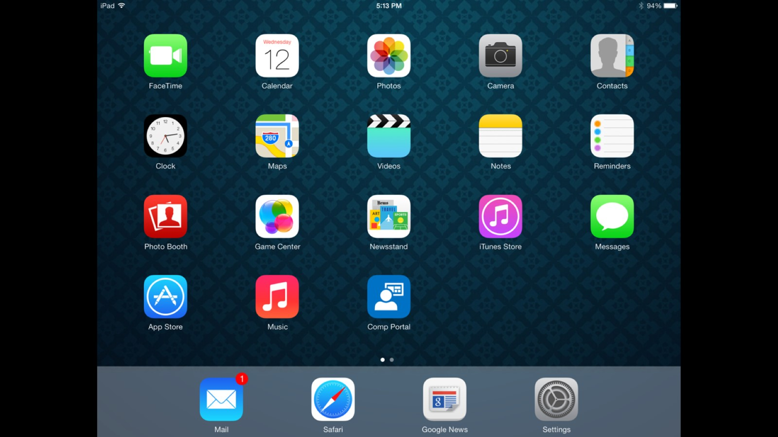

Slide 61
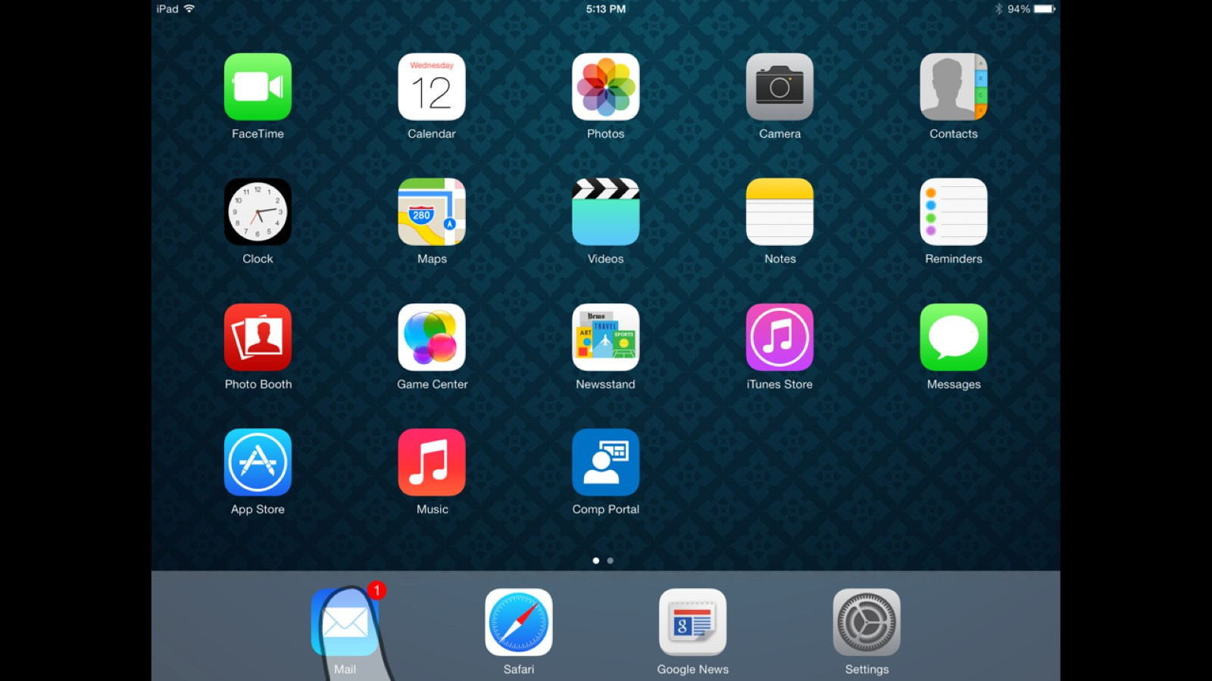

Slide 62
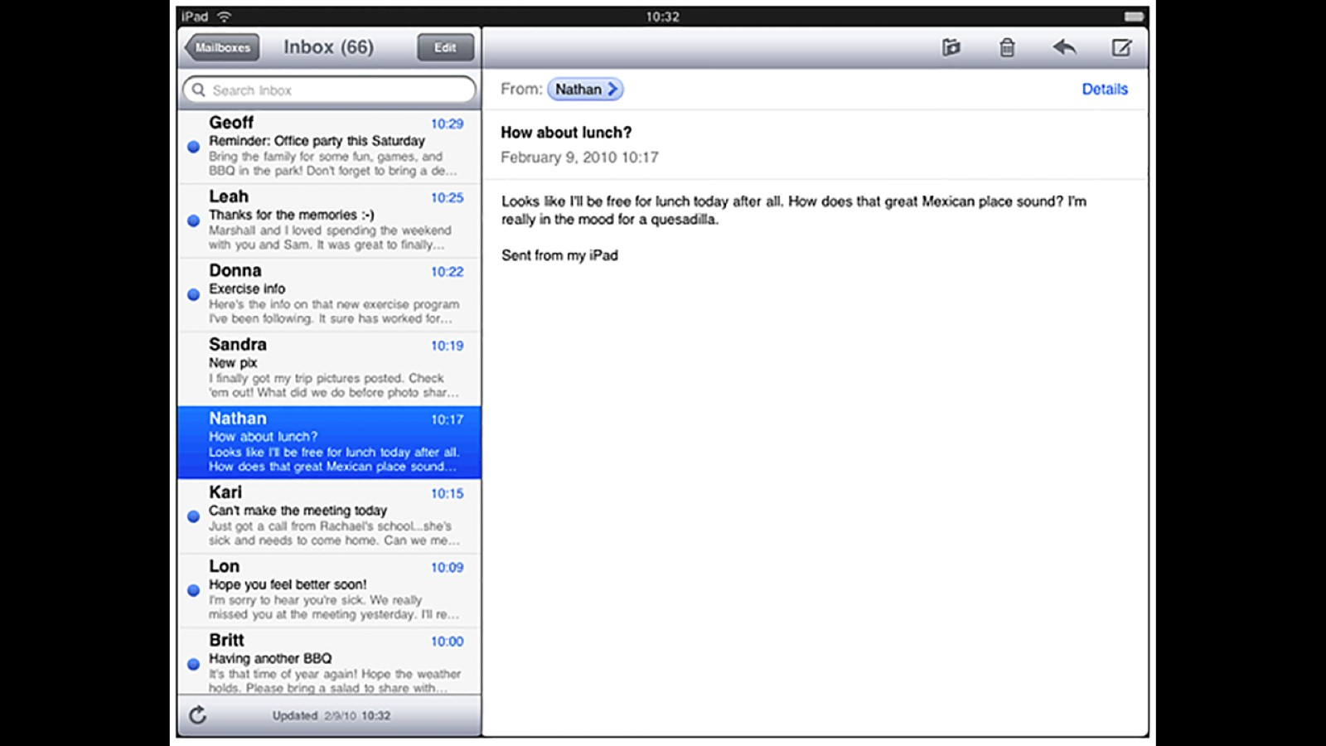

Slide 63
Solution architecture

Slide 64
Solution architecture – Secure email in O365
Azure AD
Is Device Managed & Compliant
2
Office 365 EAS Service
Who does what?
Intune: Evaluate policy compliance for device
Azure AD: Auth user, provide device compliance status
Exchange Online: Enforces access to email based on device state.
Return Device state
3
6
Set device management/ compliance status
If not compliant, Push device into quarantine
4
Intune
Attempt email connection
1
Quarantine
7
If compliant, email access is granted
Quarantine email with remediation steps
Link to enroll device/Compliance Remediation steps
5
Enrollment / Compliance Remediation
EAS Client

Slide 65
Enrollment of Corporate Windows Devices

Slide 66
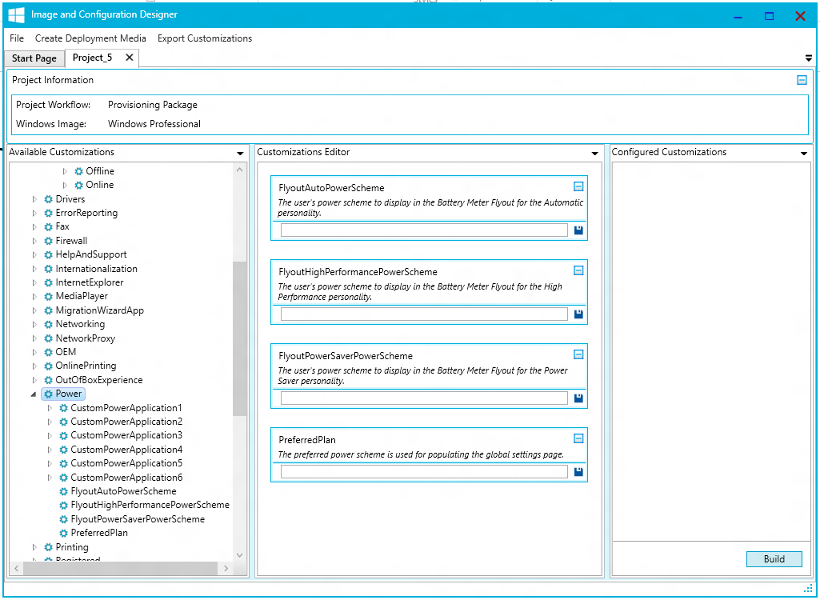
Image and Configuration Designer is used to
Build a customized Mobile or Desktop image
Create a provisioning package that allows to customize Windows devices without re-imaging.
Provisioning Package can be
Consumed from removable media (SD/USB)
Applied through USB tether or NFC tag
Attached to email or downloaded from network
Embedded in the OS image
WHAT can be customized by provisioning package:
First run experience customization
Bulk enrollment into MDM, domain join
SKU upgrade instructions e.g. Core to Enterprise
Application - Store (with VPP), Line of Business, Win32
Enterprise policies - Security restrictions, encryption, update settings
Enterprise profiles - Wi-Fi, VPN, Email
Root, CA and Client Certificates
Offline content – documents, audio/video, pictures
Settings available in unattend.xml before (Desktop only)

Slide 67
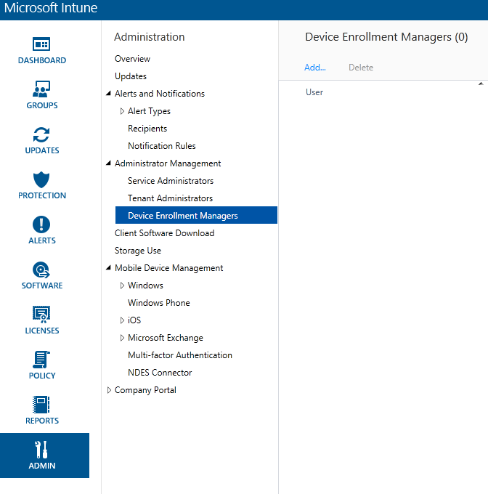
Device Enrollment Manager
New Device Enrollment Manager role in Intune, enroll up to 1000 devices using an AAD service account
Supports mass enrollment under a single account for task worker devices to minimize account and password management overhead
Allows customers to device service account for specific task worker roles (like Sales_Clerk), so all devices associated with that account can be targeted with the same apps and policies
Limits Company Portal so that user of the device can’t wipe or lock all other devices associated with that account

Slide 68
Lockdown: Restricting corporate owned devices

Slide 69
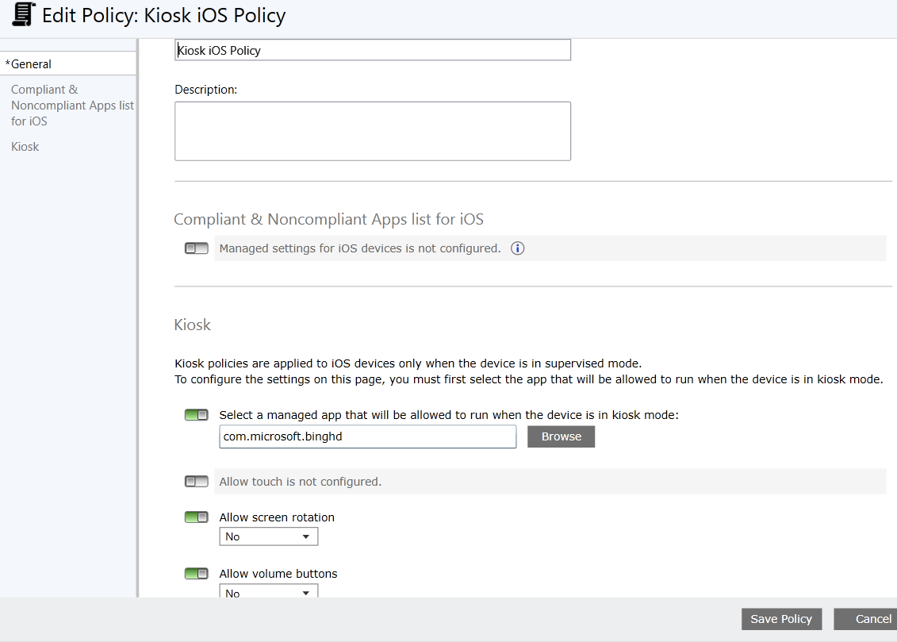
Device lockdown
Kiosk Policy allows IT admin to:
Lockdown to a single managed app
Configure device attributes that can be locked down
End user cannot modify device state
Available on iOS (supervised mode), Android, and Windows Phone 8.1 (through URI)

Slide 70
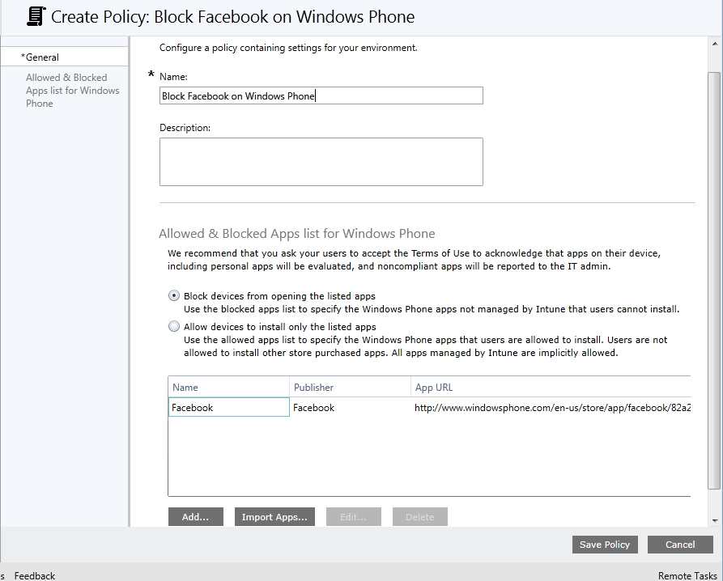
Application Allow and Deny
Block or allow specific applications on Windows Phone 8.1
Report on blocked or allowed applications in iOS and Android

Slide 71
Demo: Corp device lockdown with Intune
Jason Githens

Slide 72
Managing Corp owned Windows 10 devices

Slide 73
Related content
Breakout Sessions
Tuesday, October 28th, 3:15 PM-4:30 PM: EM-B216 - Enterprise Client Management with System Center Configuration Manager and Intune
Tuesday, October 28th, 5:00 PM-6:15 PM: EM-B326 - What’s New and Upcoming with OS Deployment in System Center Configuration Manager and the Microsoft Deployment Toolkit
Wednesday, October 29th, 8:30 AM – 9:45 AM: EM-B321 - Infrastructure Deployment for Mobile Device Management with System Center Configuration Manager and Intune
Wednesday, October 29th, 5:00 PM – 6:15 PM - Securing Mobile Device Access to Corporate Resources with Intune
Thursday, October 28th, 3:15 PM-4:30 PM: EM-B312 - Mobile Application Management with Intune
Friday, October 31st, 8:30 AM – 9:45 AM: EM-B317 - Configuring Corporate-Owned Mobile Devices with Intune

Slide 74
Resources
Learning
Sessions on Demand
Microsoft Certification & Training Resources
http://channel9.msdn.com/Events/TechEd
www.microsoft.com/learning
TechNet
Developer Network
Resources for IT Professionals
http://microsoft.com/technet
http://developer.microsoft.com

Slide 75
Enterprise Mobility Track Resources
Enterprise Mobility Suite http://aka.ms/enterprise mobilitysuite
Microsoft Intune http://aka.ms/microsoftintune
Configuration Manager http://aka.ms/configmgr
Hybrid Identity http://aka.ms/hi
Access & Info Protection http://aka.ms/aip
Desktop Virtualization http://aka.ms/virtualdesktop

Slide 76
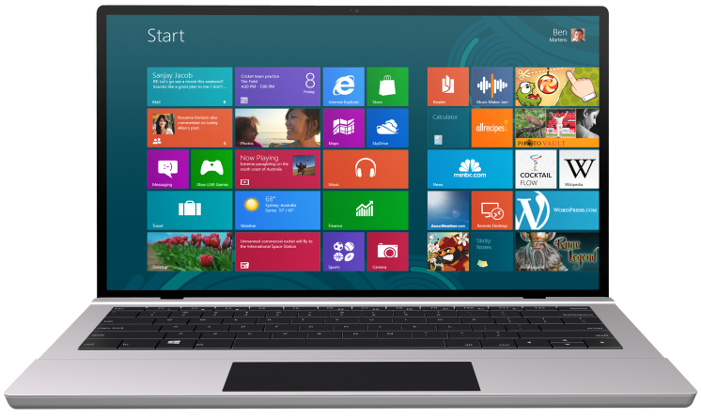
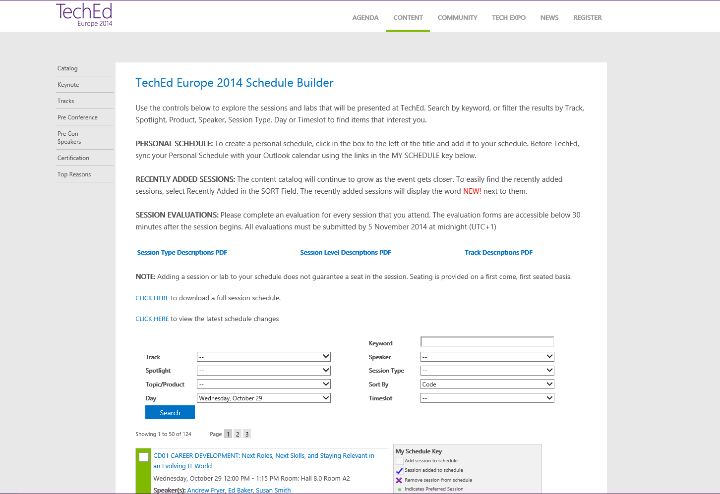
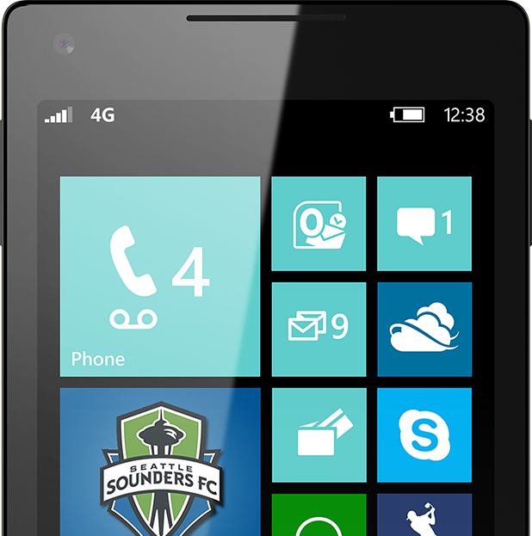
SUBMIT YOUR TECHED EVALUATIONS
We value your feedback!
Fill out an evaluation via
CommNet Station/PC: Schedule Builder
LogIn: europe.msteched.com/catalog
TechEd Mobile app for session evaluations is currently offline

Slide 77
© 2014 Microsoft Corporation. All rights reserved. Microsoft, Windows, and other product names are or may be registered trademarks and/or trademarks in the U.S. and/or other countries.
The information herein is for informational purposes only and represents the current view of Microsoft Corporation as of the date of this presentation. Because Microsoft must respond to changing market conditions, it should not be interpreted to be a commitment on the part of Microsoft, and Microsoft cannot guarantee the accuracy of any information provided after the date of this presentation. MICROSOFT MAKES NO WARRANTIES, EXPRESS, IMPLIED OR STATUTORY, AS TO THE INFORMATION IN THIS PRESENTATION.

