Slide 1


Slide 2

The Microsoft Development Platform:
Create Applications that Span Mobile and Cloud
FDN05
Jay Schmelzer
Director Program Management – Visual Studio
Microsoft Corp.

Slide 3
What we are hearing from you
“Our role is more important than ever before”
“We are required to innovate and deliver much faster”
“I need a cross-platform mobile development strategy”
“I need create applications with global scale”
“…but I have existing applications to run and evolve”

Slide 4





Developers and the new era’s needs
Optimize for Cloud and
Server workloads
Hybrid environments
Development
agility
Optimize for devices
CLOUD-FIRST
Cross-platform mobile
DEVICE-FIRST
AGILE
Core-Business
Applications

Slide 5
Web technologies available today
Standards
based
  Productivity of Visual Studio + Flexibility of the open web
Highly
interactive apps
  Modern technologies and
  modern browsers
Enterprise complexity
  Extend web LOB apps through
  Hybrid-Cloud

Slide 6
Demo
Web Apps development today

Slide 7
Cross-platform mobile development

Slide 8



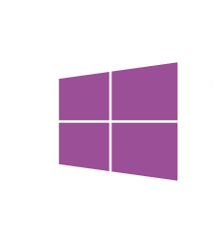
Multi-device approaches
.NET
Desktop apps
Windows Store apps
Rich experiences
Breadth of devices
Multi-device hybrid Apps
Browser-based applications
HTML

Slide 9
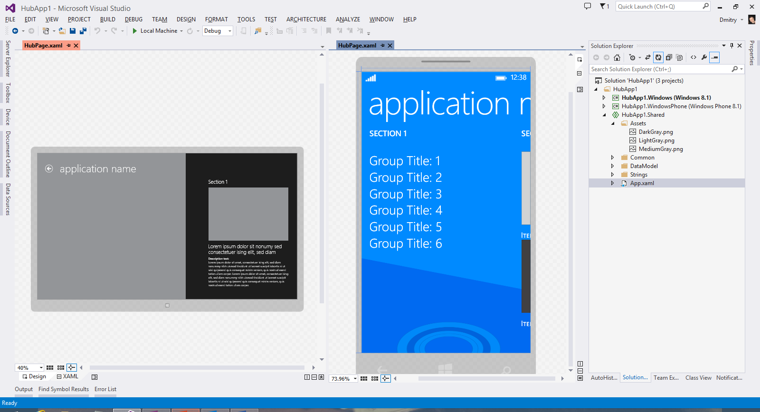

Windows Store Apps
Universal Windows apps
Shared across Windows and Windows Phone 8.1 apps
Visual Studio 2013 Update 3 RTM
http://aka.ms/universalapps
Next Generation Compiler in the Cloud for Store Apps
Uses lean runtime and VC++ optimizer for fast code execution and reduced memory usage
Preview available as VS 2013 add-in
http://aka.ms/dotnetnative
.NET Native
Native code compilation

Slide 10

.NET Native
Next Generation Compiler in the Cloud for Store Apps
Provides converged developer experience for .NET across devices
Uses lean runtime and VC++ optimizer for fast code execution and reduced memory usage
Developer Preview available today
Wordament on .NET Native:
Scenario | Improvement (%)
Cold Startup | 39.32%
Warm Startup | 31.21%
Memory Usage | 12.68%

Slide 11
.NET Native
Native runtime and compiler for .NET
  Runtime
  Lean and refactored .NET libraries and runtime
Compiler
  Powered by the same optimizing compiler backend as Visual C++
8 key benefits
Productivity of C#
  Convergence enables consistent .NET experience across all devices
Performance of C++
  Native code generated in Cloud to optimize for device arch/OS/form factor
  1st class developer experience in Visual Studio (edit/compile/debug)
  Faster app startup time
  Simple packaging, deployment and servicing (self-contained package)
  Reduced app memory usage
  Integrated with Store to enable Cloud Compilation
  Faster code execution due to advanced optimizations (using VC++ optimizer)
Available for x64, ARM (x86 is coming)
V1 is targeted at Store apps

Slide 12
Demo
Universal Windows apps
and
.NET Native

Slide 13


.NET in Android, iOS devices
Native mobile apps
Full access to device features
High flexibility and customization per device
Best UX and performance in devices
Native UI
Native UI
Native UI
C# + XIB
C# + AXML
C# + XAML
Xamarin
Shared
client app C# logic
Microsoft and Xamarin technical and business partnership
Visual Studio and C# capabilities fully available
Share app logic code across device platforms
100% APIs exposed, everything you can do in xCode, ADT you can do it with .NET

Slide 14
Demo
Native cross-platform mobile development
Xamarin demo

Slide 15

Cordova tooling in
Visual Studio
CSS | HTML
JavaScript | TypeScript
Hybrid-HTML apps
Natural path for web developers targeting devices
Shortest path for cross-platform mobile
New Cordova tooling in Visual Studio
Black Box
“Multi-Device Hybrid Apps for Visual Studio – CTP” available today
Productivity of Visual Studio for hybrid apps
Flexibility to use any JavaScript framework
Scale to complex Enterprise apps through optional TypeScript support
End-to-end development workflow included

Slide 16
Demo
Hybrid cross-device mobile development
Visual Studio Tooling for Apache Cordova

Slide 17
Connecting to O365 API

Slide 18
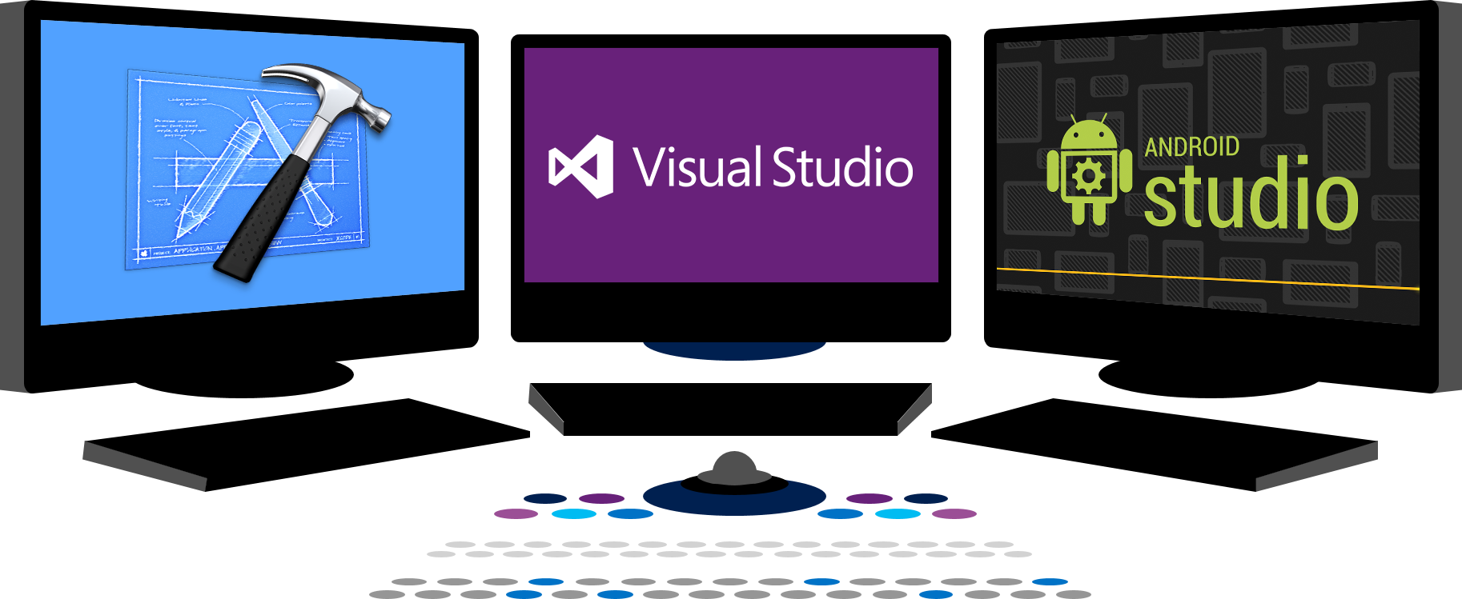


Today
EXTEND OFFICE
EVERYWHERE
CONNECT TO
OFFICE 365 SERVICES
BUILD USING
AN OPEN PLATFORM
Users and
groups

Slide 19


What’s New
EXTEND OFFICE
EVERYWHERE
CONNECT TO
OFFICE 365 SERVICES
BUILD USING
AN OPEN PLATFORM
Users and
groups
Files
My Apps
z
Users and
groups
Mail
Calendar
Contacts

Slide 20
Demo
Connecting to O365 APIs
Jeremy Thake
@jthake

Slide 21










Vision
EXTEND OFFICE
EVERYWHERE
CONNECT TO
OFFICE 365 SERVICES
BUILD USING
AN OPEN PLATFORM
Delve
Users and
groups
Files
Mail
Calendar
Users and
groups
Files
My Apps
z
Video Portal
Contacts
Office Graph
Presentations
Documents
Mail
Calendar
Contacts
Spreadsheets
Lync
OneNote
Yammer

Slide 22




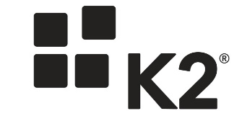




Office 365 Launch Partners

Slide 23
Future of Web development

Slide 24


Future of .NET
.NETvNext
Openness
Client apps
Web and services
  Windows Store, WPF, Windows Forms,
  Console apps and related libraries.
  ASP.NET vNext: Web Forms, MVC, Web Pages, Web API, SignalR
  WCF
Multi-purpose
  Device optimized
  Native compilation
  Small footprint, side-by-side
  Cross-device enabled
  Cloud optimized
  High throughput
  Small footprint, side-by-side
  Cross-platform enabled
Specialized
Common
  Runtime
  Compilers
  Libraries
  Next gen JIT (“RyuJIT”)
  SIMD (Data Parallelization)
  .NET Compiler Platform (“Roslyn”)
  Languages innovation
  BCL and PCL
  Entity Framework

Slide 25


ASP.NET vNext and the Modern Web
Totally Modular
Faster Development Cycle
Seamless transition
from on-premises to cloud
Choose your Editors
and Tools
Open Source
with Contributions
OSS
Cross-Platform
Fast

Slide 26
Demo
ASP.NET vNext

Slide 27
ASP.NET vNext - Summary
MVC, Web API, Web Pages 6, SignalR 3, EF 7
Feature | .NET vNext | .NET vNext (Core)
Cloud Ready | * | *
Modular Design | * | *
Dependency Injection | * | *
Consistent Tracing / Debugging | * | *
Faster Development (No Build Step) | * | *
Open Source | * | *
Full Side by Side (framework deployed inside application) |  | *
Fast startup, Low memory / High throughput (best of class) |  | *

Slide 28



Summary
Providing the best end-to-end development experience…
…on your terms
Platform
Framework
Tools
…or bring your own
…or bring your own
…or bring your own

Slide 29
Related content
Microsoft Azure and .NET Development (many)
Office 365 APIs
  DEV-B207 Office 365 Developer Kick-off
Multi-Device Apps for Visual Studio
  DEV-B217 Go Mobile with C#, Visual Studio, and Xamarin
  DEV-B321 Building Multi-Device Apps with Visual Studio Tools for Apache Cordova
ASP.NET vNext
  DEV-B344 The Future of .NET on the Server

Slide 30
DEV Track Resources
http://www.visualstudio.com
http://blogs.msdn.com/b/developer-tools/
http://msdn.microsoft.com/vstudio
visualstudio
@visualstudio
visualstudio

Slide 31

Resources
Learning
  Sessions on Demand
  Microsoft Certification & Training Resources
http://channel9.msdn.com/Events/TechEd
www.microsoft.com/learning
TechNet
Developer Network
  Resources for IT Professionals
http://microsoft.com/technet
http://developer.microsoft.com

Slide 32



Please Complete An Evaluation Form
Your input is important!
TechEd Schedule Builder
CommNet station or PC
TechEd Mobile app
Phone or Tablet
QR code

Slide 33
Evaluate this session

Slide 34


© 2014 Microsoft Corporation. All rights reserved. Microsoft, Windows, and other product names are or may be registered trademarks and/or trademarks in the U.S. and/or other countries.
The information herein is for informational purposes only and represents the current view of Microsoft Corporation as of the date of this presentation. Because Microsoft must respond to changing market conditions, it should not be interpreted to be a commitment on the part of Microsoft, and Microsoft cannot guarantee the accuracy of any information provided after the date of this presentation. MICROSOFT MAKES NO WARRANTIES, EXPRESS, IMPLIED OR STATUTORY, AS TO THE INFORMATION IN THIS PRESENTATION.

