Slide 1


Slide 2

Simplifying the Office 365 IT Experience for Admins and Partners
OFC-B210
Lawrence Chiu, Sr. Product Marketing Manager
Ivan Fioravanti, CTO at 4ward

Slide 3
Agenda
Office 365 Admin Tools
  Office 365 Admin Center
  Office 365 Service Communications API
  Office 365 Management Pack for System Center 2012 R2
  Office 365 Admin App
  Partner: 4ward365
Office 365 Partner Admin Center
PowerShell for Office 365

Slide 4
Tools for Administering Office 365

Slide 5
Administering Office 365
Office 365 Admin Center
APIs and PowerShell
Office 365 Admin App
“Out-of-the-box” solution
Easy to use but extensible
Enable an ecosystem
Access to advanced functions
“On-the-go” solution
Tools for administering Office 365

Slide 6
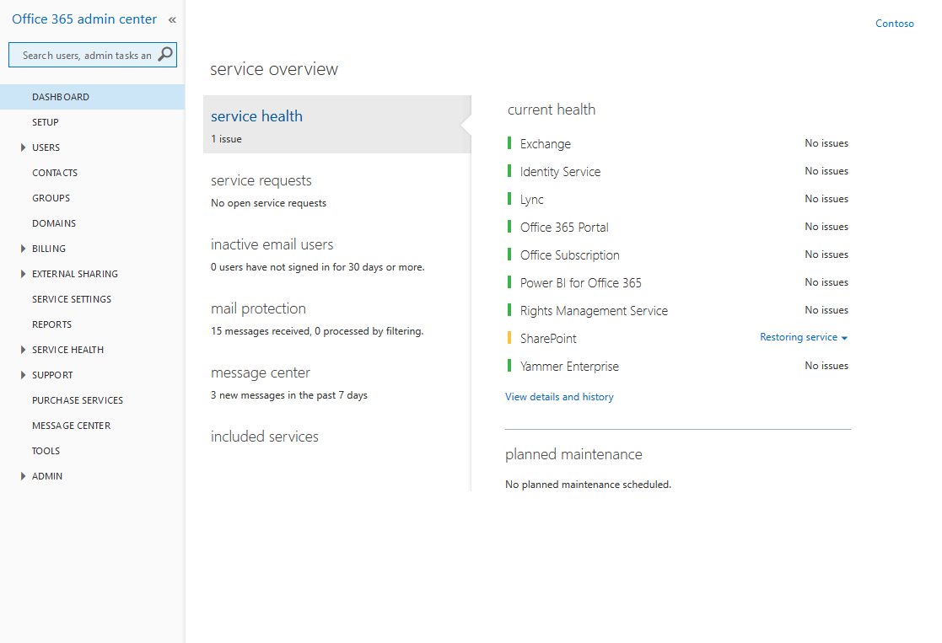
Office 365 Admin Center
Place to go to setup and administer your Office 365 service.
Management services include:
Users
Groups
Service settings
Licenses
Domains
Monitoring services include:
Service health
Service communications

Slide 7
“Simplicity is the ultimate sophistication.”
Leonardo da Vinci

Slide 8
Simplification journey
Simplified new user creation
Auto license assignment
Admin dashboard for Business Plans
More detailed user profile detail panel
Unified O365 Admin Center navigation
App-launcher top nav bar
Manual password assignment
Updated groups management
Simplified user management
Updated Message Center
External sharing
Proactive DNS records check
Cross suite top nav bar
Simplified domain setup
March 2014
gTLDs supported
Brower and OS Reports
Custom themes
Lync Device usage reports
User details to Exchange reports

Slide 9
Demo
Office 365 Admin Center

Slide 10
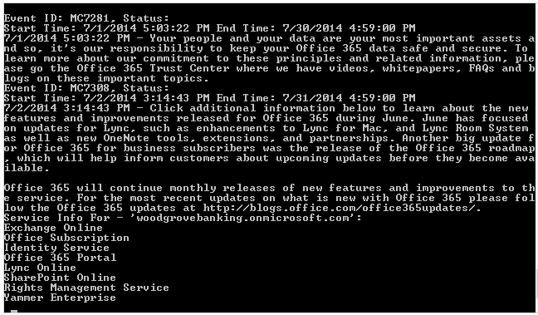
Service Communications API
Enables you access to Office 365 service communications where and how you want it.
Admins can monitor the following on their domains or on behalf of their customers (partners) :
Real-time service health
Message Center communications
Planned maintenance notifications

Slide 11
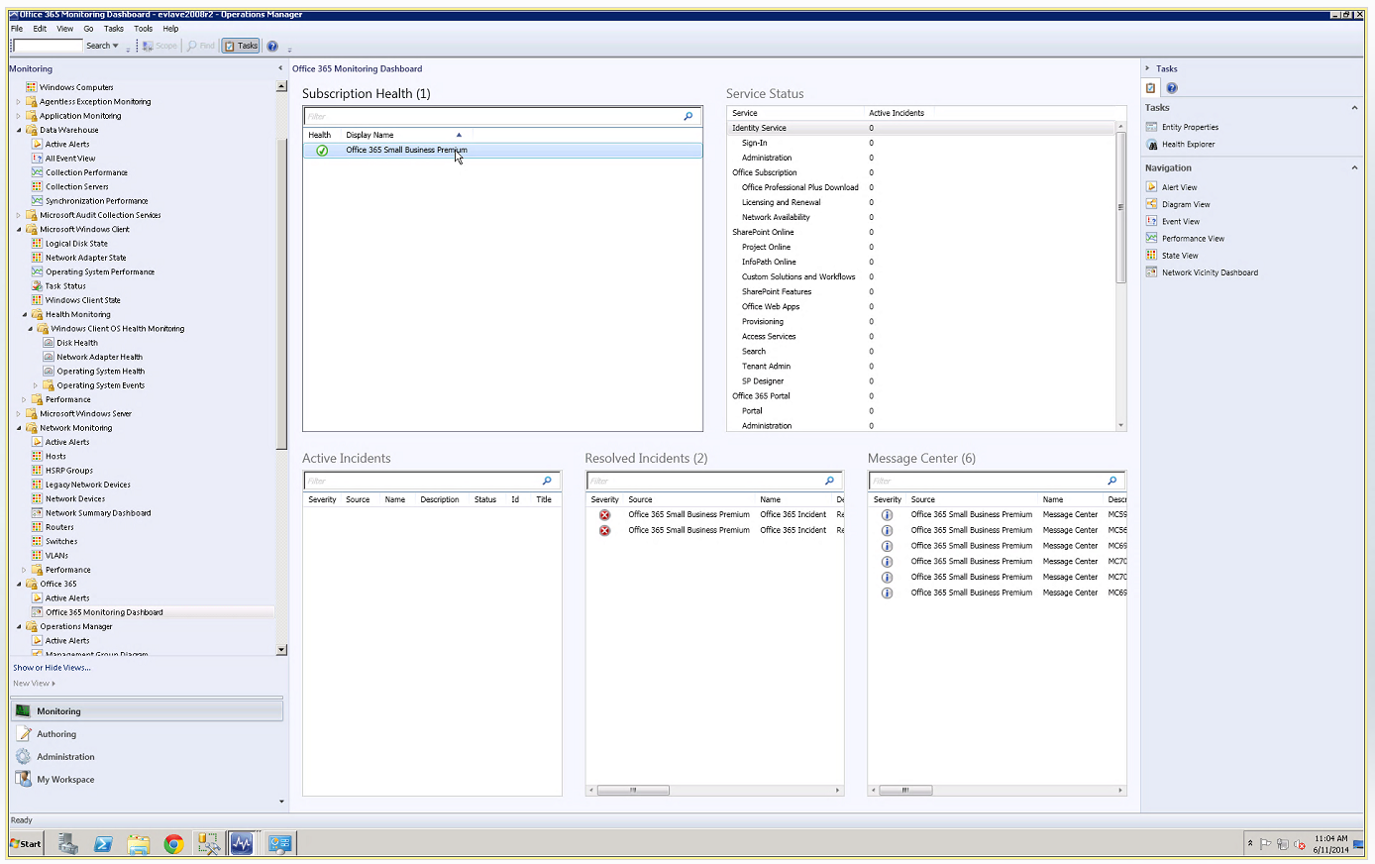
Office 365 Management Pack
Office 365 management pack will have the capability to monitor the following Office 365 service communications within System Center
Subscription health
Service status
Active/resolved incidents
Message Center communications

Slide 12
Demo
Office 365 Management Pack

Slide 13
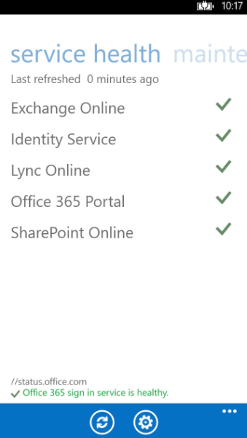
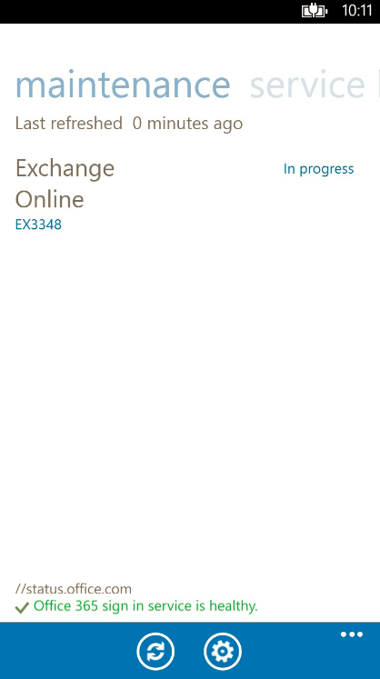
Office 365 Admin App
App supports:
Service Health Dashboard
Planned Maintenance
Supported platforms:
Windows Phone, iOS and Android

Slide 14

Ivan Fioravanti
CTO

Slide 15
What?
Multi tenant
  Aggregated reports
Reporting
  More than 60 reports
Management
  Without PowerShell
Delegation
  Filter visibility on your Office 365
www.4ward365.com

Slide 16
How?
Powered by Azure
  Multi region (US, EU, APAC)
  Shared or dedicated environment
SaaS
  No installation and maintenance needed on your side
  Up and running in few minutes
Collect information from Office 365
  PowerShell, API, Reporting
As fast as possible (web based)

Slide 17
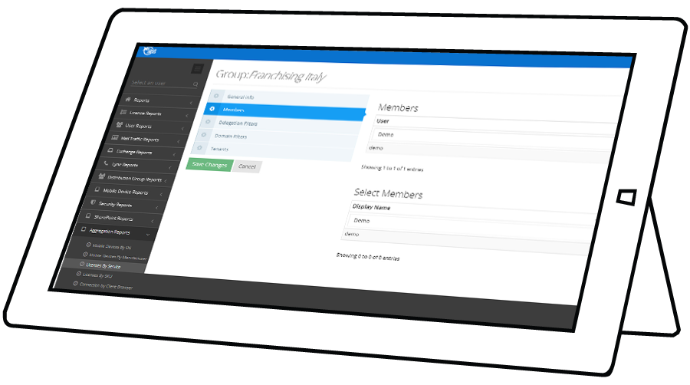
Where?
Online (http://www.4ward365.com/signup)
Available worldwide
Through distributors and resellers
Visit us at Booth #6

Slide 18
Demo

Slide 19
Coming soon
API layer
  Build your solutions on top of it
Agent On Premises
  Same experience everywhere
Offline Reporting and Analysis with Excel
  Bring your data with you
Rules engine
  “If this than that” on your Office 365

Slide 20
Partner Admin Center

Slide 21


Investing in the Partner admin experience
Features focus on making it easier and faster to view and administer customers.
Customer Acquisition
Customer Visibility
Customer Administration
Create trial & purchase offers
Provision new customers
Send delegated admin requests
Service heath information
View service requests
List of your customers
Search, sort and filter customers
Admin-on-behalf-of
Capabilities and tools to help Partners own the customer lifecycle

Slide 22
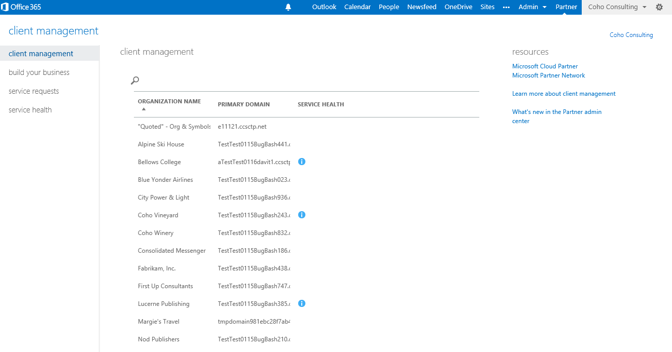
Office 365 Partner Admin Center
Tools to help Partners own the customer lifecycle
Features focus on make it easier and faster to view & administer customers
Available to MPN network members with signed MOSPA
Partners to sign into the Office 354 tenant to access the partner features
Partner Admin Center features
View customer list on single pane
Service health dashboard for a customer
Service requests for a customer
Search for customers
Perform delegated admin tasks
Create trial invitations
Create purchase offers
Create delegated admin requests

Slide 23
Demo
Office 365 Partner Admin Center

Slide 24
Office 365 PowerShell

Slide 25
What is it?
Task-based command-line shell and scripting language
Designed for system administration to help IT professionals and power users administer Windows Operating System and applications such as Office 365
PowerShell commands are called cmdlets
Manage them from the command-line interface

Slide 26
Why?
Bulk editing
Filtering data
Saving data
More functionality

Slide 27
Background
Tools
Windows PowerShell ISE (run as administrator)
Syntax
Get-MsolUser
Verb
Noun

Slide 28

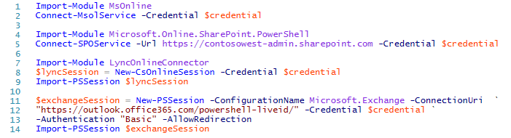
Getting started
Sign into your tenant
Import modules to control Office 365 from PowerShell
Azure Active Directory Module aka MSOnline
SharePoint Online Management Shell
Windows PowerShell Module for Lync Online
Exchange

Slide 29
Check
Useful commands to get information on your tenant.
Cmdlet | Description
Get-MsolDomain | Lists all the domains in your tenant
Get-MsolUser | Lists all the users and if their license status in your tenant
Get-SPOSite | Lists all the SPO sites in your tenant
Get-MsolAccountSku | Lists all the Office 365 business plans that you have available

Slide 30
Bulk editing
Scenario: I want to import a user list for my CSV files
Import-Csv c:\1_Demo\Demo_Users.csv | ForEach-Object { New-MsolUser -UserPrincipalName $_.UserPrincipalName -FirstName $_.FirstName -LastName $_.LastName -DisplayName $_.DisplayName -Title $_.Title -Department $_.Department -Office $_.Office -PhoneNumber $_.PhoneNumber -StreetAddress $_.StreetAddress -City $_.City -State $_.State -PostalCode $_.PostalCode -Country $_.Country -LicenseAssignment $_.LicenseAssignment -UsageLocation $_.UsageLocation -Password $_.PassWord } | Export-Csv c:\1_Demo\LogNewAssignments.csv
Cmdlet | Description
Import-Csv | Reads the data from a comma-separated values file (CSV) and then displays in tabular form
ForEach–Object | Provides a loop to perform an action on each item in a collection.
Export-Csv | Exports data into a CSV file

Slide 31
Filtering data
Scenario: I want a multi-filtered list of my users.
Cmdlet | Description
Get-MsolUser | Lists all the users in your tenant
Get-MsolUser | Select-Object DisplayName, Title | Lists all the users in your tenants with their Display Name and title in tabular form
Get-MsolUser | Get-Member | Out-GridView | Lists all the attributes associated with the user list
Get-MsolUser | Where-Object { $_.Department –eq “Legal”} | Lists all the users in the “Legal” department
Get-MsolUser | Where-Object { $_.Department –eq “Legal” –and $_.Title –eq “Director”} | Lists all the users in the “Legal” department who have the title “Director”
Get-MsolUser | Where-Object { $_.Department –eq “Legal” –and $_.Title –eq “Director” –or $_.Title -eq “Attorney” } | Lists all the users in the “Legal” department who have the title “Director” or “Attorney”

Slide 32
Saving data
Scenario: I want to export a user list
Get-MsolUser | Select-Object UserPrincipalName, FirstName, LastName, DisplayName, Title, Department, Office, PhoneNumber, StreetAddress, City, State, PostalCode, Country, LicenseAssignment, UsageLocation, Password | Export-Csv C:\1_Demo\contosowest_users.csv -NoTypeInformation
Cmdlet | Description
Select-Object | Provides a loop to perform an action on each item in a collection.
Export-Csv | Exports data into a CSV file
-NoTypeInformation | Omits the type information from the CSV file which is there. By default, the first line of the CSV file contains "#TYPE " followed by the fully-qualified name of the type of the object

Slide 33
More functionality
PowerShell enables access to more advanced settings that are not available in the admin center.
Cmdlet | Description
Set-CsMeetingConfiguration -AdmitAnonymousUsersByDefault $False -AllowConferenceRecording $False -DesignateAsPresenter "None" | Disabled the following: Anonymous users to gain automatic entrance to the meeting Attendees to record the meeting All users from your organization to be designated as presenters when they join the meeting
Set-CsMeetingConfiguration -AdmitAnonymousUsersByDefault $True -AllowConferenceRecording $True -DesignateAsPresenter "Company" | Enables the above.

Slide 34
End session
Closing the PowerShell window may leave your remote connections remain active for the next 15 minutes or so.
Closing your remote sessions properly will ensure that you have the maximum number of connections available for you tenant.
Cmdlet | Description
Get-PSSession | Lists the number of remote sessions that you have active.
Remove-PSSession $lyncSession | Closes the Lync remote session.
Remove-PSSession $exchangeSession | Closes the Exchange remote session.
Get-PSSession | Remove-PSSession | Closes all remote sessions at the same time.
Disconnect-SPOService | Closes the SharePoint Online session.

Slide 35
PowerShell Resources
Garage Series PowerShell Basics
  Part 1: http://blogs.office.com/2014/10/15/garage-series-office-365-powershell-basics-space-race/
  Part 2: http://blogs.office.com/2014/10/22/garage-series-office-365-crash-course-powershell-managing-office-365/
Manage Office 365 with Windows PowerShell
  http://technet.microsoft.com/en-us/library/dn568031.aspx
License Office 365 users with Windows PowerShell
  http://technet.microsoft.com/en-us/library/dn530773.aspx
Windows PowerShell cmdlets for Office 365
  http://technet.microsoft.com/en-us/library/hh974317.aspx

Slide 36
Tools for administration
Office 365 Admin Center
Office 365 Admin App
Office 365 Partner Admin Center
PowerShell for Office 365
Office 365 Service Communications API

Slide 37
More to come…
Simplicity
Contextual
Extensible
Easy-to-use tools
Intuitive access to advanced features
Meet the diverse needs
Mobile solutions
Build more enablers
Empower partners
Innovate

Slide 38
Office 365 Resources
Office Blogs
  http://blogs.office.com/
Office 365 Roadmap
  http://office.microsoft.com/en-us/products/office-365-roadmap-FX104343353.aspx
Office 365 Technical Network
  https://www.yammer.com/itpronetwork
Office Dev Center
  http://dev.office.com/

Slide 39
Technical Network
Join the conversation!
Share tips and best practices
with other Office 365 experts
http://aka.ms/o365technetwork

Slide 40

Resources
Learning
  Sessions on Demand
  Microsoft Certification & Training Resources
http://channel9.msdn.com/Events/TechEd
www.microsoft.com/learning
TechNet
Developer Network
  Resources for IT Professionals
http://microsoft.com/technet
http://developer.microsoft.com

Slide 41


Office 365
Exams
Managing Office 365 Identities and Requirements
EXAM
346
Deploying
Office 365 Services
EXAM
347
http://bit.ly/
O365-Cert
+
Classroom
training
Introduction
to Office 365
FLC
40041
Managing Office 365 Identities and Services
MOC
20346
Designing for Office
365 Infrastructure
5
MOC
10968
3
http://bit.ly/
O365-Training
Online
training
Office 365
Fundamentals
MVA
Managing Office 365 Identities and Services
MVA
http://bit.ly/
O365-MVA
Get certified for 1/2 the price at TechEd Europe 2014!
http://bit.ly/
TechEd-CertDeal

Slide 42


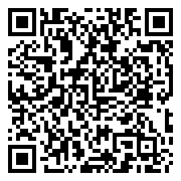
Please Complete An Evaluation Form
Your input is important!
TechEd Schedule Builder
CommNet station or PC
TechEd Mobile app
Phone or Tablet
QR code

Slide 43
Evaluate this session

Slide 44


© 2014 Microsoft Corporation. All rights reserved. Microsoft, Windows, and other product names are or may be registered trademarks and/or trademarks in the U.S. and/or other countries.
The information herein is for informational purposes only and represents the current view of Microsoft Corporation as of the date of this presentation. Because Microsoft must respond to changing market conditions, it should not be interpreted to be a commitment on the part of Microsoft, and Microsoft cannot guarantee the accuracy of any information provided after the date of this presentation. MICROSOFT MAKES NO WARRANTIES, EXPRESS, IMPLIED OR STATUTORY, AS TO THE INFORMATION IN THIS PRESENTATION.

