Slide 1


Slide 2

Get Your Own Enterprise Streaming Video Service:
Office 365 Video
OFC-B215
Jennifer Ann Mason

Slide 3
Gartner “projects that, by 2016, large companies will stream more than 16 hours of video per worker, per month”
Gartner Magic Quadrant for
Enterprise Video Content Management, Whit Andrews, September 2013

Slide 4

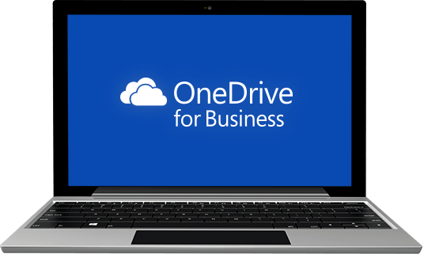
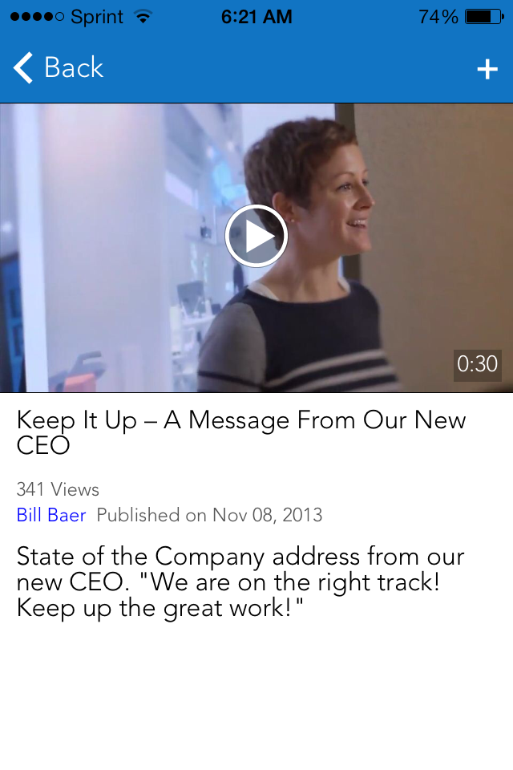
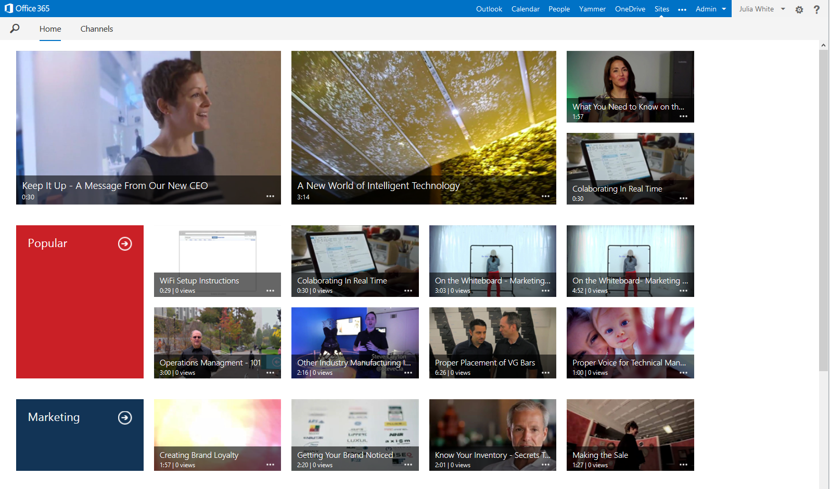
Office 365 Video powered by Azure Media Services
simple | fast | mobile | secure
easily consume video
modern, mobile, “everything in one place” video destination
share ideas broadly
rich, discoverable social video across devices
Secure and easy to manage
Scalable, encrypted, cross-geo video streaming service

Slide 5
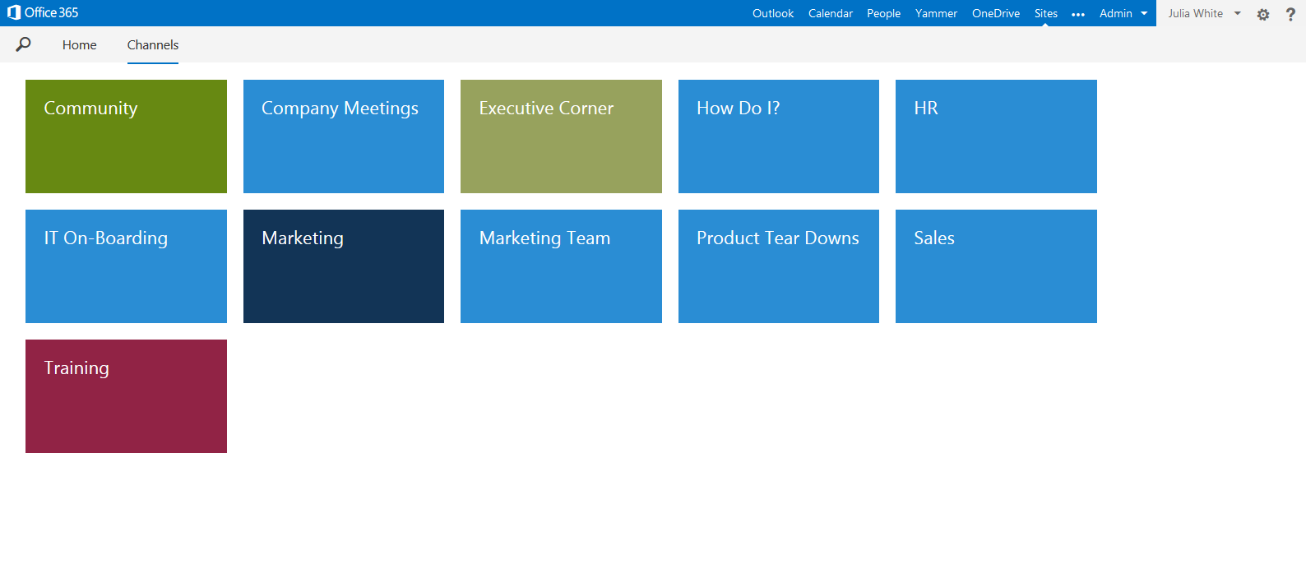
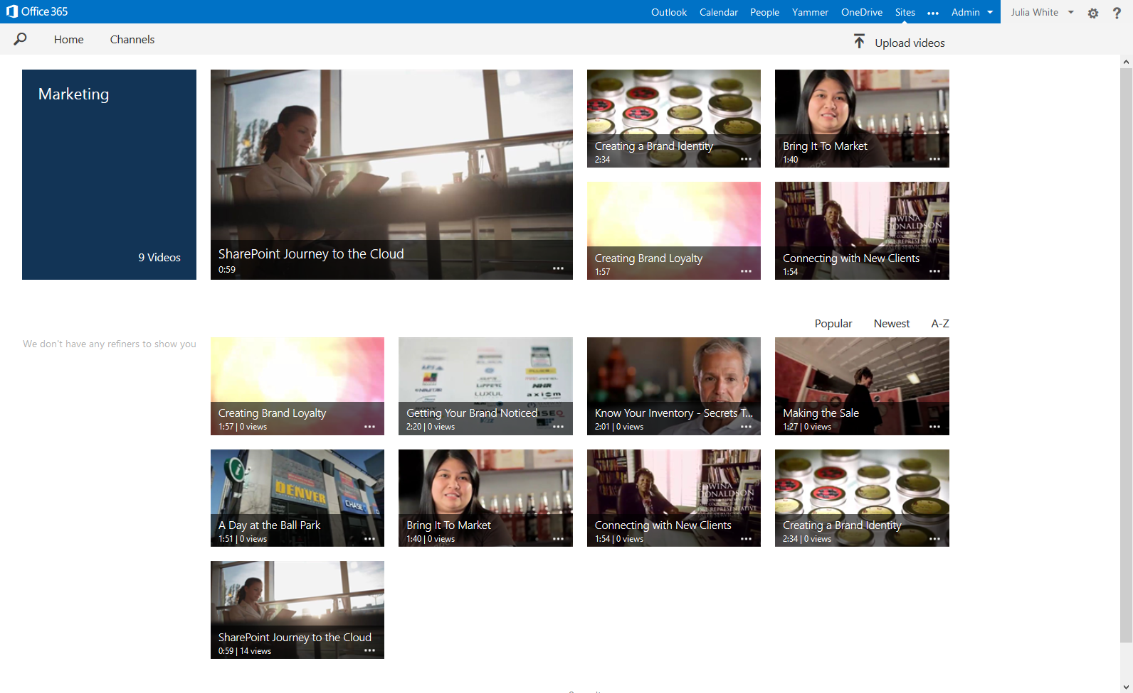
easily consume video
access
  ideas
  concepts
  changes
  via Web and mobile
educate
onboarding
training
across the globe
return to
share
help
consume
on beautiful, dynamic sites

Slide 6
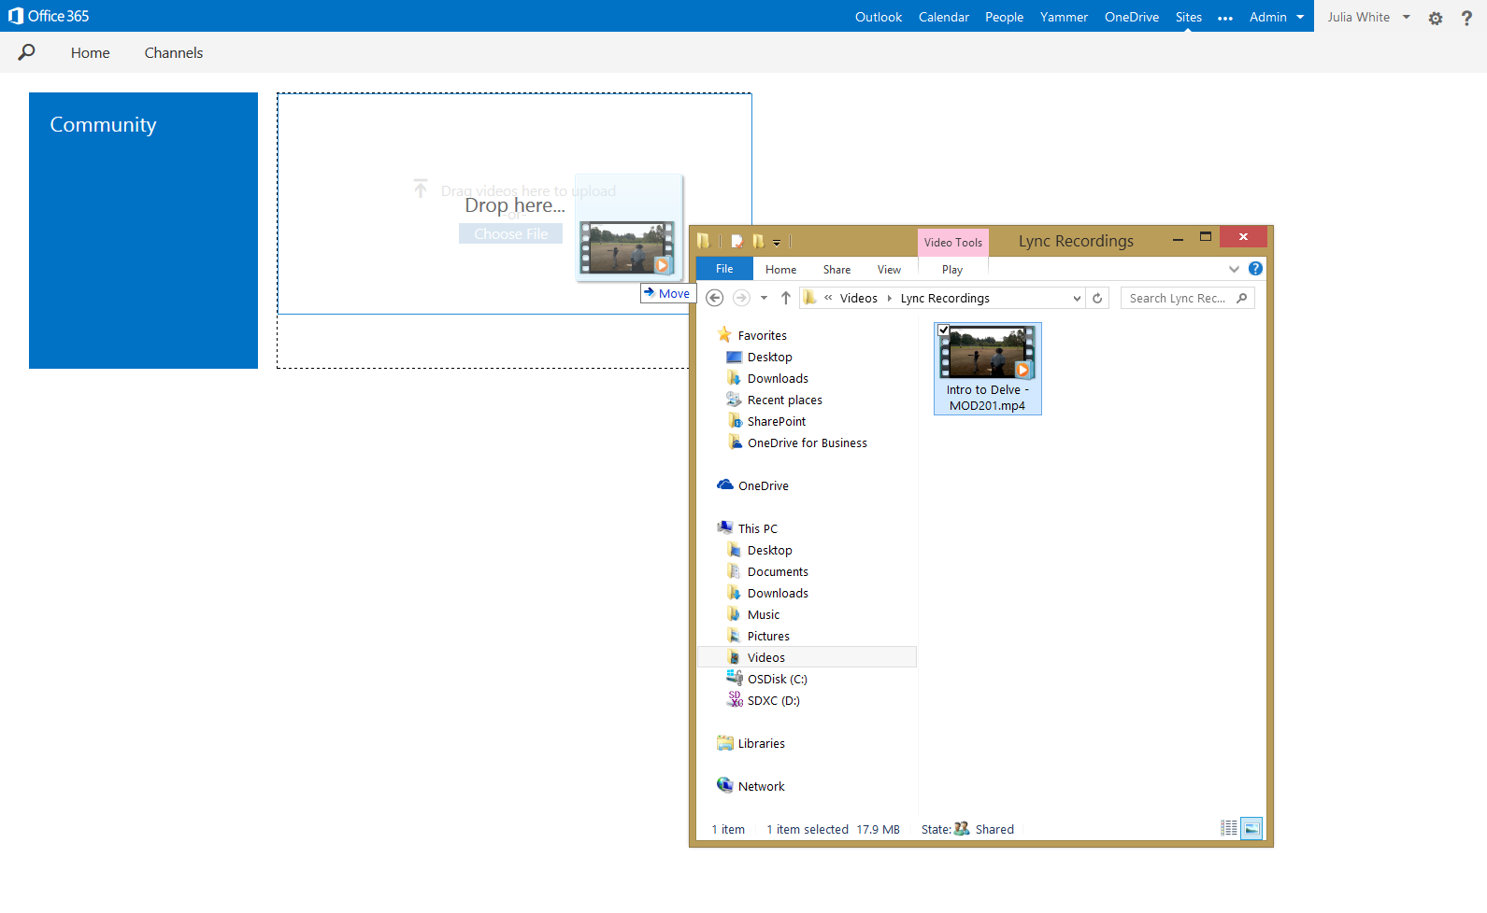
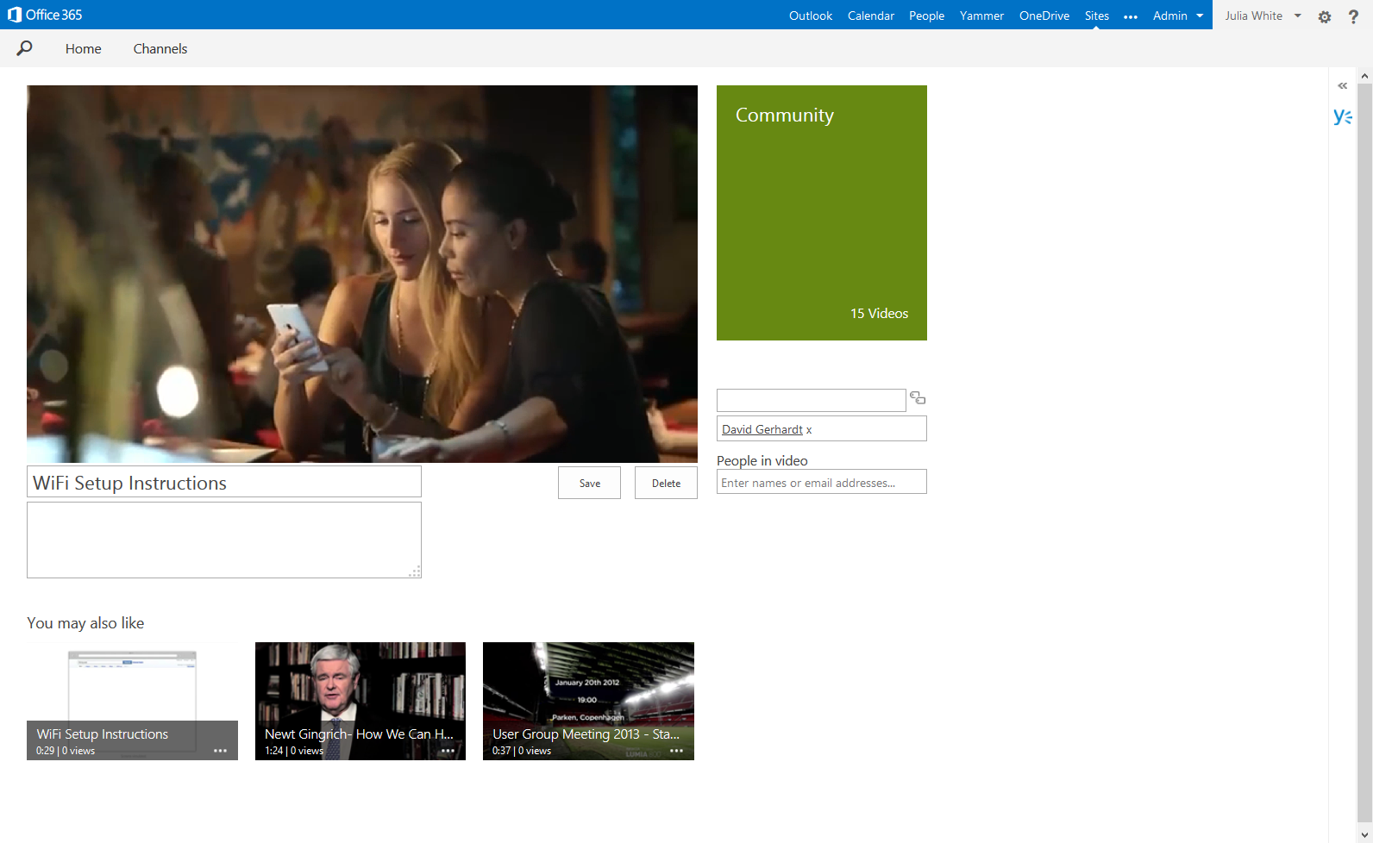
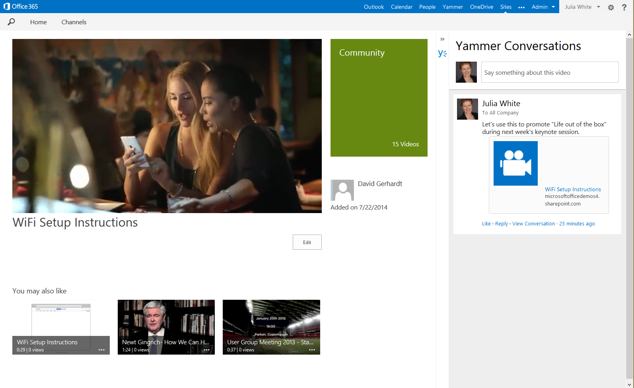
share ideas broadly
create
upload
tag
socialize

Slide 7
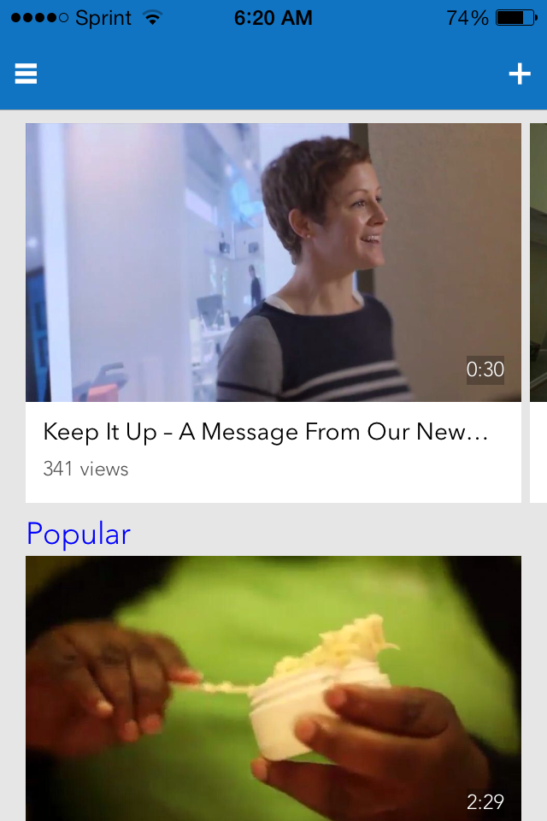
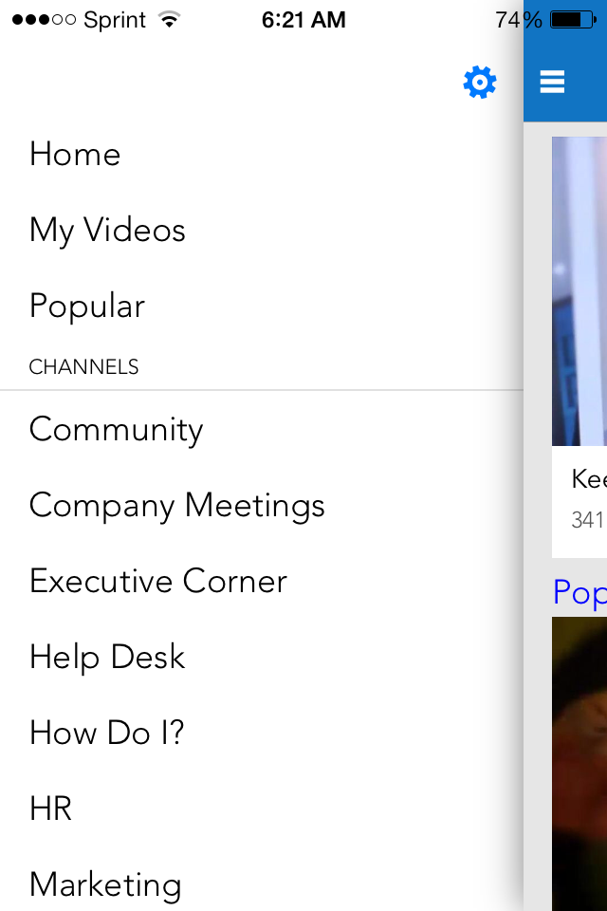
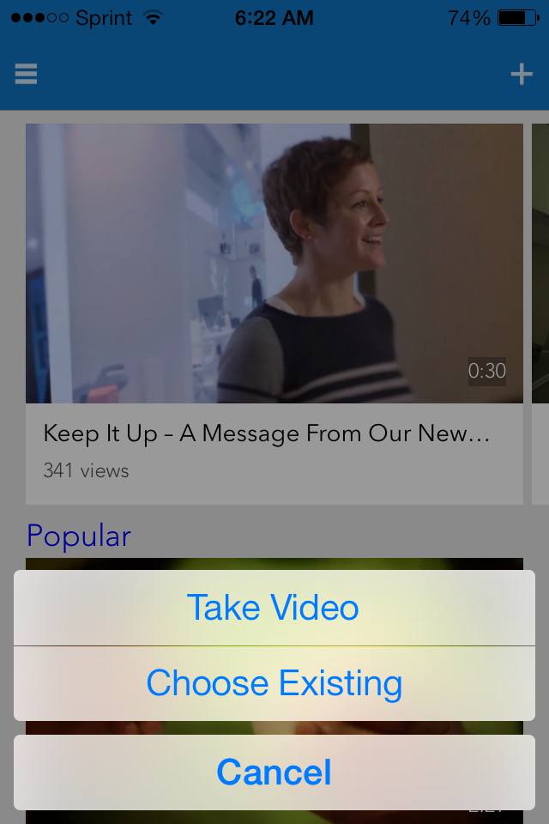
always mobile
browse
view
navigate
upload

Slide 8
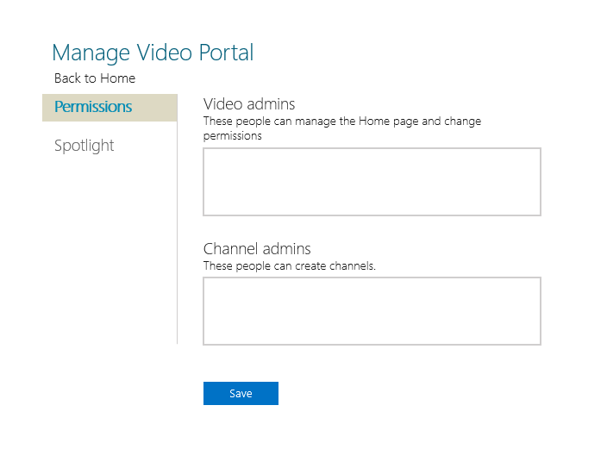
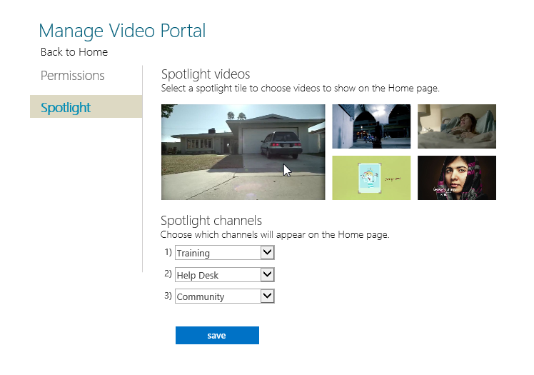
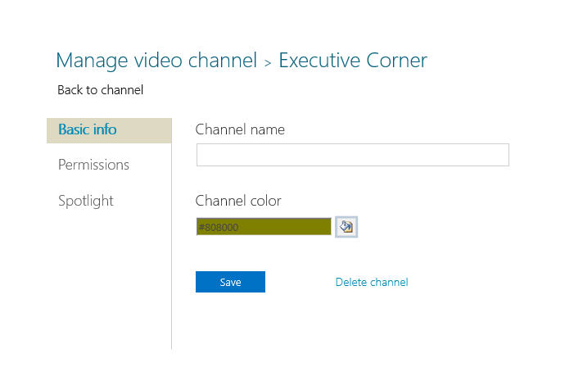
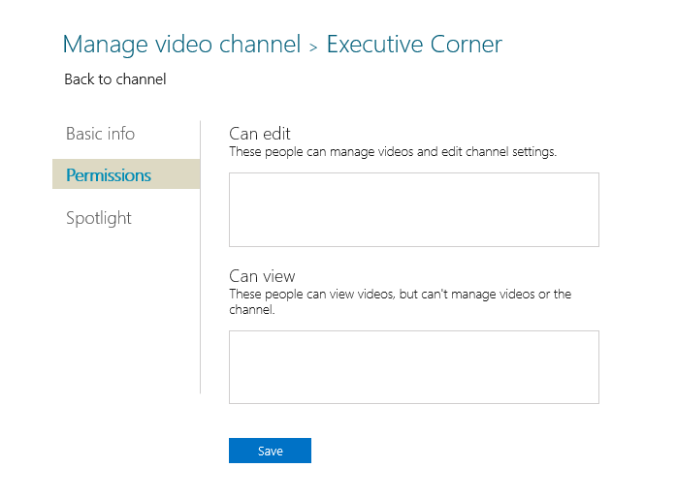
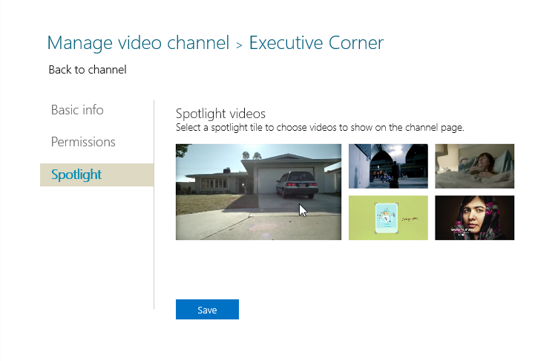
Secure and easy to manage
encryption at rest and in stream
control permissions
add/remove channels
curate
  spotlight channels
  spotlight videos

Slide 9
Demo
Office 365 Video

Slide 10

Office 365
Video architecture
Uploader
Viewers
Office 365 Video:
Portal, apps, social, curation
SharePoint Online:
Storage, metadata, security, search
Azure Media Services:
Transcoding, adaptive/secure streaming, thumbnails
Office 365 Video
SharePoint Online
Azure Media Services
Secure
Delivery
Content Storage
Metadata
Transcoding
Thumbnail

Slide 11
Azure Media Services ingest and playback
}
{
Transcoding
H.264, MPEG-1, MPEG-2, MPEG-4 v2, VC-1, WMV, DV
In .mp4, .mpeg, .mpg, .avi, .wmv, .dv, .3gp, .3g2, .3gp2, .asf, .mts, .m2ts, .mod, .ts, .vob, .xesc, .m2v, .ismv
MP3, WMA, AC-3, AAC
H.264 at 720p
400 to 3,000 kbps
HLS, Smooth Streaming, MPEG-DASH
96 kbps stereo AAC audio
* But... We’ll always
be working on better
encoding patterns.
Multiple
Formats In
Stream Any Device Out
Adaptive Smooth Streaming
Apple HLS
AES Encryption
Stream to Any Device
Stream on Any Network
Dynamic Remux

Slide 12
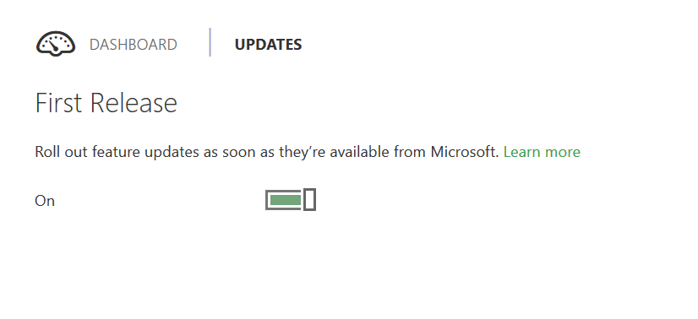
Getting Started
Sign Up for Office 365 First Release

Slide 13
Develop a Strategy
Video Portal
  Permissions
  Spotlight
Channel
  Settings
  Permissions
  Spotlight
Video Portal
Channel
…
Channel
Channel
Channel

Slide 14
Key Things to Consider:
Who are the best people to be adding videos?
  Make sure that your permissions strategy aligns with the business needs.
How will people most likely access the videos?
  The answer to this will determine how you structure your channels.

Slide 15
Licensing terms for Office 365 Video
This is a suite motion
Included in O365 E1, E3 & E4 and A2, A3 & A4 plans
Government plans are in planning, but not available at v1 GA
SPO standalone Plan 1, Plan 2, Kiosk & external users do not get use rights
Integrated Azure Media Services usage does not incur additional cost to customer – only counts against SPO storage

Slide 16
What is the business value of the O365 Video portal?
| monthly updates & innovation
Always current
Big data, solutions at scale
Less upfront cost
Less change management
Maximizing ROI
| integrated cloud infrastructure
| Microsoft builds it; it’s mobile ready
| upgrade is Microsoft’s job
| it’s included; it just works

Slide 17
Related content
Find Me Later At. . .
  Ask the Experts
  Exhibit Hall

Slide 18
Technical Network
Join the conversation!
Share tips and best practices
with other Office 365 experts
http://aka.ms/o365technetwork

Slide 19

Resources
Learning
  Sessions on Demand
  Microsoft Certification & Training Resources
http://channel9.msdn.com/Events/TechEd
www.microsoft.com/learning
TechNet
Developer Network
  Resources for IT Professionals
http://microsoft.com/technet
http://developer.microsoft.com

Slide 20


Office 365
Exams
Managing Office 365 Identities and Requirements
EXAM
346
Deploying
Office 365 Services
EXAM
347
http://bit.ly/
O365-Cert
+
Classroom
training
Introduction
to Office 365
FLC
40041
Managing Office 365 Identities and Services
MOC
20346
Designing for Office
365 Infrastructure
5
MOC
10968
3
http://bit.ly/
O365-Training
Online
training
Office 365
Fundamentals
MVA
Managing Office 365 Identities and Services
MVA
http://bit.ly/
O365-MVA
Get certified for 1/2 the price at TechEd Europe 2014!
http://bit.ly/
TechEd-CertDeal

Slide 21



Please Complete An Evaluation Form
Your input is important!
TechEd Schedule Builder
CommNet station or PC
TechEd Mobile app
Phone or Tablet
QR code

Slide 22
Evaluate this session

Slide 23


© 2014 Microsoft Corporation. All rights reserved. Microsoft, Windows, and other product names are or may be registered trademarks and/or trademarks in the U.S. and/or other countries.
The information herein is for informational purposes only and represents the current view of Microsoft Corporation as of the date of this presentation. Because Microsoft must respond to changing market conditions, it should not be interpreted to be a commitment on the part of Microsoft, and Microsoft cannot guarantee the accuracy of any information provided after the date of this presentation. MICROSOFT MAKES NO WARRANTIES, EXPRESS, IMPLIED OR STATUTORY, AS TO THE INFORMATION IN THIS PRESENTATION.

