Slide 1


Slide 2

The Microsoft Roadmap for Enterprise Social
OFC-B223
Christophe Fiessinger
Group Product Manager, Microsoft
@cfiessinger

Slide 3
Agenda
Roadmap
Work like a network
Journey
Engage using the Office Technical Network > Enterprise Social Service Updates:
https://www.yammer.com/itpronetwork

Slide 4
Work like a network

Slide 5

The world has become a giant network.
#worklikeanetwork

Slide 6



Your customers expect more.
Faster
responses
Personalized
service
Better
experiences
#worklikeanetwork

Slide 7



Yet, we continue to work like we always have.
#worklikeanetwork

Slide 8















Work like a network
Seamless social experiences across familiar applications, all delivered on an enterprise-grade platform
Listen
Adapt
Grow
to conversations
that matter
and make
smarter
decisions
your
business
#worklikeanetwork

Slide 9
Roadmap

Slide 10












People
Groups
Network
!

Slide 11

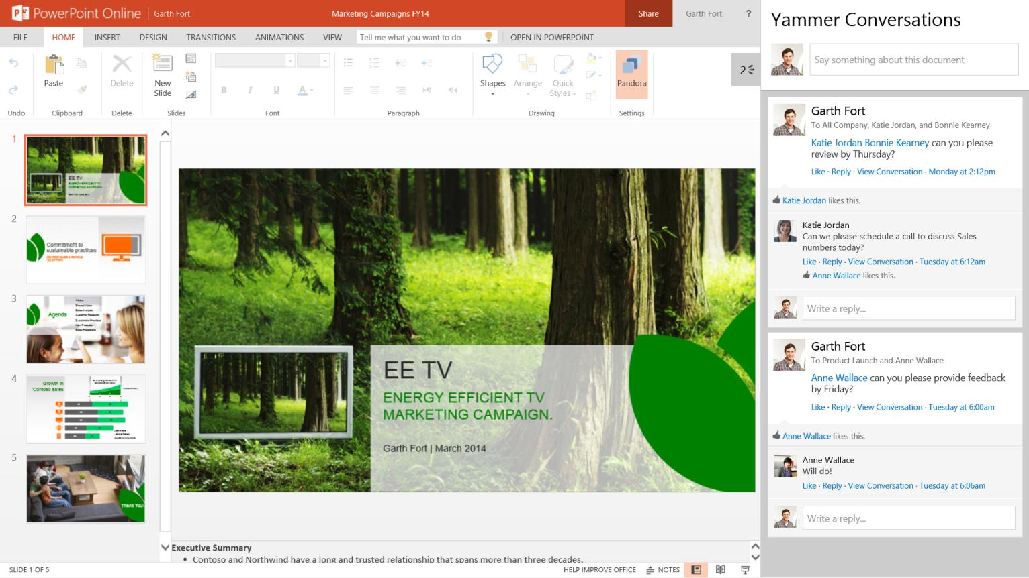

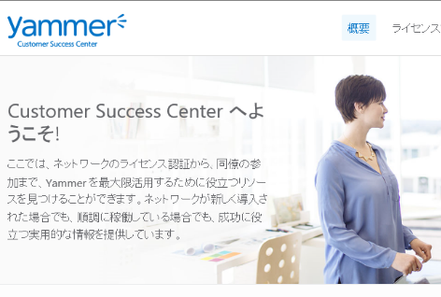


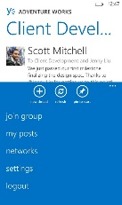
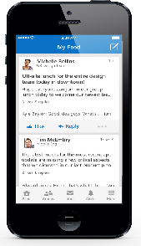
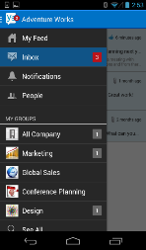

Empower People through open collaboration
Enable inline social collaboration in Office 365 and other apps, services, and line-of-business systems
Document Collaboration
CRM
Localization
Mobile

Slide 12

Introducing Groups
Brings together people, information, and apps across Office 365 to enable better communication and collaboration
Come together
Share and collaborate
Discover new information

Slide 13





















Office Graph
Office Graph
Manager
Presented to me
Direct report
Shared with me
Liked by me
Trending around me
Viewed by me
Works with

Slide 14
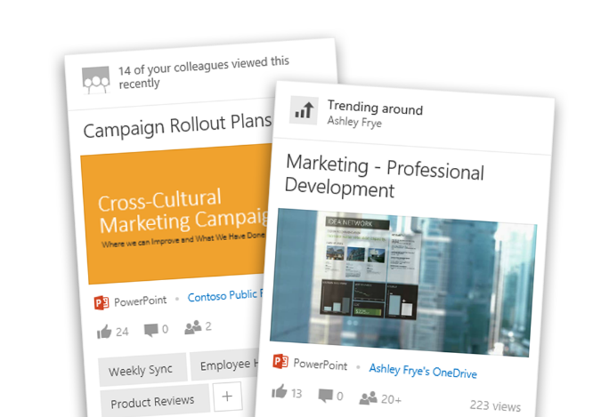
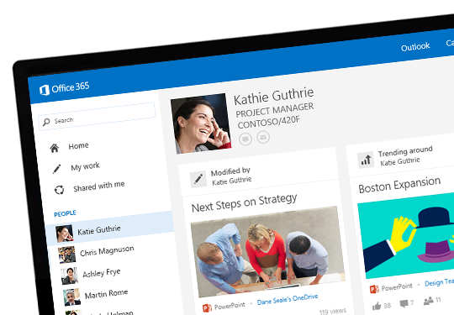
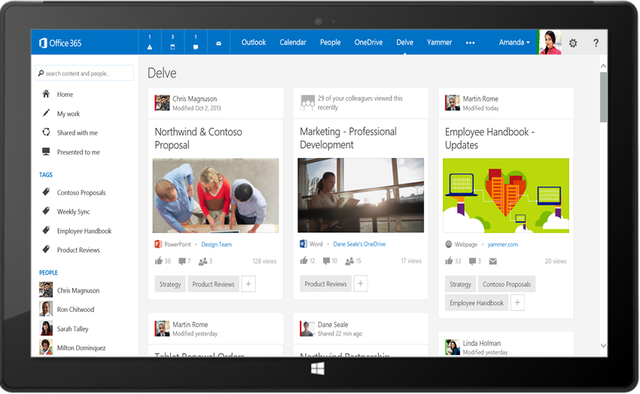
Delve – Search and Discovery Across O365
Stay In the Know
Find What you Need
Discover New Connections
Discover new information tailored to you from your network
Find just the right results from any source and take action
Connect with the right experts and learn more about their content.
Powered by Office Graph

Slide 15
Yammer & Office 365
Christophe Fiessinger

Slide 16
Journey

Slide 17
Yammer or SharePoint Social? On-premises or Cloud?
Office 365 and Yammer
  Home of innovations for Enterprise Social
Go Yammer!
SharePoint on-premises and Yammer
  Immediate adoption
  Rapid innovation
  Connect everyone
  Service Pack 1 & Yammer embed
  Committed to another SP on-premises release
  Continued hybrid improvements
SharePoint Social
  Social capabilities will be maintained
  Don’t plan on adding new features

Slide 18


Transforming work = culture + technology
“Social Enterprise is implemented 80% through organization culture and 20% through technology.”
- Gartner, September 2012
20% Tech
80%
Culture

Slide 19







The Social Journey
Define Your Vision
Evaluate, Adapt, & Iterate
Identify Business Outcomes
Launch and
Drive Success
Plan to Work Social

Slide 20


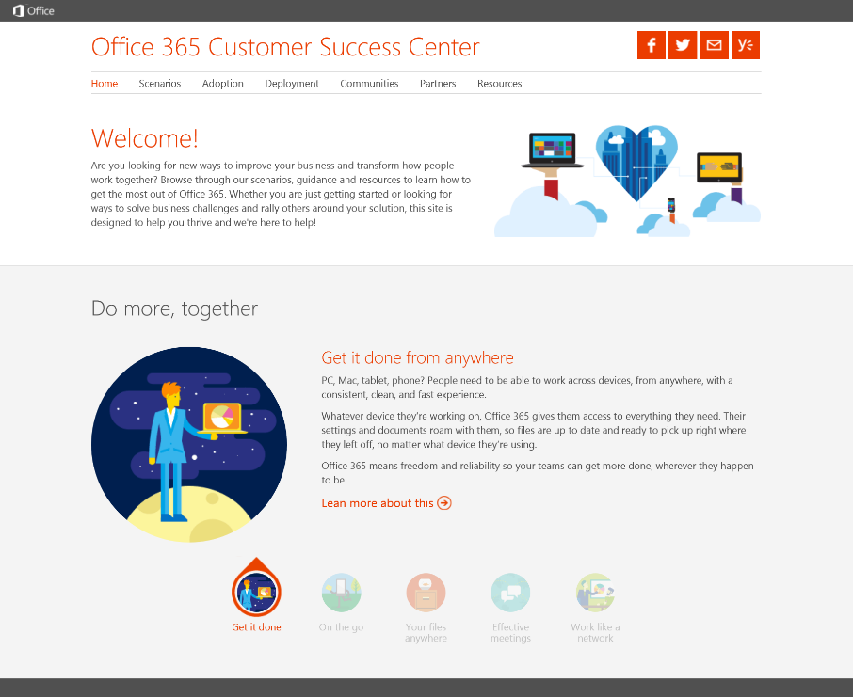



Office 365 Customer
Success Center
  Scenarios
  Scenarios inspire people to work in new ways using Office 365, along with related communication kits to support adoption.
  Learn how to get the most out of Office 365, quickly get your team onboard, and drive adoption.
  Methodology
  success.office.com 
  A four-step approach to drive adoption supported by downloadable templates and best practices.
  Communities
  Featured adoption communities where you can learn from your peers and adoption experts.
  Resources
  Helpful resources to learn about other customer stories and special offers to make it easier to get started.

Slide 21
Enterprise Social Related content
Breakout Sessions
OFC-B223 The Microsoft Roadmap for Enterprise Social – Tuesday @17:00 (8.0–D3)
OFC-B219 Introducing Delve and the Office Graph – Wednesday @8:30 (8.0–D1)
OFC-B342 Microsoft SharePoint Server 2013 on Premises and Yammer Deployment Guidance – Wednesday @15:15 (8.0–D3)
OFC-B349 Yammer Identity and User Management – Thursday @17:00 (8.0-E7)
Resources
Enterprise Social Resource Center http://enterprisesocial.com
Office 365 Customer Success Center http://success.office.com
Technical Resources http://aka.ms/yamtn
Office 365 Public Roadmap http://office.microsoft.com/roadmap
Find Me Later At Work Together booth & Ask the Experts!

Slide 22

Next Steps
1
Sign up and get started with Yammer www.yammer.com
2
Enterprise Social Resource Center http://enterprisesocial.com
3
Check out the Success Center http://success.office.com
#worklikeanetwork

Slide 23
Technical Network
Join the conversation!
Share tips and best practices
with other Office 365 experts
http://aka.ms/o365technetwork

Slide 24

Resources
Learning
  Sessions on Demand
  Microsoft Certification & Training Resources
http://channel9.msdn.com/Events/TechEd
www.microsoft.com/learning
TechNet
Developer Network
  Resources for IT Professionals
http://microsoft.com/technet
http://developer.microsoft.com

Slide 25



Please Complete An Evaluation Form
Your input is important!
TechEd Schedule Builder
CommNet station or PC
TechEd Mobile app
Phone or Tablet
QR code

Slide 26
Evaluate this session

Slide 27


© 2014 Microsoft Corporation. All rights reserved. Microsoft, Windows, and other product names are or may be registered trademarks and/or trademarks in the U.S. and/or other countries.
The information herein is for informational purposes only and represents the current view of Microsoft Corporation as of the date of this presentation. Because Microsoft must respond to changing market conditions, it should not be interpreted to be a commitment on the part of Microsoft, and Microsoft cannot guarantee the accuracy of any information provided after the date of this presentation. MICROSOFT MAKES NO WARRANTIES, EXPRESS, IMPLIED OR STATUTORY, AS TO THE INFORMATION IN THIS PRESENTATION.

Slide 28
Appendix

Slide 29
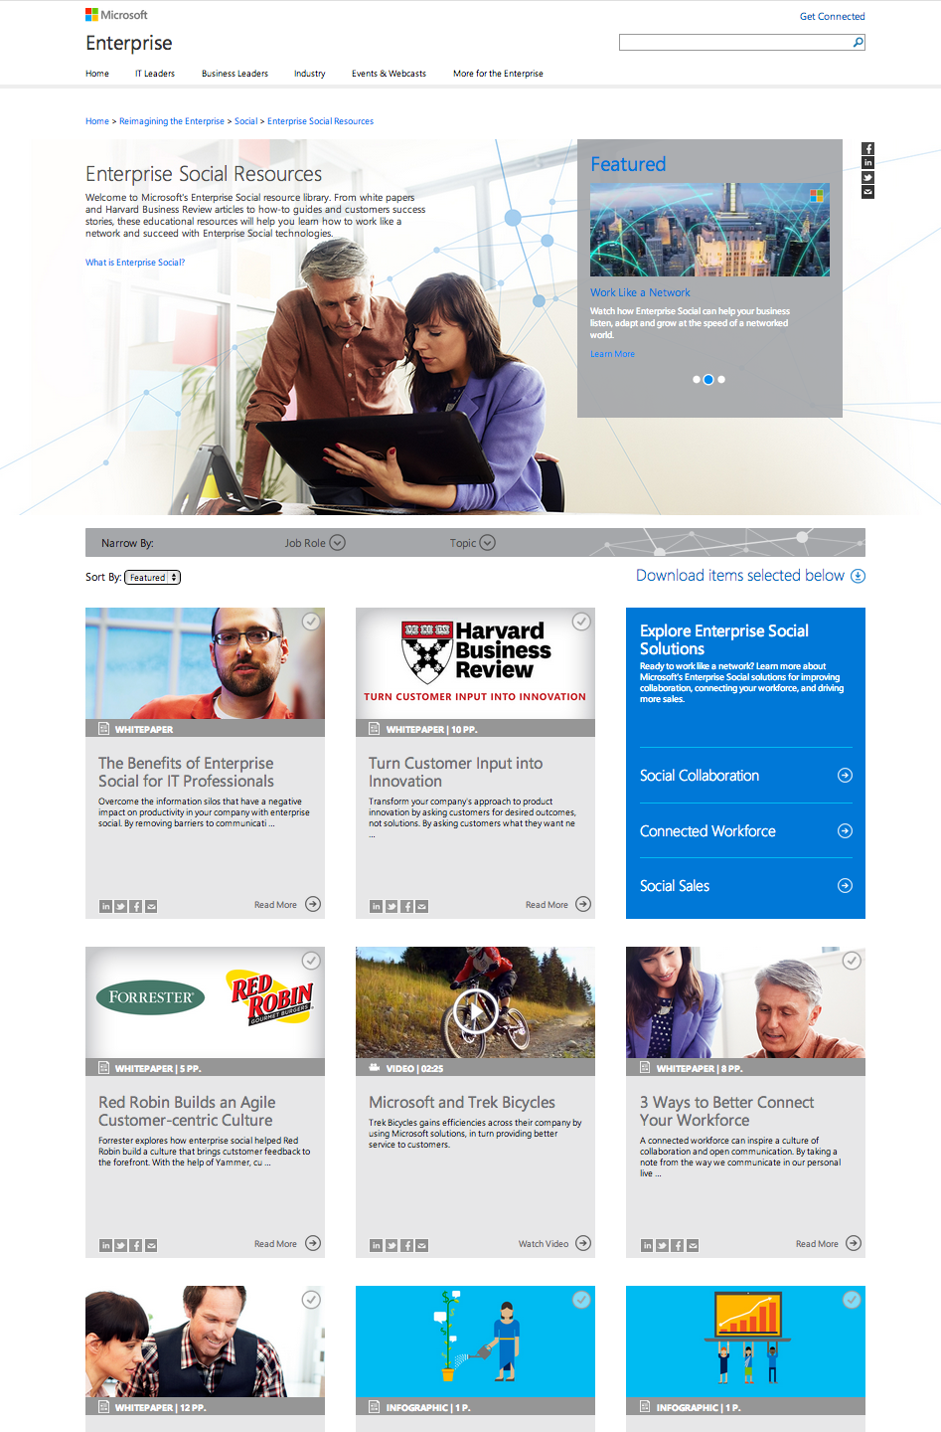

Enterprise Social Resource Center
Learn how social software can help your business
Educational content on the business value and benefits of Enterprise Social
Tailored guidance for line-of-business leads: Executives, HR, IT, Sales, Marketing, Customer Support
Customer testimonials sharing success stories with Enterprise Social
www.enterprisesocial.com

Slide 30
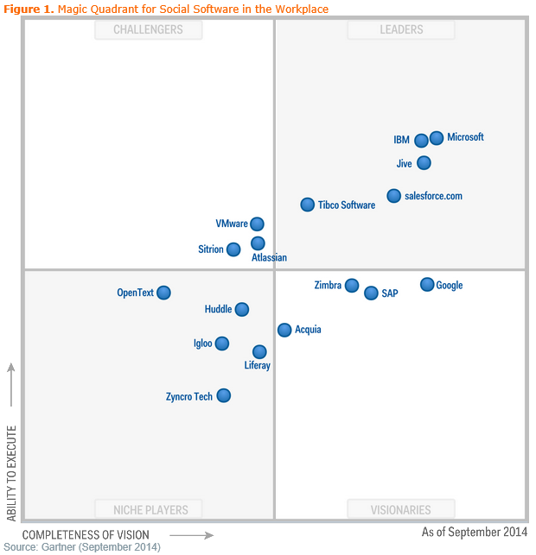
Gartner Magic Quadrant
Social Software in the Workplace – September 2014
  “Magic Quadrant for Social Software in the Workplace,” by Nikos Drakos, Jeffrey Mann and Mike Gotta, September 3, 2014.
  This graphic was published by Gartner, Inc. as part of a larger research document and should be evaluated in the context of the entire document. The Gartner document is available upon request from Microsoft.
  Gartner does not endorse any vendor, product or service depicted in its research publications, and does not advise technology users to select only those vendors with the highest ratings or other designation. Gartner research publications consist of the opinions of Gartner's research organization and should not be construed as statements of fact. Gartner disclaims all warranties, expressed or implied, with respect to this research, including any warranties of merchantability or fitness for a particular purpose.

Slide 31
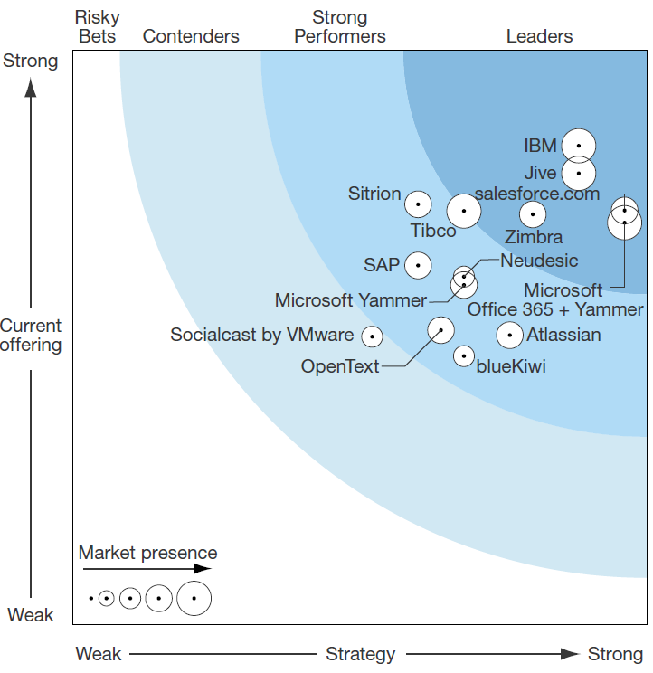
Forrester Wave
Enterprise Social Platforms – Q2, 2014
  The Forrester Wave: Enterprise Social Platforms, Q2, 2014, by Rob Koplowitz, June 5, 2014.
  The Forrester Wave™ is copyrighted by Forrester Research, Inc. Forrester and Forrester Wave™ are trademarks of Forrester Research, Inc. The Forrester Wave™ is a graphical representation of Forrester's call on a market and is plotted using a detailed spreadsheet with exposed scores, weightings, and comments. Forrester does not endorse any vendor, product, or service depicted in the Forrester Wave. Information is based on best available resources. Opinions reflect judgment at the time and are subject to change.

Slide 32
Which tool when today?
Use Groups for new teams, projects and initiatives in Office 365; for existing use cases, the following should help you decide which is tool is better suited for your needs today:
If you’re looking for a solution to provide… | Start Using….
social intranet capabilities | Yammer
external collaboration | Yammer
unstructured collaboration (e.g., ideation, feedback) | Yammer
employee engagement (e.g., communities of interest, recognition) | Yammer
team collaboration | Groups
structured project collaboration (e.g., deliverables, meetings, milestones) | Groups
file creation, collaboration, and storage | Groups
But I still need to… | Continue Using….
organize data in a hierarchy layout | Public Folders
allow users to have direct SharePoint document access via Outlook 2013 | Site Mailboxes
allow users to send messages on behalf of a group identity | Shared Mailboxes
share communications with large groups(>300) or nested groups | Distribution Groups *
moderate group conversations | Distribution Groups
business process workflow customizations on your site | Team Site
* Guidance will evolve as we deliver more cross-suite innovation in Office 365

