Slide 2
Office 365 SMB Deployment
Marissa Salazar

Slide 3
Path to a successful Office 365 deployment and adoption
Getting Started
Trial
Plan
Deployment
Infrastructure preparation
Service provisioning
Data migration
Adoption
Usage
Enhancements

Slide 4
New plans for SMBs
Business Premium
Office apps + Cloud services
$12.50 user/month
Hero offer for SMB – rich tools for most SMB productivity needs
Evolution of Small Business Premium & Midsize Business
Business
Office apps + OneDrive
Business Essentials
Cloud services
$8.25 user/month
For customers who want just the Office apps
Move customers off Office on-premises
$5 user/month
Competitively priced/featured for entry-level cloud services
Evolution of Small Business
All plans include:
300 seat cap
99.9% financially-backed uptime guarantee
24/7 phone support for critical issues
Active Directory integration

Slide 5
Core Office 365 plan layout
Business
Core needs
Enterprise
Advanced needs
One single, scalable admin experience
Business Premium
Office apps + Cloud services
Enterprise E3
Office apps + Cloud services
Business
Office apps + OneDrive
Business Essentials
Cloud services
ProPlus
Office apps + OneDrive
Enterprise E1
Cloud services
Other services (e.g. Exchange Online, OneDrive for Business, Kiosk, Project, Visio, CRM, etc.)
Combine ANY of these plans in a single Office 365 account
Business plans have 300 seat cap, per plan
Enterprise plans have no seat cap
Only top plans for SMB listed

Slide 6
Admin Experience Simplification journey
Simplified new user creation
Auto license assignment
Admin dashboard for Business Plans
More detailed user profile detail panel
Unified O365 Admin Center navigation
App-launcher top nav bar
Manual password assignment
Updated groups management
Simplified user management
Updated Message Center
External sharing
Proactive DNS records check
Cross suite top nav bar
Simplified domain setup
March 2014
gTLDs supported
Brower and OS Reports
Custom themes
Lync Device usage reports
User details to Exchange reports

Slide 7
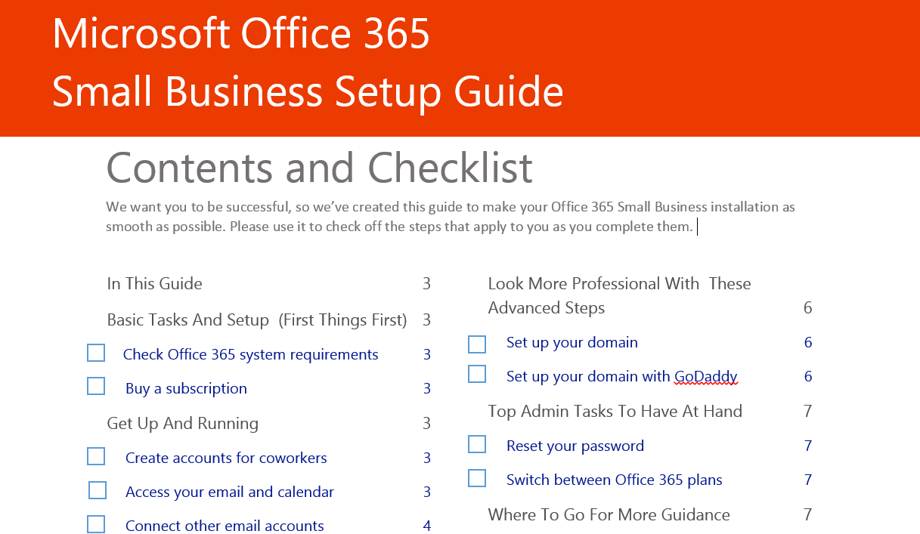
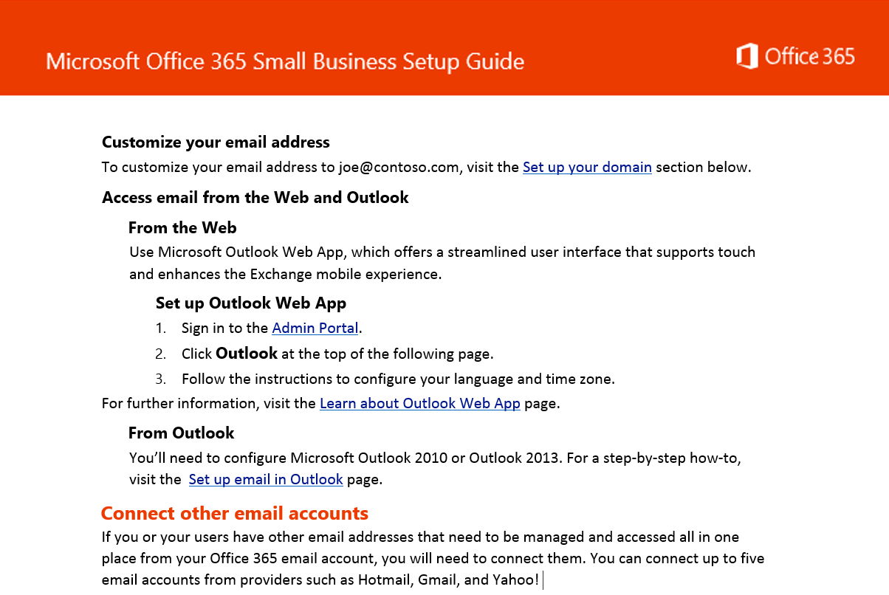
Self Guided SMB Deployment Guide
We want you to be successful, so we’ve created this guide to make your Office 365 installation as smooth as possible
Step-by-step guide to help SMB customers setup and onboard Office 365
Comprehensive, yet simple to help customers through the first month in the service

Slide 8
FastTrack Getting Started
http://deploy.office.com/getting-started

Slide 9
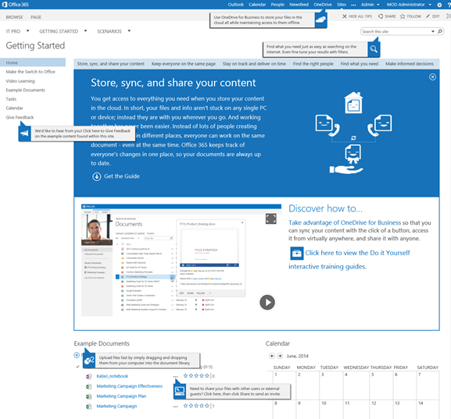
Getting Started for users
Provides an environment where business users can experience Office 365
Deployments are isolated to their own site collection so users can experience SharePoint without affecting the production environment
Users can watch training videos about Office 365 features and associated content within the site allows for immediate experience of some of the features discussed
Foster ideas and creativity to automate manual processes or enhance existing ones with FastTrack sample content

Slide 10
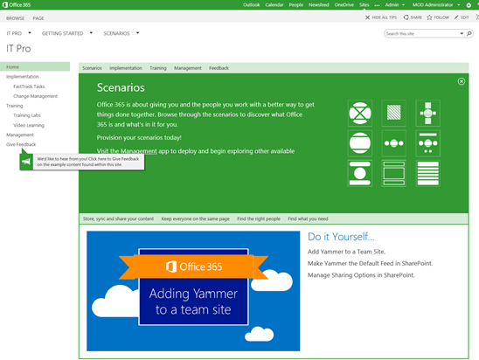
Getting Started for IT
Provides an environment where members of the IT staff can learn about Office 365
IT staff members can follow guided steps for implementation of Office 365 with the FastTrack Tasks site
Provides access to resources to facilitate and guide change management with the Change Management site
Use the FastTrack Management App to access FastTrack Labs for additional training, manage users, and gain valuable information from the feedback survey’s

Slide 11
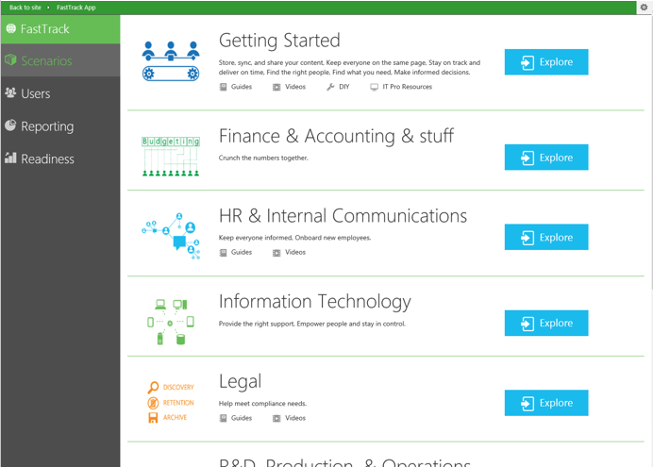
FastTrack Management App
Explore pre-built scenarios with custom content to your FastTrack site collection
Manage users, review reporting and readiness metrics
Access FastTrack Labs to train and test IT staff readiness to manage and maintain Office 365 following deployment and implementation
Manage surveys to understand the impact of FastTrack on your organization

Slide 12
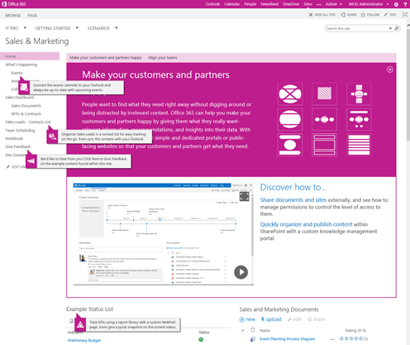
Additional scenarios
Choose from 6 content filled pre-built sites:
HR and Internal Communications
R&D, Production, and Operations
Sales and Marketing (home page pictured on right)
Finance and Accounting
Legal
Information Technology
Users can explore sample content and learn how to build custom content with the on-page videos
Review tool tips for a quick review of features while gathering ideas for site implementation
Practice building out custom features and solutions before implementing in the production environment

Slide 13
Demonstration
FastTrack Getting Started experience

Slide 14
Choices to fit your organization
Technical | Using Microsoft migration tools
Cutover
IMAP cutover
 | IMAP migration | Cutover | Staged | Hybrid
Exchange 5.5 | X
Exchange 2000 | X
Exchange 2003 | X | X | X | X
Exchange 2007 | X | X | X | X
Exchange 2010/2013 | X | X |  | X
Notes/Domino* | X
GroupWise* | X
Other* | X
Supports wide range of email platforms
Email only (no calendar, contacts, or tasks)
Exchange cutover
Good for fast, direct migrations
No server required on-premises
Coexistence
Staged Migration
Allows a staged migration
No server required on-premises
Hybrid
Enables cross-premises calendaring, smooth migration, and easy off-boarding
*Additional options available with tools from migration partners

Slide 15
Adoption
http://success.office.com

Slide 16
The situation today and challenges
Your success is measured by long-term user adoption.
Driving adoption takes time
Deployment alone is not enough
Cloud services are in constant motion

Slide 17
What do you need to do to be successful?
Key attributes of a successful adoption approach
1
2
3
4
Set vision & identify business scenarios
Map to usage scenarios & create adoption plan
Commit resources & execute on adoption plan
Measure, share success, & iterate
A deep understanding of the business goals, as well as people challenges and needs to achieve them.
A solution that people love and that helps them achieve business goals and get things done more effectively.
A strategy to drive adoption including communications, readiness, and community.
A benchmark, KPIs, and success stories to help demonstrate success internally, improve & expand.

Slide 18
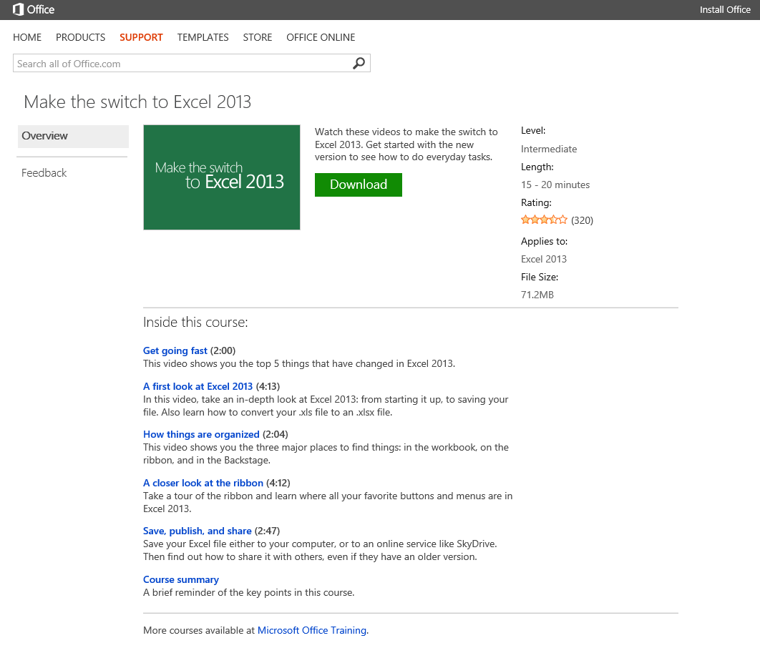
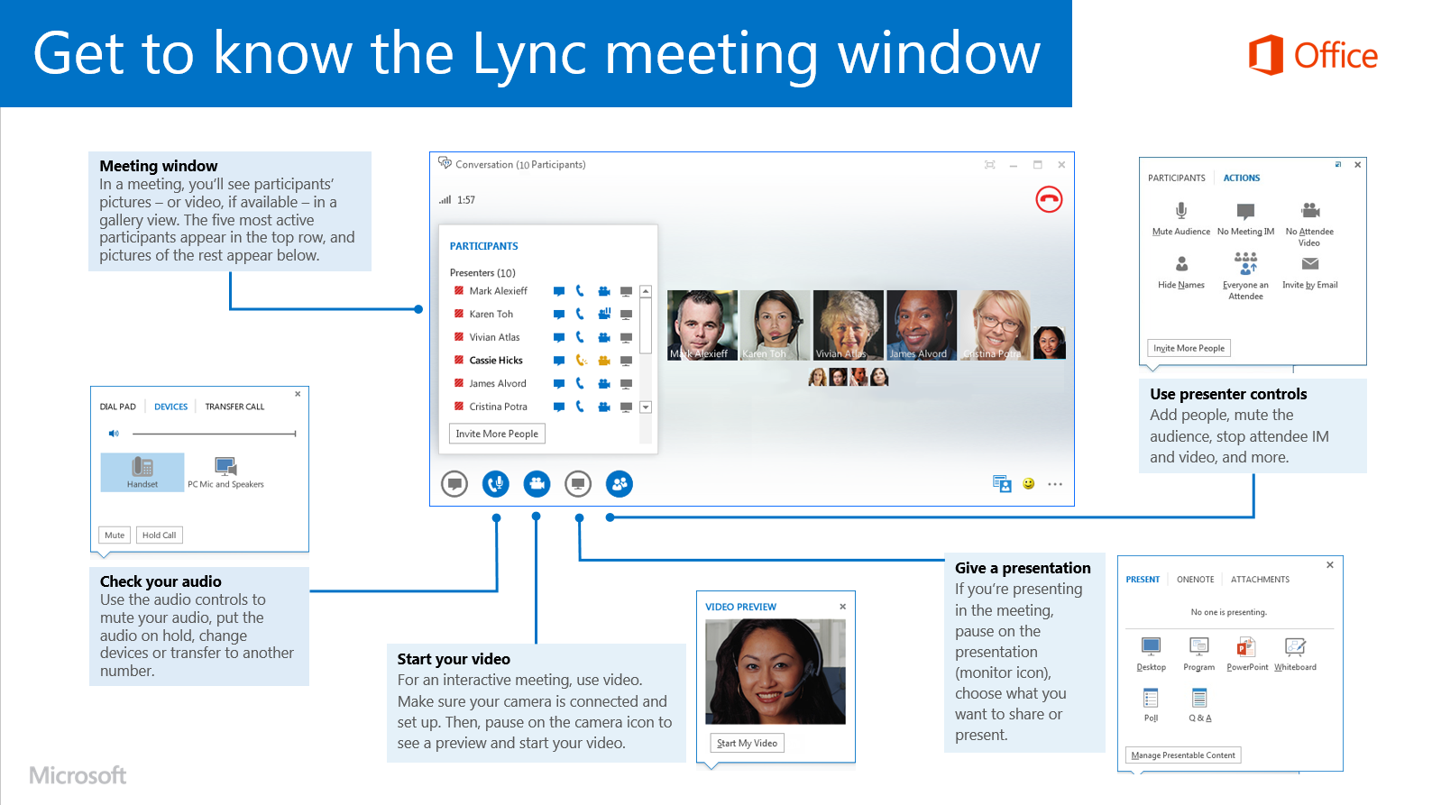
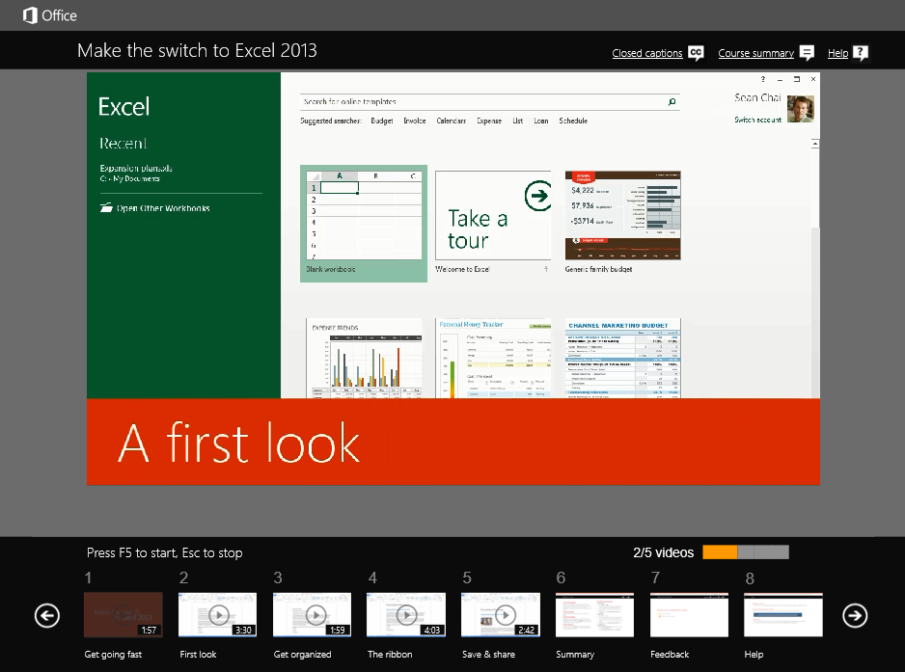
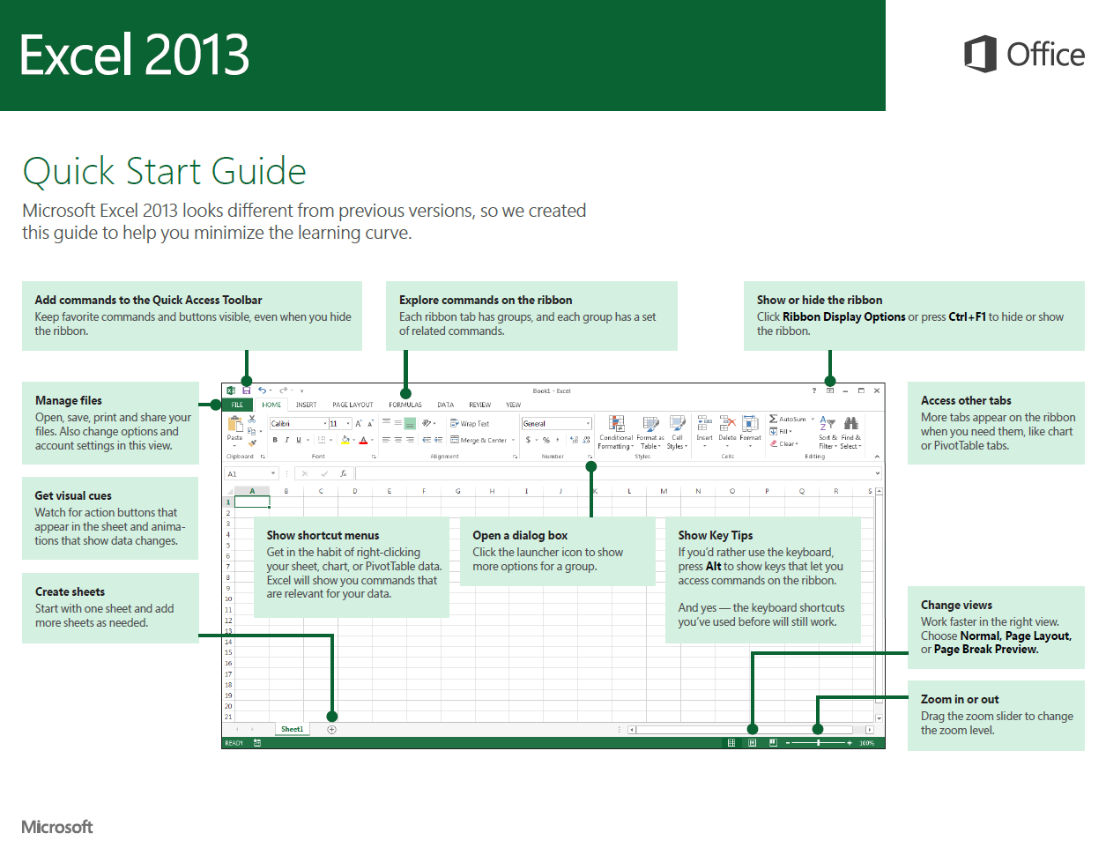
First days with Office 365
Help users transition and get started with the new apps
Quick start guides
Make the switch courses
These printable guides contain useful tips, shortcuts, and screenshots to help people find their way around Office 365.
Watch these videos to make the switch to the new Office. Get started with the new version to see how to do everyday tasks.
http://aka.ms/officestart
http://aka.ms/officetraining

Slide 19
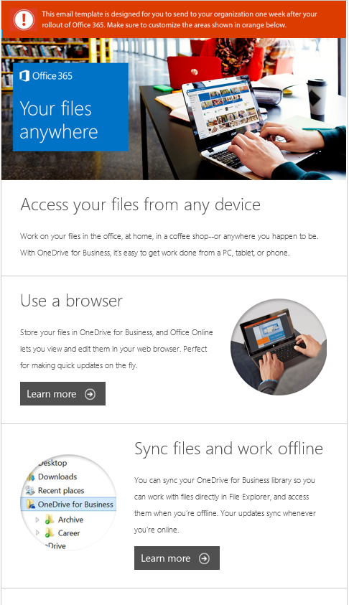
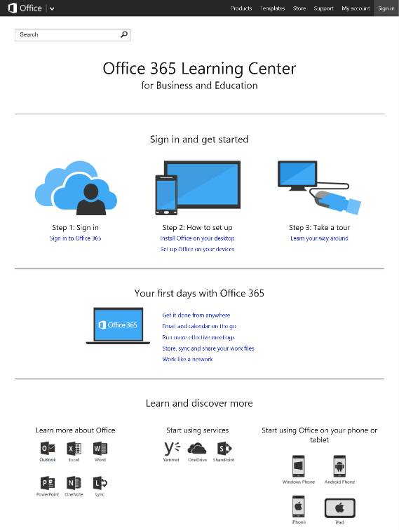
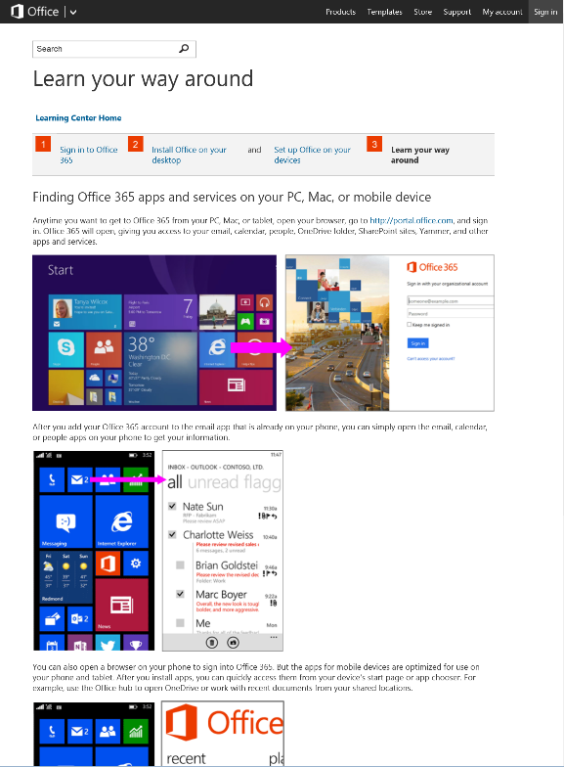
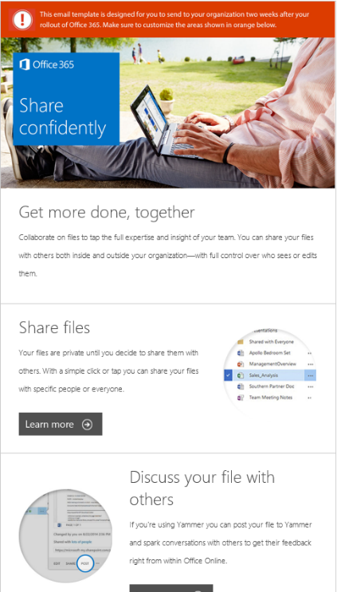
Ongoing usage and support
Increase depth & breadth of usage and manage upcoming changes in the service
Tips & Tricks emails series
Office 365 Learning Center
Customizable email templates to help maximize depth and breadth of usage over time.
Get people up and running quickly with these essential learning and training resources for Office 365.
success.office.com/resources
http://aka.ms/o365learning

Slide 20
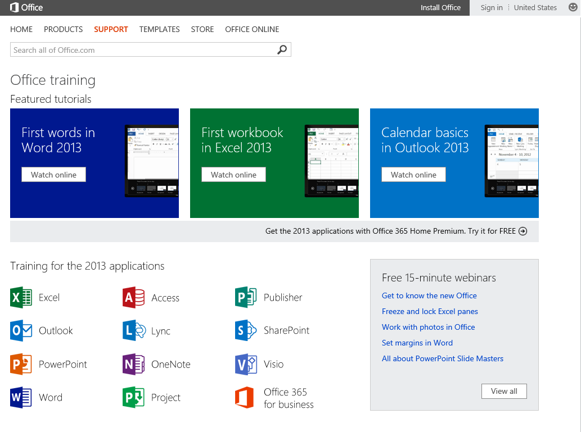
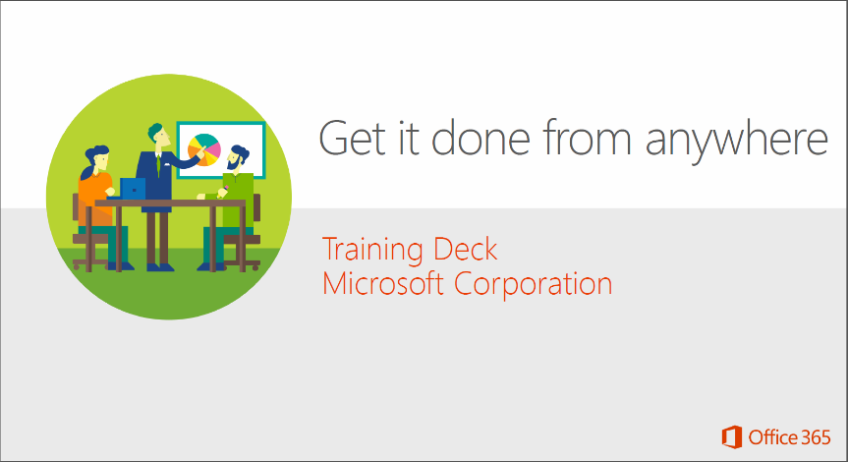
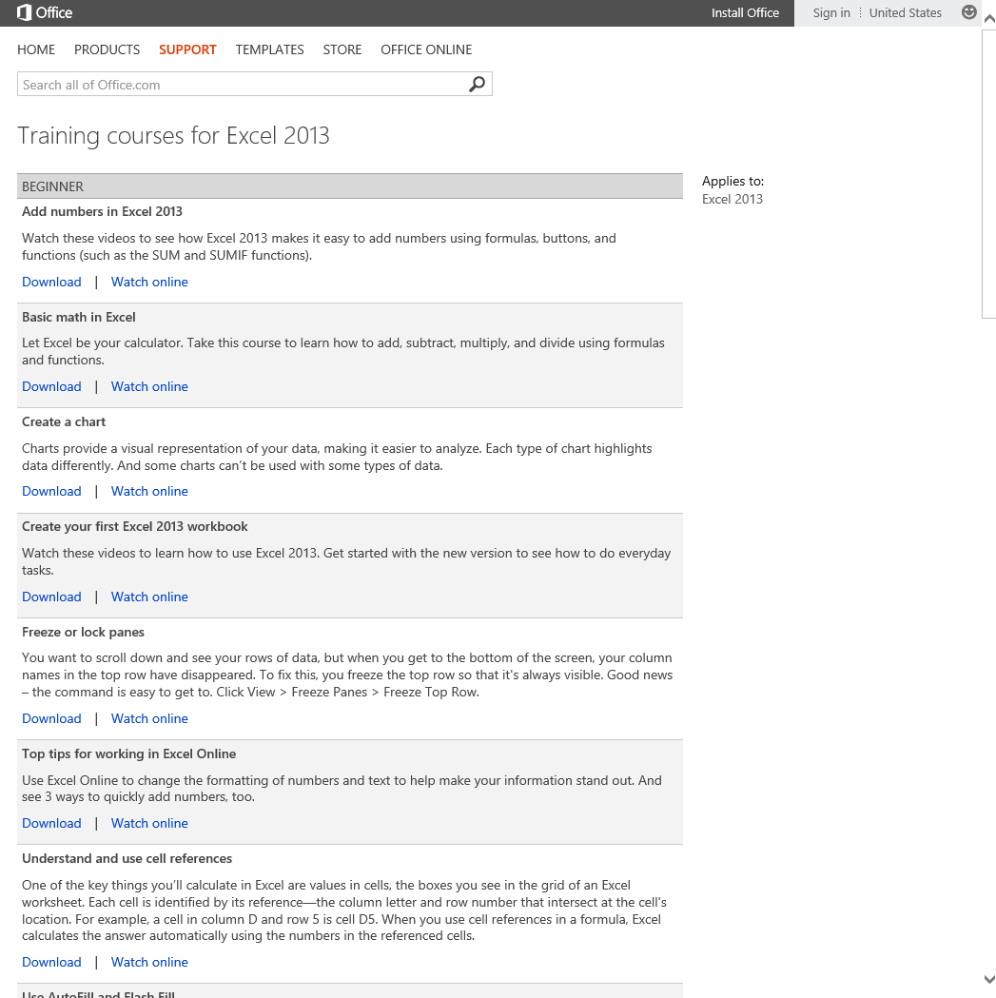
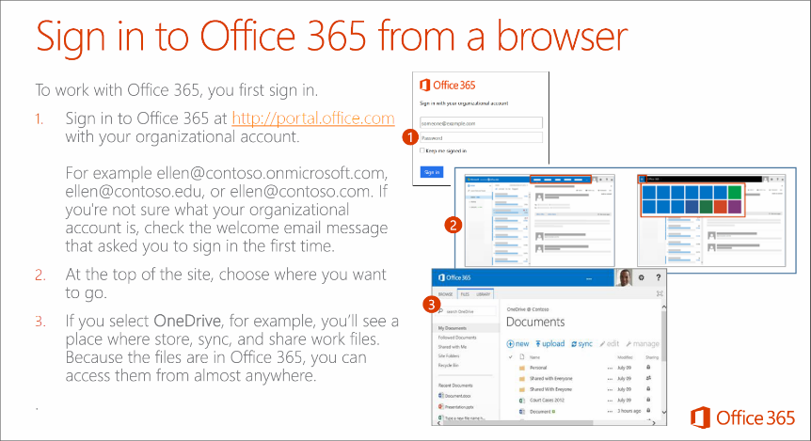
Ongoing usage and support
Increase depth & breadth of usage and manage upcoming changes in the service.
Scenarios learning path
Become an Office guru
Customizable training decks to help you organize lunch & learn sessions around the most fundamental Office 365 usage scenarios.
Learn at your own pace with these free online training courses from Microsoft.
http://aka.ms/o365learning
http://aka.ms/officetraining

Slide 21
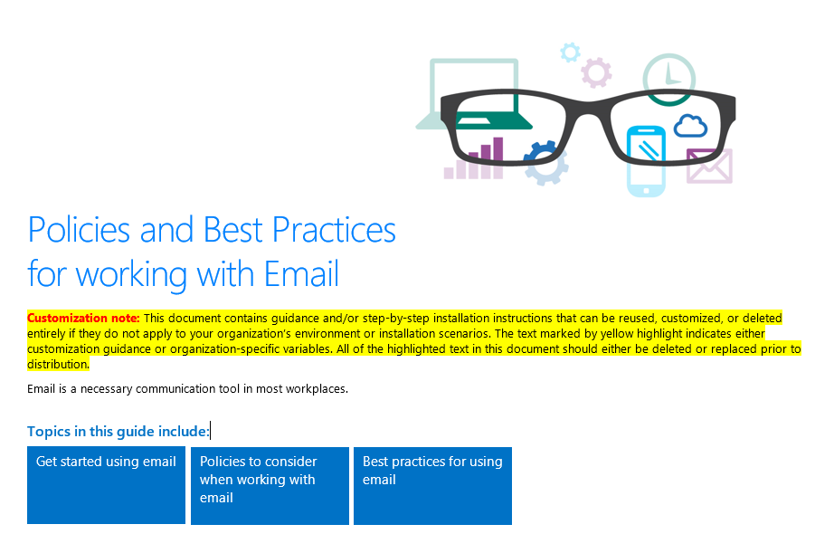
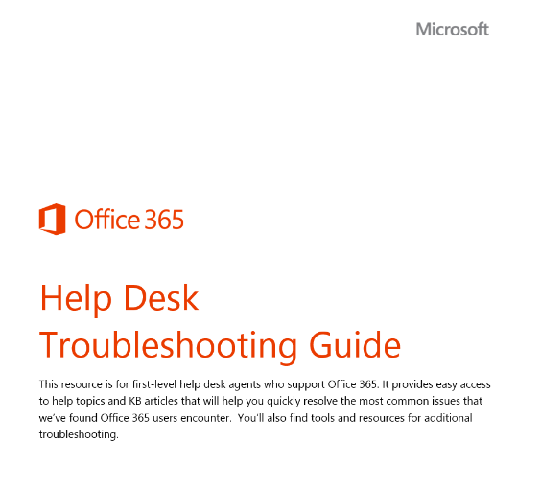
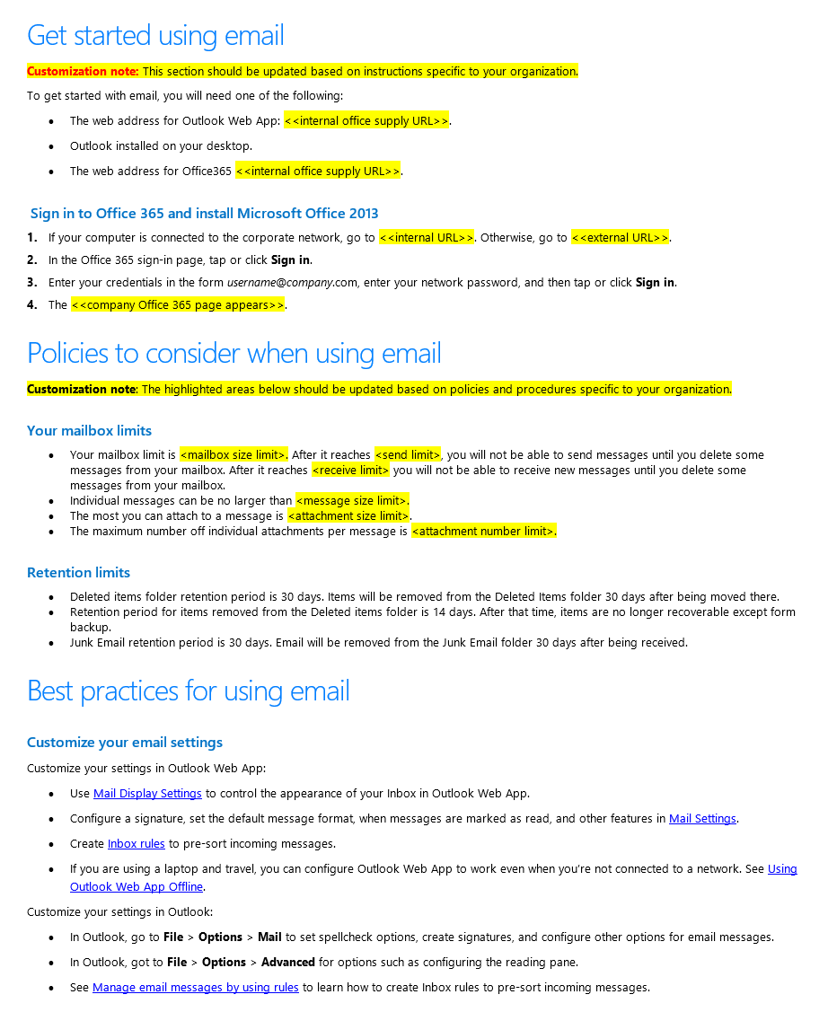
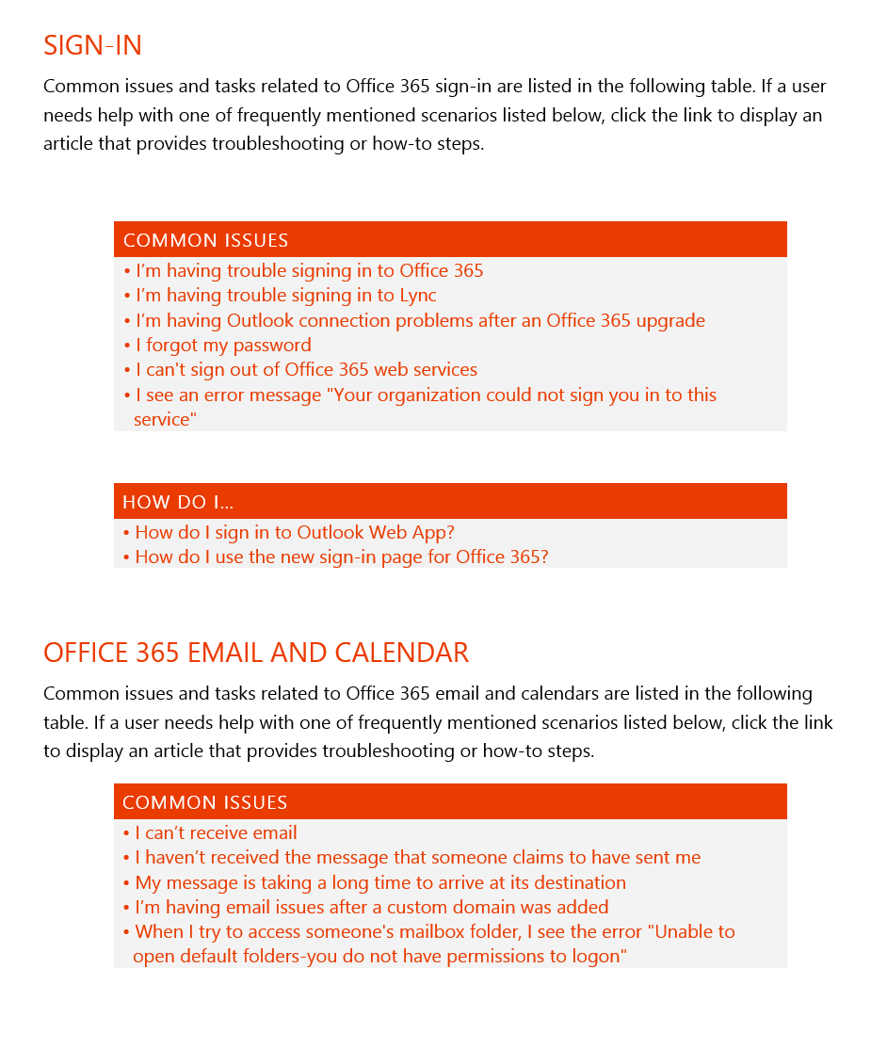
Ongoing usage and support
Increase depth and breadth of usage and manage upcoming changes in the service
Policies and best practices
Help desk resources
Use the policies templates to provide your users with guidelines about how to use Office 365 responsibly.
Use this guide to help get your help desk ready to troubleshoot Office 365 users.
http://aka.ms/policies
success.office.com/resources

Slide 22
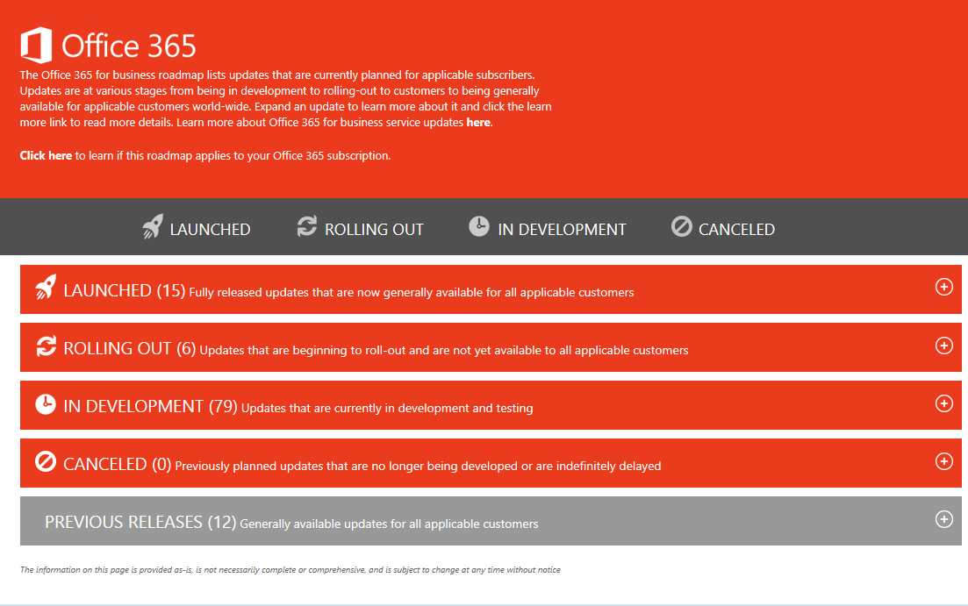
Office 365 Public Roadmap
http://office.com/roadmap
A public place where you can get information on service updates to help manage the faster paced release cycles of the cloud
Focus on new and updated functionality*
Covers what’s coming in the near-term, and some longer-term
Offers high-level details, including name, description, status
Not a comprehensive view of all change

Slide 23
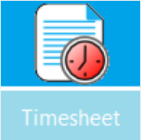
Recommended Apps for Office
Microsoft and Partner Office Apps to strengthen and enhance your business
D&B Business Verification
PayPal Invoicing
App validates, standardizes, and matches company names and addresses against D&B’s continually updated Global Reference Database of 225+ million businesses right in Excel 2013
Create and email professional invoices in just minutes, complete with a Pay button your customers can click to pay you online. You can create and manage all of your invoices without ever leaving Excel 2013.
Social Thinkers Facebook Insights
Timesheet
This app has a user friendly dashboard that allows you to login with your Facebook Data and automatically access all the insights of the Facebook Business Pages that you manage
Timesheet app keeps track of day-wise effort spent by employees on various components in the project. Allows project manager to approve, reject, review, add, etc. efforts entered by employees
Package Tracker
Poll Everywhere
After receiving an email message with a FedEx tracking number, track your packages inside your Outlook mailbox.
You ask your audience questions and they respond with their smartphone or via SMS. Their responses are displayed instantly on stunning real time visualizations in PowerPoint.
Docusign for Outlook
Solver
Sign and return or get signatures on documents sent to you in seconds with DocuSign for Outlook. Simply select who is signing and Docusign will walk you through the process of signing and returning the document.
Use this Solver App to find better ways to allocate scarce resources, maximize profits or minimize costs or risks, in a wide range of applications.

Slide 24
Join us on the Office 365 Technical Network
The new Yammer network just for you.
Connect
Discover
Engage
Get started 
Interact with Microsoft pros, engineers, MVPs, Insiders, and industry influencers.
Learn about the latest news, updates, trends, and best practices in the information technology industry.
Participate in community discussions around Office 365 topics, provide feedback, and ask questions.
www.yammer.com/itpronetwork Join the “Driving Adoption” Group.

Slide 25
Go to deploy.office.com/getting-started to provision the Getting Started content
Get up and running!
Find out more at deploy.office.com
& success.office.com
Complete a deployment plan via FastTrack or the Success Center
Explore the resources and quick start guides on the Office 365 Success Center
Find Partner Resources www.aka.ms/SMBPartnerCenter
Join the Office 365 Technical Network to connect with other IT Pros and SMBs

Slide 26
© 2014 Microsoft Corporation. All rights reserved. Microsoft, Windows, and other product names are or may be registered trademarks and/or trademarks in the U.S. and/or other countries.
The information herein is for informational purposes only and represents the current view of Microsoft Corporation as of the date of this presentation. Because Microsoft must respond to changing market conditions, it should not be interpreted to be a commitment on the part of Microsoft, and Microsoft cannot guarantee the accuracy of any information provided after the date of this presentation. MICROSOFT MAKES NO WARRANTIES, EXPRESS, IMPLIED OR STATUTORY, AS TO THE INFORMATION IN THIS PRESENTATION.

