Slide 1
Lync MVP Pub Trivia Night – Invitation Only
Want to join Lync MVPs and speakers at an exclusive Pub Trivia Night tomorrow?
Tweet a photo from a Lync session using the hashtag #LyncTEE for your chance to attend!
Two entries are randomly selected each day.
Test your Lync knowledge with questions created by MVPs.
Free food and drinks! Great prizes! *See official rules online.
If you don’t score an invite, you can compete on Twitter with @msftLync tomorrow at 7pm for your chance to win a Surface Pro 3!
TechEd Europe
#LyncTEE

Slide 2


Slide 3

Certificates in Lync Server
Steven van Houttum
Lync MVP

Slide 4
Lync Top Support Solutions
1. Solutions related to Lync Client Sign-In Process and Authentication – internal user:
  Certificate Requirements for Internal Servers
4. Solutions related setup, deployment and migration issues
  Preventing Lync Server certificate expiration

Slide 5
Agenda
How are certificates used within Lync?
Where can it go wrong & how to prevent that?
How to troubleshoot & fix issues.

Slide 6
How?
Lync Client – Lync Server
TLS/HTTPS/TLS DSK
Lync Server – Lync Server
MTLS
Lync Server – Exchange Server
MTLS/HTTPS
Between Office Servers
Oauth

Slide 7
Lync Client – Lync Server

Slide 8
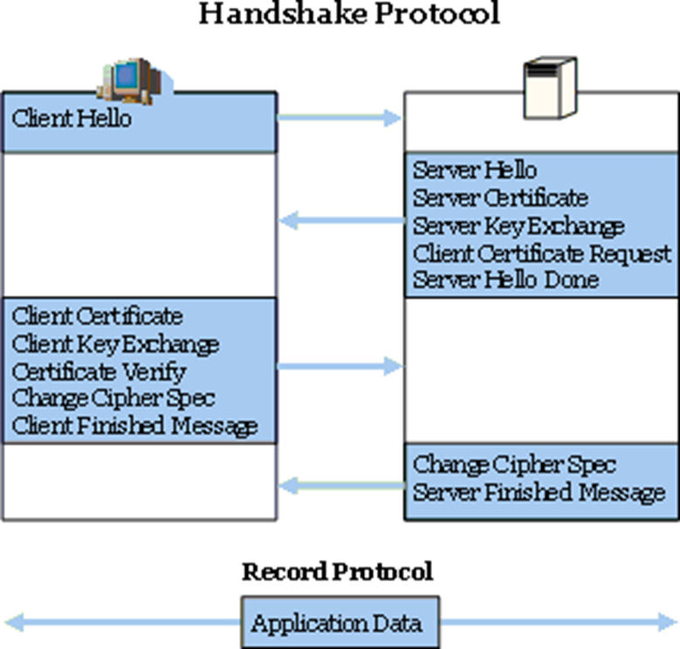
Lync TLS internals
1.Handshake and cipher suite negotiation
2.Authentication of parties
3.Key-related information exchange
4.Application data exchange

Slide 9
Demo
Analyzing Client sign in with Microsoft Message Analyzer

Slide 10
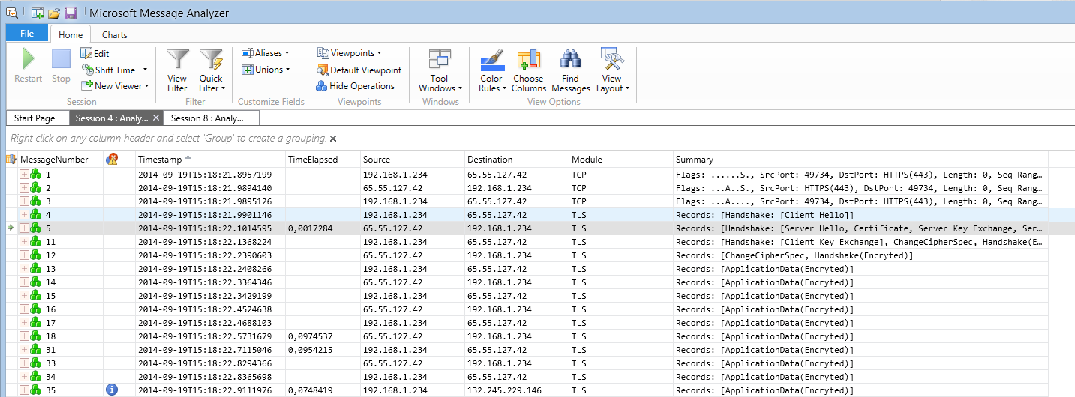
Demo: Message Analyzer (TLS)

Slide 11
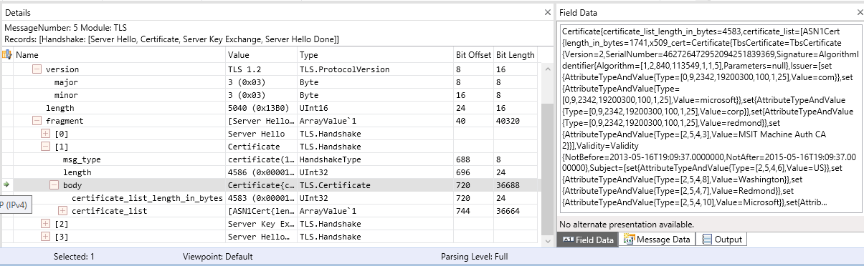
Demo: Message Analyzer (TLS)

Slide 12
Demo
Analyzing Client HTTPS traffic with Fiddler

Slide 13
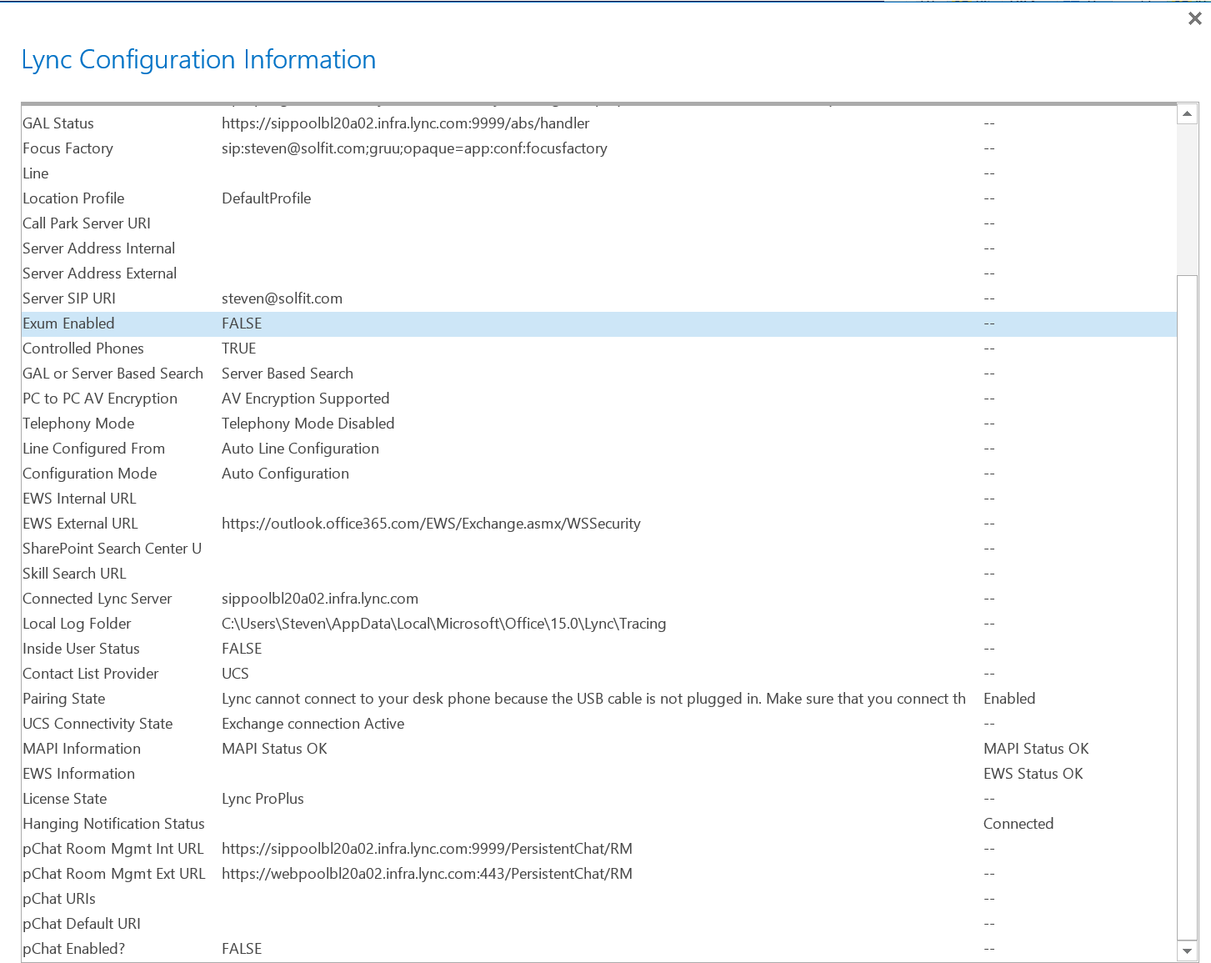
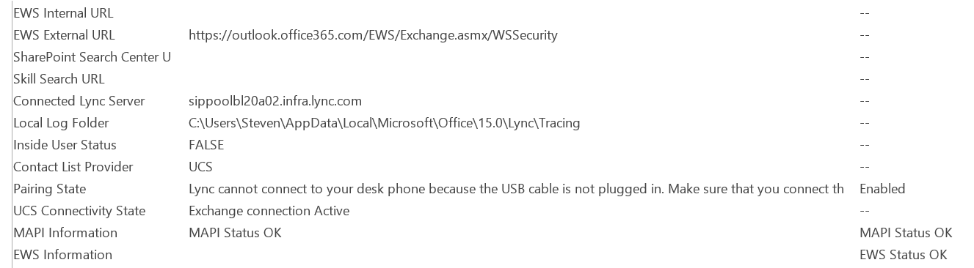
Lync Configuration Information

Slide 14
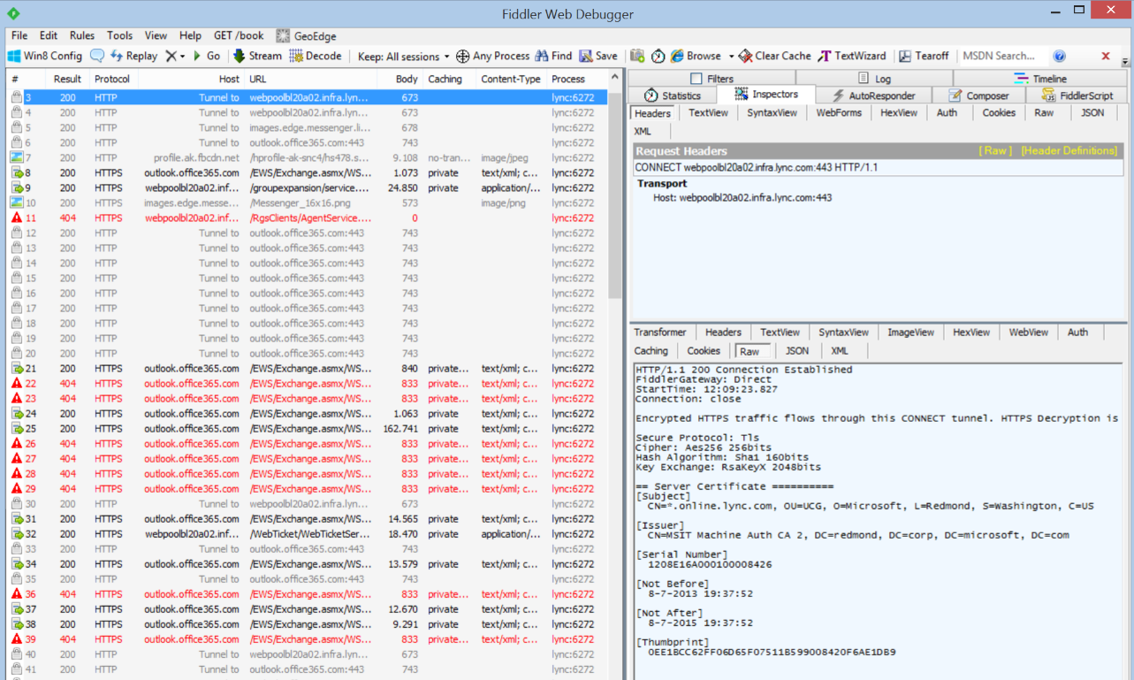
Demo: Fiddler (HTTPS)

Slide 15
Demo
Analyzing Client SIP traffic with Snooper
(or proofing that SIP is encrypted with TLS)

Slide 16
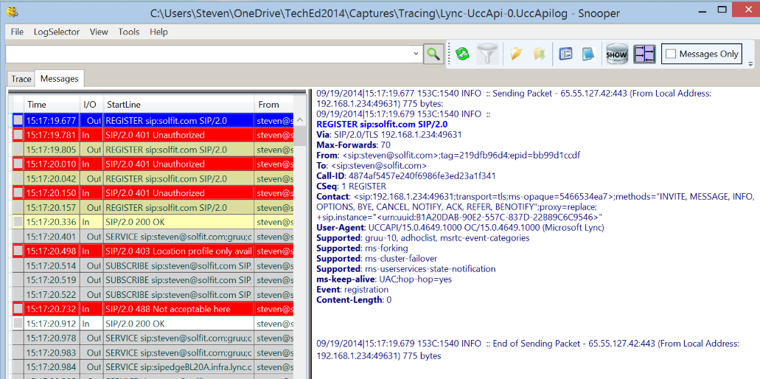
Snooper Capture Office 365 Logon

Slide 17
Certificates

Slide 18
Demo
Certificate highlights

Slide 19
Lync Server Certificate requirements
All server certificates must support server authorization (Server EKU).
All server certificates must contain a CRL Distribution Point (CDP).
All certificates must be signed using a signing algorithm supported by the operating system.

Slide 20
Certificate request - Process
Generate key pair
Collect information as required
Request certificate
Verify & Create signed certificate (CA)
Accept certificate (requires private key)

Slide 21
Certificate request – Choices
Certificate Type
  Subject Alternate Names (SAN) required?
  Wildcard
Certificate Authority
  Internal
  Public

Slide 22
Certificate request - Tools
Certificate Wizard
    View
    Import
    Remove
    Request
    Assign
Management Shell
    Get-CsCertificate
    Import-CsCertificate
    Remove-CsCertificate
    Request-CsCertificate
    Set-CsCertificate
    (Test-CsCertificateConfiguration)

Slide 23
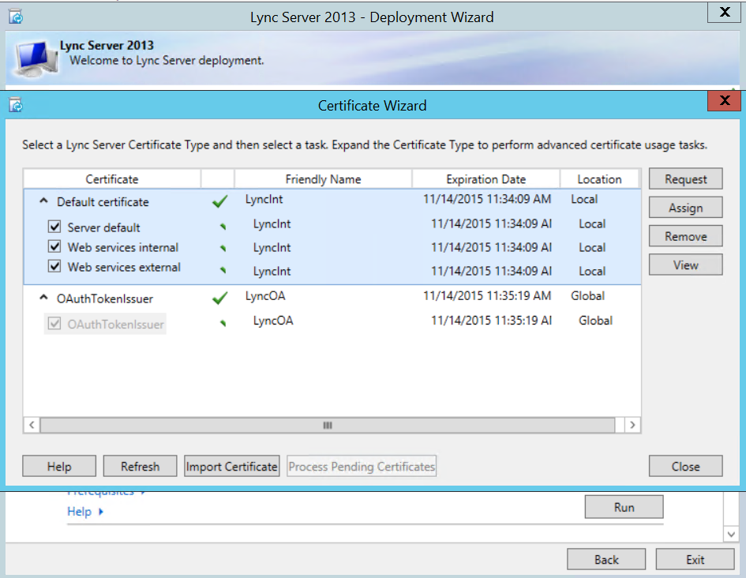

Slide 24
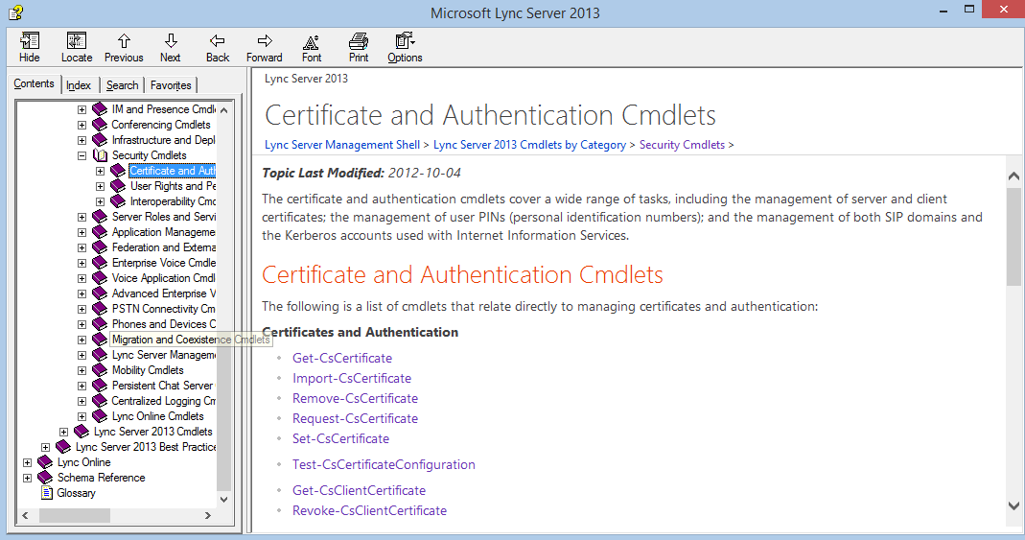
Lync Help

Slide 25
Certificate request - Internal
Default -> caveat: strict DNS
  TLS/MTLS
WebServicesInternal
  HTTPS
WebServicesExternal
  HTTPS
OAuthTokenUser

Slide 26
Certificate request – External
Reverse Proxy
  HTTPS
  Simple URLs
    /meet /dialin?
Edge
  Access Edge (TLS)
  Web conferencing Edge (TLS)
  A/V Authentication
  Internal (TLS)

Slide 27
Demo
Change Simple URL

Slide 28
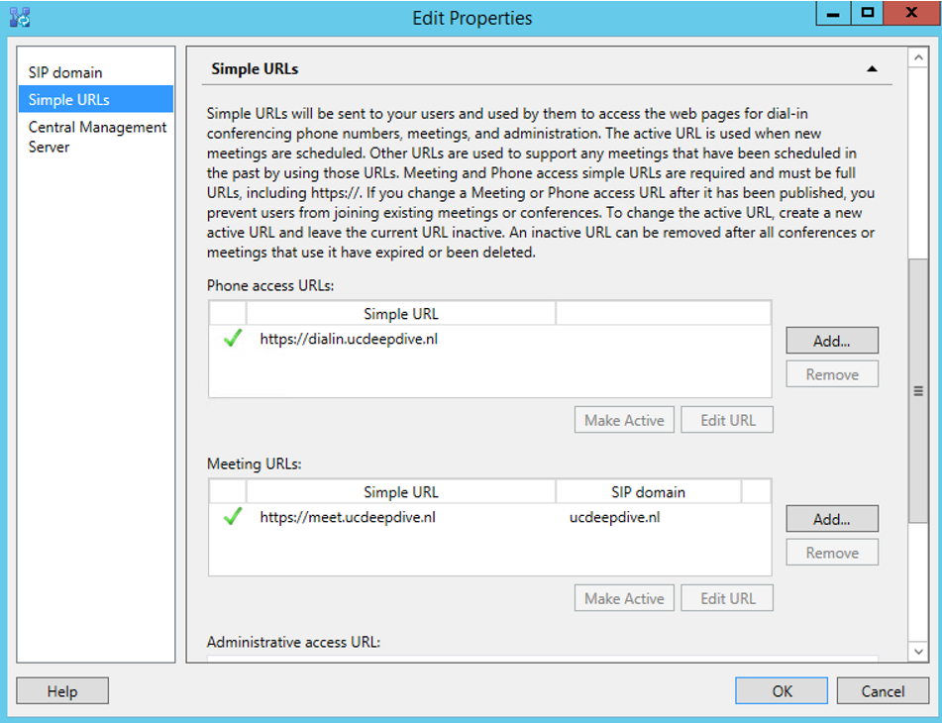
Change Simple URL

Slide 29
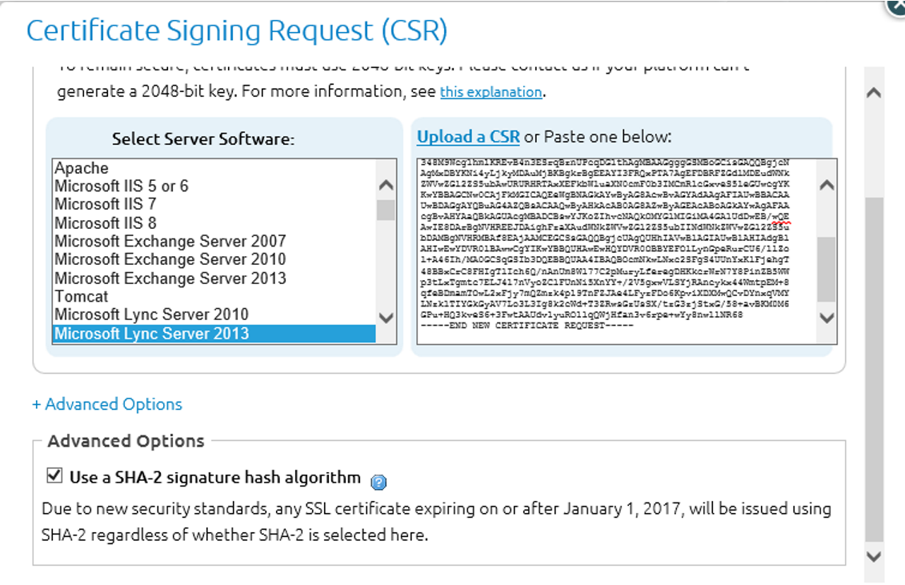
Certificate Changes

Slide 30
Certificate Changes
After January 1, 2017 SHA-1 SLL certificates No Longer Trusted by Windows.
After November 1, 2015 Certificates for Internal Names Will No Longer Be Trusted.

Slide 31
Where can it go wrong?
Deployment
Operations
CA trust
  CRL reachability internal/external
  Chain issues
  Certificate expiration
  Internal CA not trusted
Changes in Windows
Regulation changes

Slide 32


Indicators
Exclamation marks in Lync client.
Presence Unknown (federation)
  Expired certificate (or DNS) -> msdiag
No CMS replication with Edge
Lync Monitoring
Event log entry / Monitoring product

Slide 33
Certificate Revocation List – Edge Server
Federation CRL check
  Outbound port 80
  (Disable: Set-CsAccessEdgeConfiguration with KeepCrlsUpToDateForPeers set to False)
Internal CRL check
  Ensure CRL availability

Slide 34
Certificate Expiration - Impact
Internal
  Stopped Lync Services
  Office Server communication (Oauth)
External
  Stopped Lync Services
  Failed A/V sessions (media relay)
  Office 365 communication (Oauth)
  Lync Phone Edition unable to logon remotely

Slide 35
Certificate Expiration - Prevention
Monitor
Renew
Stage
  Useful for tokens
  AV (Edge) & OAuth
  Set-CsCertificate –Roll –EffectiveTime

Slide 36
Troubleshoot tools
Event log
Message Analyzer
Fiddler
Centralized Logging Service
OCSLogger
Snooper
Synthetic transactions (Test-CS...)

Slide 37
Troubleshoot tools
Microsoft Remote Connectivity Analyzer
Microsoft Connectivity Analyzer Tool
Lync Connectivity Analyzer
Lync Monitoring Server

Slide 38
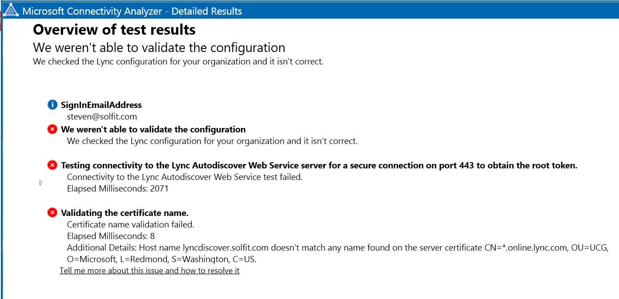
Microsoft Connectivity Analyzer Tool

Slide 39
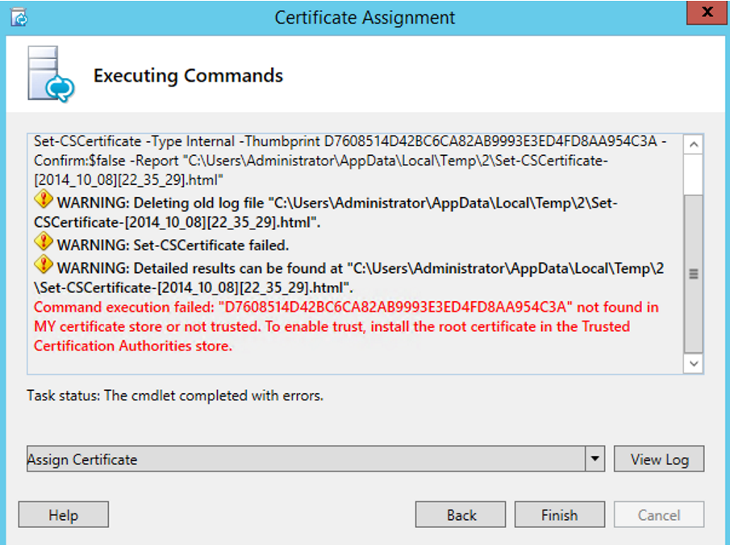
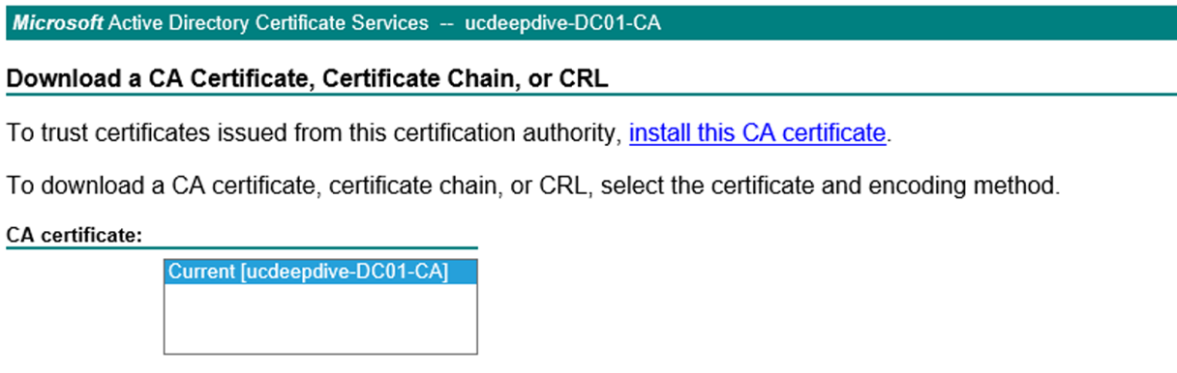
Troubleshooting Edge Deployment

Slide 40
No CMS replication with Edge
Internal edged cert expired
Internal crl not accessible
Cert store issue
Error code?

Slide 41
Troubleshooting EWS
Exclamation marks in Lync client.
  Indicates EWS issues
  Outlook test shows ok (but uses SCP)
Fiddler
  FQDN’s are ok
  Check DNS -> Fix DNS
Exchange certificate not trusted? (Fiddler)
  Deploy new Exchange certificate
Fixed!

Slide 42
Demo
Ms-diagnostics

Slide 43
Certificate Tips
Preparation is key
  Lync Planning Tool
  Technet
Choose your public CA wisely
  Cheap usually equals trouble
Know your tools
Consider HA/DR for your internal CA

Slide 44
Poodle

Slide 45
Poodle
Padding Oracle On Downgraded Legacy Encryption
Exploits SSL vulnerability
SSL is used for backwards compatibility
Mitigation: Disable SSL on IIS and disable SSL in your browser
Microsoft Security Advisory 3009008

Slide 46
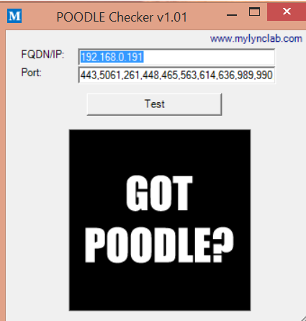
Poodle
MasterLync.com
Mylynclab.com:

Slide 47
Questions?

Slide 48
Related content
Breakout Sessions
  OFC-B325 Microsoft Lync Server 2013 Security Aspects: Secure by Design
Labs
  OFC-H307 Deploying and Configuring Microsoft Lync Edge Server 2013
  Microsoft Solutions Experience Location (MSE)
    Office 365 – Lync (Hall 7)
  Find Me Later MSE & At Ask The Expert
    Tuesday 18:15-20:30, Thursday 13:15-15:15 & 18:30-20:00

Slide 49
Technical Network
Join the conversation!
Share tips and best practices
with other Office 365 experts
http://aka.ms/o365technetwork

Slide 50

Resources
Learning
  Sessions on Demand
  Microsoft Certification & Training Resources
http://channel9.msdn.com/Events/TechEd
www.microsoft.com/learning
TechNet
Developer Network
  Resources for IT Professionals
http://microsoft.com/technet
http://developer.microsoft.com

Slide 51


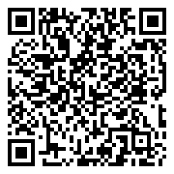
Please Complete An Evaluation Form
Your input is important!
TechEd Schedule Builder
CommNet station or PC
TechEd Mobile app
Phone or Tablet
QR code

Slide 52
Evaluate this session

Slide 53


© 2014 Microsoft Corporation. All rights reserved. Microsoft, Windows, and other product names are or may be registered trademarks and/or trademarks in the U.S. and/or other countries.
The information herein is for informational purposes only and represents the current view of Microsoft Corporation as of the date of this presentation. Because Microsoft must respond to changing market conditions, it should not be interpreted to be a commitment on the part of Microsoft, and Microsoft cannot guarantee the accuracy of any information provided after the date of this presentation. MICROSOFT MAKES NO WARRANTIES, EXPRESS, IMPLIED OR STATUTORY, AS TO THE INFORMATION IN THIS PRESENTATION.

