Slide 1


Slide 2

eDiscovery and Organizational Search in Microsoft Office
OFC-B315
Zohaib Ali

Slide 3
The importance of eDiscovery
90%
US corporations currently engaged in litigation
147
Average active lawsuits for $1B+ companies
$1M
Average cost of eDiscovery per-case
**Fullbright & Jaworski, Gartner

Slide 4



eDiscovery and Archiving in Office 365
Integrated tools to help you preserve, expire, and discover data
Archive
Deletion
Search
Keep the data you do want
Delete the data you don’t want
Find the data you need
Automated time-based criteria to delete
Set policies at item or folder level – admin or user
Set site level retention polices
Search across multiple products
De-duplication & search statistics
Case management
Export search results
Data Held In-Place
Customize holds based on filters
Hold across multiple products in a single action
Capture deleted & edited messages

Slide 5
Archiving

Slide 6


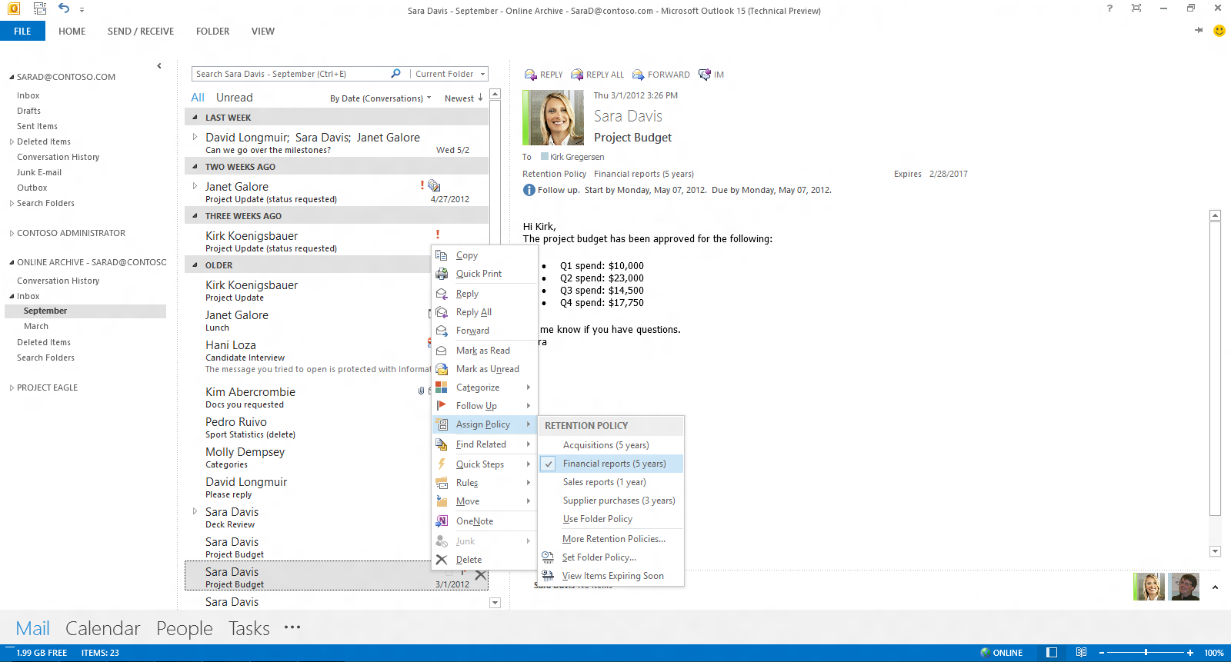
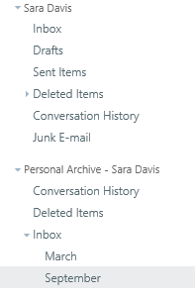
Personal Archive
Outlook
OWA
A secondary mailbox that provides additional end user storage
There are no compliance-specific controls or settings
It has no relevance to compliance archiving
Consider using the Outlook 2013 Sync Slider instead

Slide 7
In-Place Archiving
Traditional approach to archiving
In-Place archiving
Exchange
Exchange
eDiscovery and compliance
Lync
Immutable
SharePoint
Bloomberg
Archive
Others
SharePoint
3rd Party Archives
Immutable
…
Preserve data in place, instead of importing to a separate repository
Ingest data to extend beyond these workloads
Unified compliance experience and configuration across Office 365

Slide 8
Archiving
eDiscovery simplified
In-Place hold
Content stays in Exchange
and SharePoint and is made immutable
Less storage, lower costs, higher fidelity
Time and query based hold
Hold entire mailboxes and
sites, or apply a query to
hold less content
No impact to users
Seamlessly create, edit,
and delete
Users don’t know they’re on hold

Slide 9
How does Exchange
Archiving
Work?
(1) Message delivered
User A Mailbox
Inbox
(2) Message moved
to Deleted Items
…
Deleted Items
Recoverable Items
(3) Message deleted
Deletions
(4a) Message “purged”
by user
Versions
Purges
(4b) Message “purged”
by user (In-Place Hold)
Audits
DiscoveryHold
Calendar Logging

Slide 10





How does SharePoint
Archiving
Work?
  SharePoint checks to see if content has been modified since Hold
  User modifies or deletes data
  If first modification, a copy is saved to the preservation hold library
  If a filter is applied a job will run periodically checking and cleaning any content that doesn’t match Filter
**If versioning is enabled versions of documents will be saved.

Slide 11


How does Lync Archiving Work?
Server-side Archiving
All Lync modalities captured (PC, mobile, web, OWA)
Lync uses EWS to write data
User A on Hold
User A Mailbox
Inbox
Deleted Items
Recoverable Items
Deletions
Purges
Versions
DiscoveryHolds
Hold state synced

Slide 12

How does archiving work for inactive users?
  User is placed on hold
  User leaves company, AD object is deleted
  The license will be released, and the In-Place Hold remains enabled
  The hold is removed or reaches its specified end date. The data is then deleted
  Inactive data can now be searched and accessed only through eDiscovery

Slide 13
Why two different holds?
Variants
Management Options
Litigation Hold (legacy)
Exchange admin center
Powershell
In-Place Hold
eDiscovery center
Exchange Admin Center
Powershell

Slide 14
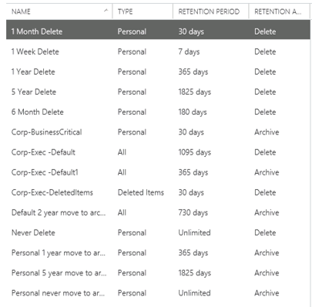
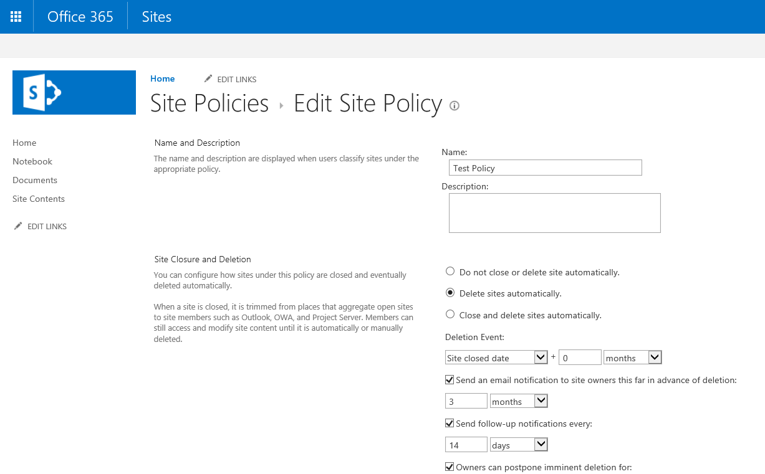
Deletion
Exchange Policies
SharePoint Site Policies
Manage storage and risk proactively with mailbox management and expiration policies
Manage central policies, and assign policies to site collections to manage retention

Slide 15
Demo
Deletion and Litigation Hold

Slide 16
eDiscovery

Slide 17
eDiscovery Process
Identify &
preserve
Search &
process
Review
Produce
Volume
Relevance

Slide 18
eDiscovery Process
Identify &
preserve
Search &
process
Review
Produce
Volume
Relevance

Slide 19
eDiscovery Process
Identify &
preserve
Search &
process
Review
Produce
Volume
Relevance

Slide 20
eDiscovery Process
Identify &
preserve
Search &
process
Review
Produce
Volume
Relevance

Slide 21
Search
eDiscovery simplified
Real time
No need to wait for indexing, always live and up-to-date
Reduce
Proximity search,
rich query syntax
Make decisions
Query and source statistics help you analyze

Slide 22
Quick Investigation
eDiscovery simplified
Early case assessment
Fast, real-
time search
Answers
in minutes,
not weeks

Slide 23
Export
eDiscovery simplified
Easy
Download from SharePoint, Exchange, and file shares—cloud or
on-premises
EDRM XML
Supports a growing industry standard for data interchange
Get it offline
Outputs native files, PSTs, pages as .MHT, Lists & Feeds as .CSV

Slide 24
Demo eDiscovery & In-Place Hold

Slide 25
Keywords and Properties
Query | Example results
“Executive Briefing” | Any content that contains the words “Executive Briefing” together, anywhere in a document, page, or message.
“Executive Briefing” AND “Summary” | Any content that contains the words “Executive Briefing” and “Summary” anywhere in the document, page, or message.
filename:budget | Any file with “budget” in its filename, such as “2014 budget projections.docx,” “2015 budget priorities.pptx,” “2014 budget planning.xlsx,” and so on.
filename:2014 budget filetype:xls | Excel files with “2014 budget” in their filenames, such as “2014 budget projections.docx,” “2015 budget priorities.pptx,” “2014 budget planning.xlsx,” and so on.
Executive NEAR(20) Briefing | Any content that contains the word “Executive” within 20 words of “Briefing.”

Slide 26
Sensitive Data
Query | Example results
SensitiveType:”Credit Card Number” | Any content that contains one hit on the rule named “Credit Card Number.”
SensitiveType:”Credit Card Number |5..” | Content that containing 5 or more Credit Card Numbers.
SensitiveType:”Credit Card Number |10..100” | Content containing between 10 and 100 Credit Card numbers.
SensitiveType:”International Banking Account Number(IBAN)” AND isViewableByExternalUsers | Content shared externally containing international bank account numbers.

Slide 27
Microsoft eDiscovery Team
Preservation of potentially relevant data
  Prevent deletion of responsive data
  Minimize disruption to the business
Find relevant data to produce to opposing parties
  Dire consequences associated with failing to produce data within aggressive deadlines
  Multi-phased approach that typically involves iterative stages of filtering across different tools
Identify & preserve
Process & search
Review
Produce
In-source
Out-source

Slide 28
Average Microsoft case from FY11-13
68 cases with active eDiscovery efforts per year
45 people under legal Hold
1.3TB
13 people’s data searched
288.8GB
Reviewed
16.8GB
Produced
4GB
Used
249 pp.
If we were to outsource the unfiltered entirety of the data to be processed and searched by
a vendor, the rough standard charge would be ~$200/GB, totaling $57,760 per case, or
$3.9 million/year.
If we outsource only the culled data, our data processing charges are reduced to $3,360 per case, saving us an average of
$3.7 million/year.

Slide 29
Technical Network
Join the conversation!
Share tips and best practices
with other Office 365 experts
http://aka.ms/o365technetwork

Slide 30


Office 365
Exams
Managing Office 365 Identities and Requirements
EXAM
346
Deploying
Office 365 Services
EXAM
347
http://bit.ly/
O365-Cert
+
Classroom
training
Introduction
to Office 365
FLC
40041
Managing Office 365 Identities and Services
MOC
20346
Designing for Office
365 Infrastructure
5
MOC
10968
3
http://bit.ly/
O365-Training
Online
training
Office 365
Fundamentals
MVA
Managing Office 365 Identities and Services
MVA
http://bit.ly/
O365-MVA
Get certified for 1/2 the price at TechEd Europe 2014!
http://bit.ly/
TechEd-CertDeal

Slide 31

Resources
Learning
  Sessions on Demand
  Microsoft Certification & Training Resources
http://channel9.msdn.com/Events/TechEd
www.microsoft.com/learning
TechNet
Developer Network
  Resources for IT Professionals
http://microsoft.com/technet
http://developer.microsoft.com

Slide 32



SUBMIT YOUR TECHED EVALUATIONS
We value your feedback!
Fill out an evaluation via
CommNet Station/PC: Schedule Builder
LogIn: europe.msteched.com/catalog
TechEd Mobile app
for session evaluations
is currently offline

Slide 33


© 2014 Microsoft Corporation. All rights reserved. Microsoft, Windows, and other product names are or may be registered trademarks and/or trademarks in the U.S. and/or other countries.
The information herein is for informational purposes only and represents the current view of Microsoft Corporation as of the date of this presentation. Because Microsoft must respond to changing market conditions, it should not be interpreted to be a commitment on the part of Microsoft, and Microsoft cannot guarantee the accuracy of any information provided after the date of this presentation. MICROSOFT MAKES NO WARRANTIES, EXPRESS, IMPLIED OR STATUTORY, AS TO THE INFORMATION IN THIS PRESENTATION.

