Slide 1


Slide 2

Large Meetings Best Practices
OFC-B323
Sandra Martinez Polo
Communications TSP
Microsoft Spain

Slide 3
OFC-B323 Large Meetings Best Practices
Sandra Martinez Polo
Communications TSP
Microsoft Spain

Slide 4
Session Objectives And Takeaways
Session Objectives:
  Understand how Lync 2013 supports meetings of up to 1000 users
  Get “best practices” for running Large and Managed meetings
Key Takeaways
  Lync 2013 can support up to 1000 users in a meeting
  Running successful Large and Managed Meetings requires some planning and adoption of “best practices”

Slide 5
Definition

Slide 6
Lync Meeting Types
Managed
Scheduled
Ad hoc
Ad hoc
  P2P
Scheduled
  Multiparty, Shared Content
  Collaboration
Managed
  Training
  All-Hands/Town Hall
White
Glove

Slide 7
Server Requirements

Slide 8





Lync Large Meeting Support
Up to 250 users
  No special infrastructure requirements
250 - 1000 Users
  Dedicated Pool
  Meeting Organizer account must be in that pool
  Apply Large Meeting policy to the Meeting Organizer
Pool A
Pool B
Pool C
Attendee
Attendee
Organizer

Slide 9
Plan Ahead (Lync Administrator)
Organizer account
  Consider dedicated Large Meeting organizer
  Can use user account – move to Large Meeting Pool
    be careful of existing meetings
  Prepare LargeMeeting policy
    Must use Lync Server Management Shell (PowerShell)
    New Parameter for Set_CSConferencingPolicy
    -AllowLargeMeetings $true
Pool A
Pool B
Pool C
Attendee
Attendee
Organizer

Slide 10
Set-CSConferencingPolicy
Recommendations for Large Meetings
Identity : Tag:LargeMeeting
AllowMultiView : False
Description : Large meeting policy for special events
AllowAnnotations : False
AllowPolls : True
EnableAppDesktopSharing : None
AllowConferenceRecording : True
AllowLargeMeetings : True
MaxVideoConferenceResolution : VGA
MaxMeetingSize : 1000

Slide 11
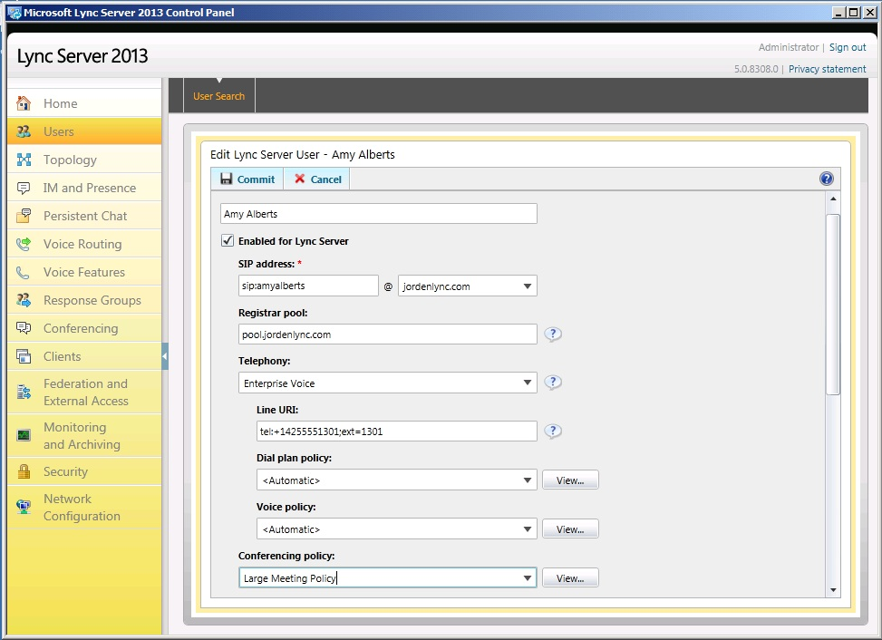
Large Meeting Policy (Lync Administrator)
Apply LargeMeeting policy to meeting organizer Lync account
  Use Lync Control Panel or
  Lync Server Management Shell
  PowerShell)

Slide 12
Scheduling the meeting

Slide 13
Book the meeting
Reminder:
  Use dedicated Large Meeting account
Create Outlook Meeting Invite
  Create meeting using A New Meeting Space
  Declare Presenters
  Check Meeting Options
  Don’t copy Meeting Text to another meeting

Slide 14
Demo
Schedule the meeting

Slide 15
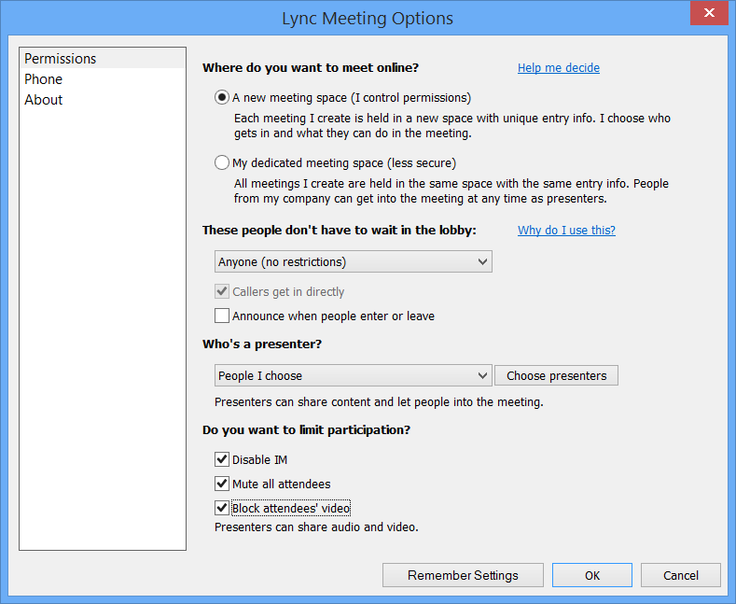

Slide 16
Meeting Room Layout

Slide 17
Meeting Room Layout Caveats
“Normal” Lync Meetings
  Most Lync Meetings are Self Contained and Self Managed
  Don’t need the White Glove Service
Larger Managed Meetings
  Specific people with specific jobs
White Glove Self-Service
  Setting the highest Exec Presentation bar
  e.g. Town Hall “production” meetings
    4 laptops/Lync accounts

Slide 18


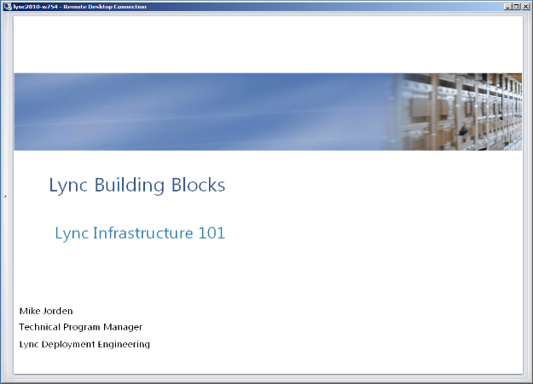
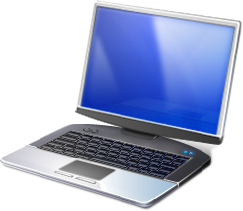


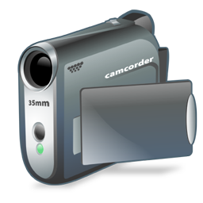

Meeting Room Layout (White Glove)
In-room audio system
(microphone and speakers)
Moderator PC
Used to monitor IM, Q&A and Mute attendees
Video Camera or
WebCam
PC joined to Lync Meeting
Presenter advances slides using remote “clicker”
Connection between in-room
Audio system and
Lync PC
PC connected to in-room
Screen showing Shared Presentation content Full Screen via Lync
Camera/WebCam PC

Slide 19
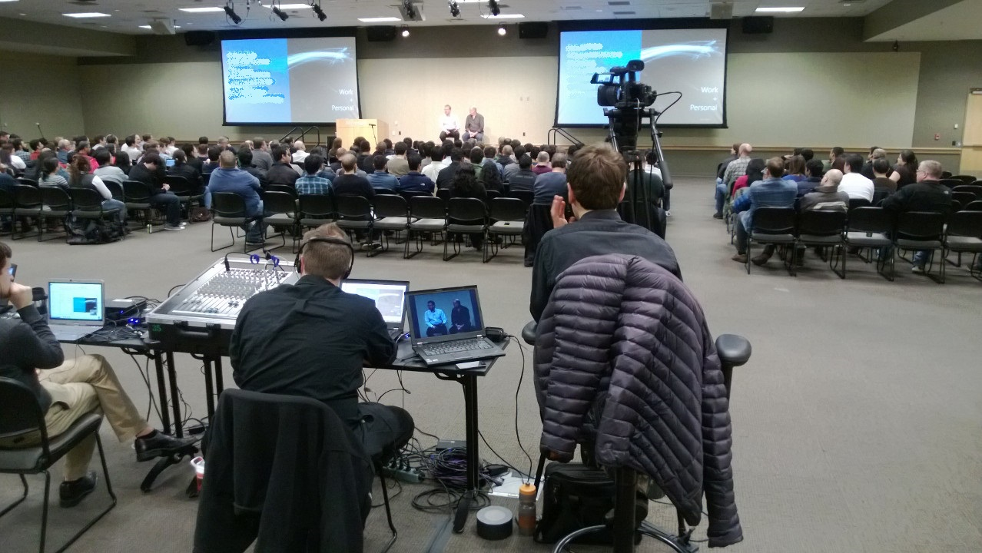

Slide 20
Audio Video
Approved Devices
  WebCams
  Speakerphones
  Wireless mics/headsets
  http://technet.microsoft.com/en-us/lync/gg278164.aspx
Capture Devices
  Mic/Line Input
  USB Mixers
  Vaddio AV Bridge

Slide 21
Large Meeting
Best Practices

Slide 22
Best Practices: Scheduling
If expecting >250 attendees, confirm with your Lync Admin that you are in the Lync Large Meeting pool before scheduling
Consider having a dedicated “Large Meeting Organizer” user account
  Allows better visibility/ability to manage scheduling of Large Meeting resources
Assign at least one back-up presenter to assist during live event
Plan for a dry-run session several days in advance of your event
From Meeting Options
  Select A New Meeting Space to ensure you are using a unique URL
  Select desired setting for These people don’t have to wait in the lobby
  Designate your presenters and attendees
  Consider enabling some/all of the following as-needed:
    Disabling IM (can’t be re-enabled during meeting)
    Muting all Attendees
    Blocking Attendees’ Video

Slide 23
Prepare The Meeting Content
Day of before the meeting
  Finalize Content
  Embed and Compress Videos
  (Other Video options?)
  Upload Meeting Content
  Don’t forget – Large Meetings – PPT only
  Only Close the meeting (Don’t end)

Slide 24
Best Practices: T-1 day
If video clip is required, ensure file is embedded in PPT and optimized
Do not use application sharing to present PPT deck
Upload PPT deck(s) and click through slides to ensure builds work properly
Determine how you will address questions
  IM window: can be distracting if you have lots of attendees
  Q&A feature: separate tab within the client – can be enabled/disabled from within the client
Consider having cycling slides to play in advance of meeting start
  Use the animation feature in PPT and set the slides to change every 10 seconds
  Communicate detail about the session, speakers, and available resources
  Share logistical information about the event
Familiarize yourself with the recording functionality and plan to have at least two separate computers recording the live session
Confirm all computers being used in the meeting have the latest version of the full Lync client installed

Slide 25
Best Practices: T-60 Minutes
Presenters/back-up presenters log in at least 30 minutes in advance of meeting start
All presenters should use hardwired internet connection
Ensure only one active audio sound source at any given time
Close out of all non-essential applications
Open up More Options (…) menu and get ready to record

Slide 26
Best Practices: In meeting
Read a welcome script:
  “Session is being recorded – please disconnect now if you do not want to participate”
  “Questions will be addressed at end of session” -OR- “Use IM window to ask questions throughout”
  “Your line is muted and you will be unmuted at the appropriate time” -OR- “Your line will be muted for the duration of the session”
Considering locking presenter’s video (Lock Video Spotlight)
Limit desktop shares to meetings with <250 participants
Record the session if appropriate
  Don’t forget to stop recording at the end of the session!

Slide 27
Prepare The Meeting Content

Slide 28
Demo
Prepare Meeting Content

Slide 29
New Features

Slide 30
New Features
Lock Video Spotlight
IM Mute
Q&A
Recording
Roster Management

Slide 31
Demo
New Features

Slide 32
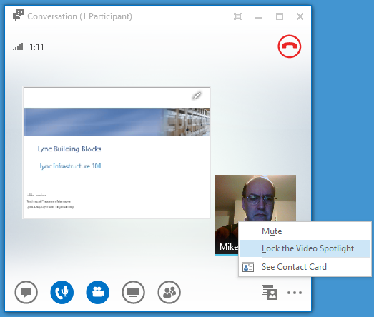
Lock Video Spotlight

Slide 33
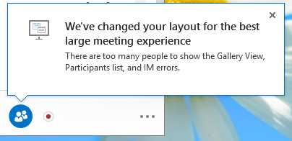
New Features
Roster Management – over 75 participants

Slide 34
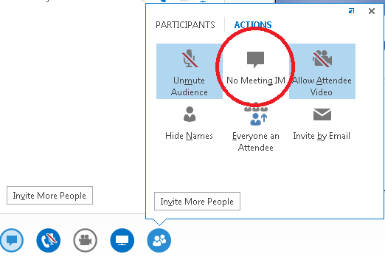
IM Mute

Slide 35
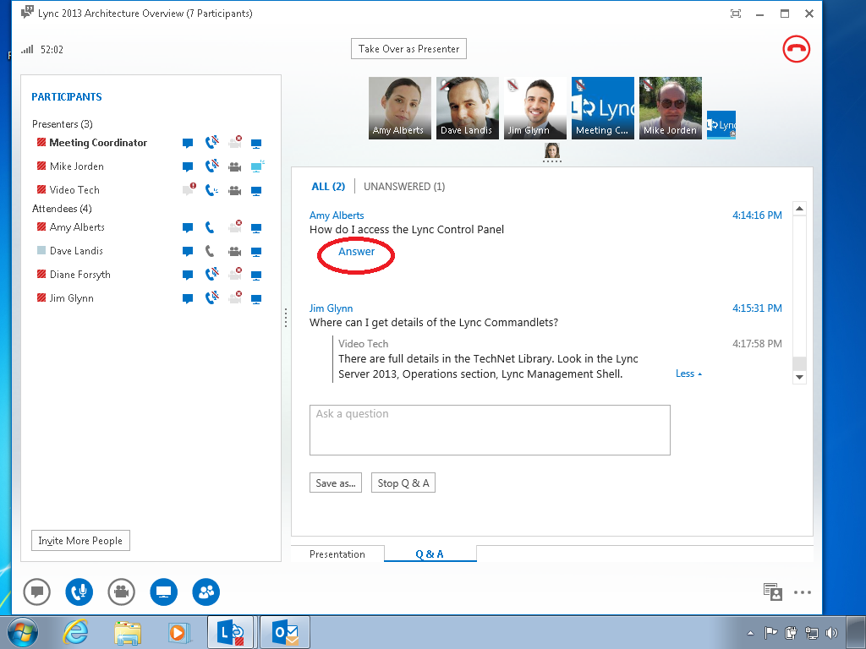
Q&A

Slide 36
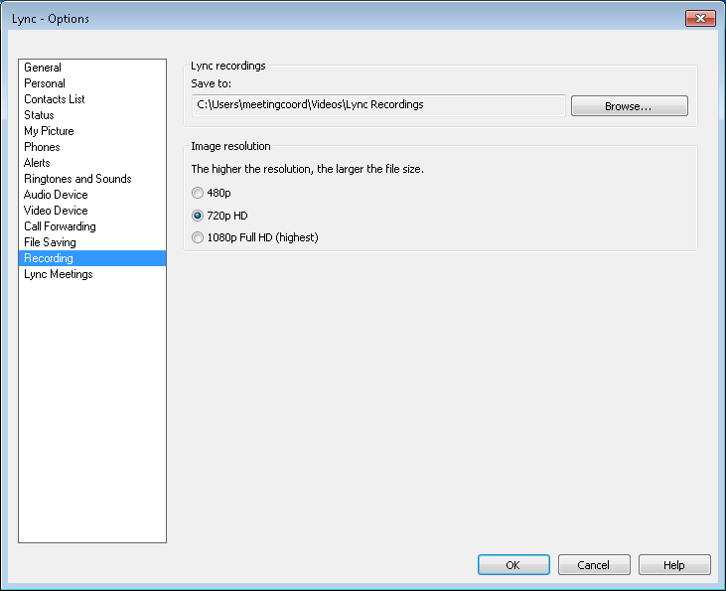
Recording Options

Slide 37
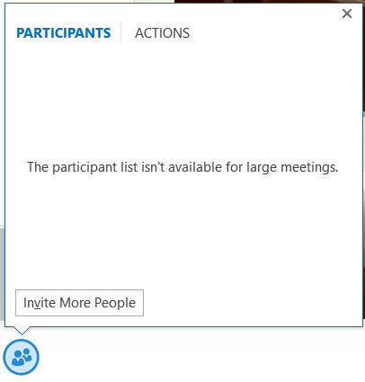
New Features
Roster Management – over 75 participants

Slide 38
Roster Management

Slide 39
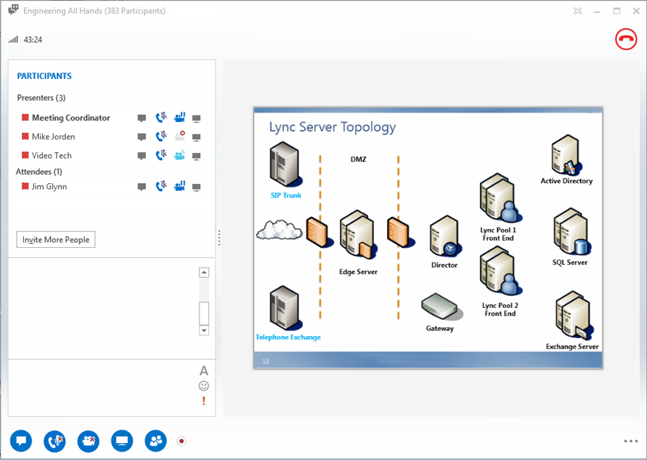

Roster Management – allowlargemeetings true

Slide 40
Set-CSConferencingPolicy
Recommendations for Large Meetings
Identity : Tag:LargeMeeting
AllowMultiView : False
Description : Large meeting policy for special events
AllowAnnotations : False
AllowPolls : True
EnableAppDesktopSharing : None
AllowConferenceRecording : True
AllowLargeMeetings : True
MaxVideoConferenceResolution : VGA
MaxMeetingSize : 1000

Slide 41
In Summary…

Slide 42
In Review: Session Objectives And Takeaways
Session Objective(s):
  Understand how Lync 2013 supports meetings of up to 1000 users
  Get “best practices” for running Large and Managed meetings
Key Takeaways
  Lync 2013 can support up to 1000 users in a meeting
  Running successful Large and Managed Meetings requires some planning and adoption of “best practices”

Slide 43
Q&A

Slide 44
Related content
Breakout Sessions
  OFC-B328 Microsoft Lync Online
  OFC- B328 Microsoft Lync Online
  OFC-B410 Enterprise Networking with Microsoft Lync Server 2013: Network Bandwidth and QoS Requirements
  OFC-B326 Microsoft Lync Server 2013: Enterprise Voice
  Labs
    OFC-IL300 Configuring HA and DR in Microsoft Lync Server 2013
Find Me Later At. . . Lync: smarpolo@microsoft.com

Slide 45

Resources
Learning
  Sessions on Demand
  Microsoft Certification & Training Resources
http://channel9.msdn.com/Events/TechEd
www.microsoft.com/learning
TechNet
Developer Network
  Resources for IT Professionals
http://microsoft.com/technet
http://developer.microsoft.com

Slide 46
Technical Network
Join the conversation!
Share tips and best practices
with other Office 365 experts
http://aka.ms/o365technetwork

Slide 47


Office 365
Exams
Managing Office 365 Identities and Requirements
EXAM
346
Deploying
Office 365 Services
EXAM
347
http://bit.ly/
O365-Cert
+
Classroom
training
Introduction
to Office 365
FLC
40041
Managing Office 365 Identities and Services
MOC
20346
Designing for Office
365 Infrastructure
5
MOC
10968
3
http://bit.ly/
O365-Training
Online
training
Office 365
Fundamentals
MVA
Managing Office 365 Identities and Services
MVA
http://bit.ly/
O365-MVA
Get certified for 1/2 the price at TechEd Europe 2014!
http://bit.ly/
TechEd-CertDeal

Slide 48
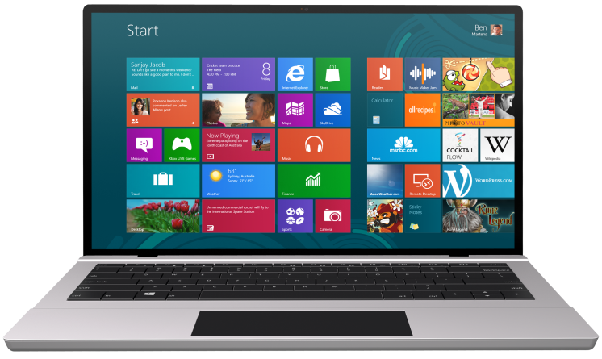


SUBMIT YOUR TECHED EVALUATIONS
We value your feedback!
Fill out an evaluation via
CommNet Station/PC: Schedule Builder
LogIn: europe.msteched.com/catalog
TechEd Mobile app
for session evaluations
is currently offline

Slide 49


© 2014 Microsoft Corporation. All rights reserved. Microsoft, Windows, and other product names are or may be registered trademarks and/or trademarks in the U.S. and/or other countries.
The information herein is for informational purposes only and represents the current view of Microsoft Corporation as of the date of this presentation. Because Microsoft must respond to changing market conditions, it should not be interpreted to be a commitment on the part of Microsoft, and Microsoft cannot guarantee the accuracy of any information provided after the date of this presentation. MICROSOFT MAKES NO WARRANTIES, EXPRESS, IMPLIED OR STATUTORY, AS TO THE INFORMATION IN THIS PRESENTATION.

