Slide 1


Slide 2

Secure by design
OFC-B325
Thomas Poett
Zahid Saeed (MSFT)

Slide 3
Agenda
Lync: Secure by Design
Secure Zones
Security Model
Solution Design
Considerations

Slide 4
Session Objectives And Takeaways
Session Objective(s):
  Obtain understanding of Lync 2013 security capabilities
  Learn how to design security for your collaboration solution
Key Takeaway
  Lync is secure! ☺
  The Lync Security deck will help to you to deliver the message

Slide 5
Lync: Secure by Design

Slide 6
Security as ….
All communication is secured by default
  Server/server, server/client and client/client
No accounts are enabled by default
  Account enabling requires admin interaction
No users are admin by default
  No groups are ever added to the admin groups, not even the enterprise admin groups
External access is disabled by default
  This access includes mobile devices, devices from home, and federated partners

Slide 7
Client Authentication options
Kerberos
  Preferred authentication method for internal clients signing in first time
NTLM
  If Kerberos is not available (e.g. for external clients) NTLM will be used for first sign in
TLS-DSK
  After first sign in the Lync Server creates a certificate for the client, that the client will use for subsequent sign ins (it is manageable with powershell)
Passive Authentication
  Allows to implement dual factor authentication, but has some limitations

Slide 8
Kerberos
Mutual ticket authentication
Based on trusted 3rd party: Active Directory (AD)
Preferred authentication protocol for AD
Requires direct connection with AD
Requires loosely synced time (<5min)

Slide 9
NTLM
NT LAN Manager Security Protocol
Challenge/Response authentication protocol
Only requires protocol layer connectivity with AD
Used for remote login with domain credentials

Slide 10
TLS-DSK
Transport Layer Security - Derived Session Key
Certificate based authentication
  Client certificate created by Lync Server
  Client certificate trusted only by Lync Server
  Client certificate stored in clients personal certificate store
Does not require connectivity to AD
  Enables Branch Survivability Scenarios
Certificate validity ranges from 8hr to 365 days (default 180)
Previous certificate used to obtain a new one

Slide 11
Passive authentication
“Passive”
  Lync Server is not doing any authentication
  Authentication is handled by ADFS
  ADFS can be integrated with existing Security Token Service (STS)
Dual Factor Authentication
  ADFS can leverage (virtual) Smart Card
  STS can provide second factor

Slide 12
Passive Authentication Limitations
Lync Server only
Per pool settings
Exchange
  Dedicated authentication required in order to get Call Logs, Unified Contact Store
SharePoint
Supported clients
  Lync 2013 desktop client
  Microsoft Lync 2013 for iPhone
  Microsoft Lync 2013 for iPad
  Microsoft Lync 2013 for Windows Phone 8

Slide 13
Server Trust Model
Server will only talk to trusted servers
  Internal servers need to be on trusted server list
  External servers need to be configured for Federation
Server will only talk to servers with certificate
  Certificate need to be valid, from a trusted Certificate Authority and have the FQDN of the server in the Subject Name or Subject Alternate Name
Encryption
  Mutual TLS
  Both servers establish TLS connection to each other

Slide 14
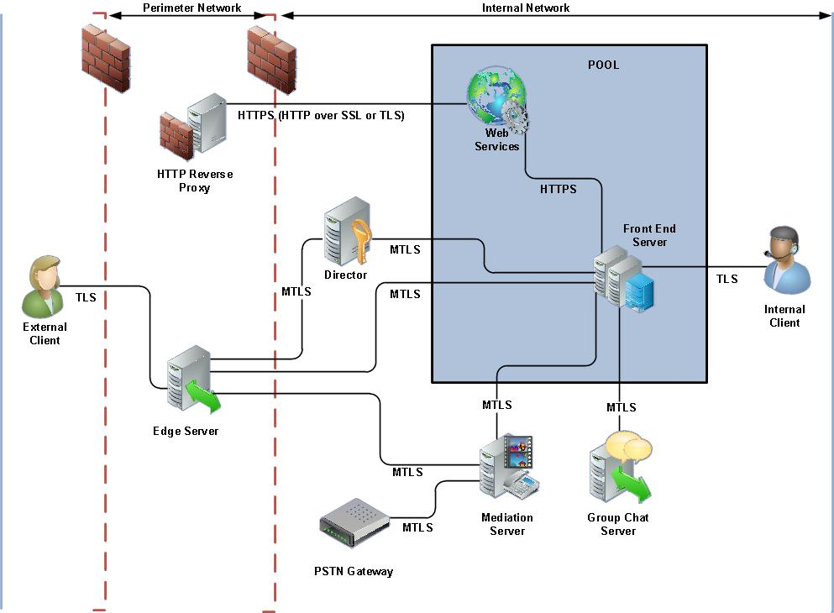

Slide 15
Secure Zones

Slide 16
Secure Zone (IP Traffic)
Internet based Access
Logon Traffic Redirection
Internal Server service segregation
Mediation Server to Gateway communication

Slide 17
General components in external access
External client
SIP Proxy
Reverse Proxy
Internal Registrar

Slide 18
Secure Zones (Web Traffic)
Internet
Inside DMZ
LAN (Servers)

Slide 19
Secure Zones (external deployment)
Internet (Unsecure)
Outside DMZ (1st line of defense)
Inside DMZ (2nd lod, high secure)
LAN (Servers) (highest secure)

Slide 20
Secure Zone (Telephony)
Communication between Mediation Server and Gateway must be secure
SRTP or and isolated LAN (not routed)
  If isolated LAN, no Media Bypass possible

Slide 21
Security Model

Slide 22
Secure Authentication flow
Director Server is final Endpoint for external and ( optional for internal) authentication
A Director Pool is no longer recommended
4. Edge presents certificate to Client
3. Server presents the certificate to Edge Server
7. Trusted and encrypted connection is established
1. After DNS resolution, client contacts the Lync Edge Access Server.
2. Edge Access Server connects to Director Server (Next Hop)
5. Client authenticates
6. Authentication is processed

Slide 23
Secure SIP Traffic flow (IM)
Session Traffic (TCP) has director server always involved (VIA HOP)
5. IM replies in the opposite direction
1. IM sent in SIP connection secured with TLS
4. IM is send to client (SIP/ TLS)
2. Edge forwards IM to Director Pool Server (SIP/MTLS)
3. Director Pool forwards IM to Frontend Pool (SIP/MTLS)

Slide 24
Secure SIP Traffic flow (P2P) – A/V & File
Session Traffic involved all user homed pools
Media Traffic runs via UPD (alt. TCP)
Media Traffic is always P2P (no frontend servers)
SIP Signaling is equal to IM
Other P2P connections are: Desktop Sharing and File Transfer, both secured with SRTP protocol
7. A/V session is established via P2P connection, secured with SRTP protocol
1. Initiate IM Session via Home Pool (SIP/ TLS)
3. IM Session is send to Client (SIP/ TLS)
Bidirectional Channel
2.IM Session is forward to second Pool (SIP/MTLS)
4. Client add A/V to the IM Session (Signaling) via SIP/TLS/MTLS)
6. Signaling is send to Client (SIP/ TLS)
5. Signaling is forwarded to second Pool (SIP/ MTLS)

Slide 25
Secure Call Establishment – Internal/External
Media Traffic via Edge Server is Proxyed (separated)
A/V Edge Server handles Media for internal and external Client separately
A/V Edge can be NATed
A/V Edge authentication
Obtain media session ports A/V Edge Server
Call internal user
A/V Edge authentication A/V Edge authentication, receives internal media port
(Within the CANDIDATES)
Call external user, inform remote user of internal media ports

Slide 26
Secure SIP Traffic flow (P2P) - Federation
ICE
First connection attempt is via UDP, than fallback to TCP
UDP are open on demand only

Slide 27
Summary Security Protocol Usage
HTTPS traffic via Reverse Proxy
Session Traffic via SIP/TLS/MTLS Proxy (Access Edge)
A/V Traffic via SRTP Proxy (A/V Edge)
(SSL, TLS/MTSL & SRTP tunnel with re-encryption)
Meeting (establ.+ files), ABS, Mobility, Dial-In, to Reverse Proxy
HTTPS (443)
Meeting (establ.+ files), ABS, Mobility, Dial-In, to Reverse Proxy
HTTPS (4443) ext WS
Sign-In, contacts, presence, IM Session Setup, … to Edge Server
SIP/ TLS
Sign-In, contacts, presence, IM Session Setup, … to Edge Server
SIP/ MTLS
Media (audio, video, appsharing, file transfer) to Edge Server
SRTP
Media (audio, video, appsharing, file transfer) to Edge Server
SRTP

Slide 28
HTTPS / IIS source traffic separation
IIS Isolation into two web sites
IIS Process isolation
File / OS isolation
Incoming web traffic (TCP 443)
web traffic
(TCP 443)
Incoming web traffic redirect
(TCP 4443)

Slide 29
Protocol utilization within Federation
Meeting (establ.+ files), ABS, Mobility, Dial-In, to Reverse Proxy
HTTPS (4443) ext WS
Meeting (establ.+ files), ABS, Mobility, Dial-In, to Reverse Proxy
HTTPS (443) ext WS
Uni-directional
Meeting (establ.+ files), ABS, Mobility, Dial-In, to Reverse Proxy
HTTPS (4443) ext WS
Sign-In, contacts, presence, IM Session Setup, Call Setup, …
to Frontend Server
SIP/ TLS
Sign-In, contacts, presence, IM Session Setup, Call Setup
to Frontend Server
SIP/ TLS
Sign-In, contacts, presence, IM Session Setup, Call Setup …
Edge <-> Edge in Federation
SIP/ MTLS
Sign-In, contacts, presence, IM Session Setup, Call Setup
to Edge Server
SIP/ MTLS
Sign-In, contacts, presence, IM Session Setup, Call Setup …
Edge <-> Frontend Server
SIP/ MTLS
Media (audio, video, appsharing, file transfer) all clients incl. Mobile
Client <-> Edge Server
SRTP
Media (audio, video, appsharing, file transfer) Edge Server <-> Edge Server
SRTP
NO Client-to-Client communication
Media (audio, video, appsharing, file transfer)
all clients incl. Mobile
Client <-> Edge Server
SRTP

Slide 30
Solution Design

Slide 31
Identify Security Needs
Company requirement
  As secure as possible
  Needs matching business requirements
High Secure / Government Institution
  Are additional security barriers or requirements necessary to fulfil
Other requirements
  Any other consideration the customer needs to realize

Slide 32
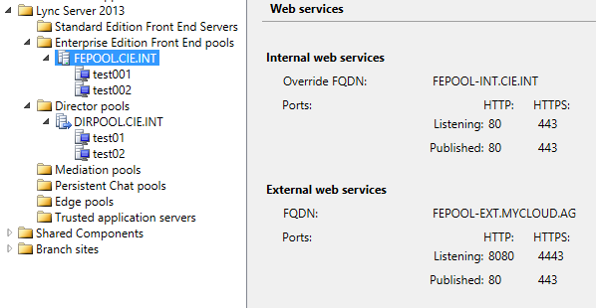
Segregation of int-/ external Web FQDN
Each pool separates into internal/ external Web Services FQDN
TCP Listening Port segregation
Reflected in certificates
Published externally

Slide 33
Simple DMZ Design
Proxy Servers (RevP/ Edge) are behind NAT
Public and private Certificate are assigned
Proxy traffic is directed to internal LAN
HTTPS
SIP
SIP
External HTTPS TCP 4443

Slide 34
Enhanced DMZ Design (high secure)
Proxy Servers (RevP/ Edge) are behind NAT
Public and private Certificate are assigned (FRONT DMZ)
Private Certificates are assigned (INSIDE DMZ)
Proxy traffic is directed to INSIDE DMZ, than to LAN (Auth. Isolation)

Slide 35
Multiple Frontend Server
Proxy Servers (Rev/ Dir) are behind NAT
Public and private Certificate are assigned (FRONT DMZ)
Private Certificates are assigned (INSIDE DMZ)
Lync Frontend Server are behind internal Firewalls

Slide 36
Additional Considerations

Slide 37
Types of Federation
Open Enhanced (Discovered Partner Domain):
  Accept any SIP domain name and use DNS SRV to locate partner server
Enhanced (Allowed Partner Domain):
  Configured partner SIP domain and DNS SRV to locate partner Edge server
Direct (Allowed Partner Server):
  Configured partner SIP domain and Edge server FQDN
Server Allow List:
  Accept any domain, use DNS SRV flinging partners Edge server of hosting provider or public instant messaging connectivity provider

Slide 38
Open Federation Security
General limits
  1 000 SIP URIs
  20 messages per second
  Statistics retained for one week
  Individually on each Edge Server
Ratio for valid/invalid SIP messages
  Partner added to watch list
  Restriction: 1 message per second
Too many users contacted
  Partner added to watch list
  Restriction: no additional users can be contacted

Slide 39
Types of internal certificates
OAuth
Lync Default
Internal Lync WebServices
External Lync WebServices
Reference:
http://technet.microsoft.com/en-us/library/gg398094.aspx
http://lyncuc.blogspot.de/2014/04/internal-certificate-deployment-in-lync.html

Slide 40
Planning for security in Lync Server 2013
  http://technet.microsoft.com/en-us/library/dn342827.aspx
  TLS and MTLS for Lync Server 2013
  http://technet.microsoft.com/en-us/library/dn481133.aspx

Slide 41
Technical Network
Join the conversation!
Share tips and best practices
with other Office 365 experts
http://aka.ms/o365technetwork

Slide 42


Office 365
Exams
Managing Office 365 Identities and Requirements
EXAM
346
Deploying
Office 365 Services
EXAM
347
http://bit.ly/
O365-Cert
+
Classroom
training
Introduction
to Office 365
FLC
40041
Managing Office 365 Identities and Services
MOC
20346
Designing for Office
365 Infrastructure
5
MOC
10968
3
http://bit.ly/
O365-Training
Online
training
Office 365
Fundamentals
MVA
Managing Office 365 Identities and Services
MVA
http://bit.ly/
O365-MVA
Get certified for 1/2 the price at TechEd Europe 2014!
http://bit.ly/
TechEd-CertDeal

Slide 43

Resources
Learning
  Sessions on Demand
  Microsoft Certification & Training Resources
http://channel9.msdn.com/Events/TechEd
www.microsoft.com/learning
TechNet
Developer Network
  Resources for IT Professionals
http://microsoft.com/technet
http://developer.microsoft.com

Slide 44


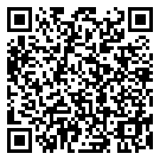
Please Complete An Evaluation Form
Your input is important!
TechEd Schedule Builder
CommNet station or PC
TechEd Mobile app
Phone or Tablet
QR code

Slide 45
Evaluate this session

Slide 46


© 2014 Microsoft Corporation. All rights reserved. Microsoft, Windows, and other product names are or may be registered trademarks and/or trademarks in the U.S. and/or other countries.
The information herein is for informational purposes only and represents the current view of Microsoft Corporation as of the date of this presentation. Because Microsoft must respond to changing market conditions, it should not be interpreted to be a commitment on the part of Microsoft, and Microsoft cannot guarantee the accuracy of any information provided after the date of this presentation. MICROSOFT MAKES NO WARRANTIES, EXPRESS, IMPLIED OR STATUTORY, AS TO THE INFORMATION IN THIS PRESENTATION.

