Slide 1


Slide 2

Lync-Skype connectivity v2
OFC-B329
Derek Whittle
Barry Castle

Slide 3

Resources
Learning
  Sessions on Demand
  Microsoft Certification & Training Resources
http://channel9.msdn.com/Events/TechEd
www.microsoft.com/learning
TechNet
Developer Network
  Resources for IT Professionals
http://microsoft.com/technet
http://developer.microsoft.com

Slide 4
Session Objectives and Takeaways
  Session Objectives
  Share deep dive information on Skype video for broadcasters (Skype TX), as well as an introduction to the opportunities of video in Lync-Skype connectivity
Takeaway 2
Lync-Skype connectivity. Video between consumers and enterprises opens up compelling new opportunities.
Takeaway 1
Lights, Camera, Action !! Skype for Media is being used by major broadcasters around the world.

Slide 5


Skype fast facts
300^{m}
average monthly connected users
600bn
minutes of video and voice minutes
45^{m}
concurrent
users
~45%
of all Skype-to-Skype minutes include video
38%
of international calling minutes (combining PSTN and Skype-to-Skype) are Skype minutes according to Telegeography
2014 © Skype. Commercially confidential

Slide 6
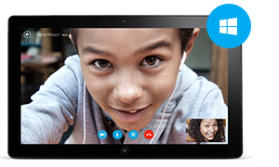
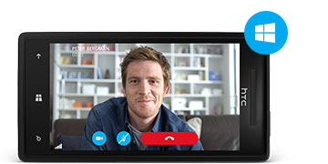



Recent Deliveries
Skype for Outlook.com
Skype for Blackberry
Skype Video Messaging
Skype on XBOX One
Office 365 Home Premium with Skype Minutes
Free Group Video Calling
Skype TX
Skype Translator demo
Lync-Skype connectivity v2 (Demonstrated)

Slide 7

Skype Initiatives
SILK Codec
  designed to deliver great voice quality in challenging network environments
Skype TX - Broadcasting Solutions
Skype Advertising
Skype in the Classroom
Reality TV programming
Skype Choir at TED
© 2014 Microsoft. All rights reserved

Slide 8
Skype TX

Slide 9

Key Segments
“Increase Skype mindshare around the world”
Broadcast
Current business strategy
Education
Radio
Enterprise

Slide 10
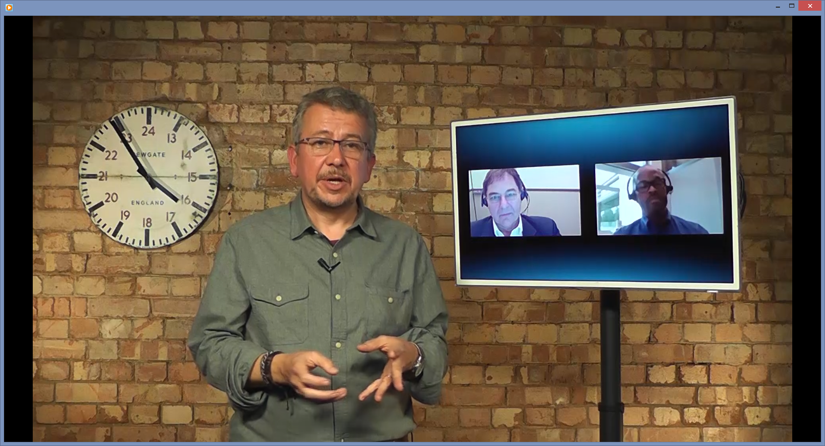
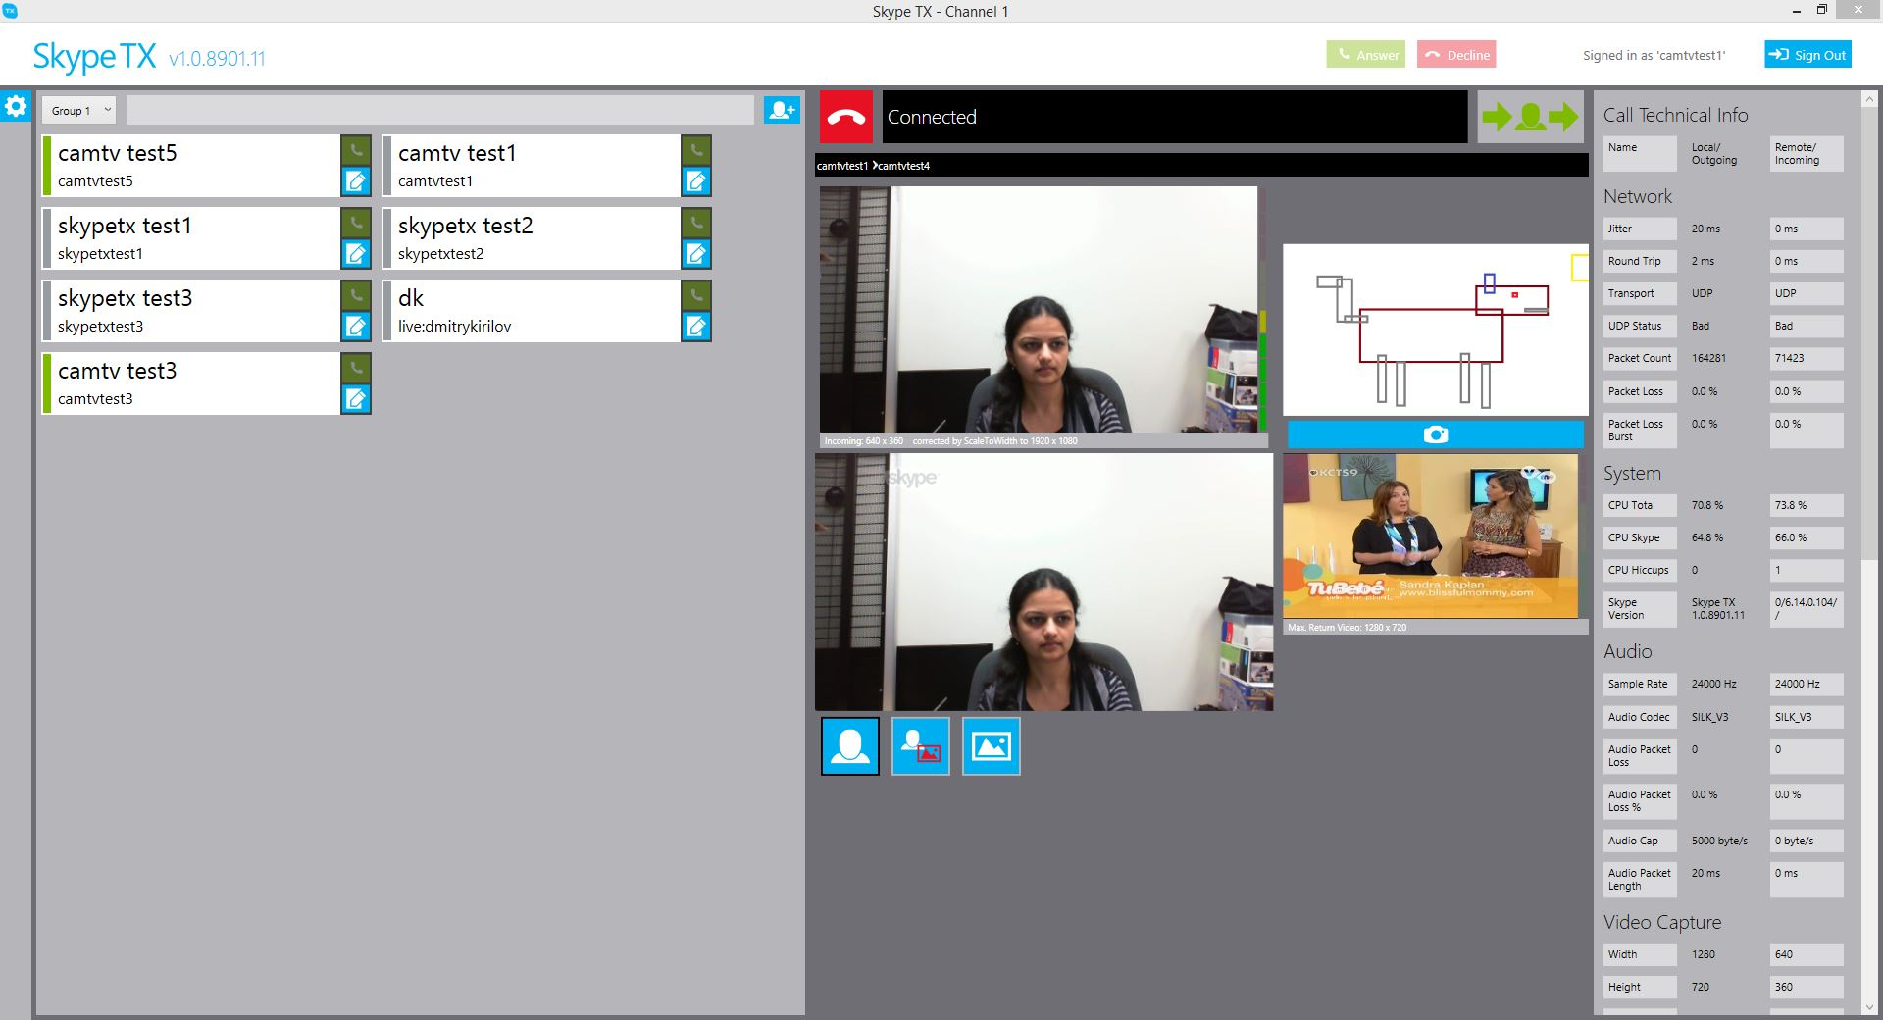


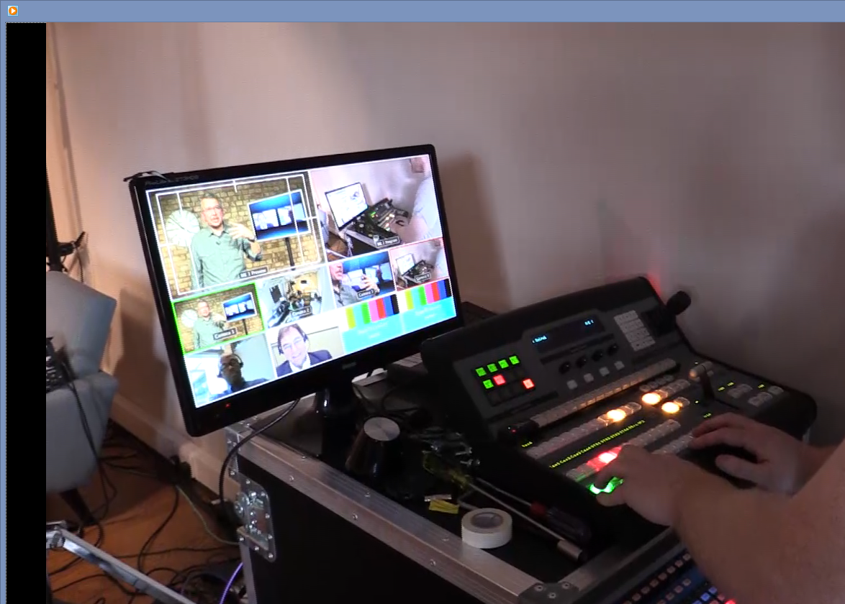
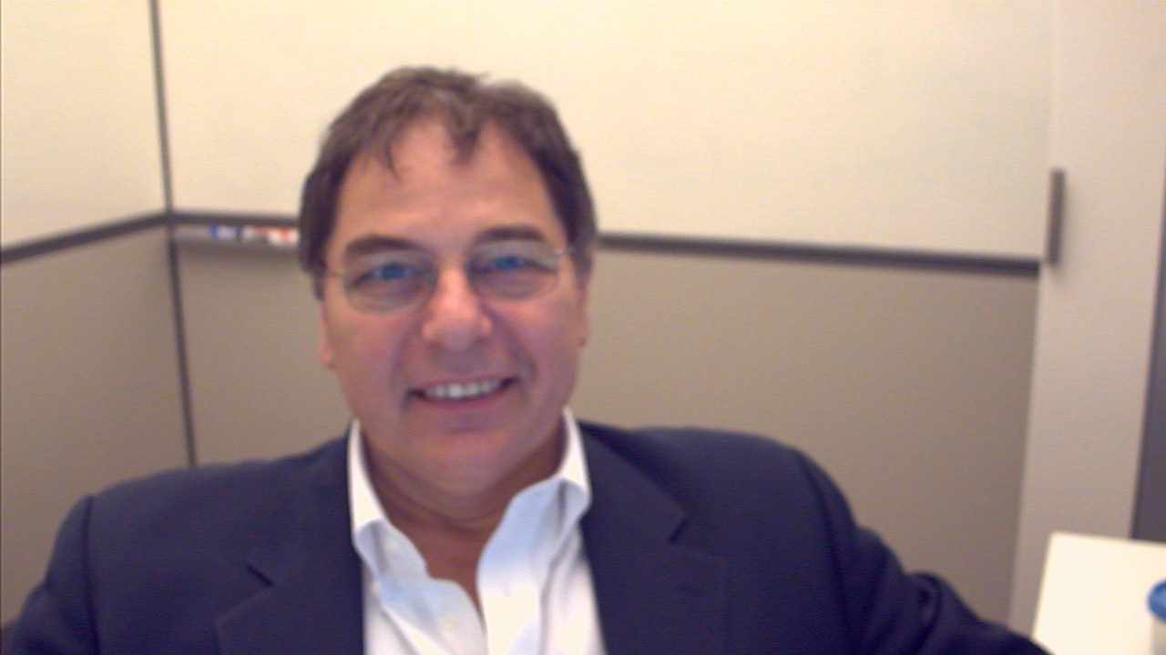



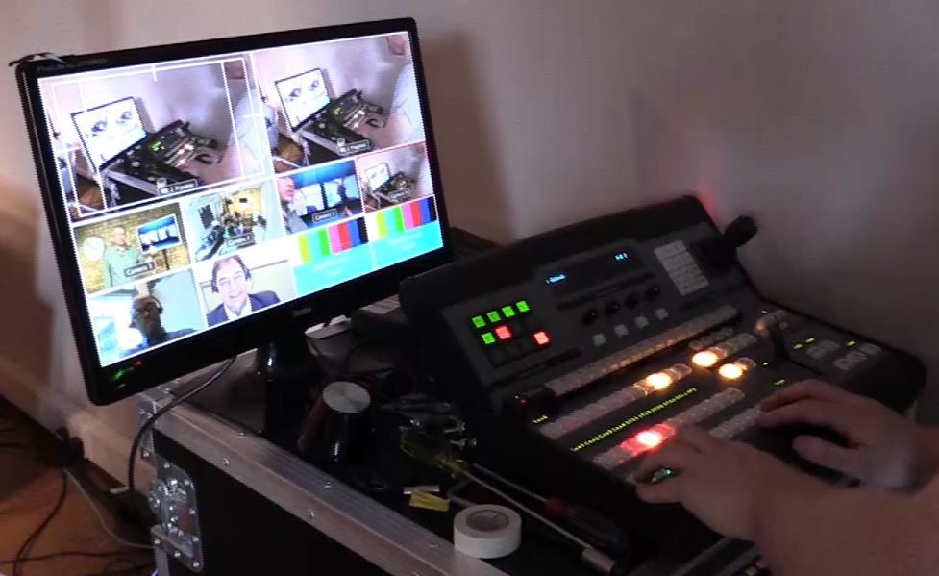
Skype TX
Hardware Components
Software Components
Skype
Skype TX client
Skype TX Control
Features:
Watermark
Aspect ratio
Orientation
Up Convert Definition: up to 1080i
Video Input/output: SD-SDI and HD-SDI (1.485 Gbit/s)
Timing reference signal
Audio gain and echo cancellation
Audio interface: HD-SDI, XLR or Ethernet
Low def. to still
Max 30
units
so far
XLR in
HD-SDI in
Ref
Skype Instance
XLR out
HD-SDI out
Skype TX Client
Skype TX
XLR in
HD-SDI in
Ref
XLR out
HD-SDI out
Skype TX
Sync Generator
Studio
Camera(s)
in
out
Audio Mixer
in
out
Video Mixer
75 ohms coax

Slide 11
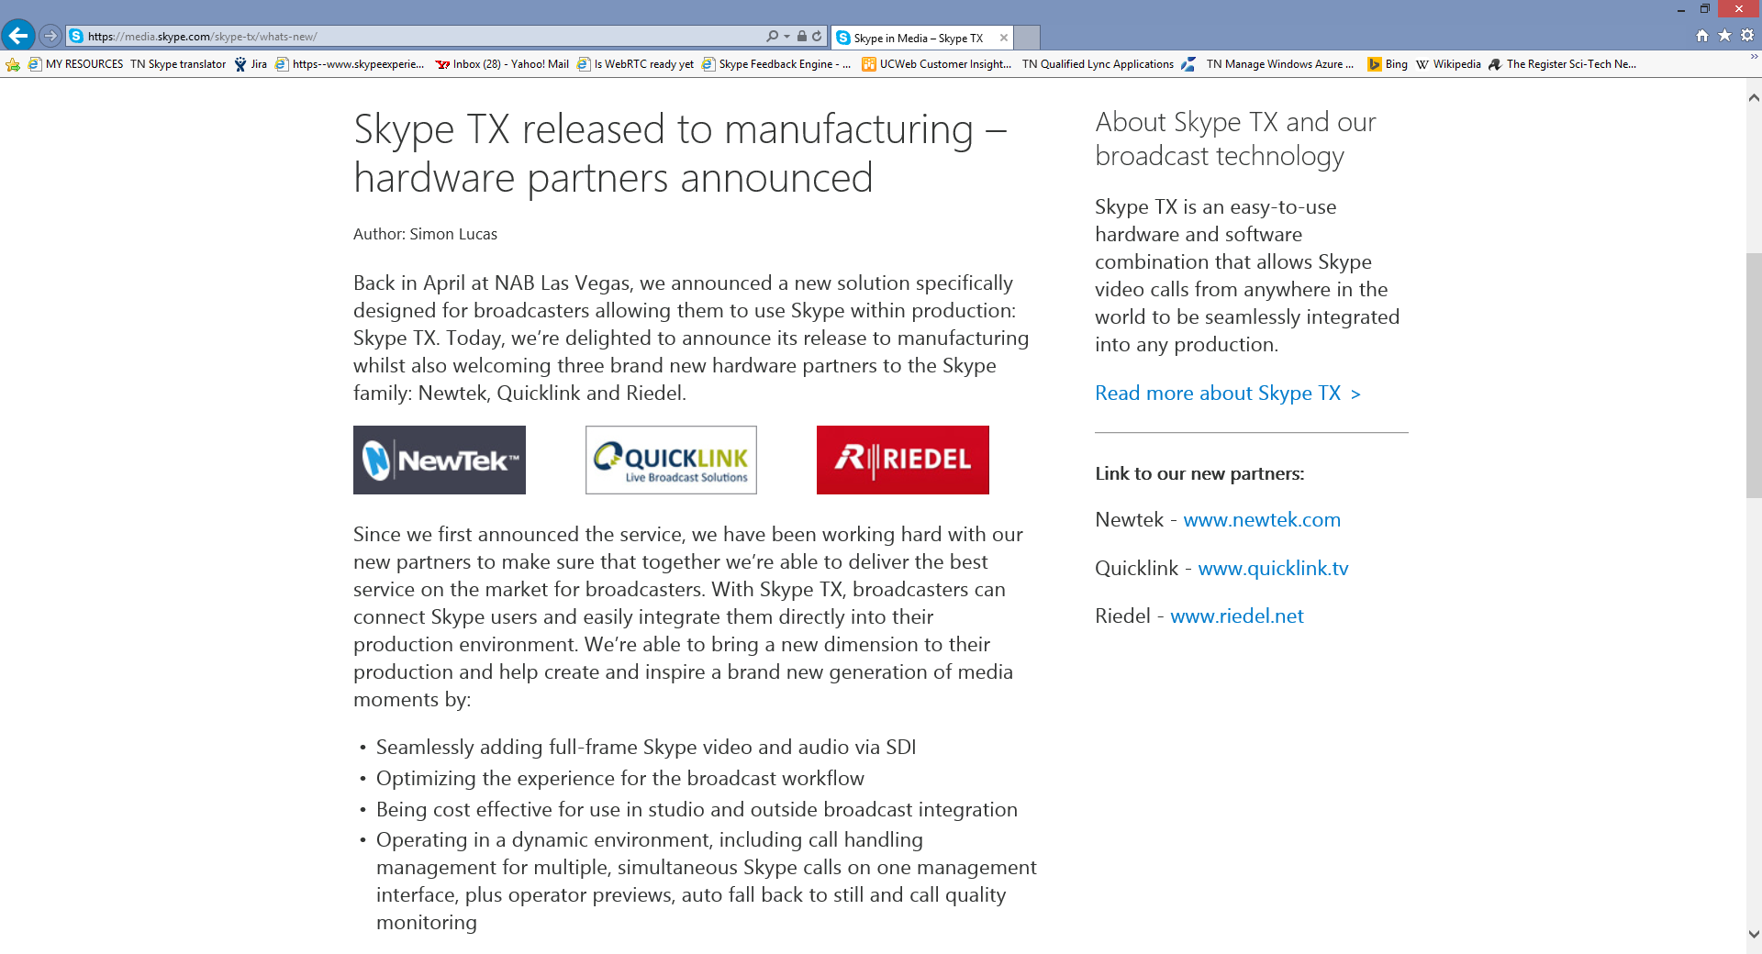
Hardware Solution Partners
NewTek TalkShow VS-100
  San Antonio Texas
  UK
  France
  + Dealer channel
QuickLink TX
        UK
Riedel STX-200
        Germany
        Burbank Can
        Various EMEA
        Various ASIAPAC

Slide 12
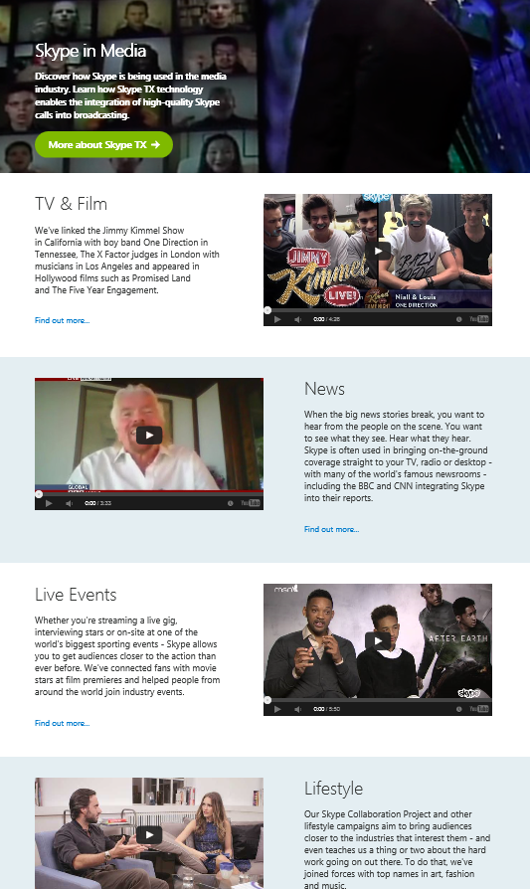
Where to find More Information
https://media.skype.com/

Slide 13
Lync and Skype

Slide 14


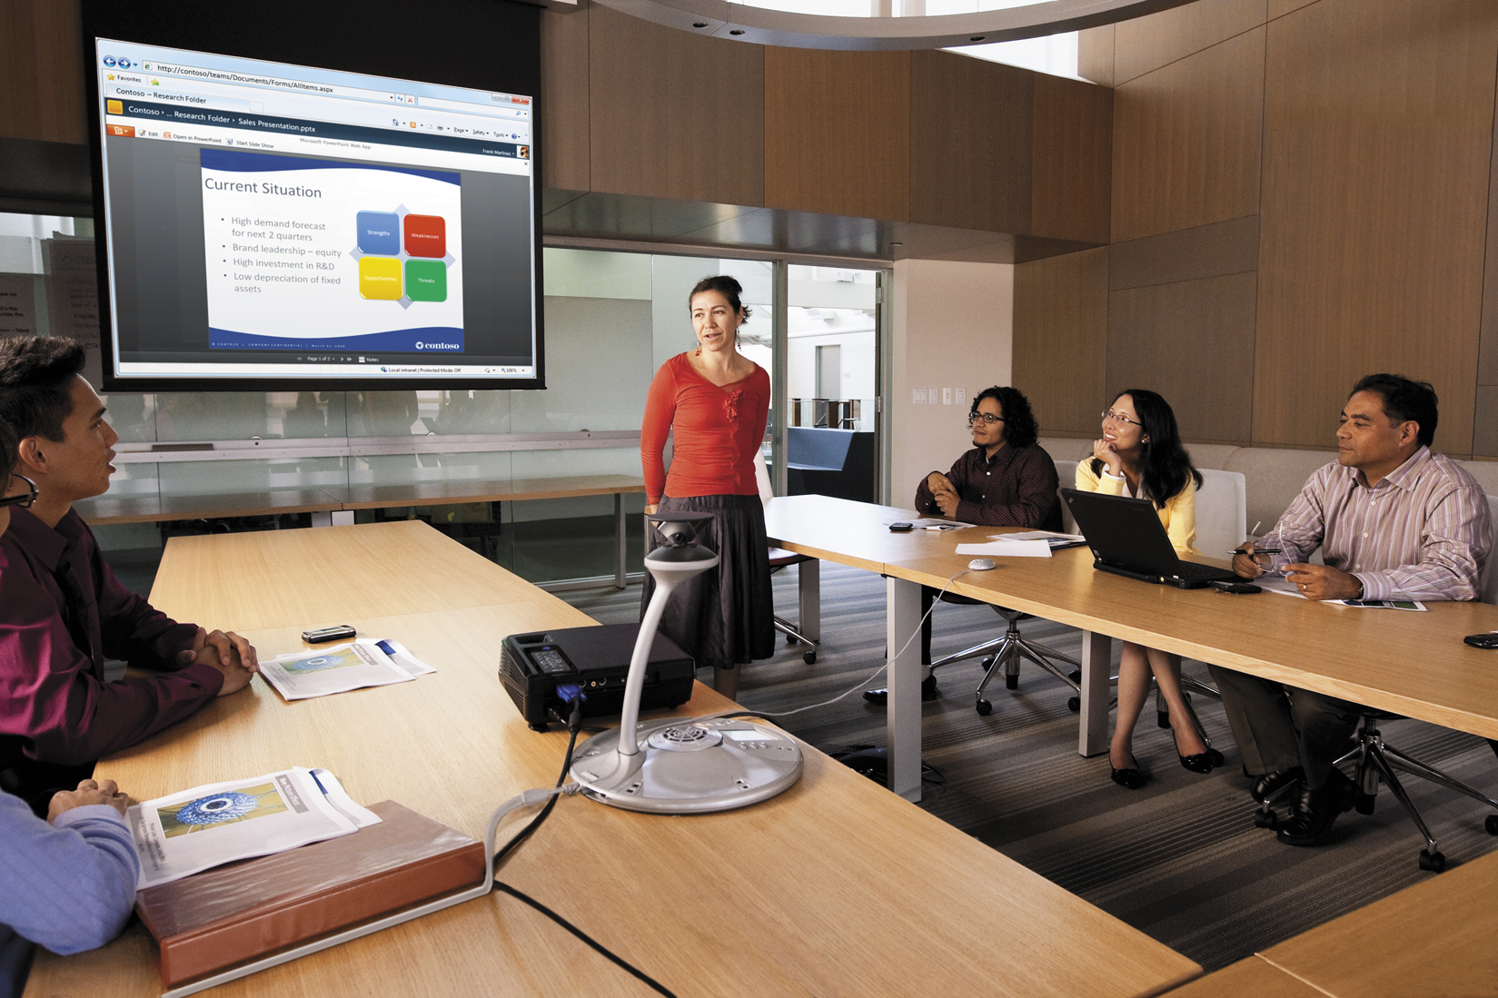


Specialized by need, universal by reach
Connecting everyone with rich communications
Medium-sized & Large Organizations
Teams &
Small Organizations
Individuals
Microsoft provides a consistent experience for communications across work and life

Slide 15












Lync-Skype Connectivity V1
Chat & Audio
Lync-Skype Connectivity opens a new communications door for enterprises searching for inventive and differentiated opportunities for new customer acquisition, customer retention, and business-to-consumer communications.
Contacts
  Skype Users with Microsoft Accounts (MSAs) can add Lync users to contact list
  Lync users can add Skype MSA contacts
Sessions
  Presence updates
  Chats and voice calls between Skype and Lync users
Not included:
  Mobile clients (Skype)
  Video and group sessions
Website Button
Call
Internet
Internet
T1, PRI, Analog
PSTN
Hybrid MS
SBC/VoIP GW
router
T1, PRI, Analog
DMZ
Edge
3rd Party
Contact
Center
chat & audio
Queues/IVR
Skills Groups
Routing Rules
Recording
Dashboard
Reporting

Slide 16
Lync-Skype Connectivity V2
Chat, Audio,
Video
With version 2, we now use standard NAT traversal protocols, Signalling is encrypted with TLS and media uses sRTP directly between callers. We’ve standardized Codecs between the clients and have added Video !!
Contacts
  Skype Users can add Lync users to contact list
  Lync users can search for and add Skype MSA contacts and SkypeIDs
Sessions
  Presence updates
  Chats, voice (Silk) and Video (H.264) calls between Skype and Lync users
  Encryption with TLS and sRTP
  NAT Traversal with Stun/Turn/Ice
Not included:
  Multi-Party Calls
  Screen Sharing
Website Button
Call
Internet
Internet
T1, PRI, Analog
PSTN
Router
Hybrid MS
SBC/VoIP GW
router
T1, PRI, Analog
DMZ
Edge
3rd Party
Contact
Center
Chat, audio,
Video
Queues/IVR
Skills Groups
Routing Rules
Recording
Dashboard
Reporting
☑ Declare domain
☑ Configure PKI
☑ Set policies

Slide 17

Lync Online – Lync Skype Connectivity V2
Chat, Audio,
Video
With version 2, we now use standard NAT traversal protocols, Signalling is encrypted with TLS and media uses sRTP directly between callers. We’ve standardized Codecs between the clients and have added Video !!
Contacts
  Skype Users can add Lync users to contact list
  Lync users can search for and add Skype MSA contacts and SkypeIDs
Sessions
  Presence updates
  Chats, voice (Silk) and Video (H.264) calls between Skype and Lync users
  Encryption with TLS and sRTP
  NAT Traversal with Stun/Turn/Ice
Not included:
  Multi-Party Calls
  Screen Sharing
Internet
Internet
router
3rd Party
Contact
Center
Queues/IVR
Skills Groups
Routing Rules
Recording
Dashboard
Reporting
DMZ
Chat, audio,
Video

Slide 18
Demo Lync-Skype connectivity Call

Slide 19
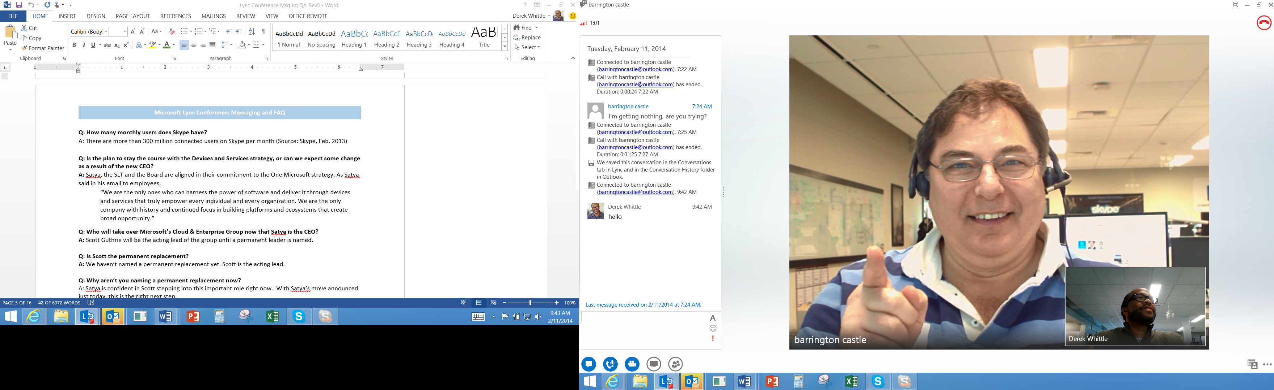
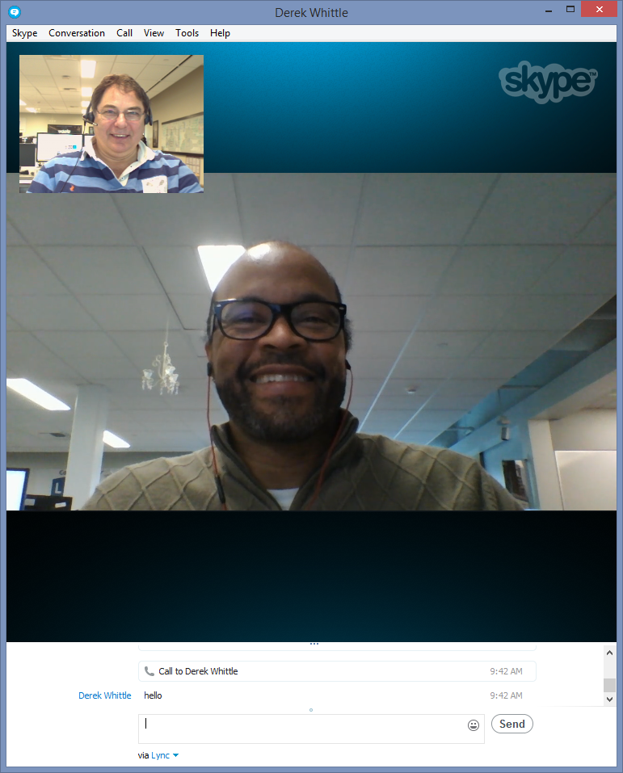
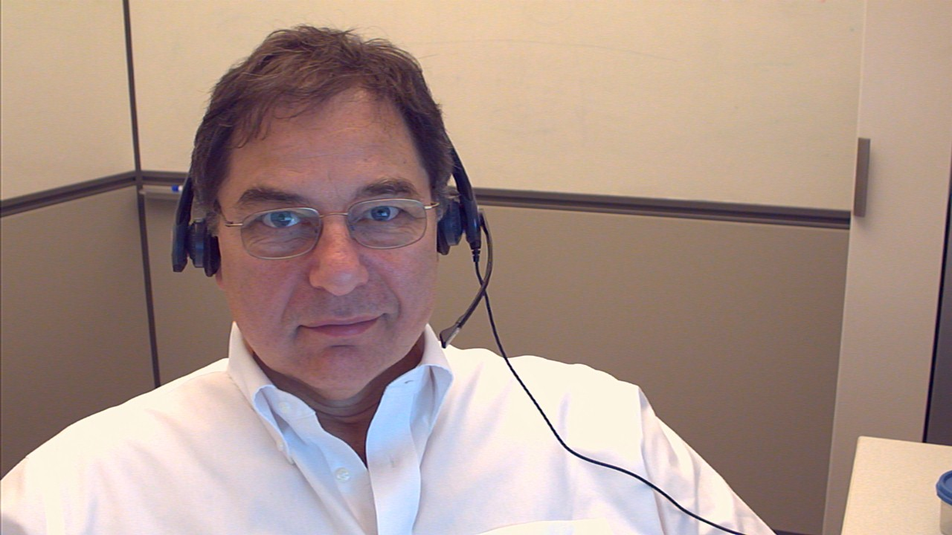


Slide 20
Opportunities

Slide 21
B2C Communicating with customers
Today’s Options
Lync Skype Connectivity v2 addresses these communications options for ‘known’ customers
1800 Numbers
Web Chat
Email
Phone calls
Face to Face meetings

Slide 22
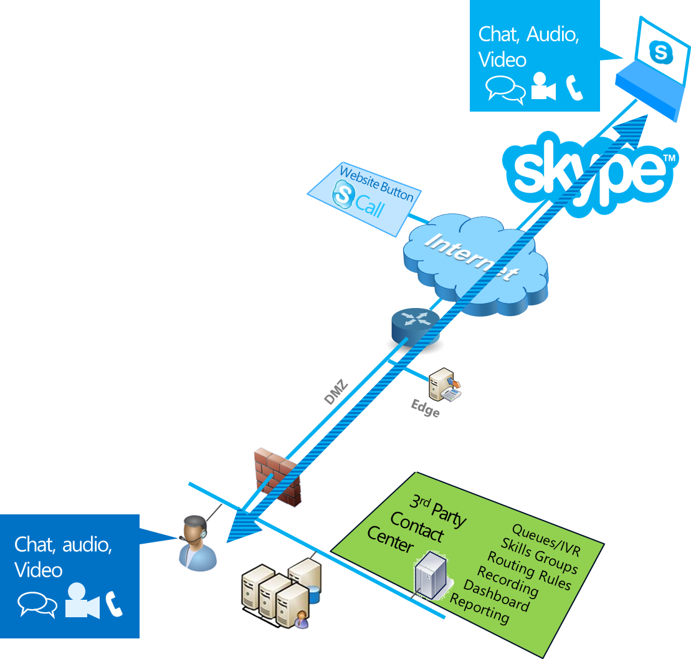
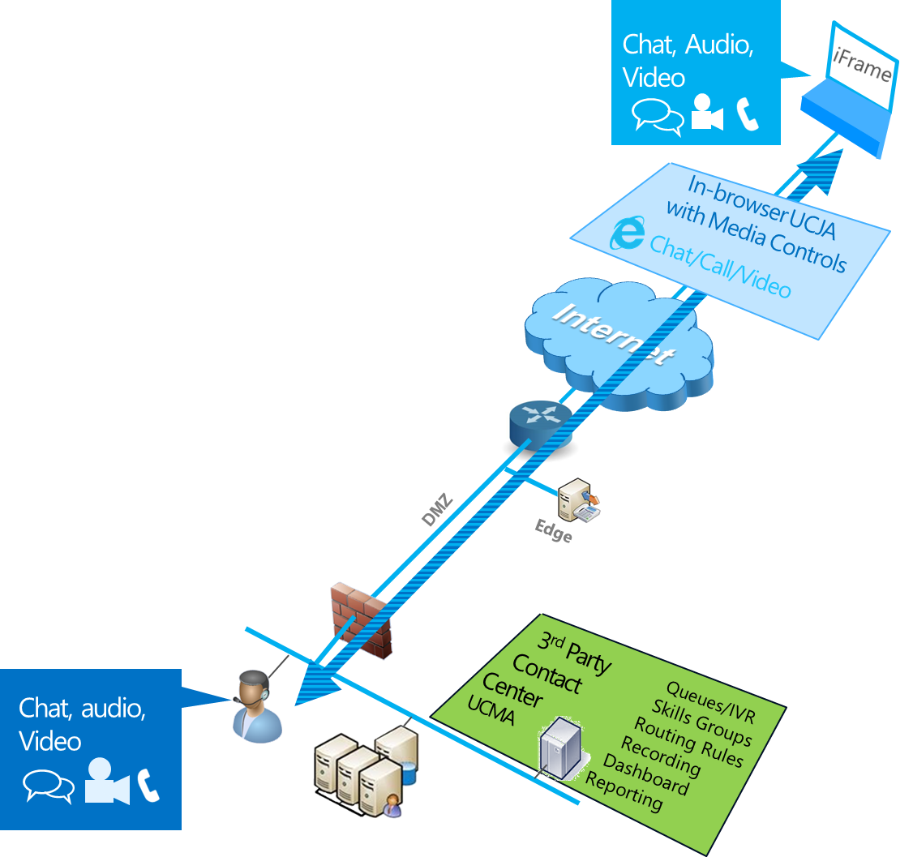
2 Complementary Options
Skype with ‘Known’ Customers
Anonymous – See demo in DEV- B303
Skype URIs (emails, websites)
Lync-Skype connectivity v2
Chat, Audio, Video
Must use Microsoft Account
Will Require UCJA Media Controls
In-browser communications
3rd-Party Browser support
Supports anonymous inbound
Chatbot offers for smart profiling

Slide 23

B2B Communicating Suppliers, Partners
Improve efficiency and performance
Leverage Skype’s Global availability
Collaborative projects
Franchise businesses
Temp staff
Out-sourcing

Slide 24

B2C Employee Retention
Keeping in touch with Friends and Family
Contributes to employee retention
Emergencies
Work/Life Balance
The Important Moments
Travelers
Participate

Slide 25

Hiring Efficiency
From Screening to Accepted Offer
Encourages the digital approaches used across the organization
Eliminate distance
Screen candidates with video
Establish relationship
Follow-up in real-time

Slide 26

Skype URI
Buttons for Emails and Web Pages
Instructions Available at:
http://developer.
skype.com/
Features
Select Graphic
Pre-Select the modality
Code Sample
skype:2:foo@
contoso.com?
call
Prerequisites
Skype side must use MSA
Contact relationship established
Call
Chat
“2“

Slide 27

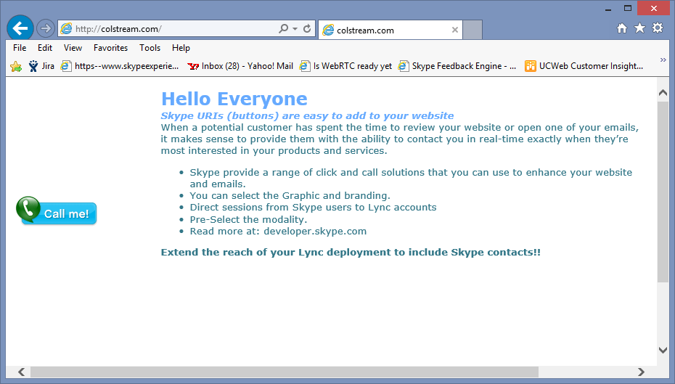


Demo Skype Button
Internet
Internet
Router
DMZ
❶ Visit Website
❷ Click the button
❸ Allow the Session
❹ Talk and Chat
Edge
ICE Server

Slide 28
View Source
Derek Whittle<br>
on Lync<br>
<script type="text/javascript" src="http://download.skype.com/share/skypebuttons/js/skypeCheck.js">
</script>
<a href="skype:2:dwhittle@microsoft.com?call&video=true"><img src="http://download.skype.com/share/skypebuttons/buttons/call_blue_white_124x52.png"
style="border: none;" width="124" height="52" alt="Skype Me™!" />
</a>

Slide 29
Demo
Skype button call - Skype to Lync

Slide 30
Underlying Technologies

Slide 31
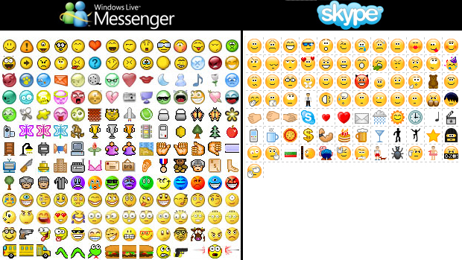
Video Codecs
H.264 AVC
Advanced Video Coding May 2003
2xcompression gain over H.263
Packet loss 1-5%
9 directional modes
H.265 HEVC
High Efficiency Video Coding Jan 2013
3D Multi-view encoding
Efficiency: 50% compression improvement over AVC
Improved frame-rate: Up to 300 fps
Computationally expensive
Over 30 directional modes
Support for Ultra High Def
Are you getting the picture?
H.263
Used by H.320 ISDN Video-conferencing in the 1990’s
Also adopted by H.323
H.264 SVC (AVC Annex G)
Scalable Video Coding July 2007
Spatial: Frame within a frame
Temporal: 7.5,15 and 30 fps
Resilient: Packet loss 20-40%
Efficient: Handles multiple clients without the need for transcoding

Slide 32
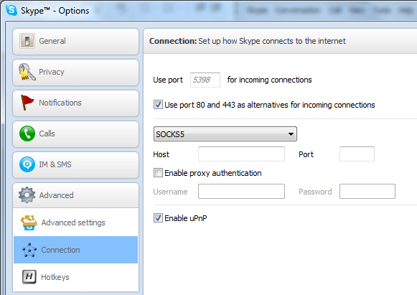



Controlling Skype on the Network
Tools/options/advanced/connection
Can also be set with a GPO
Step 1: Configure skype to use the Socks5 Proxy
Step 2: Firewall configuration - Allow inbound/outbound UDP packets between the proxy and internal computers
Step 3: Configure Proxy which should be dedicated to Skype, otherwise priority decisions will affect other traffic
Step 4: Connect the Proxy to a specific port on the router
Step 5: Create a router queue for all traffic from the Proxy
Step 6: Prioritize this queue versus other traffic
External
Skype User
Socks5
Proxy
Internet
❹
❸
Ethernet 2
Ethernet 3
❷
DMZ
❶
❺
Router (config) # priority-list 3 interface ethernet 2 high
Internal
Skype User
❻
Router (config) # priority-list 3 interface ethernet 3 medium
2013 © Skype. Commercially confidential

Slide 33
Enterprise NAT Traversal Mechanism
Stun/Turn/ICE
SIP uses the source and target IP addresses to establish a session. Network Address Translation (NAT) modifies IP addresses as packets transit onto the public internet and thereby renders the INVITE invalid. STUN, TURN and ICE resolve such session/NAT issues.
Internet
Internet
Router
DMZ
❶
❷
ICE Client
Edge
ICE Server
❸
❶ Host Candidate – Likely to fail
❷ STUN Candidate
❸ TURN Candidate – Edge Relay

Slide 34
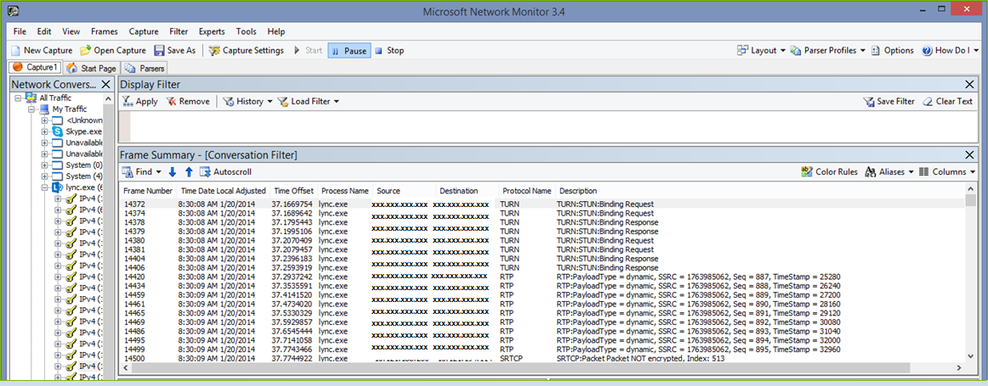
Network Monitor
Call from Lync to Skype showing STUN

Slide 35
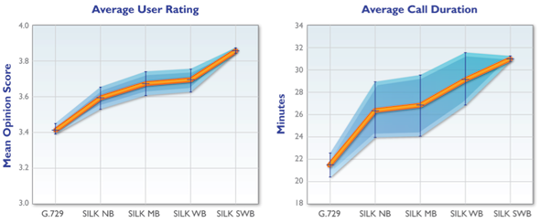
Codecs
G.729 Demo
Skype
Audio Codec: SILK
Video Codec: H.264
Lync
Audio Codec: RTA
Video Codec: H.264
Lync-Skype Connectivity
v2 Audio: SILK
v2 Video: H.264
SILK Demo
Better Codecs mean longer calls
http://blogs.skype.com/2010/09/28/the-power-of-silk/

Slide 36
Deployment Details

Slide 37
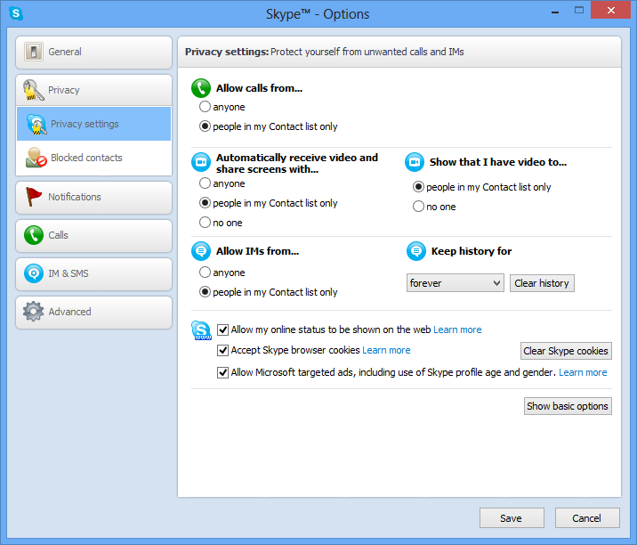
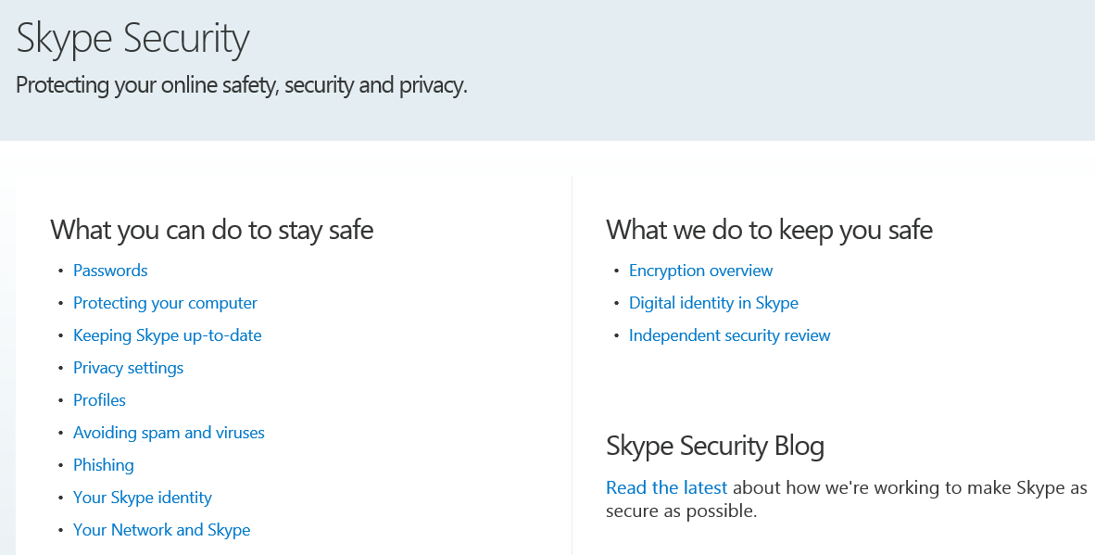
Skype Privacy
Note: Skype uses AES256 for both signaling and media
Skype maintains a Security Portal:
http://www.skype.com/intl/en-us/security/

Slide 38
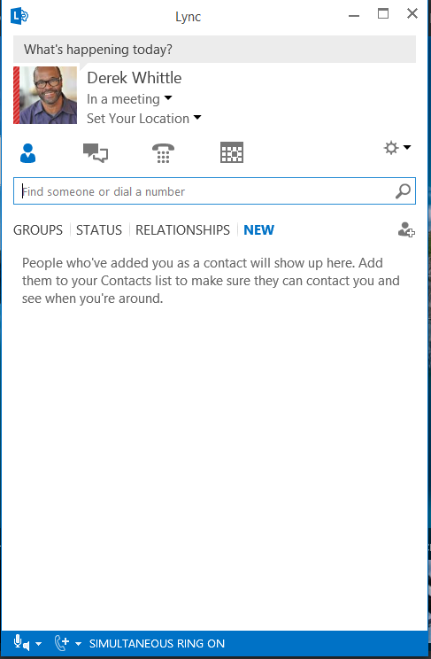
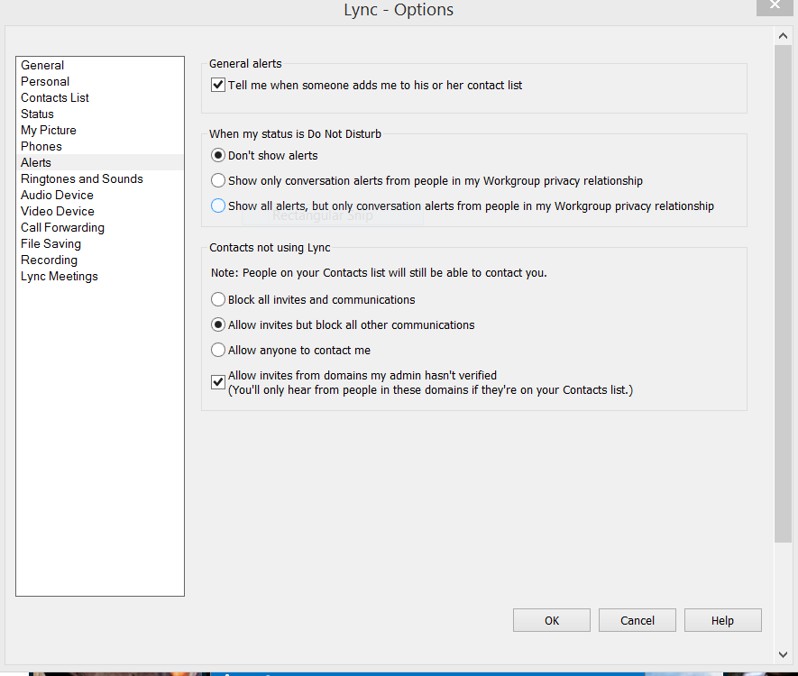
LSC Best Practices – Lync Settings

Slide 39
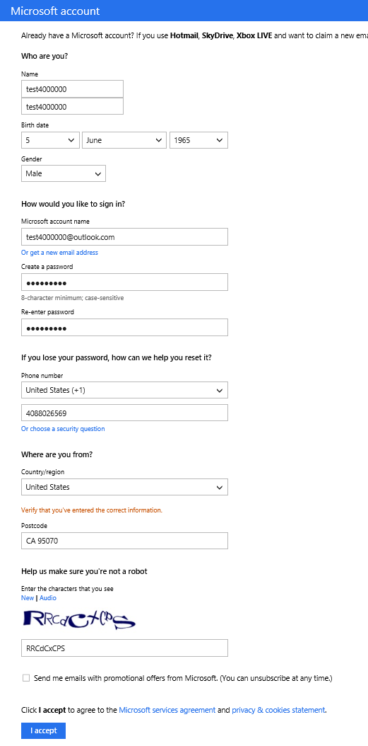
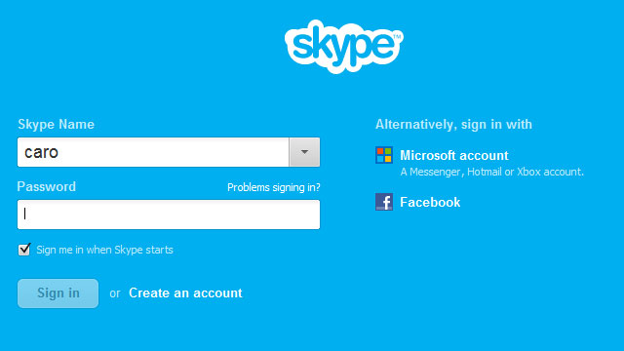
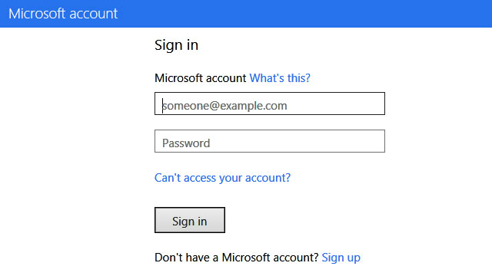
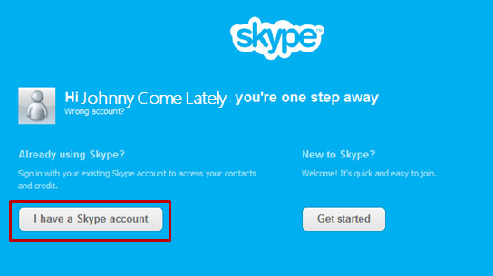
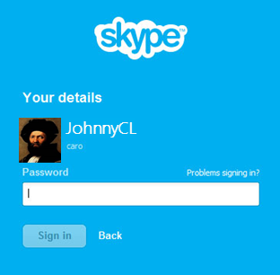
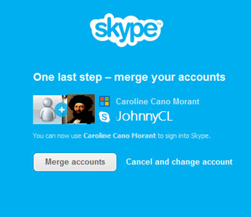
Microsoft Accounts (MSAs) and Skype
Create the MSA
Select to login with the MSA in the future
Johnny Come Lately
Merge the accounts
Login or create a Skype account
https://signup.live.com/signup.aspx?lic=1

Slide 40
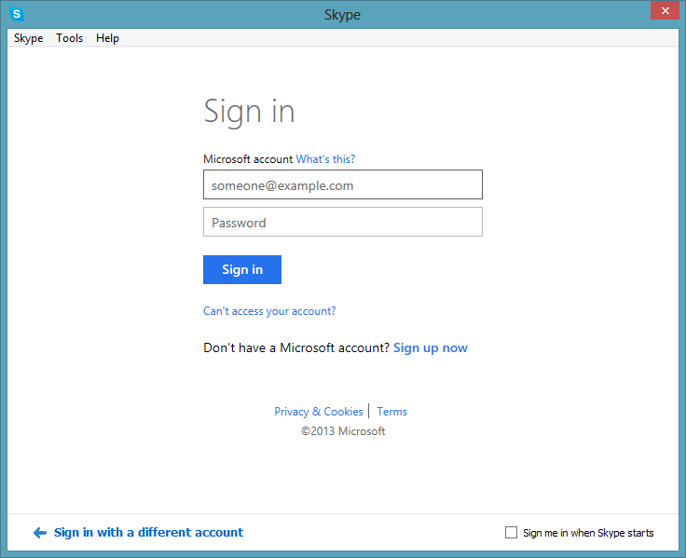
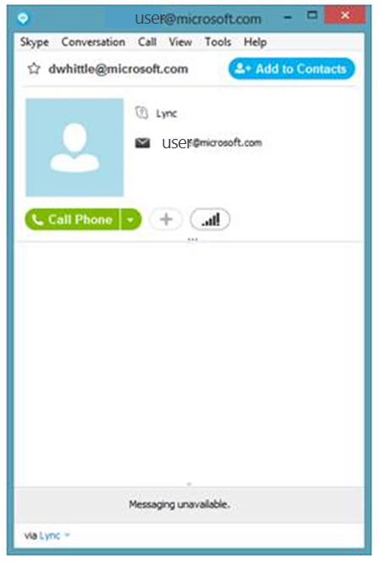
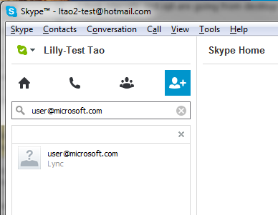
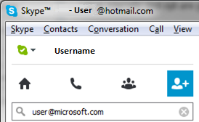
How do I add a Lync contact to Skype?
To add a Lync contact
  Type the Lync user address in Skype Search
  Select the Lync contact
  Select <Add to Contacts>
Log in with MSA
user@microsoft.com
user@microsoft.com

Slide 41
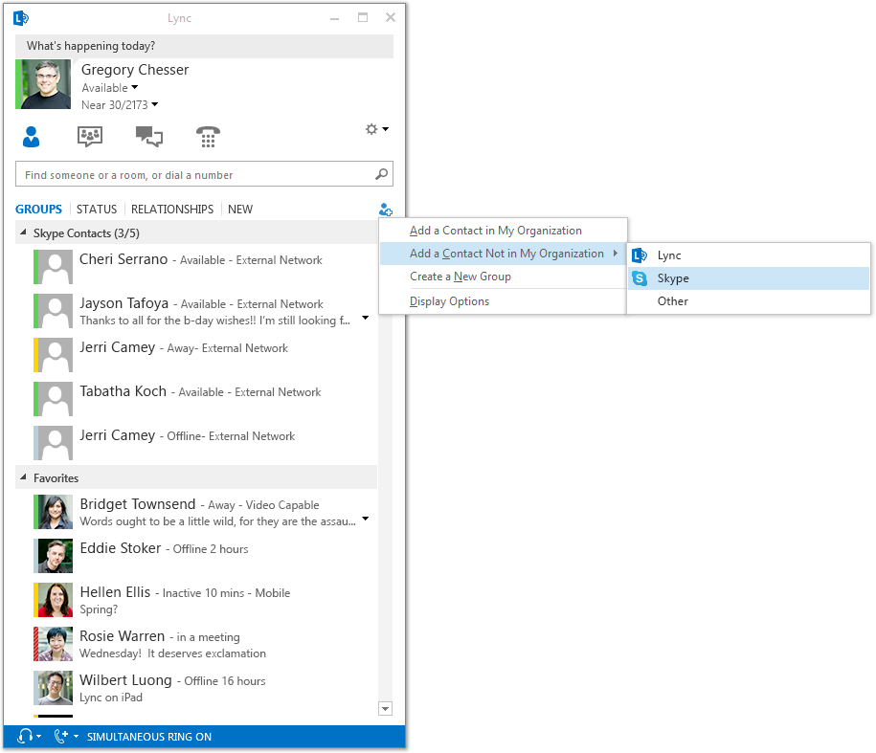
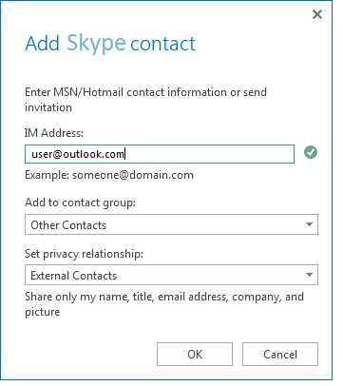

How do I add a Skype contact to Lync?
Add Contact -> Add a Contact Not in My Organization
Select Skype
Type in MSA
Assign a Group

Slide 42
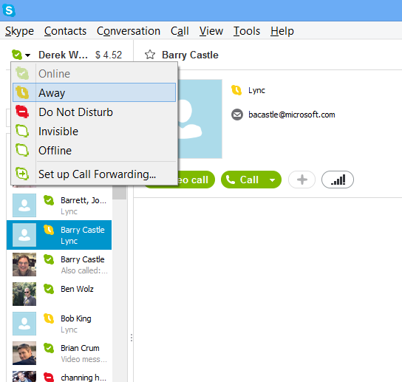
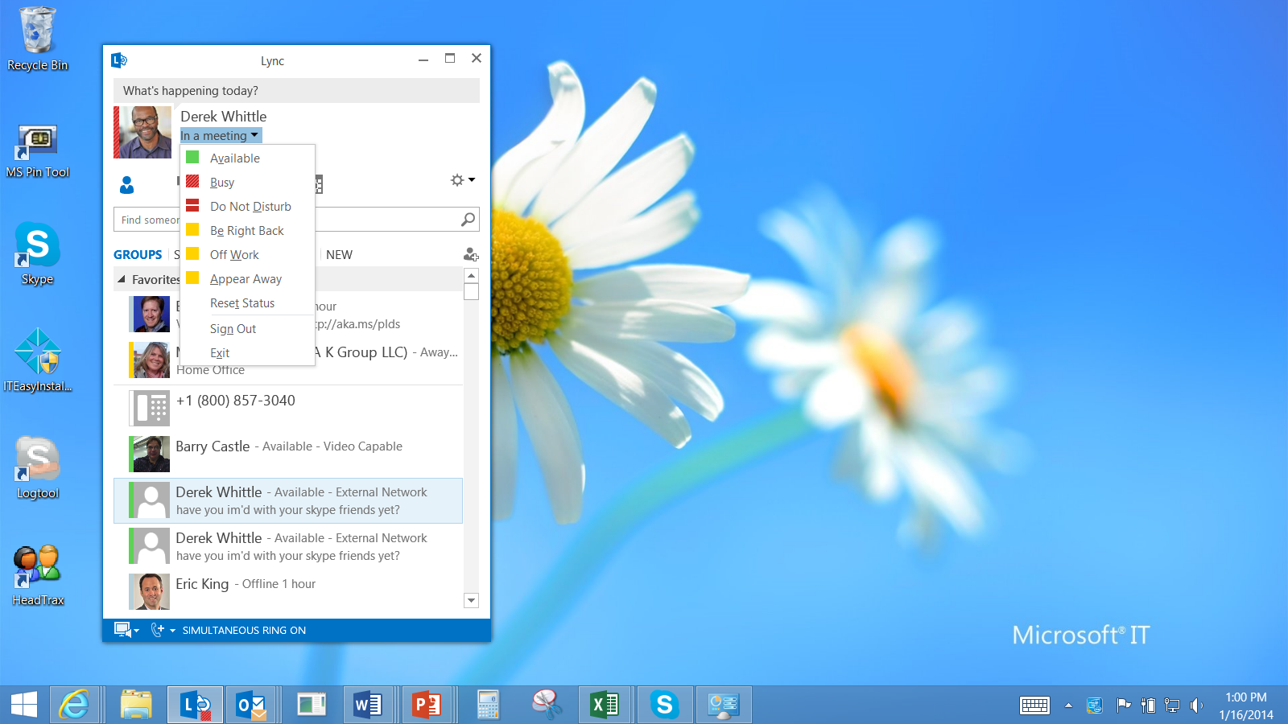
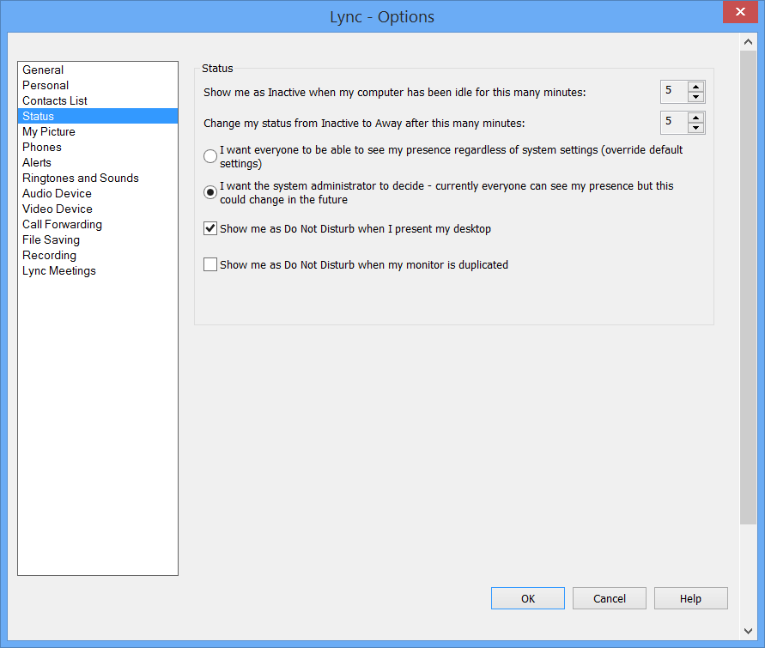
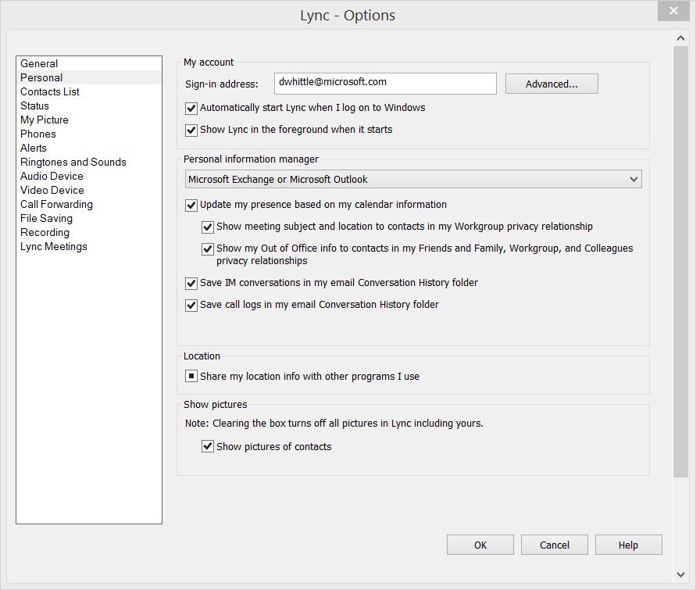
Presence Expectations
Skype Presence Modes
  Online
  Away
  Do Not Disturb
  Invisible
  Offline
  Auto
    “Show me as Away when I’ve been Inactive from <<fill-in>> minutes”
Lync Presence Modes
  Available
  Away
  Busy
  Do Not Disturb
  Be Right Back
  Off Work
  Appear Away

Slide 43
Lync Configuration

Slide 44
Setting up Lync-Skype Connectivity
Domain:
  Provision your organization for federation using https://pic.lync.com, provide your domain(s) & FQDN(s).
Certificate:
  Set up your Lync edge for federation, including public certificate.
Policies:
  Use the Lync Server Control Panel or PowerShell to enable public IM connectivity, partner discovery, partner domain discovery.
Note1: If you have Messenger connectivity working already, you’re done!
Note2: There is no additional charge for activating Lync-Skype Connectivity

Slide 45
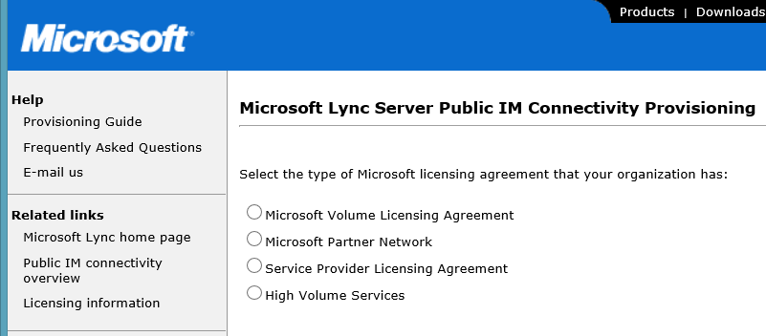
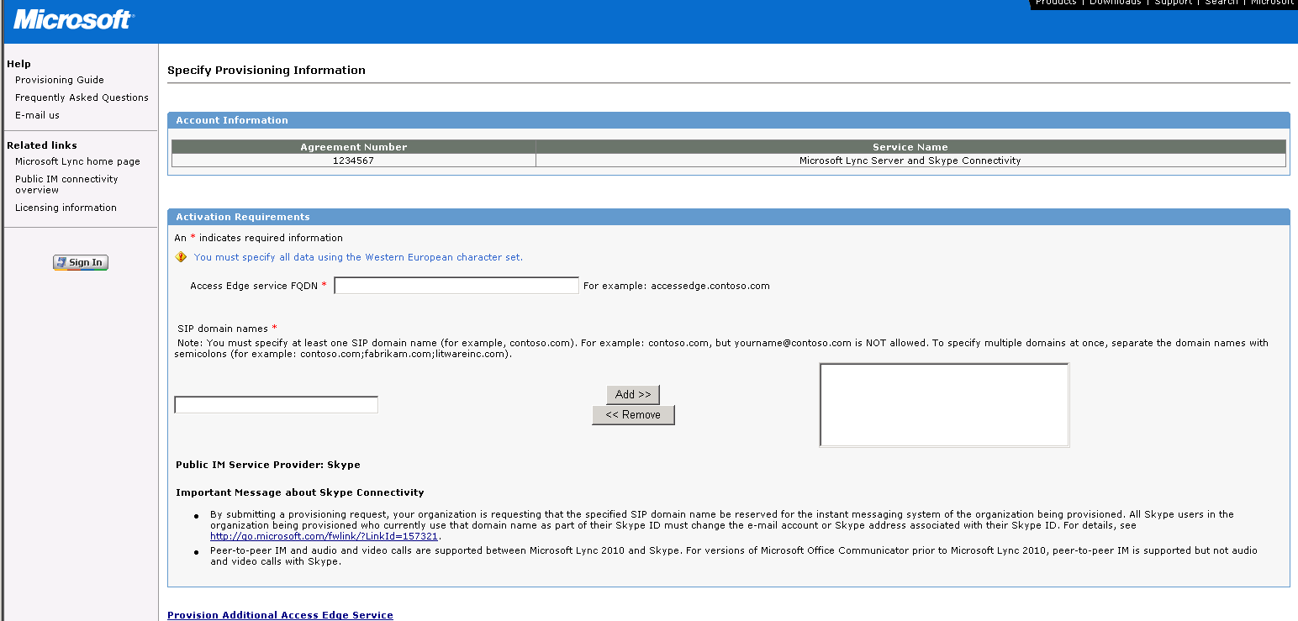
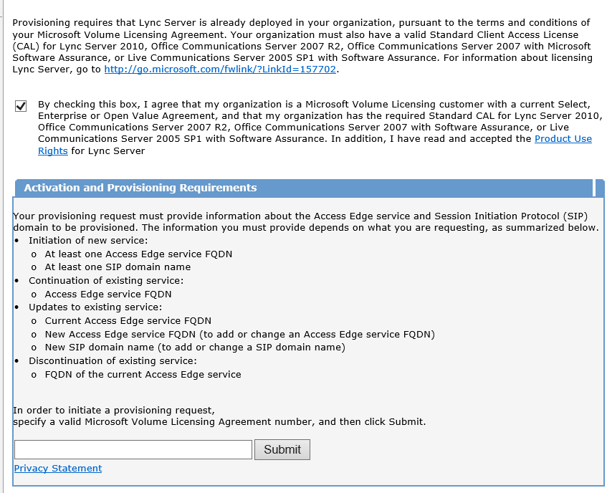
Step 1. Register your domain
Go to https://pic.lync.com to provision your domain for Skype connectivity.
1234567
This tells our service where to send inbound messages and tells Skype & Messenger that your Lync domain is available for connectivity.

Slide 46
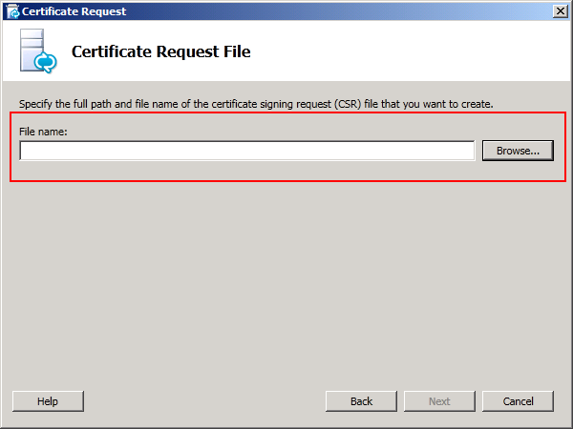
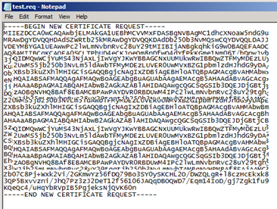
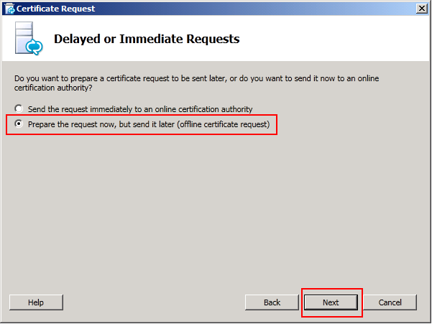
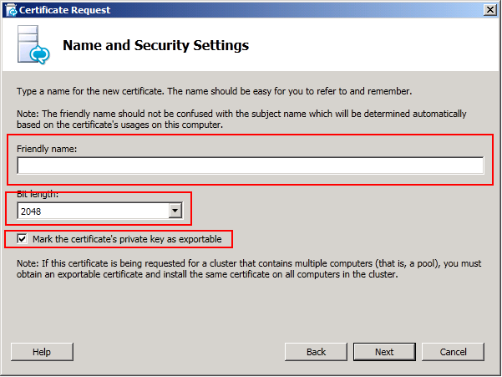
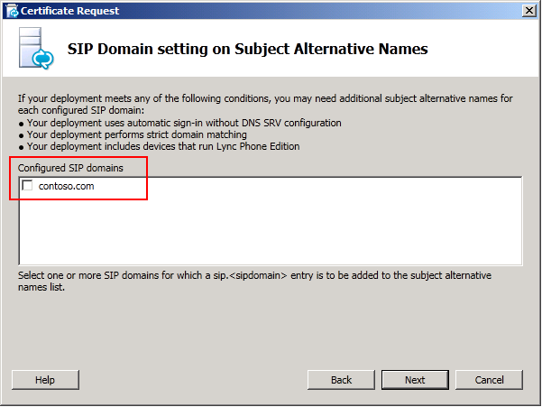
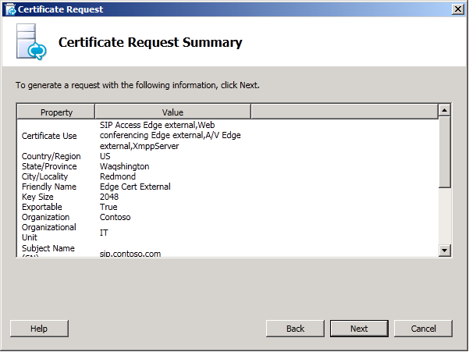
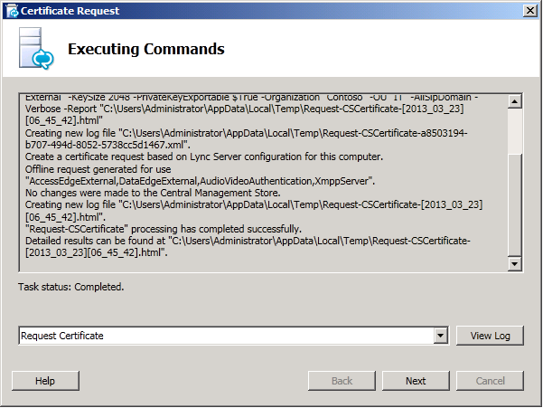

Step 2: Set up Lync Edge for Public IM Connectivity
  Note: there is no difference in the way the customer requests and assigns a certificate for Skype from other PIC (MSN, AoL, Yahoo)
Location
specified earlier
Public
Certificate
Authority
Import the certificate
In the Deployment Wizard, on the Deploy Edge Server page, next to Step 3: Request, Install, or Assign Certificates, click Run again.
On the Available Certificate Tasks page, click Import a certificate from a .p7b, pfx or .cer file.

Slide 47

Step 3: Lync Server Control Panel: External Access Policy
Set up at least one External Access Policy to enable communications with public users.
You can also assign External Access Policy to an individual user via the Users tab.

Slide 48

Lync Server Control Panel: Access Edge Configuration
Enable federation and public IM connectivity

Slide 49


Lync Server Control Panel: Enable Provider
Under “SIP Federated Providers” select “Messenger” (this will be “Skype” after we release a Lync update)
Check “Enable communications with this provider”
Important: Ensure you are happy with the “Default verification level”. We recommend keeping this to allow communications only with those you’ve added to your Contact List unless you want to allow any Skype/Messenger users to contact any of your Lync users. The user can override this from the Lync client.

Slide 50



O365 Configuration and Admin

Slide 51
Conclusions

Slide 52


Summary
Lync-Skype and Video
Compelling market drivers
Extending the reach of Lync
The latest improvements: Video, Enterprise-class Security and Best-of-Breed Audio Quality
The practical guide: Demos, tips, tricks and deployment cookbook
What’s New from Skype?
Skype for Broadcasters with Skype TX
Lync-Skype connectivity
The enabling Technologies
Implementing Lync-Skype connectivity
B2C
B2B
Friends and Family
Hiring
New Features with v2
Video, SkypeID support
Enterprise-class Security &
Best-of-Breed Audio Quality

Slide 53
Technical Network
Join the conversation!
Share tips and best practices
with other Office 365 experts
http://aka.ms/o365technetwork

Slide 54


Office 365
Exams
Managing Office 365 Identities and Requirements
EXAM
346
Deploying
Office 365 Services
EXAM
347
http://bit.ly/
O365-Cert
+
Classroom
training
Introduction
to Office 365
FLC
40041
Managing Office 365 Identities and Services
MOC
20346
Designing for Office
365 Infrastructure
5
MOC
10968
3
http://bit.ly/
O365-Training
Online
training
Office 365
Fundamentals
MVA
Managing Office 365 Identities and Services
MVA
http://bit.ly/
O365-MVA
Get certified for 1/2 the price at TechEd Europe 2014!
http://bit.ly/
TechEd-CertDeal

Slide 55



SUBMIT YOUR TECHED EVALUATIONS
We value your feedback!
Fill out an evaluation via
CommNet Station/PC: Schedule Builder
LogIn: europe.msteched.com/catalog
TechEd Mobile app
for session evaluations
is currently offline

Slide 56


© 2014 Microsoft Corporation. All rights reserved. Microsoft, Windows, and other product names are or may be registered trademarks and/or trademarks in the U.S. and/or other countries.
The information herein is for informational purposes only and represents the current view of Microsoft Corporation as of the date of this presentation. Because Microsoft must respond to changing market conditions, it should not be interpreted to be a commitment on the part of Microsoft, and Microsoft cannot guarantee the accuracy of any information provided after the date of this presentation. MICROSOFT MAKES NO WARRANTIES, EXPRESS, IMPLIED OR STATUTORY, AS TO THE INFORMATION IN THIS PRESENTATION.

