Slide 1


Slide 2

Project Server/ Online Reporting and BI
OFC-B339
Raphael Ax, PFE @ Microsoft

Slide 3
Related content
Breakout Sessions
  OFC-B213 Efficient Planning, Reporting and Decision Making with
  Microsoft Project Pro for Office 365
  OFC-B231 Project and Portfolio Management in the Cloud
Find Me Later at…
  TechExpo Hall 7 Project Kiosk (Tue, Thu, Fri)

Slide 4

Resources
Learning
  Sessions on Demand
  Microsoft Certification & Training Resources
http://channel9.msdn.com/Events/TechEd
www.microsoft.com/learning
TechNet
Developer Network
  Resources for IT Professionals
http://microsoft.com/technet
http://developer.microsoft.com

Slide 5


Office 365
Exams
Managing Office 365 Identities and Requirements
EXAM
346
Deploying
Office 365 Services
EXAM
347
http://bit.ly/
O365-Cert
+
Classroom
training
Introduction
to Office 365
FLC
40041
Managing Office 365 Identities and Services
MOC
20346
Designing for Office
365 Infrastructure
5
MOC
10968
3
http://bit.ly/
O365-Training
Online
training
Office 365
Fundamentals
MVA
Managing Office 365 Identities and Services
MVA
http://bit.ly/
O365-MVA
Get certified for 1/2 the price at TechEd Europe 2014!
http://bit.ly/
TechEd-CertDeal

Slide 6



Please Complete An Evaluation Form
Your input is important!
TechEd Schedule Builder
CommNet station or PC
TechEd Mobile app
Phone or Tablet
QR code

Slide 7
Evaluate this session

Slide 8
Here’s what we offer…
Timelines, Visio, Visio Services, Excel,
Excel Services, Project Desktop,
OData, PerformancePoint,
Business Connectivity Services,
Power View, REST, SSRS, SharePoint Apps,
Third Party Reporting Tools

Slide 9
Here’s what we care about…
Timelines, Visio, Visio Services, Excel,
Excel Services, Project Desktop,
OData, PerformancePoint,
Business Connectivity Services,
Power View, REST, SSRS, SharePoint Apps,
Third Party Reporting Tools

Slide 10
Project Server
OLAP Cube
Reporting DB
Reports

Slide 11
Reporting schema
OData
Reports

Slide 12
OData & Excel
Raphael Ax
Microsoft

Slide 13
LinQPad & Odata
Raphael Ax
Microsoft

Slide 14
Major Milestone Report
Raphael Ax
Microsoft

Slide 15
PowerPivot
Raphael Ax
Microsoft

Slide 16








The World of Data is Changing
10x increase every five years
Data
explosion
Consumerization of IT
4.3 connected devices per adult
85% from new data types
27%
using social media input
“By 2015, organizations integrating high-value, diverse, new information types and sources into a coherent information management infrastructure will outperform their industry peers financially by more than 20%.”
– Gartner, Regina Casonato et al., “Information Management in the 21st Century”

Slide 17
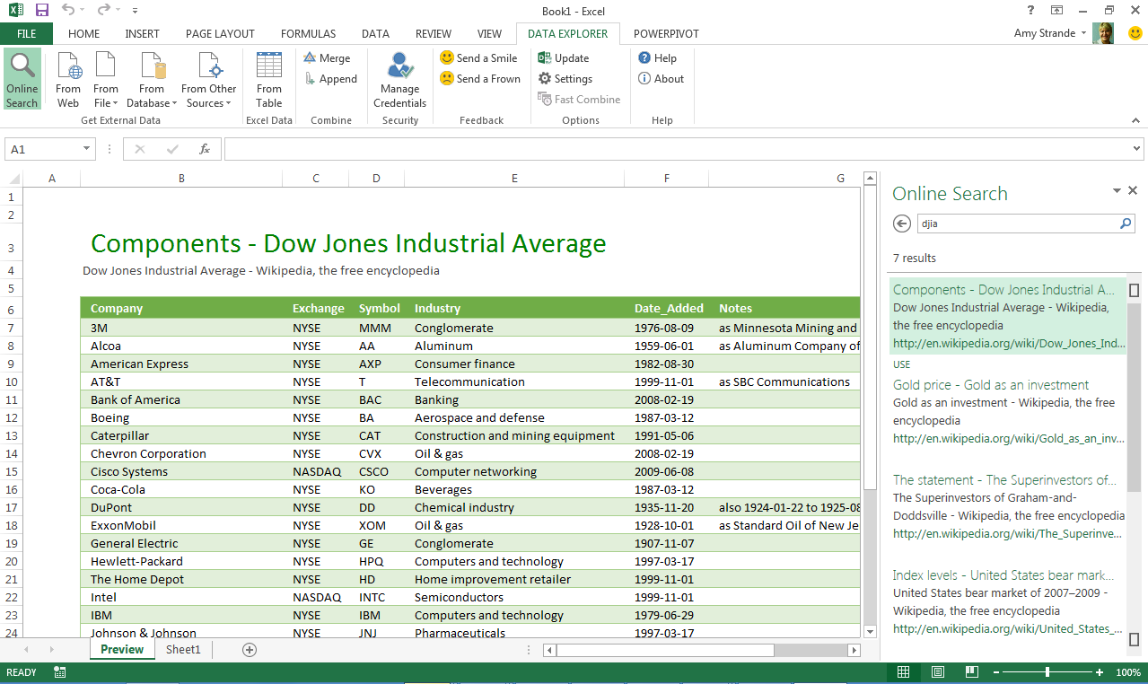
Powerful Self-Service BI with Excel 2013
Discover & Combine
Search and access internal & external data
Clean, transform, and shape data
Merge and combine data from multiple sources
Power Query – formerly project “Data Explorer”
Analyze & Model
Lightning fast analytics with in-memory technology
Model relationships, custom measures, hierarchies, and KPI’s
Visualize & Explore
Bring your data to life with interactive visualization
Explore data in new ways to discover hidden insights

Slide 18
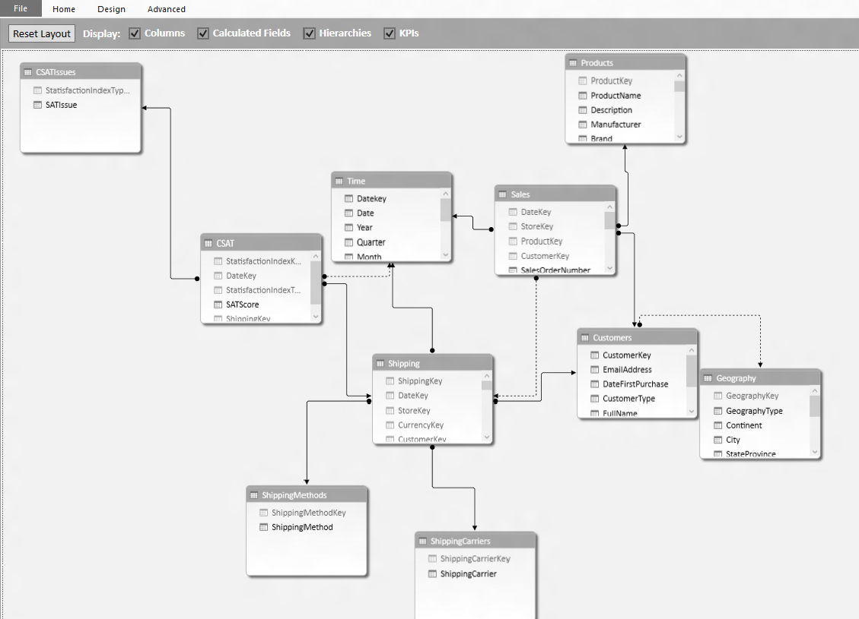
Powerful Self-Service BI with Excel 2013
Discover & Combine
Search and find internal & external data
Clean, transform, and shape data
Merge and combine data from multiple sources
Power Pivot
Analyze & Model
Lightning fast analytics with in-memory technology
Model relationships, custom measures, hierarchies, and KPI’s
Visualize & Explore
Bring your data to life with interactive visualization
Explore data in new ways to discover hidden insights

Slide 19
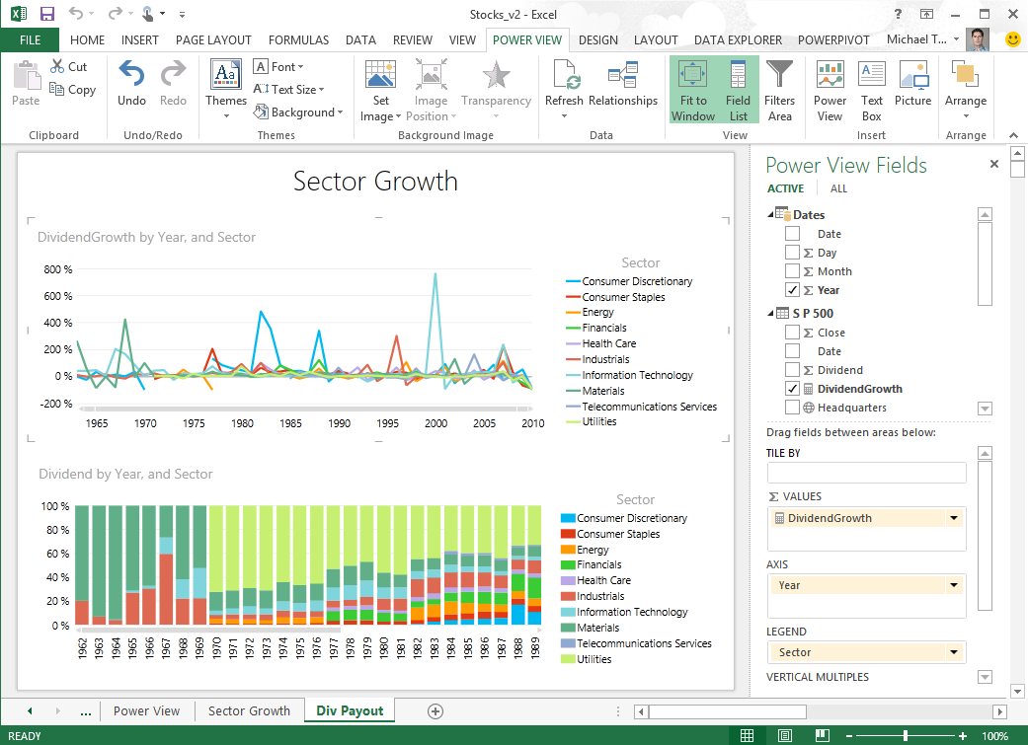
Powerful Self-Service BI with Excel 2013
Discover & Combine
Search and find internal & external data
Clean, transform, and shape data
Merge and combine data from multiple sources
Power View
Analyze & Model
Lightning fast analytics with xVelocity in-memory technology
Model relationships, custom measures, hierarchies, and KPI’s
Visualize & Explore
Bring your data to life with interactive visualization
Explore data in new ways to uncover hidden insights

Slide 20
PowerView in Excel
Raphael Ax
Microsoft

Slide 21
PowerView in SharePoint
Raphael Ax
Microsoft

Slide 22
Project Online with SSRS/ SSIS

Slide 23
Technical Network
Join the conversation!
Share tips and best practices
with other Office 365 experts
http://aka.ms/o365technetwork

Slide 24


© 2014 Microsoft Corporation. All rights reserved. Microsoft, Windows, and other product names are or may be registered trademarks and/or trademarks in the U.S. and/or other countries.
The information herein is for informational purposes only and represents the current view of Microsoft Corporation as of the date of this presentation. Because Microsoft must respond to changing market conditions, it should not be interpreted to be a commitment on the part of Microsoft, and Microsoft cannot guarantee the accuracy of any information provided after the date of this presentation. MICROSOFT MAKES NO WARRANTIES, EXPRESS, IMPLIED OR STATUTORY, AS TO THE INFORMATION IN THIS PRESENTATION.

