Slide 2
SDN with Lync Server 2013
OFC-B340
Jamie Stark

Slide 3


SUBMIT YOUR TECHED EVALUATIONS
We need your feedback!
Fill out an evaluation via
CommNet Station/PC: Schedule Builder
Phone/Tablet: TechEd Mobile app
QR Code

Slide 4
Lync MVP Pub Trivia Night – Invitation Only
Want to join Lync MVPs and speakers at an exclusive Pub Trivia Night tonight?
Tweet a photo from a Lync session using the hashtag #LyncTEE for your chance to attend!
Two entries are randomly selected each day.
Test your Lync knowledge with questions created by MVPs.
Free food and drinks! Great prizes! *See official rules online.
If you don’t score an invite, you can compete on Twitter with @msftLync tonight at 7pm for your chance to win a Surface Pro 3!
TechEd Europe
#LyncTEE

Slide 5
Agenda
A Brief Primer on SDN
Lync and Packet Networks
The Lync SDN API
Scenarios
Case Studies

Slide 6
A Brief Primer on SDN

Slide 7
In the Microsoft Cloud
VM
VM
VM
VM
VM
VM
VM
VM
VM
VM
VM
VM
VM
VM
VM
VM
VM
VM
VM
VM
VM
VM
VM
VM
App
App
App
App
App
App
Tenant
Tenant
Tenant
Software-defined Datacenter
Storage
Network
Compute

Slide 8
Software Defined Networking
Abstract underlying infrastructure from applications
Decouple the control and data planes
Logically centralize network state & intelligence
https://www.opennetworking.org/images/stories/downloads/sdn-resources/white-papers/wp-sdn-newnorm.pdf

Slide 9
OpenFlow under the hood
Controller
OpenFlow (TLS/TCP)
Network Switch
Control Plane (software)
OpenFlow Agent
Data Plane (hardware)
Flow Tables
Flow Table Rules:
Match Rule
Action
Counters
Forward
Modify
Encap / decapsulate
Drop, etc.

Slide 10
SDN Market Dynamics
Network spend moving towards SDN technologies
“Higher-layer application functions will become integrated with lower layers of the network, leading to two-way application awareness. The network will be able to adapt to changing application requirements efficiently and effectively.
In other words, applications
will be able to dictate what
the network needs to do to support them.”
– Julie Kunstler, Ovum Research
March 18, 2013
SDN market 2018 forecast of up to $35 Billion¹
In next five years, Global SDN market is forecast to grow at a CAGR of 62.3 percent. ²
By 2014, nine of the top 10 network security vendors will support OpenFlow. ³
By 2017, 60% of enterprise private cloud deployments will automate the provisioning of information security controls. ³
75% of Gartner clients are either thinking about or evaluating SDN⁴
http://www.sdncentral.com/sdn-market-sizing-2013-april/
Global Software-defined Networking Market 2014-2018
Gartner: The Impact of Software-Defined Data Centers on Information Security
Gartner: Four Key Questions to Ask Your Data Center Networking Vendor

Slide 11
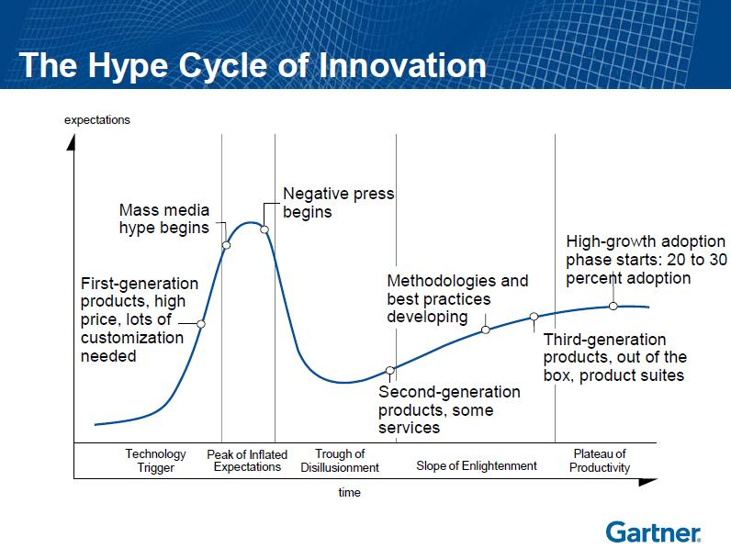
Source: Gartner

Slide 12
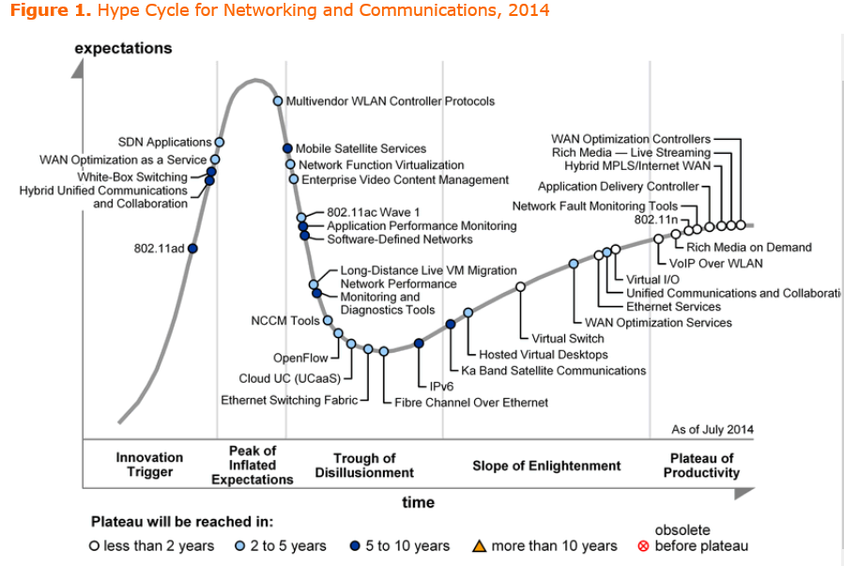
“Good examples of the work being done in this area are applications such as … the Network Optimizer for Lync from HP …. “
Source: Gartner Hype Cycle for Networking and Communications, 2014

Slide 13
Lync & Packet Networks

Slide 14
Traditional Lync Networking
ADC, IDS, SBC
Application | Partners
Presentation | Resiliency
Session | CAC
Transport | Media Ports
Network | DSCP
Data Link | LLDP & VLANs
Physical | Bandwidth
DNS Load Balancing
Session Policy Control
Splitting media
Static packet tagging
Phone vs. Laptop

Slide 15
Today’s UC&C challenges
Network issues cause 60-80% of poor end-user QoE
Poor visibility into real-time traffic
  Lync uses encryption by default, making DPI difficult and unreliable
  Skype tries to hide itself from networks
Traffic engineering / QoS is complex & easily broken
  Requires brute force static policies that must match application server settings
  Intermittent problems are tedious to diagnose, especially for Softphones and BYOD

Slide 16

Tomorrow’s UC&C Challenges

Slide 17
Applications Programming Networks
SDN Application
Communicate using Northbound interface to SDN controller
Controller
Translate requirements from Applications
Provide an abstracted view of the network
Network Elements
Could be physical or virtual
Communicate to Controller via Southbound / Control-Data-Plane Interface
App
App
App
App
Northbound API
SDN Controller Platform
Southbound API
Switch
vSwitch
vSwitch
Switch

Slide 18
UC SDN Architecture
Application
(ex: UC)
End-User Application
End-User Application
Focused NB APIs
SDN Controller
SDN Diagnostics Network Service App
SDN Security Network Service App
SDN QoS Network Service App
Traffic Eng Network Service App
Network Services Function
Network Focused NB APIs
SDN Controller
Topology
Inventory
Path Computation
Flow Programing
Statistics
Network Control & Management Functions
SB APIs (Openflow)
NE
NE
NE
NE
NE
NE
NE
NE
Network Elements

Slide 19
Lync SDN Interface

Slide 20
Lync SDN: Network Architecture
Lync Pool
With LDL
Lync SDN Managers
Media
SDN XML
SB API
Network
Devices
Signaling
Network
Controller

Slide 21
Lync SDN Interface, version 2.1
Released in September; blog post here
Partner requests; In-call Quality Updates in the API
Device information in quality reports
Fully load-balanced and redundant pool
SDN Manager state sharing with database
Simplified configuration and setup of LDL
Filtering; beginning of the subscription model

Slide 22
Lync SDN: Network Architecture (v2.1+)
Lync Pool
With LDL
Lync SDN Manager Pool
Media
SDN
XML
SB API
Network
Devices
Signaling
Network
Controllers

Slide 23
Messaging Flow
Lync
Client
Lync FE &
Dialog Listener
Lync SDN Manager
NMS/Network Controller
Lync SDN Interface
SIP messages
Invite/LRSInvite
Start
Proprietary or
backward
compatible API
Update
Ended
Error
QoE Report
Quality Update

Slide 24
Dialog Event
Events:
Start, Update, Error & End Dialog
Attributes:
SIP URIs
Call ID
IP SA/DA
Protocol
Transport S/D Ports
Media Type
Codec & BW
Signaling
Media
Lync
Dialog
Event
UC
SDN
Interface
Network Controller
South
Bound
API
Switch
IDS/IPS
Firewall
Probe
WAN
Optimizer
Router
WLAN
AP
Network Elements

Slide 25
Quality Event
Events:
Quality Update event for Voice, Video or Data
Attributes:
5 Tuple Value
NMOS Value
Delay Value
Jitter Value
Packet Loss Value
Healer Ratio Value
Signaling
Media
Lync
Dialog
Event
UC
SDN
Interface
Network Controller
South
Bound
API
Switch
IDS/IPS
Firewall
Probe
WAN
Optimizer
Router
WLAN
AP
Network Elements

Slide 26
Lync SDN Interface
Message Flow

Slide 27
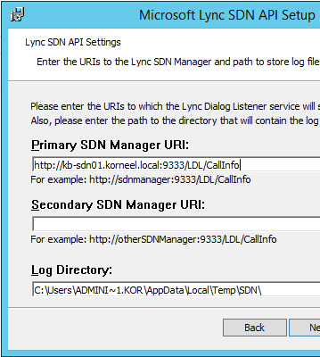
Configuring the Lync Dialog Listener
Installed on all front-ends
SDN Manager is defined during installation
Multiple SDN managers are supported for failover
Relevant configuration lines
<SubmitURI> SDN Manager URI
<hidepii> Hides Personal identifiable information.
<sendallcallqoe> When False only bad call QoE submitted.
<sendrawsdp> send the raw SDP message.
<sendcallinvites> send the call invite.
Configuration file is located at
“\Microsoft lync server\Microsoft lync SDN API\lyncdialoglistener.exe.config”

Slide 28
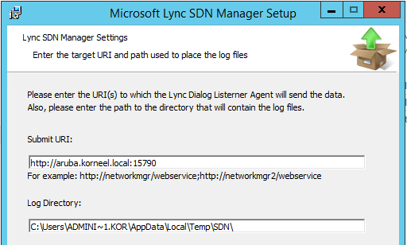

Configuring the SDN Manager
Download from http://www.microsoft.com/en-us/download/details.aspx?id=44274
SDN Manager is installed first on separate server with .net framework 4.5
During installation the SDN Controller(s) are defined
Making changes after Install? Edit the sdnmanager.exe.config file in
“c:\program files\Microsoft lync server\Microsoft Lync SDN API”

Slide 29
Lync SDN: Redundancy models in 2.1
Collocated
LSM
Single
LSM
Redundant
LSM
LSM
Pool
Lync FE &
Dialog Listener
Lync FE &
Dialog Listener
Lync FE &
Dialog Listener
Lync FE &
Dialog Listener
Lync FE &
Dialog Listener
Lync FE &
Dialog Listener
Lync FE &
Dialog Listener
Lync FE &
Dialog Listener
Lync FE &
Dialog Listener
Lync FE, LDL & SDN Manager
Lync FE, LDL & SDN Manager
Lync FE, LDL & SDN Manager
Lync SDN Manager
Primary LSM
Backup LSM
Lync FE &
Dialog Listener
Lync FE &
Dialog Listener
Lync SDN Manager
Network Controller
Network Controller
Network Controller
Network Controller
Network Controller
Network Controller
Network Controller
Network Controller

Slide 30
Scenarios

Slide 31
Lync SDN Scenarios
Diagnostics
  Proactively automate the diagnostics and troubleshooting of bad calls
Automated QoS
  Reduce the cost of deploying QoS and implementing Traffic Engineering.
Orchestration
IT Agility & Network Customization through real-time, policy-based config of network resources.

Slide 32






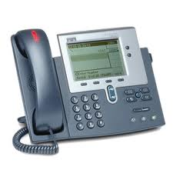

Real-Time Network Visibility
Leveraging the Microsoft Lync SDN API
UC Environments
IP Cloud
Lync
Customer
SBC
IP TOPOLOGY OSPF, BGP
CONTENT – RTP
Real-Time Network
Performance & Correlation
LYNC SDN API
CONTENT – Lync
SESSION – Lync
SESSION - SIP, H.323, SCCP, UNIStim
Content Metrics
Network Packet Loss
Jitter / Buffer Drops
R-Factor / MOS
Session Metrics
Session Attempts
Success Rate
Errors / PCAP files
Topology Metrics
Hop-by-hop tracking
Interface congestion
Path / Route Changes
Packet Loss
QoS Analysis
Complete View of the
End-User Experience
Microsoft SDN API + Nectar Real-Time CMP
Nectar Unique Visibility

Slide 33
Lync SDN Scenarios
Diagnostics
  Proactively automate the diagnostics and troubleshooting of bad calls
Automated QoS
  Reduce the cost of deploying QoS and implementing Traffic Engineering.
Orchestration
IT Agility & Network Customization through real-time, policy-based config of network resources.

Slide 34








HP & Lync SDN QoS Model
QOS SDN
Controller
Dialog
Start
OpenFlow:
Set QoS Remark
Wi-Fi
Hybrid
OpenFlow
WAN
EF
Best Effort
Static QoS Policies in
Network core and WAN
Branch 2
EF
Hybrid
OpenFlow
Best
Effort
Branch 1

Slide 35
HP & Lync SDN QoS Model
QOS SDN
Controller
Network now “Lync aware”
and enforcing trusted
per-session dynamic policies
A Hybrid SDN model, for ease of deployment and reduced risk
Wi-Fi
Hybrid
OpenFlow
WAN
EF
Ingres: Best Effort
Egress: EF
Branch 2
EF
Hybrid
OpenFlow
Ingress: Best Effort
Egress: EF
Branch 1

Slide 36


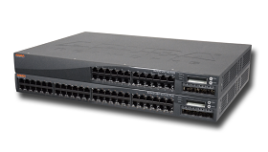

Aruba SDN Architecture
Application Layer
Application Fingerprinting and App RF for Lync
Lync
Lync SDN API
Automated Wi-Fi Traffic Engineering
Aruba MOVE Architecture
Controller Layer
Post Call Statistics
Infrastructure Layer
Diagnostics
QoS for all Lync flows – for voice, video and desktop sharing
Real-time monitoring for voice and video call quality
App RF for Lync – enable Lync aware RF Management
Remarking wired and wireless traffic with the right QoS levels

Slide 37
Aruba Networks &
Lync SDN Interface

Slide 38
Lync SDN Scenarios
Diagnostics
  Proactively automate the diagnostics and troubleshooting of bad calls
Automated QoS
  Reduce the cost of deploying QoS and implementing Traffic Engineering.
Orchestration
IT Agility & Network Customization through real-time, policy-based config of network resources.

Slide 39
Customer References

Slide 40
Aruba Networks & AFA
American Fidelity Assurance, all wireless workplace
1,500 users across 26 sites
Using SDN Interface between Lync & Aruba
Cost savings of $700k by going all wireless
Read the case study & watch the video

Slide 41
Nectar Systems & US Customer
3,000 users at 300+ locations in the U.S.
Poor call quality & conferencing experience, constant congestion, dropped calls….
Identified incorrect QoS settings within routed network
Customer believed QoS set to 40% for Lync voice….actually configured at 20%
Within days, able to correct > 95% of issues
Read Gartner opinion & three case studies here

Slide 42
Extreme Networks & City of Bellevue
~1,400 employees across 14 departments
Improved delivery of Lync over wired & wireless
“In a matter of a few hours, the QoS was completed”
$100k in savings through PBX replacement.
Read the case study here

Slide 43
HP & Istanbul Kultur University
11,000 Students, 800 staff
Lync in deployment, rollout for staff & student mobile
Hybrid mode with SDN/OpenFlow & legacy environ.
Saw big benefit in Management & operations
Read more HP Networking case studies

Slide 44
Agenda
A Brief Primer on SDN
Lync and Packet Networks
The Lync SDN API
Scenarios
Case Studies

Slide 45

Curated list of highly relevant sessions
NEXT: HA & DR – OFC-B324 – 8.0/F7
THU 1700: Mobile EV – OFC-B344 – 8.0/F7
FRI 1015: Networking – OFC-B410 – 8.0/F7
Find Me Later in the Lync / Office booth

Slide 46
References
Open Networking Foundation White Paper
http://www.sdncentral.com/sdn-market-sizing-2013-april/
Global Software-defined Networking Market 2014-2018
Gartner: The Impact of Software-Defined Data Centers on Information Security
Gartner: Four Key Questions to Ask Your Data Center Networking Vendor
Gartner Hype Cycle for Networking and Communications, 2014
Announcement of Lync SDN Interface version 2.1
Download Lync SDN Interface
Aruba Networks & AFA: Read the case study & watch the video here
Nectar Systems: Read Gartner opinion & three case studies here
Extreme Networks & City of Bellevue: Read the case study here
HP Networking & Istanbul Kultur University: Read more HP Networking case studies

Slide 47

Resources
Learning
  Sessions on Demand
  Microsoft Certification & Training Resources
http://channel9.msdn.com/Events/TechEd
www.microsoft.com/learning
TechNet
Developer Network
  Resources for IT Professionals
http://microsoft.com/technet
http://developer.microsoft.com

Slide 48



Please Complete An Evaluation Form
Your input is important!
TechEd Schedule Builder
CommNet station or PC
TechEd Mobile app
Phone or Tablet
QR code

Slide 49
Evaluate this session

Slide 50


© 2014 Microsoft Corporation. All rights reserved. Microsoft, Windows, and other product names are or may be registered trademarks and/or trademarks in the U.S. and/or other countries.
The information herein is for informational purposes only and represents the current view of Microsoft Corporation as of the date of this presentation. Because Microsoft must respond to changing market conditions, it should not be interpreted to be a commitment on the part of Microsoft, and Microsoft cannot guarantee the accuracy of any information provided after the date of this presentation. MICROSOFT MAKES NO WARRANTIES, EXPRESS, IMPLIED OR STATUTORY, AS TO THE INFORMATION IN THIS PRESENTATION.

Slide 51
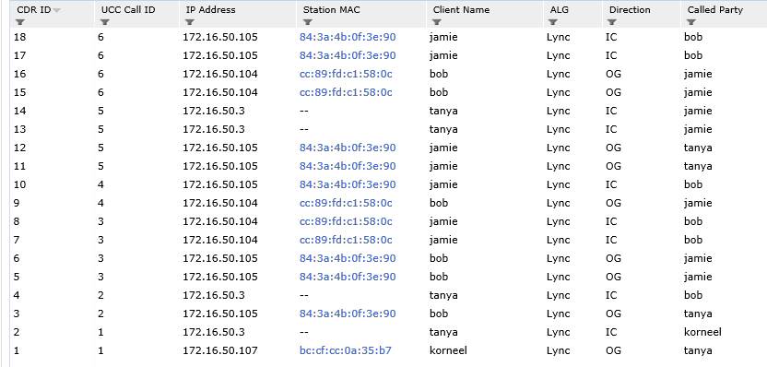
Aruba with SDN API

Slide 52
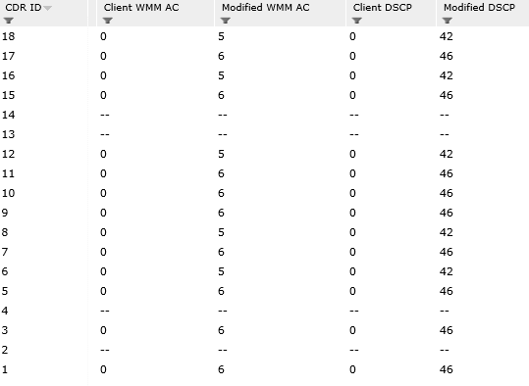
Aruba with SDN API

