Slide 1


Slide 2

SharePoint Online Performance Designing your pages to be fast
OFC-B343
Shyam Narayan
Microsoft

Slide 3
Topics
Performance at scale
What makes SPO different from on-prem SharePoint
Common mistakes
Why pages get slow
Best practices for fast pages
Tips and tricks to make your pages fast
SPO and load
SPO’s scale out and capacity management strategy
Demo: 30 seconds to 2 seconds
Making a slow page fast

Slide 4

The slowest 1% of pages in SharePoint online take more than 5,000ms to load
75% of SharePoint Online pages load in less than 1,000ms
1,000ms
5,000ms

Slide 5

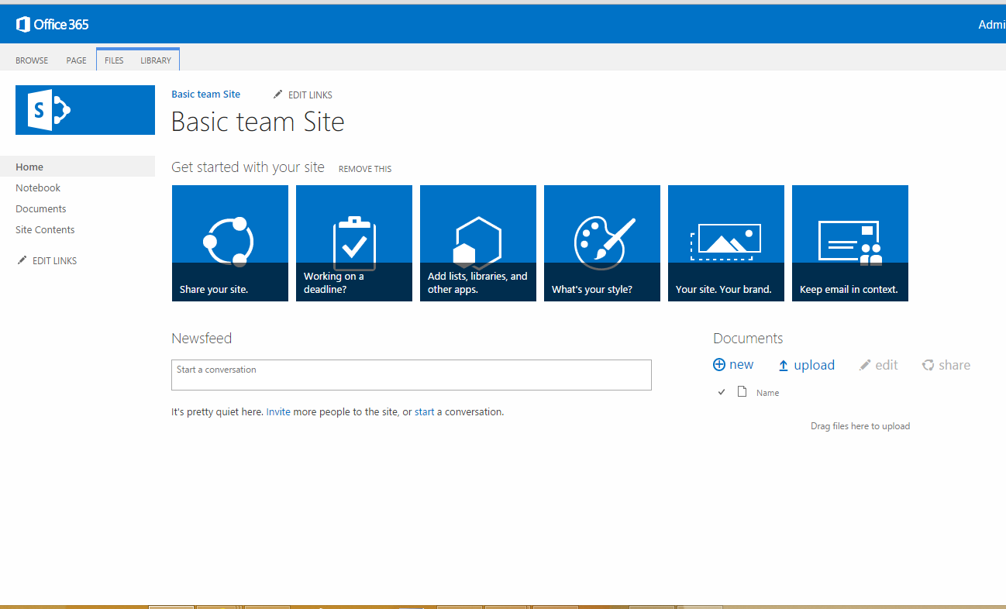
Why SharePoint pages get slow…
Server
CDN
Network
Browser
Server
Network
Microsoft
Network
ISP
Internet
Complex pages
Too many web parts
Large payload
Too many files
Large distance to server
Complex pages
Busy computer
Small cache
Expensive server interactions
Front end cache misses

Slide 6
Demo: 30 seconds to 2 seconds
Focus on the 95th
Demo site baseline
Demo site improved value

Slide 7
30 seconds to 2 seconds
Diagnosing slow performance

Slide 8
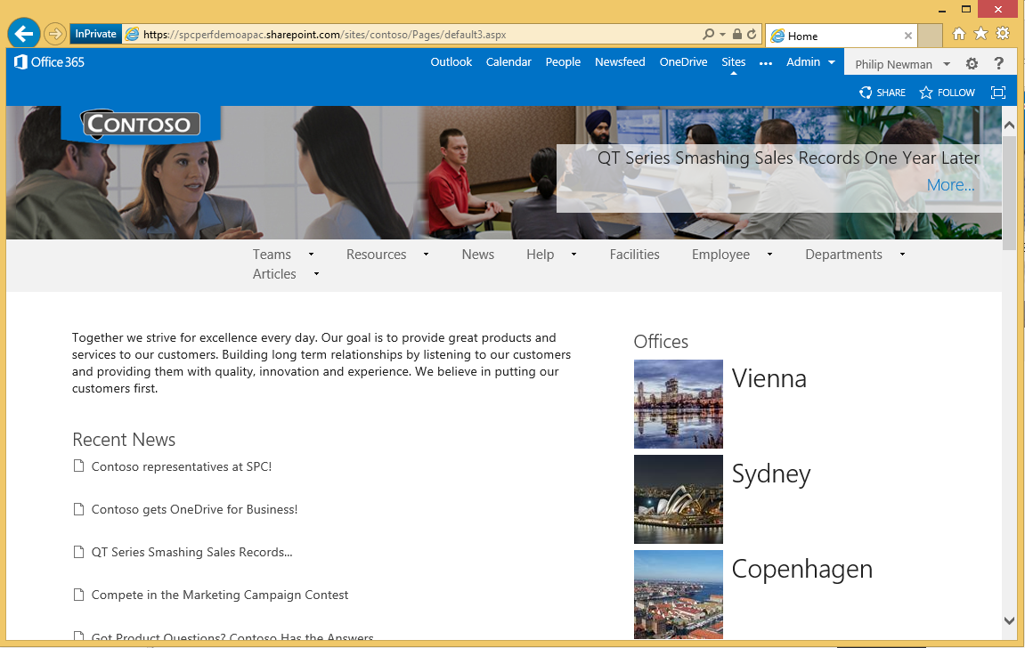


Top 5 causes of slow performance in SPO
Structural navigation
Deep navigation
Content rollup
Expensive queries
Large files
Images and videos
Lots of requests
.js, .css, images
Lots of web parts

Slide 9

Front end caches in SPO
SharePoint On-premises
SharePoint Online
10s of servers
10s of busy sites
100s of users
1,000s of servers
1,000s of busy sites
10,000s of users

Slide 10
30 seconds to 2 seconds
Structural Navigation

Slide 11
Perf tips: Structural Navigation
Use structural navigation and keep depth shallow
  Fewer sites, less work
  Will reduce server time but still have slower requests in higher percentiles (cache misses)
Use managed navigation
  Uses managed metadata – much faster than iterating over all sites
  No security trimming in navigation
Use a search query to get site structure
  Uses a search query to get site structure
  Can cache navigation in client storage

Slide 12
30 seconds to 2 seconds
Content Rollup

Slide 13
Perf tips: Content rollup
Use content by query but keep depth shallow
  Less scope, less work
  Will reduce server time but still have slower requests in higher percentiles (cache misses)
User content by search
  Uses search queries to get results
  Very rich functionality with search customization
  Client side rendering with HTML and JavaScript
Use static content
  For content that seldom changes, use static content
    Common links, department sites, etc.

Slide 14
30 seconds to 2 seconds
Image optimization and delay loading

Slide 15
Perf tips: Image optimization
Keep them small
  Compress images before uploading them to SharePoint
  Use renditions
Delay loading
  Very valuable in high-latency scenarios
  Focus on first loading “above the fold” content before content deeper in the page

Slide 16
30 seconds to 2 seconds
Reducing roundtrips

Slide 17
Perf tips: Optimize HTTP traffic
Reduce the number of HTTP requests
  Deliver static content via CDN’s if possible
  Parallelize downloads across multiple hostnames
  Bundle static assets together to reduce HTTP requests
Reduce download sizes
  Minify all JavaScript and CSS assets
  Use image sprites for common static images

Slide 18
30 seconds to 2 seconds
Demo summary

Slide 19
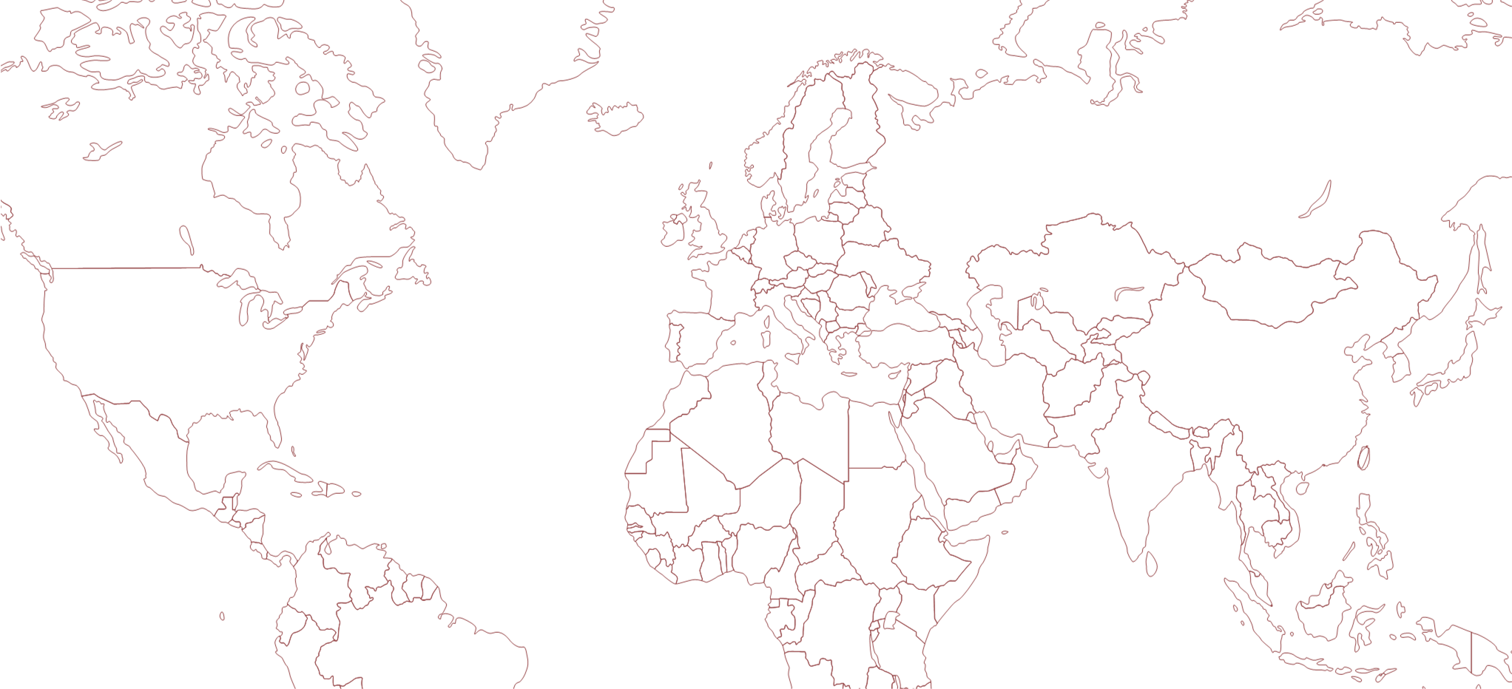
30 seconds to 2 seconds
https://snaray.sharepoint.com/sites/contoso

Slide 20
30 seconds to 2 seconds
30s
Structural to search or managed navigation
20s
Content by query to content by search
5s
Image optimization and delay loading
Optimizing HTTP traffic via CDN’s, bundling and minification
2s

Slide 21
Launch day
How SPO manages capacity
Rolling out a new portal

Slide 22
Predictive capacity: forecasting
Requests in zone
SPO forecasts future growth by trending historical load

Slide 23
Predictive capacity: forecasting
Requests in zone
Forecasts are for groups of farms in a zone
Requests per farm

Slide 24
Predictive capacity: managing farms
Average front end CPU load
85 to 100 % - Danger Zone
40% to 85 % - Buffer
As load increases, we
add capacity
Front ends in content farms run at 40% CPU
% CPU
0% to 40 % - Operating zone
Monday Tuesday Wednesday Thursday Friday

Slide 25
Launching a new site to > 10k users
Waves
Pilot
1
2
3
4
Invited users
Active users

Slide 26
…but sometimes slow rollouts isn’t an option

Slide 27
Microsoft’s Academy live
Video portal optimization

Slide 28
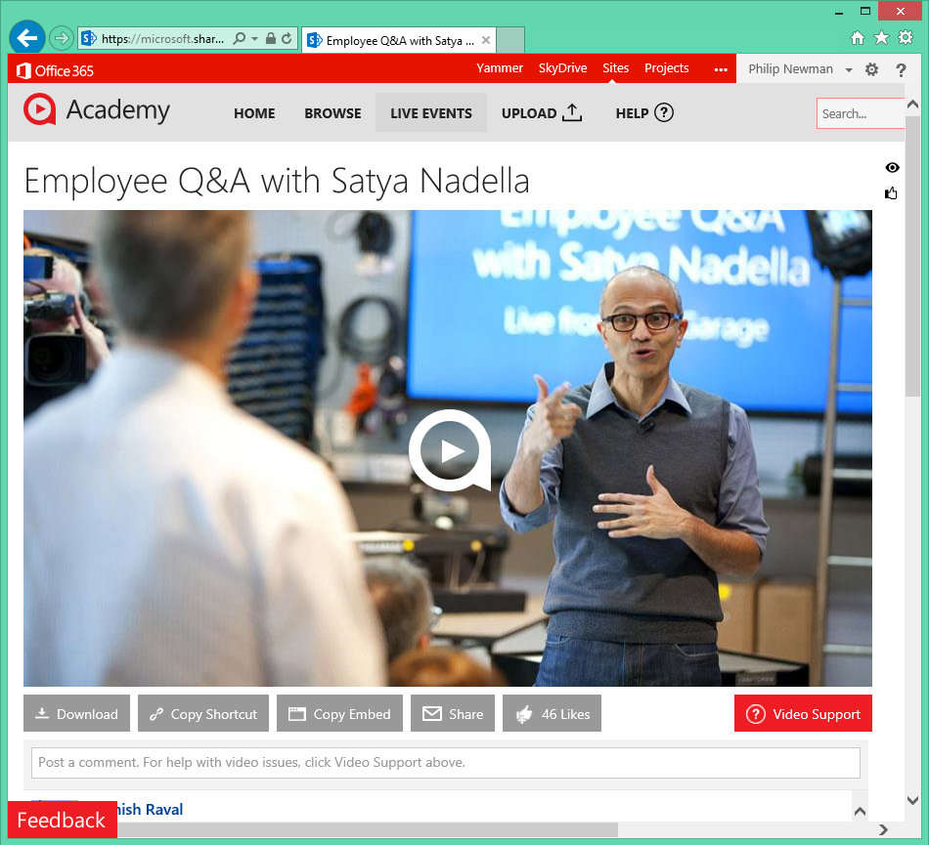
Scenario: Company-wide webcast
Microsoft’s “Academy” site hosts training videos and live broadcasts
Recent live company-wide events:
Company meeting
New CEO announcement
Optimizations:
Load static assets from CDN
Move images to asset library

Slide 29
Microsoft farm & Satya webcast
Webcast requests
Non-webcast requests
Monday Tuesday Wednesday Thursday Friday

Slide 30



In summary…
Tooling
Lightweight pages
Cloud scale
Smart rollout

Slide 31



SPO performance cheat sheet
Count requests
Identify slow requests
Focus on the “content loaded” marker
F12
Rollup using search
Navigation fix-up
Delay-load as needed
Check for large files
Renditions and delay-loading
Too many files? Combine .js and .css
Consume common libraries from CDNs

Slide 32
Related content
Breakout Sessions
  OFC-B335 Office 365 Network Topology and Performance Planning Thursday, October 30 5:00 PM - 6:15 PM Room: Hall 8.1 Room K
  OFC-B411 Office 365 Network Performance Troubleshooting
  Friday 10:15am in Hall 8.0, Room D4
Online Resources
  Office 365 Performance Management on TechNet, see http://aka.ms/tune
  Office 365 Performance Management course, see http://aka.ms/tunemva
Find Me Later At. . .
  Office 365 booth in the expo hall

Slide 33
Technical Network
Join the conversation!
Share tips and best practices
with other Office 365 experts
http://aka.ms/o365technetwork

Slide 34


Office 365
Exams
Managing Office 365 Identities and Requirements
EXAM
346
Deploying
Office 365 Services
EXAM
347
http://bit.ly/
O365-Cert
+
Classroom
training
Introduction
to Office 365
FLC
40041
Managing Office 365 Identities and Services
MOC
20346
Designing for Office
365 Infrastructure
5
MOC
10968
3
http://bit.ly/
O365-Training
Online
training
Office 365
Fundamentals
MVA
Managing Office 365 Identities and Services
MVA
http://bit.ly/
O365-MVA
Get certified for 1/2 the price at TechEd Europe 2014!
http://bit.ly/
TechEd-CertDeal

Slide 35

Resources
Learning
  Sessions on Demand
  Microsoft Certification & Training Resources
http://channel9.msdn.com/Events/TechEd
www.microsoft.com/learning
TechNet
Developer Network
  Resources for IT Professionals
http://microsoft.com/technet
http://developer.microsoft.com

Slide 36



SUBMIT YOUR TECHED EVALUATIONS
We value your feedback!
Fill out an evaluation via
CommNet Station/PC: Schedule Builder
LogIn: europe.msteched.com/catalog
TechEd Mobile app
for session evaluations
is currently offline

Slide 37


© 2014 Microsoft Corporation. All rights reserved. Microsoft, Windows, and other product names are or may be registered trademarks and/or trademarks in the U.S. and/or other countries.
The information herein is for informational purposes only and represents the current view of Microsoft Corporation as of the date of this presentation. Because Microsoft must respond to changing market conditions, it should not be interpreted to be a commitment on the part of Microsoft, and Microsoft cannot guarantee the accuracy of any information provided after the date of this presentation. MICROSOFT MAKES NO WARRANTIES, EXPRESS, IMPLIED OR STATUTORY, AS TO THE INFORMATION IN THIS PRESENTATION.

