Slide 1


Slide 2

Everything You Need To Know about SMTP Transport for Microsoft Office 365
OFC-B350
Brian Reid – C7 Solutions Ltd

Slide 3
What we will look at
Scenarios for Office 365 mail flow
Mail flow testing
Connectors and routing
Changing mail flow endpoints
Ensuring your mail flow remains compliant
Decommissioning Exchange Server on-premises

Slide 4
Mail flow scenarios

Slide 5
Mail flow scenarios
Staged
Hybrid
Exchange Online Protection standalone
Partner

Slide 6
Staged mail flow

Slide 7
Preparation for staged mail flow
Domains
  Add all domains used in email on-premises to Office 365 and verify
  Set domains to InternalRelay
  You cannot change the automatically created domains of tenant.onmicrosoft.com and tenant.mail.onmicrosoft.com
Users
  Install DirSync
  User Principal Name: This will get stamped as an secondary email address in Office 365 so ensure no one else have this as an email address already
Certificates
  Can use the same certificate for SMTP as being used by Outlook Anywhere
  Add certificate subject name or subject alternative name to connectors to do TLS mail flow

Slide 8
Routing
To Office 365 Mailboxes
  Ensure valid mail route exists to tenant.mail.onmicrosoft.com directly from on-premises server
  [Optional] Safe list on-premises IP’s in EOP
  [OR] New-InboundConnector type On-Premises
To On-Premises Mailboxes
  Ensure return route from EOP to on-premises exists with New-OutboundConnector using on-premises endpoint as smarthost value (this is required, do not rely on MX record for return path)

Slide 9
Staged migration
Your staged migration is now ready to take place
  Move mailboxes using Office 365
  Mailbox migration uses Outlook Anywhere to connect
TargetAddress attribute
  At start of each mailbox migration the TargetAddress attribute on-premises is set on the user object in Active Directory in the form of “SMTP:alias@tenant.mail.onmicrosoft.com”
  On-premises server will now deliver all new emails to Office 365 mailbox
  From now on, email to mailbox is routed Internet > MX > On-Premises Server > Exchange Online Protection > Office 365 mailbox
  Outbound email routes differently by default:
  [To internet] Office 365 mailbox > Exchange Online Protection > MX for target domain
  [To unmigrated on-premises mailbox] Office 365 mailbox > EOP > MX for on-premises domain
  [or] via Outbound Connector

Slide 10


targetAddress and Routing
MX to On-Premises (staged migration)
user1@contoso.com
EmailAddresses= SMTP:user1@contoso.com
    smtp:user1@contoso.mail.onmicrosoft.com
Inbound connector; ConnectorType: OnPremises
Or Connection filter: On-premises IP address listed
Ensure your SPF record contains on-premises IP
when using the InboundConnector method
[optional] On-premises
send connector for contoso.mail.onmicrosoft.com
MX points to on-premise
user1@contoso.com (mailbox or mail user [preferred])
targetAddress=SMTP:user1@contoso.mail.onmicrosoft.com

Slide 11
targetAddress and Routing
MX to Office 365 (staged migration)
MX points to Exchange Online Protection
user2@contoso.com (mail user)
targetAddress=SMTP:user2@contoso.com
[ExternalEmailAddress]
Create Outbound
connector
Address space: contoso.com
SmartHosts: on-premises
endpoint
ConnectorType: OnPremises
RecipientDomains: contoso.com (etc.)
user2@contoso.com (mailbox)
EmailAddresses= SMTP:user1@contoso.com

Slide 12
Hybrid mail flow

Slide 13
Preparation for Hybrid mail flow
Run the Hybrid Configuration Wizard (HCW)
  This will create the connectors needed for mail flow both on-premises and in Exchange Online
Review the on-premises connectors
  Send Connector on-premises for the tenant unique address space (tenant.mail.onmicrosoft.com) that enforces TLS and maintains Exchange headers called “Outbound to Office 365”
  Default Receive Connector on-premises modified to receive from Exchange Online as well as everywhere else.
  Modified from Exchange Online to maintain headers, enforce TLS and “AcceptCloudServicesMail”
Review the Exchange Online connectors
  Inbound Connector that only accepts from a server with your digital certificate
  Outbound Connector to your on-premises Hybrid server(s) and will only send to servers that hold your digital certificate
  Mail flow is controlled via settings such as RemoteDomains and RouteAllMessagesViaOnPremises

Slide 14
Hybrid mail flow
Mailboxes and their counterpart objects
  Objects exist at both Exchange Online and on-premises to route emails in either direction
  DirSync and mailbox moves control these objects and what they do
Like staged, its all targetAddress based
  RemoteMailboxes are objects in Exchange on-premises that represent Exchange Online mailboxes
  They have a targetAddress (RemoteRoutingAddress in PowerShell) attribute that determines email destination
  This attribute has a value such as SMTP:alias@tenant.mail.onmicrosoft.com
  MailUser objects in Exchange Online usually represent mailboxes on-premises.
  MailUser objects have the targetAddress (ExternalEmailAddress in PowerShell) value set to their email address on-premises
  MailUser objects are also used on-premises for users that have email addresses outside of the on-premises and Exchange Online

Slide 15
targetAddress routing
How targetAddress controls mail routing
  The RemoteRoutingAddress (targetAddress in AD) of a Remote Mailbox tells Exchange Server to readdress and redeliver its email to Exchange Online via the routing address of tenant.mail.onmicrosoft.com
  A send connector on-premises created by the Hybrid Configuration Wizard routes emails being delivered to the tenant.mail.onmicrosoft.com address space
  The ExternalEmailAddress (targetAddress in Azure AD) of a MailUser in Exchange Online is used to readdress and redeliver its email
  Email for on-premises mailboxes is delivered via the Outbound Connector created by the Hybrid Configuration Wizard.
  This Outbound Connector deals with emails for the shared address space of domain.com

Slide 16
targetAddress and Routing
MX to On-Premises (hybrid)
user1@contoso.com
EmailAddresses= SMTP:user1@contoso.com
    smtp:user1@contoso.mail.onmicrosoft.com
“Inbound from GUID”
Inbound connector
ConnectorType: OnPremises
RequireTLS: True
TlsSenderCertificateName: <I>Issuer<S>Subject
On-premises
send connector for contoso.mail.onmicrosoft.com
MX points to on-premise
user1@contoso.com (remote mailbox)
targetAddress=SMTP:user1@contoso.mail.onmicrosoft.com

Slide 17
targetAddress and Routing
MX to Office 365 (hybrid)
MX points to Exchange Online Protection
user2@contoso.com (mail user)
targetAddress=SMTP:user2@contoso.com
[ExternalEmailAddress]
“Outbound to GUID”
outbound connector
SmartHosts: on-premises
hybrid server(s)
ConnectorType: OnPremises
RecipientDomains: contoso.com (etc.)
TlsSettings: DomainValidation
TlsDomain: Subject of on-premises certificate
user2@contoso.com (mailbox)
EmailAddresses= SMTP:user2@contoso.com

Slide 18
Other routing options
Inbound via 3rd party service
  As long as this service does not sit between Exchange on-premises and Exchange Online then this is supported
Centralized Mailflow
  All external email flows via on-premises
  Hybrid mail connectors are modified to include * address space via on-premises
  Need to modify your receive connector though to allow relay

Slide 19
EOP standalone mail flow

Slide 20
EOP mail flow options
Domains
  Add your domain to EOP and verify it
  Set AcceptedDomain to Authoritative if you will add recipients and want EOP to block invalid recipients at its edge with directory based edge blocking
Recipients
  Optionally add your recipients to EOP (manually with PowerShell, individually with EAC or via DirSync if you have Active Directory on-premises)
  Required to add recipients is using directory based edge blocking
  If using DirSync then on-premises safe lists are uploaded to EOP and utilised
Connectors
  OutboundConnector to on-premises server to mail does not loop
  InboundConnector so that outgoing email can be inspected

Slide 21
EOP Routing
MX points to Exchange Online Protection
Inbound connector
ConnectorType: OnPremises
RequireTLS: True
TlsSenderCertificateName: <I>Issuer<S>Subject
[OR] if no certificate on-premises, use
on-premises IP address to set restriction
Users added to EOP
Contoso.com = Authoritative
Outbound connector
SmartHosts: on-premises
endpoint
ConnectorType: OnPremises
RecipientDomains: contoso.com (etc.)
Opportunistic TLS
user1@contoso.com
EmailAddresses= SMTP:user1@contoso.com

Slide 22
EOP final steps
Firewall
  Block inbound TCP 25 except from EOP
Spam to Junk Email folder
  Create two transport rules in on-premises Exchange to route SCL 6 (or higher) emails to the users junk email folder
  Consider the new bulk mail options as well (http://blogs.technet.com/b/exchange/archive/2014/09/25/take-advantage-of-eops-new-bulk-mail-detection.aspx)
Change your MX record to EOP

Slide 23
Custom mail flow

Slide 24
Partner connectors
Partner is typically for interacting with business partners
  Restrict to receive emails from given IP ranges
  Use specific smarthost value for outbound rather than MX delivery if possible
  Require TLS encryption when sending or receiving with TlsAuthLevel settings

Slide 25
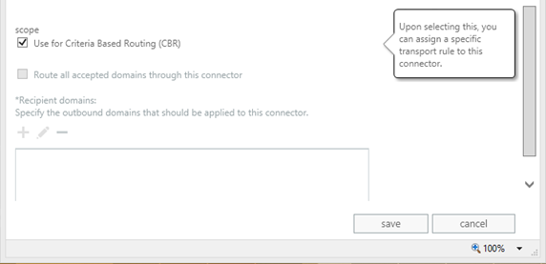
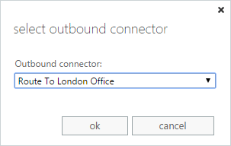
Conditional routing
Route emails based on properties of the email and not the recipient domain
Create connectors that are “
criteria based routing (CBR)”
Create a transport rule to redirect the
message to the CBR connector you just
made

Slide 26
Connectors and site resiliency
SMTP has built-in load balancing
  Multiple MX records of same priority
  Multiple A records of same name, but different IP addresses
  Multiple MX records of decreasing priority (increasing number = decreasing priority)
Exchange has built-in load balancing for transport
  Will connect to any server in target delivery group
  Will use least cost routing to determine where to fall back to in event of outage
Can use MX records to configure connectors
  Create MX records in DNS with different priorities and multiple A records if required and use the name of the MX record for the smarthost value.

Slide 27
Resilient connectors
Send Connector or Outbound Connector
  Smarthosts = hybrid.contoso.com
Create the following in DNS for contoso.com
  mail IN A 1.2.3.4
  oxford IN A 5.6.7.8
  harvard IN A 4.3.2.1
  @ IN MX 10 mail.contoso.com
  hybrid IN MX 10 oxford.contoso.com
  hybrid IN MX 20 harvard.contoso.com
More info
  http://www.c7solutions.com/2012/05/highly-available-geo-redundancy-with-html
  http://www.c7solutions.com/2014/03/highly-available-office-365-to-on-premises-mail-routing

Slide 28
How to test mail flow

Slide 29
Testing mail flow for staged migrations
Test TCP Port 25 availability to EOP endpoint
  telnet domain-com.mail.protection.outlook.com 25
  Or use an SMTP test tool – lots are available online
Simulate objects that will be created
  Create cloud mailbox and create Mail User on-premises
  Set mail user to have the tenant.mail.onmicrosoft.com address that the cloud mailbox has
  Give mail user a valid email address at your domain
  Send emails to the valid email address at your domain – they should appear in the cloud mailbox
  You could use exrca.com to send any email from an external source
Troubleshoot
  Check the queues on the Exchange Server for clues for hold ups
  Read output from protocol logs or connectivity logs on Exchange Server

Slide 30
Firewall considerations
Inbound SMTP
  Ensure that your on-premises servers can receive from the published IP addresses for Exchange Online Protection
  > http://technet.microsoft.com/en-GB/library/dn163583(v=exchg.150).aspx for the list of IPs
  > http://technet.microsoft.com/en-GB/library/dn163581(v=exchg.150).aspx for changes
  For your hybrid servers, the hybrid connector should only receive from these addresses unless you have multiple receive connectors configured
Outbound SMTP
  Ensure your Exchange Servers use a smarthost to deliver emails to Office 365
  The smarthost value matches the MX record that you will use for Office 365 (eventually)
  > tenant-com.mail.protection.outlook.com

Slide 31
Changing mail flow endpoint to Office 365

Slide 32
Changing SMTP endpoint
You can change your MX record before, during or after migration – any will work!
If beforehand:
  Ensure that AcceptedDomain in Office 365 is InternalRelay and for any migrated mailbox, ensure TargetAddress properly set on on-premises object
If after migration:
  Change AcceptedDomain to Authoritative in Office 365 to stop mail flow to on-premises servers
If during migration:
  Treat it as if you changed it beforehand as you need mail flow between Office 365 and on-premises servers in both directions

Slide 33
When is the best time to change endpoint?
MVP and MCM Survey
  When do you change the MX record in a
  staged migration?

Slide 34
Endpoint and regional compliance
Which do you use for your MX record?
1. smtp.office365.com
2. tenant-com.mail.protection.outlook.com
3. tenant-com.mail.eo.outlook.com
4. mail.messaging.microsoft.com
5. mail.global.frontbridge.com
✓

Slide 35
Finishing SMTP migration
Enable SMTP logging in Exchange Server
  Daily logs, W3SVC logging and check all options (if Exchange 2003) or Protocol Logging on the inbound receive connectors and outbound send connectors (if Exchange 2007 or later)
  Each day copy contents of log file to Excel and auto-filter the data
  Look for IP addresses that send email to your on-premises servers from 24 hours after MX record is changed
Is it a real email?
  If the SMTP log shows a number of SMTP verbs for the receipt of the email
  And it shows it being forwarded to the Office 365 smarthost endpoint for tenant.mail.onmicrosoft.com then this is a connection that you need to investigate
And then finally…
  Disable SMTP service and get ready to decommission service

Slide 36
Appendix
Journaling
DirSync and modifying objects
Moving distribution groups

Slide 37
Related content
Breakout Sessions
  OFC-B317 Office 365 Exchange Hybrid Deployment
  OFC-B220 Black Belt Exchange and Office 365 PowerShell
Labs
  OFC-H319 Installing and Configuring the Microsoft Exchange Server 2013 Edge Role
Microsoft Solutions Experience Location (MSE)
Find me tomorrow all afternoon at MSE. . .

Slide 38

Resources
Learning
  Sessions on Demand
  Microsoft Certification & Training Resources
http://channel9.msdn.com/Events/TechEd
www.microsoft.com/learning
TechNet
Developer Network
  Resources for IT Professionals
http://microsoft.com/technet
http://developer.microsoft.com

Slide 39
Technical Network
Join the conversation!
Share tips and best practices
with other Office 365 experts
http://aka.ms/o365technetwork

Slide 40


Office 365
Exams
Managing Office 365 Identities and Requirements
EXAM
346
Deploying
Office 365 Services
EXAM
347
http://bit.ly/
O365-Cert
+
Classroom
training
Introduction
to Office 365
FLC
40041
Managing Office 365 Identities and Services
MOC
20346
Designing for Office
365 Infrastructure
5
MOC
10968
3
http://bit.ly/
O365-Training
Online
training
Office 365
Fundamentals
MVA
Managing Office 365 Identities and Services
MVA
http://bit.ly/
O365-MVA
Get certified for 1/2 the price at TechEd Europe 2014!
http://bit.ly/
TechEd-CertDeal

Slide 41



Please Complete An Evaluation Form
Your input is important!
TechEd Schedule Builder
CommNet station or PC
TechEd Mobile app
Phone or Tablet
QR code

Slide 42
Evaluate this session

Slide 43


© 2014 Microsoft Corporation. All rights reserved. Microsoft, Windows, and other product names are or may be registered trademarks and/or trademarks in the U.S. and/or other countries.
The information herein is for informational purposes only and represents the current view of Microsoft Corporation as of the date of this presentation. Because Microsoft must respond to changing market conditions, it should not be interpreted to be a commitment on the part of Microsoft, and Microsoft cannot guarantee the accuracy of any information provided after the date of this presentation. MICROSOFT MAKES NO WARRANTIES, EXPRESS, IMPLIED OR STATUTORY, AS TO THE INFORMATION IN THIS PRESENTATION.

Slide 44
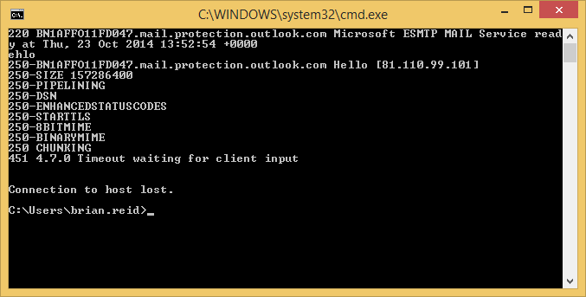
Proving STARTTLS offered

Slide 45
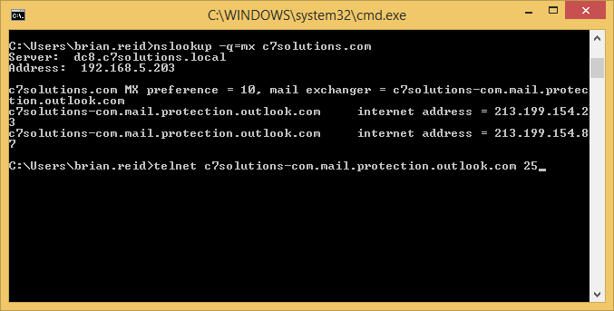
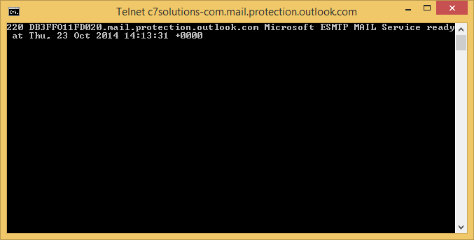



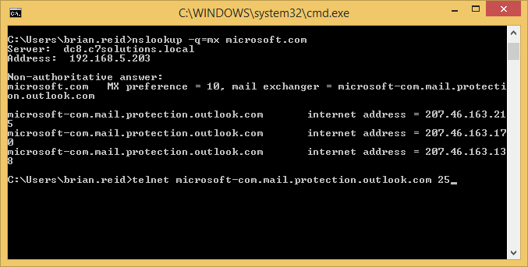


Regional connectivity for EOP
DB = Dublin
AM = Amsterdam
BY = Boydton, VA
BN = ????

Slide 46
Journaling
Service restrictions
  Exchange Online mailboxes cannot be the target of a journal rule
  But you can journal Exchange Online mailboxes to an on-premises mailbox or third party
  You will probably need to create additional connectors for this mail flow and tell the third party to receive from Office 365
Duplicate journaling
  In staged or hybrid environments you might be journaling from both on-premises and Exchange Online if mail flow goes through both environments
  Journal databases on-premises rather than journal rules can help here if needed
  This might result in duplicate journaling, but this is better than not recording the message at all
  Some third party journal services will dedupe these for you

Slide 47
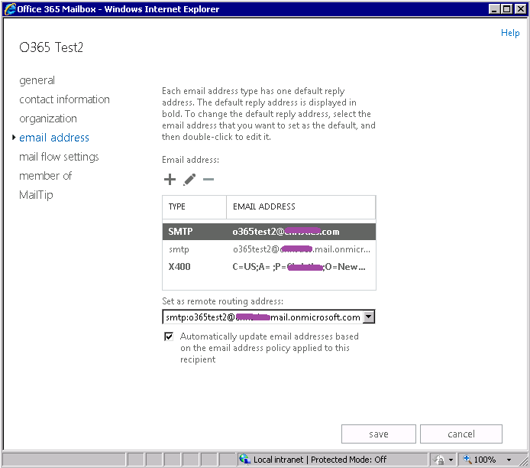
Dirsync and the master object
  When using DirSync, all objects that it pushes to the cloud can
  only be edited in the on-premises Active Directory
Recommendations
  Keep an Exchange Server on-premises for the admin tools
  This keeps things like email address policy working as well –
  Unsupported is manual edits in ADSIEdit or ADUC Attribute Editor
  tab http://www.c7solutions.com/2014/07/creating-mailboxes-in-
  office-365-when-using-dirsync
There is no Office 365 email address policy
  Cloud created objects get their UPN as the default email address and they get alias@tenant.onmicrosoft.com as an additional address
  Hybrid Wizard modifies the on-premises email address policy to include %m@tenant.mail.onmicrosoft.com

Slide 48
Read-only distribution groups?
In Exchange Online, the DirSync’ed distribution groups cannot be modified in the cloud
  You need to change them on-premises, or you need to change the source of authority
Changing source of authority for distribution groups
  You need to export the group email address, name and membership (etc.) to a CSV file
  You need to delete them on-premises (and maybe leave a mail contact object depending upon your mail flow routing)
  Then run DirSync to update Azure Active Directory
  Then wait for Azure Active Directory to sync to Exchange Online
  Then you can recreate the groups from a CSV file using Remote PowerShell

