Slide 2

MBAM 2.5
WIN-B312
Nate Canen and Jeff Pinkston

Slide 3
Confidentiality Slide

Slide 4
Session Objectives And Takeaways
Session Objective(s):
  Articulate the value proposition of MBAM 2.5
  Show customers how MBAM 2.5 can help drive improved compliance (encryption, regulations)
  MBAM can be easily deployed in complex environments
MBAM 2.5 adds significant value and addresses many top customers pain points

Slide 5
Agenda
Introduction to MBAM
Deployment Improvements
Enforcement Policy
Performance

Slide 6
Introduction to MBAM

Slide 7
BitLocker Administration & Monitoring
Enact BitLocker policy on Windows desktop devices
Escrow recovery key to a centralized server
Users or Helpdesk can recover a BitLocker key
Compliance reporting

Slide 8


History of MBAM
  MBAM 1.0 (Spring 2012)
  Simplify provisioning
  and deployment
  Provide reporting
  (e.g.: compliance & audit)
  Reduce costs
  (e.g.: Simplified Recovery)
  MBAM 2.0 (Spring 2013)
  Improving compliance
  and security
  Integrating with existing systems
  (e.g.: SCCM)
  Reduce costs
  (e.g.: Self Service)
  MBAM 2.0 SP1 (Fall 2013)
  Localization
  Support for Blue wave of products
  Bug Fixes

Slide 9
Introducing MBAM 2.5
Support for Complex Enterprise Environments
  High Availability and Scalability
  Multi-Forest Domains
Deployment Improvements
  Separated Install from Configuration
  Configuration through a wizard or PowerShell
Additional Client Functionality
  Pin Complexity
  Enforced Policy

Slide 10
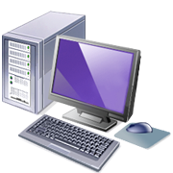


MBAM Logical Architecture
Windows
Escrow Services
2. Machine escrows key, reports compliance
Self-Service Portal
3. User recovers key
1. Machine gets policy
Administration &
Helpdesk Website
3. HD recovers key
4. Admin checks compliance
Active Directory

Slide 11
Software Components
Administration Server
Compliance and Audit Reports
OR
System Center Configuration Manager
Database Components
Admin
Web Site
Admin
Web Service
Reporting
Web Site
Reporting
Web Service
Recovery
Database
Compliance /Audit
Database
Self-Service Server
Desktop Components
Self-Service
Web Site
Self-Service
Web Service
MBAM Agent
Management Console
CM Reports

Slide 12
Deployment Improvements

Slide 13

Support for Enterprise Scenarios and Topologies
Challenges
Poor integration with AD accounts and SPNs
Enterprises want high availability and disaster recovery
Limitations in complex multi-forest environments
Solutions for MBAM 2.5
Using AD accounts and groups across the board
Support for load balancing of web components
Support for highly available SQL configurations
Support for both multi-forest and FQDN’s
PowerShell + new UI support for configuration

Slide 14
Demo
Web Server
MBAM-Web1
SQL Server
MBAM-SQL1
Client
NLB
Cluster
Web Server
MBAM-Web2
SQL Server
MBAM-SQL2
Domain Controller
MBAM-DC1

Slide 15

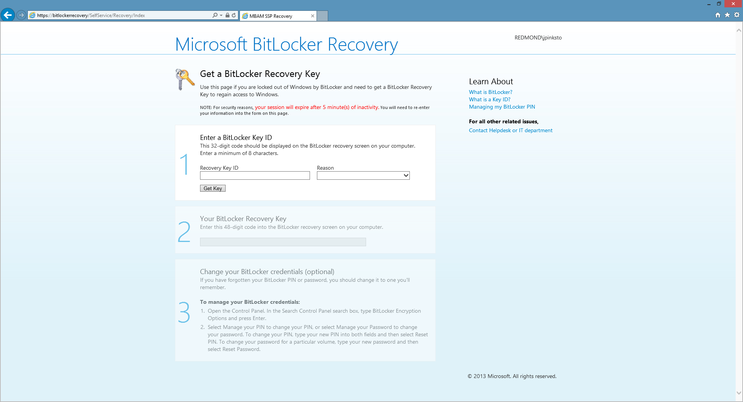

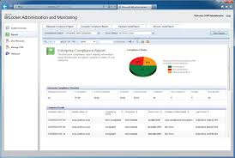
Authentication
Client machine
Domain authenticated
Escrow Service
App Pool account
granted RW
Databases
Self-service Portal
Domain user
Domain user added
to HelpDesk group
Helpdesk Website
Domain user added
to Reporting group
MBAM Report
Reporting service
Account granted R

Slide 16
Demo
Getting Started

Slide 17
SQL Configuration
Web Server
MBAM-Web1
SQL Server
MBAM-SQL1
Client
Setup secure communication
Configure Windows Clustering
Install MBAM binaries
Configure MBAM databases
Setup Availability Group
NLB
Cluster
Web Server
MBAM-Web2
SQL Server
MBAM-SQL2
Domain Controller
MBAM-DC1

Slide 18
Demo
SQL Server Configuration

Slide 19
Website Configuration
Setup NLB
Install MBAM binaries
Configure MBAM websites
Customizing the websites
Web Server
MBAM-Web1
SQL Server
MBAM-SQL1
Client
NLB
Cluster
Web Server
MBAM-Web2
SQL Server
MBAM-SQL2
Setup constrained delegation
Domain Controller
MBAM-DC1

Slide 20
Demo
Website Configuration

Slide 21
SPN for Web Components
What the heck is an SPN?
  Required for Kerberos authentication
  Like a DNS CNAME for services that Kerberos uses to authenticate the client to the service
Can’t MBAM create it for me?
  We’ll sure try, but you need rights in AD.
  Install will give a warning with instructions if you don’t have rights.
Fine, how do I set one up manually
  Setspn –s http/<your host name> <mbam app pool credential>
  Example: Setspn –s http/nlb.corp.contoso.com corp\mbampoolaccount

Slide 22
Enforcement Policy

Slide 23
Improved Compliance & Enforcement
Challenges
Driving maximum compliance
Users able to perpetually postpone encryption
Lack of PIN complexity
Solutions for MBAM 2.5
Added grace period for encryption postponement
Automatic encryption enforcement
Prevent use of simple PINs (1234, 1111, etc)
Support use of Enhanced PINs (Unicode/ASCII, etc)

Slide 24
Demo
Enforce Policy

Slide 25
Enforce Policy
Grace Period
User can postpone encryption until grace period.
Grace period starts when MBAM agent detects non-compliance.
Enforcement
For TPM-only policy, encryption begins in the background after grace period expires.
For TPM+PIN policy, MBAM requires user input.

Slide 26
Performance

Slide 27
Performance
Challenges
Improved scalability on less hardware
More real-time reports
Solutions for MBAM 2.5
500k clients on minimal hardware
Major database and other performance improvements
No more CreateCache job for Enterprise Compliance Report

Slide 28
Sizing Guidance
Two server topology (web/SQL) recommended to support 500k clients
Web
Hardware Component | Minimum Requirement | Recommended Requirement
Processor | 2.33 GHz (quad-core) | 2.33 GHz or greater (quad-core)
RAM | 4 GB | 8 GB
Disk Space | 1 GB | 2 GB
SQL
Hardware Component | Minimum Requirement | Recommended Requirement
Processor | 2.33 GHz (quad-core) | 2.33 GHz or greater (quad-core)
RAM | 8 GB | 12 GB
Disk Space | 5 GB | 5 GB or greater

Slide 29
Summary

Slide 30
MBAM 2.5
Support for Complex Enterprise Environments
  High Availability and Scalability
  Multi-Forest Domains
Deployment Improvements
  Separated Install from Configuration
  Configuration through a wizard or PowerShell
Additional Client Functionality
  Pin Complexity
  Enforced Policy

Slide 31
Q&A

Slide 32
Appendix

Slide 33
Related Content
Breakout Sessions/Hands on Labs
  WIN-B311: Non-persistent VDI: Optimize your environment with App-V and UE-V - Wed 10:15
  WIN-B312: Deploying Microsoft BitLocker Administration and Monitoring (MBAM) 2.5 - Wed 15:00
  WIN-B316: Project Virtual Reality Check: Microsoft App-V 5 Performance, Tuning, and Optimization (App-V PTO) - Fri 14:45
  WIN-B322: The Circle of Life for an App-V 5.0 Package: From Sequence to Termination - Tues 17:00
  WIN-B325: Microsoft Office 2013 and App-V: Everything You Need to Know - Thurs 12:00
  WIN-H300: Microsoft BitLocker Administration and Monitoring 2.5

Slide 34
Windows Resources
Windows 10
http://aka.ms/trywin10
  Stop by the Windows Booth to sign up for the Windows Insider Program to
  get a FREE Windows 10 T-shirt, whiles supplies last!
  Windows Springboard
  windows.com/itpro
  Windows Enterprise
  windows.com/enterprise
  Microsoft Desktop Optimization Package (MDOP)
  microsoft.com/mdop
  Desktop Virtualization (DV)
  microsoft.com/dv
  Windows To Go
  microsoft.com/windows/wtg
  Internet Explorer TechNet
  http://technet.microsoft.com/ie

Slide 35

Resources
Learning
  Sessions on Demand
  Microsoft Certification & Training Resources
http://channel9.msdn.com/Events/TechEd
www.microsoft.com/learning
TechNet
Developer Network
  Resources for IT Professionals
http://microsoft.com/technet
http://developer.microsoft.com

Slide 36


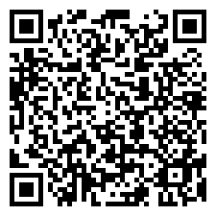
Please Complete An Evaluation Form
Your input is important!
TechEd Schedule Builder
CommNet station or PC
TechEd Mobile app
Phone or Tablet
QR code

Slide 37
Evaluate this session

Slide 38


© 2014 Microsoft Corporation. All rights reserved. Microsoft, Windows, and other product names are or may be registered trademarks and/or trademarks in the U.S. and/or other countries.
The information herein is for informational purposes only and represents the current view of Microsoft Corporation as of the date of this presentation. Because Microsoft must respond to changing market conditions, it should not be interpreted to be a commitment on the part of Microsoft, and Microsoft cannot guarantee the accuracy of any information provided after the date of this presentation. MICROSOFT MAKES NO WARRANTIES, EXPRESS, IMPLIED OR STATUTORY, AS TO THE INFORMATION IN THIS PRESENTATION.

