Slide 2
Windows 8.1 Deployment Using Free Tools from Microsoft
WIN-B314
Johan Arwidmark (@jarwidmark)
Mikael Nyström (@mikael_nystrom)

Slide 3
Ask The Experts
Key and floorplan
Cloud and Datacenter Platform
Data Platform and Business Intelligence
Developer Platform and Tools
Enterprise Mobility
Office 365
Windows
Microsoft Azure
Trustworthy Computing
Following this session at 18:30 in Hall 5
Meet with Microsoft Product Experts
Snacks and Beverages Served
CDP
DEV
AZR
TWC
EM
OFC
WIN
DBI

Slide 4
MDT 2013 and WDS – Better Together
MDT 2013 adds deployment solution to WDS
Dynamic Deployments via Rules Engine
Deployment Scenarios
Bare Metal
Computer Refresh
Computer Replace

Slide 5
DEMO
Setup the deployment solution

Slide 6
Bare Metal Deployments
Assuming no data to backup
You decide on automation level
Assigning settings during deployment

Slide 7
DEMO
Bare Metal Deployments

Slide 8
Computer Refresh
Either to same or newer operating system
USMT used for migrating data and settings
Customizing the backup

Slide 9
DEMO
Computer Refresh

Slide 10
Computer Replace
Common Scenario
Separate Backup Task Sequence
Can be used for advanced refresh scenarios too

Slide 11
DEMO
Computer Replace

Slide 12
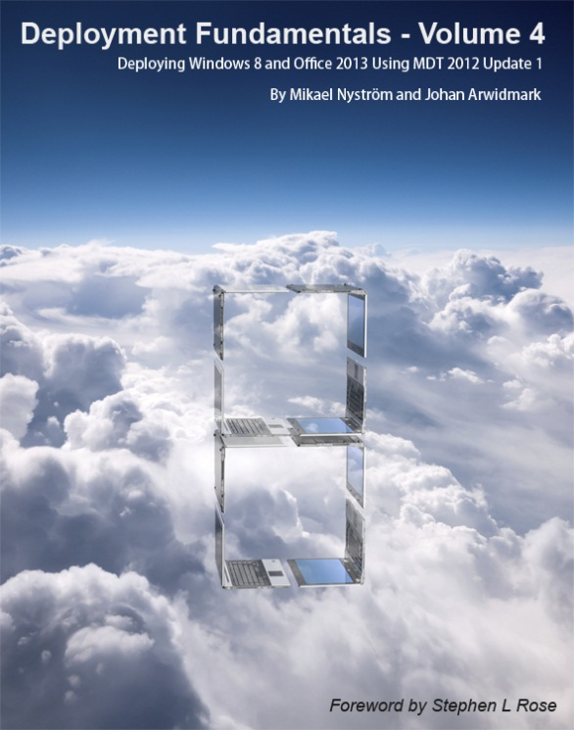
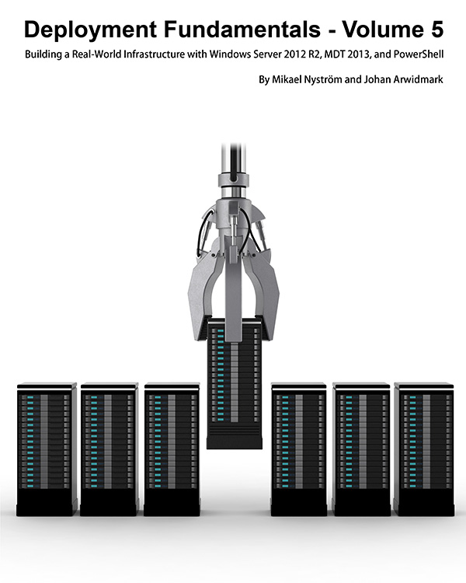
Resources – trainings, videos, books
deploymentartist.com

Slide 13
Related content
WIN-B412: Advanced MDT Customizations
WIN-B324: Real-World Windows 8.1 Deployments
WIN-B338: Windows 10: Deployment
Ask The Experts on Thursday

Slide 14
Windows Resources
Windows 10 http://aka.ms/trywin10
Stop by the Windows Booth to sign up for the Windows Insider Program to get a FREE Windows 10 T-shirt, whiles supplies last!
Windows Springboard windows.com/itpro
Windows Enterprise windows.com/enterprise
Microsoft Desktop Optimization Package (MDOP) microsoft.com/mdop
Desktop Virtualization (DV) microsoft.com/dv
Windows To Go microsoft.com/windows/wtg
Internet Explorer TechNet http://technet.microsoft.com/ie

Slide 15
Resources
Learning
Sessions on Demand
Microsoft Certification & Training Resources
http://channel9.msdn.com/Events/TechEd
www.microsoft.com/learning
TechNet
Developer Network
Resources for IT Professionals
http://microsoft.com/technet
http://developer.microsoft.com

Slide 16
Ask The Experts
Key and floorplan
Cloud and Datacenter Platform
Data Platform and Business Intelligence
Developer Platform and Tools
Enterprise Mobility
Office 365
Windows
Microsoft Azure
Trustworthy Computing
Following this session at 18:30 in Hall 5
Meet with Microsoft Product Experts
Snacks and Beverages Served
CDP
DEV
AZR
TWC
EM
OFC
WIN
DBI

Slide 17
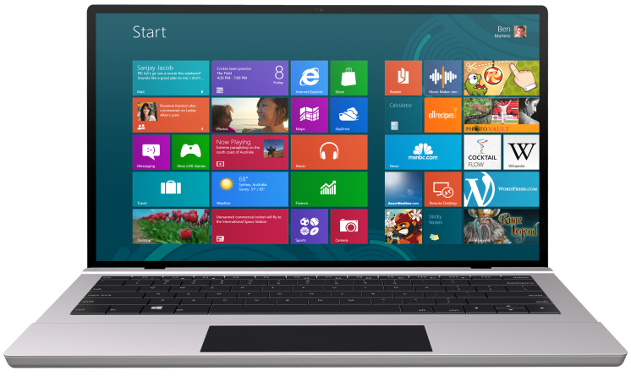
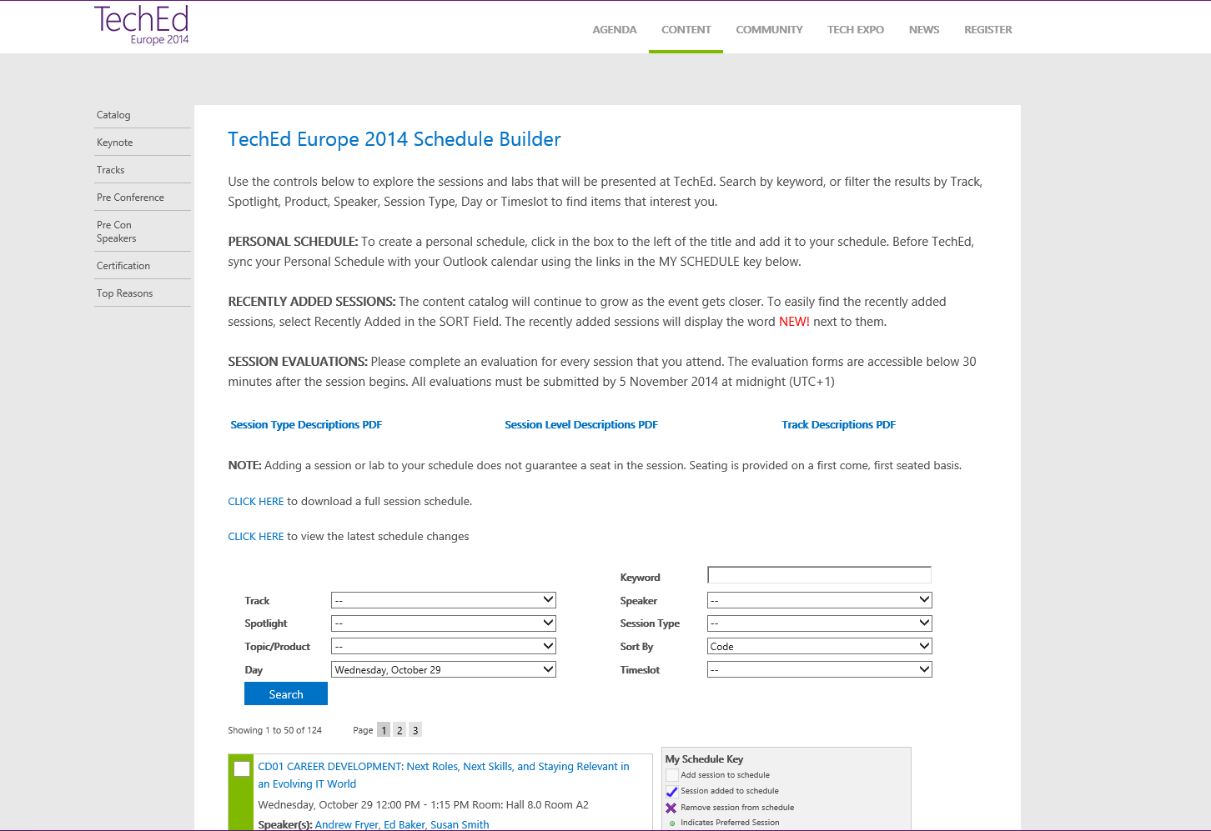
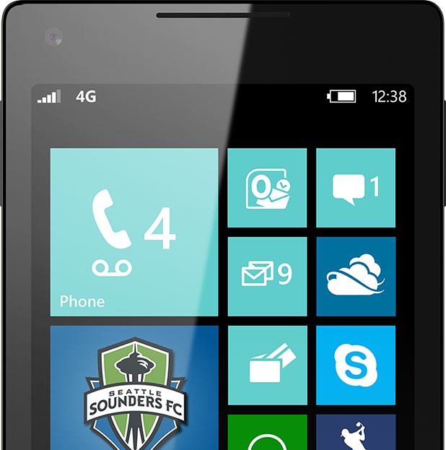
SUBMIT YOUR TECHED EVALUATIONS
We value your feedback!
Fill out an evaluation via
CommNet Station/PC: Schedule Builder
LogIn: europe.msteched.com/catalog
TechEd Mobile app for session evaluations is currently offline

Slide 18
© 2014 Microsoft Corporation. All rights reserved. Microsoft, Windows, and other product names are or may be registered trademarks and/or trademarks in the U.S. and/or other countries.
The information herein is for informational purposes only and represents the current view of Microsoft Corporation as of the date of this presentation. Because Microsoft must respond to changing market conditions, it should not be interpreted to be a commitment on the part of Microsoft, and Microsoft cannot guarantee the accuracy of any information provided after the date of this presentation. MICROSOFT MAKES NO WARRANTIES, EXPRESS, IMPLIED OR STATUTORY, AS TO THE INFORMATION IN THIS PRESENTATION.

