Slide 2
Windows 8.1: Black Belt Security
WIN-B345
WIN-B318
Sami Laiho - Sovelto
Senior Technical Fellow

Slide 3
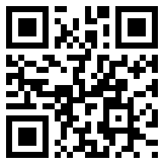
WHOAMI /ALL
http://www.samilaiho.com/
MVP Windows Expert – IT Pro
SpringBoard Technical Expert Panel member
Senior Technical Fellow @ Sovelto
Senior Technical Fellow @ adminize.com
Twitter: @samilaiho
Free newsletter:
http://eepurl.com/F-GOj

Slide 4
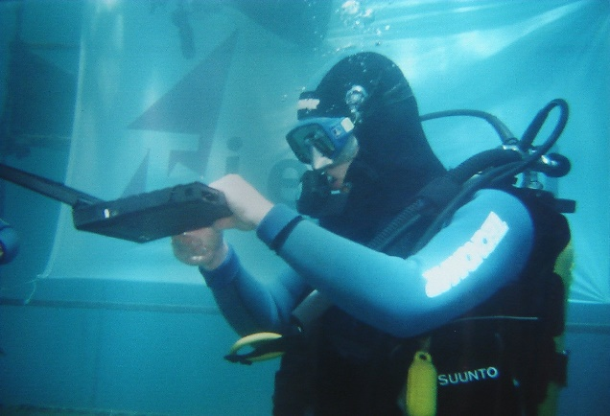
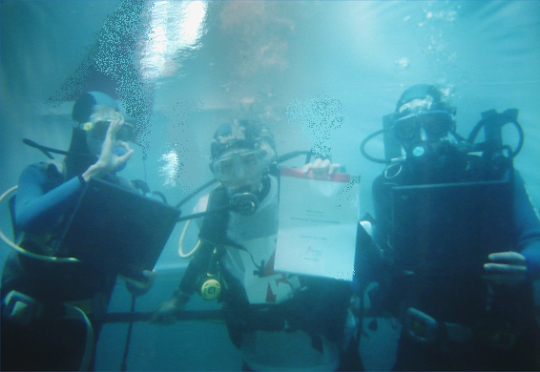
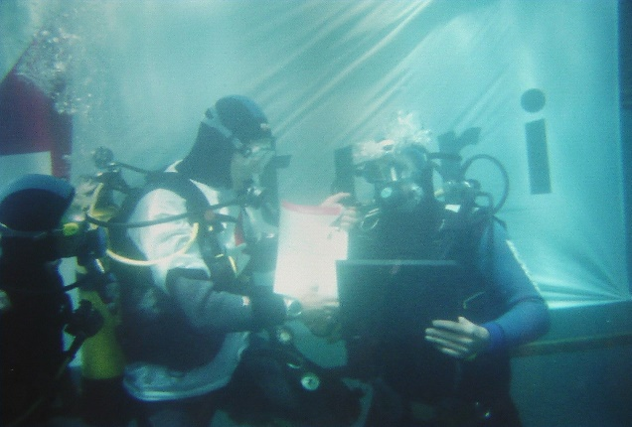
Windows XP Deep Dive in 2001

Slide 5
Forgive my English
When most get Administrator or Spanish get Administrador
we get…

Slide 6
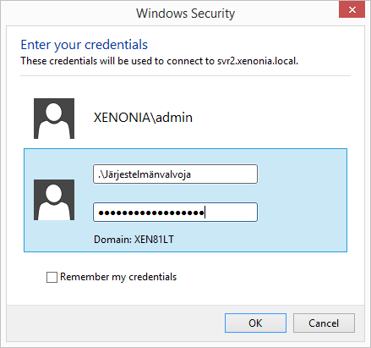
JÄRJESTELMÄNVALVOJA

Slide 7
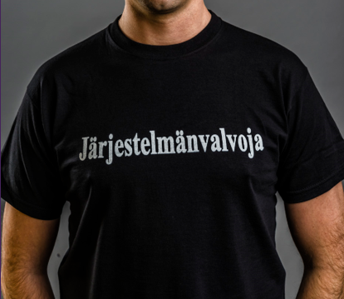
Housekeeping
After the session I’ll exchange business cards for swag

Slide 8
Projects
www.wioski.com
Free replacement for SteadyState
www.adminize.com
Getting rid of admin rights and provide onetime admin passwords
You never have to worry about changing local admin passwords again!
blog.win-fu.com
http://win-fu.com/
My video based training site

Slide 9
Agenda
The human factor in security
How proactive security beats reactive security
Different ways to compromise a system and how to prevent it from happening

Slide 10
Human factor

Slide 11
Meanwhile in Norway

Slide 12
Physical security and social engineering
Hotel in Oslo a week ago
Me: ”A colleague of yours asked me to get a new key because mine didn’t work”
She: ”I’ll make you a new one”
Me: ”This wooden key doesn’t seem to work still. Your colleague used a plastic key so maybe it’s because of the thicker material that it works. You think you could make a key like that?”
She: ”I have to go check this in the backroom – just a second”
She: ”Here’s a key for you but you can’t tell anyone you got it because it’s a master key that can open any door in the hotel”

Slide 13
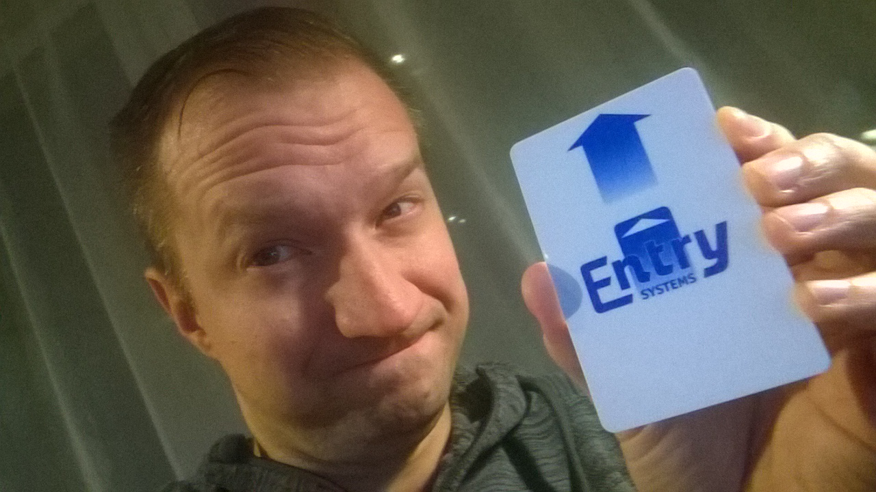

Slide 14
Meanwhile in Finland

Slide 15
Finnish 150M€ Car shopping center
CEO of the company has gotten an offer from a man in UK to transfer 30M€ to him to fund the project
The money is from Regina Chiluba, widow of former Zambian president Fredrick Chiluba
CEO sends 336000€ to fund the transaction of the money
His transaction is frozen as a security measure
He gets the money back and…
Sends it again…

Slide 16
The world is changing
Symantec, F-Secure and almost every other AM-company has said that their reactive solutions aren’t adequate to protect PC’s in the future
We need to change the focus from reactive to proactive

Slide 17
Reactive solutions
Anti-malware, network inspection service (NIS), software blacklisting…
Always trying to catch up – “always” late!
Needed on top of proactive measures – ‘just in case’

Slide 18
Proactive solutions
Correct permission levels, whitelisting, firewalls, IPSec…
Keeps your computer clean and efficient
Doesn’t rely on updates / fingerprints found by others
More important than reactive measures

Slide 19
Notes from the field
“Only 25% have admin rights”
“Only our laptop users have admin rights”
“We don’t use firewalls on the internal network”
“Executives get admin rights”
“We tried whitelisting but gave up”
“MAC and Linux are good ‘cause they don’t need antivirus”

Slide 20
Proactive security in Windows
Encryption - BitLocker
Limited user rights
Different levels of Admin accounts
UAC
AppLocker whitelisting
Host based firewalls
IPSec

Slide 21
My Laptop currently
Doesn’t have an Anti-Malware enabled
Has all firewall ports open

Slide 22
I travel on airports more than 150 days a year… Am I scared?

Slide 23
Absolutely NOT!
Instead of reactive protection I have
AppLocker Whitelisting – All software needs to be preapproved by me
I use IPSec – No one can talk to me without a certificate
No admin rights – I can’t disable my own protections
BitLocker – I’m protected against physical theft of data or someone breaking into my laptops OS
Current OS that’s up to date
Correct hardware – No DMA ports/interfaces!

Slide 24
DMA-attacks
Applications readily available to
Crack passwords
Steal BitLocker keys

Slide 25
A few demonstrations
Why encryption?
Why UAC?
Why no admin rights?
Why many levels of user accounts for Domain Admins?
Why UAC is not enough?
Why Whitelisting software?

Slide 26
Why encryption
Sami Laiho

Slide 27
How to prevent it?
BitLocker becomes mandatory

Slide 28
It’s the last day of TechEd so time to give back!!

Slide 29
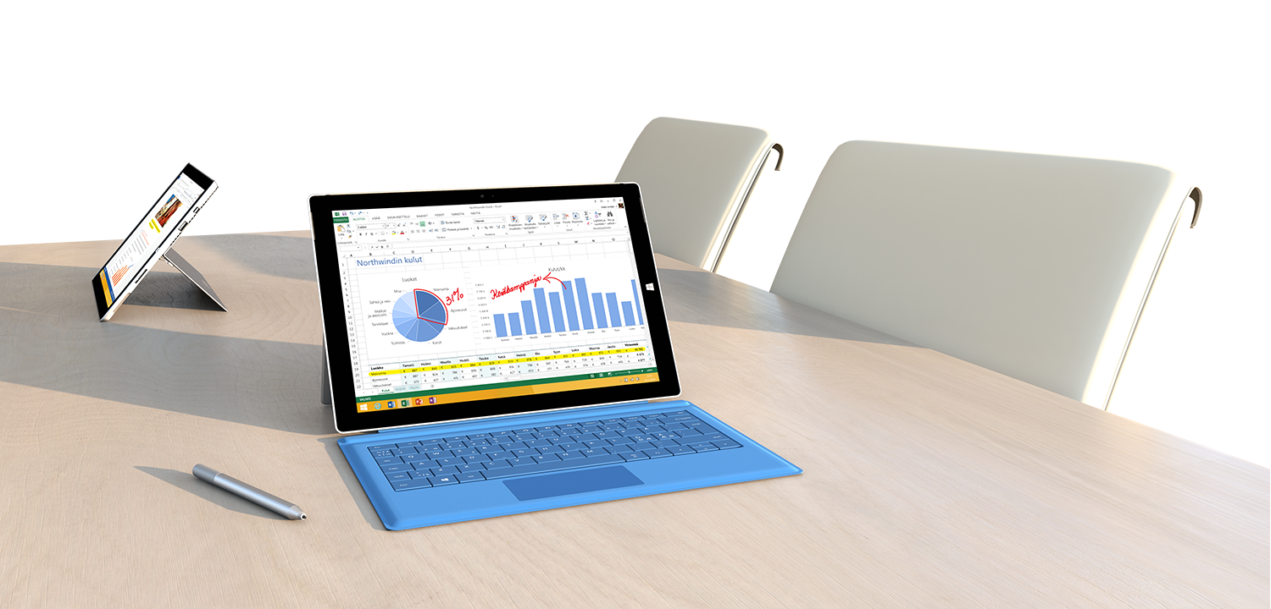
100 quickest to download this slide deck and click on the picture below will get a free Surface 3 Pro!!

Slide 30
How to prevent it?
UAC is really, Yes I mean Really, Good for you

Slide 31
Why no admin rights for end users?
Sami Laiho

Slide 32
How to prevent it?
If you really need to secure Group Policy settings change the refresh settings
Don’t give users Admin rights!

Slide 33
Too few levels of admins
Sami Laiho

Slide 34
How to prevent it?
At least three user accounts for Domain Admins

Slide 35
Why UAC is not enough?
Sami Laiho

Slide 37
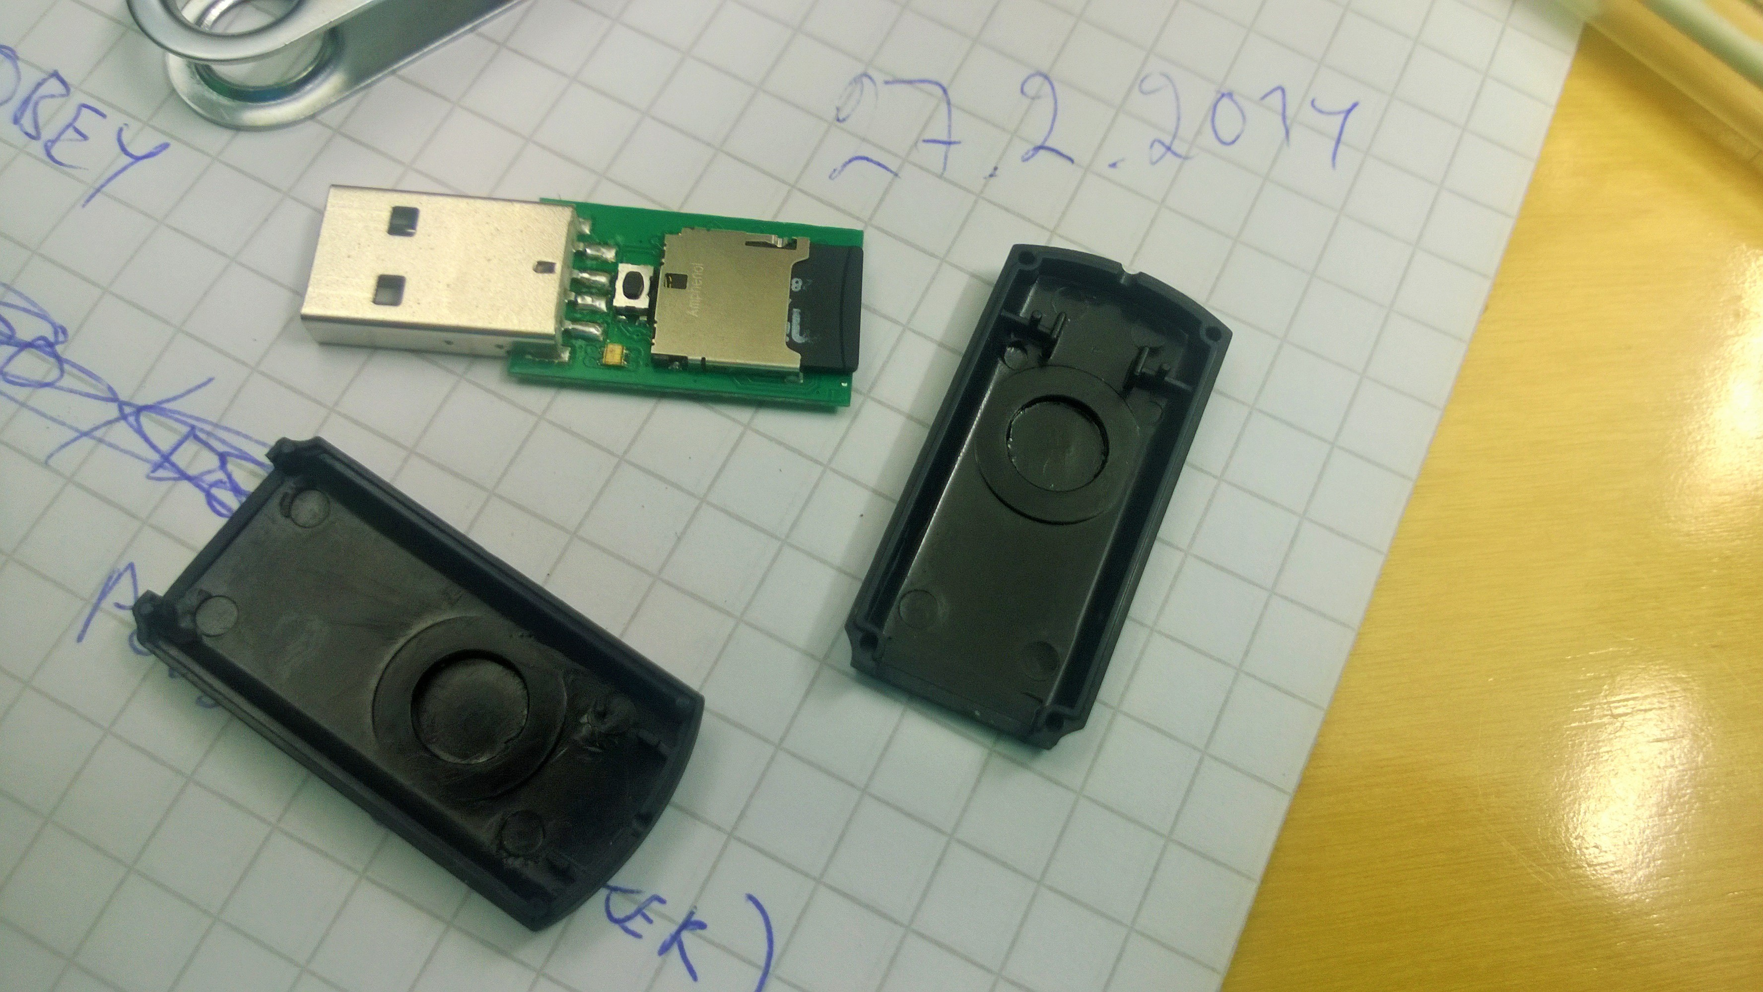

Slide 38
BadUSB
Sami Laiho

Slide 39
How to prevent it?
Always use limited user accounts for daily use – Not just UAC!
Use only tamper proof devices that are known to use signed firmware and that can’t be flashed
Teach people about it
More info:
http://www.zdnet.com/badusb-big-bad-usb-security-problems-ahead-7000032211/
https://www.youtube.com/watch?v=nuruzFqMgIw
https://github.com/adamcaudill/Psychson
https://www.youtube.com/watch?v=xcsxeJz3blI

Slide 40
BadMouse!
Sami Laiho

Slide 41
Why whitelisting software?
Sami Laiho

Slide 42
How to prevent it?
Use AppLocker!
Remember to audit your installation with AccessChk!

Slide 43
”Thank you for joining!” ”Remember the evals!” ”Follow me on Twitter @samilaiho”

Slide 44
Related content
Breakout Sessions
WIN-B319
WIN-B329
WIN-B318

Slide 45
Resources
Learning
Sessions on Demand
Microsoft Certification & Training Resources
http://channel9.msdn.com/Events/TechEd
www.microsoft.com/learning
TechNet
Developer Network
Resources for IT Professionals
http://microsoft.com/technet
http://developer.microsoft.com

Slide 46
Windows Resources
Windows 10 http://aka.ms/trywin10
Stop by the Windows Booth to sign up for the Windows Insider Program to get a FREE Windows 10 T-shirt, whiles supplies last!
Windows Springboard windows.com/itpro
Windows Enterprise windows.com/enterprise
Microsoft Desktop Optimization Package (MDOP) microsoft.com/mdop
Desktop Virtualization (DV) microsoft.com/dv
Windows To Go microsoft.com/windows/wtg
Internet Explorer TechNet http://technet.microsoft.com/ie

Slide 47
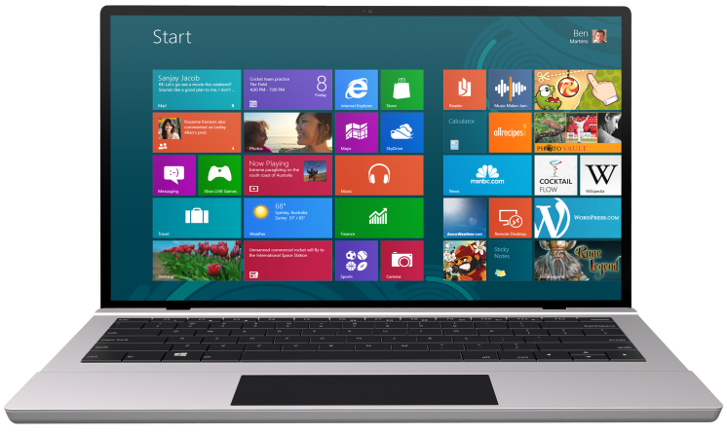
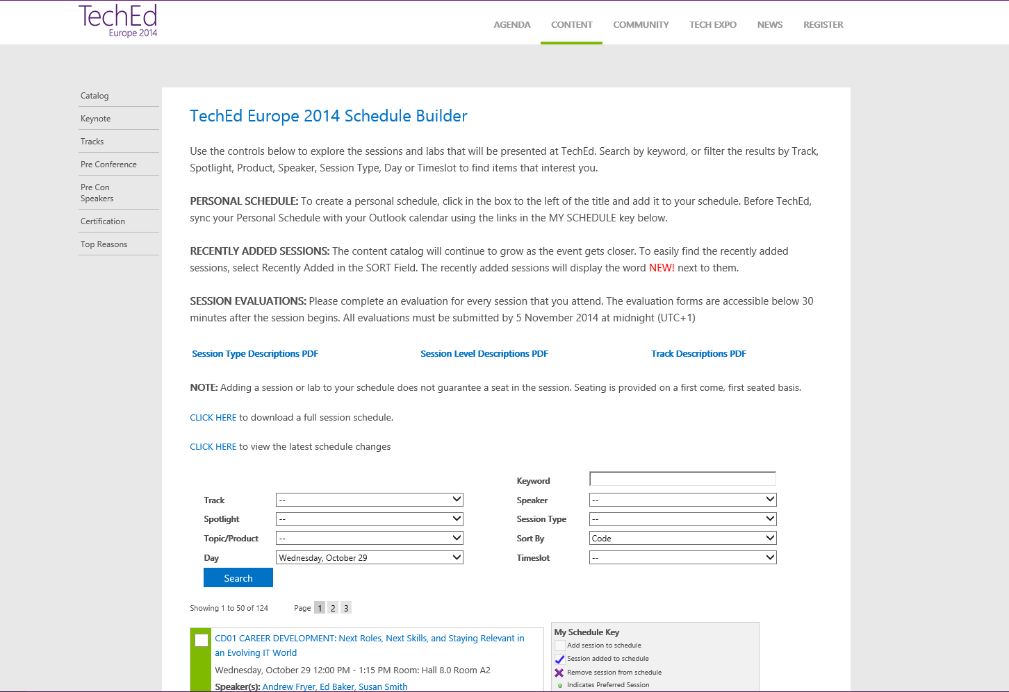
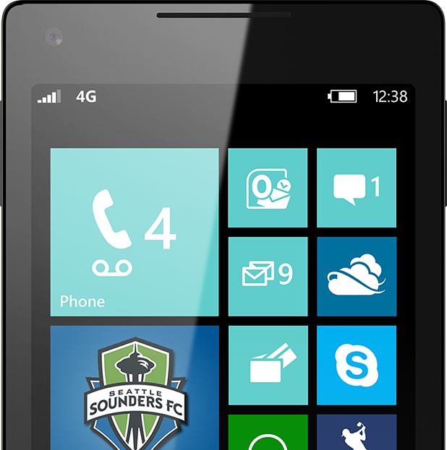
SUBMIT YOUR TECHED EVALUATIONS
We value your feedback!
Fill out an evaluation via
CommNet Station/PC: Schedule Builder
LogIn: europe.msteched.com/catalog
TechEd Mobile app for session evaluations is currently offline

Slide 48
© 2014 Microsoft Corporation. All rights reserved. Microsoft, Windows, and other product names are or may be registered trademarks and/or trademarks in the U.S. and/or other countries.
The information herein is for informational purposes only and represents the current view of Microsoft Corporation as of the date of this presentation. Because Microsoft must respond to changing market conditions, it should not be interpreted to be a commitment on the part of Microsoft, and Microsoft cannot guarantee the accuracy of any information provided after the date of this presentation. MICROSOFT MAKES NO WARRANTIES, EXPRESS, IMPLIED OR STATUTORY, AS TO THE INFORMATION IN THIS PRESENTATION.

