Slide 2
The Circle of Life for an App-V 5.0 Package: From Sequence to Termination
WIN-B322
Thamim Karim

Slide 3
Thamim Karim Senior Premier Field Engineer

Slide 4
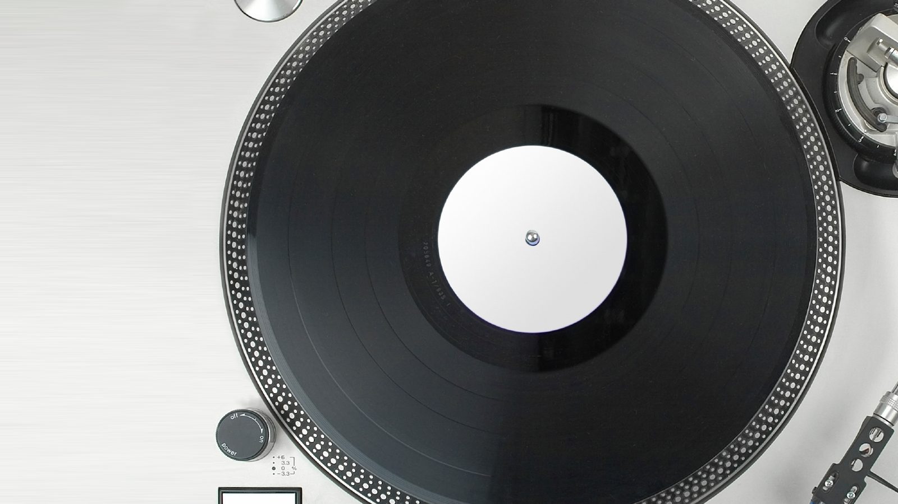
The Circle of Life for an App-V 5.0 Package
| CREATE | DELIVER | CHANGE | ADAPT | UPDATE | CONNECT | INTEGRATE | TERMINATE

Slide 5
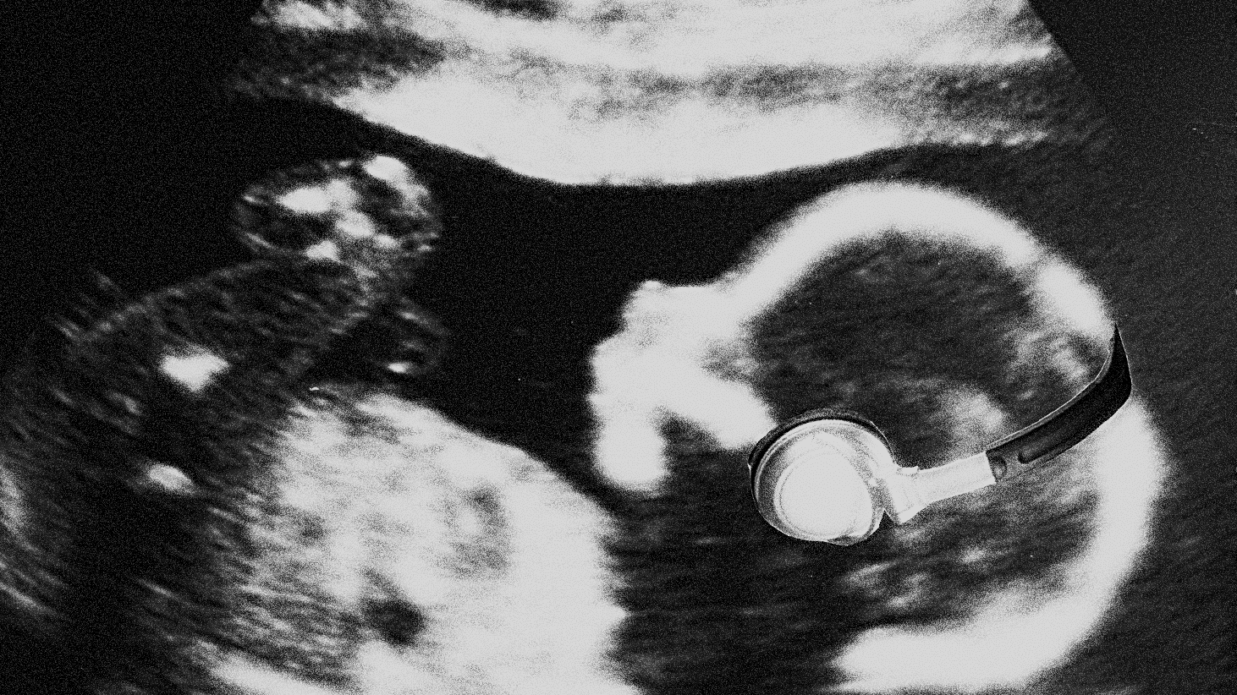
Create

Slide 6
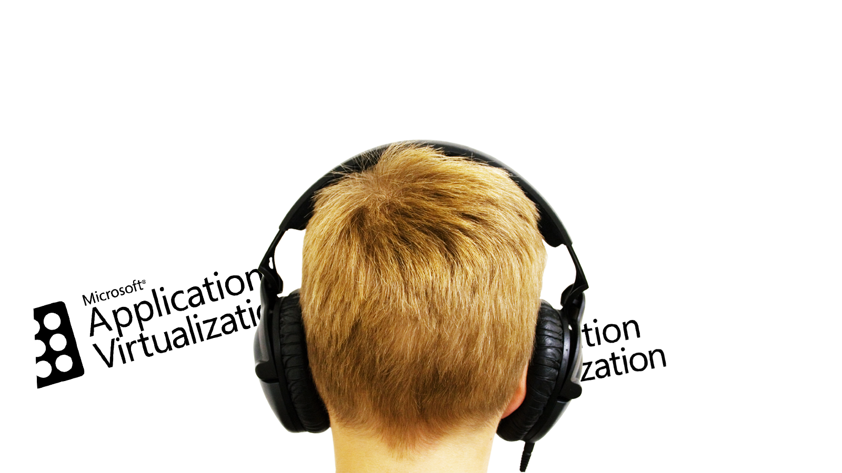
Deliver

Slide 7
Change

Slide 8
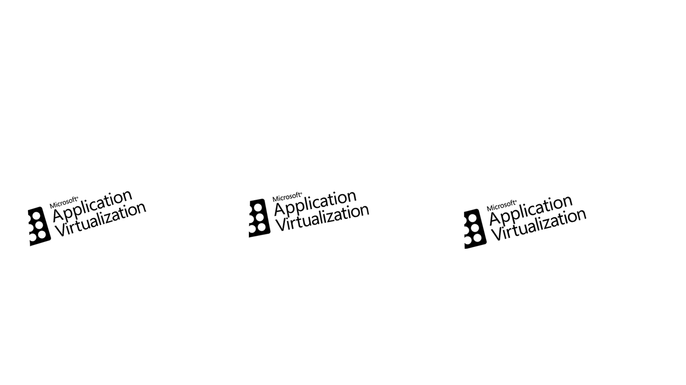
Adapt

Slide 9
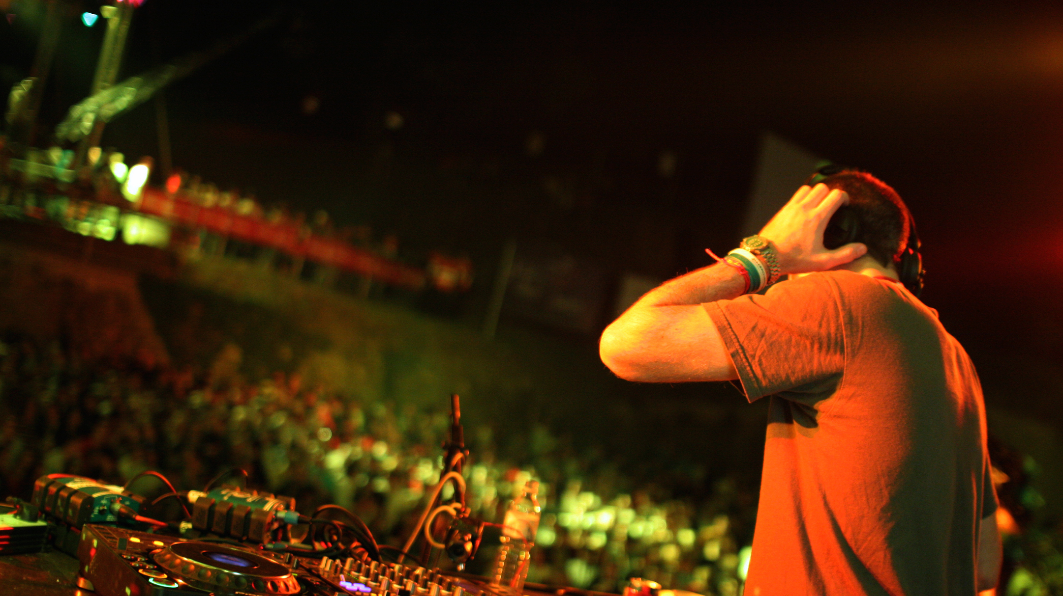
Update

Slide 10
Connect

Slide 11
Integrate

Slide 12
Terminate

Slide 13
The Circle of Life for an App-V 5.0 Package
| CREATE | DELIVER | CHANGE | ADAPT | UPDATE | CONNECT | INTEGRATE | TERMINATE

Slide 14
Questions?

Slide 15
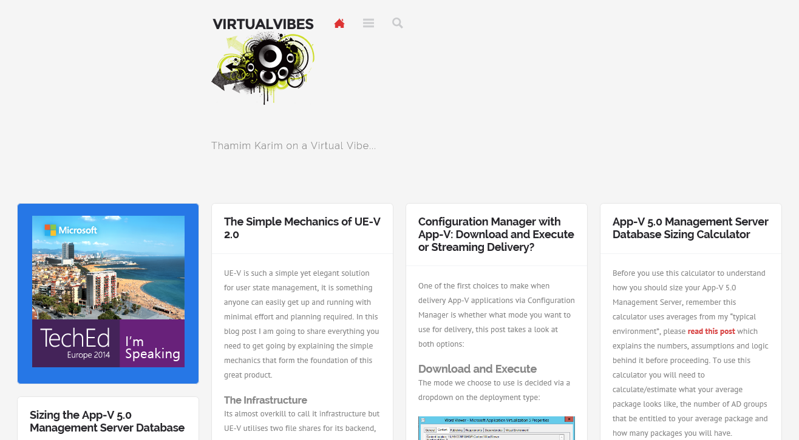
www.virtualvibes.co.uk

Slide 16
Related content
Breakout Sessions WIN-B311 Non-Persistent VDI: Optimize Your Environment with App-V and UE-V WIN-B316 Project Virtual Reality Check: Microsoft App-V 5.0 Performance, Tuning, and Optimization WIN-B325 Office 2013 and App-V: Everything You Need to Know
Labs EM-H310 Implementing App-V 5.0 in System Center 2012 R2 Configuration Manager
Find Me Later At. . . Windows Management Booth Wednesday 12:45pm-2:30pm Thursday 3:45pm-5:30pm

Slide 17
Related content
Microsoft Virtual Academy http://www.microsoftvirtualacademy.com/training-courses/the-circle-of-life-for-an-app-v-5-0-package

Slide 18
Resources
Learning
Sessions on Demand
Microsoft Certification & Training Resources
http://channel9.msdn.com/Events/TechEd
www.microsoft.com/learning
TechNet
Developer Network
Resources for IT Professionals
http://microsoft.com/technet
http://developer.microsoft.com

Slide 19
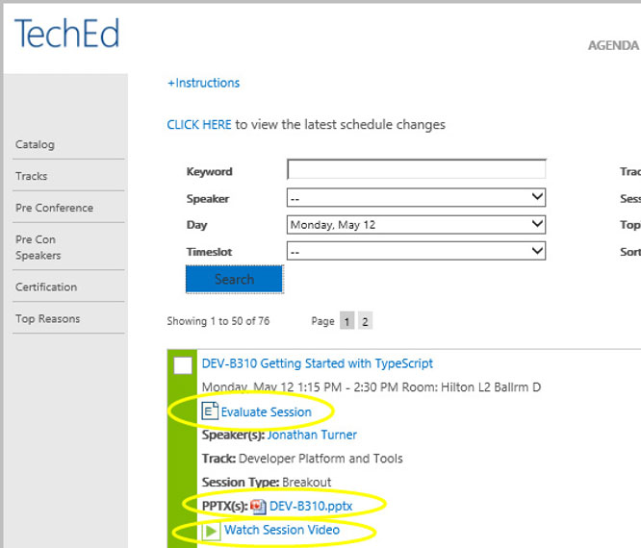
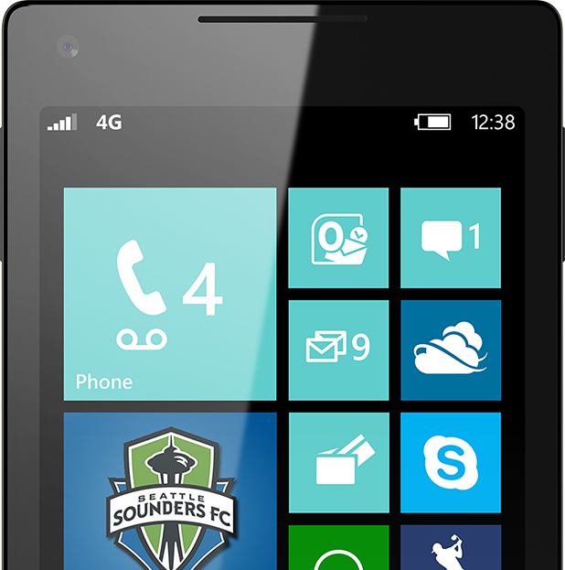
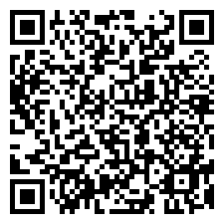
Please Complete An Evaluation Form Your input is important!
TechEd Schedule Builder
CommNet station or PC
TechEd Mobile app
Phone or Tablet
QR code

Slide 20
Evaluate this session

Slide 21
© 2014 Microsoft Corporation. All rights reserved. Microsoft, Windows, and other product names are or may be registered trademarks and/or trademarks in the U.S. and/or other countries.
The information herein is for informational purposes only and represents the current view of Microsoft Corporation as of the date of this presentation. Because Microsoft must respond to changing market conditions, it should not be interpreted to be a commitment on the part of Microsoft, and Microsoft cannot guarantee the accuracy of any information provided after the date of this presentation. MICROSOFT MAKES NO WARRANTIES, EXPRESS, IMPLIED OR STATUTORY, AS TO THE INFORMATION IN THIS PRESENTATION.

