Slide 1
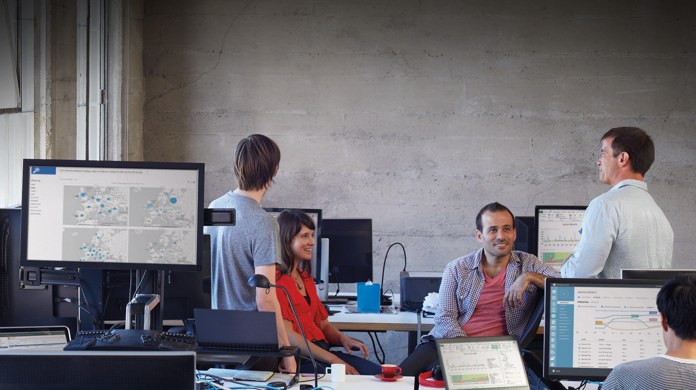

Slide 2
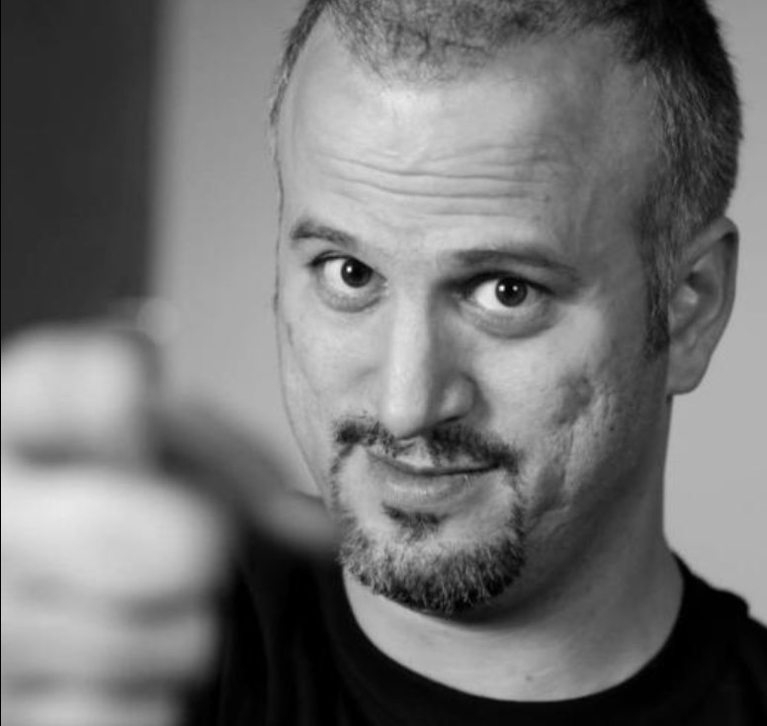


WIN-B326
Advanced Windows Defense
Erdal OZKAYA
www.ErdalOzkaya.com

Slide 3

Warning!
This Presentation Contains some information which you should not use in live targets or networks without permissions..

Slide 4
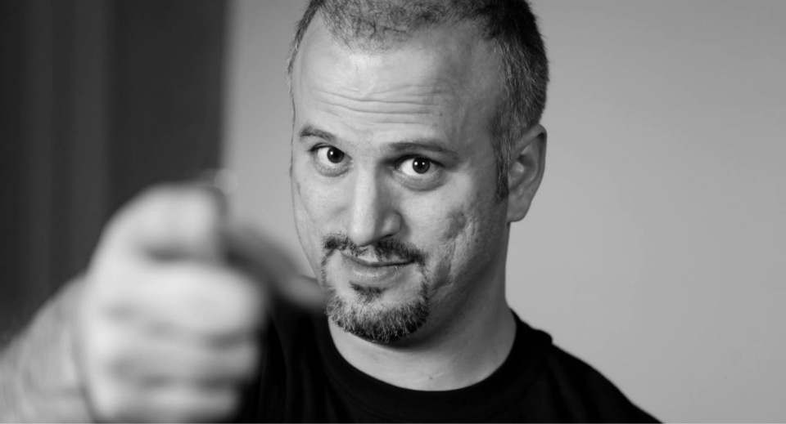





Erdal Ozkaya
www.ErdalOzkaya.com

Slide 5
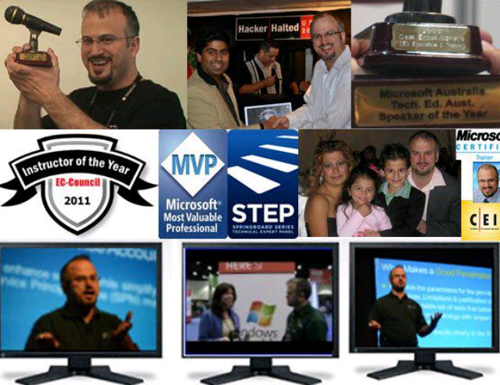
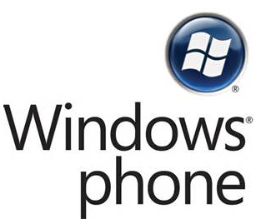







Who am I ?
Erdal Ozkaya
Lecturing @ CSU
@Erdal_Ozkaya
www.fb.com\YourMCT
www.YourMCT.com
https://www.linkedin.com/pub/erdal-ozkaya

Slide 6






Tweet About the session to win
@Erdal_Ozkaya
#TEE14 #StopCyberCrime
100 Anti Virus + Key Logger to give away
Windows To Go Sticks
Secunia CSI 6 Month Licence
KEMP Load Balancer
USB Sticks and much more….
TrueSec Stickers ☺

Slide 7

What is in this session ?

Slide 8
What do you think ?
?

Slide 9
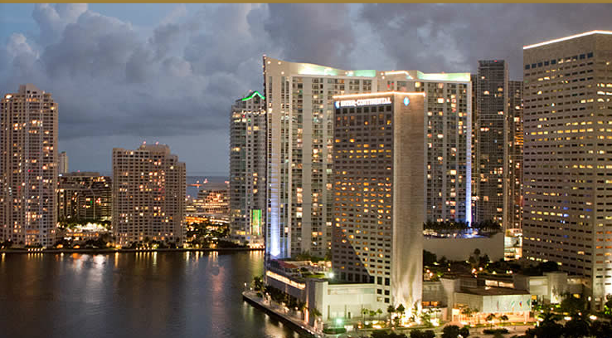
Holiday ?

Slide 10
What are really talking about ?
Guess WHAT?

Slide 11
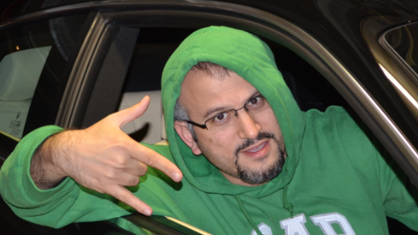
Me ☺

Slide 12
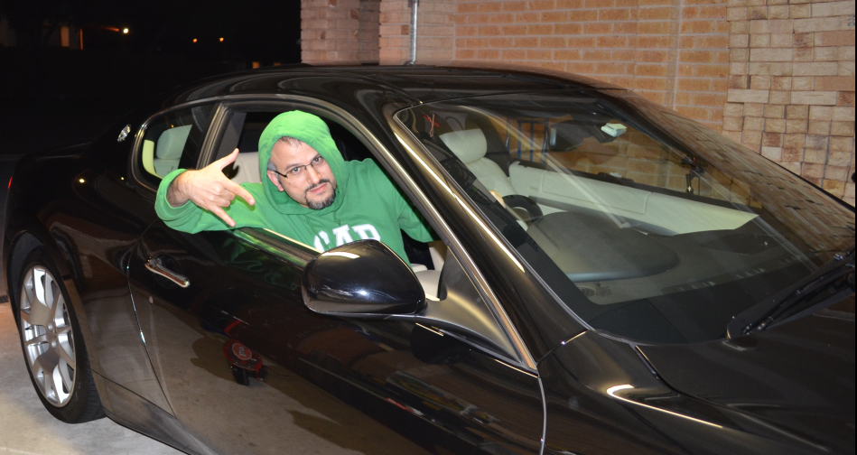
Look Carefully ?

Slide 13
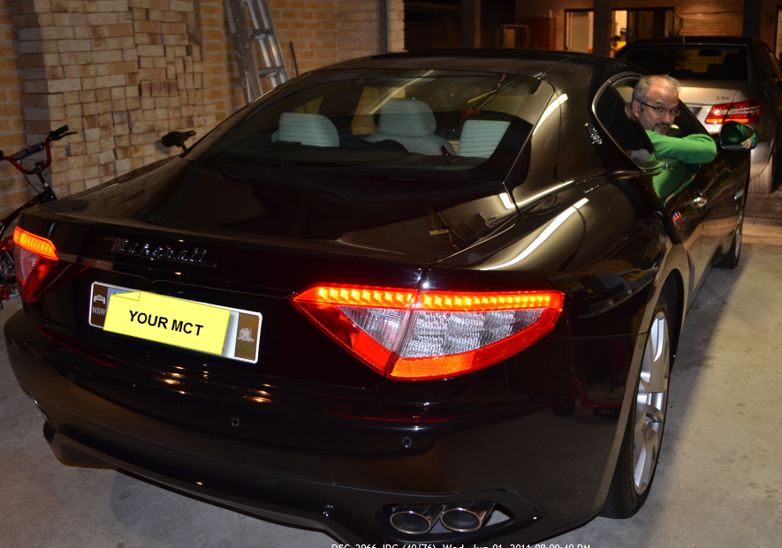

Slide 14
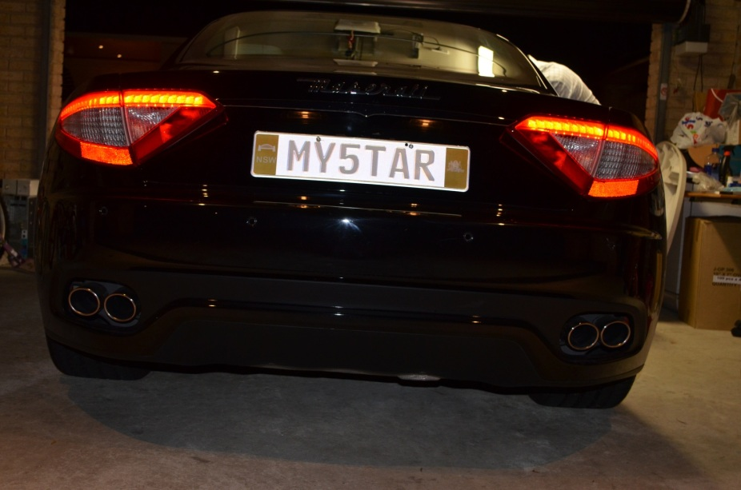
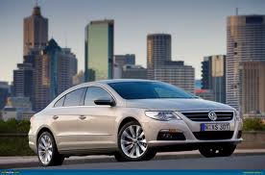
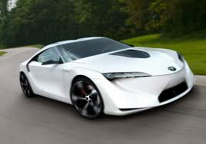
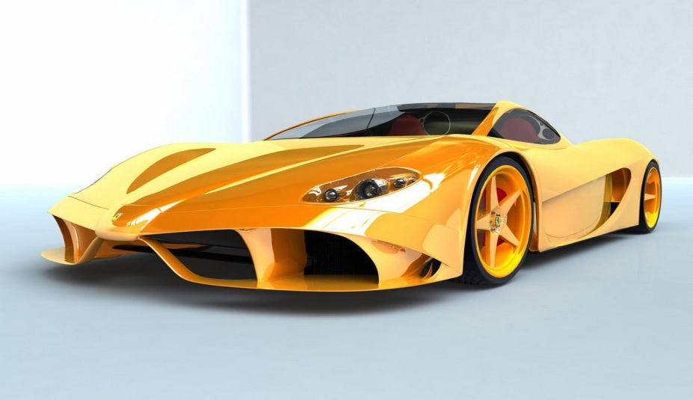
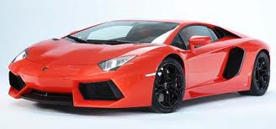
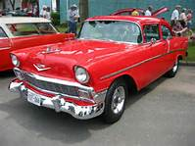
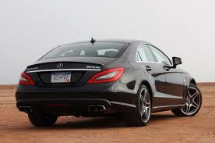

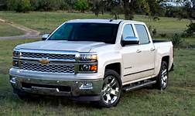
Cars ?

Slide 15
Algebra ?
{−x2−2xy+12=0 (1)−y2−2xy+12=0 (2)

Slide 16
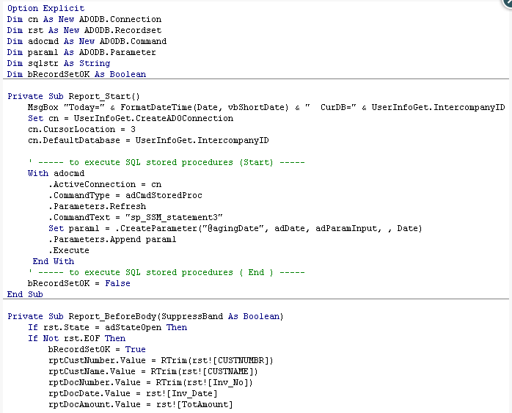
Or ?

Slide 17

What About ?
Source: iStock photography

Slide 18

Source: iStock photography

Slide 19

Welcome back ☺
Of Course Advanced Windows Defense!

Slide 20

One up on a day ; Security used to measured..
Neuschwanstein Castle

Slide 21

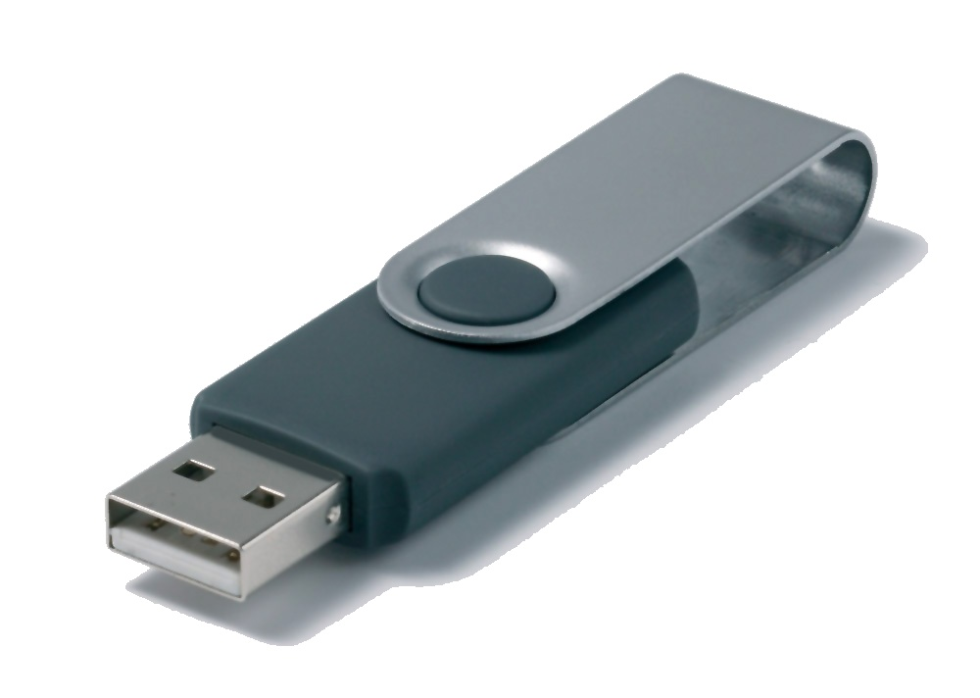
Let’s start ☺
Who wants a Free USB Stick ? From Tech Ed Expo?
BUT : all what add in to it is a HTML file

Slide 22
Demo
Phishing attack

Slide 23



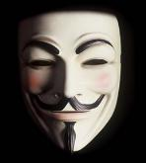
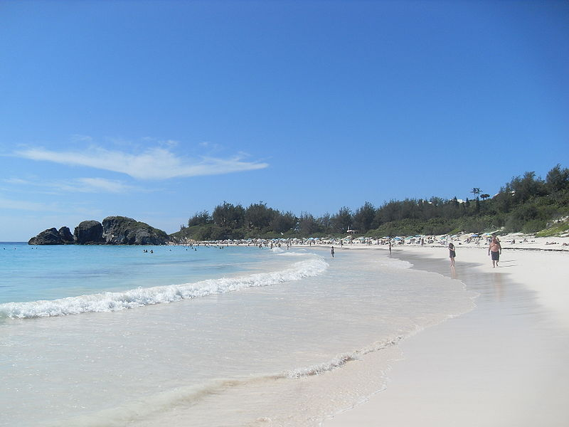
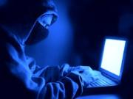
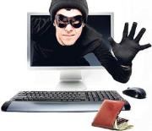
Pass the Hash
Every time you connect to the internet, you have instant and direct IP connectivity to…
Online Services
Internet cafes in
vacation spots
Activities
  Ideological Movements
  Nation
  States
  Organized
  Crime
Wonderful Internet Services

Slide 24



Pass-the-Hash Definition
“Hash” = cached credential
  Usually not “cleartext”
  Identically powerful to “cleartext” by most systems
  Can be stored in memory or persisted on disk
Most operating systems cache credentials for single sign on (SSO)
Username/
Hash
Username/
Password

Slide 25


Slide 27






Slide 28
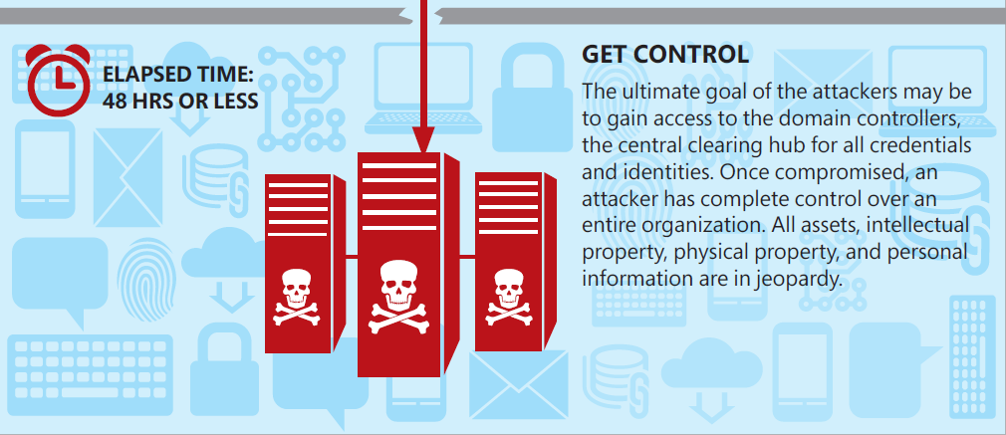
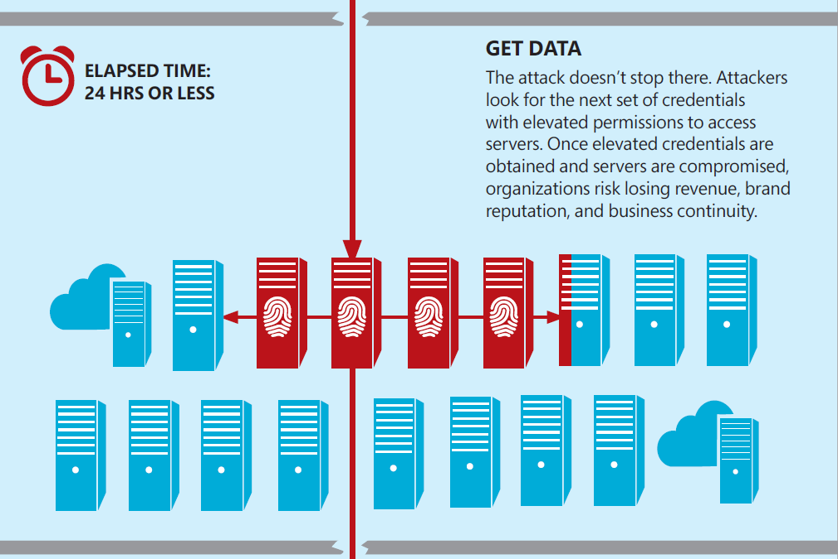
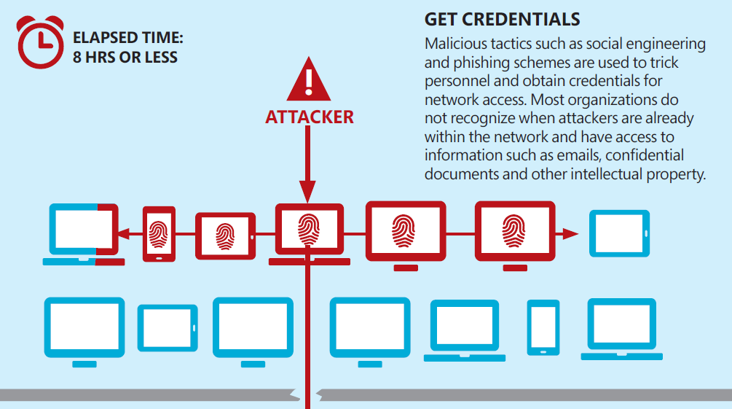










Slide 29
Demo
More pass the hash…

Slide 30
Where is the Industry standing ?

Slide 31
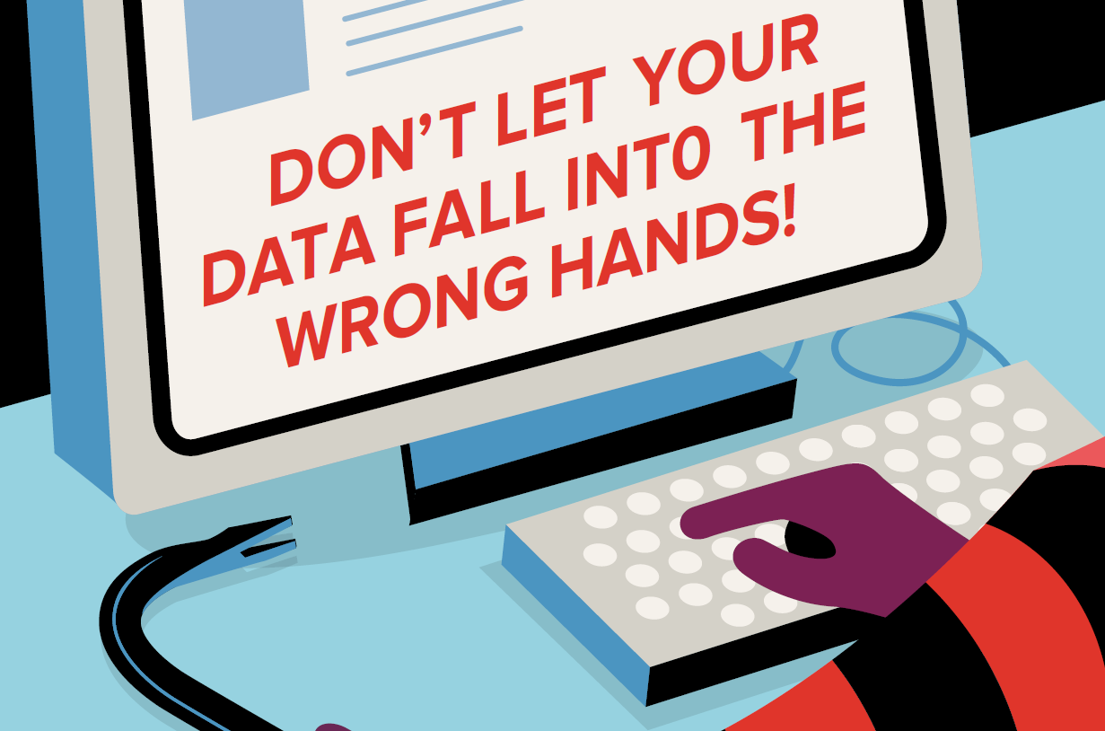
Source: Canon Australia

Slide 32
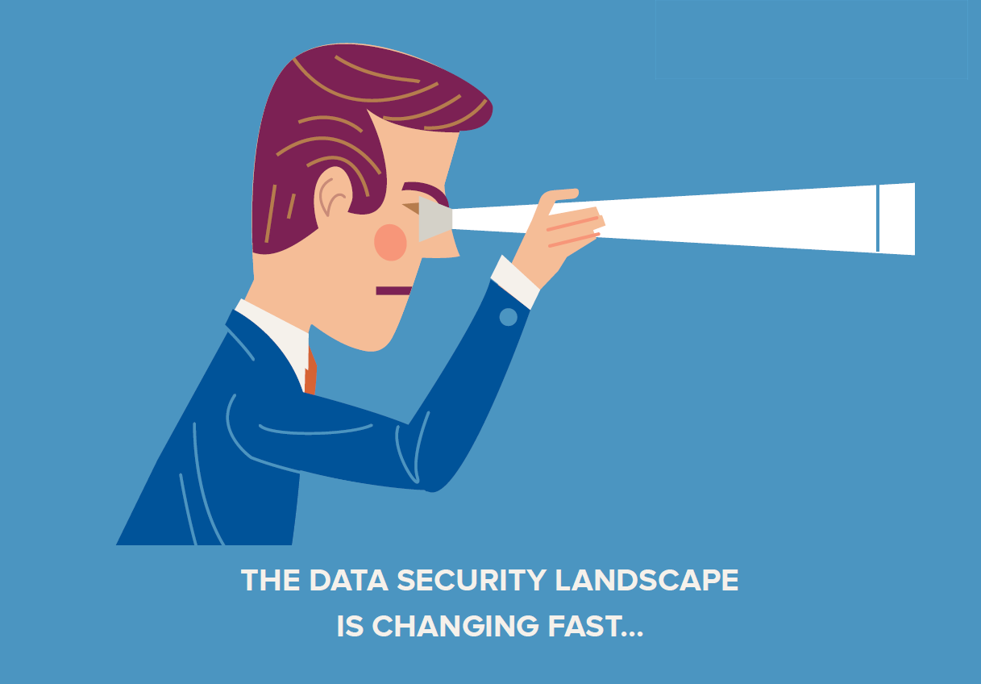

Slide 33
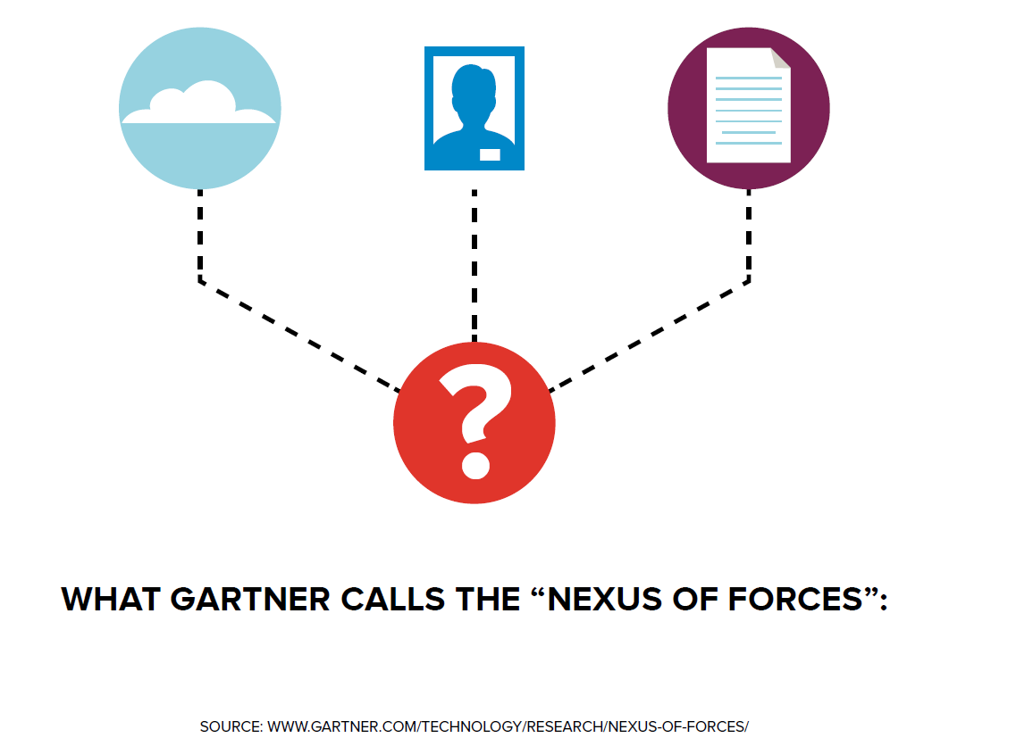

Slide 34


Has made the world smaller
Source: Flicker

Slide 35
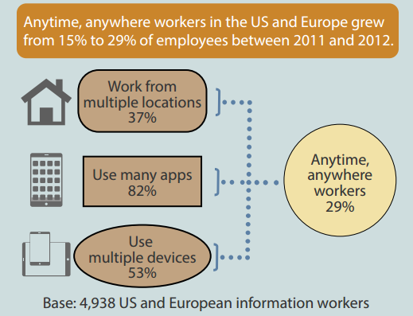
and transformed how we work.
Source: Forrester 2013 Mobile Workforce Adoption Trends
Retrieved from http://www.microsoft.com/global/en-gb/enterprise/PublishingImages/
devices-and-mobility-hub/travel-and-tourism/FORRESTER_-_2013_Mobile_Workforce_Adoption_Trends.pdf

Slide 36
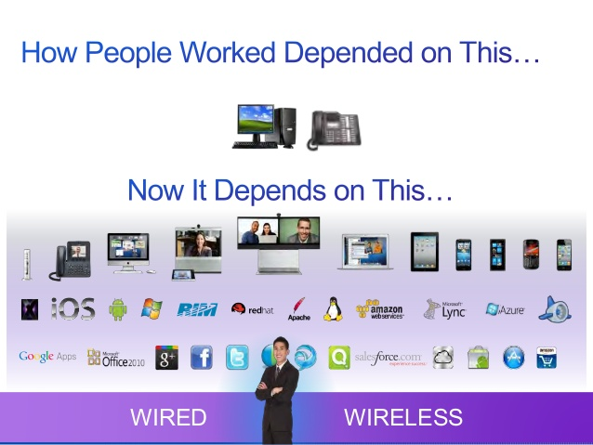
….Sometimes with our approval

Slide 37
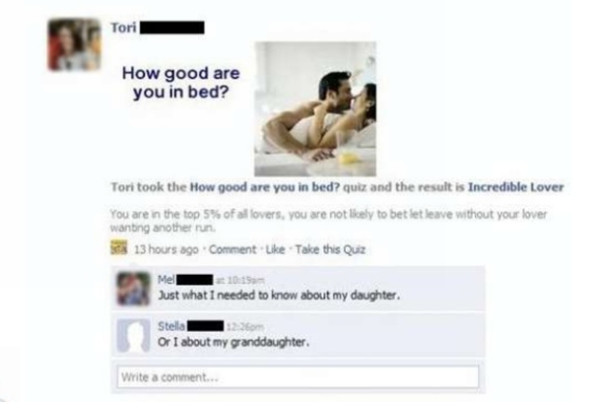
But it has also exposed our private data like never before.

Slide 38
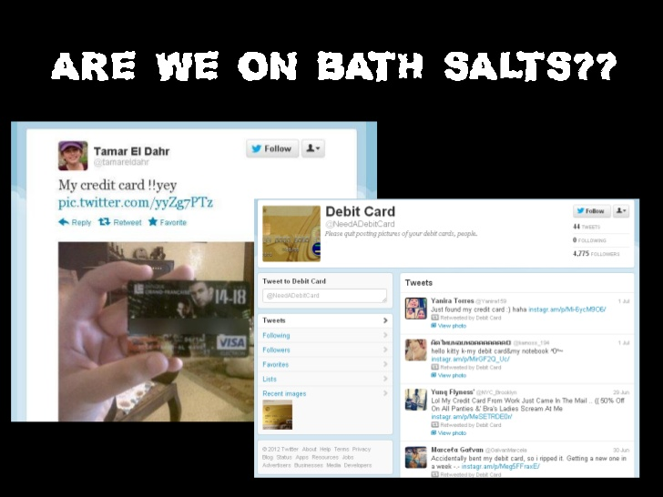

Slide 39
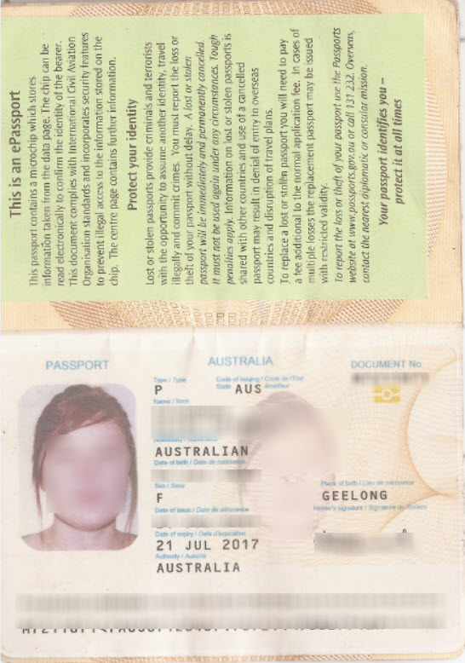

Slide 40
….Sometimes not ☹

Slide 41
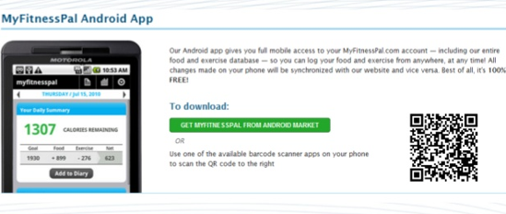
Just a small example

Slide 42
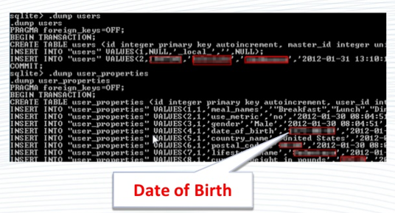
!!!!

Slide 43
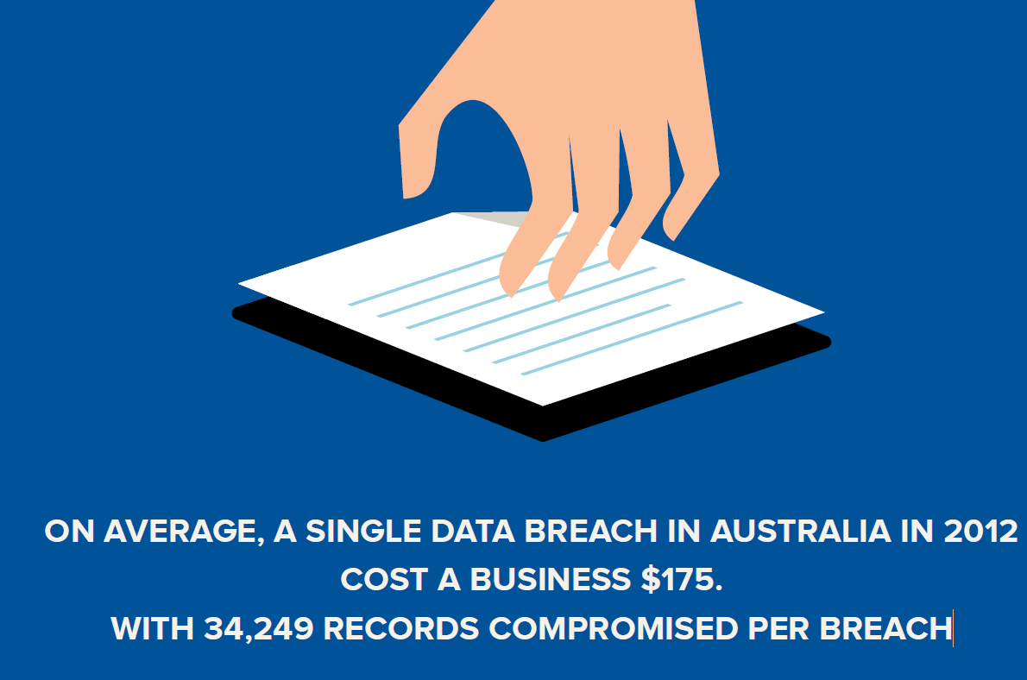
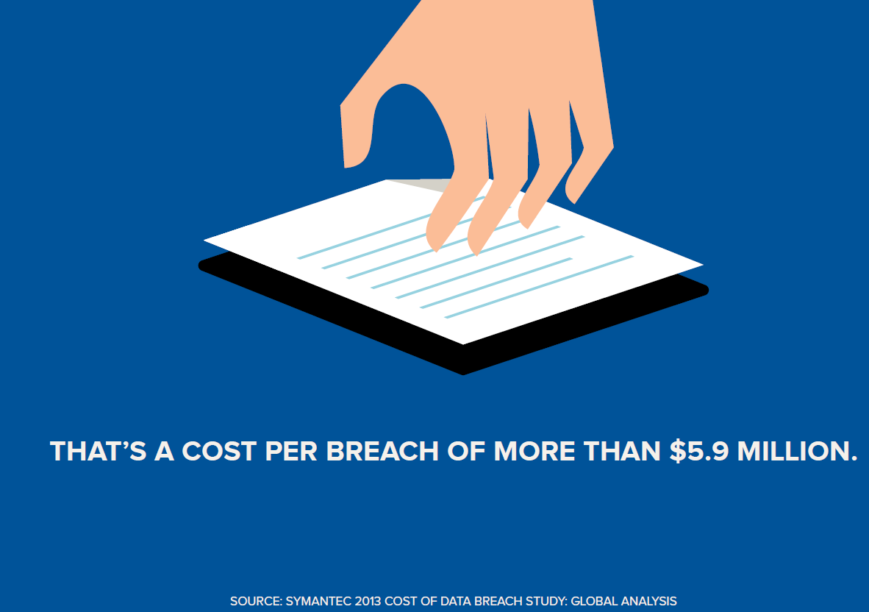

Slide 44


A data breach can also cost you:
Customers

Slide 45

Reputation.
Source: Flicker

Slide 46

or
Competitive edge.

Slide 47
How can we be more secure?

Slide 48
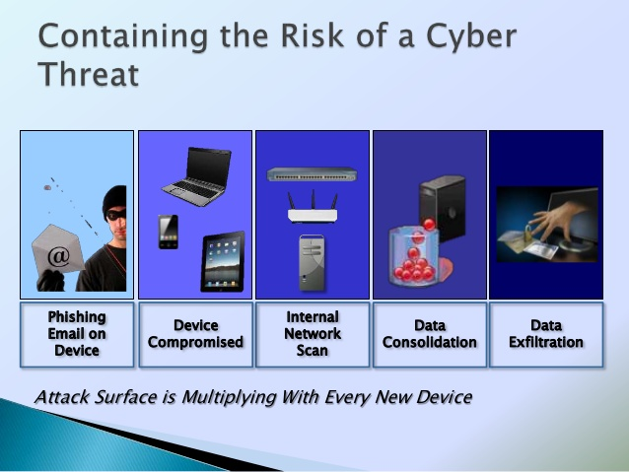
Cyber-attacks are getting more sophisticated. Malware is easier to access

Slide 49
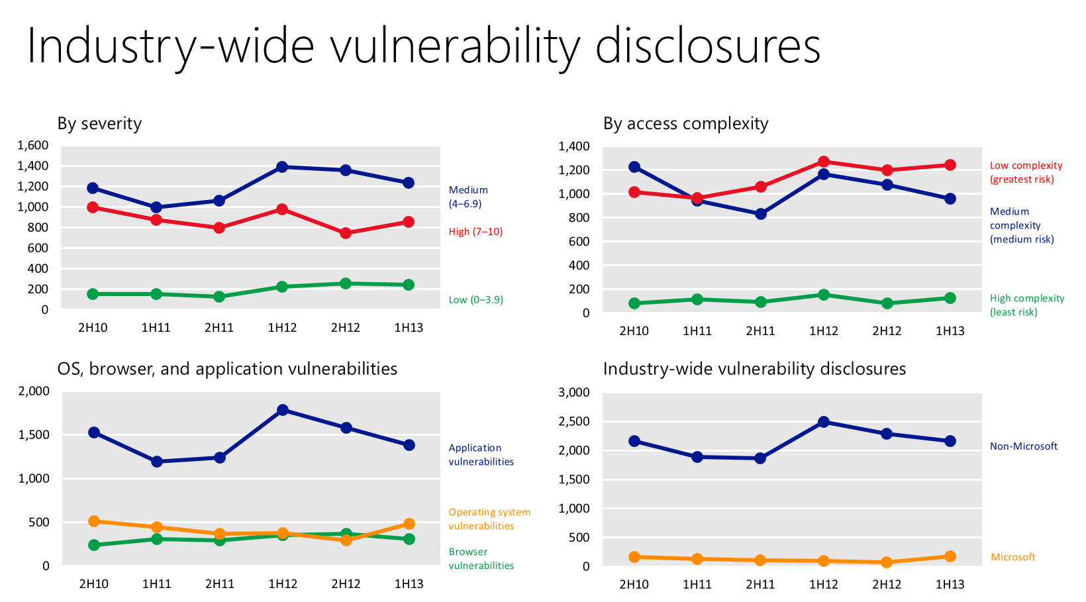
Industry-wide vulnerability disclosures
By severity
By access complexity
OS, browser, and application vulnerabilities
Industry-wide vulnerability disclosures

Slide 50
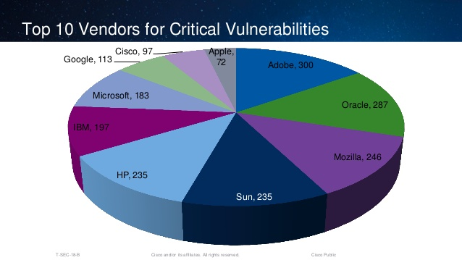

Slide 51
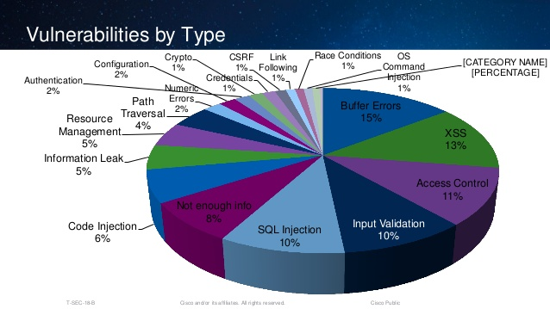

Slide 52
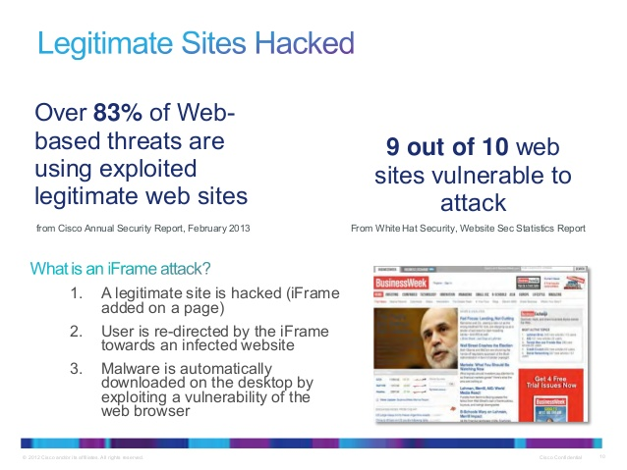

Slide 53
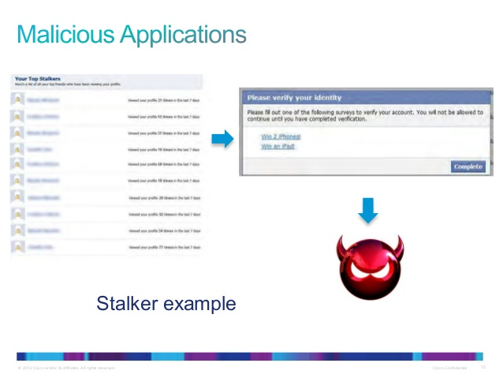

Slide 54
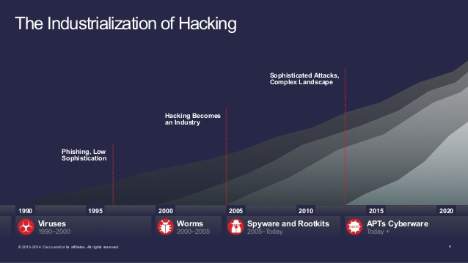

Slide 55
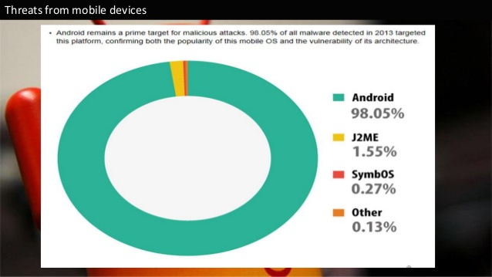
Mobile First Cloud First ! But keep in mind

Slide 56
Demo
Vulnerability Assesment

Slide 57
How do they attack?

Slide 58
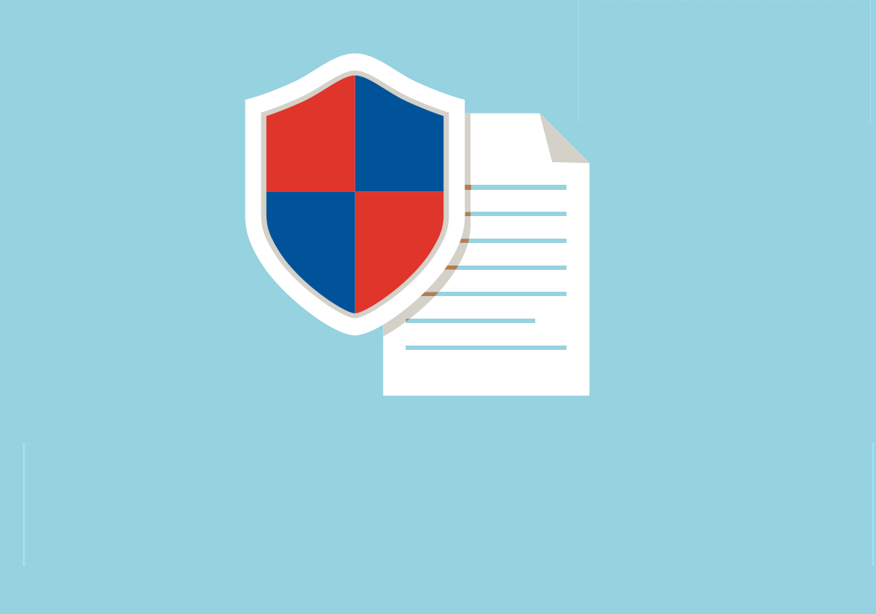
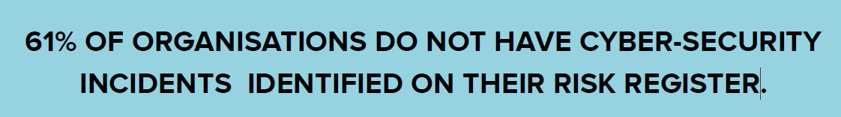
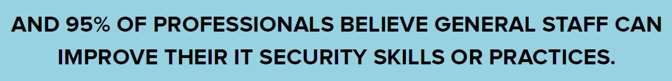

Slide 59
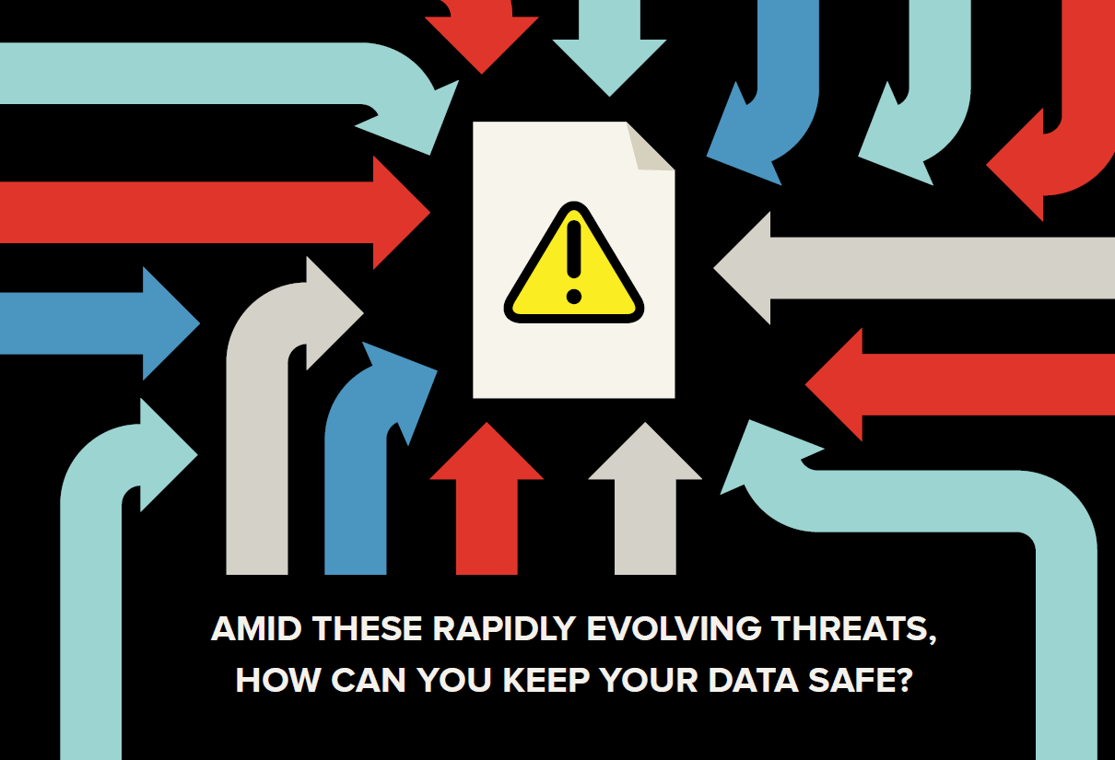

Slide 60
Demo
Malware Analysis

Slide 61
How to make Windows more secure ?

Slide 62

Challenges

Slide 63


Slide 64


Do a business impact analysis

Slide 65


Audit your security policies
Check your enterprise security priorities are in sync with your business goals.
Do you have a BYOD policy?
Do you have a disaster recovery plan?
PDCA (ISO 27001)
Create an Action Plan

Slide 66
Choose your tools ( Free from MS)
Microsoft Security Compliance Manager
Attack Surface Analyzer
Microsoft Baseline Security Analyzer (MBSA)
Microsoft Security Compliance Manager
And many more…

Slide 67

Image Source: Canon

Slide 68

Recommendations

Slide 69
Thank You ☺

Slide 70



SUBMIT YOUR TECHED EVALUATIONS
We value your feedback!
Fill out an evaluation via
CommNet Station/PC: Schedule Builder
LogIn: europe.msteched.com/catalog
TechEd Mobile app
for session evaluations
is currently offline

Slide 71

Resources
Learning
  Sessions on Demand
  Microsoft Certification & Training Resources
http://channel9.msdn.com/Events/TechEd
www.microsoft.com/learning
TechNet
Developer Network
  Resources for IT Professionals
http://microsoft.com/technet
http://developer.microsoft.com

Slide 72


© 2014 Microsoft Corporation. All rights reserved. Microsoft, Windows, and other product names are or may be registered trademarks and/or trademarks in the U.S. and/or other countries.
The information herein is for informational purposes only and represents the current view of Microsoft Corporation as of the date of this presentation. Because Microsoft must respond to changing market conditions, it should not be interpreted to be a commitment on the part of Microsoft, and Microsoft cannot guarantee the accuracy of any information provided after the date of this presentation. MICROSOFT MAKES NO WARRANTIES, EXPRESS, IMPLIED OR STATUTORY, AS TO THE INFORMATION IN THIS PRESENTATION.

