Slide 2
Top 10 Best Practices for OS Deployment with ConfigMgr 2012 R2
WIN-B328
Greg Ramsey
Tools Strategist, Dell, Inc.

Slide 3
Agenda
Best Practices
Demos, Demos, Demos
Get Social: #TEWINB328

Slide 4
“KISS—start simple, and work your way toward complexity.”
Rob Marshall

Slide 5
“Automate process to import drivers and create driver packages.”
Kent Agerlund
“Automate, Automate, Automate. Manually building images is not what anyone should be paid for. It’s a waste of money and time.”
Jason Sandys

Slide 6
“Add CMTrace to the path statement for WinPE, and essential files to your boot.wim.”
Mike Terrill

Slide 7
Demo
Greg

Slide 8
“ Access hidden task sequences on-demand.”
Niall Brady

Slide 9
“Use MDT Lite Touch to build your reference image.”
Johan Arwidmark

Slide 10
“Implement a Pre-Flight Checklist.”
Troy Martin

Slide 11
“Restrict TS to reduce risk. Configure deployment for only boot media and PXE.”
John Marcum, Todd Hemsell

Slide 12
“Always use MDT integration with the Validate step to prevent the ultimate oops.”
Tim Mintner

Slide 13
Demo
Greg

Slide 14
“Be patient, and think before you act.”
Aaron Czechowski

Slide 15
“Please, test on one system first.”
Michael Niehaus

Slide 16
Honorable Mentions….
Use RBA to reduce risk – Greg Ramsey
Use PowerShell Scripts to fill in the gaps in OSD Process – Trevor Sullivan
Listen to Johan – Multiples. . .
Continue on Error is not your friend – Greg Ramsey
PnP only works at Contoso

Slide 17
Q&A
Ramseyg@Hotmail.com
www.ramseyg.com

Slide 18
Related content
Breakout Sessions
EM-B326 - What’s New and Upcoming with OS Deployment in System Center Configuration Manager and the Microsoft Deployment Toolkit
WIN-B324 - Real-World Windows Deployment: Notes from the Field
WIN-B338 - Windows 10: Deployment
Labs
EM-IL300 -Deploying Windows 8.1 to Bare Metal Clients Using System Center 2012 R2 Configuration Manager
Microsoft Solutions Experience Location (MSE)
Find Me Later At. . .

Slide 19
Resources
Learning
Sessions on Demand
Microsoft Certification & Training Resources
http://channel9.msdn.com/Events/TechEd
www.microsoft.com/learning
TechNet
Developer Network
Resources for IT Professionals
http://microsoft.com/technet
http://developer.microsoft.com

Slide 20
Windows Resources
Windows 10 http://aka.ms/trywin10
Stop by the Windows Booth to sign up for the Windows Insider Program to get a FREE Windows 10 T-shirt, whiles supplies last!
Windows Springboard windows.com/itpro
Windows Enterprise windows.com/enterprise
Microsoft Desktop Optimization Package (MDOP) microsoft.com/mdop
Desktop Virtualization (DV) microsoft.com/dv
Windows To Go microsoft.com/windows/wtg
Internet Explorer TechNet http://technet.microsoft.com/ie

Slide 21
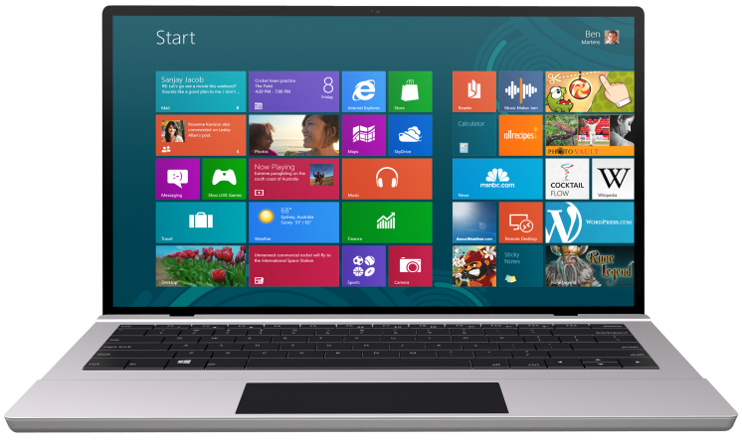
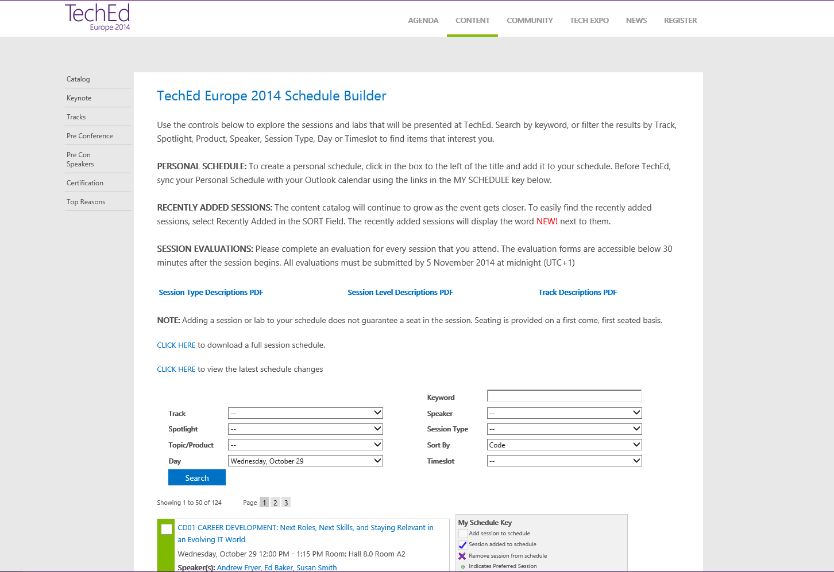
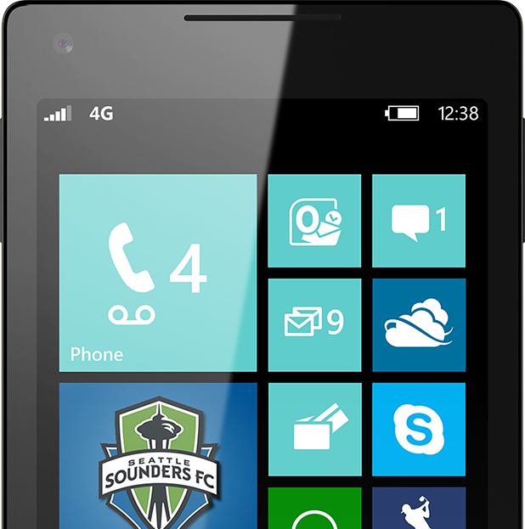
SUBMIT YOUR TECHED EVALUATIONS
We value your feedback!
Fill out an evaluation via
CommNet Station/PC: Schedule Builder
LogIn: europe.msteched.com/catalog
TechEd Mobile app for session evaluations is currently offline

Slide 22
© 2014 Microsoft Corporation. All rights reserved. Microsoft, Windows, and other product names are or may be registered trademarks and/or trademarks in the U.S. and/or other countries.
The information herein is for informational purposes only and represents the current view of Microsoft Corporation as of the date of this presentation. Because Microsoft must respond to changing market conditions, it should not be interpreted to be a commitment on the part of Microsoft, and Microsoft cannot guarantee the accuracy of any information provided after the date of this presentation. MICROSOFT MAKES NO WARRANTIES, EXPRESS, IMPLIED OR STATUTORY, AS TO THE INFORMATION IN THIS PRESENTATION.

