Slide 2
Three-Way Data Binding in Universal Apps: View, View Model, and Cloud
WIN-B356
Shen Chauhan
Senior Program Manager
TED | Developer Experience

Slide 3
@shenchauhan shen.chauhan@microsoft.com

Slide 4
Agenda
Quick Data binding 101
MVVM Overview
Azure Mobile Services
SignalR
What happens when we put all this technology together?
DEMO!!!

Slide 5
Quick Data binding 101

Slide 6
What is data binding?
“An underlying connection between the user interface (view) and the application/business logic (view model/model).
When data is bound to the user interface a change in the data will reflect in the user interface and vice versa (depending on the binding mode)”

Slide 7
INotifyPropertyChanged and DataContext
We implement INotifyPropertyChanged on our View Models to enable our properties to be data bound.
Each property should fire the PropertyChanged event to notify the user interface of change.
We set the DataContext of the View (XAML file) to the ViewModel (our C# file) so it has a reference to what it should set it’s context to.

Slide 8
The various modes of data binding
One Time
Only binds data from the View Model to the View once
One Way (default)
Only binds data from the View Model to the View, but will reflect changes made in View Model
Two Way
Binds data from the View Model to the View and back.

Slide 9
MVVM (Model-View-ViewModel) Overview

Slide 10
What is MVVM?
“A design pattern to help create layers of abstraction between the user interface, the application and business logic to allow you to create a testable, modular application”

Slide 11
Tools and frameworks
PRISM (Microsoft Patterns and Practices)
DEV-B213 Building Universal apps using P&P Prism
MVVM Light
Unity Dependency Injection
Managed Extensibility Framework (MEF)
Autofac
Funq
Ninject
........

Slide 12
There are performance implications so watch out!

Slide 13
Azure Mobile Services

Slide 14
What is Azure Mobile Services?
“An Azure service dedicated to helping you to build scalable cloud based mobile applications (on any platform). Services offered include Push Notification services, 3rd Party Authentication (Facebook, Twitter, Microsoft and Google) and storage APIs.”
For more information go to session: DEV-B312 Building Customer Facing Mobile Apps with Microsoft Azure

Slide 15
SignalR

Slide 16
What is SignalR?
“An extension of ASP.NET to allow communication using the best transport available between client and server. ”
More in depth session on: DEV-B343 Building Real-Time Applications with ASP.NET SignalR

Slide 17
Key features
.Available for:
.NET
JavaScript
Windows Runtime (Modern Applications)
Web Sockets, Server Send Events, Forever Frame and Ajax long polling
SignalR controllers are called Hubs
Ability to push information based on groups so the message doesn’t have to sent to all clients

Slide 18
How to create a hub
public class TestHub : Hub
{
public void Hello()
{
// hello is a dynamic method that the client will subscribe to.
Clients.All.hello("Hello world! :)");
}
}

Slide 19
What happens when we put all this technology together?

Slide 20
We are going to create an application!
A Universal application sends a message to Azure Mobile Services via SignalR (Windows Runtime)
Mobile Services relays that message to a Web site via SignalR (Javascript)
Mobile devices that will be viewing web site will see the changes

Slide 21
Architecture Diagram
Azure Mobile Services
Universal Application
Web Site

Slide 22
Demo
Shen Chauhan

Slide 23
Related content
DEV-B343 Building Real-Time Applications with ASP.NET SignalR
DEV-B312 Building Customer Facing Mobile Apps with Microsoft Azure
DEV-B213 Building Universal apps using P&P Prism
Labs
DEV-H215 Real-Time Web Applications with Microsoft ASP.NET SignalR
Find Me Later At. . . WIN-B357 Window 8.1 Programming with C# and XAML

Slide 24
Track resources
http://www.asp.net/signalr
http://azure.microsoft.com/en-us/services/mobile-services/
http://compositewpf.codeplex.com/
https://dev.windows.com/en-us

Slide 25
Resources
Learning
Sessions on Demand
Microsoft Certification & Training Resources
http://channel9.msdn.com/Events/TechEd
www.microsoft.com/learning
TechNet
Developer Network
Resources for IT Professionals
http://microsoft.com/technet
http://developer.microsoft.com

Slide 26
Windows Resources
Windows 10 http://aka.ms/trywin10
Stop by the Windows Booth to sign up for the Windows Insider Program to get a FREE Windows 10 T-shirt, whiles supplies last!
Windows Springboard windows.com/itpro
Windows Enterprise windows.com/enterprise
Microsoft Desktop Optimization Package (MDOP) microsoft.com/mdop
Desktop Virtualization (DV) microsoft.com/dv
Windows To Go microsoft.com/windows/wtg
Internet Explorer TechNet http://technet.microsoft.com/ie

Slide 27
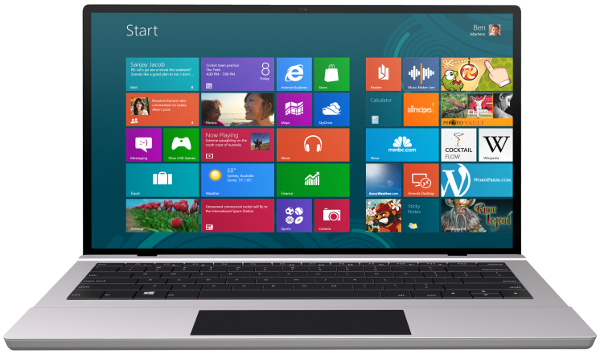
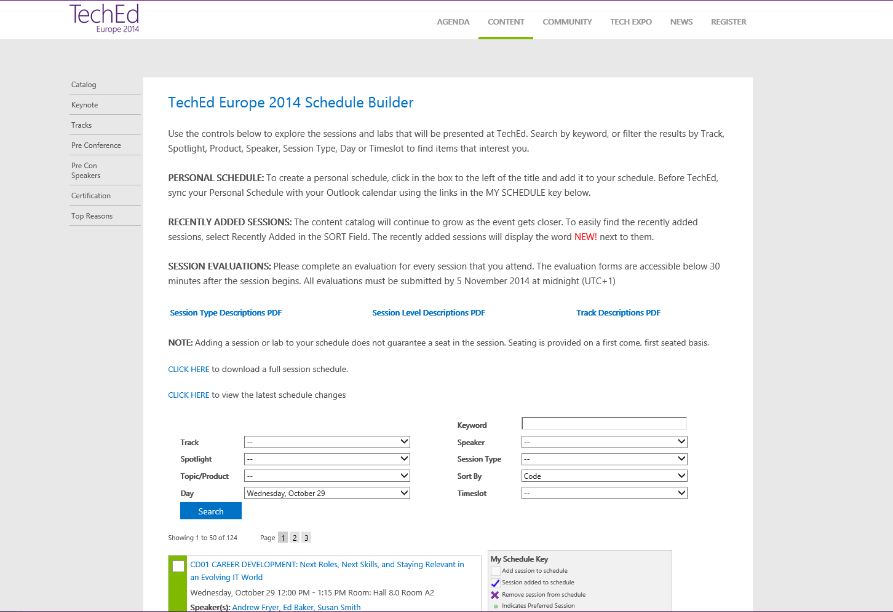
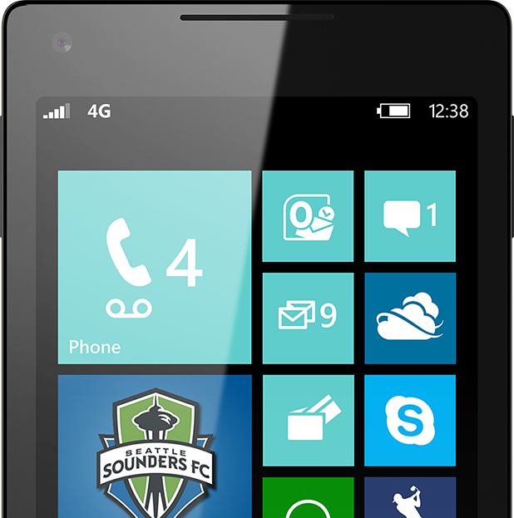
SUBMIT YOUR TECHED EVALUATIONS
We value your feedback!
Fill out an evaluation via
CommNet Station/PC: Schedule Builder
LogIn: europe.msteched.com/catalog
TechEd Mobile app for session evaluations is currently offline

Slide 28
© 2014 Microsoft Corporation. All rights reserved. Microsoft, Windows, and other product names are or may be registered trademarks and/or trademarks in the U.S. and/or other countries.
The information herein is for informational purposes only and represents the current view of Microsoft Corporation as of the date of this presentation. Because Microsoft must respond to changing market conditions, it should not be interpreted to be a commitment on the part of Microsoft, and Microsoft cannot guarantee the accuracy of any information provided after the date of this presentation. MICROSOFT MAKES NO WARRANTIES, EXPRESS, IMPLIED OR STATUTORY, AS TO THE INFORMATION IN THIS PRESENTATION.

