Slide 1
The Case of the Unexplained…
Mark Russinovich
CTO, Microsoft Azure

Slide 2
Outline
Introduction
Sluggish Performance
Error Messages
Buggy Behavior
Blue Screens

Slide 3
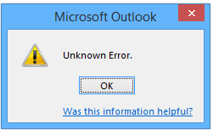
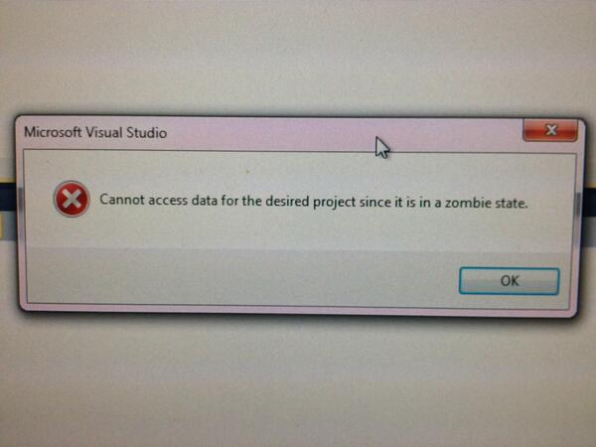
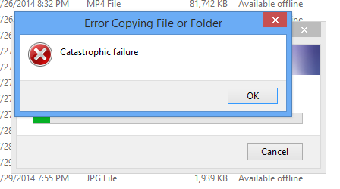
Troubleshooting
Most applications do a poor job of reporting unexpected errors
Locked, missing or corrupt files
Missing or corrupt registry data
Permissions problems
Errors manifest in several different ways
Misleading error messages
Crashes or hangs

Slide 4
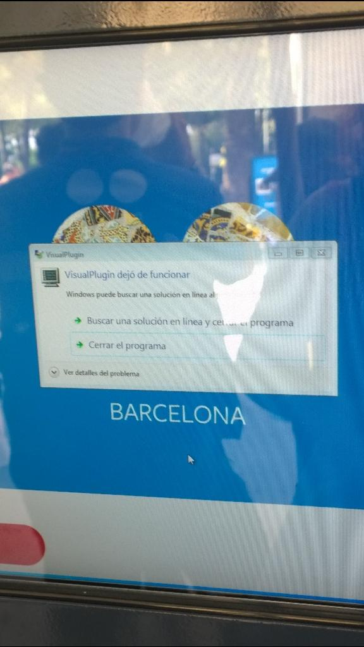

Slide 5
Troubleshooting
Most applications do a poor job of reporting unexpected errors
Locked, missing or corrupt files
Missing or corrupt registry data
Permissions problems
Errors manifest in several different ways
Misleading error messages
Crashes or hangs

Slide 6
Purpose of Talk
Show you how to solve these classes of problems by peering beneath the surface
Interpreting process, file and registry activity
Interpreting call stacks
You’ll learn tools and techniques to help you solve seemingly unsolvable problems

Slide 7
Tools We’ll Use
Sysinternals: www.microsoft.com/technet/sysinternals
Process Explorer – process/thread viewer
Process Monitor – file/registry/process/thread tracing
Procdump – process memory dumper
Autoruns – displays all autostart locations
SigCheck – shows file version information
PsExec – execute processes remotely or in the system account
TcpView – shows TCP/IP endpoints
Strings – dumps printable strings in any file
Zoomit – presentation tool I’m using
Microsoft downloads:
Debugging Tools for Windows: Windbg application and kernel debugger: www.microsoft.com/whdc/devtools/debugging (//dbg)

Slide 8
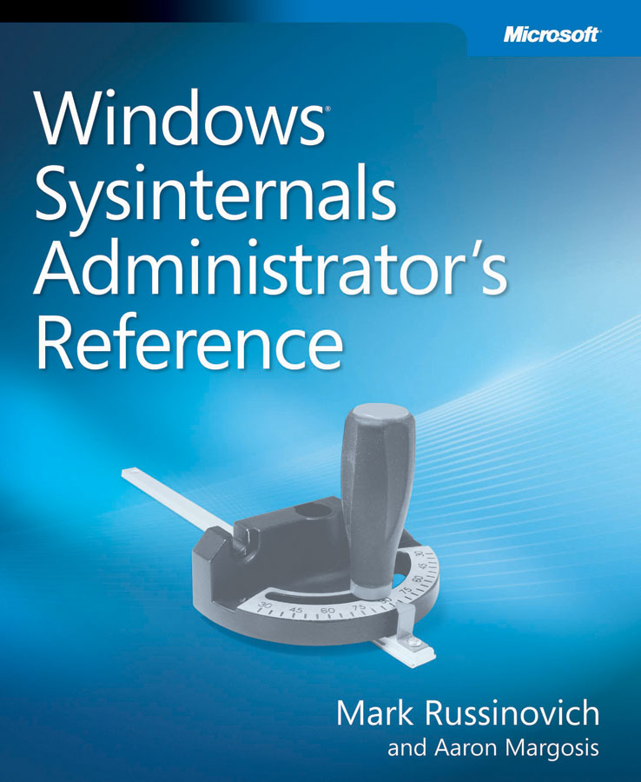
The Sysinternals Administrator’s Reference
The official guide to the Sysinternals tools
Covers every tool, every feature, with tips
Written by markruss and aaronmar
Full chapters on the major tools:
Process Explorer
Process Monitor
Autoruns
Other chapters by tool group
Security, process, AD, desktop, …

Slide 9
Outline
Sluggish Performance
Error Messages
Buggy Behavior
Blue Screens

Slide 10
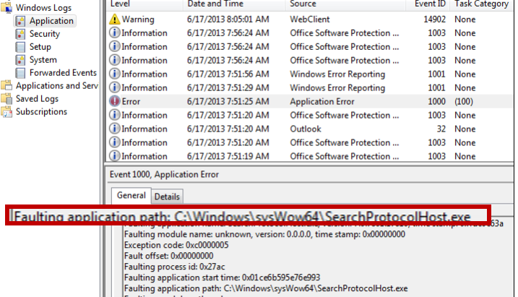
The Case of the Random Sluggishness
System would suddenly get sluggish and cursor would switch rapidly between ready and waiting
Looked at event log and saw SearchProtocolHost crash

Slide 11
Process Explorer
Process Explorer is a Task Manager replacement
You can literally replace Task Manager with Options->Replace Task Manager
Hide-when-minimized to always have it handy
Hover the mouse to see a tooltip showing the process consuming the most CPU
Open System Information graph to see CPU usage history
Graphs are time stamped with hover showing biggest consumer at point in time
Also includes other activity such as I/O, kernel memory limits

Slide 12
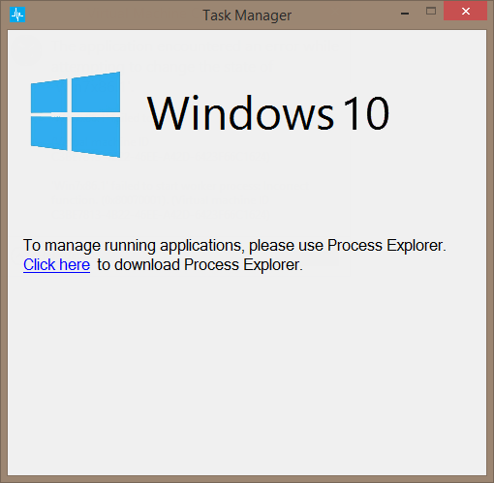

Slide 13
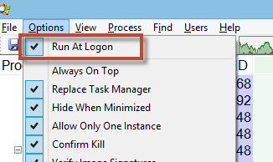
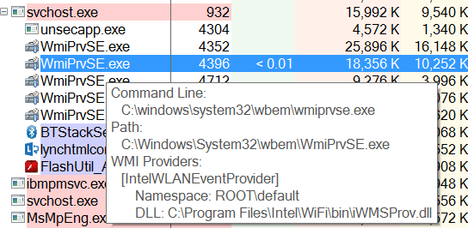
New Features
Run automatically at logon:
WMI provider hosts
Win 8.1 DPI Awareness

Slide 14
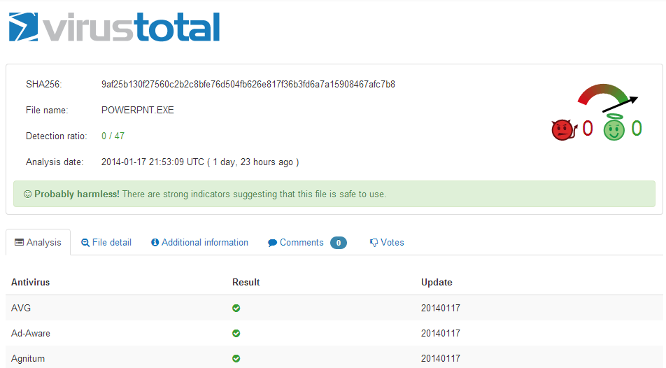
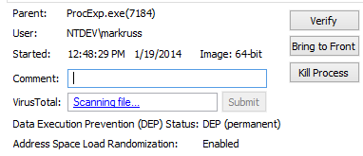
VirusTotal Integration
VirusTotal.com is Antivirus-as-a-Service (AaaS)
You can have Process Explorer check file hashes
Check all displayed files with Options->Check VirusTotal
Results reported in VirusTotal column as well as DLL and process properties
Uploads hashes
Reports results as positive detection rate or “Unknown”
You can submit unknown files for scanning
Options->Submit Unknown Executables submits all portable executable (PE) images < 32 MB in size
Can submit on-demand with context menu or properties dialog

Slide 15
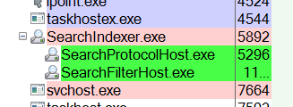
The Case of the Random Sluggishness (Cont)
Disabled search service and problem went away
But lost Outlook search capability
Had to dig deeper
Looked in Process Explorer and saw flashing green and red protocol host processes

Slide 16
The Case of the Random Sluggishness (Cont)
Configured just-in-time debugging with Procdump to capture a dump:
procdump -ma -i C:\dumps

Slide 17
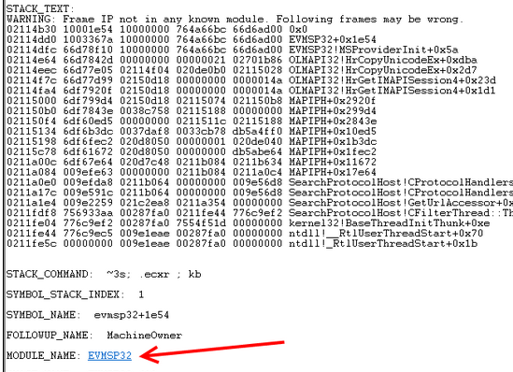
The Case of the Random Sluggishness (Cont)
Dump file pointed at EVMSP32.DLL:
Didn’t know what EVMSP32 was…

Slide 18
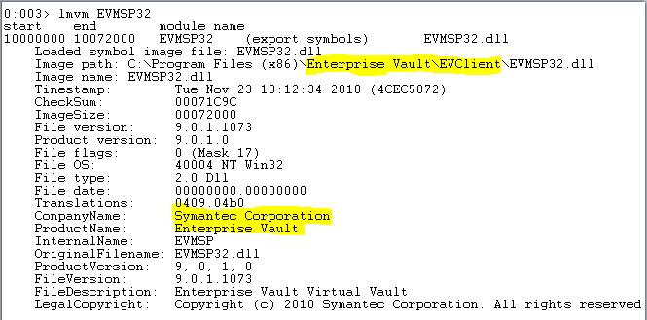
The Case of the Random Sluggishness: Solved
Looked at image properties:
Uninstalled Symantec Enterprise Vault: problem solved

Slide 19
The Case of the Stuttering Blu-ray Playback
User experienced glitching a minute or two into playback of any Blue-ray DVD
Upgraded DVD player software: no change
Identified player model in Device Manger:
Web searches revealed scattered issues, but no solution
No firmware upgrade available

Slide 20
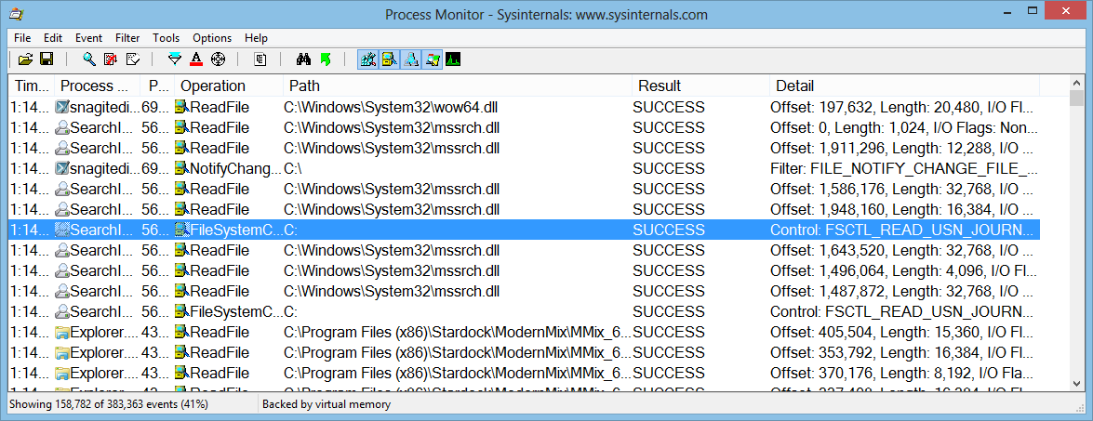
Process Monitor
Process Monitor is a real-time file, registry, process and thread monitor
When in doubt, run Process Monitor!
It will often show you the cause for error messages
It many times tells you what is causing sluggish performance

Slide 21
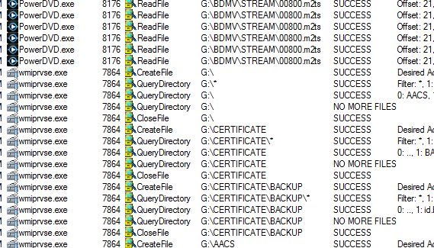
The Case of the Stuttering Blu-ray Playback (Cont)
Decided to capture Process Monitor trace
Set filter to just watch DVD drive (G:\)
Noticed Wmiprsve traversing disk directories

Slide 22
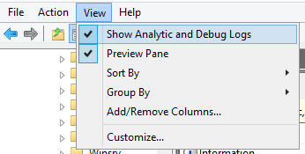
The Case of the Stuttering Blu-ray Playback (Cont)
Enabled WMI tracing:
In Event Viewer showed debug logs:
Enabled WMI-Activity tracing log

Slide 23
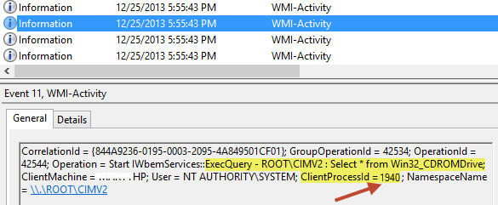
The Case of the Stuttering Blu-ray Playback (Cont)
Played back DVD until stutter and then stopped tracing and opened log
Found entries referencing CDROM class:
Next step was to identify client process (1940)…

Slide 24
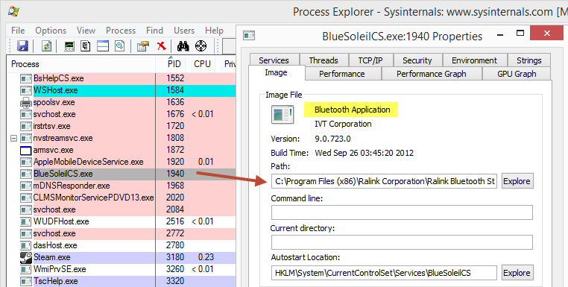
The Case of the Stuttering Blu-ray Playback (Cont)
Opened Process Explorer and found it was Bluetooth service:

Slide 25
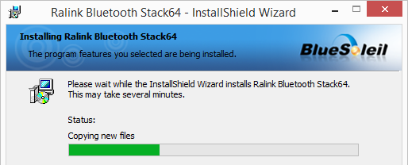
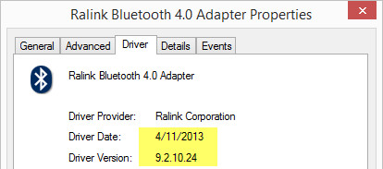
The Case of the Stuttering Blu-ray Playback: Solved
Stopped service and stutter disappeared:
Went to vendor web site and found new version:
No service in update: problem solved

Slide 26
The Case of the Slow Printers
Company switched from using wired printers for printing labels to wireless
After 8 new printers were deployed noticed performance issues:
2 printers printed “quickly”
The other 6 took up to 10 seconds to print
All printers were same make and model
Behavior consistent regardless of printing client

Slide 27
The Case of the Slow Printers (Cont)
Captured Process Monitor trace of printing to slow and fast printer
Noticed that printing to fast printer read PrinterPath in HKLM\SOFTWARE\Microsoft\Windows NT\CurrentVersion\Print\Providers\Client Side Rendering Print Provider\Servers\print\Monitors\Client Side Port

Slide 28
The Case of the Slow Printers (Cont)
Checked key and saw that fast printers had the key, but not slow ones
Added similar keys for all printers and restarted Spooler Service: problem solved

Slide 29
Outline
Sluggish Performance
Error Messages
Buggy Behavior
Blue Screens

Slide 30
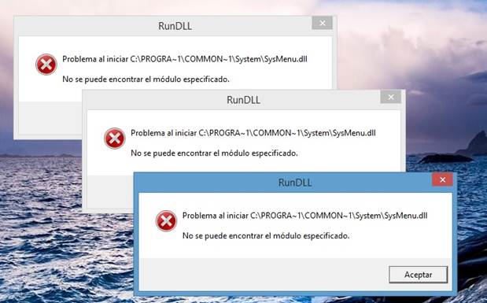
The Case of the Post-Win8.1 RunDLL Errors
After a user upgraded from Windows 8 to Windows 8.1 they saw three RunDLL error dialogs every logon:

Slide 31
Autoruns
Shows every place in the system that can be configured to run something at boot & logon
Standard Run keys and Startup folders
Shell, userinit
Services and drivers
Tasks
Winlogon notifica`tions
Explorer and IE addins (toolbars, Browser Helper Objects, …)
More and ever growing…
Each startup category has its own tab and all items display on the Everything tab
Startup name, image description, company and path

Slide 32
Identifying Autostarts
Zoom-in on add-ons (including malware) by selecting these filter options:
Verify Code Signatures
Hide Microsoft Entries
Select an item to see more in the lower window
Online search unknown images
Double-click on an item to look at where its configured in the Registry or file system
Has other features:
Can also show empty locations (informational only)
Includes compare functionality
Includes equivalent command-line version, Autorunsc.exe

Slide 33
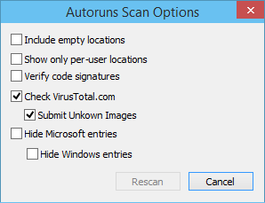
New: VirusTotal Integration
You can have Autoruns check VirusTotal for hashes
Option to submit files for scanning
Will be posted to Sysinternals next week!

Slide 34
The Case of the Post-Win8.1 RunDLL Errors: Solved
Contacted friend who ran Autoruns and identified entries:
Looks like potentially-unwanted software: http://www.herdprotect.com/sysmenu.dll-5488c8c5d8a353184fc345a91a06d0c034e846d8.aspx
Disabled entries: problem solved

Slide 35
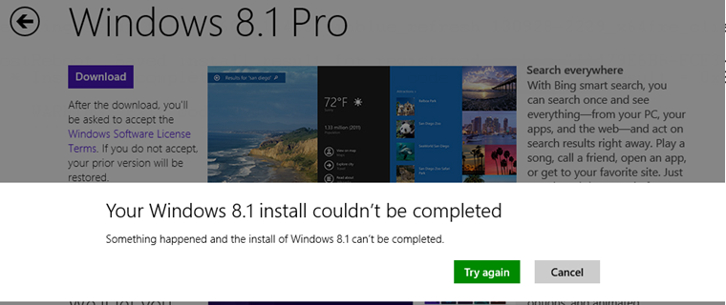
The Case of the Failed Windows 8.1 Upgrade
User tried to upgrade Windows 8 Media Center to Windows 8.1
Installer kept restarting at the 50% mark
Rebooting and retrying didn’t fix the problem

Slide 36
The Case of the Failed Windows 8.1 Upgrade (Cont)
Looked in Windows Update log (C:\Windows\WindowsUpdate.log) and found error code:

Slide 37
The Case of the Failed Windows 8.1 Upgrade: Solved
Captured a Process Monitor trace of the installation
Found access denied on C:\ProgramData\Microsoft\Crypto\RSA\MachineKeys directory:
Gave Administrators full access: problem solved
Posted in http://answers.microsoft.com/en-us/windows/forum/windows8_1_pr-windows_install/the-install-of-the-81-preview-fails-over-and-over/72fd28d4-fa75-4904-b727-bbb30fa434b2

Slide 38
The Case of the Windows Installer Failure
Windows Installer package failed to install on Server 2008 R2
Others installed successfully
Enabled verbose installer logging (KB223300)
Saw error 0x8002801C:
Translated with Err utility to “Error accessing the OLE registry”
Had to look deeper…

Slide 39
The Case of the Windows Installer Failure (Cont)
Captured a Process Monitor log and saw TypeLib registration, which corresponds to OLE error:
Captured a trace from a working system to compare:
Minor differences, so had to look deeper…

Slide 40
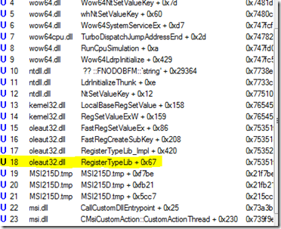
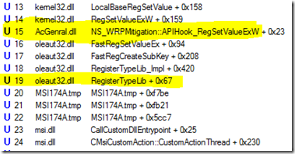
The Case of the Windows Installer Failure (Cont)
Compared stacks of event from both traces:
Working system has appcompat shim (AcGeneral.dll)
Failing
Working

Slide 41
The Case of the Windows Installer Failure: Solved
Looked at failing system log and found where appcompat shimming was disabled:
Re-enabled shimming: problem solved

Slide 42
Outline
Sluggish Performance
Error Messages
Buggy Behavior
Blue Screens

Slide 43
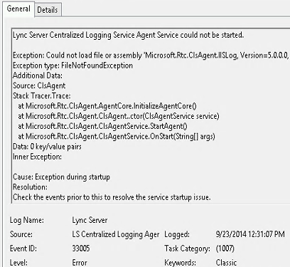
The Case of the Failed Lync Logging
Microsoft support engineer installed August 2014 Cumulative Update for Lync Server 2013 at customer site
Diagnostics reported Lync logging service was unavailable
Engineer repro’d on a test system and found that others reported the same problem in forums
Event log showed logging agent failed to start because of missing assembly

Slide 44
The Case of the Failed Lync Logging (Cont)
Captured Procmon traces on failing and working servers and set a filter for assembly
Failing
Working

Slide 45
The Case of the Failed Lync Logging: Solved
Saw that assembly folder was missing on failed system
Copied folder from working system: problem solved
Lync team root caused issue to conflict with update

Slide 46
Outline
Sluggish Performance
Error Messages
Buggy Behavior
Blue Screens

Slide 47
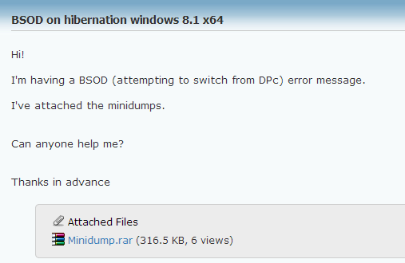
The Case of the Hibernation Bluescreen
User complained on user group about system crashing:
http://www.eightforums.com/bsod-crashes-debugging/42293-bsod-hibernation-windows-8-1-x64.html

Slide 48
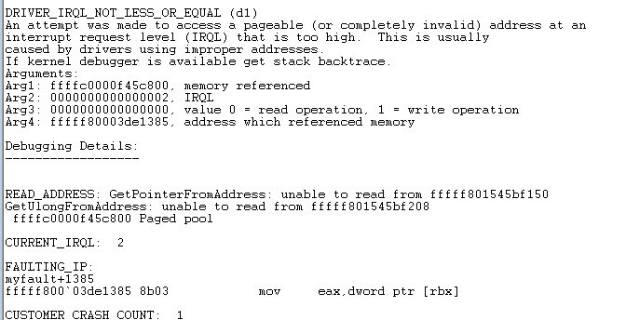
The Case of the Hibernation Bluescreen (Cont)
Another user analyzed one of the crashes, which pointed at Myfault.sys:

Slide 49
The Case of the Hibernation Bluescreen (Cont)
Posted helpful answer:
Case closed...?

Slide 50
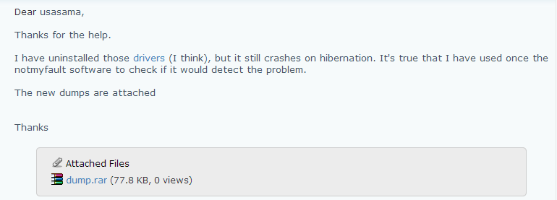
The Case of the Hibernation Bluescreen (Cont)
User answered back:

Slide 51
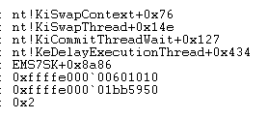
The Case of the Hibernation Bluescreen (Cont)
New analysis pointed at EM7SK.sys:

Slide 52
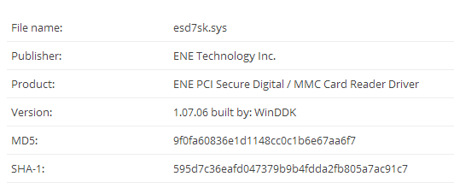
The Case of the Hibernation Bluescreen: Solved
Web search showed it was PCI SD reader:
Windows supports the reader natively
Uninstalled: problem solved
http://www.herdprotect.com/esd7sk.sys-595d7c36eafd047379b9b4fdda2fb805a7ac91c7.aspx

Slide 53
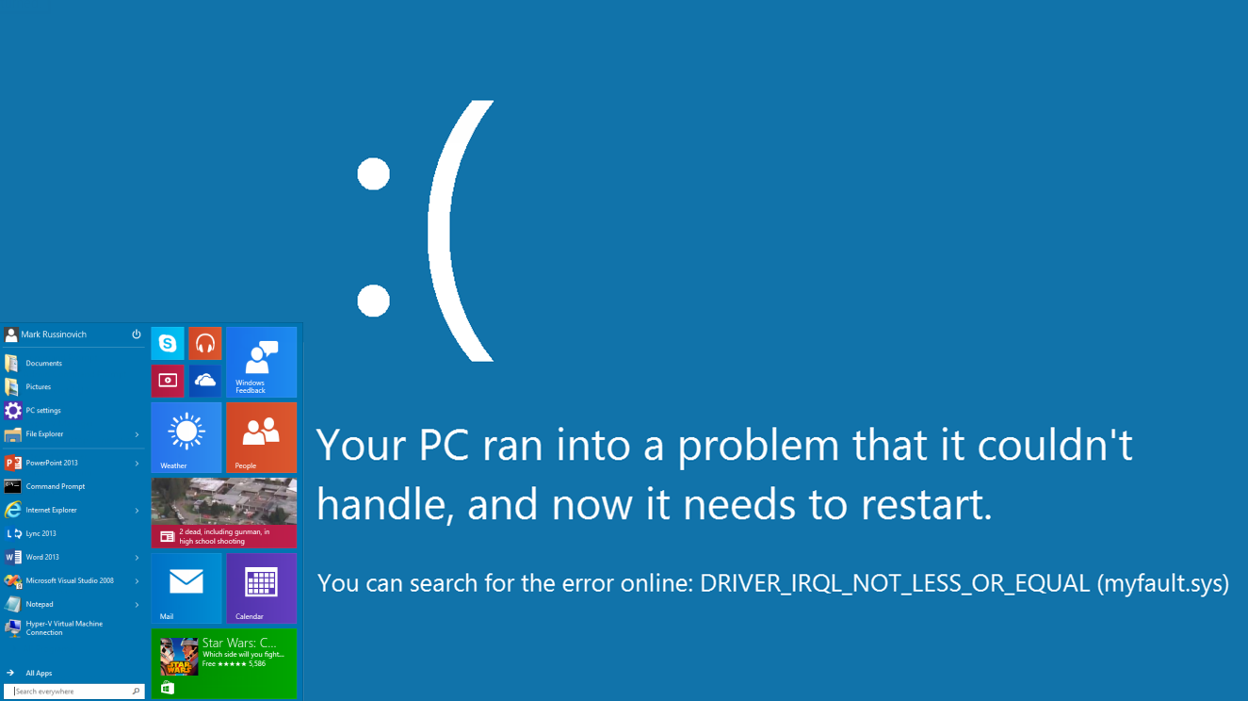

Slide 54
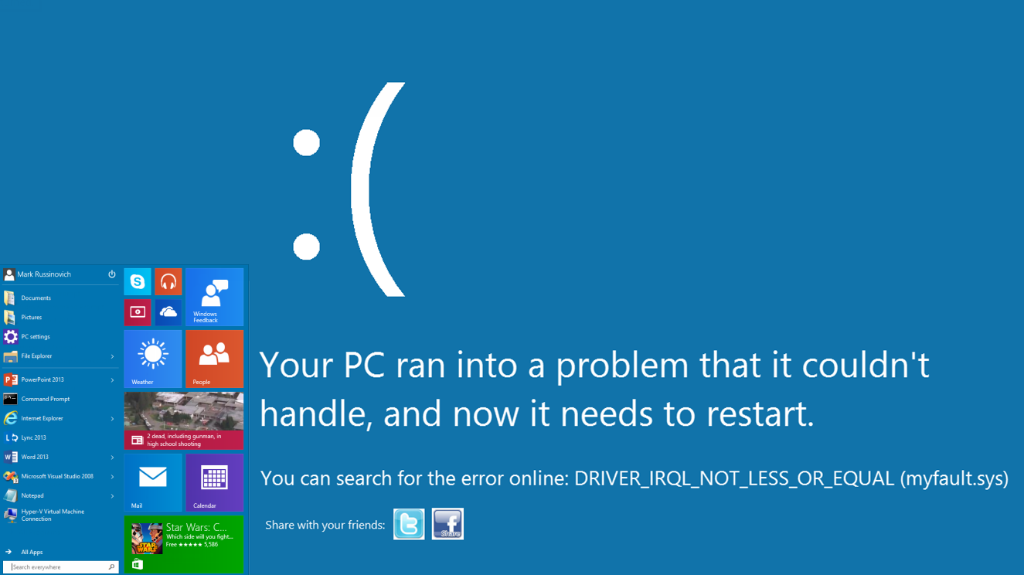

Slide 55
Summary and More Information
A few basic tools and techniques can solve seemingly impossible problems
I learn by always trying to determine the root cause
Resources:
Sysinternals Administrator’s Reference
Webcasts of two previous “Case of the Unexplained “ talked
Sysinternals->Mark’s Webcasts
My blog
Windows Internals: understand the way the OS works
If you’ve solved one, send me a description, screenshots and log files!

Slide 56
When in doubt, run Process Monitor!

