Slide 2
Bridging the Gap: Securely Connecting Windows Azure and Private Clouds
ATC-B303
John Morello
Lead Architect

Slide 3
Agenda
  Hybrid design points
  Azure networking architecture
  Connecting clouds walk through
  Active Directory best practices
  Extending Active Directory walk through
  Securing hybrid clouds

Slide 4
Hybrid design points

Slide 5



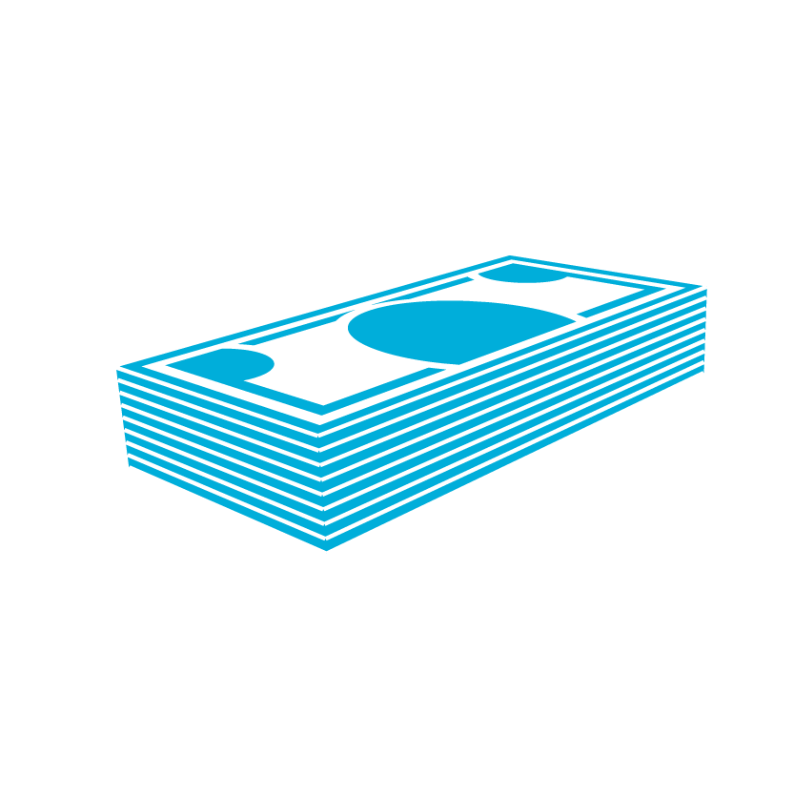

Enterprise challenges driving hybrid IT
Drive greater
IT efficiency
Reduce time
to solution
Scale
dynamically
Balance
performance
with cost
Ensure
compliance

Slide 6
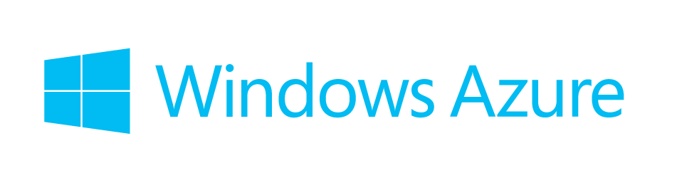


Microsoft’s hybrid cloud platform
Virtualization
Data
Identity
Development
DevOps and mgmt

Slide 7

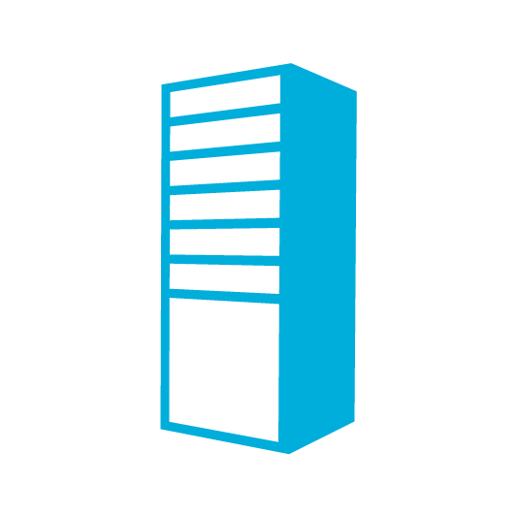

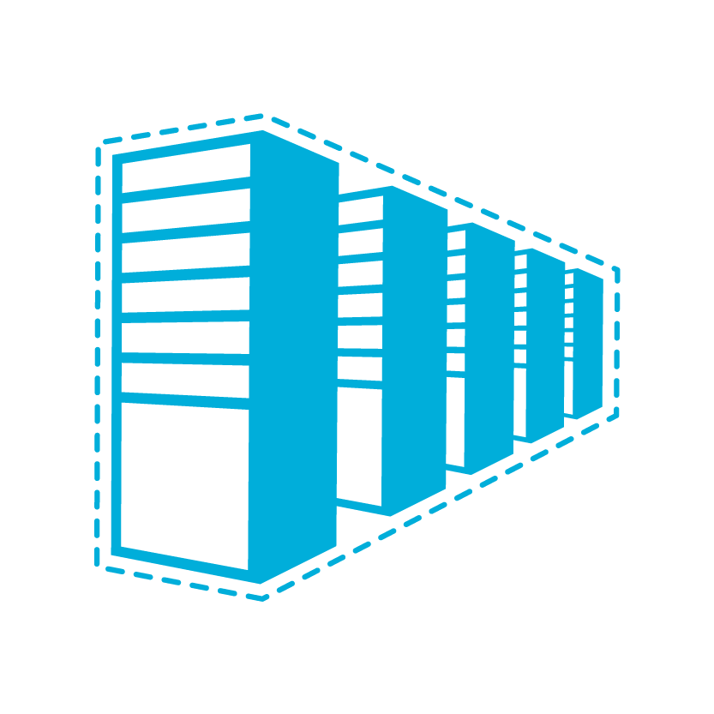

Connecting private and public
Private cloud
Public cloud
App Monitoring & Management
System Center
API
Common Framework
.NET 4.5
API
Data Synchronization
SQL Azure Data Sync
Application-Layer
Connectivity & Messaging
Service Bus
Secure Machine-to-Machine Connectivity
Windows Azure Connect
Secure Site-to-Site
Network Connectivity
Virtual Network

Slide 8
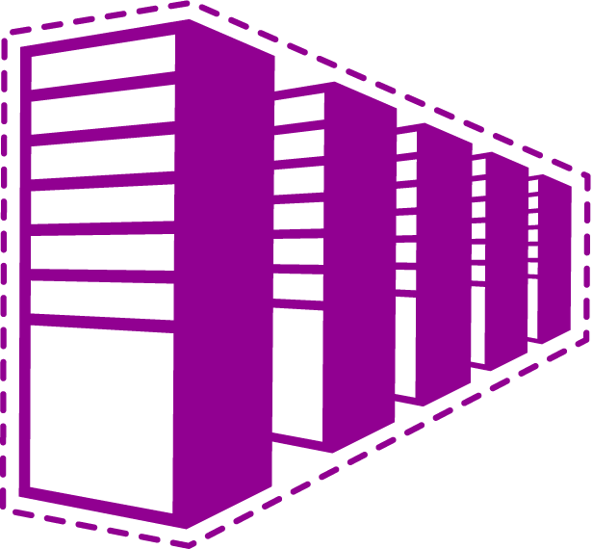
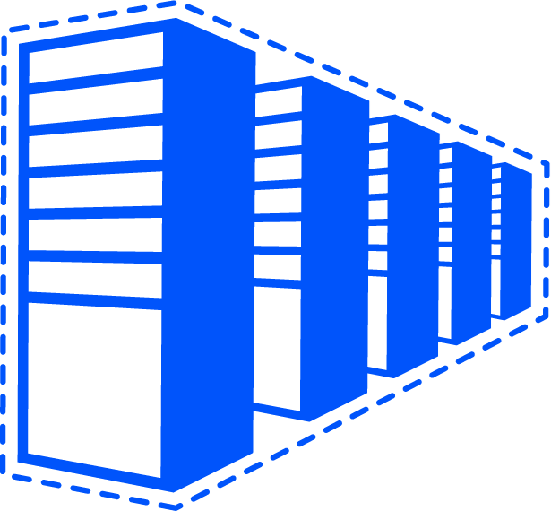
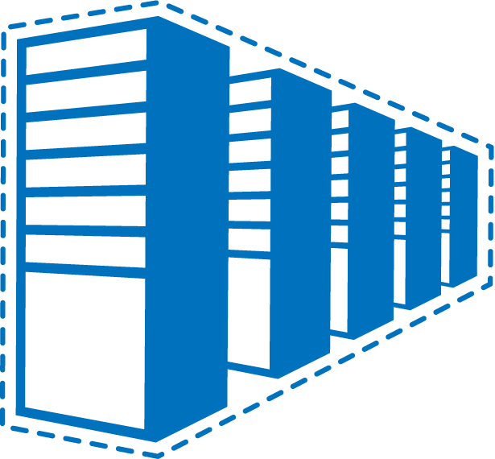
Common IaaS pattern
Contoso Production VNet in Windows Azure (10.1.0.0/16)
Contoso HQ (10.0.0.0/16)
10.1.2.0/24
10.1.3.0/24
SQL farm
IIS servers
131.57.23.120
65.52.249.22
10.1.0.4
10.1.1.4
10.0.0.10
10.0.0.11
S2S VPN tunnels
Contoso Test in Windows Azure (10.2.0.0/16)
AD / DNS
S2S VPN
Device
Exchange
BRK Gateway
10.2.2.0/24
10.2.3.0/24

Slide 9
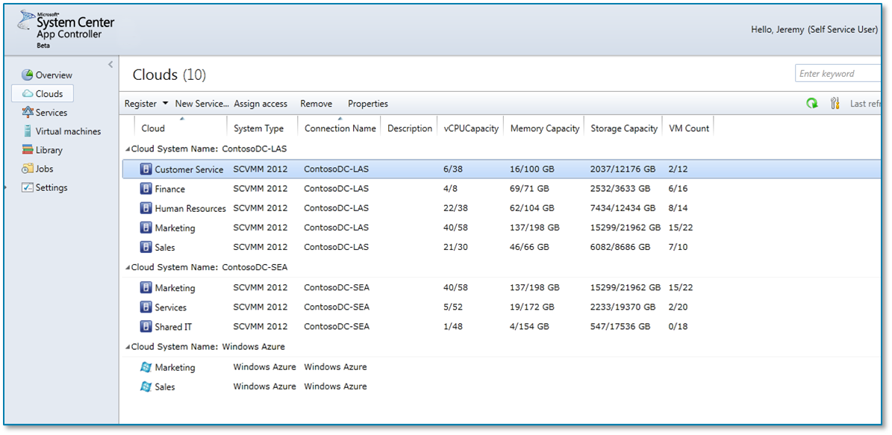


The journey
Hello, Jeremy (Self Service User)
Self-service delegation
Traditional
Virtualized
Private Cloud
Public Cloud
Clouds
Traditional
Virtualized
Private Cloud
Public Cloud
Virtual Machines
Distribution of Models Used Today
Distribution of Models Used Today
We will support your journey
on your terms
Future distribution of computing models
Future distribution of computing models
Cloud Computing is a journey
Single pane of glass visibility to your applications across your private cloud and Windows Azure
Physical, virtual & cloud management
Applications self-service across clouds
Physical, virtual & cloud management
Applications self-service across clouds

Slide 10
Azure networking architecture

Slide 11

Virtual Network
Currently available
A protected private virtual
network in the cloud
Networking on-ramp for migrating existing apps and services to Windows Azure
Virtual private networks in Windows Azure
Connect to on-premises resources securely over industry standard site-to-site VPN
Setup secure private IPv4 networks fully contained within Windows Azure
IP address persistence
Inter-service DIP-to-DIP communication
Your “virtual” datacenter in the cloud
Enables many new scenarios
Extend your networks to
Windows Azure securely over S2S VPN
Run “hybrid” apps that span cloud and
their premises
IP level connectivity between Windows Azure and your premises
Hybrid / private cloud
Enterprise identity and access control
Centralized monitoring and management
SharePoint in Windows Azure
PaaS and IaaS working together

Slide 12
Contoso’s scenario
Contoso Production VNet in Windows Azure (10.1.0.0/16)
Contoso HQ (10.0.0.0/16)
10.1.2.0/24
10.1.3.0/24
SQL farm
IIS servers
131.57.23.120
65.52.249.22
10.1.0.4
10.1.1.4
10.0.0.10
10.0.0.11
S2S VPN tunnels
Contoso Test in Windows Azure (10.2.0.0/16)
AD / DNS
S2S VPN
Device
Exchange
BRK Gateway
10.2.2.0/24
10.2.3.0/24

Slide 13
Configuration steps
Windows Azure Portal (API)
Network Admin
Network configuration
VPN device config script
Deployment
package
IT Admin
ContosoCorpOffice (10.0.0.0/16)
ContosoVNet (10.1.0.0/16) MyAffinityGroup
FrontEndSubnet
(10.1.1.0/24)
ADSubnet
(10.1.2.0/24)
GatewaySubnet
(10.1.0.0/24)
S2S VPN device
131.57.23.45
GW IP
65.57.23.45
SQLSubnet
(10.1.3.0/24)
BESubnet
(10.1.4.0/24)
DNS2
10.0.0.21
DNS1
10.0.0.20

Slide 14
Virtual Network details
Availability
SLA
GA as part of IaaS release (Apr 2013)
Ready to use now
VNet SLA tied to compute availability SLA
99.9% Gateway service up time
No SLA on connectivity
  Many external factors influence connectivity, throughput and latency
Billing
VNet capability supported for free
Gateway charges
  $0.05 per hour for gateway service
  Standard egress bandwidth charges for cross-premises connectivity

Slide 15
Point-to-Site
Connect from anywhere securely
Complements Virtual Networks
From remote dev environments, labs, coffee shops, hotels, the French Quarter, wherever…
Fully integrated with Virtual Networks
Enjoy all the benefits of IaaS without having to deploy any software / configure startup scripts
Co-exists with S2S VPN connectivity
Infrastructure-less VPN connectivity to your Azure workloads
Key scenarios
Software-based, infrastructure-less connectivity
Standard Windows in-box VPN clients
No agents or plugins to install!
No dependency on Azure SDK
Easy to setup & standards compliant
Prototyping
Dev-testing
Demos from customer sites, conference or exhibition venues
Small branch office connectivity

Slide 16
Connecting clouds walk through
Connect Contoso’s on-premises datacenter to Azure using a Cisco ASA

Slide 17
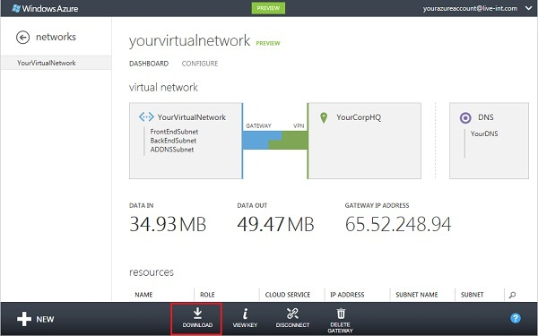
VPN end state

Slide 18
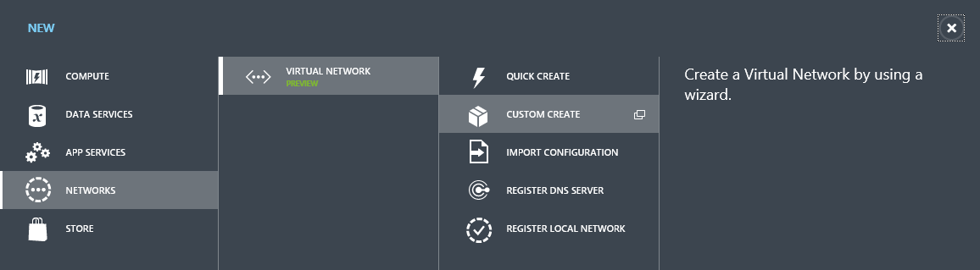
Setup Azure Virtual Network
What you need to know
  Cisco ASA external IP
  Domain Controller IP
  On-premises subnet
  On-premises DNS server

Slide 19
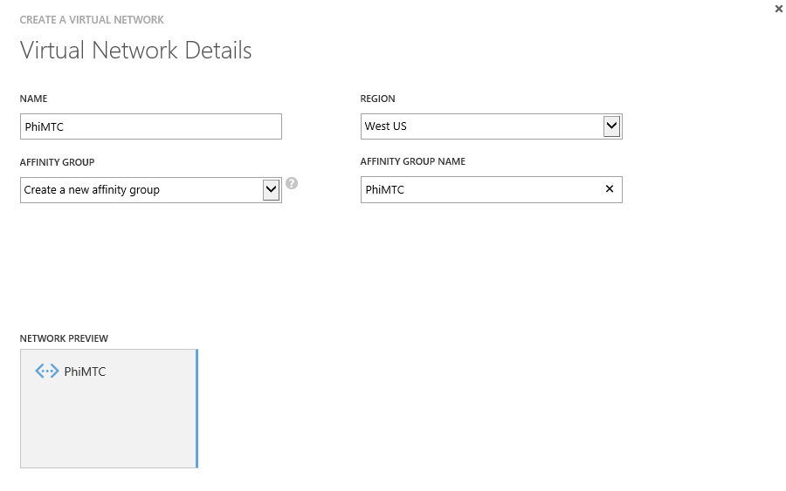
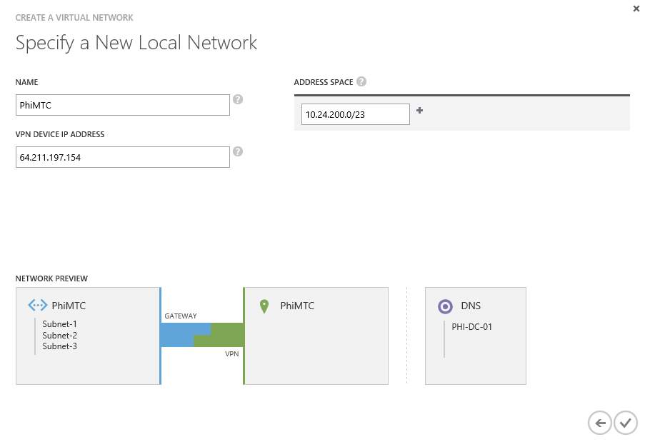
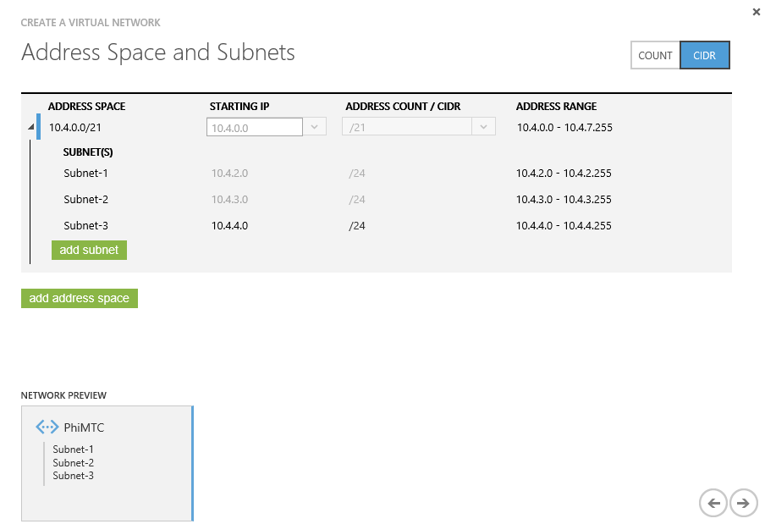
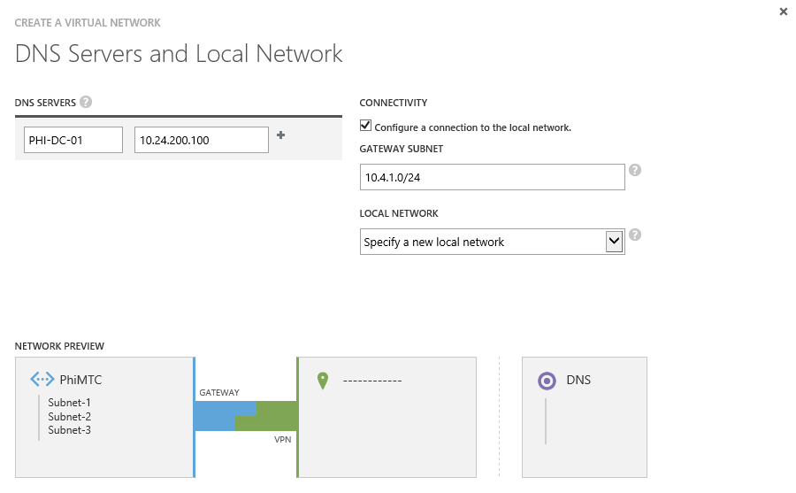

Slide 20
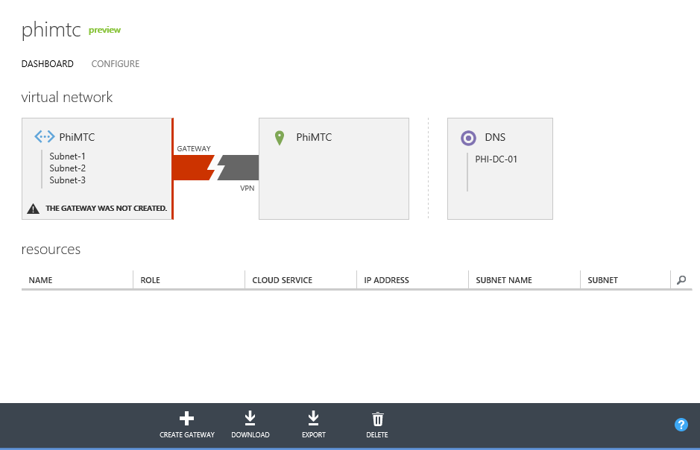
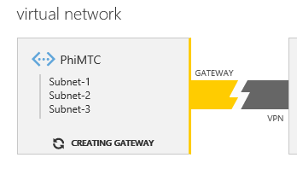

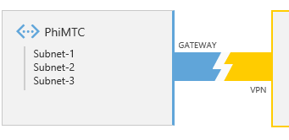
Create Azure Virtual Network Gateway

Slide 21
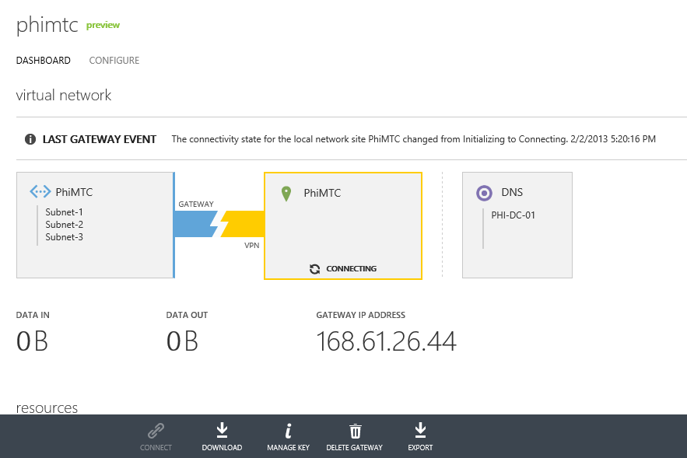
Configure Cisco ASA
What you need:
  Azure gateway IP
  Azure gateway pre-shared key
  Configuration script
  Azure subnet (specified in VNet)

Slide 22
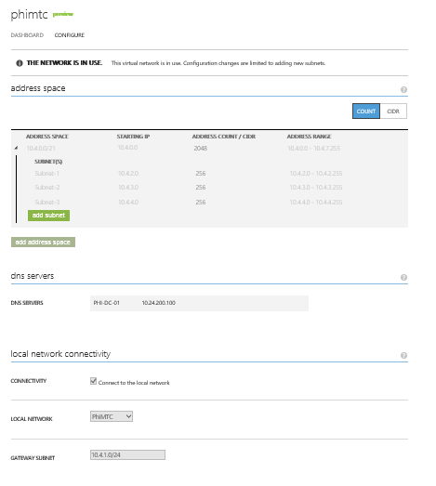
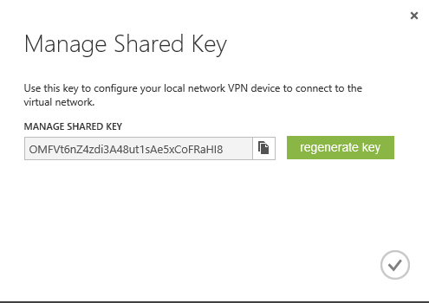
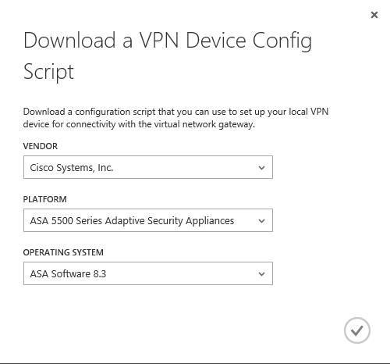
Gather data

Slide 23
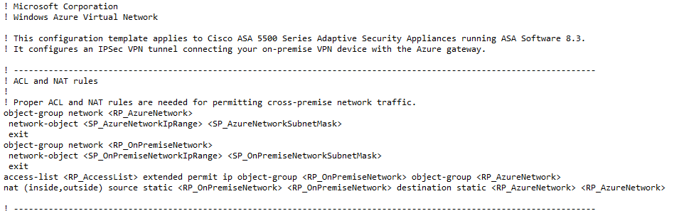
Edit the configuration script

Slide 24
Example Cisco ASA configuration script
! Microsoft Corporation
! Windows Azure Virtual Network
! This configuration template applies to Cisco ASA 5500 Series Adaptive Security Appliances running ASA Software 8.3.
! It configures an IPSec VPN tunnel connecting your on-premise VPN device with the Azure gateway.
! ---------------------------------------------------------------------------------------------------------------------
! ACL and NAT rules
!
! Proper ACL and NAT rules are needed for permitting cross-premise network traffic.
object-group network Azure
network-object 10.4.0.0 255.255.0.0
exit
object-group network ContosoDatacenter
network-object 192.168.1.0 255.255.255.0
exit
access-list AzureAccess extended permit ip object-group ContosoDatacenter
object-group Azure
nat (inside,outside) source static ContosoDatacenter ContosoDatacenter destination static Azure Azure
! ---------------------------------------------------------------------------------------------------------------------
! Internet Key Exchange (IKE) configuration
!
! This section specifies the authentication, encryption, hashing, Diffie-Hellman, and lifetime parameters for the Phase
! 1 negotiation and the main mode security association. We have picked an arbitrary policy # "10" as an example. If
! that happens to conflict with an existing policy, you may choose to use a different policy #.
crypto isakmp enable outside
crypto isakmp policy 10
authentication pre-share
encryption aes
hash sha
group 2
lifetime 28800
exit

Slide 25
Configuration script continued
! ---------------------------------------------------------------------------------------------------------------------
! IPSec configuration
!
! This section specifies encryption, authentication, and lifetime properties for the Phase 2 negotiation and the quick
! mode security association.
crypto ipsec transform-set Azure_Transformset esp-aes esp-sha-hmac
crypto ipsec security-association lifetime seconds 3600
crypto ipsec security-association lifetime kilobytes 102400000
! ---------------------------------------------------------------------------------------------------------------------
! Crypto map configuration
!
! This section defines a crypto map that binds the cross-premise network traffic to the
! IPSec transform set and remote peer. We have picked an arbitrary ID # "10" as an example. If
! that happens to conflict with an existing crypto map, you may choose to use a different ID #.
crypto map Azure_CryptoMap 10 match address AzureAccess
crypto map Azure_CryptoMap 10 set peer 168.62.202.101
crypto map Azure_CryptoMap 10 set transform-set Azure_Transformset
crypto map Azure_CryptoMap interface outside
! ---------------------------------------------------------------------------------------------------------------------
! Tunnel configuration
!
! This section defines an IPSec site-to-site tunnel connecting to the Azure gateway and specifies the pre-shared key
! value used for Phase 1 authentication.
tunnel-group 168.62.202.101 type ipsec-l2l
tunnel-group 168.62.202.101 ipsec-attributes
pre-shared-key f1u811XCKhTXU6TcN8y1rBTyOOzmDg2CMGaPFCpVynBUztxxxx
exit
! ---------------------------------------------------------------------------------------------------------------------
! TCPMSS clamping
!
! Adjust the TCPMSS value properly to avoid fragmentation
sysopt connection tcpmss 1350

Slide 26
End state

Slide 27
Active Directory best practices

Slide 28
Core concepts
Use only Windows Azure Virtual Machines (IaaS)
Do not sysprep DCs
Windows Server 2012 supports Virtual Domain Controller Cloning, Windows Azure currently does not

Slide 29
Placement of the Active Directory DIT
Active Directory DITs/sysvol should be deployed on data disks
  “Data disks” and “OS disks” are two distinct Azure virtual-disk types
  Unlike OS disks, data disks do not cache writes by default; DITs should not be stored on volumes using write-behind caching

Slide 30
Read-Only DCs (RODC)?
Using RODCs on Windows Azure is a no-brainer… or is it?
  this isn’t really what they’re designed for; designed to be caching DCs used at physically insecure branch sites
Is HBI/PII a concern?
  RODCs do offer ROFAS (a filtered attribute set) which permits targeted attributes to be excluded from RO replicas; RODCs introduce known and unknown app-compat issues
Finally, RODCs NEVER replicate anything outbound
  They do need to populate cacheable secrets which requires on-demand traffic to obtain them as a user/computer authenticates; consider that the absence of outbound traffic through the lack of replication yields cost savings

Slide 31
New forest and trust?
  Add replica DCs in Azure or build a new forest and create a trust?
  Compatibility
  Security (e.g. selective authentication & SID filtering)
  Compliance/privacy (HBI/PII concerns)
  Cost
    Replicate more or generate more outbound traffic as a result of authentication and query load?
  Resiliency/fault-tolerance
    if the link goes down, trusted scenarios are likely entirely broken

Slide 32
IP addressing
Azure VMs require that you configure the VM to use “DHCP leased addresses”
    Leases never expire or move between VMs
    This “non-static” configuration is the opposite of what most Active Directory administrators are used to doing
When an Azure VM leases an address, it is routable for the period of the lease
    The period of the lease directly equates to the lifetime of the service
    Traditional on-premises best practices for domain controller addressing do NOT apply
    Do NOT statically define a previously leased address as a workaround

Slide 33
Name resolution
  Deploy Windows Server DNS on the domain controllers
    Azure DNS does not meet the complex name resolution needs of Active Directory (DDNS, SRV records, etc.)
  DNS remains a critical configuration item for domain controllers and domain-joined clients
    Clients/DCs must be capable of registering and resolving resources within their own domains/forests and across trusts
  Since static addressing is not supported, these settings MUST be configured within the virtual network definition

Slide 34
IP addressing and DNS summary
Deploy a Windows Azure Virtual Network
Use DHCP-leased addresses on your virtual DCs
Install and configure Windows Server DNS on the domain controller(s) in Windows Azure
Configure both the DCs’ and the domain-members’ DNS client resolver settings as follows:
        Preferred DNS server: on-premises DNS IP address
        Alternate DNS server: loopback address or another DNS server running on a DC on the same virtual network

Slide 35
Extending Active Directory walk through
Extend Contoso’s Active Directory to Azure

Slide 36
Deploying a replica DC in Azure
Create a cloud service
Configure AD Sites and Services
Build a replica DC VM
Promote it as a replica DC
Validate DC operation

Slide 37
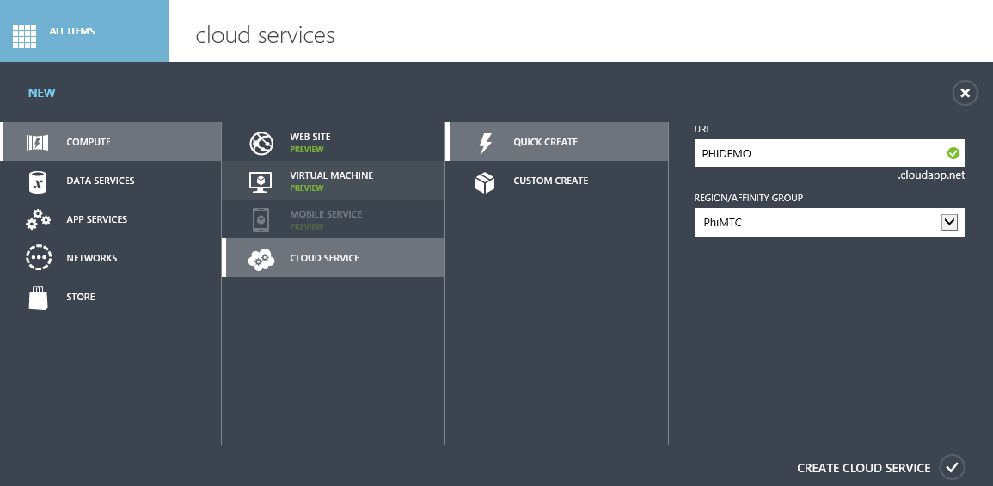
Create Cloud Service

Slide 38
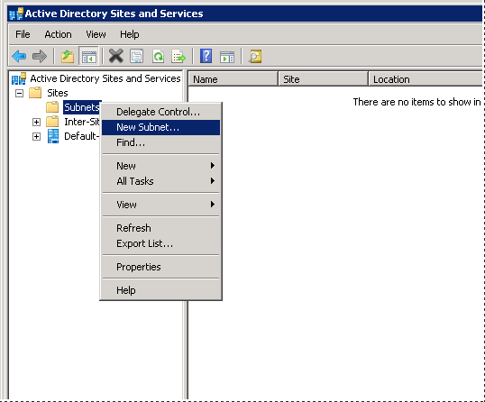
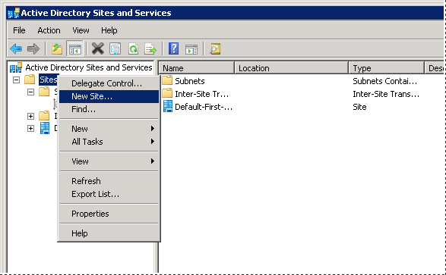
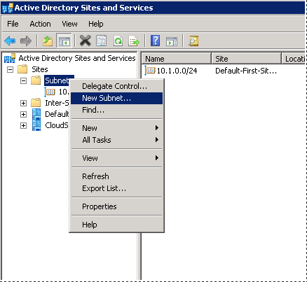
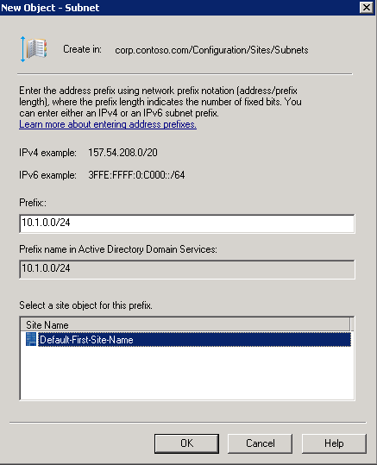
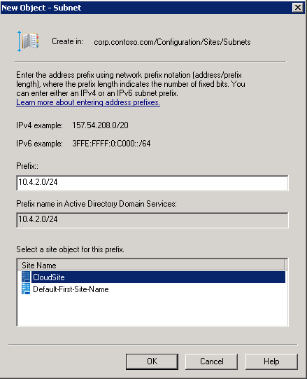
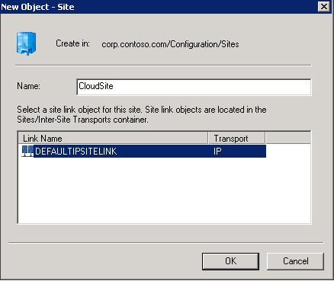
Setup AD Sites and Services

Slide 39
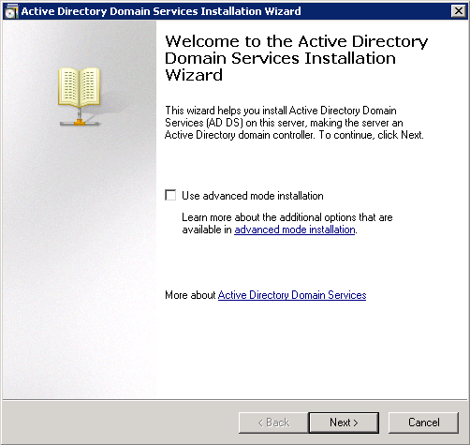
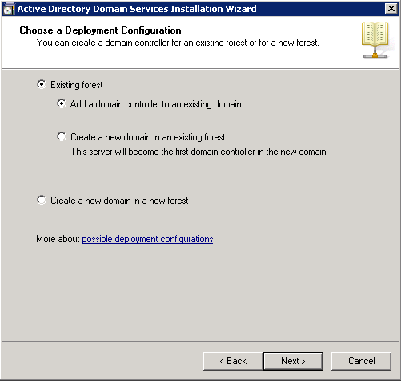
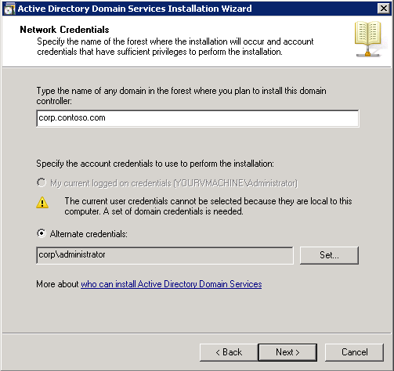
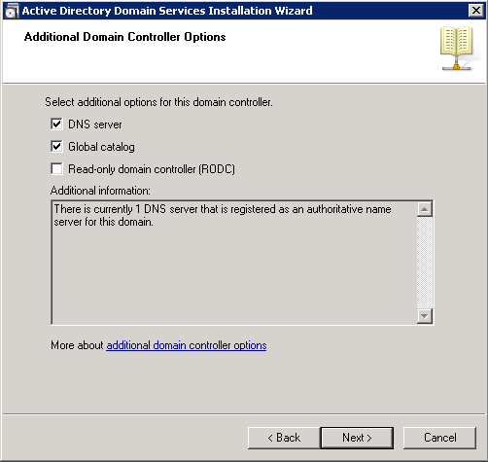
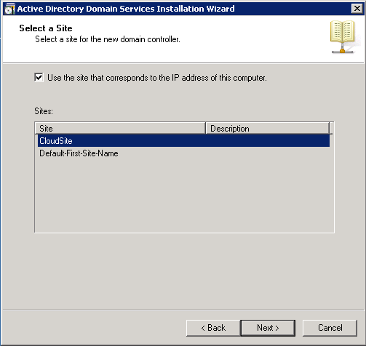
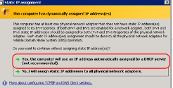
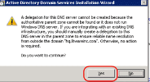
Build replica DC in Azure
Stand up an Azure VM in the newly created VNet
DCPromo the new VM utilizing the newly created Site in AD
Verify it with DCDIAG /c /v

Slide 40
Deploy domain joined VMs in Azure
Do it by hand with manual join
Use PowerShell for automation

Slide 41
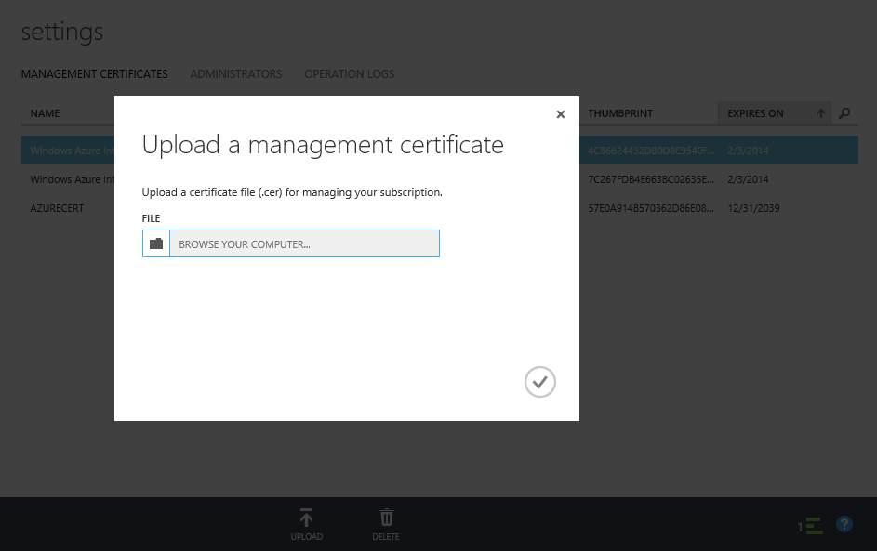
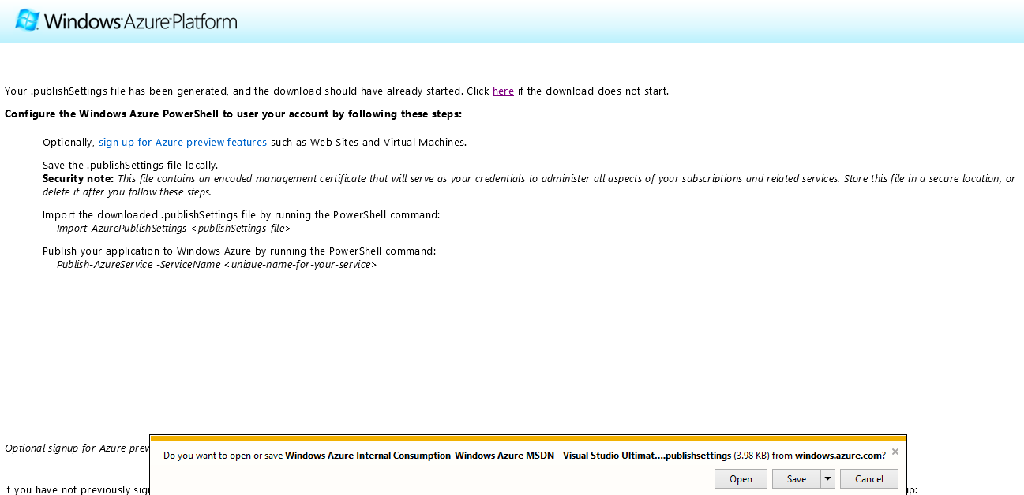
Requirements to leverage PowerShell
Install Azure PowerShell tools
Create a Certificate
Upload the management certificate
Import Settings
makecert -sky exchange -r -n "CN=<CertificateName>" -pe -a sha1 -len 2048 -ss My "<CertificateName>.cer"
Get-AzurePublishSettingsFile
Import-AzurePublishSettings <publishSettings-file>

Slide 42
Get available images to use
Get-AzureVMIMage | ft imagename
ImageName
---------
2cdc6229df6344129ee553dd3499f0d3__BizTalk-Server-2013-Beta
5112500ae3b842c8b9c604889f8753c3__OpenLogic-CentOS63JAN20130122
a699494373c04fc0bc8f2bb1389d6106__Win2K8R2SP1-Datacenter-201212.01-en.us-30GB.vhd
a699494373c04fc0bc8f2bb1389d6106__Win2K8R2SP1-Datacenter-201301.01-en.us-30GB.vhd
a699494373c04fc0bc8f2bb1389d6106__Windows-Server-2012-Datacenter-201301.01-en.us-30GB.vhd
b39f27a8b8c64d52b05eac6a62ebad85__Ubuntu-12_04_1-LTS-amd64-server-20121218-en-us-30GB
b39f27a8b8c64d52b05eac6a62ebad85__Ubuntu-12_10-amd64-server-20121218-1-en-us-30GB
b4590d9e3ed742e4a1d46e5424aa335e__SUSE-Linux-Enterprise-Server-11-SP2-New
fb83b3509582419d99629ce476bcb5c8__Microsoft-SQL-Server-2012-Evaluation-12-20-2012-GDR-11.0.2218.0_SQL11
MSFT__Win2K8R2SP1-Datacenter-201210.01-en.us-30GB.vhd
MSFT__Windows-Server-2012-Datacenter-201210.01-en.us-30GB.vhd

Slide 43
Sample PowerShell
#Deploy a new VM and join it to the domain
#-------------------------------------------
#Specify the DNS address
$myDNS = New-AzureDNS -Name 'ContosoDC2' -IPAddress '10.4.3.1'
# OS Image to Use
$image = 'MSFT__Windows-Server-2012-Datacenter-201210.01-en.us-30GB.vhd'
$service = 'myazuresvcindomainM1'
$AG = 'YourAffinityGroup'
$vnet = 'YourVirtualNetwork'
$pwd = 'p@$$w0rd'
$size = 'Small'
#VM Configuration
$vmname = 'MyTestVM1'
$MyVM1 = New-AzureVMConfig -name $vmname -InstanceSize $size -ImageName $image |
Add-AzureProvisioningConfig -WindowsDomain -Password $pwd -Domain 'corp' -DomainPassword 'p@$$w0rd' -DomainUserName 'Administrator' -JoinDomain 'corp.contoso.com'|
Set-AzureSubnet -SubnetNames 'BackEnd'
New-AzureVM -ServiceName $service -AffinityGroup $AG -VMs $MyVM1 -DnsSettings $myDNS -VNetName $vnet

Slide 44
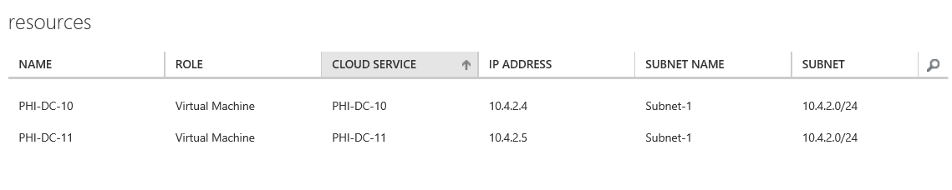
Session end state

Slide 45
Securing a hybrid cloud

Slide 46
Core concepts
Cloud services
Endpoints
Different platform, but same best practices

Slide 47
Cloud Services with VMs
Multiple Virtual Machines can be hosted within the same cloud service
Cloud Service
Virtual Machine
Virtual Machine
VM
VM

Slide 48
Port forwarding input endpoints
Endpoint
Public Port
Local Port
Protocol (TCP/UDP)
Name
Cloud App/Hosted Service
VM1
PORT 5586
PORT 3389
LB/IP
VM2
PORT 5587
PORT 3389
Single Public IP Per Cloud Service

Slide 49
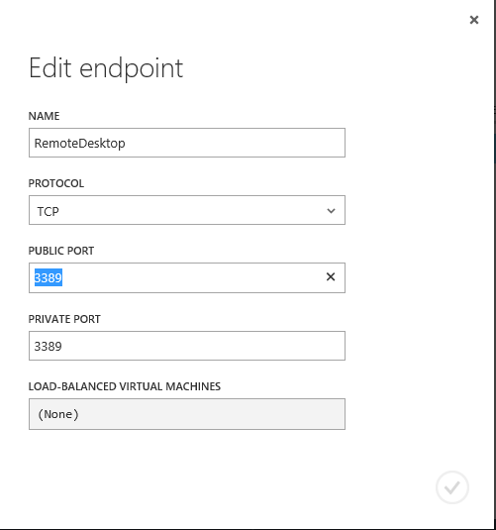
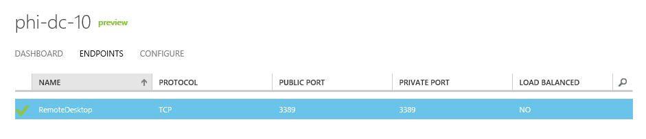
Endpoints

Slide 50
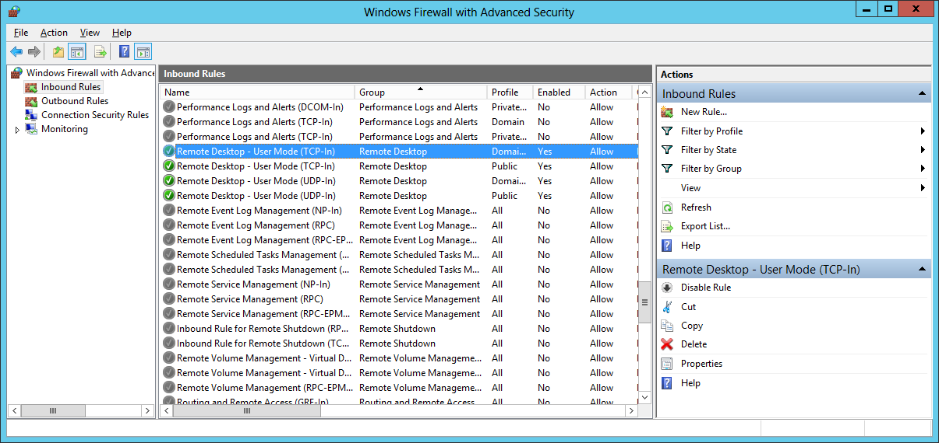
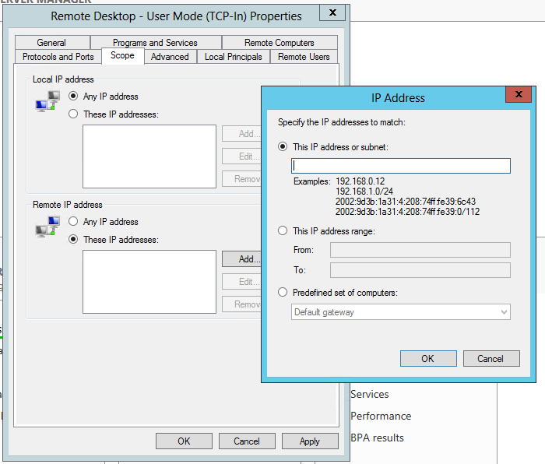
Firewall

Slide 51
Same best practices
No security magic… gravity and The Ten Immutable Laws still apply
For IaaS, still need to manage updates
Strong passwords, least privilege, defense in depth

Slide 52
Summary

Slide 53
If you only remember 3 things…
Virtual Networks can invisibly extend your datacenter into Azure
You can safely run DC VMs in Azure by following a few best practices
Fundamental security best practices still apply to VMs you run in Azure

Slide 54

Related content
MDC-B212: Infrastructure Services on Windows Azure: Virtual Machines and Virtual Networks with Mark Russinovich
MDC-B318: Enabling Multi-Tenant IaaS Clouds in Microsoft System Center and Windows Server
MDC-B360: Hybrid Networking Offerings in Windows Azure
MDC-B361: Best Practices from Real Customers: Deploying to Windows Azure Infrastructure Services (IaaS)

Slide 55
Trustworthy Computing Resources
Trustworthy Computing (TwC) is a long-term, collaborative effort to deliver more secure, private,
and reliable computing experiences for everyone.
Learn more at:
http://microsoft.com/twc
Cloud Security Readiness Tool
Pass the Hash Guidance
Data, Insights and Guidance (Security Intelligence Report, volume 14)
and more…

Slide 56

Resources
Learning
  Sessions on Demand
  Microsoft Certification & Training Resources
http://channel9.msdn.com/Events/TechEd
www.microsoft.com/learning
TechNet
msdn
  Resources for IT Professionals
  Resources for Developers
http://microsoft.com/technet
http://microsoft.com/msdn

Slide 57





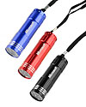

Complete an evaluation on CommNet and enter to win!

Slide 58



Evaluate this session
Required Slide
*delete this box when your slide is finalized
Your MS Tag will be inserted here during the final scrub.
Scan this QR code to evaluate this session and be automatically entered in a drawing to
win a prize

Slide 59

© 2013 Microsoft Corporation. All rights reserved. Microsoft, Windows and other product names are or may be registered trademarks and/or trademarks in the U.S. and/or other countries.
The information herein is for informational purposes only and represents the current view of Microsoft Corporation as of the date of this presentation. Because Microsoft must respond to changing market conditions, it should not be interpreted to be a commitment on the part of Microsoft, and Microsoft cannot guarantee the accuracy of any information provided after the date of this presentation. MICROSOFT MAKES NO WARRANTIES, EXPRESS, IMPLIED OR STATUTORY, AS TO THE INFORMATION IN THIS PRESENTATION.

