Slide 2
Hackers (Not) Halted: About issues that are (not) obvious to manage
ATC-B307
Paula Januszkiewicz
MVP: Enterprise Security, MCT
CQURE: CEO, Penetration Tester | paula@cqure.pl
IDesign: Security Architect | paula@idesign.net

Slide 3
Agenda
Idea of (NOT)
Online
1
2
3
4
Offline
Summary

Slide 4
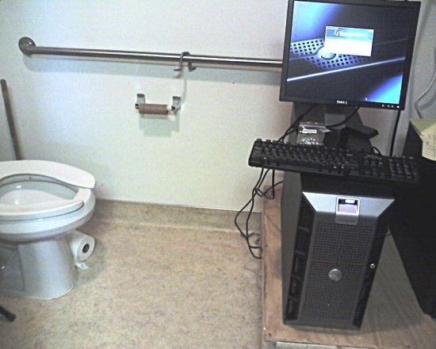

Slide 5
Session goal
Become more familiar hard to manage issues
Know why situations can happen
Know the mitigation plan
Think through the points of entry
They may be based on relationships with people
Major conclusion: Operating system is just a piece of code, number of possible targets is almost over

Slide 6
Agenda
Idea of (NOT)
Online
1
2
3
4
Offline
Summary

Slide 7
Offline access
Can be used to solve problems
… but it should be never treated as the problem solving method
Is a perfect starting point for the attack
Deserves to be in the security planning process
Is very often overlooked
While offline injection, even on the client machine can be dangerous

Slide 8
Demo: Offline Access
Service and remote control

Slide 9
Why this was possible?
Booting from USB / CD / DVD was allowed
User took laptop home
Offline encryption was not implemented
HTTP monitoring was not in place (hard)
Antimalware signatures were not installed (so?!)
The mitigation plan: BitLocker / TrueCrypt etc.

Slide 10
BitLocker
Available since Windows Vista
Managed using GPO + MBAM
Keys are assigned to machine not to user
Fully invisible for the user
Protects from offline access
But does not prevents all other online hacks

Slide 11
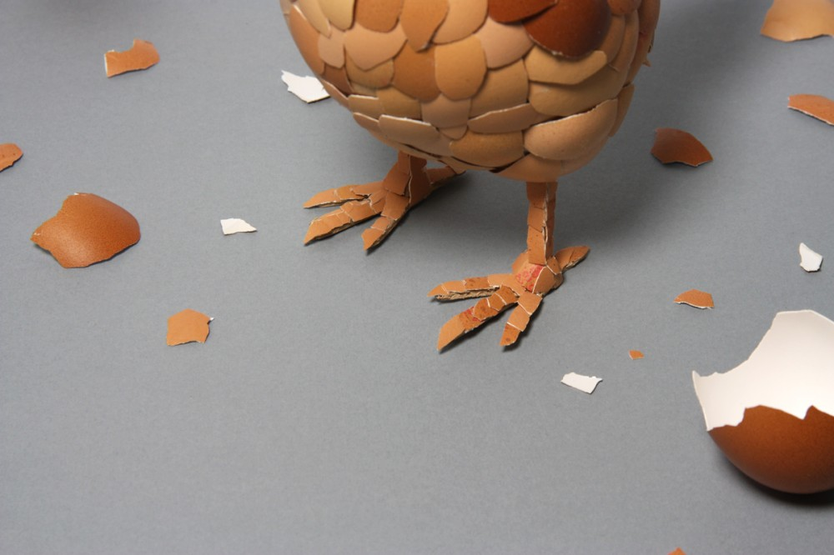
Demo: Rubber Quack Quack

Slide 12
Why this was possible?
User was a Domain User and Local Admin
USB management was weak
Attacker had physical access to the machine
Laptop owner trusted 3rd party pen drive
The mitigation plan: Security Awareness + USB Management

Slide 13
Agenda
Idea of (NOT)
Online
1
2
3
4
Offline
Summary

Slide 14
Denial of Service: Kind of oldschool
Can happen because they are easy and effective
Unfortunately their popularity is rising, we need to take steps to prepare
Target availability not confidentiality
But sometimes availability costs more
They are hard to avoid
But there are several mitigation plans available

Slide 15
Demo: DoS Concepts
… and DoS mitigation

Slide 16
Why this was possible?
nec Hercules contra plures
Website performance was not properly managed
There was defence implemented
For example: reverse proxy, load balancer
The mitigation plan: Know the expensive queries for your app

Slide 17
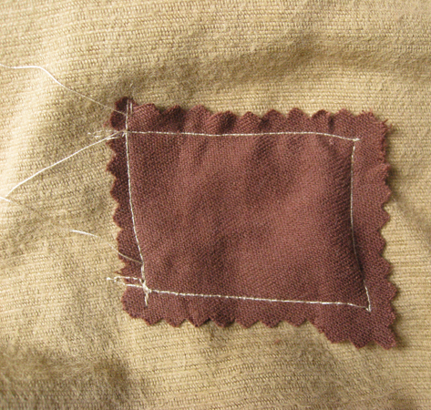
Unpatched System and Applications
Terminal Servers, Domain Controllers
The most important servers unconsistently patched
Exploits are immediately available
Metasploit etc.
Reverse engineering of patches
Best known points of attack
Java, Adobe

Slide 18
Demo: Holly Grail
Holy Local System

Slide 19
Why this was possible?
Server was not patched
User is used to bed security practices
Security hole was just a point of entry, rootkit works like shown by design
DKOM driver requires high privileges to install
The mitigation plan: Manage the update process for all boxes

Slide 20
Unproperly Managed Access Control
Repositories are never over
FTP Servers, File Shares for the common good
The problem exists in people
Existing solutions are not efficient, comfortable
Digital signatures are ignored, we are used to that!
Portable Apps
Enterprise approved apps are not enugh
Warning: Portable Apps sometimes require high privileges

Slide 21
Demo: Infecting Repositories
To do if you are in the bad mood

Slide 22
Agenda
Idea of (NOT)
Online
1
2
3
4
Offline
Summary

Slide 23
Summary: Hackers (Not) Halted
Because people tend to take shortcuts
Because we prefer habits over good practices
Because hard problems are easy to ignore
Because acting is easier than planning

Slide 24
Trustworthy Computing Resources
Trustworthy Computing (TwC) is a long-term, collaborative effort to deliver more secure, private, and reliable computing experiences for everyone.
Learn more at:
http://microsoft.com/twc
Cloud Security Readiness Tool
Pass the Hash Guidance
Data, Insights and Guidance (Security Intelligence Report, volume 14)
and more…

Slide 25
Resources
Learning
Sessions on Demand
Microsoft Certification & Training Resources
http://channel9.msdn.com/Events/TechEd
www.microsoft.com/learning
TechNet
msdn
Resources for IT Professionals
Resources for Developers
http://microsoft.com/technet
http://microsoft.com/msdn

Slide 26
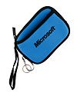
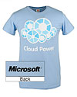
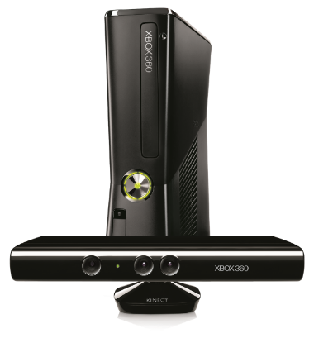
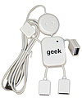
Complete an evaluation on CommNet and enter to win!

Slide 27
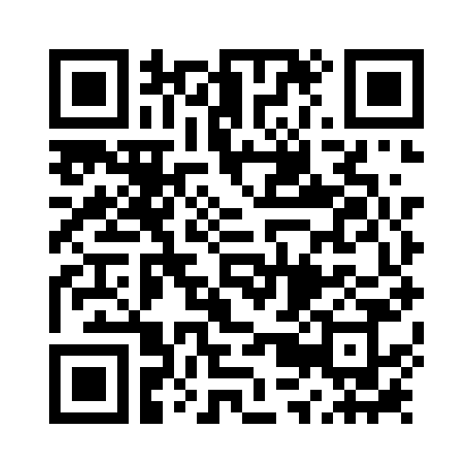
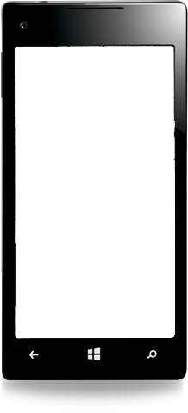
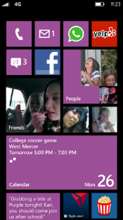
Evaluate this session
Required Slide
*delete this box when your slide is finalized
Your MS Tag will be inserted here during the final scrub.
Scan this QR code to evaluate this session and be automatically entered in a drawing to win a prize

Slide 28
© 2013 Microsoft Corporation. All rights reserved. Microsoft, Windows and other product names are or may be registered trademarks and/or trademarks in the U.S. and/or other countries.
The information herein is for informational purposes only and represents the current view of Microsoft Corporation as of the date of this presentation. Because Microsoft must respond to changing market conditions, it should not be interpreted to be a commitment on the part of Microsoft, and Microsoft cannot guarantee the accuracy of any information provided after the date of this presentation. MICROSOFT MAKES NO WARRANTIES, EXPRESS, IMPLIED OR STATUTORY, AS TO THE INFORMATION IN THIS PRESENTATION.

