Slide 2
Manage SQL Server System and Performance Data with PowerShell
DBI-B203
Allen White
UpSearch
allen.white@upsearch.com
@SQLRunr

Slide 3
About Me
Practice Manager at UpSearch
Over 35 years in IT
Career covered multiple disciplines – operations, development, telecommunications, network design/administration and database design and administration
Started using Sybase in 1992, MS SQL Server in 1995
Microsoft Certified IT Professional: Database Administrator and Database Developer, Microsoft Certified Trainer (MCT)
Awarded Microsoft MVP Award for SQL Server for last 6 years

Slide 4
PowerShell – the Administrator’s Tool
Windows Management Framework
WinRM – SOAP-based Protocol for Managing Servers
BITS – Background File Transfer Service
PowerShell
WMF 3.0 released with Windows Server 2012
Part of Microsoft’s Common Engineering Criteria (CEC)
Why Use PowerShell to Manage SQL Server
Lightweight Access to Server Management
Repeatable Management through Scripting
Access both Windows and SQL Server Properties
“PowerShell is a Core IT Skill – Learn it or be Left Behind”
Jeff Snover - Lead Architect for Windows Server & System Center Datacenter

Slide 5
Environment & Security
Command Line
Tab completion auto completes commands, etc.
Get-History returns previously run commands
Up/Down arrows scrolls through previously run commands
Integrated Scripting Environment – ISE (PS 2.0+)
Scripts allow you to batch commands together
You must include the path to the script to run it
By requiring the path, prevents scripts from “hijacking” operating system commands
By default you cannot run scripts
Set-ExecutionPolicy set by default to Restricted
Change to RemoteSigned to run local scripts
NOT the case for sqlps.exe, though

Slide 6
PowerShell Language
PowerShell is an Object-Based Language
Not Object-Oriented
Cmdlets are Command-Line Utilities built into PowerShell
They use a Verb-Noun Naming Convention
Get-Process
Stop-Service
Three most important cmdlets
Get-Help
Get-Command
Get-Member

Slide 7
PowerShell Language
Assignment Operators
=, +=, -=
Comparison Operators
-eq, -ne, -lt, -le, -gt, -ge, -and, -or, -not, -like
Variables
Begin with a $ character
Are .NET objects
Use Get-Member to see variable type, methods, properties
Demo

Slide 8
Why Maintain a Server Inventory
Need an overview of your Domain
Allows you to identify outliers
You can see resource usage
How much are you using now?
What's the growth rate?
Reports help you justify new resources

Slide 9
What Data Do You Collect?
Computer Name, Domain, Make, Model
Operating System Versions and Patch Levels
Total Physical Memory
Local Disk (SAN storage is local)
SQL Server Instance Information
Version, Edition, Service Pack
Default Data, Log, Backup Location
Configuration Options
Databases with files and sizes
Logins and Users

Slide 10
A Little Bit about WMI
WMI - Windows Management Instrumentation
Provides Access to All Windows System Information
Information Grouped into Classes
Win32_ComputerSystem
provides computer name and model, number of processors, etc.
Win32_OperatingSystem
provides OS type, service pack installed, etc.
Win32_PhysicalMemory
provides physical memory device, and capacity, etc.
Win32_LogicalDisk
provides local storage size, free space, etc.

Slide 11
Getting WMI Data
PowerShell V2 and V1 – Get-WMIObject
PowerShell V3+ – Get-CimInstance
Get-WMIObject is Deprecated
Uses remote procedure calls (RPCs)
Can cause problems with access, firewall issues
Get-CimInstance uses WinRM
Demo

Slide 12
Access SQL Server via SMO
SMO – Server Management Objects
Redesigned from predecessor – DMO
Distributed Management Objects – SQL 2000 and earlier
Provides a SQL Server Management API
You can manage SQL Server via VB.Net, C# and PowerShell
Provides access to properties not available in T-SQL
Loaded via DLLs installed with Client tools
C:\Program Files\Microsoft SQL Server\110\SDK\Assemblies
Microsoft.SqlServer.Smo.dll
Microsoft.SqlServer.SmoExtended.dll
Microsoft.SqlServer.SqlWmiManagement.dll

Slide 13
Connect to the Server
Connect to SQL Server by instantiating a Server object
$svr = New-Object ('Microsoft.SqlServer.Management.Smo.Server') 'SQLTBWS\INST01'
Access the SQL Server WMI objects by instantiating a ManagedComputer object at the Windows server level
$mgt = New-Object ('Microsoft.SqlServer.Management.Smo.WMI.ManagedComputer') 'SQLTBWS'

Slide 14
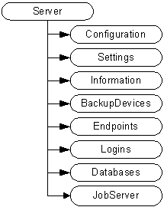
The SMO Object Model

Slide 15
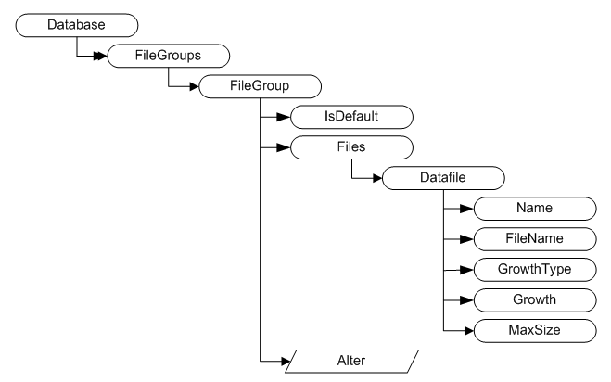
The Database Object

Slide 16
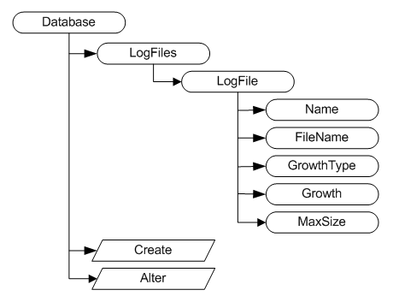
The Database Object

Slide 17
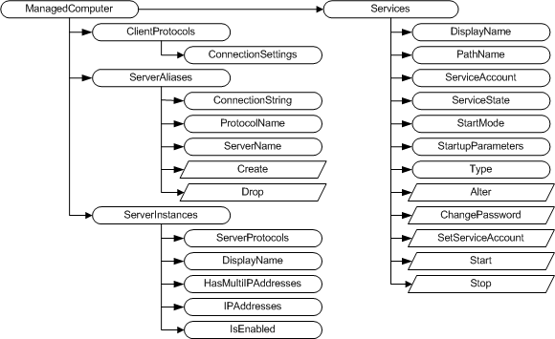
ManagedComputer Object

Slide 18
Demo

Slide 19
Capture Performance Baseline
Baseline shows normal performance
Deviations from Baseline require investigation
Frequency of Data Capture is important
Too often impacts performance
Too seldom can miss important events
Balance comes with experience

Slide 20
Key Performance Indicators
Which counters show us system health
There’s no “right” answer
These are my choices

Slide 21
Operating System Counters
Object | Counter | Look For
Processor | % Processor Time | <= 80%
Memory | Available MBytes | Low Memory, Server Paging
Paging File(_Total) | % Usage | Should be < 70%
PhysicalDisk(*) | Avg. Disk Sec/Read | Latency. Avg time to read data (<.02)
PhysicalDisk(*) | Avg. Disk Sec/Write | Latency. Avg time to write data (<.02)
System | Processor Queue Length | > 10 threads/proc and CPU > 80%

Slide 22
SQL Server Counters
Object | Counter | Look For
Access Methods | Forwarded Records/sec | < 10 per 100 batch requests/sec
Access Methods | Page Splits/sec | <20 per 100 batch requests/sec
Buffer Manager | Buffer cache hit ratio | below 90% is bad
Buffer Manager | Page life expectancy | >= (DataCacheSize/4*300)
General Statistics | Processes blocked | Baseline, check for changes
SQL Statistics | Batch Requests/sec | > 1000 is busy system
SQL Statistics | SQL Compilations/sec | <10% of batch requests/sec
SQL Statistics | SQL Re-Compilations/sec | <10% of compilations/sec

Slide 23
Scripting the Data Capture
Capture the counter data
# Initialize Perfcounters
$ppt = new-object System.Diagnostics.PerformanceCounter
$ppt.CategoryName = 'Processor'
$ppt.CounterName = '% Processor Time'
$ppt.InstanceName = '_Total'
$pptv = $ppt.nextvalue()
Insert into Performance Database
Wait defined interval and do it again

Slide 24
Pull Counters from Perfmon Log
$logcntr = import-counter 'C:\Perfmon\SQLTBWS_SQLPerf.blg'
foreach ($cntr in $logcntr) {
$dtm = $cntr.Timestamp
$clist = $cntr.CounterSamples
foreach ($sample in $clist) {
switch -wildcard ($sample.Path) {
'*% Processor Time*' { $ppt = $sample.CookedValue }
'*Available MBytes*' { $mab = $sample.CookedValue }
...
'*Buffer cache hit ratio*' { $bch = $sample.CookedValue }
'*Page life expectancy*' { $ple = $sample.CookedValue }
'*SQL Compilations/sec*' { $cmp = $sample.CookedValue }
'*SQL Re-Compilations/sec*' { $rcm = $sample.CookedValue }
}
}

Slide 25
Demo

Slide 26
References
Learn Windows PowerShell 3 in a Month of Lunches, Second Edition, Don Jones and Jeff Hicks
http://www.manning.com/jones3/
Understanding and Using PowerShell Support in SQL Server 2008
http://msdn.microsoft.com/en-us/library/dd938892.aspx
Let PowerShell do an Inventory of your Servers
http://www.simple-talk.com/sql/database-administration/let-powershell-do-an-inventory-of-your-servers/
SQL Server & Windows Documentation Using Windows PowerShell
http://sqlpowerdoc.codeplex.com/

Slide 27
Track Resources
Download Data Explorer
SQL Server Website
Hands-On Labs
@sqlserver
Download Geoflow
Get Certified!
mva
Windows Azure
Microsoft Virtual Academy

Slide 28
Resources
Learning
Sessions on Demand
Microsoft Certification & Training Resources
http://channel9.msdn.com/Events/TechEd
www.microsoft.com/learning
TechNet
msdn
Resources for IT Professionals
Resources for Developers
http://microsoft.com/technet
http://microsoft.com/msdn

Slide 29
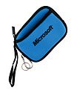
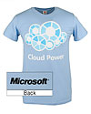
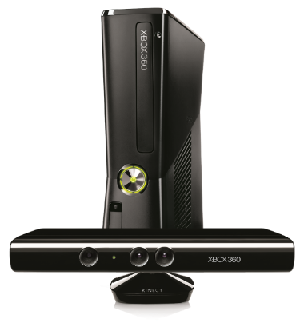
Complete an evaluation on CommNet and enter to win!

Slide 30
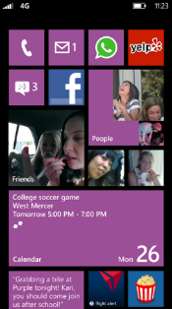
Evaluate this session
Required Slide
*delete this box when your slide is finalized
Your MS Tag will be inserted here during the final scrub.
Scan this QR code to evaluate this session and be automatically entered in a drawing to win a prize

Slide 31
© 2013 Microsoft Corporation. All rights reserved. Microsoft, Windows and other product names are or may be registered trademarks and/or trademarks in the U.S. and/or other countries.
The information herein is for informational purposes only and represents the current view of Microsoft Corporation as of the date of this presentation. Because Microsoft must respond to changing market conditions, it should not be interpreted to be a commitment on the part of Microsoft, and Microsoft cannot guarantee the accuracy of any information provided after the date of this presentation. MICROSOFT MAKES NO WARRANTIES, EXPRESS, IMPLIED OR STATUTORY, AS TO THE INFORMATION IN THIS PRESENTATION.

