Slide 2
Microsoft SQL Server In-Memory OLTP Project "Hekaton": Management Deep Dive
DBI-B308
Sunil Agarwal
Program Manager
sunila@microsoft.com

Slide 3
Agenda
In-memory Data Structures
Managing Memory and Garbage Collection
Hekaton Persistence and Storage Management
Logging and Recovery

Slide 4
Hekaton In-Memory Data Structures
Rows
New row format
Hekaton: Structure of the row is optimized for in-memory residency and access.
One copy of row
Indexes point to rows, they do not duplicate them.
Indexes
Hash Index for equality search
memory-optimized B-tree for range and equality search (In CTP2)
Do not exist on disk – recreated during recovery.

Slide 5
MemOpt Table: Row Format
Row header
Payload (table columns)
8 bytes * (IdxLinkCount – 1)
Begin Ts
End Ts
StmtId
IdxLinkCount
8 bytes
8 bytes
4 bytes
2 bytes
Key Points
Begin/End timestamp determines row’s validity
There is no data or index page. Just rows
Row size limited to 8060 bytes to allow data to be moved to SQL table
Not every SQL table schema is supported

Slide 6
Key lookup: Btree vs Mem-Opt Table
Non clustered index
Hash index on Name
R1
R2
R3
Matching index record

Slide 7
Hekaton: Memory Management
Hekaton data resides in memory at all times.
No paging.
Must configure SQL box with sufficient memory to store memory-optimized tables. Max supported 512GB
Failure to allocate memory will fail transactional workload at run-time
Integrated with SQL Server memory manager and reacts to memory pressure where possible.
Integration with Resource Governor (Post CTP1)
“Bind” a database to a resource pool.
Ensures memory consumption from recovery is accounted for.
Hard limit (80% of phys. memory) to ensure system remains stable under low-memory situations.

Slide 8
“Hekaton” Memory
Table Data
Rule of thumb: 2 x data_size
Index Data
Bucket_count x pointer_size
Considerations
Configuration
Use resource governor
Monitoring
Use DMVs, SMO, SSMS
Management

Slide 9
Memory Considerations
Scenario
Symptom
Diagnosis
Solution
Inserting more rows than rows that can fit in memory
Transactions start failing
Read error log
Identify via DMVs, SSMS whether “Hekaton” is using most memory
Free up memory
Add memory
Identify and stop long running transactions
Recovering database that does not fit in memory
Database does not come online
Memory pressure from “Hekaton” workload on other workloads
Operations in other workloads start failing

Slide 10
Hekaton: Garbage Collection
Row Versions
Updates, deletes, and aborted insert operations create row versions that (eventually) are no longer visible to any transaction.
Slow down scans of index structures
Create unused memory that needs to be reclaimed (i.e. Garbage Collected)
Garbage Collection (GC)
Analogous to version store cleanup task for disk-based tables to support Read Committed Snapshot (RCSI)
System maintains ‘oldest active transaction’ hint
Design Goals:
Non-blocking, Cooperative, Efficient, Responsive, Scalable
Active transactions work cooperatively and pick up parts of GC work
A dedicated system thread to do GC

Slide 11
Cooperative Garbage Collection
Hash Index
TX4: Begin = 210
Oldest Active Hint = 175
Key Points
Scanners can remove expired rows when found.
Offloads work from GC thread
Ensures that frequently visited areas of the index are clean of expired rows.
100
200
1
John
Smith
Kirkland
200
∞
1
John
Smith
Redmond
50
100
1
Jim
Spring
Kirkland
300
∞
1
Ken
Stone
Boston

Slide 12
Demo: Memory Management
Sunil Agarwal

Slide 13
Hekaton: Durability
Hekaton table can be durable or non-durable
Default is ‘durable’. Non-durable tables ideal candidate for transient data
Stored in a single memory-optimized File Group
Storage used for Memory-optimized have very different access pattern.
Filegroup can have multiple containers (volumes)
Additional containers aid in parallel recovery. Recovery at the speed of IO
Example: Database with Memory-Optimized tables
CREATE DATABASE Hekaton_DB ON
PRIMARY (NAME = [Hekaton_DB_PRIMARY], FILENAME = 'C:\Hekaton_test\sqlservr\data\Hekaton_DB_data.mdf'),
FILEGROUP [Hekaton_DB_hk_fs_fg] CONTAINS MEMORY_OPTIMIZED_DATA
(NAME = [Hekaton_DB_hk_fs_dir], FILENAME = 'C:\Hekaton_test\sqlservr\data\Hekaton_DB_hk_fs_dir')
LOG ON (name = [Hekaton_DB_log], Filename='C:\Hekaton_test\sqlservr\data\Hekaton_DB.ldf', size=100MB)

Slide 14
Hekaton Storage
Filestream is the underlying storage mechanism
Checksums and single-bit correcting ECC on files
Data files
~128MB in size with 256KB page size
Stores only the inserted rows (i.e. table content)
Chronologically organized streams of new row versions
Delta files
File size is not constant, write 4KB pages over time.
Stores IDs of deleted rows.

Slide 15
Hekaton Storage: Data and Delta Files
0
100
Transaction Timestamp Range
Data File
TS (ins)
TableId
RowId
Row pay load
TS (ins)
TableId
RowId
Row pay load
TS (ins)
TableId
RowId
Row pay load
Data file contains rows inserted
within a given transaction range
Checkpoint File Pair
Delta File
TS (ins)
TS (del)
RowId
TS (ins)
TS (del)
RowId
TS (ins)
TS (del)
RowId
Delta file contains deleted rows
within a given transaction range

Slide 16
Hekaton Storage: Populating Data/Delta files
Del Tran1 (TS150)
Del Tran2 (TS 450)
SQL Transaction log
Del Tran2 (TS 450)
Del Tran3 (TS 250)
Insert into Hekaton T1
Del Tran1(TS150)
Log in SQL Table
Del Tran3 (TS 250)
Insert into Hekaton T1
Offline Checkpoint Thread
Data file has a pre-allocated size (128 MB).
Hekaton Engine switches to new data file when the current file is full.
Transaction does not span data files
Once a data file is closed, it becomes read-only
Row deletes are tracked in delta file
Files are append only
Delete 150 TS
Delete 250 TS
Delete 450 TS
New Inserts
Memory-optimized Table Filegroup
Range 100-199
Range 200-299
Range 300-399
Range 400-499
Range 500-
Data file with rows generated in timestamp range
IDs of Deleted Rows (height indicates % deleted)

Slide 17
Hekaton Storage: Merge Operation
What is a Merge Operation?
Merges 2 or more adjacent data/delta files pairs into 1 pair
Need for Merge
Deleting rows causes data files to have stale rows
Manual checkpoints cause file closes before they are ‘full‘
DMV: sys.dm_xtp_checkpoint_files can be used to find inserted/deleted rows and freespace
Benefits of Merge
Reduces storage (i.e. fewer data/delta files) required to store active data rows
Improves the recovery time as there will be fewer files to load
Merge is an ONLINE background Operation
Stored Procedure provided to invoke Merge manually

Slide 18
Hekaton Storage: Merge Operation
Files as of Time 500
Files as of Time 600
Memory-optimized Table Filegroup
Memory-optimized Table Filegroup
Range 100-199
Range 200-299
Range 300-399
Range 400-499
Range 100-199
Range 200-299
Range 300-399
Range 400-499
Range 500-599
Range 200-299
Range 300-399
Range 200-399
Merge
200-399
Data file with rows generated in timestamp range
IDs of Deleted Rows (height indicates % deleted)
Files Under Merge
Deleted Files

Slide 19
Hekaton: Transaction Logging
Uses SQL transaction log to store content
Each HK log record
contains a SQL log record header followed by opaque Hekaton-specific log content.
All logging in Hekaton is logical
No log records for physical structure modifications.
No index-specific / index-maintenance log records.
No UNDO information is logged
Example:
Inserting 10 rows of 100 bytes each into mem-opt table in one SQL transaction

Slide 20
Hekaton: Storage Considerations
Capacity needed is 2-3 x size of durable memory optimized tables
Use sequential bandwidth sufficient to meet RTO
Spinning media
Data
Per transaction log consumption is less than disk based tables
Latency is important
SSDs
Log

Slide 21
Hekaton: Checkpoint
SQL Checkpoint
Gets Triggered – Recovery Interval, manual checkpoint
Dirty pages are flushed to keep RTO within ‘Recovery Interval’
Causes burst of IO activity @checkpoint. IOs are ‘random’
Some customers use manual checkpoint to control when checkpoint could be done
With SQL -12 ‘Incremental checkpoint’, the burst of IO activity is spread out
Required to move the ‘log truncation point forward.
Hekaton Checkpoint
Not tied to recovery interval or SQL checkpoint. Has its own log truncation LSN
Gets triggered when
Generated log exceeds a threshold (1GB) or internal
Min time-threshold has crossed since last checkpoint or manual checkpoint
Under design discussions on integration with automatic SQL checkpoint
No burst of IO activity. Data and Delta files are being populated continuously.
Checkpoint is a “set of {Data, Delta} files and the LSN to apply transaction log from last active LSN”

Slide 22
Hekaton: Database Backup
Integrated with SQL Database Backup
Memory-Optimized file group is backed up as part SQL database backup
Backup compression just works
Piece-meal restore
Hekaton File Group must be restored with primary file group
Existing backup scripts work with minimal or no changes
Integrated with 3rd party tools
Not supported
Differential backup
CHECKSUM validation of Hekaton Storage as part of backup (under consideration)

Slide 23
Hekaton: Log Backup
Transaction log records are backed up as part of SQL transaction log backup
Log backup includes the log records and Hekaton data and delta files
Starting CTP2, log back will NOT have data/delta files
Recovery Models:
All three recovery models are supported
Hekaton data is fully logged
Impact on transaction log size during Bulk Import if loading data into durable table

Slide 24
Demo: Logging and Storage
Sunil Agarwal

Slide 25
Hekaton: Recovery
Analysis Phase
Finds the last completed checkpoint
Data Load
Load from set of data/delta files from the last completed checkpoint
Parallel Load by reading data/delta files using 1 thread / file
Redo phase to apply tail of the log
Apply the transaction log from last checkpoint
Concurrent with SQL REDO
No UNDO phase for mem-opt tables
Hekaton only logs committed transactions

Slide 26
Hekaton: Recovery Parallel load
Recovery Steps
Analyze
Load HK
REDO
UNDO (SQL)
Impact on RTO
Load speed of data
Size of durable tables
Memory
Optimized Tables
Recovery Data Loader
Recovery Data Loader
Recovery Data Loader
filter
filter
filter
Delta map
Delta map
Delta map
Data
File1
Delta
File1
Data
File2
Delta
File3
Data
File3
Delta
File2
Memory Optimized Container - 1
Memory Optimized Container - 2

Slide 27
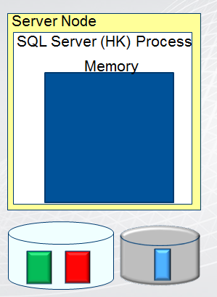
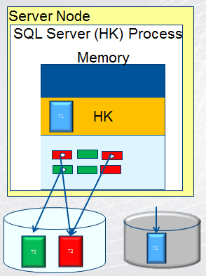
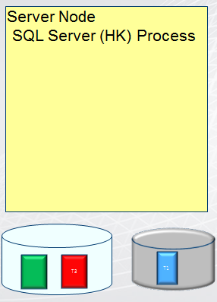
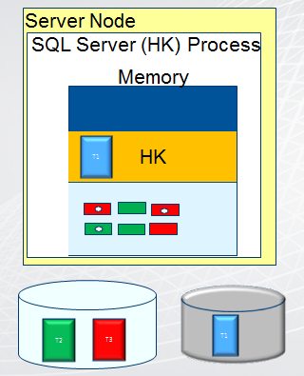
Hekaton: Recovery After Clean Shutdown
Checkpoint Done
HK: Table T1 is loaded
HK: SQL Process Restarts
HK: SQL Process Exits
SQL Server exits
HK: Checkpoint Done
SQL Server Restarts
SQL Server Process
SQL Server Process
SSQL Server Process
QL Server Process
Memory
Memory
Memory
HK
T1
T1
T2
T3

Slide 28
Summary
In-memory Data Structures
Managing Memory and Garbage Collection
Hekaton Persistence and Storage Management
Logging and Recovery

Slide 29
Track Resources
Download Data Explorer
SQL Server Website
Hands-On Labs
@sqlserver
Download Geoflow
Get Certified!
mva
Windows Azure
Microsoft Virtual Academy

Slide 30
Resources
Learning
Sessions on Demand
Microsoft Certification & Training Resources
http://channel9.msdn.com/Events/TechEd
www.microsoft.com/learning
TechNet
msdn
Resources for IT Professionals
Resources for Developers
http://microsoft.com/technet
http://microsoft.com/msdn

Slide 31
Complete an evaluation on CommNet and enter to win!

Slide 32
Evaluate this session
Required Slide
*delete this box when your slide is finalized
Your MS Tag will be inserted here during the final scrub.
Scan this QR code to evaluate this session and be automatically entered in a drawing to win a prize

Slide 33
© 2013 Microsoft Corporation. All rights reserved. Microsoft, Windows and other product names are or may be registered trademarks and/or trademarks in the U.S. and/or other countries.
The information herein is for informational purposes only and represents the current view of Microsoft Corporation as of the date of this presentation. Because Microsoft must respond to changing market conditions, it should not be interpreted to be a commitment on the part of Microsoft, and Microsoft cannot guarantee the accuracy of any information provided after the date of this presentation. MICROSOFT MAKES NO WARRANTIES, EXPRESS, IMPLIED OR STATUTORY, AS TO THE INFORMATION IN THIS PRESENTATION.

