Slide 2
SQL Server 2012
AlwaysOn Customer Panel:
Mission Critical Deployments and Lessons Learned
DBI-B318
Sanjay Mishra, Microsoft Corporation
Michael Steineke, Edgenet, Inc.
David P. Smith, Active Network
Ayad Shammout, CareGroup Healthcare Systems
Wolfgang Kutschera, bwin party
Thomas Grohser, Bridgewater

Slide 3

Setting the Stage
  Assumed Pre-requisites for this presentation: Basic knowledge of
    AlwaysOn Failover Cluster Instances (FCI)
    AlwaysOn Availability Groups (AG)
    Windows Server Failover Clustering (WSFC)

Slide 4
Setting the Stage
  AlwaysOn ≠ Availability Groups
  AlwaysOn = { SQL Server Failover Cluster Instances, Availability Groups }
  Availability Groups ≠ Database Mirroring

Slide 5
SQL Server 2012 AlwaysOn Customer Panel
 | Customer | SQL Server 2012 AlwaysOn HA+DR Solution | Highlights covered during this presentation
1 | Edgenet | Multi-site Failover Cluster Instance (FCI) for HA and DR | MSDTC Support TEMPDB on local storage
2 | Active Network (ServiceU) | Failover Cluster Instance for local HA + Availability Group for DR | Quorum Model: Last Man Standing Instance names, file paths
3 | Caregroup Healthcare Systems | Availability Group for HA and DR | Virtualized with Hyper-V Host Clustering for Live Migration
4 | bwin.party | Availability Group for HA and DR | Zero data loss (multiple sync secondaries) Use of 3rd data center to automatically failover between primary and secondary data centers
5 | Bridgewater | Availability Group for HA and DR | Replaced disparate technologies with one Using storage replication to provide DR for the Replication Distributor

Slide 6
Setting the Stage
  There is much more to each of these deployments than we can discuss in this session.
  Come by the SQL Server Technical Learning Center (TLC) / Booth and discuss with us.

Slide 7
Edgenet

Slide 8
About Edgenet
Leader in Data Services, Guided Selling and Marketing Solutions
Consumers and businesses want details about products. At Edgenet, we organize that product information to increase sales.
Provide retail applications
  Help retailers sell configurable products
  Help consumers compare and purchase the right product for them.
Collect, certify and distribute product data
  Google Search & Shopping
  Bing Search & Shopping
  Retailers
  One of Four Active US GDSN-certified pools
Rigorous certification and data quality scoring process

Slide 9
Edgenet Multi-site FCI Solution
Configuration
SLA: 99.99% Annual uptime
Provides high availability and disaster recovery for our data pool applications
  Near real-time data replication with MSDTC support
  Additional, read-Only secondary to offload Exports & BI Workload
Software / Hardware
  SQL Server 2012 Enterprise
  Windows Server 2008 R2 Datacenter
  Brocade 5300 - 8 Gb FC Switches
  EMC Clariion CX4-80
  EMC RecoverPoint CE – Disk Based Replication
  NEC Express 5800/A1080a-D GX

Slide 10
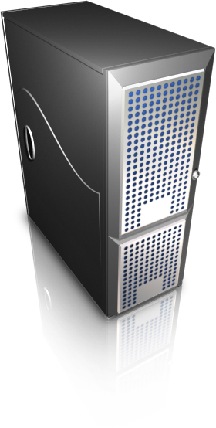




Edgenet HA / DR Topology Diagram
Multi-site FCI for HA/DR + AG readable secondary replica
Primary Site - Milwaukee
DR Site - Atlanta
300 Mb Ethernet Connection
10.10.10.0/24
11.11.11.0/24
WSFC Node A
FCI Active Node
WSFC Node B
FCI Passive Node
Asynchronous SAN Replication
EMC RecoverPoint CE Appliances
EMC RecoverPoint CE Appliances
Hardware Replicated LUNS
850 Miles
Hardware Replicated LUNS
LUNS for AG secondary
WSFC Node C
Availability Group Secondary Replica
(Synchronous, Readable)

Slide 11
Edgenet HA / DR Solution
Cluster, Disk and Instances
3 Node Windows Server Failover Cluster
  2 Nodes (one at each data center) SQL Stretch Cluster (Multi-site FCI)
    850 mi. – Milwaukee to Atlanta
  1 Node in the primary DC hosting AG readable secondary
4 Clustered SQL instances, 1 Clustered MSDTC
11 TB of useable SAN replicated storage – 54 LUNS
Multi-Subnet (two)
TempDB on Local Disk
  Saves money on storage replication licensing
  Reduces cross-data center storage replication traffic
  Enables use of local solid state storage to improve performance

Slide 12
Edgenet Distance Cluster Solution
Deployment Considerations
Multi-Subnet Cluster
  Instances have ‘Register All Providers’
    Both IPs are registered to single Name record in DNS
  Clients need to support ‘MultiSubnetFailover = True’
  http://msdn.microsoft.com/en-us/library/ff878716(v=SQL.110).aspx#DNS
Install Time Considerations
  Network latency between cluster nodes will cause SQL installations to take more time than a non-cluster installation
  Use SQL Slipstream functionality for SP’s & CU’s when installing SQL in a multi-site cluster
  Plan appropriate time to apply post-installation updates
  Fix in SQL 2012 CU1 addressed LUN validation time
    This dropped hours off our installs because we have 75+ LUNs

Slide 13
Active Network
(ServiceU)

Slide 14
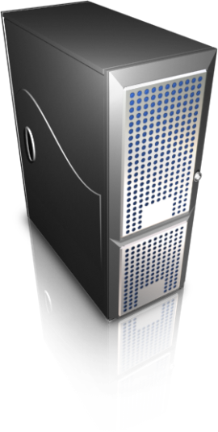

FCI + DBM Solution (Pre-2012)
SQL Server FCI #1
SQL Server FCI #2
Database
Mirroring
Windows Server Failover Cluster #1
Windows 2008 SQL 2008
Windows Server Failover Cluster #2
Windows 2008 SQL 2008

Slide 15
FCI + AG Solution (SQL Server 2012)
(FCIs for local high availability, AG for Disaster Recovery)
PRIMARY
SECONDARY
Availability Group Asynchronous Data Movement
This is a single Windows cluster instead of a Windows cluster at each site.

Slide 16
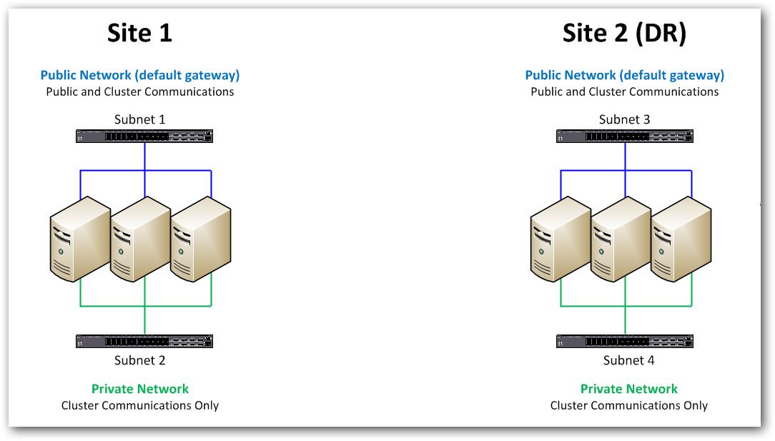
Single Subnet Communication
Single Subnet Cluster Communications
Goals: Resiliency and QoS
Communication happens within the same subnet
Heartbeats – all interfaces, not just “cluster communications” network

Slide 17
Single Subnet - PlumbAllCrossSubnetRoutes
Single Subnet Cluster Communications (with PlumbAllCrossSubnetRoutes=1)
Purpose = discover valid routes
Communication occurs from all nodes to every other node, on every interface
Means that public ← → private communication is attempted

Slide 18
Multi-Subnet Communication
Multi-Subnet Cluster Communication Resiliency
Connectivity
Options
Single NIC; remove private network
NIC teaming on public network
Establish communication between each subnet across sites

Slide 19
Multi-Subnet Communication
Multi-Subnet Cluster Communications (Options 1 & 2)
Connectivity
  Private network heartbeat pings are failing and counting towards the threshold value (failover)*
Options 1& 2 (single public NIC and public NIC teaming):
  Resiliency is lost – there is no private network; all public network hardware and paths must be redundant
  QoS must be established

Slide 20
Multi-Subnet Communication
Multi-Subnet Cluster Communications (continued)
Connectivity
Connectivity
Option #3: Create communication between private network (VPN Tunnel or PTP)
Requires setting a static route on the private network since gateway is on the public network
There is still a problem (public network at each site not communicating with private networks at each site, and vice versa) and log entries are being created on networking gear – may be a big problem in some environments

Slide 21
Multi-Subnet Communication
Multi-Subnet Cluster Communications (continued)
Connectivity
Connectivity
Connectivity
Connectivity
Star topology solves this problem AND can provide additional network protection if an interface goes down.
Involves 2 more static routes (3 total) for Public-to-Private communications
Creates significant complexity

Slide 22
Multi-Subnet Communication
Windows Server 2012
Connectivity
PlumbAllCrossSubnetRoutes has an additional value of 2 that can be set
  Will try all interfaces and use the first successful interface for cross-subnet communications.
  Provides local resiliency and QoS at each site, but with limited resiliency across networks. It is simple and probably what you need for a DR scenario.

Slide 23
Minimizing Downtime during Migration
Plan, test the plan, fix the plan, rinse and repeat. Lots.
Use Log Shipping (LS) to seed DBM, then use DBM to the new cluster. See ServiceU Case Study for more information.
Use DNS aliases for connection strings from application servers
  Best practice
  Lowered TTL to 1 minute prior to upgrade
  If using temporary hardware and AGs, use alias to point to AG Listener, then you can use SQL Server to change primary/secondary roles
Database upgrade (metadata operation)
  First step on restore or failover is for SQL Server to upgrade all databases
  Takes time, and is dependent on storage IOPS, probably not CPU/Memory
  Move non-critical DBs first if you have any (via DBM)
  Reduces total time for remaining DB upgrades to complete
Involve multiple people
  SQL team to check SQL Server and run tests
  Application team to run pre-scripted tests
  Others as needed for your environment
Our upgrade from SQL Server 2008 to 2012 was accomplished in < 3 minutes with 28 DBs and about 750 GB of data, including extensive testing.

Slide 24
CareGroup Healthcare Systems

Slide 25
CareGroup Healthcare Systems
Among Top 5 Large Healthcare Systems Nationally
Four Hospitals located in Boston
16,000 Employees
146 Mission Critical Clinical Applications
2+ Million Patient Medical Records
Annual Revenue : $2 Billion
HA/DR requirements for clinical databases:
  RTO : 0 downtime
  RPO: No data loss
All mission-critical applications are enabled for high availability and DR
Ranked #1: Most Innovative IT nationwide (InformationWeek)
Case Study: http://www.microsoft.com/casestudies/Case_Study_Detail.aspx?casestudyid=4000001003

Slide 26
CareGroup DB Classification & SLA
80+ databases rated “AAA”
  RPO 0 & RTO 0
  Standard HA/DR Solution: AlwaysOn FCI + AlwaysOn AG
  Use EMC Clariion SAN with SSD disk
300+ databases rated “AA”
  RPO =<1 hour & RTO 1 hour
  Standard HA/DR Solution: Hyper-V and AlwaysOn AG
  Use EMC Clariion SAN
Rest of the databases rated “A”
  RPO & RTO 1 day
  Selective HA/DR
DR Site matches Primary Site infrastructure

Slide 27
Caregroup Hyper-V & Live Migration Deployment
Each host is equipped with the following 1GHz NIC cards:
    Cluster management
    Cluster Private 1
    Cluster Private 2
    Live Migration
    Guest Virtual Public Network
    Guest Backup Network
Two x64 systems with compatible processors.
All the hosts that take part in live migration have Windows Server 2008 R2 x64 SP1 installed.
Required shared storage, which is Fiber Channel SAN.
The Hyper-V role and the Failover Cluster feature must be installed on all servers participating in live migration.

Slide 28





SQL Server 2012 HA / DR
Architecture for “AA” applications
HW & OS Failure Protection
OS & SQL Failure Protection
Disk & DB Failure Protection
Windows 2008 R2 Hosts Cluster
Sync
Primary Site
Primary
Availability Group: BillingSys
Hyper-V
Node B
Hyper-V
Node A
Windows 2008 R2 Guest Cluster
ASync
DR Site
Node C

Slide 29
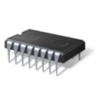


How We Use Hyper-V Live Migration
User still connected
without interruption
Configuration Data
Memory Content
Memory Sync
Sync AG: BillingSys
Hyper-V
Node A
Sync Availability Group: BillingSys
Hyper-V
Node B
Denali_A VHD
(in Cluster Shared Volume)
Denali_B VHD
(in Cluster Shared Volume)
CSV
Windows 2008 R2 Host Cluster

Slide 30
AlwaysOn AG Cross-Cluster Migration
HADR cluster context determines which WSFC cluster manages the metadata for availability replicas
1- Switch node 3 & node 4 to Win 2008 HADR Cluster conext
Windows 2008 R2 Cluster
Windows 2012 Cluster
6- Create new AG “AG1”
2- Connect to Primary and add new replica to AG
AG1
AG1
3- Delete AG1_Listener
Primary
7- Create new listener “AG1_Listener”
4- Take AG1 offline
Node 1
SQL 2012
Data Synchronization
Node 3
SQL 2012 SP1
AG1_Listener (VNN)
AG1_Listener (VNN)
Secondary
Replica
Secondary
Replica
Node 2
SQL 2012
Node 4
SQL 2012 SP1
5- Switch node 3 & node 4 to local HADR cluster context

Slide 31
AG Listener Issue:
MultiSubnetFailover feature, the client code attempts to connect to both IP addresses of the listener, because the listener (a Clustered VNN) consists of 2 IP addresses and RegisterAllProviderIP=1
Symptoms: after AG Failover, client connection is intermittent
Issue is related to Anti-Virus and Windows 2008 R2 network driver filter
Workaround is to set RegisterAllProviderIP=0. In this scenario, only one IP address is registered in DNS.
Downside is: in event of failover, the online IP address must be unregistered and offline IP address registered in DNS. In addition, old IP address is likely cached and DNS registration may not be instantaneous.

Slide 32
bwin party

Slide 33
The System
Real money handling system for bwin.party
Authoritative system for Responsible Gaming Limitations
Includes a specialized Data Warehouse
Multiple databases, and multiple availability groups in the topology
4 servers in the topology
    Each server is hosting the primary replica of an AG, and secondary replica of other AGs
    Focus on 1 AG in this presentation

Slide 34
HA/DR objectives
>99.99% availability in the last years
>99.99% availability even with maintenance
RPO: Zero data loss
RTO: 10 seconds or less
Worst case scenario: Loss of a complete datacenter
Must still be able to do maintenance during Worst Case
Data Warehouse systems are not included in the SLA

Slide 35
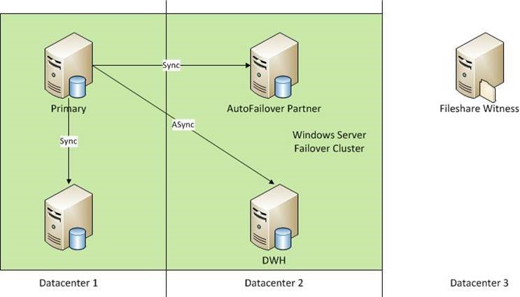
Setup – SQL 2012

Slide 36
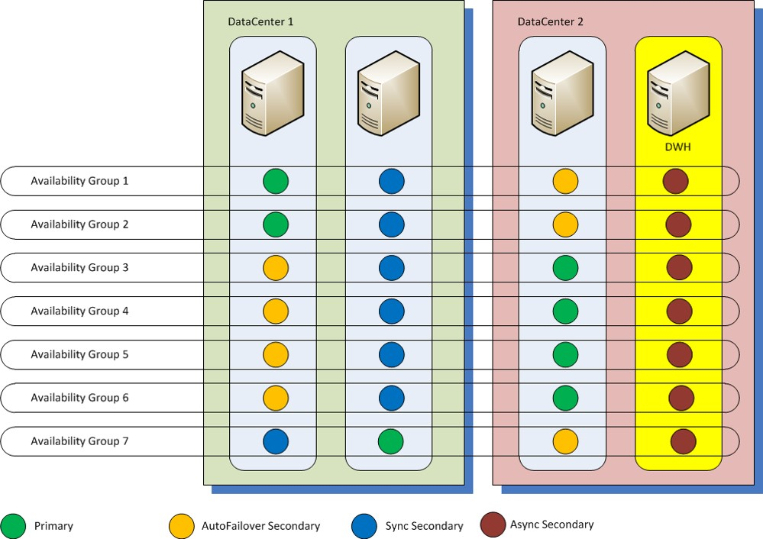
Availability Group Placement
Backups performed on Node2
Node1
Node2
Node3
Node4

Slide 37
Key Setup Points
Quorum Model: Node and FileShare Majority
Each node has a vote
FileShare in 3rd Datacenter
Automatic Failover between Datacenters
    Avoiding downtime in case of Datacenter failure

Slide 38
Considerations for Migration
Migration involves other teams, not just the DBA team
Change in Connection string necessary as the Database Mirroring connection string only works with one secondary
Different machines used different OS versions before. This is no longer possible
All machines in the topology now need to be in the same Active Directory domain

Slide 39
Post-Migration Considerations
Monitoring of availability groups is different from monitoring database mirroring
DBA skillsets need to improve vastly to manage the system, even if you only look at the DB side
Increased number of components involved leads to increased complexity in troubleshooting
Troubleshooting needs involvement from other teams, not just DBAs

Slide 40
A word on Windows Server 2012
Windows 2012 makes a lot of things easier
Dynamic Quorum is a blessing
So is Cluster Aware Updating
RDMA lets backups run faster
…

Slide 41
Another word on Windows Server 2012
Getting there is a pain if you have Availability Groups
  No in-place upgrade
  Cross-Cluster AG movement is script based and error prone
  Have to do all AGs at once
Windows 2012 RTM has some incompatibilities -> You need hotfixes for some features to even run
  e.g. FileStream in Availability Groups will not work without a patch
Sometimes AGs will not sync after a forced failover
  Not 100% sure if this is a Windows issue, but it has never happened on 2008R2…

Slide 42
Bridgewater

Slide 43
SQL Server 2012 Deployment considerations
Requirements
  Security for data and intellectual property
  RTO and RPO close to zero
  1000+ databases, 200+ AGs , 100+ servers
  All servers are virtual
  Cross datacenter HA/DR for replication

Slide 44


SQL Server 2012 AlwaysOn Availability Groups
Datacenter C
Readable Replicas
Datacenter A
Datacenter B
P
AFSR
SR
ASR
Delayed log shipping
File Table
DLS
DLS

Slide 45

SQL Server 2012 Replication Distributor DR Handling
Distribution Databases
Datacenter A
Datacenter B
D1
D1
DR Failover virtual machines
Local HA: Failover Clustering
Dn
Dn
SRDF/S
Storage Replication

Slide 46
Security and HA/DR
Goal: Provide same connection experience and security during normal operation and HA/DR
Ensure
Logins are created on all instances (use sp_help_revlogin for SQL Server logins)
Database owner is the same (low privilege login) on all nodes
  AlmostOn: Need to failover to each node to change settings
  Or use exec(‘RESTORE DATABSE xyz ….’) AS LOGIN = ‘DesiredDatabaseOwner’ -- needs DBCreator
Trustworthy setting is the same on all nodes
  AlmostOn: Need to failover to each node to change setting to true (false by default)
Delegation and constrained delegation is setup for all SPNS on and for all instances
Outgoing linked servers are created with same credentials on all instances

Slide 47
How to do excellent DR test
Goal: Regular DR Testing without increase of downtime
Solution: Combine DR test and patching.
Every patch cycle (monthly) the datacenters switch roles
All applications are instructed to use only the current primary replica in datacenter A (primary site)
Readable secondary's in datacenter B are patched.
Availability Groups are failed over to servers in datacenter B
Datacenter B becomes primary site, datacenter A becomes secondary
Servers in datacenter A are patched
Servers in datacenter A resume role as readable secondary

Slide 48

Track resources
Required Slide
*delete this box when your slide is finalized
Track PMs will supply the content for this slide, which will be inserted during the final scrub.
Resource 1
Resource 2
Resource 3
Resource 4

Slide 49

Resources
Learning
  Sessions on Demand
  Microsoft Certification & Training Resources
http://channel9.msdn.com/Events/TechEd
www.microsoft.com/learning
TechNet
msdn
  Resources for IT Professionals
  Resources for Developers
http://microsoft.com/technet
http://microsoft.com/msdn

Slide 50







Complete an evaluation on CommNet and enter to win!

Slide 51

© 2013 Microsoft Corporation. All rights reserved. Microsoft, Windows and other product names are or may be registered trademarks and/or trademarks in the U.S. and/or other countries.
The information herein is for informational purposes only and represents the current view of Microsoft Corporation as of the date of this presentation. Because Microsoft must respond to changing market conditions, it should not be interpreted to be a commitment on the part of Microsoft, and Microsoft cannot guarantee the accuracy of any information provided after the date of this presentation. MICROSOFT MAKES NO WARRANTIES, EXPRESS, IMPLIED OR STATUTORY, AS TO THE INFORMATION IN THIS PRESENTATION.

