Slide 2
The DBAs Worst Nightmares
DBI-B319
Rick Kutschera

Slide 3
Goals
Describe problem scenarios
Demonstrate how to Troubleshoot the issues
Show possible ways to fix them with minimal impact on data quality and availability

Slide 4
Disclaimer
Some scenarios I will show can have side effects when done outside of a lab environment. The routes shown here are primarilly meant to show different angles to tackle a problem, please ensure that you understand the full consequences of those before using them.

Slide 5
Setup
SQL Server 2012 SP1 (11.0.3350) Enterprise Edition
Same database for all scenarios
Single Datafile
Single Transaction Log
Full Recovery Model

Slide 6
The Dead Zoo, Part 1

Slide 7
Dead Zoo 1, Scenario
Database is offline
A data file is missing/corrupt

Slide 8
Demo
The Dead Zoo, Part 1

Slide 9
Dead Zoo 1, Troubleshooting 1/2

Slide 10
Dead Zoo 1, Troubleshooting 2/2

Slide 11
Dead Zoo 1, Fix 1/2
BACKUP LOG FunDB_Zoo1
TO DISK='C:\MSSQL\Backup\Zoo1Tail.bak'
WITH NO_TRUNCATE, COMPRESSION, INIT, STATS=1

Slide 12
Dead Zoo 1, Fix 2/2
RESTORE DATABASE FunDB_Zoo1
FROM DISK='C:\MSSQL\Backup\DeadZoo1\FunDB_Full.bak'
WITH NORECOVERY, STATS=5
RESTORE LOG FunDB_Zoo1
FROM DISK='C:\MSSQL\Backup\DeadZoo1\FunDB_Log.bak'
WITH NORECOVERY, STATS=5
RESTORE LOG FunDB_Zoo1
FROM DISK='C:\MSSQL\Backup\Zoo1Tail.bak'
WITH NORECOVERY, STATS=5
RESTORE DATABASE FunDB_Zoo1
WITH RECOVERY

Slide 13
The Dead Zoo, Part 2

Slide 14
Dead Zoo 2, Scenario
Database is offline
The transaction log is corrupt/missing

Slide 15
Demo
The Dead Zoo, Part 2

Slide 16
Dead Zoo 2, Troubleshooting 1/2

Slide 17
Dead Zoo 2, Troubleshooting 2/2

Slide 18
Dead Zoo 2, Warning
In this scenario transactional consistency is lost
The data needs to be manually checked afterwards to ensure that it is logically usable

Slide 19
Dead Zoo 2, Fix
ALTER DATABASE FunDB_Zoo2 SET EMERGENCY
ALTER DATABASE FunDB_Zoo2 SET SINGLE_USER
DBCC CHECKDB ('FunDB_Zoo2', REPAIR_ALLOW_DATA_LOSS)
ALTER DATABASE FunDB_Zoo2 SET MULTI_USER

Slide 20
The Limping Coyote

Slide 21
Limping Coyote, Scenario
Querying the LupusName field of the DeadLupus table results in an error
Doing a SELECT * query on the same table works without problems

Slide 22
Demo
The limping Coyote

Slide 23
Limping Coyote, Troubleshooting 1/2
SELECT LupusName FROM DeadLupus
DBCC TRACEON (3604)
DBCC PAGE (15, 1, 6740)
DBCC TRACEOFF (3604)
SELECT * FROM sys.indexes WHERE object_id=2121058592 AND index_id=2

Slide 24
Limping Coyote, Troubleshooting 2/2
SQL Reports a logical consistency error on a page
DBCC PAGE shows that the inconsistency is on an index page
Sys.indexes gives the information what index it is
Caution: Running the SELECT statement with Read Uncommitted isolation will spoil the error message

Slide 25
Limping Coyote, Fix
DROP INDEX ncLupus ON DeadLupus
GO
CREATE NONCLUSTERED INDEX ncLupus ON DeadLupus
(LupusName)
GO

Slide 26
The Crashed Bird

Slide 27
Crashed Bird, Scenario
Querying the DeadBirdies table results in an error

Slide 28
Demo
The crashed Bird

Slide 29
Crashed Bird, Troubleshooting
SQL Reports a logical consistency error on a page
DBCC PAGE shows that the inconsistency is on a data page (Clustered Index)
Index recreate is not an option in this case
DBCC CHECKDB also can‘t rebuild this without data loss

Slide 30
Crashed Bird, Fix 1/2
BACKUP LOG FunDB_Bird
TO DISK='C:\MSSQL\BACKUP\BirdTail.bak'
WITH NO_TRUNCATE, INIT, COMPRESSION, STATS=5
RESTORE DATABASE FunDB_Bird PAGE='1:2480'
FROM DISK='C:\MSSQL\BACKUP\DeadBird\FunDB_Full.bak'
WITH NORECOVERY
RESTORE LOG FunDB_Bird
FROM DISK='C:\MSSQL\BACKUP\DeadBird\FunDB_Log.bak'
WITH NORECOVERY
RESTORE LOG FunDB_Bird
FROM DISK='C:\MSSQL\BACKUP\BirdTail.bak'
WITH NORECOVERY
RESTORE DATABASE FunDB_Bird WITH RECOVERY

Slide 31
Crashed Bird, Fix 2/2
The fix shown is available in Enterprise Edition only!
If you do not have Enterprise Edition available a Full Restore is your only option
In this scenario that would mean restoring to a second location and then copying the table over to the original DB

Slide 32
The Killed Bunny

Slide 33
Killed Bunny, Scenario
A user deleted a lot of records from a table
The records need to be recovered

Slide 34
Demo
The killed Bunny

Slide 35
Killed Bunny, Fix 1/5
SELECT [Transaction ID], COUNT(*)
FROM fn_dblog(null, null)
WHERE Operation='LOP_DELETE_ROWS'
GROUP BY [Transaction ID]
ORDER BY 2 DESC

Slide 36
Killed Bunny, Fix 2/5
SELECT MAX([Current LSN])
FROM fn_dblog(null, null)
WHERE [Transaction ID]='0000:000016e6'

Slide 37
Killed Bunny, Converting LSNs
Convert all three blocks from Hex to Decimal
89 -> 137
23B0 -> 9136
94 -> 148
Pad the numbers
First block doesn‘t need padding
Second block needs padding to 10 digits -> 0000009136
Third block needs padding to 5 digits -> 00148
Combine the numbers
Final LSN: 137000000913600148

Slide 38
Killed Bunny, Fix 3/5
BACKUP LOG FunDB_Bunny
TO DISK='C:\MSSQL\BACKUP\BunnyTail.bak'
WITH NO_TRUNCATE, INIT, COMPRESSION, STATS=5

Slide 39
Killed Bunny, Fix 4/5
RESTORE DATABASE FunDB_Bunny
FROM DISK='C:\MSSQL\BACKUP\DeadBunny\FunDB_Full.bak'
WITH NORECOVERY, STATS=5
RESTORE LOG FunDB_Bunny
FROM DISK='C:\MSSQL\BACKUP\DeadBunny\FunDB_Log.bak'
WITH NORECOVERY, STATS=5

Slide 40
Killed Bunny, Fix 5/5
RESTORE LOG FunDB_Bunny
FROM DISK='C:\MSSQL\BACKUP\BunnyTail.bak'
WITH NORECOVERY, STATS=5
, STOPBEFOREMARK='LSN:137000000913600148'
RESTORE DATABASE FunDB_Bunny WITH RECOVERY

Slide 41
Track Resources
Download Data Explorer
SQL Server Website
Hands-On Labs
@sqlserver
Download Geoflow
Get Certified!
mva
Windows Azure
Microsoft Virtual Academy

Slide 42
Resources
Learning
Sessions on Demand
Microsoft Certification & Training Resources
http://channel9.msdn.com/Events/TechEd
www.microsoft.com/learning
TechNet
msdn
Resources for IT Professionals
Resources for Developers
http://microsoft.com/technet
http://microsoft.com/msdn

Slide 43
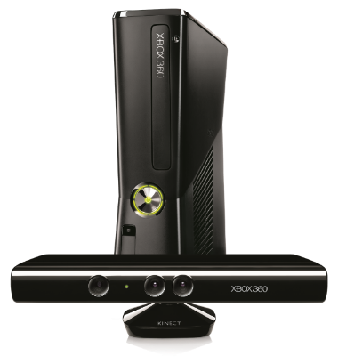
Complete an evaluation on CommNet and enter to win!

Slide 44
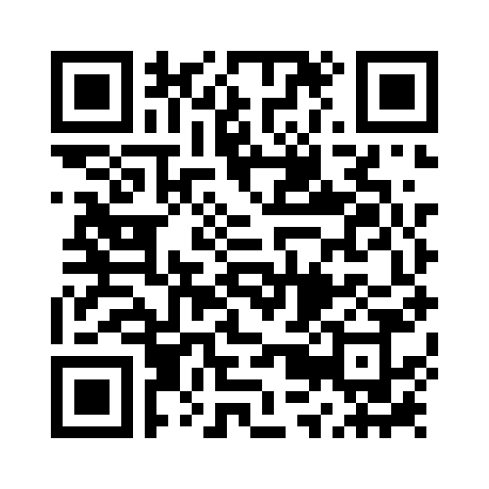
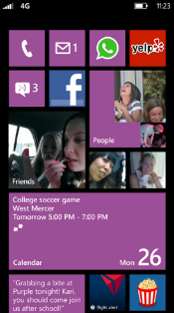
Evaluate this session
Required Slide
*delete this box when your slide is finalized
Your MS Tag will be inserted here during the final scrub.
Scan this QR code to evaluate this session and be automatically entered in a drawing to win a prize

Slide 45
© 2013 Microsoft Corporation. All rights reserved. Microsoft, Windows and other product names are or may be registered trademarks and/or trademarks in the U.S. and/or other countries.
The information herein is for informational purposes only and represents the current view of Microsoft Corporation as of the date of this presentation. Because Microsoft must respond to changing market conditions, it should not be interpreted to be a commitment on the part of Microsoft, and Microsoft cannot guarantee the accuracy of any information provided after the date of this presentation. MICROSOFT MAKES NO WARRANTIES, EXPRESS, IMPLIED OR STATUTORY, AS TO THE INFORMATION IN THIS PRESENTATION.

