Slide 2
Tips and Tricks for Building Rich Reports in Microsoft SQL Server 2012 Reporting Services
DBI-B320
Riccardo Muti

Slide 3
objective
After this session, you will be able to design reports that encourage immediate understanding and make insights pop.

Slide 4
agenda
Use tablix to organize data
Use graphics and colors to emphasize data
Choose the right visual
More tricks

Slide 5
sample data
United States
Department of Agriculture
http://explore.data.gov/Agriculture/U-S-Lettuce-Statistics/w87x-qfjw

Slide 6
agenda
Use tablix to organize data
Use graphics and colors to emphasize data
Choose the right visual
More tricks

Slide 7
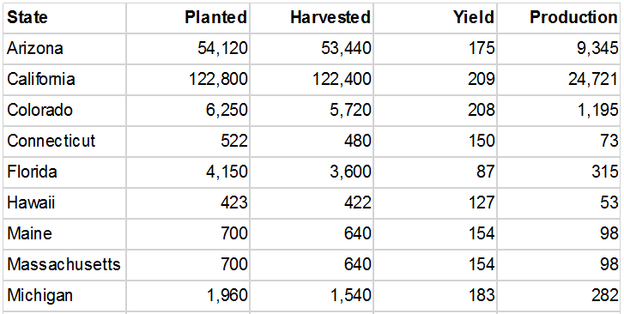
tablix = table
columns
row
rows
row group

Slide 8
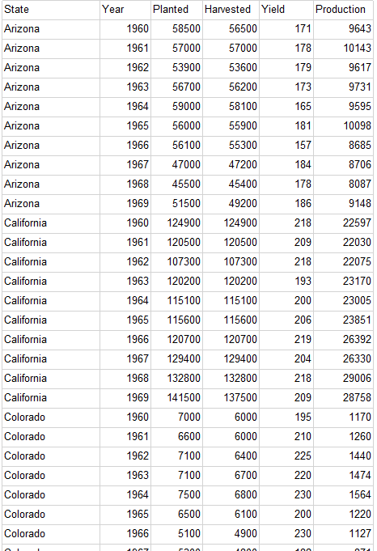
tablix = table

Slide 9
Demo
Building a table

Slide 10
tablix = table

Slide 11
tablix = table + matrix
column group
column
row
row group

Slide 12
tablix = table + matrix ++
column group
column
column
column
column

Slide 13
Demo
Building a matrix

Slide 14
agenda
Use tablix to organize data
Use graphics and colors to emphasize data
Choose the right visual
More tricks

Slide 15
emphasize data

Slide 16
emphasize data
no fluff
thin font
space, not lines
dim labels
1 accent color

Slide 17
emphasize data
visualize rules
simple icons

Slide 18
emphasize data
color scales
small area
=Code.ColorScaleRYG(dataValue, 0.8, 1.0)
http://blogs.msdn.com/b/bobmeyers/archive/2009/07/31/add-excel-like-color-scale-conditional-formatting-to-your-reports.aspx

Slide 19
emphasize data

Slide 20
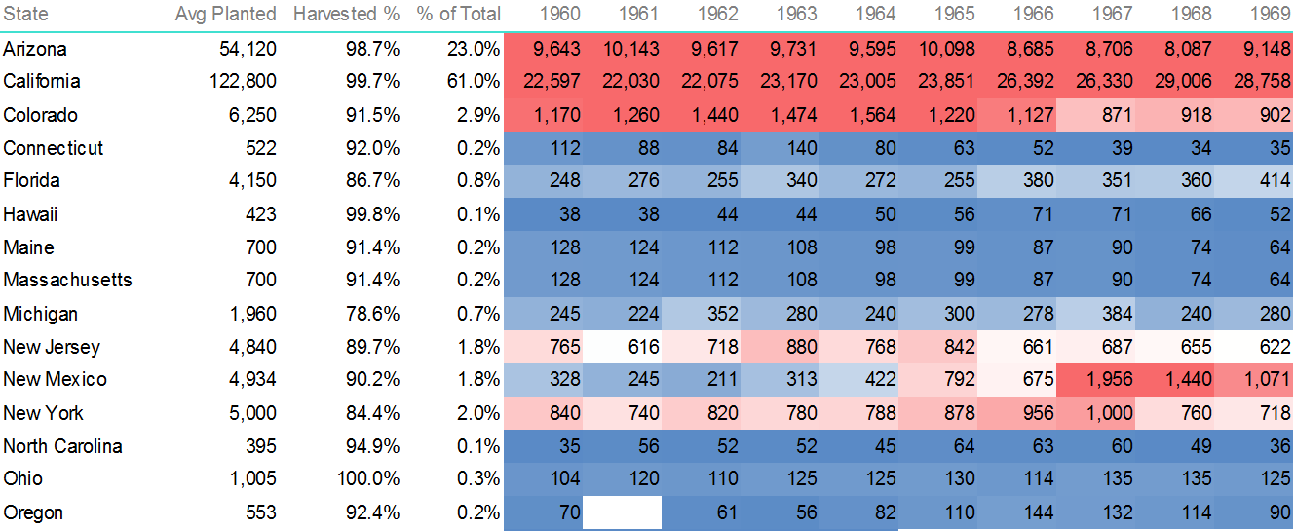
emphasize data

Slide 21
emphasize data
color scales
small area
lighter fills
darker lines/text
98.7%
98.7%

Slide 22
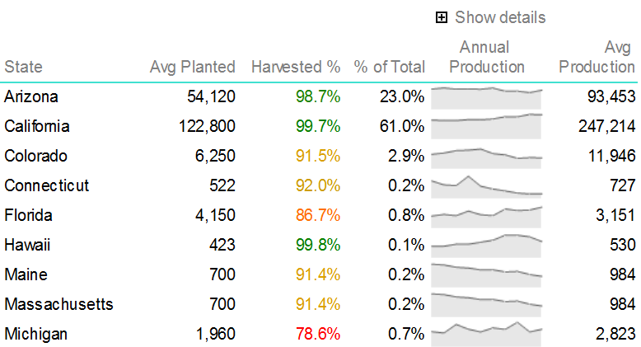
emphasize data
time = sparkline
simple colors
expandable
align axes?

Slide 23
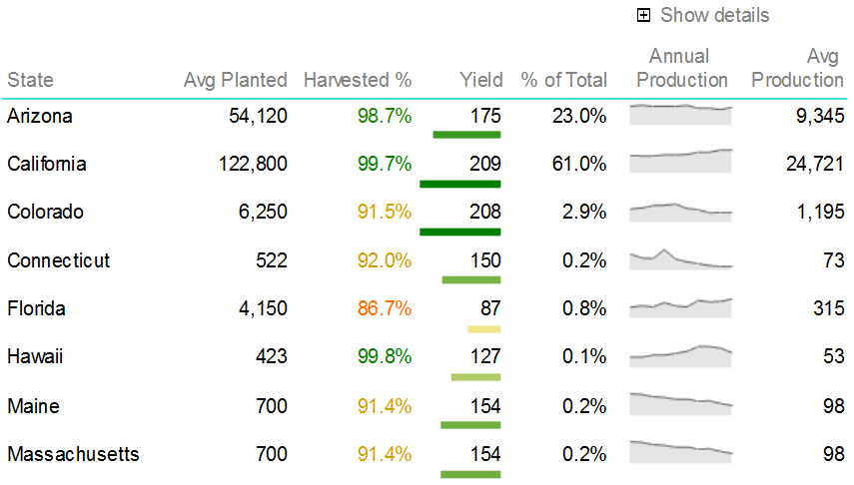
emphasize data
data bars
use color
align axis

Slide 24
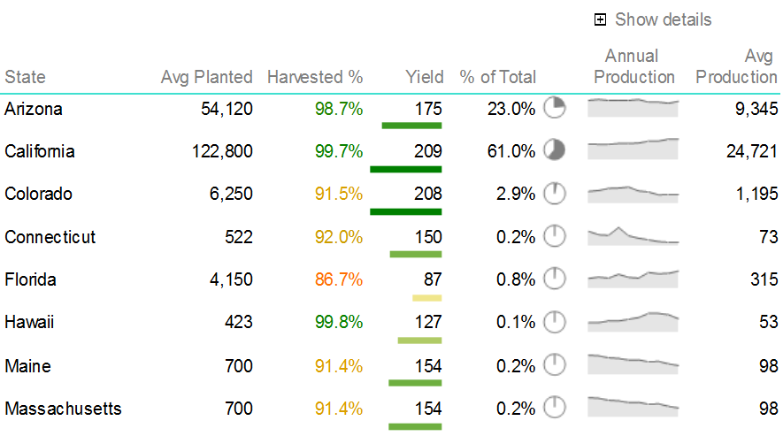
emphasize data
sparkpies?
simple colors
12:00

Slide 25
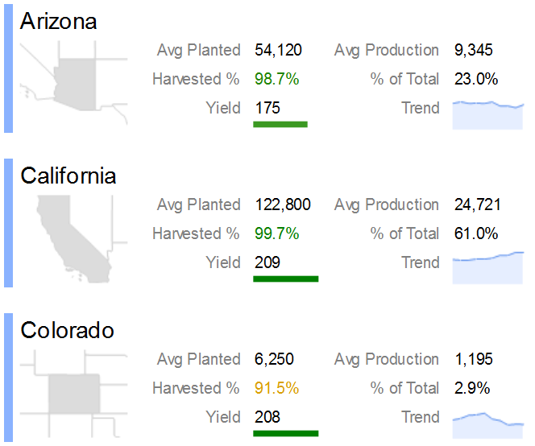
emphasize data
cards
use a picture
butterfly align
space between
1 accent hue

Slide 26
Demo
Emphasize data

Slide 27
agenda
Use tablix to organize data
Use graphics and colors to emphasize data
Choose the right visual
More tricks

Slide 28
the right visual
make your tables pop

Slide 29
the right visual
use bars for categories

Slide 30
the right visual
use lines for sequence

Slide 31
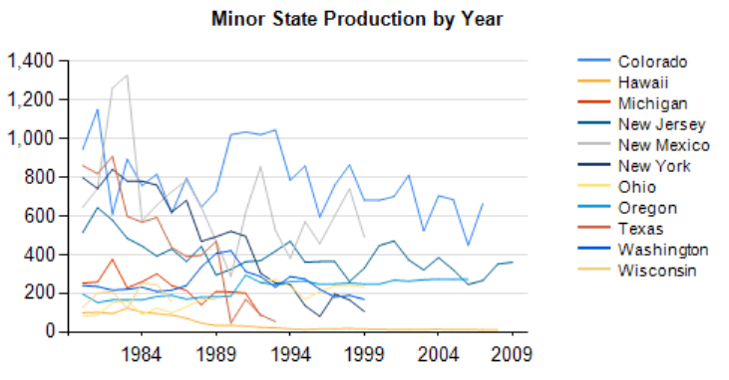
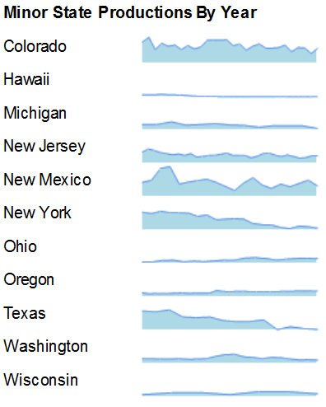
the right visual
consider sparklines instead of series

Slide 32
the right visual
use a scatter chart for correlation

Slide 33
agenda
Use tablix to organize data
Use graphics and colors to emphasize data
Choose the right visual
More tricks

Slide 34
more tricks
Add clipboard data using XML data source
Integrate related data using Lookup
Display short lists using LookupSet
Optimize for output to Excel

Slide 35
clipboard data
?

Slide 36
clipboard data
…

Slide 37
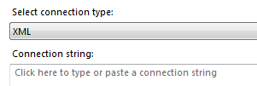
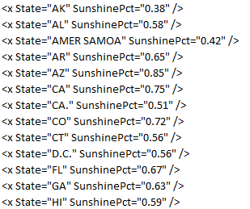
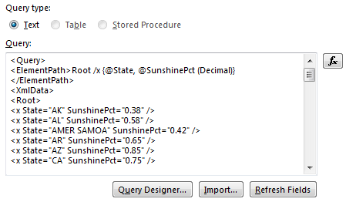
clipboard data

Slide 38
related data
dataset 1
dataset 2
=Lookup(thisfield, otherField, returnField, datasetName)

Slide 39
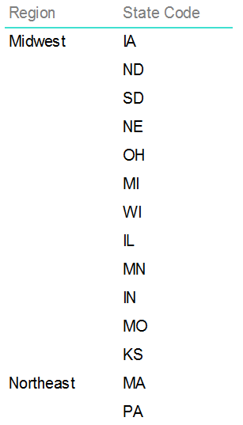
short lists
=Join(LookupSet(thisfield, otherField, returnField, datasetName), delimiter)
=Code.JoinSorted(...)
=Code.JoinDistinctSorted(...)
*NOTE: matches one field only – no group context or filters

Slide 40
output to Excel

Slide 41
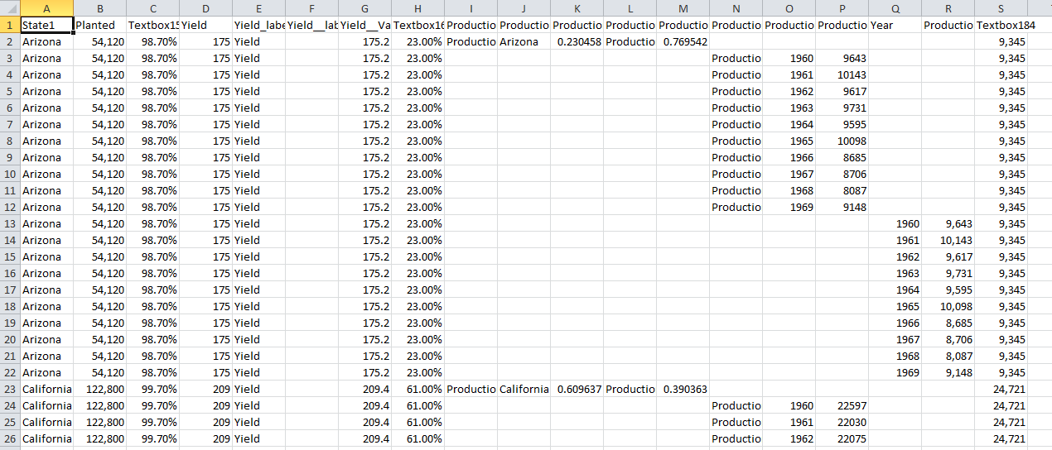
output to Excel

Slide 42
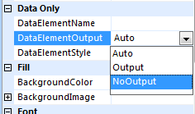
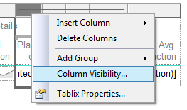
output to Excel
Try it!
Set textbox names in tables
Set group names in charts
Turn off output for redundant visuals and sparklines
Add extra hidden columns just for output
Turn on output for hidden elements

Slide 43
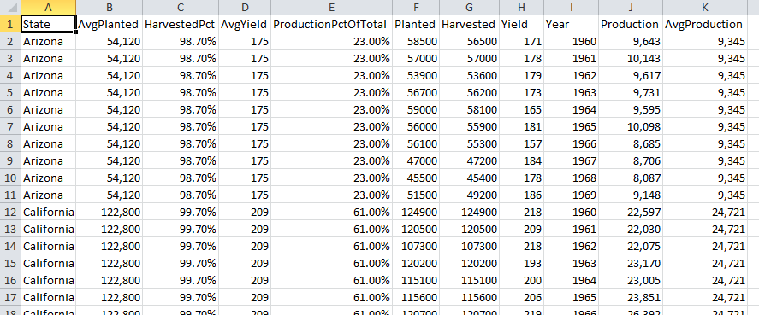
output to Excel

Slide 44
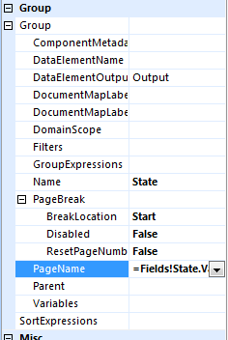
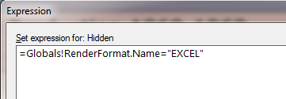
output to Excel
For “rich” Excel export:
Add sheet names for page breaks
Consider Excel-specific visibility

Slide 45
no more tricks

Slide 46
agenda
Use tablix to organize data
Use graphics and colors to emphasize data
Choose the right visual
More tricks

Slide 47
objective
After this session, you will be able to design reports that encourage immediate understanding and make insights pop.

Slide 48
Related content
DBI-B316: Running BI Workloads on Windows Azure Virtual Machines

Slide 49
Track Resources
Download Data Explorer
SQL Server Website
Hands-On Labs
@sqlserver
Download Geoflow
Get Certified!
mva
Windows Azure
Microsoft Virtual Academy

Slide 50
Resources
Learning
Sessions on Demand
Microsoft Certification & Training Resources
http://channel9.msdn.com/Events/TechEd
www.microsoft.com/learning
TechNet
msdn
Resources for IT Professionals
Resources for Developers
http://microsoft.com/technet
http://microsoft.com/msdn

Slide 51
Complete an evaluation on CommNet and enter to win!

Slide 52
Evaluate this session
Required Slide
*delete this box when your slide is finalized
Your MS Tag will be inserted here during the final scrub.
Scan this QR code to evaluate this session and be automatically entered in a drawing to win a prize

Slide 53
© 2013 Microsoft Corporation. All rights reserved. Microsoft, Windows and other product names are or may be registered trademarks and/or trademarks in the U.S. and/or other countries.
The information herein is for informational purposes only and represents the current view of Microsoft Corporation as of the date of this presentation. Because Microsoft must respond to changing market conditions, it should not be interpreted to be a commitment on the part of Microsoft, and Microsoft cannot guarantee the accuracy of any information provided after the date of this presentation. MICROSOFT MAKES NO WARRANTIES, EXPRESS, IMPLIED OR STATUTORY, AS TO THE INFORMATION IN THIS PRESENTATION.

