Slide 2
Enriching Big Data for Analysis
DBI-B401
Lara Rubbelke, Microsoft
Adam Jorgensen, Pragmatic Works

Slide 3
Data Science
Business Intelligence
Data Mining
Real-Time
Query
Analytics
Hive
Operational
Batch
Self-Service
Hadoop DB
Data Warehouse
Predictive
Pivot
Machine Learning
SQL
Visualization
Map Reduce
Pig
Insight
Ad-Hoc
Map Reduce
Hadoop
Reporting
Interactive
Dremel
Exploratory
Cloud Scale
Drill
Unstructured
Social
Big Query
Text Analytics
The Digital Shoebox

Slide 4
Data Consumption
Analysis/Modeling/Query/Reporting/Visualization
Data Refinement
Aggregation/Compression/Transformation/Extraction
Data Acquisition
Streaming/Trickle/Bulk Transfer

Slide 5
Analyzing Flight Delays
Excel, Power View, PowerPivot, Data Explorer
HTTP
ODBC
ODBC
Windows Azure HDInsight Service
ODBC
SQL Server Analysis Services
ASV
Hive
Windows Azure Blob Storage
Gzip Files & Transfer to ASV via AZCopy

Slide 6
HDInsight Service

Slide 7
Hadoop architecture.
Active Directory (Future)
Pipeline / workflow
(Oozie)
Metadata
(HCatalog)
Graph
(Pegasus)
Stats processing
(RHadoop)
Business Intelligence
(Excel, Power View, SSAS…)
NoSQL Database
(HBase)
Scripting
(Pig)
Query
(Hive)
Machine Learning
(Mahout)
Data Integration
( ODBC / SQOOP/ REST)
System Center
(Future)
Log file aggregation
(Flume)
Distributed Processing
(Map Reduce)
Distributed Storage
(HDFS)

Slide 8
Storage Infrastructure
Azure Storage Vault (ASV)
Azure Blob Storage
Azure Flat Network Storage
HDInsight Compute Nodes (Large VMs)
http://dennyglee.com/2013/03/18/why-use-blob-storage-with-hdinsight-on-azure/

Slide 9
Storage Infrastructure
Stream data
to compute
Push data
back to storage
Azure Storage Vault (ASV)
Azure Blob Storage
Azure Flat Network Storage
map
sort
shuffle
reduce
HDInsight Compute Nodes (Large VMs)
http://dennyglee.com/2013/03/18/why-use-blob-storage-with-hdinsight-on-azure/

Slide 10
Using Azure Storage with HDInsight
Good CMD CLI support (Not fs or DFS commands)
Example Access URI
asv[s]://[<container>@]<accountname>.blob.core.windows.net/<path>
Filesystems Available to Hdinsight
Default, Public, Private (with edit to core-site.xml file
<property>
<name>fs.azure.account.key.<accountname>.blob.core.microsoft.com</name>
<value><enterthekeyvaluehere></value>
</property>

Slide 11
Data Acquisition

Slide 12
Data Movement to the Cloud
Windows Azure Blob Storage Perks
Data Reuse
HDInsight Cluster Independence
Lower Cost
Geo Replication
Elastic Scale of Storage
Scale tips
Fewer, larger files is better than many, smaller files
Test different file formats to find optimal performance and support
Multiple storage accounts for concurrent loads where possible
Thur 1pm – 2:15pm
DBI-B334 Data Management in Microsoft HDInsight: How to Move and Store Your Data

Slide 13
Data Movement to the Cloud Compress Files
Saves about 80-90% space
HDInsight supports Gzip, BZ2, and Deflate (Hive)
Reduces disk I/O and network traffic
Costs less for direct storage costs
Microsoft Whitepaper on Compression in HDInsight

Slide 14
Data Movement to the Cloud Move Files
Microsoft Solutions
AZCopy
Portal UI (Small Files)
Hadoop Command Line Interface (CLI)
Third Party
Aspera
Attunity CloudBeam

Slide 15
AZCopy
Copy all files with recursion and verbose
AzCopy "C:\Flights" https://storagename.blob.core.windows.net/data/flights /destKey:InsertKey /S /V
Copy all files which have oct in the file name
AzCopy "C:\Flights" https://storagename.blob.core.windows.net/data/flights oct /destKey:InsertKey /S
Similar to robocopy for Azure Storage
Copy to/from Azure Storage
Between Local Filesystem and Azure
Between Storage Accounts

Slide 16
Data Refinement

Slide 17
Analyzing Flight Delays
Excel, Power View, PowerPivot, Data Explorer
HTTP
ODBC
ODBC
Windows Azure HDInsight Service
ODBC
SQL Server Analysis Services
ASV
Hive
Windows Azure Blob Storage
Gzip Files & Transfer to ASV via AZCopy

Slide 18
Data Preparation with Hive & Pig
Create structure over files
Process and refine data with SQL syntax
Generates/runs MapReduce
“Data Warehouse” focused
Process & shape data
Scripting language for ETL/ELT
Generates/runs MapReduce

Slide 19
Hive Architecture
Hive
HiveQL
Metastore
ODBC
JDBC
Hive Web Interface (HWI)
Command Line Interface (CLI)
Thrift Server
Compiler, Optimizer, Executor
Hadoop
Head Node
Name Node
Data Nodes / Task Nodes

Slide 20
Data Preparation with Hive
CREATE EXTERNAL TABLE flights(…column definitions…)
fields terminated by ','
lines terminated by '\n'
stored as textfile
location 'asv://cluster.blob.core.windows.net/flights_raw';
Use EXTERNAL when
Data used outside Hive
You need data to be updatable in real time
Data needed when you drop the cluster or the table
Hive should not own data and control settings, dirs, etc.
Use INTERNAL when
You want Hive to manage the data and storage
Short term usage
Creating table based on existing table (AS SELECT)

Slide 21
Data Preparation with Hive
Statement Level Compression
set mapred.output.compress=true;
set hive.exec.compress.output=true;
set mapred.output.compression.codec=org.apache.hadoop.io.compress.GzipCodec;
CREATE EXTERNAL TABLE flights(…column definitions…)
partitioned by (Year string)
fields terminated by ','
lines terminated by '\n'
stored as textfile
LOCATION 'asv://storage.blob.core.windows.net/flights
ALTER TABLE flights ADD PARTITION (Month= ‘10’)
LOCATION 'asv://storage.blob.core.windows.net/flights/flights_raw_10';
ALTER TABLE flights ADD PARTITION (Year = ‘11’)
LOCATION 'asv://storage.blob.core.windows.net/flights/flights_raw_11';
…
Partition

Slide 22
Hive Best Practices
Performance
Fewer, larger files are better
Partition for range searches
Order of tables, columns in queries can affect performance, largest table last!
Indexes may help some queries, but have limitations
Compress where possible… but be sure that user tools will read compression
Operations
Supports textfile, sequence file, RCfile, avro
Use Hive and XML File Processing for XML files
Remove headers before loading
Partition for loading
Configuration
Configure your SmallFileSize and number of reducers to match your workload

Slide 23
Tuning Your Hive
Know before you go!
Leverage Best Practices (partitioning, compression, etc.. )
Know your Join Types
What size tables are you joining?
Did you update your configuration files correctly?
How to Use Explain
Add EXPLAIN before the last query you run in your batch to generate Abstract Syntax Tree
Be careful with LIMIT statement
Watch for bottlenecks between MAPS/Reducers – You may need more nodes ☺

Slide 24
Data Consumption

Slide 25
Analyzing Flight Delays
Excel, Power View, PowerPivot, Data Explorer
HTTP
ODBC
ODBC
Windows Azure HDInsight Service
ODBC
SQL Server Analysis Services
ASV
Hive
Windows Azure Blob Storage
Gzip Files & Transfer to ASV via AZCopy

Slide 26
Data Explorer
Suited for self-service data that fits in Excel
Data driven shaping – design while you drive
Ideal for sampling data – Take care with the size of the data
Partition data in Hadoop/Hive based on user workloads
No governors to prevent users from pulling “too much data”
Does not read compressed or binary files
Search, Access & Shape
Simplify access to data in Hadoop
Easily preview, shape, & format your data
Combine with Unstructured
Combine and refine data across multiple sources
Gain insight across relational, unstructured, & semi-structured data

Slide 27
Scale for Everyone! Why do we need Analysis Services?
Quality & Accuracy
Cleanse data and improve data quality
Combine unstructured, multi-structured, and structured data
Client Tools
Analysis, Reports, Scorecards, Dashboards, Custom Apps
Scale User-driven BI
Build and deploy secure & scalable BI solutions
Deliver metadata management capabilities
BI Semantic Model
Data model
Business logic & queries
Data access
Security, Governance & Compliance
Deliver credible, consistent data to the right users
Data Sources
Databases, LOB Applications, Big Data, Odata Feeds, Spreadsheets, Text Files

Slide 28
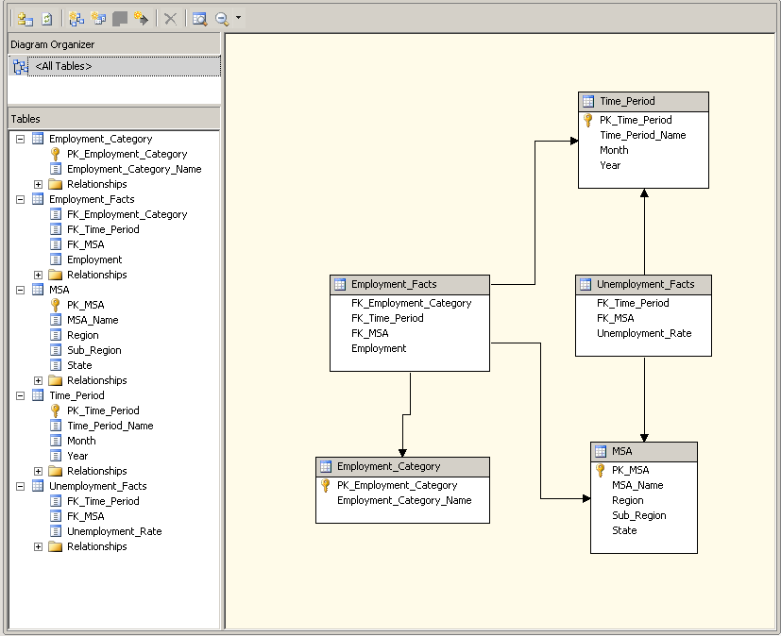
Scale for Everyone!
Analysis Services OLAP Integration
http://technet.microsoft.com/en-us/library/jj710329.aspx

Slide 29
Scale for Everyone!
Analysis Services
Install SQL Server
Create Linked Server to Hive
Create Views for Hive tables
Use Views in Data Source View
Proceed with caution!
Remember to use SSAS Best Practices for large scale Analysis Services cubes.
Performance Guide: http://sqlcat.com/sqlcat/b/whitepapers/archive/2011/10/10/analysis-services-2008-r2-performance-guide.aspx
Operations Guide: http://sqlcat.com/sqlcat/b/whitepapers/archive/2011/06/01/sql-server-2008r2-analysis-services-operations-guide.aspx

Slide 30
SSAS Tabular with HDInsight
No Direct Query Support
Use Compression in Hive to speed processing
Partition in tabular AND hive
Improved end to end loading performance
Know before you go!
ODBC Driver
SSDT 32 Bit
Service Account Configuration
User DSN > Service Account as You with Access > Connect with Service Account

Slide 31
Where Do I Deploy BI?
Balance the costs of egress and latency to move data off the cloud with the storage and compute of a Windows Azure VM
Azure IaaS
On-Prem
PowerShell to Create a Azure VM Running SQL Server Business Intelligence

Slide 32
Scale for Everyone!
PolyBase
Scale unstructured and relational data together
Create SQL Tables (As Select) direct from Hadoop
Create Hive Tables (as Select) direct from PDW
Leverage Infiniband performance within your Hadoop cluster

Slide 33
Next Steps

Slide 34
Next Steps
Read a bit
HDInsight Documentation and Tutorials
Programming Hive Book
http://blogs.msdn.com/cindygross
Sign up: Windows Azure HDInsight Service http://www.windowsazure.com/en-us/home/features/preview/
Download Microsoft HDInsight Developer Preview http://www.microsoft.com/web/gallery/install.aspx?appid=HDINSIGHT-PREVIEW
Download Data Explorer
http://www.microsoft.com/en-us/download/details.aspx?id=36803
Download GeoFlow
http://www.microsoft.com/en-us/download/details.aspx?id=38395

Slide 35
Big Data Resources
Hadoop: The Definitive Guide by Tom White
SQL Server Sqoop http://bit.ly/rulsjX
JavaScript http://bit.ly/wdaTv6
Twitter https://twitter.com/#!/search/%23bigdata
HortonWorks Sandbox http://www.hortonworks.com
Azure Data Marketplace ttp://datamarket.azure.com/
Top 50 Big Data Influencers http://bit.ly/153e1yJ
PASS Big Data Virtual Chapter http://www.sqlpass.org
Hive http://hive.apache.org
Excel to Hadoop via Hive ODBC http://tinyurl.com/7c4qjjj
Hadoop On Azure Videos http://tinyurl.com/6munnx2
Klout http://tinyurl.com/6qu9php
Microsoft Big Data http://microsoft.com/bigdata
Denny Lee http://dennyglee.com/category/bigdata/
Carl Nolan http://tinyurl.com/6wbfxy9
Cindy Gross http://tinyurl.com/SmallBitesBigData

Slide 36
Track Resources
Download Data Explorer
SQL Server Website
Hands-On Labs
@sqlserver
Download Geoflow
Get Certified!
mva
Windows Azure
Microsoft Virtual Academy

Slide 37
Resources
Learning
Sessions on Demand
Microsoft Certification & Training Resources
http://channel9.msdn.com/Events/TechEd
www.microsoft.com/learning
TechNet
msdn
Resources for IT Professionals
Resources for Developers
http://microsoft.com/technet
http://microsoft.com/msdn

Slide 38
Complete an evaluation on CommNet and enter to win!

Slide 39
Evaluate this session
Required Slide
*delete this box when your slide is finalized
Your MS Tag will be inserted here during the final scrub.
Scan this QR code to evaluate this session and be automatically entered in a drawing to win a prize

Slide 40
© 2013 Microsoft Corporation. All rights reserved. Microsoft, Windows and other product names are or may be registered trademarks and/or trademarks in the U.S. and/or other countries.
The information herein is for informational purposes only and represents the current view of Microsoft Corporation as of the date of this presentation. Because Microsoft must respond to changing market conditions, it should not be interpreted to be a commitment on the part of Microsoft, and Microsoft cannot guarantee the accuracy of any information provided after the date of this presentation. MICROSOFT MAKES NO WARRANTIES, EXPRESS, IMPLIED OR STATUTORY, AS TO THE INFORMATION IN THIS PRESENTATION.

Slide 41
Appendix

