Slide 2
TypeScript: Scaling up JavaScript
DEV-B203
Jonathan Turner

Slide 3
Session Objective and Takeaways
Why TypeScript?
Discuss the overarching goals of TypeScript and the problems it addresses.
What is TypeScript?
Identify TypeScript's key features and how those features help build JavaScript applications.
What’s next in TypeScript
Understand how TypeScript will evolve towards its final release later this year.

Slide 4
Application scale JavaScript development is hard.

Slide 5
TypeScript is a language for application scale JavaScript development.

Slide 6
TypeScript is a typed superset of JavaScript that compiles to plain JavaScript.

Slide 7
TypeScript is a typed superset of JavaScript that compiles to plain JavaScript. Any browser. Any host. Any OS. Open Source.

Slide 8
TypeScript
Starts with JavaScript
All JavaScript code is TypeScript code, simply copy and paste
All JavaScript libraries work with TypeScript
Optional static types, classes, modules
Enable scalable application development and excellent tooling
Zero cost: Static types completely disappear at run-time
Ends with JavaScript
Compiles to idiomatic JavaScript
Runs in any browser or host, on any OS

Slide 9
TypeScript Demo

Slide 10
TypeScript preview
Compiler
Open Source, written in TypeScript
Tooling
Visual Studio language service, browser hosted playground
Libraries
Static typing of DOM, jQuery, node.js, WinRT, WinJS, …
And More
Lots of samples and formal Language Specification

Slide 11
TypeScript so far…
Community response
Over 2100 CodePlex posts, 80 forks, 600 StackOverflow questions, and 175 feature requests
TypeScript ecosystem
Over 130 *.d.ts library typings developed by library creators and users
TypeScript support in tools
ASP.NET, node.js, compile-in-client, Ruby, grunt, and more

Slide 12
Application scale JavaScript development is hard.

Slide 13
Application scale JavaScript development is hard. TypeScript makes it easier. http://typescriptlang.org

Slide 14
Resources
Learning
Sessions on Demand
Microsoft Certification & Training Resources
http://channel9.msdn.com/Events/TechEd
www.microsoft.com/learning
TechNet
msdn
Resources for IT Professionals
Resources for Developers
http://microsoft.com/technet
http://microsoft.com/msdn

Slide 15
Plan details and subscriber benefits
Free Plan for up to 5 users
Included for certain paid MSDN subscribers:
Version control (TFVC or Git)
Comment on changesets & commits
Work item tracking and tagging
Team rooms
Agile planning tools
Feedback Management
Agile Portfolio Management*
Build*
Web-based test case management*
Load testing*
New!
New!
New!
New!
Additional information at http://tfs.visualstudio.com
* Capability in preview – limits may apply. Authoring load tests requires Visual Studio Ultimate 2013 Preview.

Slide 16
MSDN Subscribers – Accelerate Your Development & Test using Cloud VMs We’ve enhanced the Windows Azure MSDN benefit and added cloud use rights for select MSDN software. You’ve already got it, now use it!
Activate and try out your Windows Azure MSDN benefit today & you could win an Aston Martin V8 Vantage!
Learn more and activate today at http://aka.ms/AzureContest

Slide 17
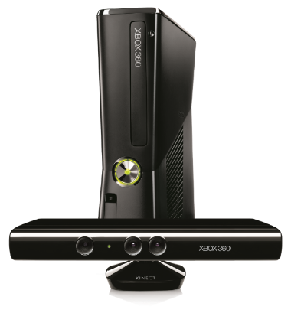
Complete an evaluation on CommNet and enter to win!

Slide 18
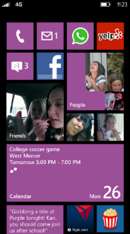
Evaluate this session
Required Slide
*delete this box when your slide is finalized
Your MS Tag will be inserted here during the final scrub.
Scan this QR code to evaluate this session and be automatically entered in a drawing to win a prize

Slide 19
© 2013 Microsoft Corporation. All rights reserved. Microsoft, Windows and other product names are or may be registered trademarks and/or trademarks in the U.S. and/or other countries.
The information herein is for informational purposes only and represents the current view of Microsoft Corporation as of the date of this presentation. Because Microsoft must respond to changing market conditions, it should not be interpreted to be a commitment on the part of Microsoft, and Microsoft cannot guarantee the accuracy of any information provided after the date of this presentation. MICROSOFT MAKES NO WARRANTIES, EXPRESS, IMPLIED OR STATUTORY, AS TO THE INFORMATION IN THIS PRESENTATION.

