Slide 2
Building an MVVM-Based Architecture That Works
DEV-B304
Chris Klug
chris@activesolution.se
@ZeroKoll

Slide 3
Who is that guy?

Slide 4
Welcome to the messed up world that is my head!

Slide 5
Shu Ha Ri ”first learn, then detach, and finally transcend”

Slide 7
Architecture is the differentiator

Slide 8
Simplify development or maintenance

Slide 9
UI
View
Application Logic
ViewModel
Model
Out of the box approach
Model-View-ViewModel (MVVM)

Slide 10
View
ViewModel
Services
Model

Slide 11
View
ViewModel
Services
Model
Platform-specific
functionality

Slide 12
Portable Class Library Forcing separation / guiding architecture

Slide 13
View
Platform specific
ViewModel
Portable/Common
Services
Service Implementation
Platform specific
Model
Platform-specific
functionality
Portable/Common

Slide 14
To framework or not to framework NuGet, BYO or maybe “plain vanilla”

Slide 15
Dependency Inversion

Slide 16
Options for DI
Singleton
Factory
Service Locator
Dependency Injection

Slide 17
VM <> V Communication Coupling, interfaces or bindings

Slide 18
VM <> VM Communication Events, callbacks or event aggregator

Slide 19
Asynchronocity Yes…you have to go there…

Slide 20
Action<T> || async/await
Flexible and easy to use || Simple, easy and integrated
Manual threading || Simplicity
Backwards compatible || NuGet Microsoft.Bcl.Async

Slide 21
Useful platform abstractions NavigationService, Dispatcher, Application

Slide 22
Questions? ”There is no such thing as a stupid question” chris@59north.com @ZeroKoll http://chris.59north.com/

Slide 23
Resources
Learning
Sessions on Demand
Microsoft Certification & Training Resources
http://channel9.msdn.com/Events/TechEd
www.microsoft.com/learning
TechNet
msdn
Resources for IT Professionals
Resources for Developers
http://microsoft.com/technet
http://microsoft.com/msdn

Slide 24
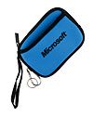
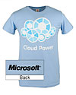
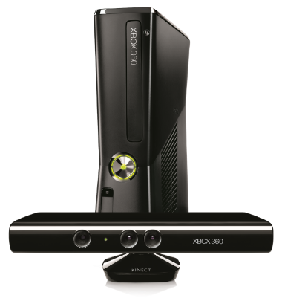
Complete an evaluation on CommNet and enter to win!

Slide 25
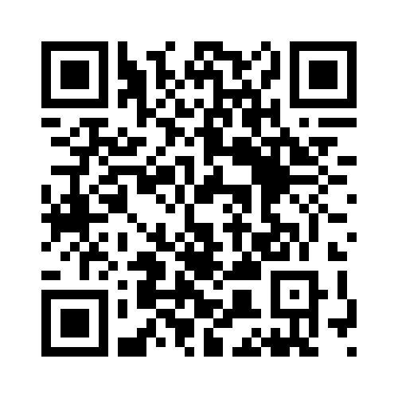
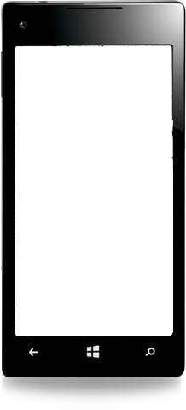
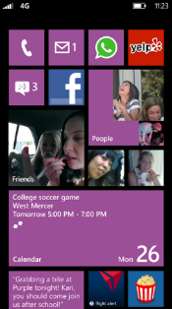
Evaluate this session
Required Slide
*delete this box when your slide is finalized
Your MS Tag will be inserted here during the final scrub.
Scan this QR code to evaluate this session and be automatically entered in a drawing to win a prize

Slide 26
© 2013 Microsoft Corporation. All rights reserved. Microsoft, Windows and other product names are or may be registered trademarks and/or trademarks in the U.S. and/or other countries.
The information herein is for informational purposes only and represents the current view of Microsoft Corporation as of the date of this presentation. Because Microsoft must respond to changing market conditions, it should not be interpreted to be a commitment on the part of Microsoft, and Microsoft cannot guarantee the accuracy of any information provided after the date of this presentation. MICROSOFT MAKES NO WARRANTIES, EXPRESS, IMPLIED OR STATUTORY, AS TO THE INFORMATION IN THIS PRESENTATION.

