Slide 2
DirectX Graphics Development with Microsoft Visual Studio 2012
DEV-B322
Eric Battalio
ebattali@microsoft.com

Slide 3
http://www.halowaypoint.com/halo4/en-US#!images/screenshots/ce74650a-bfc6-4126-a02d-d7db778eff25

Slide 4
Spoilers
DirectX is not just for games!
Visual Studio 2012 and DirectX can help you create unique store apps that stand out from the crowd
Manage your graphics assets
Debug with graphics diagnostic tools (Alt-F5)
Join the community

Slide 5
Agenda
Overview of DirectX
Build a simple proof-of-concept app using C++
Debug our app using graphic diagnostic tools
Brainstorm ways to extend the app

Slide 6
What makes a great app?
Easy to use
Fast and fluid
Aesthetically pleasing
Smart interaction
Just works
Unique experience

Slide 8
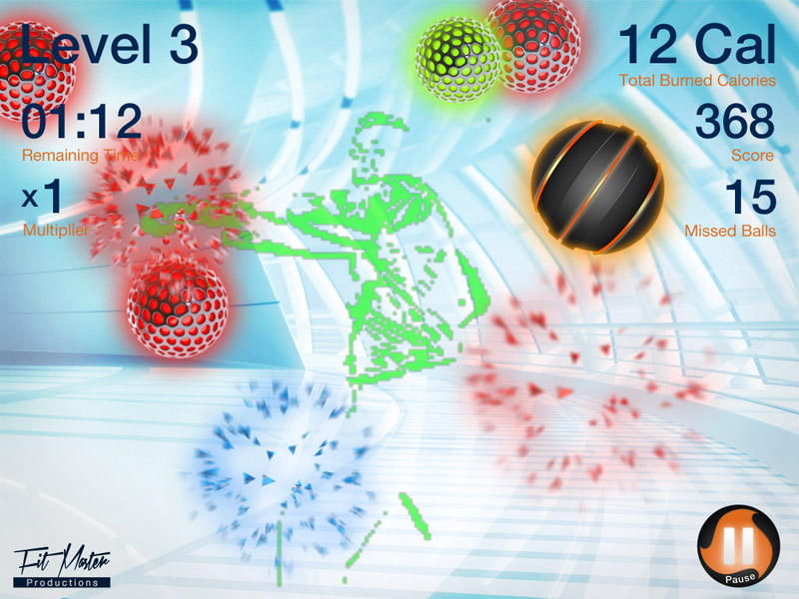

Slide 9
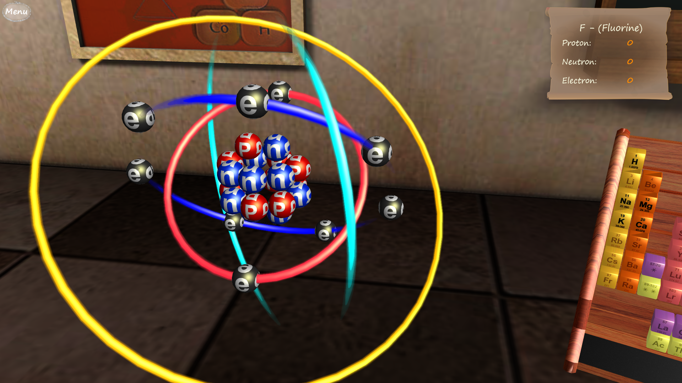

Slide 10
DirectX can help!
Multimedia APIs, not just graphics
Includes Direct2D / Direct3D, DirectWrite, DirectXMath
XAudio2, and XInput
Current version is 11.1

Slide 11
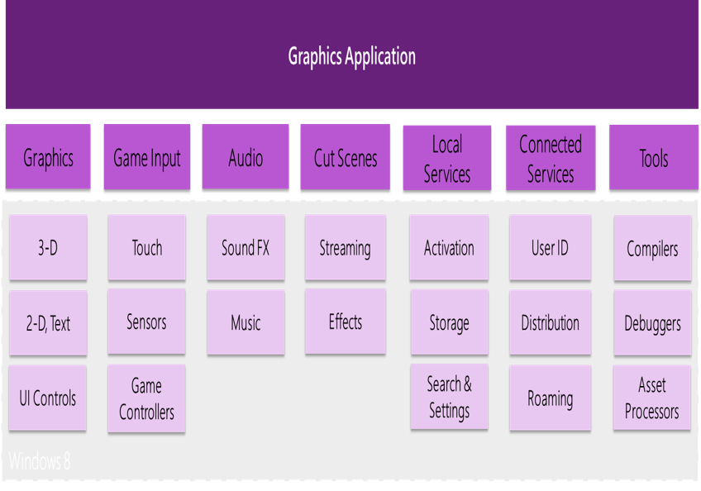
DirectX for Windows 8 developers
Direct3D 11.1 support for Windows Store and desktop apps
Visual Studio tooling

Slide 12
Demo
Virtual Experiment Laboratory
Developed by Gokhan Sengun, Netas Telekomunikasyon A.S.

Slide 13
You don’t have to start from scratch
Visual Studio 2012 templates
Windows Store Direct3D, Windows Phone 8 Direct3D, C++ Win32 for desktop apps, …
Samples
80+ samples for DirectX in Visual Studio 2012 on MSDN Code Gallery
DirectX Toolkit (DirectXTK)
Visual Studio 3D Starter Kit

Slide 14
You don’t have to start over
Use C++ with DirectX APIs
Write other parts of your app in VB or C#
Combine XAML and DirectX in the same app
Develop for Windows Store, Windows Desktop, Windows Phone 8

Slide 15
You don’t have to start big
Start with a proof of concept
Work out all the kinks
Add new features incrementally
Solicit feedback

Slide 16
Demo
Probability lab proof of concept – rolling a die

Slide 17
We have a prototype!
Began with the VS 3D Starter Kit
Created the die with the mesh editor
Brought the die to life with physics and C++

Slide 18
Demo
The app lands in QA

Slide 19
Graphics debugging scenarios
Seeing how the device is set up
See all DirectX events for a particular frame
See a draw event move through a graphics pipeline
See the call stack for a particular DirectX event
See how a pixel is changed by DirectX events
Step through HLSL code
Analyze Direct3D objects and resources

Slide 20
Primary ways to debug DirectX 11.1 code
Capture locally using Visual Studio Graphics Debugger
Capture remotely using capture API

Slide 21
How do you start graphics diagnostics?
Alt-F5
Debug > Graphics > Start Diagnostics

Slide 22
Demo
Tracking down issues in the prototype app

Slide 23
Extending the app
Add more die and supporting objects
Spice it up with ambient sounds, music
Increase interactivity
Bonus: Learn how to deploy the app and more with expert Roberto Sonnino at aka.ms/3dkdice
Bonus: Go behind the scenes of the Virtual Experiment Laboratory with Gokhan Sengun at aka.ms/virtlabintv

Slide 24
Learn more from the community
Physics libraries, image tools
Samples, code snippets, frameworks
Discussion, advice, feedback
Contribute and share your experiences!

Slide 25
Pop Quiz!
How do you launch the graphics debugger?
How do you capture a frame?
Where can you share your development experiences?

Slide 26
Plan details and subscriber benefits
Free Plan for up to 5 users
Included for certain paid MSDN subscribers:
Version control (TFVC or Git)
Comment on changesets & commits
Work item tracking and tagging
Team rooms
Agile planning tools
Feedback Management
Agile Portfolio Management*
Build*
Web-based test case management*
Load testing*
New!
New!
New!
New!
Additional information at http://tfs.visualstudio.com
* Capability in preview – limits may apply. Authoring load tests requires Visual Studio Ultimate 2013 Preview.

Slide 27
MSDN Subscribers – Accelerate Your Development & Test using Cloud VMs We’ve enhanced the Windows Azure MSDN benefit and added cloud use rights for select MSDN software. You’ve already got it, now use it!
Activate and try out your Windows Azure MSDN benefit today & you could win an Aston Martin V8 Vantage!
Learn more and activate today at http://aka.ms/AzureContest

Slide 28
Resources
Learning
Sessions on Demand
Microsoft Certification & Training Resources
http://channel9.msdn.com/Events/TechEd
www.microsoft.com/learning
TechNet
msdn
Resources for IT Professionals
Resources for Developers
http://microsoft.com/technet
http://microsoft.com/msdn

Slide 29
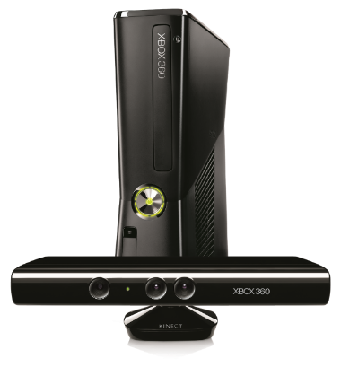
Complete an evaluation on CommNet and enter to win!

Slide 30
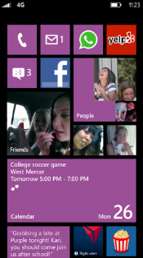
Evaluate this session
Required Slide
*delete this box when your slide is finalized
Your MS Tag will be inserted here during the final scrub.
Scan this QR code to evaluate this session and be automatically entered in a drawing to win a prize

Slide 31
© 2013 Microsoft Corporation. All rights reserved. Microsoft, Windows and other product names are or may be registered trademarks and/or trademarks in the U.S. and/or other countries.
The information herein is for informational purposes only and represents the current view of Microsoft Corporation as of the date of this presentation. Because Microsoft must respond to changing market conditions, it should not be interpreted to be a commitment on the part of Microsoft, and Microsoft cannot guarantee the accuracy of any information provided after the date of this presentation. MICROSOFT MAKES NO WARRANTIES, EXPRESS, IMPLIED OR STATUTORY, AS TO THE INFORMATION IN THIS PRESENTATION.

