Slide 2
Testing and Debugging Microsoft SharePoint Applications with Microsoft Visual Studio 2012
DEV-B332
Benjamin Day & Brian Randell

Slide 3
Who are these guys?

Slide 4
Benjamin Day
Brookline, MA
Consultant, Coach, & Trainer
Microsoft MVP for Visual Studio ALM
Team Foundation Server, Software Testing, Scrum, Software Architecture
Scrum.org Classes
Professional Scrum Developer (PSD)
Professional Scrum Foundations (PSF)
www.benday.com, benday@benday.com, @benday

Slide 5
Brian A. Randell
Partner with MCW Technologies
Microsoft MVP for Visual Studio ALM
Member of Pluralsight’s Technical Staff
brianr@mcwtech.com | @brianrandell | www.mcwtech.com/blogs/brianr

Slide 6
Here’s the mission.

Slide 7
Show you the testing & debugging features in Visual Studio 2012.

Slide 8
Apply the Visual Studio 2012 testing features to your SharePoint code.

Slide 9
Show you why you should care.

Slide 10
Debug stuff.

Slide 11
The testing features.
Test the ‘guts’ with Unit Tests & the VS Fakes Framework
Test a user interface with Coded UI Tests
Find performance problems with Load Tests

Slide 12
Debugging features.
IntelliTrace
IntelliTrace
IntelliTrace

Slide 13
What’s a unit test?

Slide 14
It’s code-based proof that your stuff works.

Slide 15
Small chunks of code that run and validate small chunks of code in your app.

Slide 16
Small chunk = unit test

Slide 17
Lots of small chunks = the test suite.

Slide 18
Automated.

Slide 19
Should run fast.

Slide 20
Should not get in your way.

Slide 21
If something in your automated test suite is failing…

Slide 22
…your app is broken.

Slide 23
Unit tests are automated debugging.

Slide 24
“Now what does this have to do with an airplane bathroom?”

Slide 25
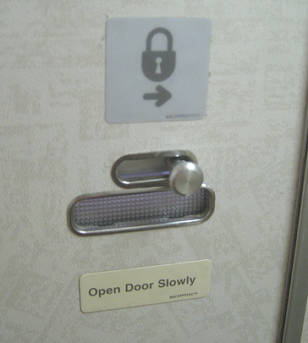
How would you test this?

Slide 26
Anything that makes it hard to test causes…

Slide 27
…testing friction.

Slide 28
The Microsoft Fakes Framework helps you to minimize testing friction.

Slide 29
The Microsoft Fakes Framework
Unit test in isolation
Use delegates & lambda expressions
Shims
(Magic)
Substitute hard-coded types with *something else* at runtime
Stubs
Helps if you’re interface-driven
Creates default() implementations of an interface
including properties & methods

Slide 30
Fakes & Unit Tests with SharePoint

Slide 31
Sweet.

Slide 32
“What if it doesn’t go as smoothly as your demo?”

Slide 33
Debugging.

Slide 34
Actually, have you looked at the debugging features lately?

Slide 35
(Ben hadn’t.)

Slide 36
There’s a lot more than just watch windows, breakpoints, and F11.

Slide 37
Breakpoint labeling.

Slide 38
Import & Export Breakpoints.

Slide 39
Conditional breakpoints.

Slide 40
Breakpoint hit counts.

Slide 41
Pinnable data tips.

Slide 42
Import & export data tips.

Slide 43
And then there’s the 800 lb. gorilla of debugging in Visual Studio 2012…

Slide 44
IntelliTrace

Slide 45
IntelliTrace®

Slide 46
… because

Slide 47
F11 can start to suck

Slide 48
IntelliTrace serves you …

Slide 49
2 ways

Slide 50
live debugging

Slide 51
historical debugging

Slide 52
With SharePoint, you can do both.

Slide 53
IntelliTrace captures debugger state information during program execution.

Slide 54
It’s all about eliminating the “no repro” scenario.

Slide 55
IntelliTrace collects: IntelliTrace Events Method entry/exit calls Breakpoints

Slide 56
IntelliTrace live debugging supports two modes: Events only Events and Methods

Slide 57
IntelliTrace
A feature of Visual Studio Ultimate
Visual Studio 2010 provides live debugging and historical debugging (from test)
Visual Studio 2012 adds historical debugging (from production)
Supports managed code only
Visual Basic and Visual C# version 2.0 and higher
Visual Studio 2012 Update 2 provides enhanced support specific to SharePoint 2010 and 2013

Slide 58
Live Debugging with IntelliTrace

Slide 59
Awesome.

Slide 60
So we’ve got tests for the innards.

Slide 61
What about the user interface?

Slide 62
“Gimme something for the tedium.”

Slide 63
Coded UI Tests.

Slide 64
Unit Tests vs. Coded UI Tests
Unit Tests
Coded UI Tests
Tests at the API level
If it tests a UI, it’s testing an abstraction.
(not quite testing the UI)
UI testing has been hard
Test stuff as you build it
UI testing
Test a running application
Simulates a user’s keyboard and mouse activities
Test stuff that’s pretty much done
Integration testing

Slide 65
Unit tests test your APIs. Coded UI Tests test your running user interfaces.

Slide 66
Coded UI with SharePoint

Slide 67
Wickid.

Slide 68
“But what if it’s slow?”

Slide 69
“Our company is toast if our SharePoint app is slow.”

Slide 70
Load Testing.

Slide 71
The Purpose of Load Testing
Identify the capabilities of your application
Possible goals
Explore
Verify
Find the limits
Crush

Slide 72
The Obligatory “Eat Your Vegetables” Slide.
Load test throughout the development cycle.
Catch problems early
Establish performance baseline
Watch for performance trends
Cheaper to fix early
Plan for performance
Best Practice

Slide 73
Cheaper to Fix Early
Graph courtesy of May-Dupp Info, LLC

Slide 74
Dose Of Reality
You know you should work that way.
You probably don’t.
You have problems.
How do you figure out what’s going wrong?

Slide 75
What is a Web Performance Test?
Test type in Visual Studio 2012 Ultimate
Exist in a Web Performance and Load Test project
Collection of HTTP requests
Simulates a user using an ASP.NET (or other web) application
Building block of Load Tests

Slide 76
Load Tests
Made up of…
...Web Performance Tests
…Unit Tests
Simulates lots of users hitting your app

Slide 77
Two ways to run load tests.
Generate load from Visual Studio 2012
Uses only 1 core/processor
Limited to 250 simulated users
Generate load from a Test Rig
Far better test
Simulate lots more users

Slide 78
Load Test Rig & The Application
Controller
Orchestrates
Licensing
PerfMon Counters
Agent (1..n)
Simulates users
Controller
Agent 1
SharePoint
Database
Agent 2
Coordinates & Gathers Information
Generates Load
Application Under Test
Agent n

Slide 79
Load Testing a SharePoint app

Slide 80
Nice

Slide 81
We’re almost done.

Slide 82
Remember earlier, we showed you IntelliTrace?

Slide 83
Wouldn’t it be cool if you could use that with your production sites?

Slide 84
You can.

Slide 85
IntelliTrace in Production
Free to collect
Download “xcopyable” package
Activate via command-line, PowerShell, whatever
Run app
Collect logs
Analyze with Visual Studio 2012 Ultimate
Visual Studio 2012 Update 2 provides enhanced support specific to SharePoint 2010 and 2013

Slide 86
historical debugging with IntelliTrace

Slide 87
In summary.

Slide 88
Unit testing.

Slide 89
The Fakes Framework.

Slide 90
IntelliTrace.

Slide 91
Coded UI Tests.

Slide 92
Load Testing.

Slide 93
Thank you.
www.mcwtech.com
www.benday.com

Slide 94
Resources
Learning
Sessions on Demand
Microsoft Certification & Training Resources
http://channel9.msdn.com/Events/TechEd
www.microsoft.com/learning
TechNet
msdn
Resources for IT Professionals
Resources for Developers
http://microsoft.com/technet
http://microsoft.com/msdn

Slide 95
Complete an evaluation on CommNet and enter to win!

Slide 96
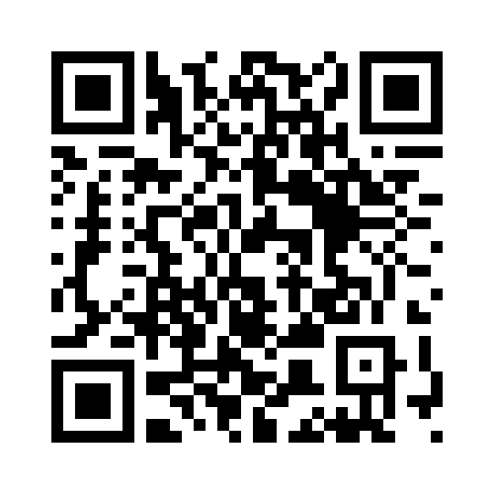
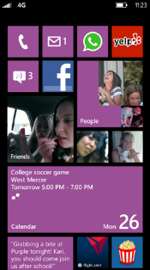
Evaluate this session
Required Slide
*delete this box when your slide is finalized
Your MS Tag will be inserted here during the final scrub.
Scan this QR code to evaluate this session and be automatically entered in a drawing to win a prize

Slide 97
© 2013 Microsoft Corporation. All rights reserved. Microsoft, Windows and other product names are or may be registered trademarks and/or trademarks in the U.S. and/or other countries.
The information herein is for informational purposes only and represents the current view of Microsoft Corporation as of the date of this presentation. Because Microsoft must respond to changing market conditions, it should not be interpreted to be a commitment on the part of Microsoft, and Microsoft cannot guarantee the accuracy of any information provided after the date of this presentation. MICROSOFT MAKES NO WARRANTIES, EXPRESS, IMPLIED OR STATUTORY, AS TO THE INFORMATION IN THIS PRESENTATION.

