Slide 2
Under the Hood of WinRT Background APIs
DEV-B403
Tony Champion

Slide 3
Agenda
Why do we need background APIs?
Explore the available APIs
Goal:
To understand the available background APIs and how they affect your Windows Store apps.

Slide 4
Why Background APIs?

Slide 5
App Life Cycle

Slide 6
Windows Store app Life Cycle
Running
App
Suspending
Suspended
App
Terminated
App
Low Resources
Resuming

Slide 7
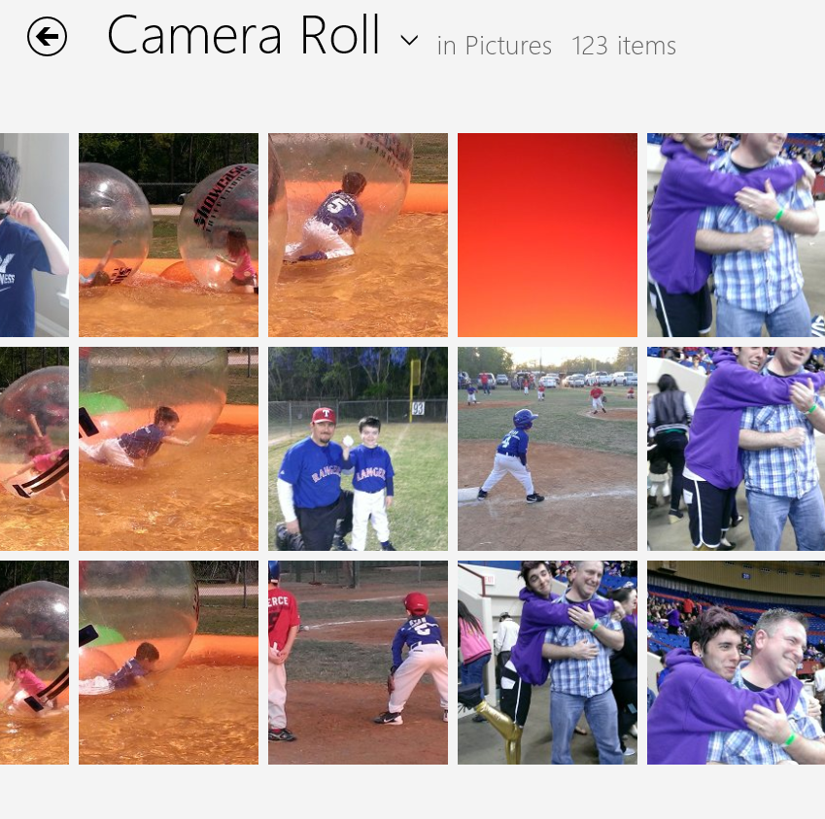
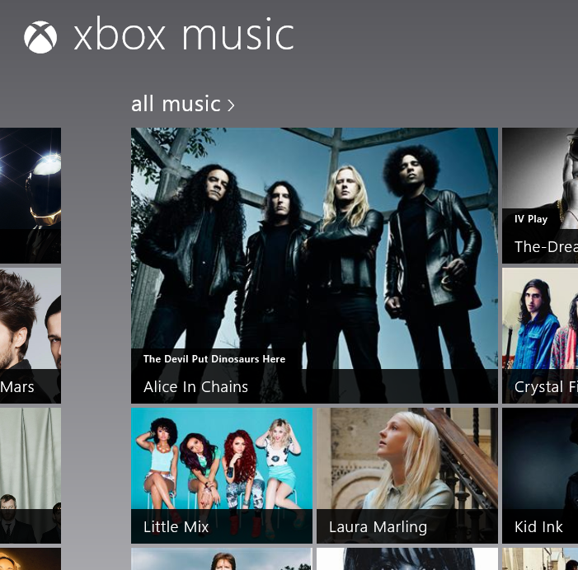
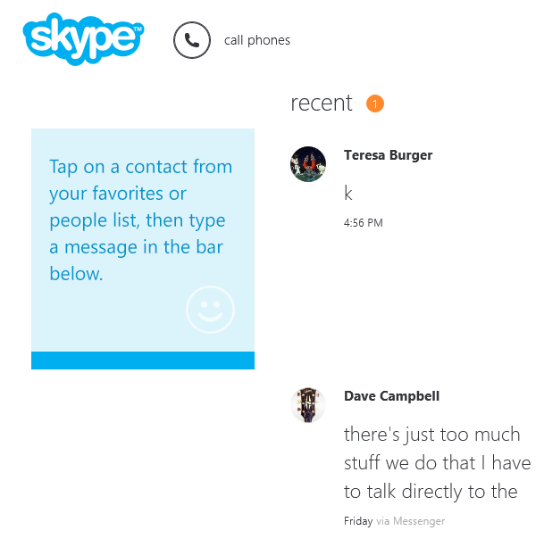
What type of apps does this affect?

Slide 8
What about LOB apps
Real time communications
Large data transfers
Periodic updates

Slide 9
Connecting with Device

Slide 10
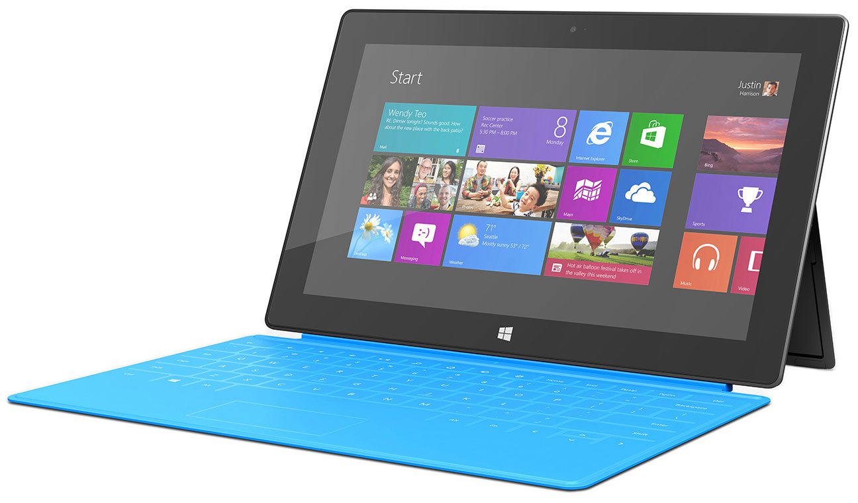
User logs on
Internet is available
Time zone changes
changes

Slide 11
Background APIs

Slide 12
Playing Audio and Video

Slide 13
Audio and Video
XAML
HTML
<audio/>
<video/>
<MediaElement/>

Slide 14
3 Requirements

Slide 15
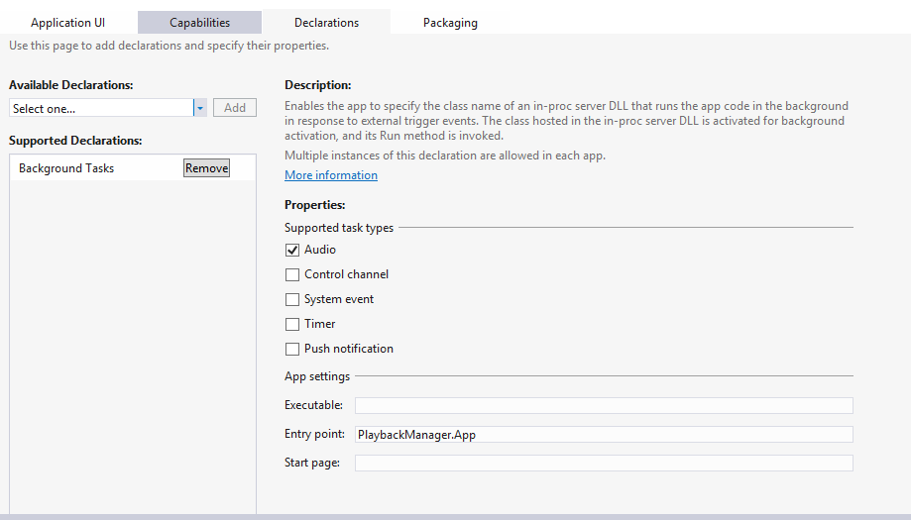

Slide 16
Audio Category
Two types support background audio categories
BackgroundCapableMedia
Communications
Local media playback
Streaming playlist
Streaming radio
Music videos
Movies and more…
Voice over IP (VoIP)
Real-time chat

Slide 17
Set Audio Category
HTML
audtag.setAttribute("msAudioCategory",
"backgroundcapablemedia");
C#
media.AudioCategory = AudioCategory.Communications;

Slide 18
Register for Transport Controls
Play / Pause
Sound Level
Next / Previous Track
Audio Information

Slide 19
Register for Transport Controls
MediaControl.PlayPauseTogglePressed += PlayPause;
MediaControl.PlayPressed += PlayPressed;
MediaControl.PausePressed += PausePressed;
MediaControl.StopPressed += StopPressed;

Slide 20
Background Audio
Tony Champion

Slide 21
Transferring Data

Slide 22
BackgroundTransfer APIs
Upload and download files outside of your app
Runs when app is suspended or terminated
App receives notifications when app is restarted
Supports multiple protocols
Protocol | Upload | Download
HTTP
HTTPS
FTP

Slide 23
Secure transfers
Supports multiple authentication schemes
Basic server credentials
Proxy credentials
Cookies
Custom HTTP headers

Slide 24
Network and Power Aware
Designed for power efficiency
Handles network status changes and glitches
Auto recovery
Uses Cost Policy to determine connection
Can prevent from transferring data on metered network

Slide 25
Transferring Files
Progress
Background
Downloader
Download Operation
Control
Start
Pause
Resume

Slide 26
Creating a Background Transfer
private async void DownloadFile(
Uri source,
StorageFile destinationFile)
{
var downloader = new BackgroundDownloader();
var dl = downloader.CreateDownload(source,
destinationFile);
await dl.StartAsync();
}

Slide 27
Reconnecting to Downloads
BackgroundDownloader.GetCurrentDownloadsAsync
Returns a collection of DownloadOperations
Can attach to progress events with AttachAsync

Slide 28
Background Transfers
Tony Champion

Slide 29
Background Tasks

Slide 30
Background Tasks
Execute code outside of your app in response to a system event
Will execute even if your app is suspended or terminated
Used for executing small amounts of code that required limited resources

Slide 31
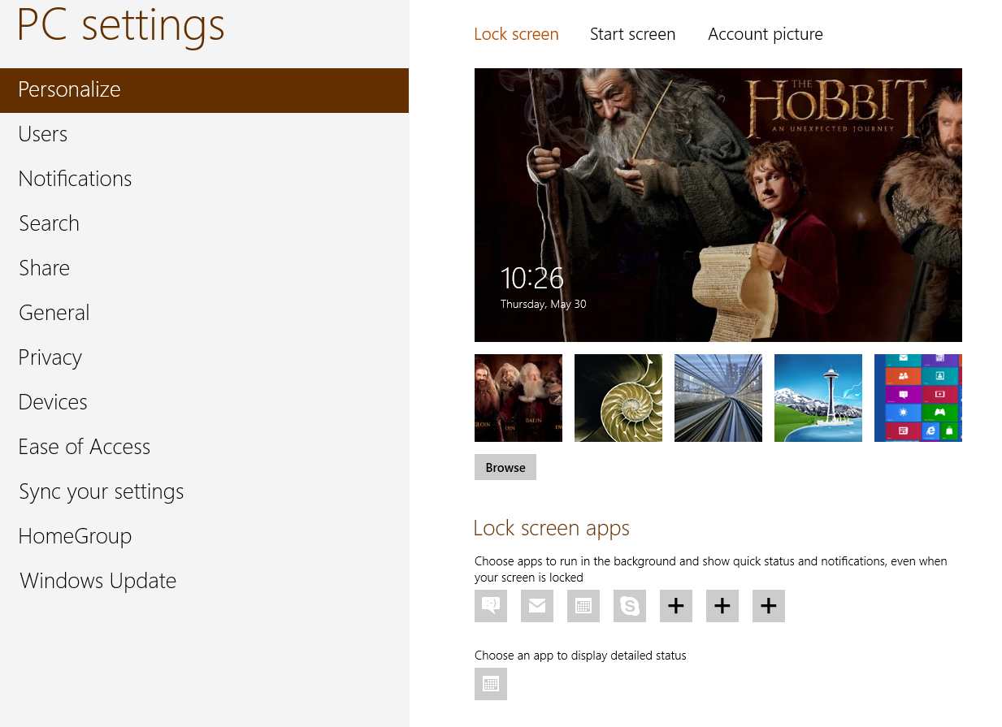

Slide 32
Lock Screen Benefits
Apps on the lock screen are given more benefits
Can run longer
Access to more network resources
Can be triggered more frequently
More event opportunities

Slide 33
Adding to Lock Screen
BackgroundExecutionManager.RequestAccessAsync
Can only set it once per app

Slide 34
Resource Quotas
System resource quotas are enforced on background tasks
 | CPU usage quota | Refresh time
App not on lock screen | 1 sec | 2 hrs
App on lock screen | 2 secs | 15 min

Slide 35
Network Quotas
Network quotas when on battery power
Based on 1 Mbps of throughput
All quotas are suspended when app is running
Refresh Time | 15 min | 2 hr | Daily
App not on lock screen | n/a | 0.625 MB | 7.5 MB
App on lock screen | 0.469 MB | 3.75 MB | 45 MB

Slide 36
Trigger
Each background task has a single trigger
Control Channel
Push Notification
Maintenance
Timer
System Event
Some triggers require app to be on lock screen

Slide 37
Conditions
Background tasks can have one or more conditions
Prevents task from running unnecessarily
Internet Available / Unavailable
Session Connected / Disconnected
User Present / Not Present

Slide 38
Prepping your Solution

Slide 39
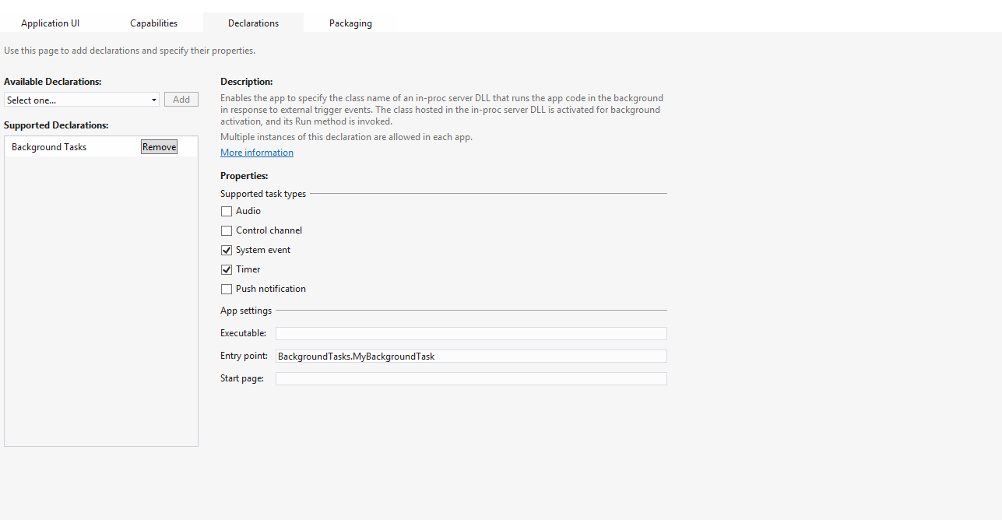

Slide 40
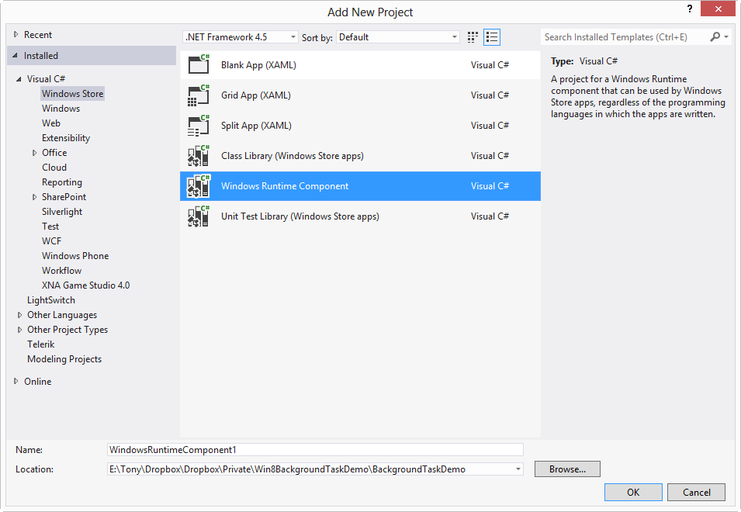

Slide 41
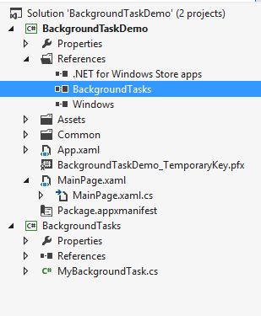

Slide 42
Defining Tasks

Slide 43
Creating Background Task Class
public sealed class MyClass : IBackgroundTask
{
public void Run(IBackgroundTaskInstance task)
{
// Insert background code
}
}
Windows.ApplicationModel.Background

Slide 44
Deferral for Async Operations
public void Run(IBackgroundTaskInstance taskInstance)
{
BackgroundTaskDeferral deferral = taskInstance.GetDeferral();
// do some async work
deferral.Complete();
}

Slide 45
Registering a Background Task
var builder = new BackgroundTaskBuilder();
builder.Name = “MyRegisteredTask";
builder.TaskEntryPoint = "Tasks.MyBackgroundTask";
builder.Register();

Slide 46
Accessing Registered Tasks
foreach (var task in
BackgroundTaskRegistration.AllTasks)
{
task.Value.Unregister(true);
}

Slide 47
Background Task Basics
Tony Champion

Slide 48
Triggers

Slide 49
Control Channel
Maintain long running network connection
Minimize network and resource usage
Not supported in JavaScript
Push Notification
Keep Alive

Slide 50
Push Notification
** Not the same a Windows Notification Services **
Provides way to process incoming network packets
Can be configured to run in a low power, connected stand-by state

Slide 51
Server Keep Alive
Wakes up app on regular interval to send data to server
Avoids time-outs due to inactivity
Intervals set between 15 minutes and 24 hours

Slide 52
Network Keep Alive
Used for network intermediaries: proxies and IP translators
Time period is auto calculated by Windows
Can request interval to be shorter if still experiencing dropped connections

Slide 53
Push Notification
Receives raw data from Windows Notification Services
Not required for toasts or tiles
Limited to 5k messages
Not for confidential information
App must be in the Windows Store

Slide 54
Use Cases for Push Notification
Notification that an action is required
Email is available
Incoming communication message
Notify client that it needs to sync data

Slide 55
Time and Maintenance
Time based recurring triggers
Can be set to a minimum of 15 minute intervals
TimeTrigger
MaintenanceTrigger
Must be on lock screen to run
Device must be plugged into AC power to run

Slide 56
System Event
Fires based on the system event that is it assigned to
SmsReceived | SessionConnected
UserPresent | ServicingComplete
UserAway | LockScreenApplicationAdded
NetworkStateChange | LockScreenApplicationRemoved
ControlChannelReset | TimeZoneChange
InternetAvailable | OnlineIdConnectedStateChange

Slide 57
System Event Demo
Tony Champion

Slide 58
Debugging

Slide 59
Matching Names
1
2
3

Slide 60
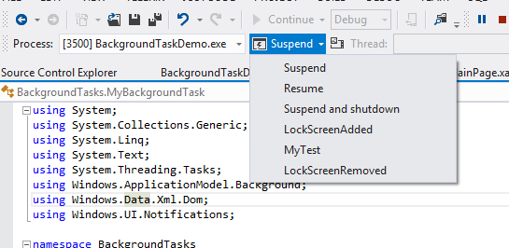
Manual Trigger
Does not support: ControlChannel, PushNotification, and SystemEvent.SmsReceived

Slide 61
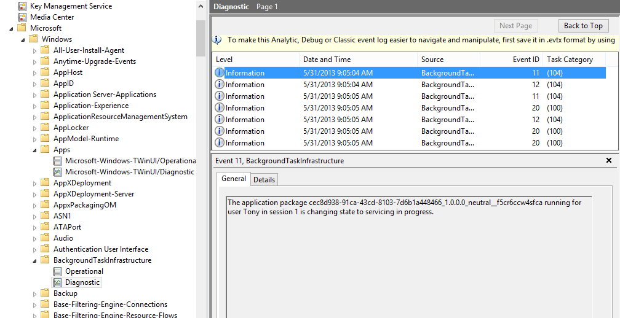
Event Viewer

Slide 62
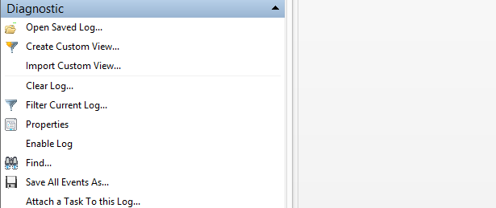
Enabling Diagnostic Log
1
2

Slide 63
Wrap Up

Slide 64
Things to Remember
Be considerate of system resources
Does your app need background APIs?
Is there a different approach?
Be aware of resource constraints
Plan for the lock screen

Slide 65
Resources
Learning
Sessions on Demand
Microsoft Certification & Training Resources
http://channel9.msdn.com/Events/TechEd
www.microsoft.com/learning
TechNet
msdn
Resources for IT Professionals
Resources for Developers
http://microsoft.com/technet
http://microsoft.com/msdn

Slide 66
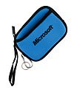
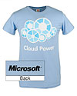
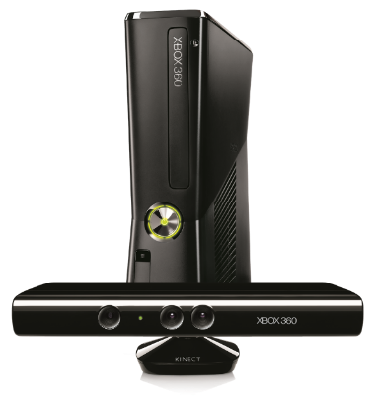
Complete an evaluation on CommNet and enter to win!

Slide 67
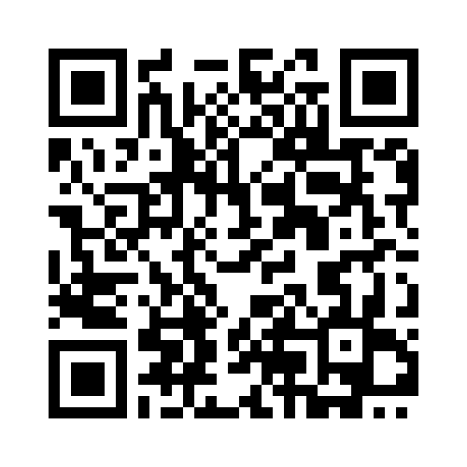
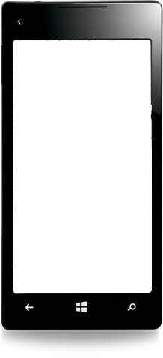
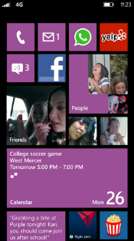
Evaluate this session
Required Slide
*delete this box when your slide is finalized
Your MS Tag will be inserted here during the final scrub.
Scan this QR code to evaluate this session and be automatically entered in a drawing to win a prize

Slide 68
© 2013 Microsoft Corporation. All rights reserved. Microsoft, Windows and other product names are or may be registered trademarks and/or trademarks in the U.S. and/or other countries.
The information herein is for informational purposes only and represents the current view of Microsoft Corporation as of the date of this presentation. Because Microsoft must respond to changing market conditions, it should not be interpreted to be a commitment on the part of Microsoft, and Microsoft cannot guarantee the accuracy of any information provided after the date of this presentation. MICROSOFT MAKES NO WARRANTIES, EXPRESS, IMPLIED OR STATUTORY, AS TO THE INFORMATION IN THIS PRESENTATION.

